Slide 1
WebGL, Websockets, and DIS
DoD M&S Standards to the Web Browser

Slide 2
Emerging Web Technologies
•WebGL: Native Javascript bindings for OpenGL (3D) in the browser, accelerated by GPU
• Websockets: TCP socket-like connections to Javascript in the web browser
When combined these two technologies allow Networked Virtual Environments in the web browser with no plugins
Open-DIS allows DoD-Standard DIS to be serialized to Javascript/JSON and sent to the browser

Slide 3
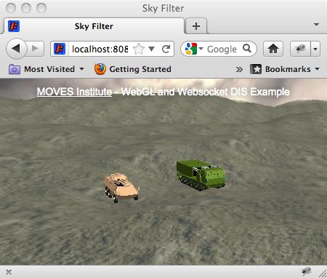
3D Content in The Browser Using DoD Standards

Slide 4
Architecture
Web Browser Window
DIS in JSON
Format
Native
DIS Traffic
Server
Web Browser:
WebGL, Javascript,
Websockets, DIS Protocol
Web Browser Window
Server: 3D content, communication with web browsers

Slide 5
Architecture
The desktop web browser (Firefox 7/8, Chrome, Safari) connects to the server and downloads 3D content
Client establishes a two-way websocket connection to the server
DIS is sent to the web browser in JSON javascript format; 3D content in the browser moves
Web browser can also send DIS to the server, so DIS traffic can be generated from the browser as well
Javascript in the browser can provide physics, logic, etc

Slide 6
Status
Proof of concept
Contact: Don Brutzman (brutzman@nps.edu, 831-656-2149)
Don McGregor (mcgredo@nps.edu)

