Slide 1


Ensemble-Based Detection of Global Climate Anomalies Using Surface Temperature and CO₂ Emission Indicators: A Majority-Voting Unsupervised Framework with SHAP Interpretability
11th IEEE Asia-Pacific Conference on Computer Science and Data Engineering (IEEE CSDE 2026)
Paper ID: 5303
K. M. Arafat Islam, Abdul Fardaus, Arif Mahmud
Dept. of Computer Science & Engineering, Daffodil International University & Green University of Bangladesh, Dhaka, Bangladesh
1–3 November 2026
Cox’s Bazar, Bangladesh
Notes:
[Title, about 10 sec]
Good morning everyone. I am Arafat Islam from Daffodil International University. Our paper is about finding unusual years in the global climate record, using three machine learning detectors and SHAP.

Slide 2
Agenda / Outline
CSDE 2026
01
02
03
Introduction
Research Objectives
Methodology
04
05
06
Results Analysis and Discussion
Conclusion and Future Work
References
IEEE CSDE 2026 | 1–3 November 2026 | Cox’s Bazar, Bangladesh
Notes:
[Agenda, about 5 sec]
I will cover the problem, our method, the results, and the conclusion.

Slide 3



Introduction
CSDE 2026
Background
1.49°C
Global warming has reached an estimated 1.49°C above pre-industrial levels, and 2024 recorded the highest surface temperature anomaly in the 170-year instrumental record.
Problem Statement
Estimated human-induced warming above pre-industrial levels (as of 2023)
No labeled ground truth exists, so supervised methods cannot tell genuine anomalies from normal variability. A year can be unusual in level, rate of change, or against its neighbors.
Motivation and Contribution
A majority-voting ensemble of three unsupervised detectors on 171 years of temperature and CO₂ data, a combination not previously reported. Validated against documented events and explained with SHAP.
Source: [Ref. 1]
IEEE CSDE 2026 | 1–3 November 2026 | Cox’s Bazar, Bangladesh
Notes:
[Introduction, about 40 sec]
2024 was the hottest year on record, and warming is now about 1.49 degrees above pre-industrial levels. But which years are truly unusual? There are no labels, so we cannot use supervised learning. A year can be unusual in its level, in how fast it changes, or compared to its neighbors. So we combine three detectors by majority vote, on 171 years of temperature and CO2 data. Then we check the results against documented events and explain them with SHAP.

Slide 4
Research Objectives
CSDE 2026
01
02
03
Detect Anomalies
Validate Findings
Explain the Model
Identify anomalous years in 171 years (1854–2024) of temperature and CO₂ data using a majority-voting ensemble of three unsupervised detectors.
Validate consensus anomalies against the documented historical climate record and a 12-event author-defined external evaluation set.
Identify which features drive detection via SHAP interpretability, and confirm their necessity through an ablation study.
RESEARCH QUESTION
Which individual years represent genuine global climate anomalies, as opposed to ordinary variability, and which features most reliably signal that departure?
IEEE CSDE 2026 | 1–3 November 2026 | Cox’s Bazar, Bangladesh
Notes:
[Research Objectives, about 25 sec]
We had three objectives. One, detect anomalous years. Two, validate them against the historical record and twelve documented events. Three, explain which features matter, using SHAP and an ablation study.

Slide 5
Methodology
CSDE 2026
1
2
3
4
Data Collection
Feature Engineering
Standardization
Ensemble Detection
HadCRUT5 temperature anomaly + Global Carbon Budget CO₂ per capita, merged by year (1854–2024).
Six-dimensional vector per year: level, year-over-year change, and 5-year moving average for both series.
Full-series z-score normalization (zero mean, unit variance) before model fitting.
Three detectors run independently; outputs consolidated by majority vote (≥ 2 of 3).
Dataset and Tools
171 annual observations (1854–2024). Temperature −0.23 to 1.53°C; CO₂ 0.20 to 4.85 t per person; correlation r = 0.82. scikit-learn + SHAP, seed 42.
Evaluation Metrics
Precision / Recall / F1 against a 12-event external evaluation set; z-score baseline; Mann-Whitney U test; 95% Wilson score CI.
IEEE CSDE 2026 | 1–3 November 2026 | Cox’s Bazar, Bangladesh
Notes:
[Methodology I, about 45 sec]
We use two public datasets: global temperature anomaly and CO2 per person, from 1854 to 2024. For each year we build six features: the level, the yearly change, and the five-year average, for both series. The change features show how fast things move. We standardize all features, run three detectors independently, and combine them by majority vote. We evaluate with precision, recall and F1 against twelve documented events.

Slide 6
Methodology
CSDE 2026
1
2
3
4
Isolation Forest
One-Class SVM
Local Outlier Factor
Majority Vote
Isolation-based; 200 trees, contamination = 0.05. Flags 9 years (5.26%).
Boundary-based; RBF kernel, ν = 0.05. Flags 12 years (7.02%).
Density-based; 20 nearest neighbors, contamination = 0.05. Flags 9 years (5.26%).
A year is a consensus anomaly once ≥ 2 of 3 detectors agree.
Why Three Detectors?
Isolation-based, boundary-based, and density-based methods capture different anomaly structures — disagreement is as informative as agreement.
Why Majority Voting?
Unanimous voting misses genuine signals; a single detector or a union adds noise. Majority (≥2/3) balances sensitivity and precision.
IEEE CSDE 2026 | 1–3 November 2026 | Cox’s Bazar, Bangladesh
Notes:
[Methodology II, about 40 sec]
The three detectors work differently. Isolation Forest finds years that are easy to separate from the rest. One-Class SVM draws a boundary around normal years. Local Outlier Factor compares each year with its nearest neighbors. A year is a consensus anomaly if at least two detectors agree. This avoids too much noise, and avoids missing real signals.

Slide 7
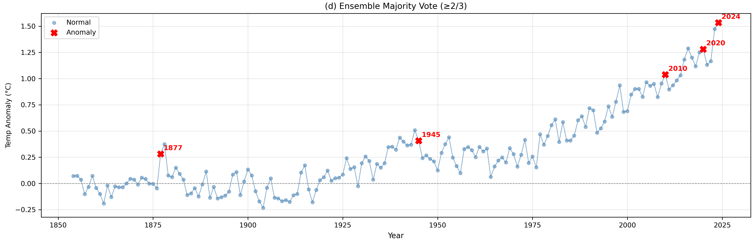
Results Analysis and Discussion
CSDE 2026
Key Findings
Five consensus anomalies: 1877, 1945, 2010, 2020, 2024 (rate 2.92%); only 1877 got all 3 votes
Each matches a documented event: El Niño (1877, 1945) or modern record warmth (2010, 2020, 2024)
2024 is the highest anomaly on record (+1.533°C), near the 1.49°C warming estimate
Discussion
Year | Votes | Temp (°C) | CO₂ (t) | YoY (°C) | Matched event
1877 | 3/3 | 0.282 | 0.506 | +0.328 | Major El Niño; largest yearly jump
1945 | 2/3 | 0.407 | 1.799 | −0.102 | Wartime El Niño; SST measurement change
2010 | 2/3 | 1.038 | 4.745 | +0.084 | Modern period of record warmth
2020 | 2/3 | 1.280 | 4.458 | +0.029 | Modern period of record warmth
2024 | 2/3 | 1.533 | 4.729 | +0.060 | Highest anomaly on record
IF flags recent years, OC-SVM transitional years (1907 to 1992), LOF 1914 to 1932: no single detector is complete
Anomaly score falls over time, i.e. more anomalous (R² = 0.232, p < 0.001); post-1950 vs pre-1950 Mann-Whitney p < 0.000002
2020s: 2 of 5 completed years flagged (40% vs ~3% per decade); decade incomplete, so read with caution
IEEE CSDE 2026 | 1–3 November 2026 | Cox’s Bazar, Bangladesh
Notes:
[Results I: Consensus Anomalies, about 50 sec]
Voting gives five anomalies: 1877, 1945, 2010, 2020 and 2024. Only 1877 got all three votes. 1877 and 1945 match El Nino events. 2010, 2020 and 2024 are in the modern period of record warmth, and 2024 is the highest on record. So every flagged year matches a real event. Also, the anomaly score keeps falling over time, which means the climate is moving further from normal.

Slide 8
Results Analysis and Discussion
CSDE 2026
Key Findings
Ensemble: Precision 0.80 with 1 false positive; z-score baseline 0.21 with 23 false positives (3.8×)
F1 = 0.47, close to the best single detector (Isolation Forest 0.48); OC-SVM weakest (0.25)
Recall = 0.33: majority voting is deliberately conservative, trading coverage for precision
Method | TP | FP | FN | Precision | Recall | F1
Z-score baseline | 6 | 23 | 6 | 0.21 | 0.50 | 0.29
Isolation Forest | 5 | 4 | 7 | 0.56 | 0.42 | 0.48
One-Class SVM | 3 | 9 | 9 | 0.25 | 0.25 | 0.25
LOF | 3 | 6 | 9 | 0.33 | 0.25 | 0.29
Ensemble (≥2/3) | 4 | 1 | 8 | 0.80 | 0.33 | 0.47
Discussion
Precision = flagged years that are correct; recall = documented events found (4 of 12)
95% Wilson CI for ensemble precision [0.38, 0.96] (4 of 5 flagged years correct): small sample, so indicative
No labeled ground truth exists; the 12-event set comes from climate-science records
Evaluation set (author-defined, 12 documented events): 1877, 1902, 1918, 1940, 1945, 1963, 1976, 1992, 1998, 2016, 2020, 2024. TP/FP/FN are counted against it.
IEEE CSDE 2026 | 1–3 November 2026 | Cox’s Bazar, Bangladesh
Notes:
[Results II: Model Evaluation, about 50 sec]
We compared against twelve documented events. The simple z-score baseline has precision 0.21, with 23 false alarms. Our ensemble has precision 0.80 with only one false alarm, which is 3.8 times better. F1 is 0.47, close to the best single detector. Recall is lower, 0.33, because majority voting is careful: it flags fewer years, but they are more reliable. The sample is small, so treat these numbers as indicative.

Slide 9
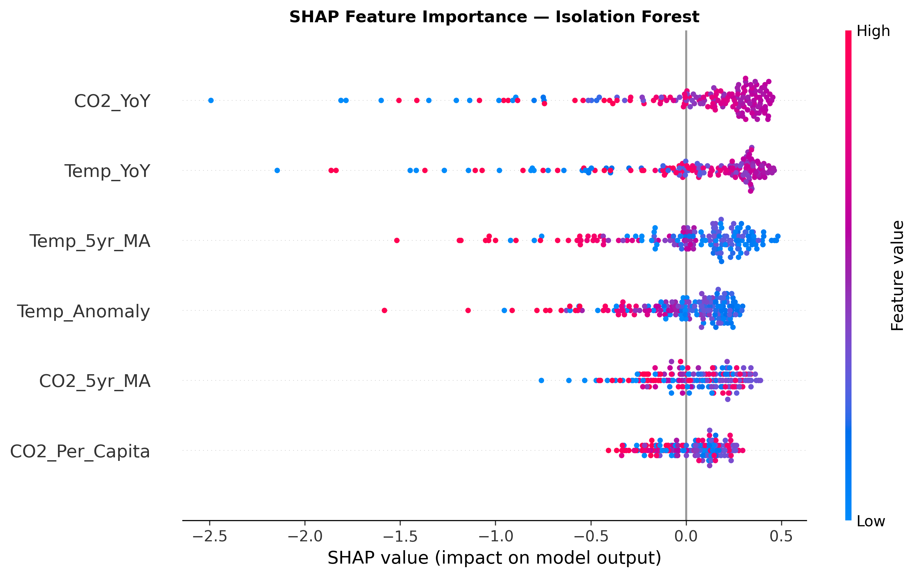
Results Analysis and Discussion
CSDE 2026
Key Findings
SHAP ranks CO₂ year-over-year change first (mean |SHAP| 0.370), then Temp YoY (0.353) and 5-year temperature average (0.284)
Raw CO₂ per-capita level is least important (0.146): rate of change beats absolute level
This pattern shows only through the engineered features, not in the raw data
Discussion
Ablation: neither YoY (F1 0.44) nor moving average alone (F1 0.21) is enough; all 6 features give precision 0.80
Sensitivity to contamination c (0.01 to 0.10): 1945 and 2020 flagged at every value; 1877, 2010, 2024 appear from c = 0.05
Selected c = 0.05 gives 5 anomalies; c ≥ 0.07 adds weaker years (8 at 0.07, 13 at 0.10)
Feature configuration | Features | Precision | Recall | F1
Base only (Temp, CO₂) | 2 | 0.38 | 0.25 | 0.30
Base + year-over-year | 4 | 0.67 | 0.33 | 0.44
Base + moving average | 4 | 0.29 | 0.17 | 0.21
Full set (proposed) | 6 | 0.80 | 0.33 | 0.47
IEEE CSDE 2026 | 1–3 November 2026 | Cox’s Bazar, Bangladesh
Notes:
[Results III: Interpretability and Robustness, about 45 sec]
SHAP shows that the yearly change in CO2 and in temperature matter most. The raw CO2 level matters least. So speed of change matters more than the level itself. The ablation confirms it: two base features give precision 0.38, and all six give 0.80. And in the sensitivity test, 1945 and 2020 are flagged at every setting, so they are robust.

Slide 10


Conclusion and Future Work
CSDE 2026
Conclusion
Future Work
Majority-voting ensemble identifies 5 consensus anomalies in 171 years of joint temperature–CO₂ data: 1877, 1945, 2010, 2020, 2024
Every flagged year matches an independently documented climatic or anthropogenic event
Precision = 0.80, the highest of all methods and 3.8× the z-score baseline
Extend to sea-level rise and methane concentrations
Move to monthly resolution to capture sub-annual anomalies
Test soft-voting schemes and robustness under alternative feature representations
Limitations: only two global indicators, annual resolution, no causal attribution, and a small author-defined evaluation set (n = 12).
IEEE CSDE 2026 | 1–3 November 2026 | Cox’s Bazar, Bangladesh
Notes:
[Conclusion and Future Work, about 35 sec]
To conclude, three detectors with majority voting found five anomalies in 171 years, and each matches a documented event. Precision is 0.80, the highest of all methods. Limitations: only two indicators, yearly data, and a small evaluation set. Future work: sea-level rise, methane, monthly data, and soft voting.

Slide 11
References
CSDE 2026
[1] A. Jarvis and P. M. Forster, “Estimated human-induced warming from a linear temperature and atmospheric CO₂ relationship,” Nat. Geosci., vol. 17, no. 12, pp. 1222–1224, 2024.
[2] F. T. Liu, K. M. Ting, and Z.-H. Zhou, “Isolation forest,” in Proc. 8th IEEE Int. Conf. Data Mining (ICDM), Pisa, Italy, 2008, pp. 413–422.
[3] B. Schölkopf, J. C. Platt, J. Shawe-Taylor, A. J. Smola, and R. C. Williamson, “Estimating the support of a high-dimensional distribution,” Neural Comput., vol. 13, no. 7, pp. 1443–1471, 2001.
[4] M. M. Breunig, H.-P. Kriegel, R. T. Ng, and J. Sander, “LOF: Identifying density-based local outliers,” in Proc. ACM SIGMOD Int. Conf. Manage. Data, Dallas, TX, USA, 2000, pp. 93–104.
[5] S. M. Lundberg and S.-I. Lee, “A unified approach to interpreting model predictions,” in Proc. Adv. Neural Inf. Process. Syst. (NeurIPS), 2017, pp. 4765–4774.
IEEE CSDE 2026 | 1–3 November 2026 | Cox’s Bazar, Bangladesh
Notes:
[References, about 5 sec]
The references are listed here.

Slide 12


Thank You
Questions & Discussion
Islam15-5498@diu.edu.bd | Paper ID: 5303
1–3 November 2026
Cox’s Bazar, Bangladesh
Notes:
[Thank You, about 5 sec]
Thank you. I am happy to take questions.

