Slide 1

Submitted From:
MD Dulal Hossain
ID : 213902116
Section : 213 D_5
Course Code : CSE 312
Title : Group Chat Application Using java.
Submitted To :
Rusmita Halim Chaity
Lecturer,
Department of CSE, GUB.

Slide 2




Outline
Introduction
Implementation
Overview
Objectives
Project Details
Workflow
Source Code
Chapter 1
Chapter 2
Performance
Chapter 3
Chapter 4
Conclusion
Results Analysis
Testing
Discussion
Limitations
Future Work
References

Slide 3
Outline
Introduction
Implementation
Overview
Objectives
Project Details
Workflow
Source Code
Chapter 1
Chapter 2
Performance
Chapter 3
Chapter 4
Conclusion
Results Analysis
Testing
Discussion
Limitations
Future Work
References

Slide 4
Outline
Introduction
Implementation
Overview
Objectives
Project Details
Workflow
Source Code
Chapter 1
Chapter 2
Performance
Chapter 3
Chapter 4
Conclusion
Results Analysis
Testing
Discussion
Limitations
Future Work
References

Slide 5
Outline
Introduction
Implementation
Overview
Objectives
Project Details
Workflow
Source Code
Chapter 1
Chapter 2
Performance
Chapter 3
Chapter 4
Conclusion
Results Analysis
Testing
Discussion
Limitations
Future Work
References

Slide 6
Outline
Introduction
Implementation
Overview
Objectives
Project Details
Workflow
Source Code
Chapter 1
Chapter 2
Performance
Chapter 3
Chapter 4
Conclusion
Results Analysis
Testing
Discussion
Limitations
Future Work
References

Slide 7
Outline
Introduction
Implementation
Overview
Objectives
Project Details
Workflow
Source Code
Chapter 1
Chapter 2
Performance
Chapter 3
Chapter 4
Conclusion
Results Analysis
Testing
Discussion
Limitations
Future Work
References

Slide 8
Introduction
Overview
Objective
The project comprises a JavaFX-based chat application with client-server architecture, supporting text and image exchange, featuring emoji selection and login functionality.
Develop a multi-client chat application using JavaFX, enabling users to communicate in real-time, share text messages, and exchange images with emoji support, facilitated by a central server.

Slide 9
Implementation
Project Details
Workflow
The project is a Java-based chat application featuring a client-server architecture. It includes a server-side component for handling client connections and a client-side interface for sending and receiving messages, with added functionalities like emoji support.
Server Initialization: Server starts, awaits clients.
Client Connection: Clients connect to server.
Messaging: Clients send messages, images.
Display: Server and clients display messages.
Emoji Picker: Clients use emoji picker for messages.
Source Code
Explain this parts for better understand.

Slide 10

Source Code Client Part
Step 4
Step 2
Step 3
Step 1

Slide 11
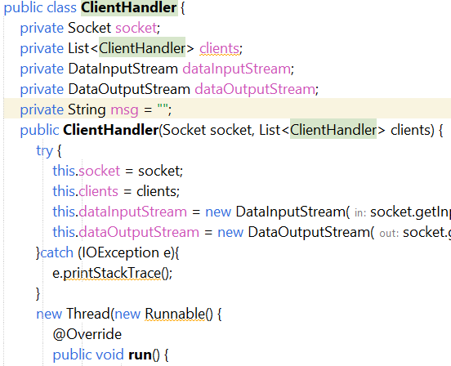
Client Handler
Step 4
Step 2
Step 3
Step 1
Figure 2.1: Code for Client Handler part.

Slide 12
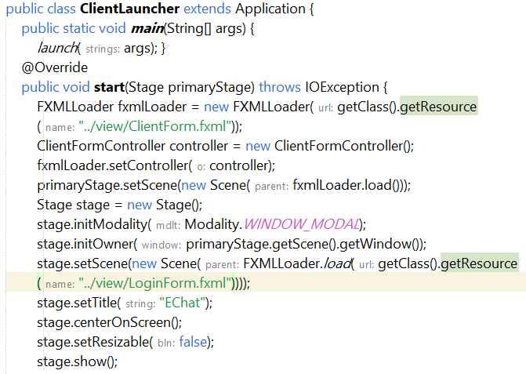
Client Launcher
Step 4
Step 2
Step 3
Step 1
Figure 2.2: Code for Client Launcher part.

Slide 13
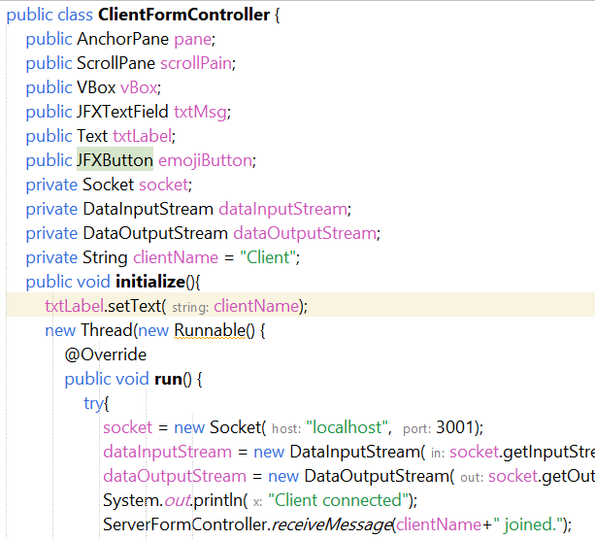
Client Form Controller
Step 4
Step 2
Step 3
Step 1
Figure 2.3: Code for Client Form Controller part.

Slide 14
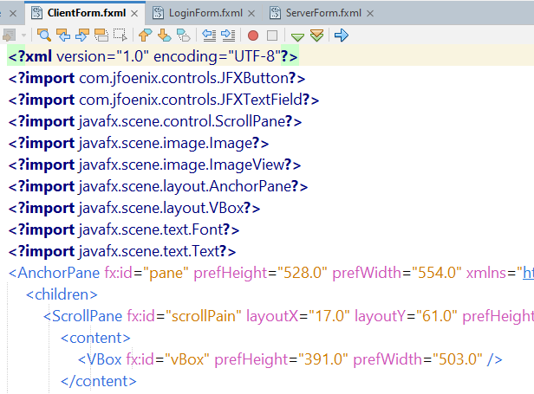
Client Form Fxml
Step 4
Step 2
Step 3
Step 1
Figure 2.4: Code for Client Form Fxml part.

Slide 15
Source Code Server Part
Step 4
Step 2
Step 3
Step 1

Slide 16
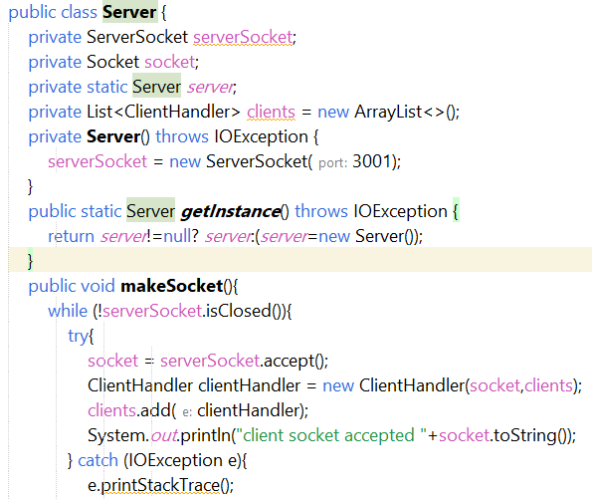
Server
Step 4
Step 2
Step 3
Step 1
Figure 2.5: Code for Server part.

Slide 17
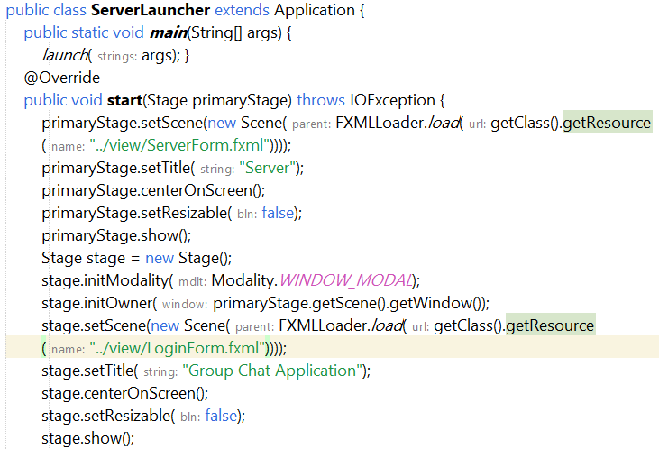
Server Launcher
Step 4
Step 2
Step 3
Step 1
Figure 2.6: Code for Server Launcher part.

Slide 18
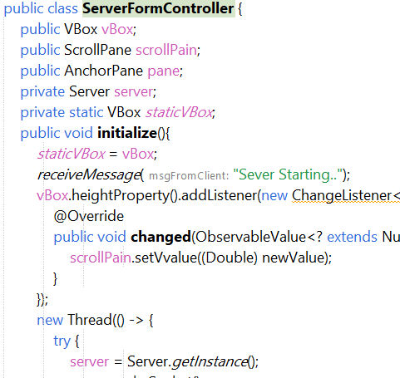
Server Form Controller
Step 4
Step 2
Step 3
Step 1
Figure 2.7: Code for Server Form Controller part.

Slide 19
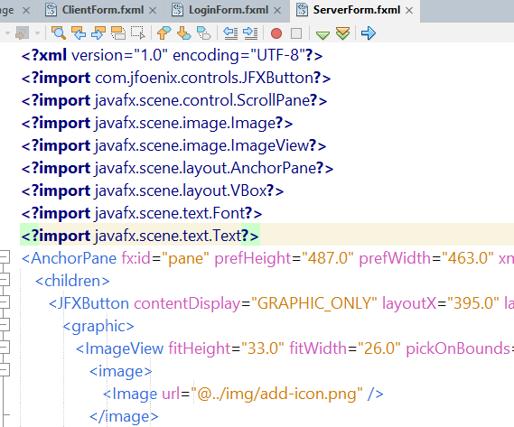
Server Form Fxml
Step 4
Step 2
Step 3
Step 1
Figure 2.8: Code for Server Form Fxml part.

Slide 20
Source Code
Login & Emoji part
Step 2
Step 3
Step 1

Slide 21
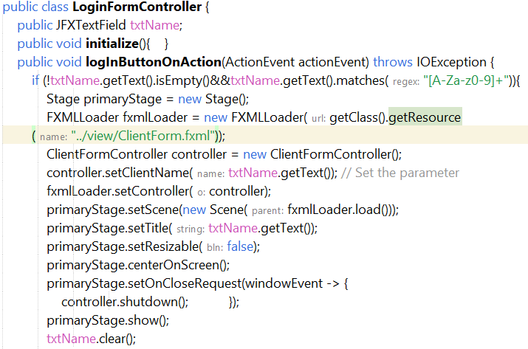
Login Form Controller
Step 2
Step 3
Step 1
Figure 2.9: Code for Login Form Controller part.

Slide 22
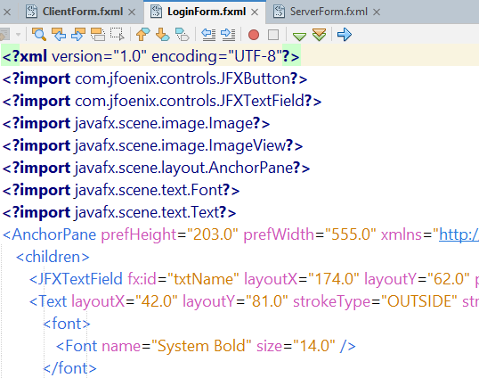
Login Form Fxml
Step 3
Step 2
Step 1
Figure 2.10: Code for Login Form Fxml part.

Slide 23
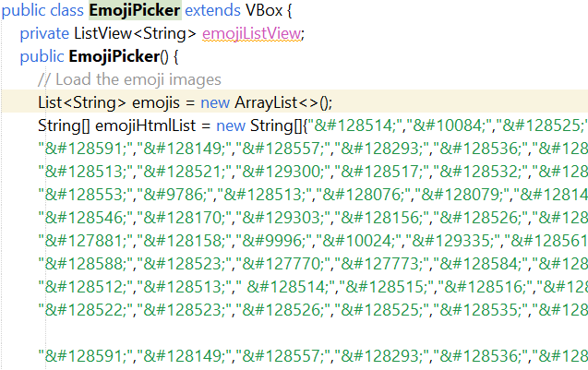
Emoji Picker
Step 2
Step 3
Step 1
Figure 2.11: Code for Emoji Picker part.

Slide 24
Performance
Result Analysis
Testing
The project consists of a simple chat application with client and server components implemented in Java, featuring GUIs with emoji support and functionality for sending text messages and images.
Ensure the server and client GUIs open.
Connect clients to the server.
Exchange messages and images between clients.
Verify proper message and image display.

Slide 25
Testing
Step 6
Step 2
Step 5
Step 4
Step 3
Step 1

Slide 26
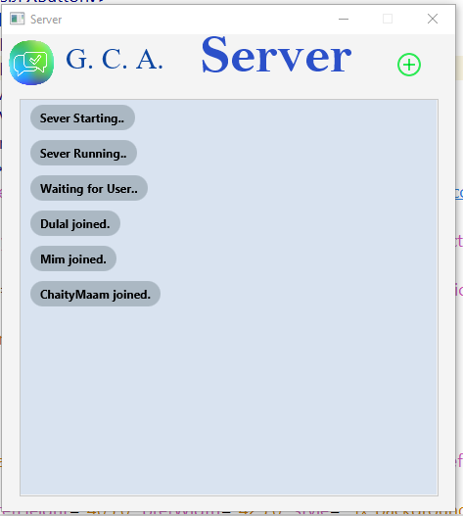
Open Server
Step 6
Step 4
Step 2
Step 5
Step 3
Step 1
Figure 3.1: Open Server Part.

Slide 27
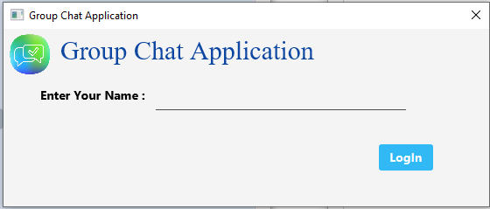
Login
Step 6
Step 2
Step 5
Step 4
Step 3
Step 1
Figure 3.2: Login part .

Slide 28
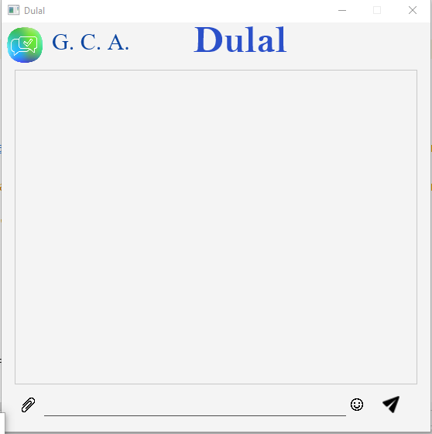
Client
Step 6
Step 2
Step 5
Step 4
Step 3
Step 1
Figure 3.3: Client part.

Slide 29
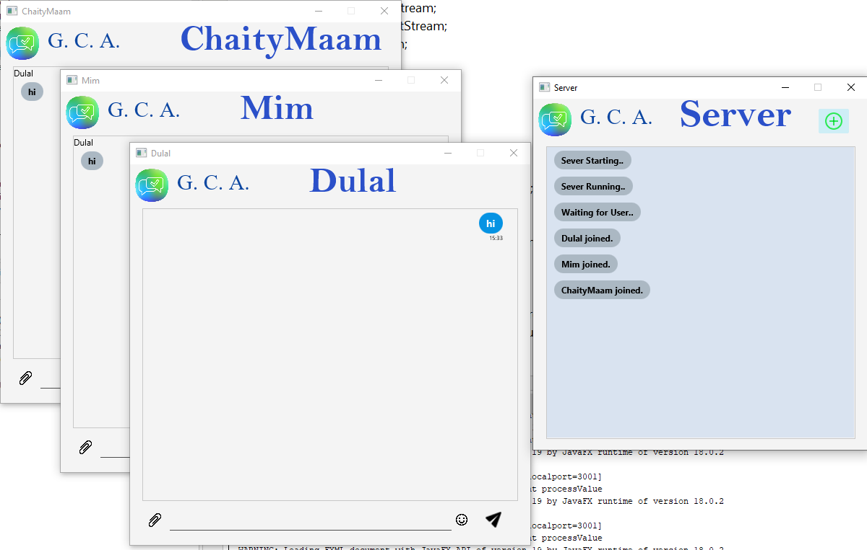
Sent Message
Step 6
Step 2
Step 5
Step 4
Step 3
Step 1
Figure 3.4: Sent Message Hi To All.

Slide 30
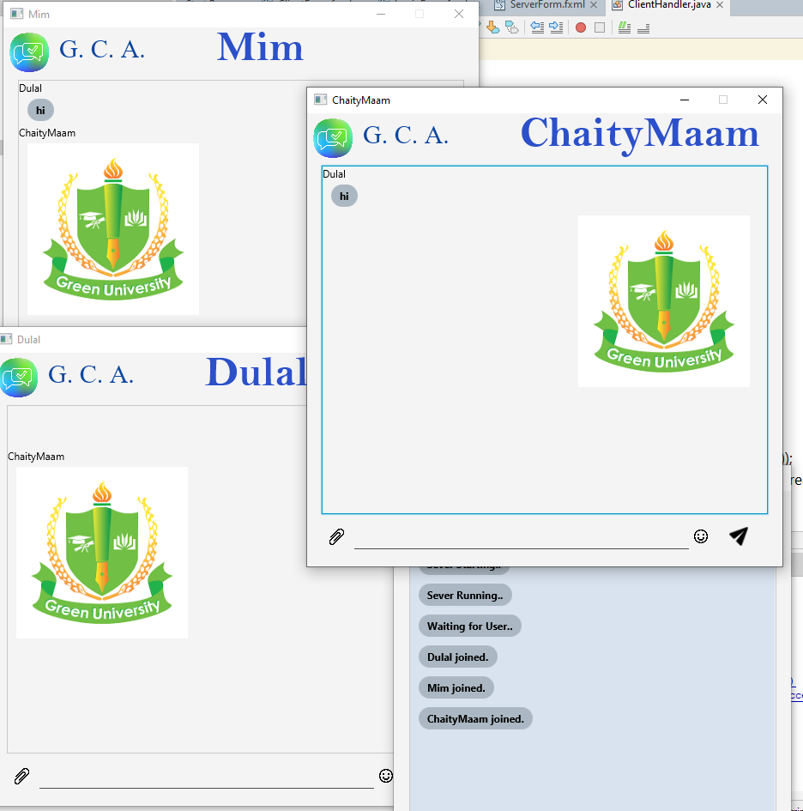
Picture sent
Step 6
Step 5
Step 2
Step 4
Step 3
Step 1
Figure 3.5: Picture sent part.

Slide 31
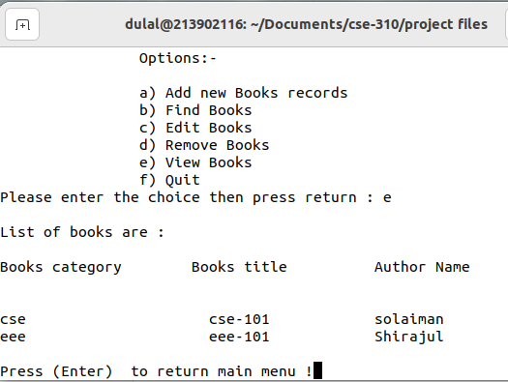
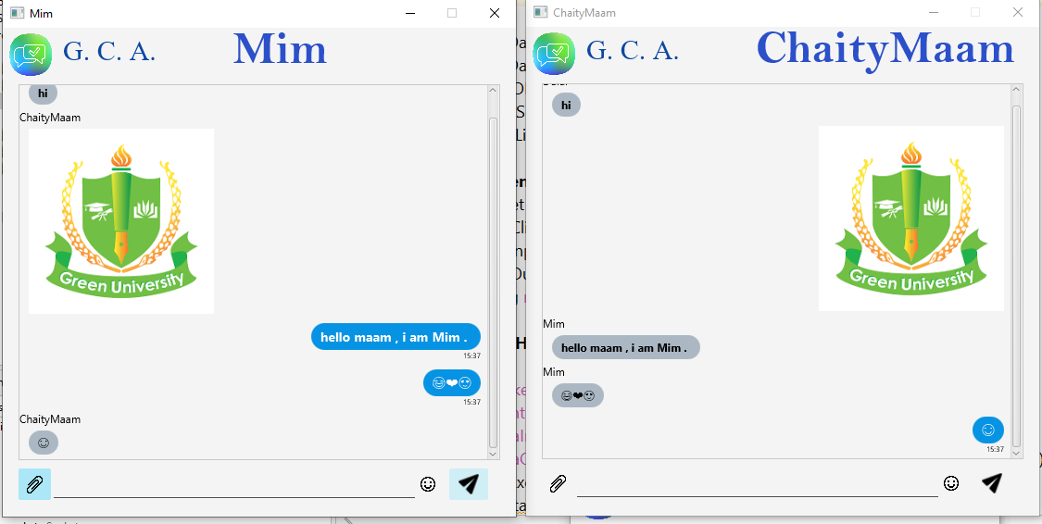
Emoji sent
View& Quit
Step 2
Step 6
Step 5
Step 4
Step 23
Step 1
Figure 3.6: View-Books.
Figure 3.6: Emoji sent part

Slide 32
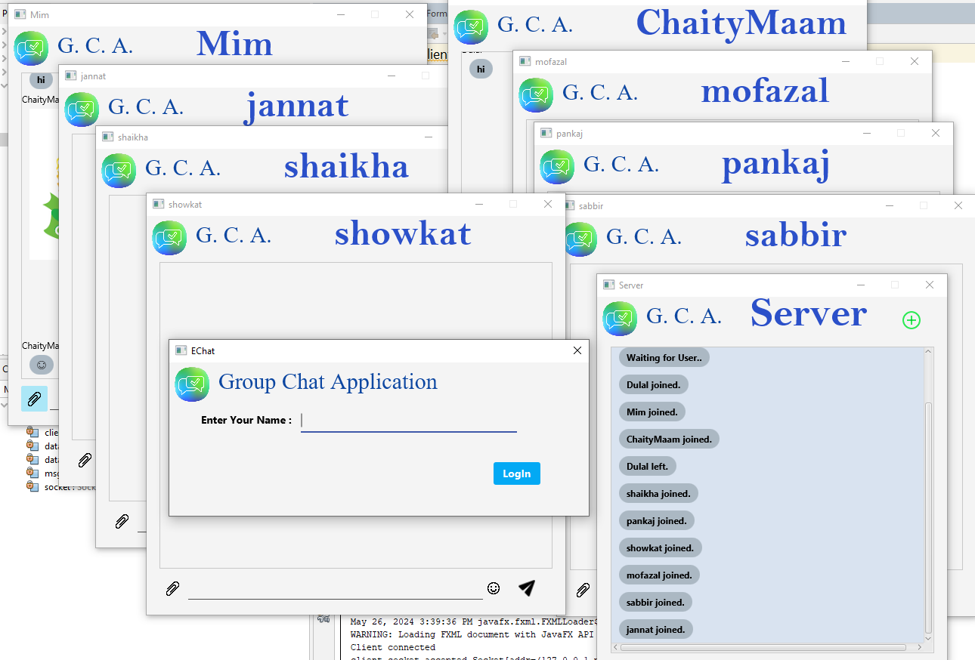
Multi User
View& Quit
Step 2
Step 6
Step 5
Step 4
Step 23
Step 1
Figure 3.6: View-Books.
Figure 3.7: Multi User part .

Slide 33
Conclusion…
Discussion
Limitations
The project implements a chat application with JavaFX GUI, utilizing server-client architecture. Features include message exchange, emoji integration, and file sharing.
Limited error handling, lack of user authentication, scalability concerns, absence of file transfer protocol, and potential security vulnerabilities.

Slide 34
Conclusion
Future Work
References
Future work for this project could include implementing additional features such as private messaging, user authentication, and file sharing. Improvements in user interface design and scalability for larger user bases would also be beneficial.
https://www.geeksforgeeks.org/java/?ref=outind
https://www.javatpoint.com/java-tutorial
https://www.learnjavaonline.org/

Slide 35
Thank You
Keep Learning, Keep Grinding

