Slide 1
Arduino RC Car Hack w/ Xbox 360 Remote
By: Ryan Smith

Slide 2
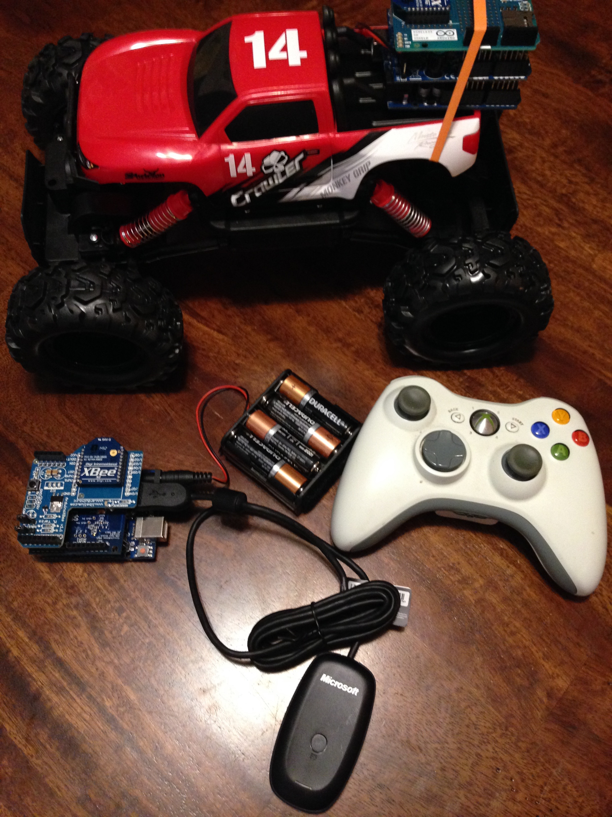

Slide 3
Intro
Hack a Maisto Rock Crawler with Arduino Uno
Take control away from stock micro controller
Integrate XBee RF Modules
Use Xbox 360 controller to command Arduino

Slide 4
This project is great for many reasons..
If not familiar, it introduces us to:
Arduinos and its capability to drive motors
The Arduino IDE; how to save and load sketches
Working with shields to enhance your Arduino
Working with XBees and the XCTU software
Configuration
Serial Communication
Connecting a USB device to your Arduino
Basic Soldering

Slide 5
Purpose
We get familiar with some great technology
We have an Enhanced RC Car
Better radio frequency range (using XBee)
Better remote
More precise control of motors
Our original car had either full throttle or zero throttle; with PWM we can implement more of gas pedal effect
Gives us the important ground work for future (much more sophisticated) changes

Slide 6
Expansive Options
Implement “one button” maneuvers (i.e. car turns around at the press of a button)
Introduce a camera and stream video
Attach recording device (i.e spy car)
Autonomous features
i.e sonar, GPS
Feed Video to Virtual Reality Headset

