Slide 1
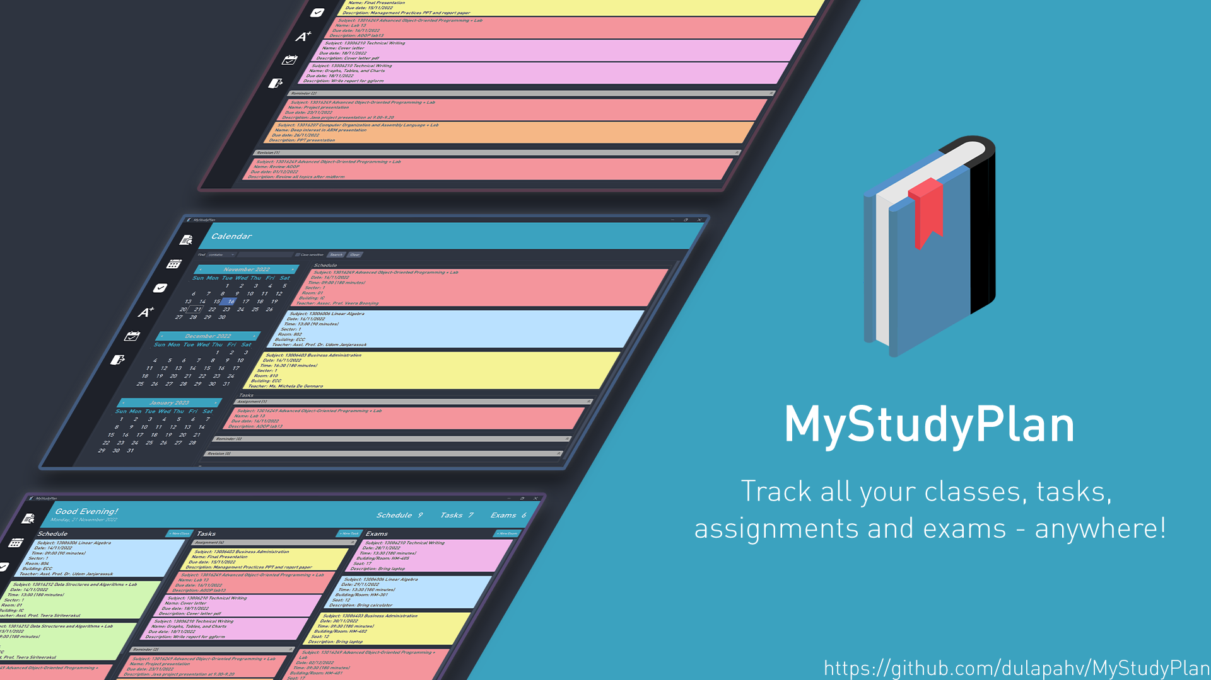

Slide 2
Problem Description
A timetable management app for university students would be beneficial because it would allow students to better organize their time and schedule their classes around other commitments.
This would lead to improved academic performance and decreased stress levels. In addition, a timetable management app would allow students to share their schedules with classmates and professors, which would facilitate communication and collaboration.

Slide 3
