Slide 1
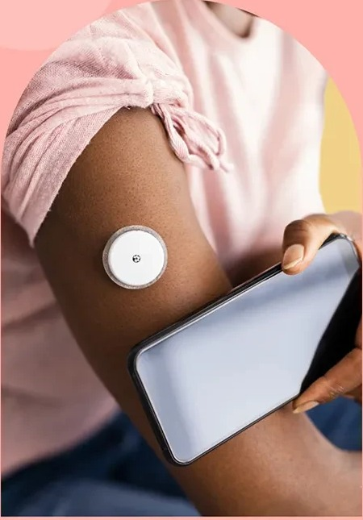

A Multi-Organ Digital Twin for Type 2 Diabetes
Other twins forecast glucose. Kaya shows what glucose does to the liver, eyes and kidneys, and lets a doctor test a change on the virtual patient first.
Team Kaya
Dulari Bhushan · Prateek Giddaplavar
Indian Institute of Technology, Hyderabad
Happiest Health Summit 2026 · Digital Twin Challenge, Phase 1
Notes:
[Slide 1 | about 0:30 | running total 0:30]
Good morning. We are Team Kaya from IIT Hyderabad: Dulari Bhushan and Prateek Giddaplavar. Kaya is a multi-organ digital twin for Type 2 Diabetes. Most digital twins forecast glucose. Kaya shows what that glucose is doing to the liver, eyes and kidneys, and lets a doctor test a change on the virtual patient before trying it on the real one.
---
Sources and caveats: Kaya: a multi-organ digital twin for Type 2 Diabetes. IIT Hyderabad. Team: Dulari Bhushan and Prateek Giddaplavar. Submission to the Happiest Health 'Reimagining and Reforming Healthcare in India' Summit 2026, Digital Twin Challenge, Phase 1.

Slide 2
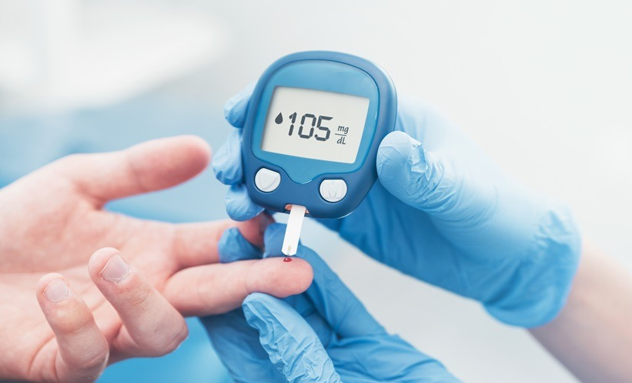
PREFACE
Diabetes is rarely the killer. Its complications are
1
The damage is silent
Fatty liver turns to fibrosis, retinopathy is found after vision is lost, kidney function slowly declines. It builds for years before anyone notices.
2
We watch sugar, not organs
Glucose is checked every day. The liver, eyes and kidneys are checked once a year, if at all.
What gets measured, over one year
3
Kaya connects the two
Glucose
every day
A living virtual copy of each patient that links daily glucose to the organs it harms, and lets a doctor ask what happens if we change something.
Organs
once a year, if at all
Notes:
[Slide 2 | about 0:35 | running total 1:05]
Diabetes by itself rarely kills. The damage comes from complications that build silently over years: fatty liver turning into fibrosis, retinopathy found only after vision is lost, kidney function slowly declining. Today we watch sugar closely, with a reading every day, but the organs are checked once a year, if at all. Kaya connects those two worlds. It is a living virtual copy of each patient that links daily glucose to the organs it harms.
---
Sources and caveats: Preface. The disease is rarely fatal by itself; complications are. Existing apps and twins focus on managing sugar. Kaya connects the continuous glucose signal to organ damage. The chart is illustrative: continuous glucose versus an annual organ check.

Slide 3
THE PROBLEM · INDIA
India's diabetes burden is huge, and still growing
101 M
136 M
Of Indians who know they have diabetes, how many hit the target?
Indians live with diabetes
more are prediabetic
11.4% of adults (ICMR-INDIAB)
15.3% of adults, on the way in
43%
157 M
do not know they have it
adults by 2050
about 39 M adults (IDF 2025)
from about 90 M today (IDF)
Sources: ICMR-INDIAB, Lancet Diabetes & Endocrinology 2022 and 2023; IDF Diabetes Atlas, 11th ed. (2025). Survey estimates; methods differ between sources.
Notes:
[Slide 3 | about 0:40 | running total 1:45]
Now the scale in India. The ICMR-INDIAB survey estimates about 101 million Indians live with diabetes, and another 136 million have prediabetes. The IDF estimates that 43 percent of adults with diabetes do not know they have it, and projects around 157 million by 2050. Even among people who know, control is poor: about 36 percent reach their sugar target, and only 7.7 percent reach sugar, blood pressure and cholesterol targets together. This is the population where complications are quietly building.
---
Sources and caveats: Scale: ICMR-INDIAB (2023) estimates 101 million Indians with diabetes (11.4%) and 136 million with prediabetes (15.3%). IDF Atlas 2025: about 89.8 million adults aged 20-79 in 2024 (second only to China), 43% undiagnosed, projected 156.7 million by 2050. Control: in the ICMR-INDIAB national study of 5,789 people with known diabetes, 36.3% had good glycaemic control, 48.8% good blood pressure control, 41.5% LDL on target, and only 7.7% met all three. The IDF India figures come from a news summary of the Atlas; verify against the Atlas before final submission.

Slide 4
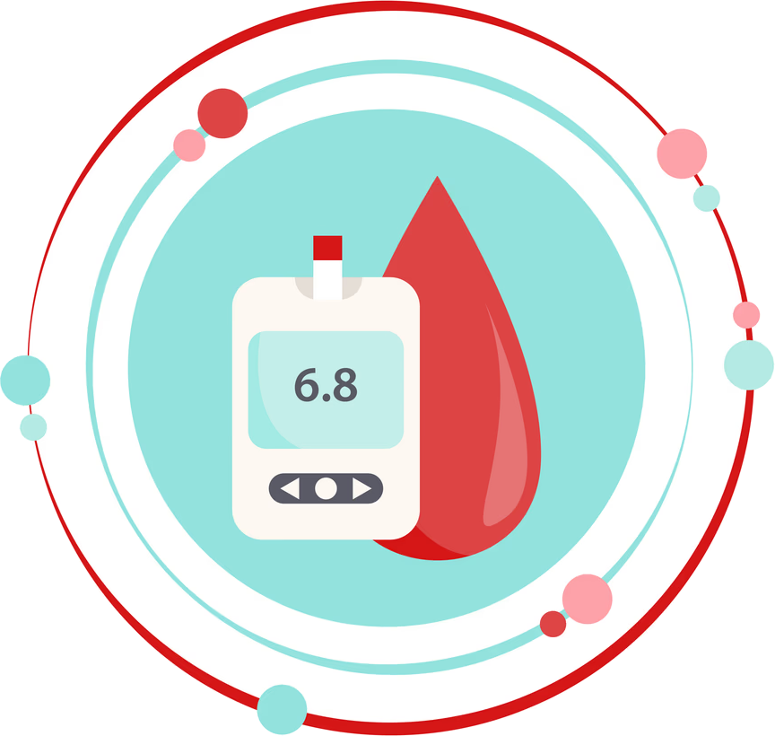
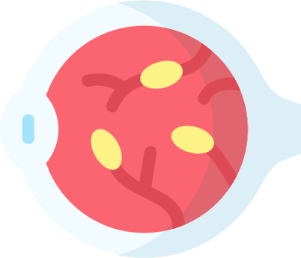
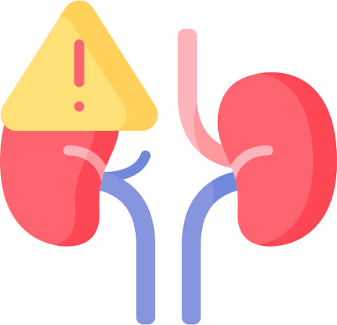
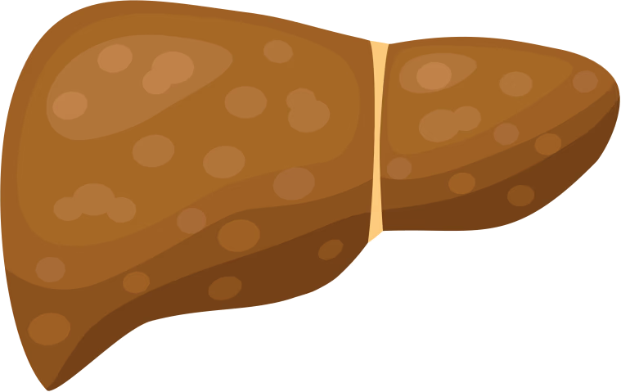
THE PROBLEM · WHAT GOES WRONG
Years of high sugar damage the eyes, kidneys and liver
Eyes
of people with diabetes aged 50+ have retinopathy; 3.6% already sight-threatening
17%
Retinopathy is found only after vision is lost
Kidneys
show kidney damage (albuminuria or CKD) in Indian clinic studies
34–44%
High glucose
Silent until failure and dialysis
sustained for years, with no symptoms
Liver
of Indians with type 2 diabetes have fatty liver; 26% have significant fibrosis
Also harms the heart, nerves and feet
56%
Fatty liver progresses to fibrosis and cirrhosis
Sources: National DR Survey 2015-19 (age 50+); Indian clinic studies (Delhi 34%, Kolkata 44%); SPRINT and DiaFib-Liver studies. Studies differ in method and population.
Notes:
[Slide 4 | about 0:40 | running total 2:25]
What goes wrong when sugar stays high for years? Eyes: in the national retinopathy survey, about 17 percent of people with diabetes over 50 had retinopathy, and 3.6 percent already had sight-threatening disease. Kidneys: Indian clinic studies report kidney damage in roughly a third to nearly half of patients. Liver: more than half of Indians with type 2 diabetes have fatty liver, and about a quarter already have significant fibrosis. The kidney and liver numbers come from clinic studies, not national surveys, and every one of these is silent until it is late.
---
Sources and caveats: Complications. Eyes: National Diabetic Retinopathy Survey 2015-19 (21 districts, age 50+): DR in 16.9% of people with diabetes, sight-threatening 3.6%. Kidneys: Indian hospital studies report albuminuria or CKD in roughly 34-44% of people with type 2 diabetes (Delhi 34.4%, Kolkata 43.8% with UACR above 30); these are single-centre studies, not national. Liver: SPRINT (924 patients, 101 cities) found NAFLD in 56.5%; DiaFib-Liver (9,202 adults) found clinically significant fibrosis in 26%, advanced fibrosis in 14%.

Slide 5
THE PROBLEM · WHY IT IS MISSED
The damage builds silently and is found late
Illustrative course of a diabetic complication
Kaya flags risk here
Diagnosis
Years of silent damage, no symptoms
Blindness, dialysis, cirrhosis
Today: found when it already hurts
📅
Checks are rare
🩺
Specialists are scarce
🧩
Data sits in silos
43% of adults with diabetes in India are undiagnosed, and only 36% of those diagnosed control their sugar.
About 1 ophthalmologist per 100,000 people, around 80% of them in cities. Screening is mostly urban.
Glucose sensors, lab reports and eye scans live apart. Nobody links daily glucose to organ damage.
Sources: IDF Atlas 2025; ICMR-INDIAB 2022; World Diabetes Foundation (ophthalmologist density). The timeline is a conceptual illustration, not patient data.
Notes:
[Slide 5 | about 0:35 | running total 3:00]
Why is it found so late? Three reasons. Checks are rare, and many people are undiagnosed. Specialists are scarce: about one ophthalmologist per hundred thousand people, most of them in cities. And data sits in silos: glucose sensors, lab reports and eye scans live apart, and nobody links daily glucose to organ damage. So the first alarm is often blindness, dialysis or cirrhosis. We want the flag to come years earlier.
---
Sources and caveats: Why the damage is missed. The timeline is conceptual. Ophthalmologist density is from World Diabetes Foundation project pages (about 1 per 100,000, about 80% in cities); these figures are dated and should be re-checked.

Slide 6
MARKET LANDSCAPE
Today's tools manage sugar. They stop short of the organs
📟
📱
🧬
🔬
Glucose monitors and CGMs
Coaching apps
Metabolic twin programmes
Single-organ AI and tests
Abbott FreeStyle Libre, Dexcom, Medtronic
Sugar.fit, BeatO, Fitterfly, Ultrahuman
Twin Health
AI retina screening (e.g. Remidio), FibroScan, yearly eGFR and UACR labs
Does well
Accurate real-time glucose, low-sugar alerts
Does well
Diet, activity and habit coaching, affordable
Does well
Personalised metabolic guidance towards remission
Does well
Strong for one organ at one moment
Does not solve
Stops at glucose. No view of liver, eye or kidney damage
Does not solve
Tracks sugar and habits, not organ risk
Does not solve
Built around metabolic data. No per-organ risk or doctor what-if in public descriptions
Does not solve
A snapshot, not linked to daily glucose. Each in its own silo
Based on public product descriptions. Company names are examples, not an exhaustive list.
Notes:
[Slide 6 | about 0:35 | running total 3:35]
What exists today? CGMs and meters, from companies like Abbott, Dexcom and Medtronic, give accurate glucose but stop there. Coaching apps like Sugar.fit, BeatO and Fitterfly help with habits, again around sugar. Twin Health offers a metabolic twin focused on remission. And single-organ tools, such as AI retina screening or FibroScan, are strong but they are snapshots, each in its own silo.
---
Sources and caveats: Market landscape, based on public information. Twin Health markets a whole-body metabolic digital twin for reversing type 2 diabetes using CGM, sleep, activity and stress data; its public descriptions do not describe per-organ risk or a clinician what-if tool. Verify competitor claims before the final submission. India diabetes device market is estimated at USD 4.8 billion, reaching 7.7 billion by 2030 (Frost & Sullivan, via BioSpectrum).

Slide 7
THE GAP
No one links daily glucose to organ damage
 | CGMs and meters | Coaching apps | Metabolic twin | Single-organ AI | Kaya
Tracks and forecasts glucose | ● | ◐ | ● | ○ | ●
Diet and lifestyle coaching | ○ | ● | ● | ○ | ◐
Liver risk from daily glucose | ○ | ○ | ◐ | ◐ | ●
Eye: retinopathy grade and progression | ○ | ○ | ○ | ◐ | ●
Kidney: eGFR trajectory and risk | ○ | ○ | ○ | ○ | ●
Doctor what-if on a virtual patient | ○ | ○ | ◐ | ○ | ●
Patient app in Hindi, Telugu, Kannada, with voice | ○ | ◐ | ◐ | ○ | ●
The gap: connect glucose to the liver, eyes and kidneys, and let a doctor test a change on the twin before the real patient.
● does it ◐ partial or not publicly documented ○ does not
Notes:
[Slide 7 | about 0:30 | running total 4:05]
Side by side, glucose tracking is well covered. But liver risk from daily glucose, retinopathy progression, a kidney trajectory, a what-if tool for the doctor, and a patient app in Indian languages with voice: almost nobody connects these. That is the gap Kaya is built for. This comparison is based on public product descriptions.
---
Sources and caveats: Comparison is based on public product descriptions and should be verified before the final submission. Kaya's coaching is limited to nudges (a next action and why), so it is marked partial. Kaya's organ modules are validated on real data where it exists (NHANES, APTOS and IDRiD, CGMacros); the glucose-to-organ links are simulated on a synthetic cohort and not clinically validated.

Slide 8
OUR SOLUTION
Meet Kaya: one living twin for every patient
🧩
1 Fuse
🔮
2 Foresee
🧪
3 Test first
One twin per patient
Sugar and organs together
Try it on the twin
Hospital records and labs, wearable glucose, heart rate and sleep, and the retina scan, combined into one patient state.
Glucose two hours ahead, plus liver, eye and kidney risk and where each is heading, with honest uncertainty.
A doctor or patient changes a meal, a walk, sleep or a medicine and sees the new glucose curve and one-year organ risk.
2 h
4
~1 ms
3
glucose forecast, every 5 min
glucose, liver, eye, kidney
per reading, no GPU needed
roles: patient, doctor, admin
Notes:
[Slide 8 | about 0:35 | running total 4:40]
So, Kaya, in three ideas. One, fuse: we combine hospital records and labs, wearable glucose, heart rate and sleep, and the retina scan into one twin per patient. Two, foresee: we forecast glucose two hours ahead and estimate liver, eye and kidney risk and where each is heading, with honest uncertainty. Three, test first: a doctor or the patient changes a meal, a walk or a medicine on the twin and sees the effect before doing it for real. It runs at about a millisecond per reading, with no GPU.
---
Sources and caveats: Kaya fuses static EHR data and dynamic wearable data into one twin per patient, runs four organ modules (glucose, liver, eye, kidney) and a what-if engine. Glucose forecast re-runs on each 5-minute reading using a pure NumPy model in about 1 ms with no GPU. Three roles use it: patient, doctor and admin.

Slide 9
WHAT IS NEW
Every gap we found, Kaya answers
GAP IN TODAY'S TOOLS
WHAT KAYA DOES
Stops at glucose
Links glucose to the liver, eyes and kidneys in one twin, with each organ's trend
No way to test a change
What-if engine: change a meal, walk, sleep or medicine and see glucose and one-year organ risk, before vs after
Black-box scores
Explains itself: why an alert fired, SHAP drivers per patient, Grad-CAM retina heat-map, calibrated uncertainty
Not built for Indian patients
Patient app in English, Hindi, Telugu and Kannada with voice; retina grader tested on the Indian IDRiD set
Snapshots, not a live picture
Live mode re-forecasts on every 5-minute reading; catches 72% of lows, 45 minutes ahead
Hard to plug in and run
FHIR R4 and live-reading APIs, Docker deploy, an admin page with health, audit trail and self-test
Notes:
[Slide 9 | about 0:30 | running total 5:10]
Every gap we found has an answer. It stops at glucose: we link glucose to three organs. No way to test a change: the what-if engine. Black-box scores: every alert shows its reason, with SHAP drivers and a retina heat-map. Not built for India: four languages with voice, and a retina grader tested on an Indian dataset. Snapshots: live mode re-forecasts every five minutes and catches 72 percent of lows about 45 minutes ahead. Hard to run: a FHIR API, Docker, and an admin page.
---
Sources and caveats: Mapping from market gaps (previous slides) to what Kaya has built. Alert replay: at about one false alert per patient-day, 72% of hypoglycaemia episodes are caught with a median 45 minutes of warning. The retina grader reaches quadratic kappa 0.71 on the Indian IDRiD test set after fine-tuning.

Slide 10
WHAT WE HAVE BUILT
Nine things Kaya already does, end to end
Live mode
Full patient record
Medical reports
⏱️
🗂️
📄
The twin updates on every 5-minute reading
14-day glucose, organs, labs and every alert with its reason
Labs, retina, liver scan, X-ray, ECG, foot exam, with trends
What changed
What to do now
Adherence diary
🔄
🧭
📒
Since the last visit: labs, eyes, medicines, last 7 days
One next action and why, plus a five-second quick log
Missed evening doses reach the doctor's attention list
Report upload
Voice and chat
Clinical summary PDF
📤
🎙️
🖨️
Patients add a PDF or photo; Sarvam Document AI reads the values
Ask in your language; safety rules run in code first
One click from the doctor view, with forecast and what-if
Notes:
[Slide 10 | about 0:15 | running total 5:25]
Around the core we built the supporting product: a full patient record, medical reports with trends, a what-changed summary, one action a day with a quick log, an adherence diary, report upload read by Sarvam Document AI, a voice assistant and a one-click clinical PDF. You will see most of these in the demo.
---
Sources and caveats: Features built so far. All data is synthetic. Uploaded reports are shown to the doctor as unverified and are not used by the twin; the twin uses verified panels only. The voice assistant checks emergency words and medicine questions in code before any language model is called, and replaces any reply containing dose advice.

Slide 11
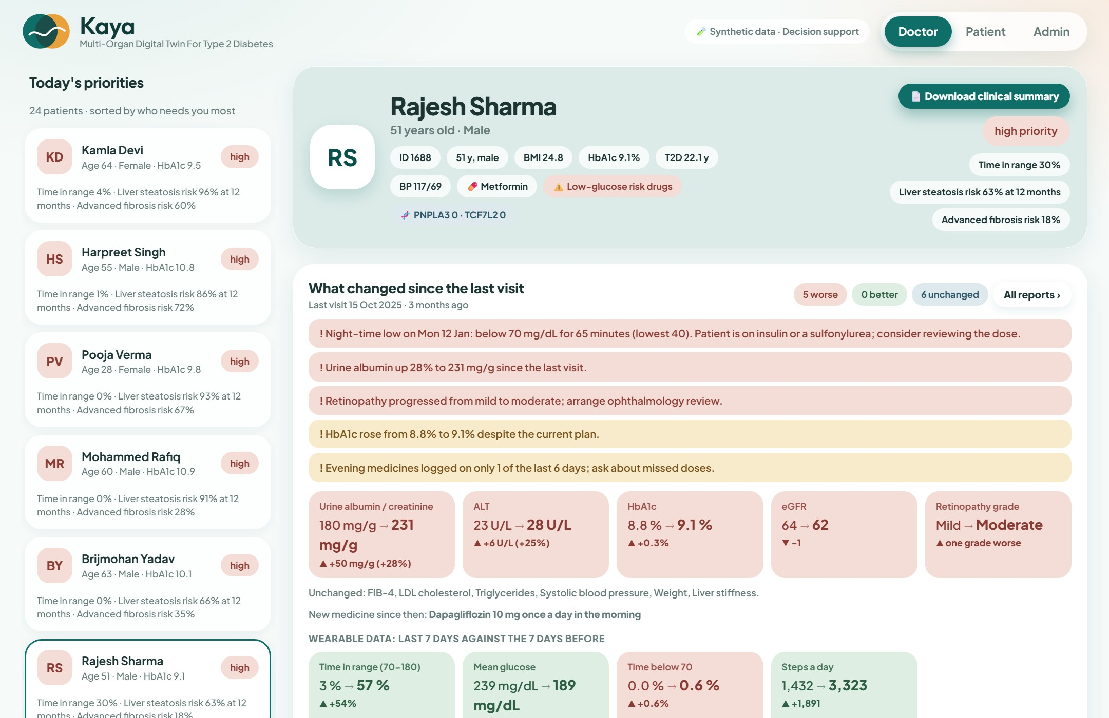
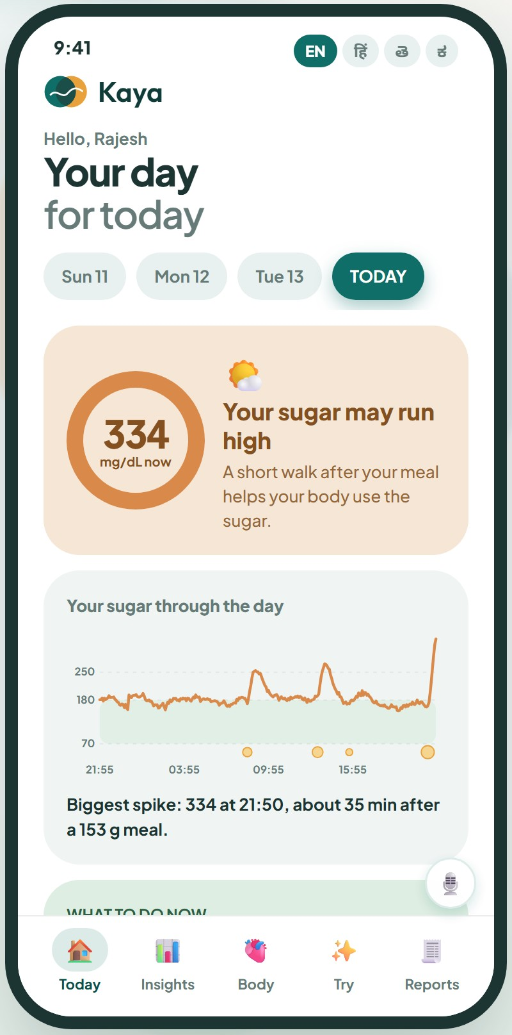
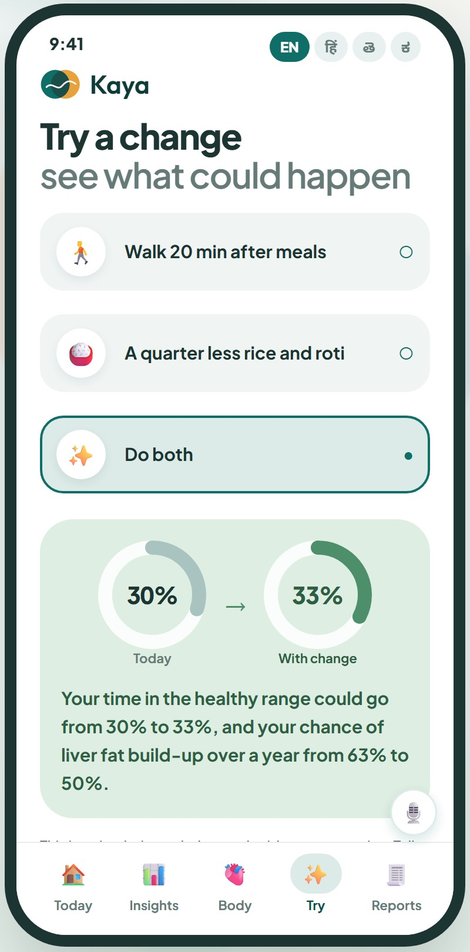
THE PRODUCT
See it working: doctor workspace and patient app
Doctor: triage, what changed, glucose twin
Patient: Today · Try a change
Notes:
[Slide 11 | about 0:10 | running total 5:35]
Here is what it looks like: the doctor workspace on the left, the patient app on the right. I will show both live shortly.
---
Sources and caveats: Screenshots of the running app with a synthetic patient (Rajesh Sharma). Doctor view: triage list sorted by risk, what changed since the last visit, glucose twin with forecast. Patient view: plain-language day summary with one next action, and Try a change, showing time in range and liver-fat risk before and after.

Slide 12
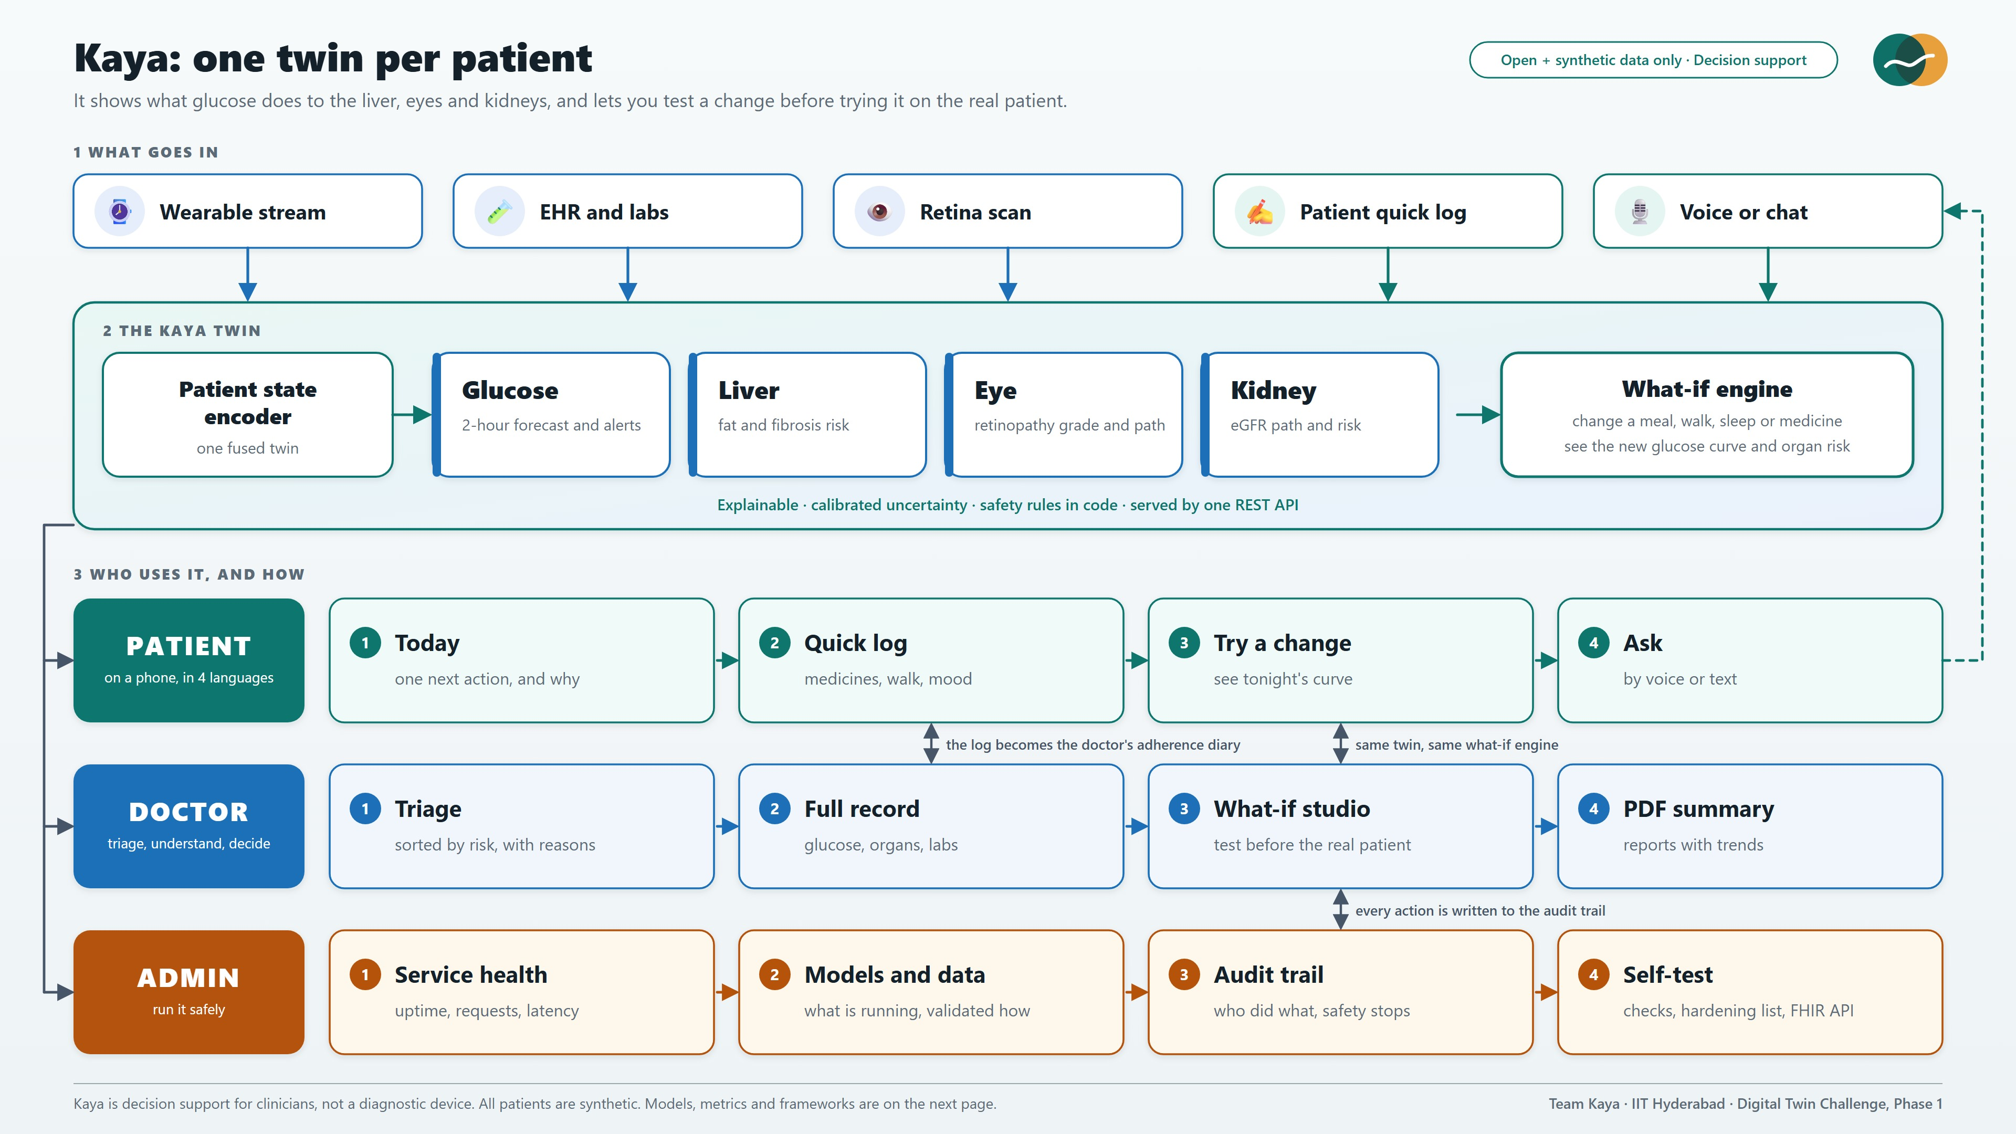
Notes:
[Slide 12 | about 0:35 | running total 6:10]
This is the architecture. On top, five inputs: the wearable stream, EHR and labs, the retina scan, the patient's quick log and voice. They feed one patient-state encoder, then four organ modules and the what-if engine. Below are the three roles, patient, doctor and admin, all served by one REST API. The dashed loop shows patient logs and questions feeding back into the twin.
---
Sources and caveats: System architecture. Inputs (wearable stream, EHR and labs, retina scan, patient quick log, voice or chat) feed one patient-state encoder. Four organ modules and the what-if engine sit on top. Three roles use the product: patient, doctor and admin. The dashed loop shows patient logs and questions feeding back into the twin.

Slide 13
THE AI / ML MODELS
Four models tested on real data, plus a fifth for the heart
Glucose forecast error (mg/dL, lower is better)
Liver and kidney: AUROC (higher is better)
80% intervals really cover 80%. Catches 72% of lows, 45 min early.
Eye grader: kappa 0.89 on APTOS, 0.71 on the Indian IDRiD set.
🩸
Glucose
GRU (PyTorch) + LightGBM
🟤
Liver
LightGBM + logistic, SHAP
👁️
Eye
EfficientNet-B2 (timm)
🫘
Kidney
LightGBM + logistic, SHAP
Notes:
[Slide 13 | about 0:40 | running total 6:50]
The models, each tested on real data. Glucose: a GRU blended with LightGBM beats a no-change baseline at every horizon, about 21 versus 26 mg/dL error at one hour, with intervals that really cover 80 percent. Liver: trained on 4,745 real adults from NHANES, it reaches 0.83 AUROC for advanced fibrosis against 0.63 for the standard FIB-4 score. Kidney matches a strong simple baseline at 0.85, so our value there is the eGFR trajectory, which we label as a simulation. Eye: EfficientNet-B2 reaches kappa 0.89 on APTOS, and 0.71 on the Indian IDRiD set after fine-tuning.
---
Sources and caveats: Glucose: out-of-sample on real CGMacros recordings (34 subjects): RMSE 12.6 / 21.1 / 28.2 mg/dL at 30 / 60 / 120 minutes versus 16.3 / 25.8 / 36.7 for no-change; conformal 80% intervals cover about 80%; event probabilities are isotonic-calibrated. Liver: NHANES 2017-18, 4,745 adults with FibroScan labels: advanced fibrosis AUROC 0.83 versus FIB-4 0.63; steatosis 0.83 versus FLI 0.82. Kidney: NHANES, 4,827 adults: low eGFR 0.85 (same as a simple baseline), albuminuria 0.76; the product value is the eGFR path, which is a labelled simulation. Eye: EfficientNet-B2 ordinal grader, kappa 0.89 on APTOS held-out, 0.71 on Indian IDRiD after fine-tuning (0.57 without). Progression risk is a simulation with editable assumptions.

Slide 14
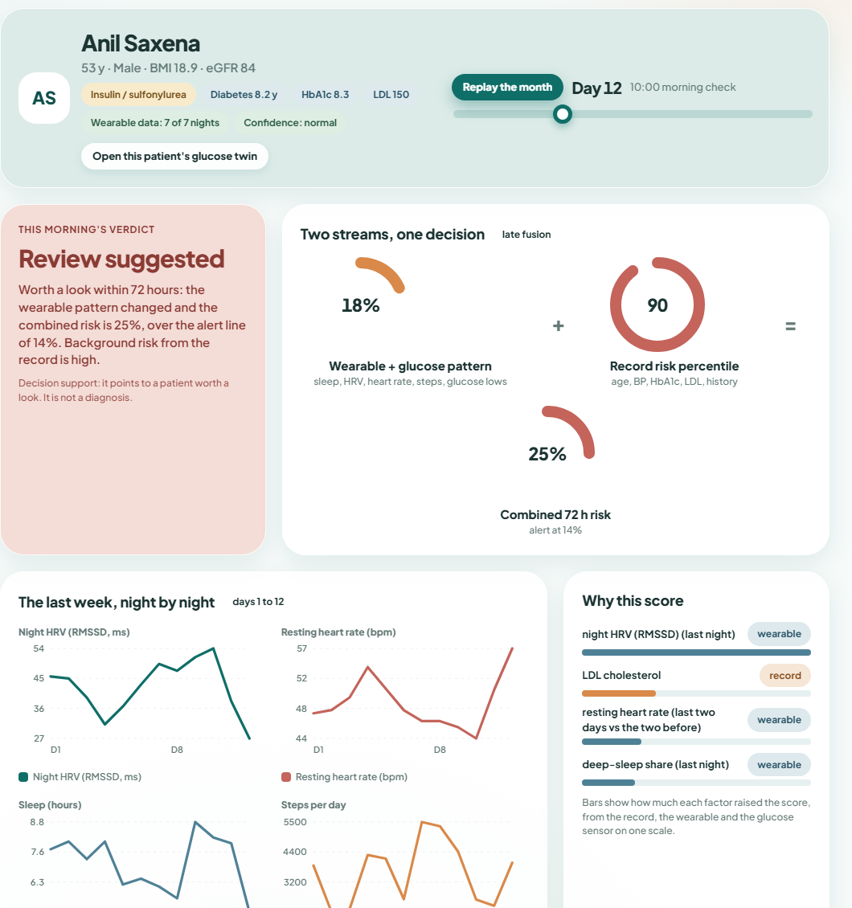
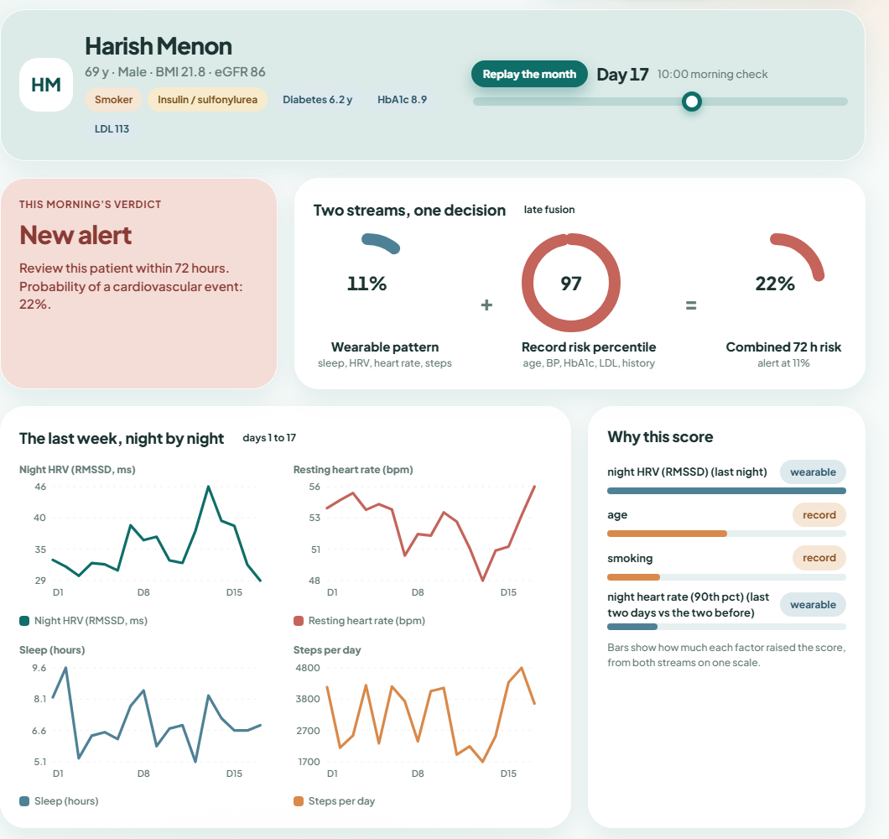
THE AI / ML MODELS · TWO STREAMS FUSED
The Heart watch: a week of nights, read with the record
What the fusion study measured
Wearable week (sleep, HRV, heart rate) plus the record flag a cardiovascular event up to 72 hours ahead.
AUROC 0.82. Wearable alone 0.80; record alone 0.69; simple clinical rule 0.68.
71% of events caught, a median 22 hours early, at about 1 false alert per patient-month.
For glucose, medicines lift low-glucose AUROC from 0.85 to 0.95; HRV and sleep add little.
Synthetic data with assumed couplings: it shows the fusion works, not clinical accuracy.

Slide 15
TECHNICAL STACK
Open data in, explainable models, one clean platform
DATA
AI / ML
TRUST AND LANGUAGE
PLATFORM
CGMacros
real CGM, 34 people
PyTorch
GRU glucose forecaster
Conformal, isotonic
honest uncertainty
FastAPI, Pydantic
REST, WebSocket, FHIR
📈
🔥
🎯
⚡
NHANES 2017-18
labs + FibroScan
LightGBM, scikit-learn
liver, kidney, glucose
Sarvam AI
speech, chat, voice
React 18, Vite
doctor, patient, admin
🩺
🌳
🗣️
⚛️
APTOS + IDRiD
retina, incl. Indian
EfficientNet-B2
retina grading via timm
Sarvam Document AI
reads uploaded reports
NumPy live model
about 1 ms, no GPU
👁️
🖼️
📄
🧮
Synthetic cohort
2,000, privacy-safe
SHAP, Grad-CAM
explains every prediction
Safety rules in code
run before the model
Docker, GitHub CI
tests on every push
🧬
🔦
🛡️
🐳
Full detailed diagram in the appendix.
Notes:
[Slide 14 | about 0:15 | running total 7:05]
The stack is deliberately simple: open data, PyTorch and LightGBM models, SHAP and Grad-CAM for explanations, Sarvam AI for Indian-language voice and document reading, and FastAPI, React and Docker. The live model runs in pure NumPy, so the demo needs no GPU.
---
Sources and caveats: Technical stack. Data: CGMacros (PhysioNet), NHANES 2017-18, APTOS 2019 and IDRiD, and a synthetic cohort (our generator plus simglucose). Models: PyTorch GRU with quantile and event heads, LightGBM, scikit-learn, timm EfficientNet-B2, SHAP, Grad-CAM, conformal prediction and isotonic calibration. Language: Sarvam AI (saaras:v4 speech-to-text, sarvam-105b-conversations chat, bulbul:v4-flash text-to-speech) and Sarvam Document AI, all called from the server so the key never reaches the browser. Platform: FastAPI, Pydantic, WebSocket, FHIR R4, ReportLab PDFs, React 18 with Vite, NumPy live model, Docker Compose and GitHub Actions. Training used 3x NVIDIA RTX A5000.

Slide 16
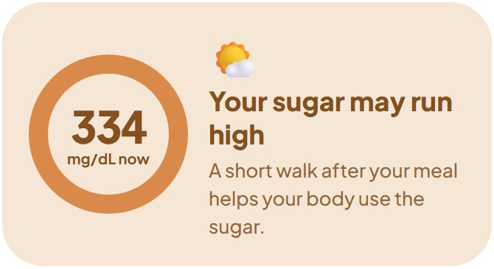
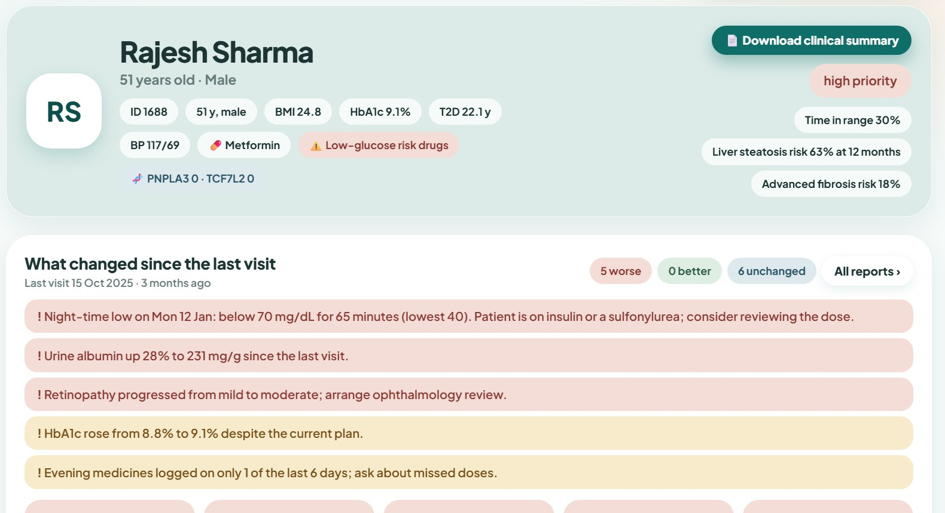
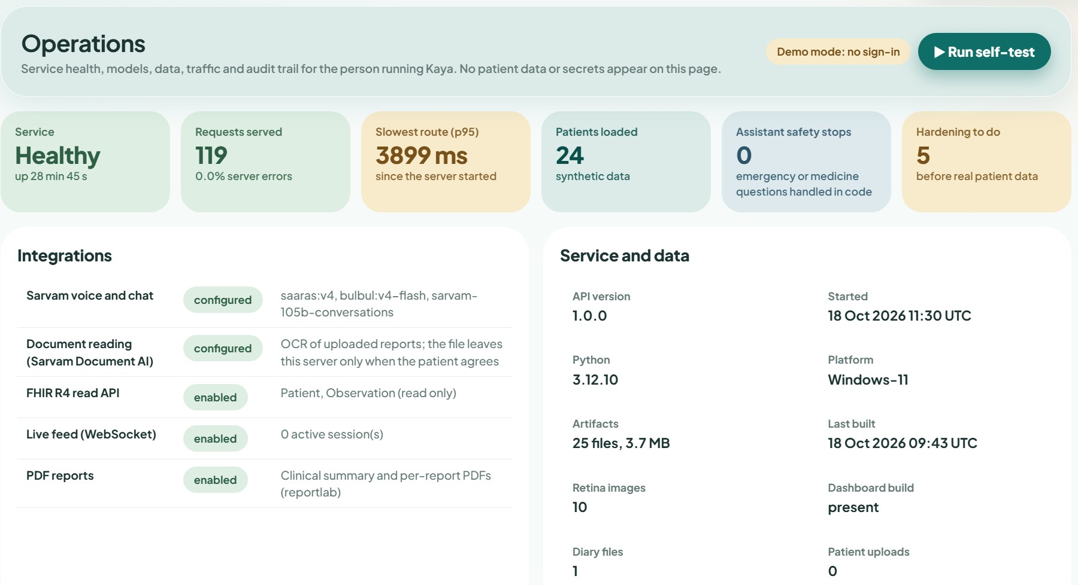
WHO IT IS FOR
Three people, one twin, each with their own view
Patient
Doctor
Admin
People living with Type 2 diabetes
Diabetologists and care teams
Clinic admins and hospital IT
One clear next action, and why
See how habits hit the organs
Try a change before making it
Voice help; upload reports
Triage list sorted by risk
Full record, what changed
What-if before changing care
One-click clinical PDF
Service health and latency
Model and data inventory
Audit trail, safety counts
Self-test, FHIR R4 API
Knows what to do next
Sees who needs help today
Runs it safely
Notes:
[Slide 15 | about 0:35 | running total 7:40]
Who is it for? Three people. The patient gets one clear next action each day, sees how habits affect organs, can try a change before making it, and asks questions by voice in their own language. The doctor sees who needs help today and why, opens a full record, sees what changed since the last visit, and tests a what-if before changing treatment. The admin, meaning clinic administrators and hospital IT, sees service health, which models are running and how they were validated, an audit trail and a self-test.
---
Sources and caveats: Three roles. Patient: the app shows one next action and why, how habits affect organs, a try-a-change simulator, and a voice assistant in four languages; patients can upload reports as PDF or photo. Doctor: triaged list, full record, what changed, what-if, PDF. Admin: operations page with service health, model inventory, traffic, assistant safety counters, audit trail (in memory), self-test and a hardening checklist; FHIR R4 read API for hospital IT. Persistent audit log, consent records and ABDM alignment are on the roadmap.

Slide 17
WHERE WE ARE
Built and working today, with an honest road ahead
BUILT AND WORKING
NEXT
WHAT WE STATE OPENLY
Glucose, liver, eye and kidney modules
What-if engine and live mode
Doctor, patient and admin views
English, Hindi, Telugu, Kannada, with voice
Report upload read by Document AI
FHIR R4 read API, PDF reports
Docker deploy, tests on every push
Consent records and a persistent audit log
Sign-in and hardening before real data
Fuller FHIR and ABDM alignment
Drift monitoring on the admin page
Pilot with a hospital partner on real Indian patient data
Native-speaker review of Indian-language texts
Decision support, not a diagnostic device
Glucose-to-organ links are simulated on a synthetic cohort
Not yet clinically validated
Every module is validated on real data wherever real data exists
Metrics are out-of-sample
Notes:
[Slide 16 | about 0:30 | running total 8:10]
Where we are, honestly. Built: the four modules, what-if and live mode, three role views, four languages with voice, report upload, a FHIR read API and automated tests. Next: consent records, a persistent audit log, sign-in before any real data, ABDM alignment and a pilot with a hospital partner. And what we state openly: Kaya is decision support, not a diagnostic device, and the glucose-to-organ links are simulated on a synthetic cohort and not yet clinically validated.
---
Sources and caveats: Status as of this submission. The glucose-to-organ links are simulated because no public dataset links one person's glucose stream to their liver, eye and kidney outcomes; each module is validated on real data where it exists (CGMacros, NHANES, APTOS and IDRiD).

Slide 18
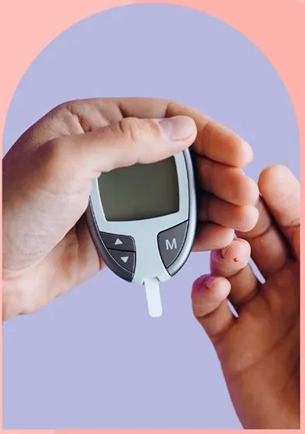
See the organs behind the glucose
Kaya gives every patient a living twin, every doctor a way to test a change first, and every clinic a platform it can run safely.
Team Kaya
Dulari Bhushan · Prateek Giddaplavar
Indian Institute of Technology Hyderabad
Notes:
[Slide 17 | about 0:15 | running total 8:25]
To close: Kaya gives every patient a living twin, every doctor a way to test a change first, and every clinic a platform it can run safely. Let me show you. [Switch to the live demo.]
---
Sources and caveats: Closing. Thank the judges; offer the live demo: doctor view, patient view and admin view on synthetic patients.

Slide 19

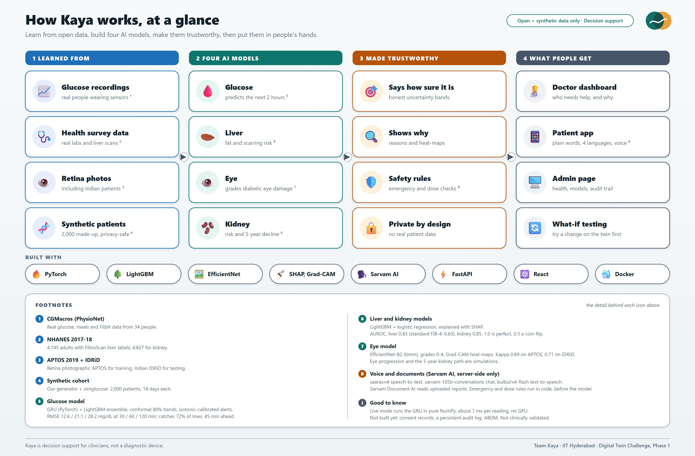
Notes:
[Appendix]
Appendix: detailed architecture with data sources, models and footnotes. Not part of the talk; open it only if asked.
---
Sources and caveats: Appendix: detailed architecture with data sources, models, trust features and what people get. Footnotes give dataset names, model names and headline metrics.

