Slide 1
ALTRIUM HR
Sprint 1 Review
Core Feature Deep-Dive: Secure Login & Authentication
Dimanthi Hewagama
Scrum Master
Diheli Abeysinghe
Business Analyst
Dulathmi Dunuwille
Developer & Quality Assurance

Slide 2
SLIDE 1
Agile Roles & Sprint Goal
Agile Roles This Sprint
Sprint Goal
DH
Dimanthi Hewagama
Identify Altrium's recruitment-tracking needs, analyze the existing manual process, and deliver Sprint 1's foundation: the product backlog, acceptance criteria, test cases, use case / activity / sequence diagrams, ERD, and low-fidelity wireframes.
Scrum Master
Led stand-ups, coordinated the schedule, and kept the sprint on track.
DA
Diheli Abeysinghe
Business Analyst
Gathered and documented requirements; communicated scope across the team.
In this presentation, we drill into one core feature that anchors every workflow in the system:
DD
Dulathmi Dunuwille
Developer & QA
Designed the schema, built the auth system, and tested it end-to-end.
Secure Login & Role-Based Authentication
1

Slide 3
SLIDE 2
Sprint 1 Backlog
1
Secure HR login
16
Interviewer: view assigned candidates & CVs
2
IT Admin: create / edit / deactivate user accounts
17
Interviewer: record interview feedback (score + notes)
3
IT Admin: assign role-based permissions
18
Hiring Manager: advance / reject between rounds
4
IT Admin: recruitment activity audit logs
19
HR: retain candidate records after closure
5
HR: create, edit & close job vacancies
20
Interviewer: edit own feedback only
6
HR: configurable interview stages per vacancy
21
Feedback modification history (audit trail)
7
HR: individual & bulk CV upload
22
Hiring Manager: view feedback across interviewers
8
Centralized candidate database
23
HR: send selection / rejection emails
9
HR: shortlist / reject candidates after CV review
24
Management: recruitment dashboard
10
HR: assign interviewers & hiring managers
25
Management: recruitment KPI monitoring
11
HR: schedule interviews (date, time, panel, stage)
26
Management: per-vacancy reports
12
HR: send interview invitation emails
27
Management: export reports as PDF
13
HR: view all candidates
28
Leadership: org-wide recruitment dashboard
14
HR: search & filter candidates
29
HR: candidate history across vacancies
15
HR: last-reviewed-CV tracking
30
Hiring Manager: compare shortlisted candidates
2

Slide 4
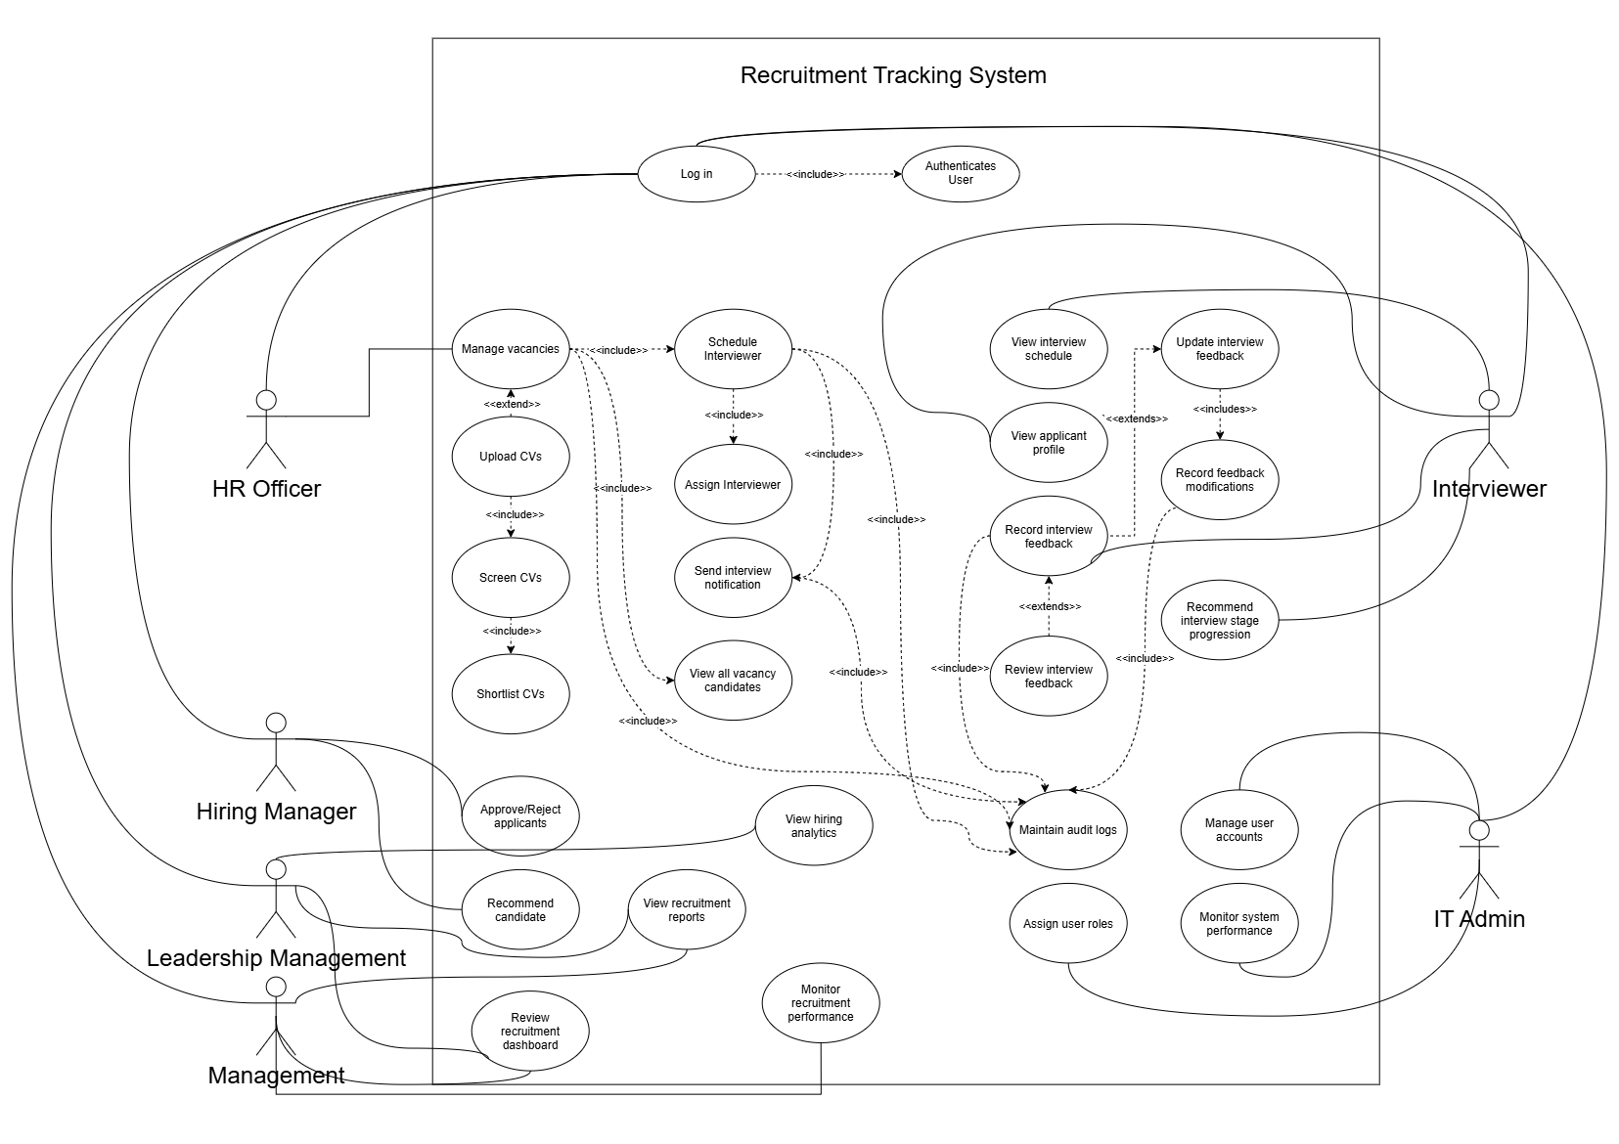
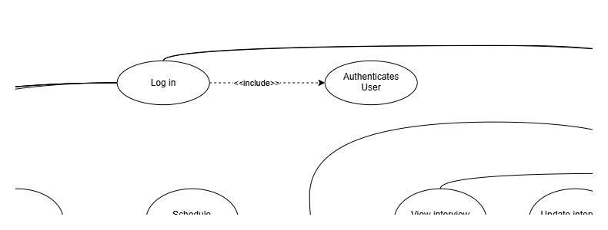
SLIDE 3
Use Case Diagram — Secure Login
Every actor in the system converges on “Log in.” It is the one use case shared by HR, Interviewer, Hiring Manager, Management, Leadership and IT Admin alike.
Why this is the core feature: nothing else in the Recruitment Tracking System is reachable until this use case succeeds — it is the single shared gateway for all six roles.
<<include>> Authenticates User: credential check, account-status check, and role resolution all happen inside this one included use case (see Activity & Sequence Diagrams next).
Figure 3 — full system Use Case Diagram
3

Slide 5
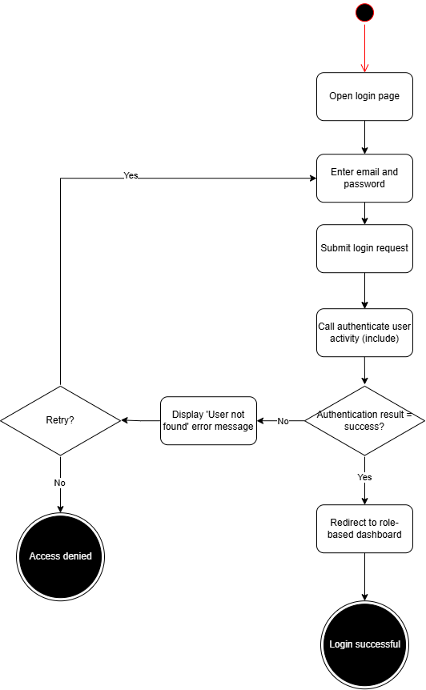
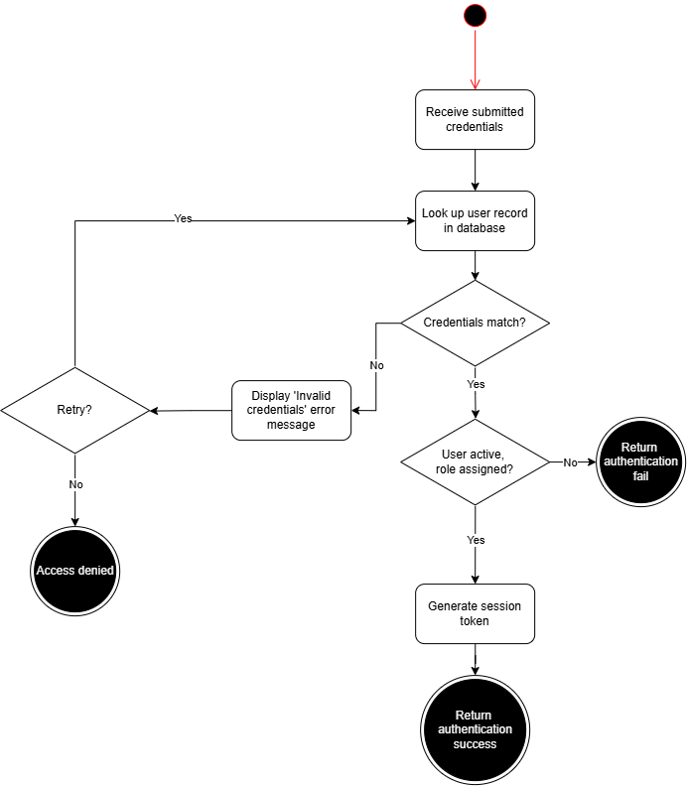
SLIDE 4
Activity Diagram — Secure Login
Design note for Q&A
These diagrams show two distinct messages (“User not found” / “Invalid credentials”) for clarity of flow.
The shipped system deliberately collapses both into one generic “Invalid email or password” response.
This is a security decision, not an oversight: a distinct message would let an attacker enumerate which email addresses have accounts (or which are deactivated). Same rule applies to the “User active, role assigned?” branch — a deactivated account fails the same way as a wrong password.
Figure 5 — Authenticate User (<<include>>)
Figure 4 — Login
4

Slide 6
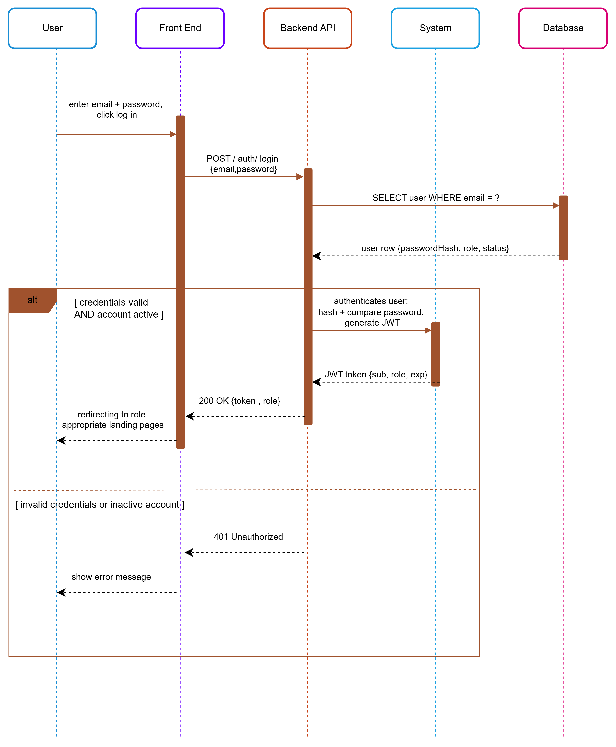
SLIDE 5
Sequence Diagram — Secure Login
Figure 60 — User → Front End → Backend API → Database
5

Slide 7
SLIDE 6
Test Cases — Secure Login
VALID DATA
TCI-01
INVALID DATA
TCI-03
Steps: Navigate to login → enter hr@altrium.test / password123 → click Log in
Steps: Enter a valid email (hr@altrium.test) with the wrong password (Password123) → click Log in
Expected: User is authenticated and navigated to the correct role-based landing page.
Expected: Rejected with “Invalid email or password” — no hint that the email was correct.
VALIDATION
TCI-05
NON-FUNCTIONAL
NEW
Steps: Leave both the email and password fields blank → click Log in
Steps: Inspect the network request/response and the database row created at signup.
Expected: Client/server reject the empty submission with “Invalid email or password” — same generic message, no field is ever silently accepted empty.
Expected: Password is never present in plaintext anywhere: it is bcrypt-hashed before storage, and no API response at any endpoint ever returns passwordHash.
TCI-01, TCI-03 and TCI-05 are documented in Sprint1_Manual_Test_Cases.docx. The non-functional case is new — no such case existed anywhere in the Sprint 1 test suite before this review.
6

Slide 8
SLIDE 7
Sprint Retrospective — Dimanthi Hewagama
Role held this sprint: Scrum Master
Second role performed (roles were swapped)
TO BE COMPLETED — name the second Agile role you covered during Sprint 1.
What went well in both roles
TO BE COMPLETED — one concrete win from each role you held.
A challenge you faced switching roles
TO BE COMPLETED — be specific: what was harder than expected?
What you'd do differently next sprint
TO BE COMPLETED — one actionable change.
7

Slide 9
SLIDE 8
Sprint Retrospective — Diheli Abeysinghe
Role held this sprint: Business Analyst
Second role performed (roles were swapped)
TO BE COMPLETED — name the second Agile role you covered during Sprint 1.
What went well in both roles
TO BE COMPLETED — one concrete win from each role you held.
A challenge you faced switching roles
TO BE COMPLETED — be specific: what was harder than expected?
What you'd do differently next sprint
TO BE COMPLETED — one actionable change.
8

Slide 10
SLIDE 9
Sprint Retrospective — Dulathmi Dunuwille
Role held this sprint: Developer & Quality Assurance
Second role performed (roles were swapped)
TO BE COMPLETED — name the second Agile role you covered during Sprint 1.
What went well in both roles
TO BE COMPLETED — one concrete win from each role you held.
A challenge you faced switching roles
TO BE COMPLETED — be specific: what was harder than expected?
What you'd do differently next sprint
TO BE COMPLETED — one actionable change.
9

Slide 11
SLIDE 10 (OPTIONAL)
Workload Matrix
Team Member
Role
Key Contributions
Dimanthi Hewagama
Scrum Master
Organized and led meetings and stand-ups, coordinated the team's schedule, divided and assigned tasks among members, and kept the sprint on track.
Diheli Abeysinghe
Business Analyst
Gathered and documented requirements; communicated scope and clarifications across the team.
Dulathmi Dunuwille
Developer
Designed and implemented the full Prisma/MySQL schema and built the Express/JWT authentication system with role-based access control.
Dulathmi Dunuwille
Quality Assurance
Manually tested and verified all authentication endpoints end-to-end against the live database and confirmed password hashing.
All members also collaboratively contributed to the Product Backlog, WBS, Activity/Use Case/Sequence Diagrams, ERD and Low-Fidelity Wireframes.
10

