Slide 1
ALTRIUM HR
Sprint 1 Review
Core Feature Deep-Dive: CV Screening & Last-Reviewed Tracking
Dimanthi Hewagama
Scrum Master
Diheli Abeysinghe
Business Analyst
Dulathmi Dunuwille
Developer & Quality Assurance

Slide 2
SLIDE 1
Agile Roles & Sprint Goal
Agile Roles This Sprint
Sprint Goal
DH
Dimanthi Hewagama
Identify Altrium's recruitment-tracking needs, analyze the existing manual process, and deliver Sprint 1's foundation: the product backlog, acceptance criteria, test cases, use case / activity / sequence diagrams, ERD, and low-fidelity wireframes.
Scrum Master
Led stand-ups, coordinated the schedule, and kept the sprint on track.
DA
Diheli Abeysinghe
Business Analyst
Gathered and documented requirements; communicated scope across the team.
In this presentation, we drill into the core feature that directly answers the client's accountability problem — who reviewed a candidate's CV, and when:
DD
Dulathmi Dunuwille
Developer & QA
Designed the schema, built the CV review/tracking flow, and tested it end-to-end.
CV Screening & Last-Reviewed Tracking
1

Slide 3
SLIDE 2
Sprint 1 Backlog
1
Secure HR login
16
Interviewer: view assigned candidates & CVs
2
IT Admin: create / edit / deactivate user accounts
17
Interviewer: record interview feedback (score + notes)
3
IT Admin: assign role-based permissions
18
Hiring Manager: advance / reject between rounds
4
IT Admin: recruitment activity audit logs
19
HR: retain candidate records after closure
5
HR: create, edit & close job vacancies
20
Interviewer: edit own feedback only
6
HR: configurable interview stages per vacancy
21
Feedback modification history (audit trail)
7
HR: individual & bulk CV upload
22
Hiring Manager: view feedback across interviewers
8
Centralized candidate database
23
HR: send selection / rejection emails
9
HR: shortlist / reject candidates after CV review
24
Management: recruitment dashboard
10
HR: assign interviewers & hiring managers
25
Management: recruitment KPI monitoring
11
HR: schedule interviews (date, time, panel, stage)
26
Management: per-vacancy reports
12
HR: send interview invitation emails
27
Management: export reports as PDF
13
HR: view all candidates
28
Leadership: org-wide recruitment dashboard
14
HR: search & filter candidates
29
HR: candidate history across vacancies
15
HR: last-reviewed-CV tracking
30
Hiring Manager: compare shortlisted candidates
2

Slide 4
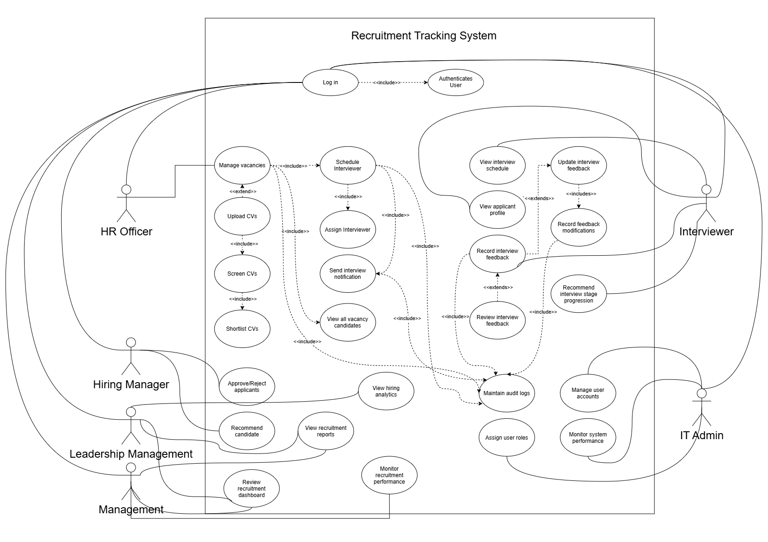
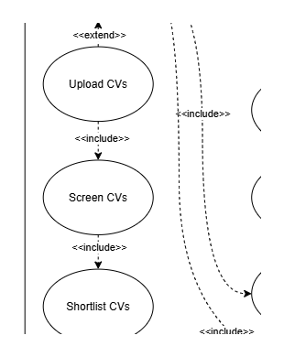
SLIDE 3
Use Case Diagram — CV Screening & Tracking
HR's <<include>> chain: Upload CVs -> Screen CVs -> Shortlist CVs. There is no separate bubble named for last-reviewed tracking — it is part of the Screen CVs use case, the same way Interview Stage Rules extends Manage vacancies.
Why this is a strong core feature: it is the one use case that produces an audit trail HR, Hiring Managers and Management all rely on — real accountability, not just a workflow step.
Figure 3 — full system Use Case Diagram
3

Slide 5
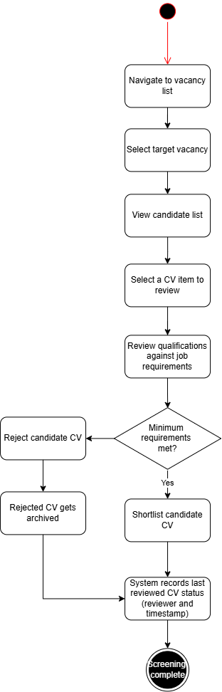
SLIDE 4
Activity Diagram — CV Screening & Tracking
What the diagram gets right
Design note for Q&A
Both the Reject and Shortlist branches converge on “System records last reviewed CV status (reviewer and timestamp)” before Screening complete — this matches the real Candidate.lastCvReviewedByUserId / lastCvReviewedAt fields exactly.
The diagram ties the “records last reviewed” step to the end of one HR officer's screening decision.
The real trigger is broader: getCandidate() updates reviewer + timestamp on every GET of a candidate record, by any authenticated role, whether or not a decision is made.
Gap to own in Q&A
No step here covers writing a review note. The live system has a free-text note field the diagram never shows — an intentional simplification, not a build defect.
Framing: this is a deliberate simplification for the diagram's clarity, not a contradiction — the field-level behavior (who/when) is correct, only the trigger scope is narrower on paper than in the build.
Figure 9 — CV Screening
4

Slide 6
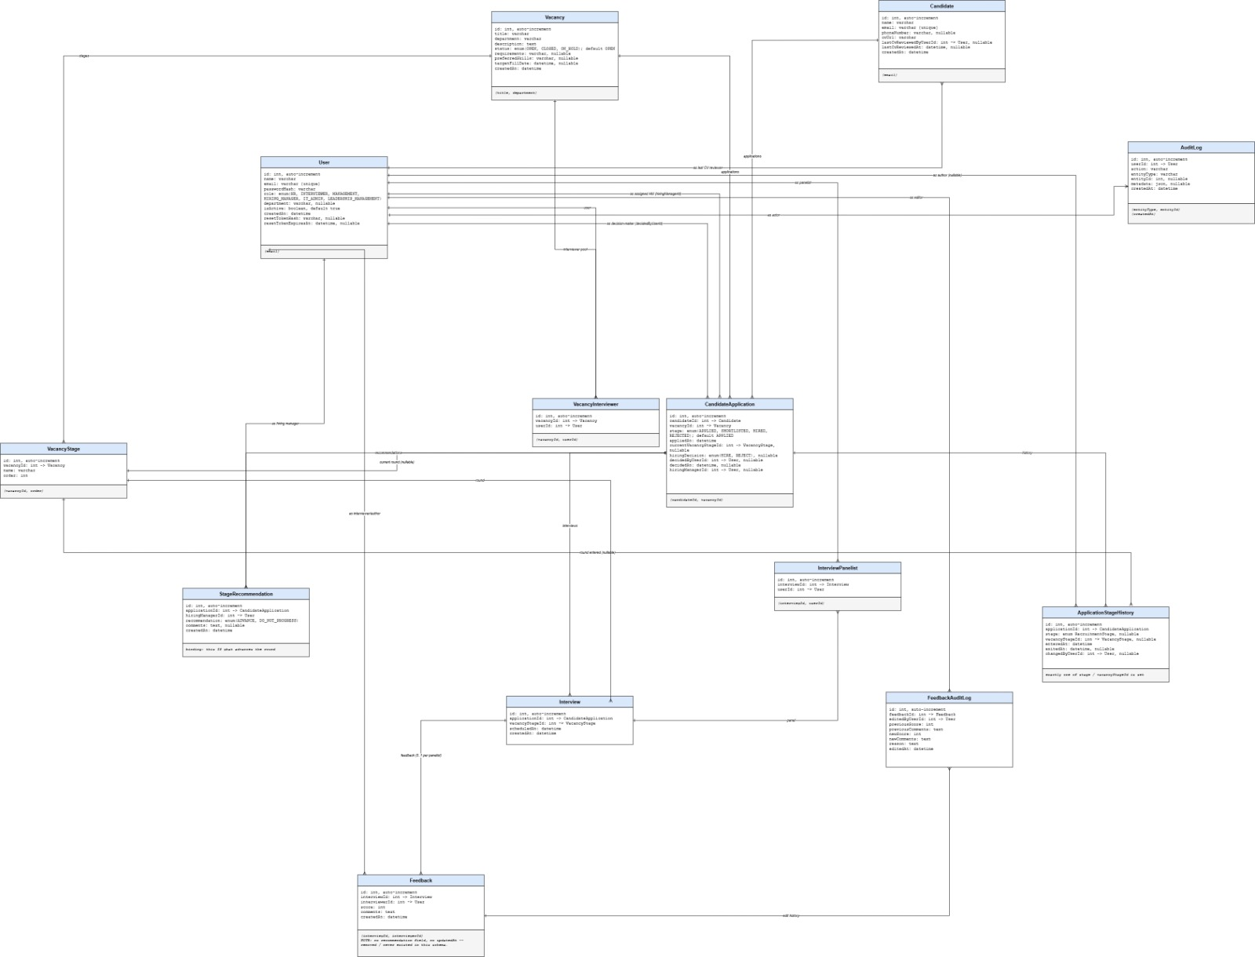
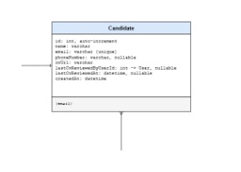
SLIDE 5
ERD — Candidate CV-Review Fields
No Sequence Diagram was drawn for this feature in the Sprint 1 document — the ERD is shown here instead, per the brief's “Sequence Diagram (if drawn) / ERD” allowance.
Correct: lastCvReviewedByUserId and lastCvReviewedAt are both shown on Candidate, matching schema.prisma exactly.
Gap to own: lastCvReviewNote (the free-text note field) is missing from this box. Schema comment marks it as added in a later frontend-corrections pass, after the original ERD was drawn — a genuine, checkable reason, not an excuse invented after the fact.
Figure 22 — full system ERD
5

Slide 7
SLIDE 6
Test Cases — CV Screening & Tracking
VALID DATA
TCI-35
EDGE CASE — NEEDS REWORDING
TCI-36
Steps: Log in as HR Officer → open a candidate who has already been reviewed.
Steps: Two HR Officers view the same candidate within a fraction of a second of each other.
Expected: The last reviewer's name and the review timestamp are displayed on the candidate record.
Expected: Doc claims: “only the most recent review is shown, but both events are retained in review history.” Reality: there is no review-history table — only the single latest reviewer/timestamp is stored, and the second view silently overwrites the first.
VALIDATION
NEW
NON-FUNCTIONAL
NEW
Steps: Log in as an Interviewer (not HR) and open a candidate detail page that HR already reviewed.
Steps: Save a review note on a candidate, then reload the candidate detail page.
Expected: “Last Reviewed By” switches to the Interviewer's name/time immediately — confirms the trigger is any authenticated role viewing the record, not an HR-only screening action.
Expected: The note persists (Candidate.lastCvReviewNote) and is shown back to any HR user who opens the same record — it is not tied to a single browser session.
TCI-35 and TCI-36 are documented in Sprint1_Manual_Test_Cases.docx (US-15). TCI-36's “review history” claim does not match the schema — flag this before presenting it. The other two cases are new; no such cases existed in the Sprint 1 test suite before this review.
6

Slide 8
SLIDE 7
Sprint Retrospective — Dimanthi Hewagama
Role held this sprint: Scrum Master
Second role performed (roles were swapped)
TO BE COMPLETED — name the second Agile role you covered during Sprint 1.
What went well in both roles
TO BE COMPLETED — one concrete win from each role you held.
A challenge you faced switching roles
TO BE COMPLETED — be specific: what was harder than expected?
What you'd do differently next sprint
TO BE COMPLETED — one actionable change.
7

Slide 9
SLIDE 8
Sprint Retrospective — Diheli Abeysinghe
Role held this sprint: Business Analyst
Second role performed (roles were swapped)
TO BE COMPLETED — name the second Agile role you covered during Sprint 1.
What went well in both roles
TO BE COMPLETED — one concrete win from each role you held.
A challenge you faced switching roles
TO BE COMPLETED — be specific: what was harder than expected?
What you'd do differently next sprint
TO BE COMPLETED — one actionable change.
8

Slide 10
SLIDE 9
Sprint Retrospective — Dulathmi Dunuwille
Role held this sprint: Developer & Quality Assurance
Second role performed (roles were swapped)
TO BE COMPLETED — name the second Agile role you covered during Sprint 1.
What went well in both roles
TO BE COMPLETED — one concrete win from each role you held.
A challenge you faced switching roles
TO BE COMPLETED — be specific: what was harder than expected?
What you'd do differently next sprint
TO BE COMPLETED — one actionable change.
9

Slide 11
SLIDE 10 (OPTIONAL)
Workload Matrix
Team Member
Role
Key Contributions
Dimanthi Hewagama
Scrum Master
Organized and led meetings and stand-ups, coordinated the team's schedule, divided and assigned tasks among members, and kept the sprint on track.
Diheli Abeysinghe
Business Analyst
Gathered and documented requirements; communicated scope and clarifications across the team.
Dulathmi Dunuwille
Developer
Designed and implemented the full Prisma/MySQL schema and built the CV screening / last-reviewed tracking flow end-to-end.
Dulathmi Dunuwille
Quality Assurance
Manually tested and verified the CV review flow against the live database, including the reviewer/timestamp overwrite behavior.
All members also collaboratively contributed to the Product Backlog, WBS, Activity/Use Case/Sequence Diagrams, ERD and Low-Fidelity Wireframes.
10

