Slide 1
Chapter 3:
Expressions and Interactivity

Slide 2
3.1
The cin Object

Slide 3
The cin Object
Standard input object
Like cout, requires iostream file
Used to read input from keyboard
Information retrieved from cin with >>
Input is stored in one or more variables

Slide 4
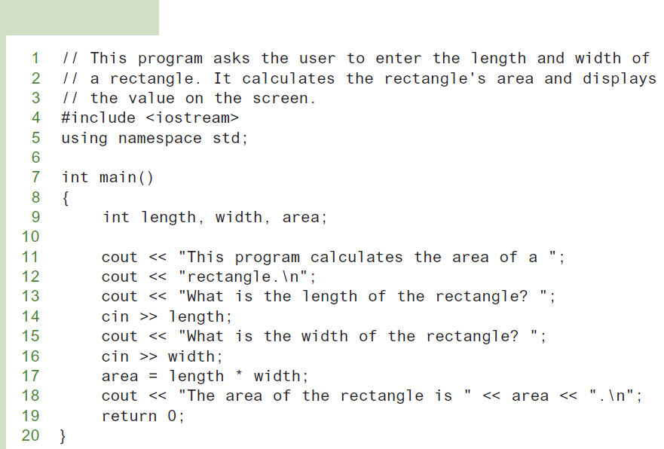
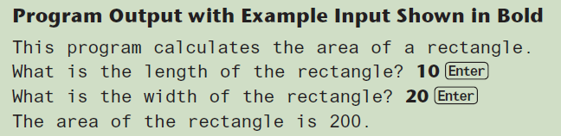
The cin Object
Program 3-1

Slide 5
The cin Object
cin converts data to the type that matches the variable:
  int height;
  cout << "How tall is the room? ";
  cin >> height;

Slide 6
Displaying a Prompt
A prompt is a message that instructs the user to enter data.
You should always use cout to display a prompt before each cin statement.
cout << "How tall is the room? ";
cin >> height;

Slide 7
The cin Object
Can be used to input more than one value:
  cin >> height >> width;
Multiple values from keyboard must be separated by spaces
Order is important: first value entered goes to first variable, etc.

Slide 8
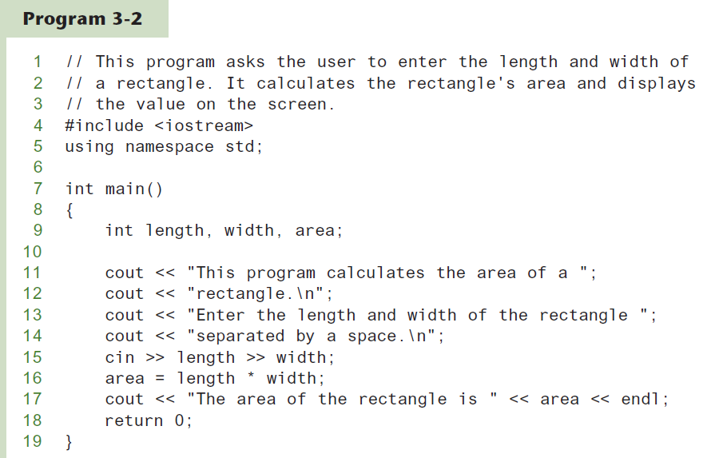
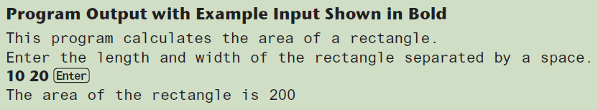
Using cin To Read Multiple Values

Slide 9
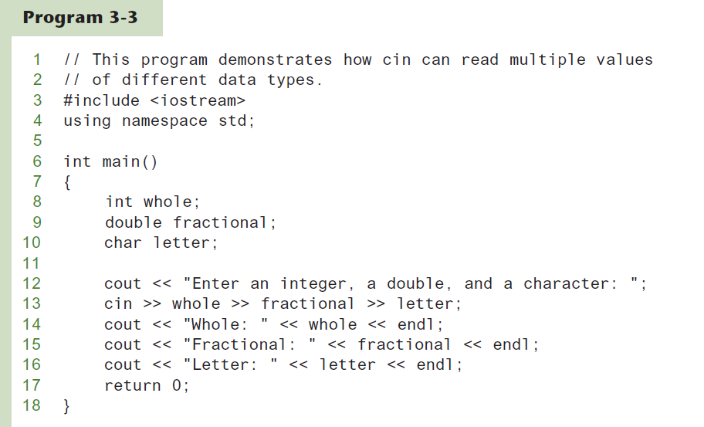
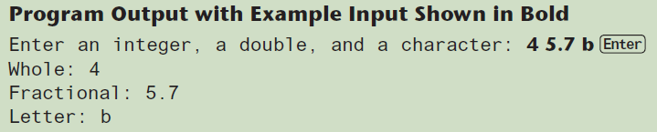
Using cin To Read Values of Different Data Types

Slide 10
3.2
Mathematical Expressions

Slide 11
Mathematical Expressions
Can create complex expressions using multiple mathematical operators
An expression can be a literal, a variable, or a mathematical combination of constants and variables
Can be used in assignment, cout, other statements:
  area = 2 * PI * radius;
  cout << "border is: " << 2*(l+w);

Slide 12
Order of Operations
In an expression with more than one operator, evaluate in this order:
  - (unary negation), in order, left to right
  * / %, in order, left to right
  + -, in order, left to right
In the expression 2 + 2 * 2 – 2
evaluate
first
evaluate
third
evaluate
second

Slide 13
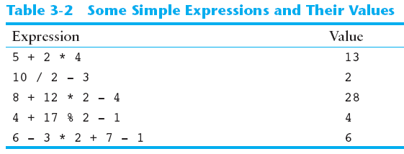
Order of Operations

Slide 14
Associativity of Operators
- (unary negation) associates right to left
*, /, %, +, - associate right to left
parentheses ( ) can be used to override the order of operations:
  2 + 2 * 2 – 2 = 4
  (2 + 2) * 2 – 2 = 6
  2 + 2 * (2 – 2) = 2
  (2 + 2) * (2 – 2) = 0

Slide 15
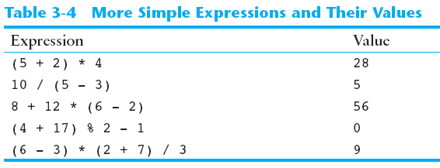
Grouping with Parentheses

Slide 16
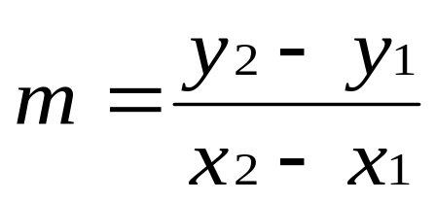
Algebraic Expressions
Multiplication requires an operator:
  Area=lw is written as Area = l * w;
There is no exponentiation operator:
  Area=s² is written as Area = pow(s, 2);
Parentheses may be needed to maintain order of operations:
  is written as
  m = (y2-y1) /(x2-x1);

Slide 17
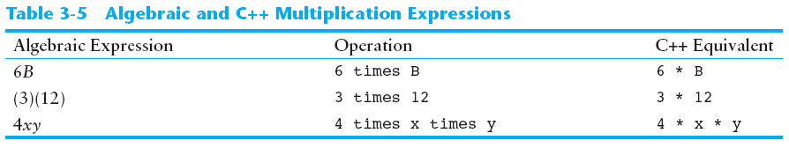
Algebraic Expressions

Slide 18
3.3
When You Mix Apples with Oranges: Type Conversion

Slide 19
When You Mix Apples with Oranges: Type Conversion
Operations are performed between operands of the same type.
If not of the same type, C++ will convert one to be the type of the other
This can impact the results of calculations.

Slide 20
Hierarchy of Types
Highest:
Lowest:
Ranked by largest number they can hold
long double
double
float
unsigned long
long
unsigned int
int

Slide 21
Type Coercion
Type Coercion: automatic conversion of an operand to another data type
Promotion: convert to a higher type
Demotion: convert to a lower type

Slide 22
Coercion Rules
1) char, short, unsigned short automatically promoted to int
2) When operating on values of different data types, the lower one is promoted to the type of the higher one.
3) When using the = operator, the type of expression on right will be converted to type of variable on left

Slide 23
3.4
Overflow and Underflow

Slide 24
Overflow and Underflow
Occurs when assigning a value that is too large (overflow) or too small (underflow) to be held in a variable
Variable contains value that is ‘wrapped around’ set of possible values
Different systems may display a warning/error message, stop the program, or continue execution using the incorrect value

Slide 25
3.5
Type Casting

Slide 26
Type Casting
Used for manual data type conversion
Useful for floating point division using ints: double m;
m = static_cast<double>(y2-y1)
/(x2-x1);
Useful to see int value of a char variable:
char ch = 'C';
cout << ch << " is "
<< static_cast<int>(ch);

Slide 27
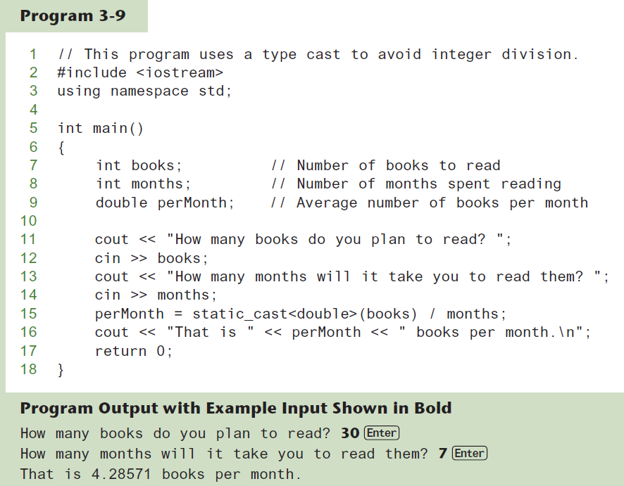
Type Casting

Slide 28
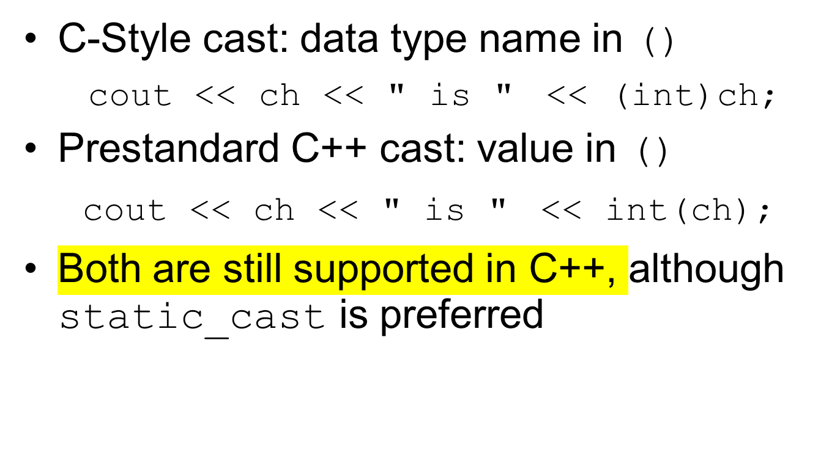
C-Style and Prestandard Type Cast Expressions

Slide 29
3.6
Multiple Assignment and Combined Assignment

Slide 30
Multiple Assignment and Combined Assignment
The = can be used to assign a value to multiple variables:
  x = y = z = 5;
Value of = is the value that is assigned
Associates right to left:
  x = (y = (z = 5));
value
is 5
value
is 5
value
is 5

Slide 31
Combined Assignment
Look at the following statement:
  sum = sum + 1;
  This adds 1 to the variable sum.

Slide 32
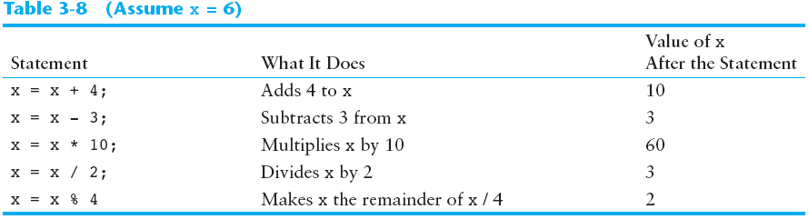
Other Similar Statements

Slide 33
Combined Assignment
The combined assignment operators provide a shorthand for these types of statements.
The statement
  sum = sum + 1;
  is equivalent to
  sum += 1;

Slide 34
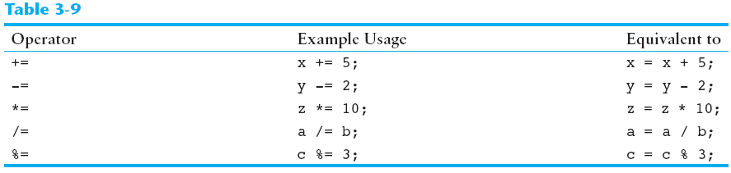
Combined Assignment Operators

Slide 35
3.7
Formatting Output

Slide 36
Formatting Output
Can control how output displays for numeric, string data:
  size
  position
  number of digits
Requires iomanip header file

Slide 37
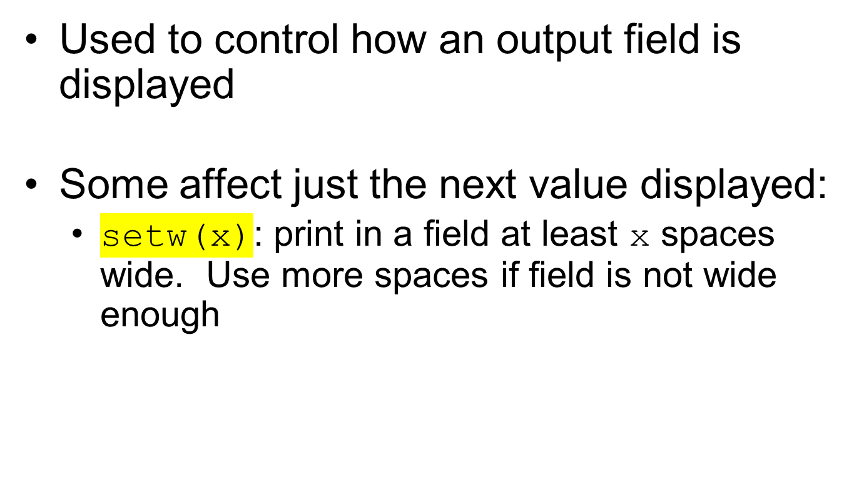
Stream Manipulators

Slide 38
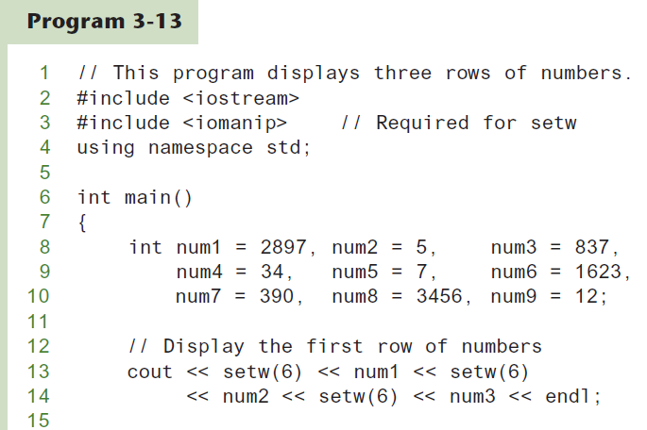
The setw Stream Manipulator
Continued…

Slide 39
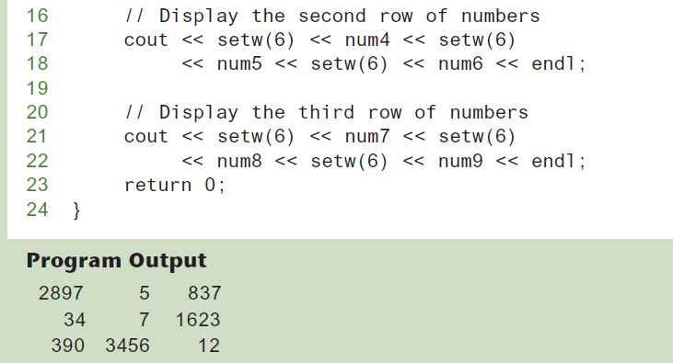
The setw Stream Manipulator

Slide 40
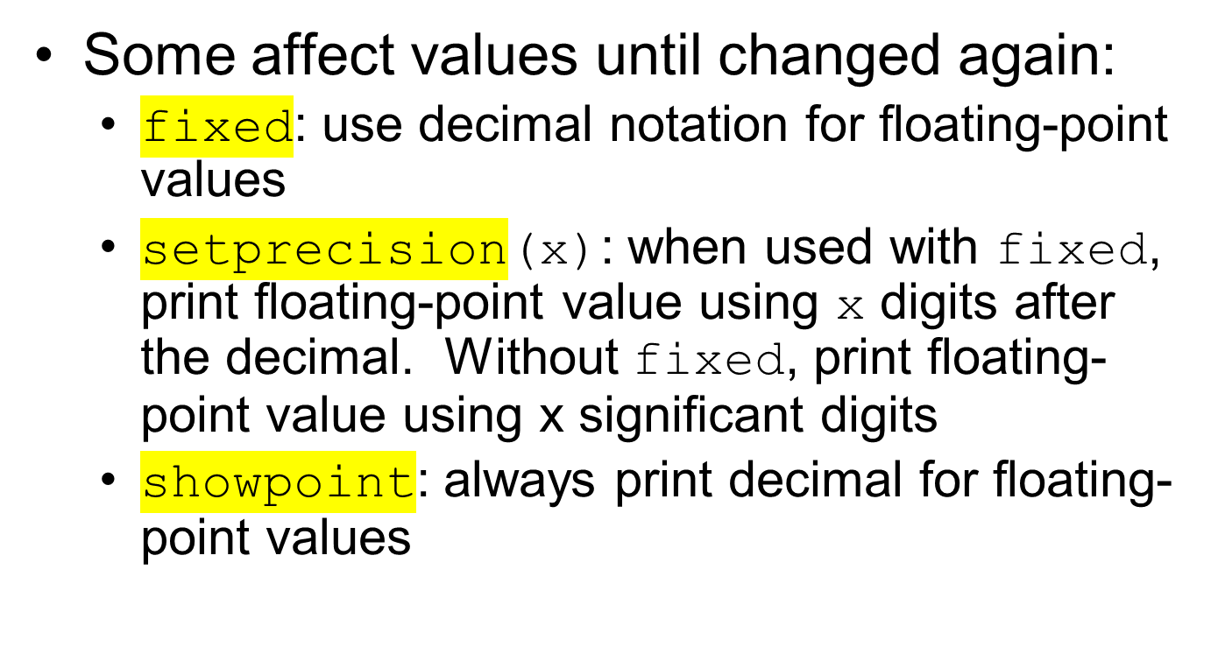
Stream Manipulators

Slide 41
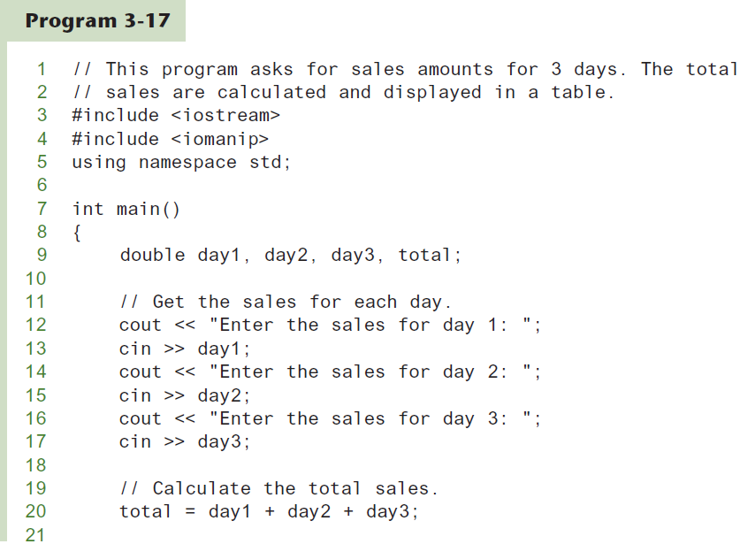
More Stream Manipulators
Continued…

Slide 42
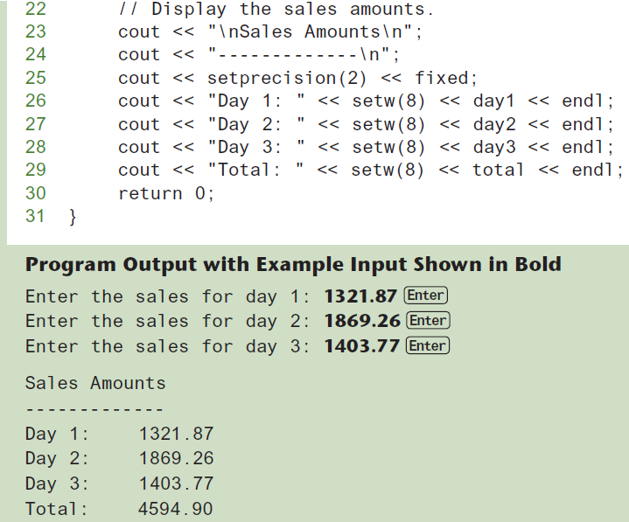
More Stream Manipulators

Slide 43
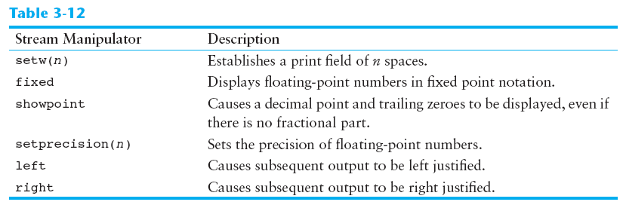
Stream Manipulators

Slide 44
3.8
Working with Characters and string Objects

Slide 45
Working with Characters and string Objects
Using cin with the >> operator to input strings can cause problems:
It passes over and ignores any leading whitespace characters (spaces, tabs, or line breaks)
To work around this problem, you can use a C++ function named getline.

Slide 46
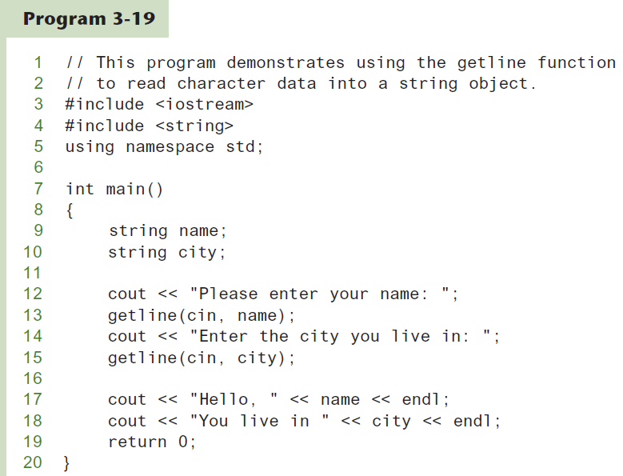
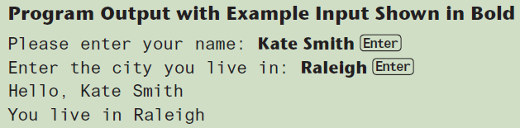
Using getline in Program 3-19

Slide 47
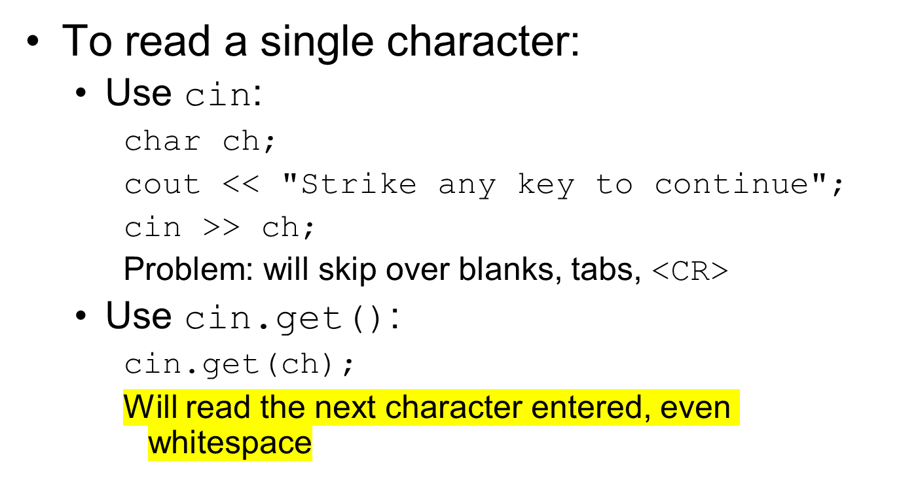
Working with Characters and string Objects

Slide 48
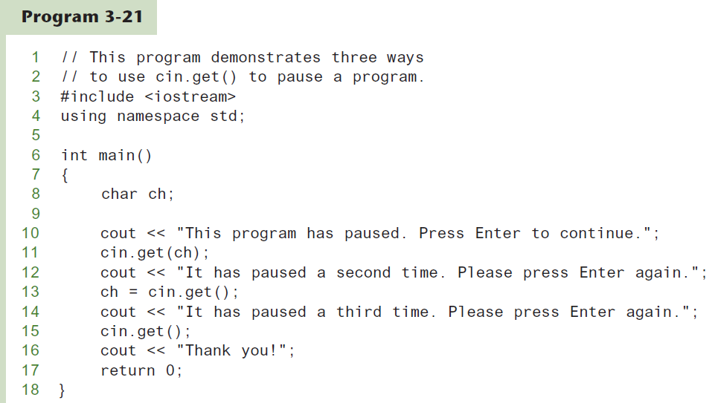
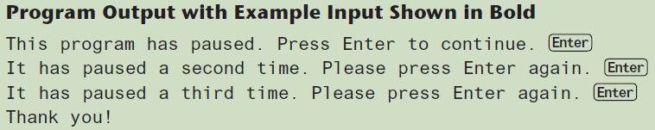
Using cin.get()

Slide 49
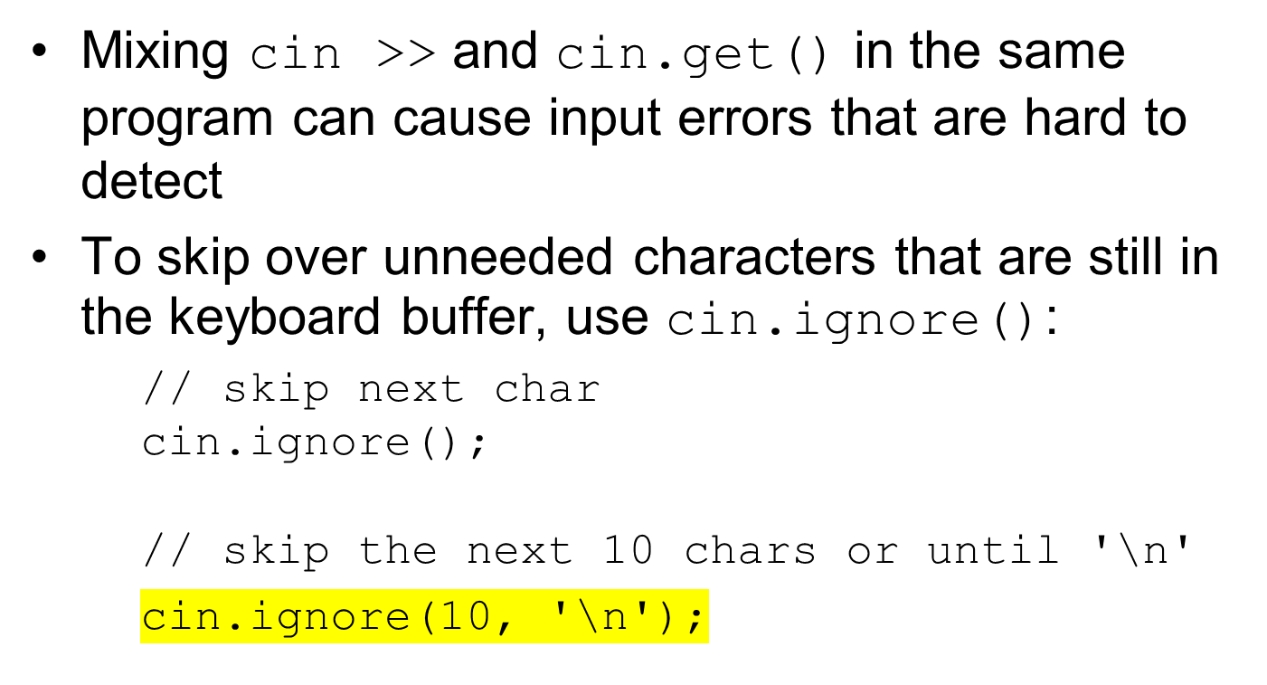
Working with Characters and string Objects

Slide 50
string Member Functions and Operators
To find the length of a string:
To concatenate (join) multiple strings:
string state = "Texas";
int size = state.length();
greeting2 = greeting1 + name1;
greeting1 = greeting1 + name2;
Or using the += combined assignment operator:
greeting1 += name2;

Slide 51
3.9
More Mathematical Library Functions

Slide 52
More Mathematical Library Functions
Require cmath header file
Take double as input, return a double
Commonly used functions:
sin | Sine
cos | Cosine
tan | Tangent
sqrt | Square root
log | Natural (e) log
abs | Absolute value (takes and returns an int)

Slide 53
More Mathematical Library Functions
These require cstdlib header file
rand(): returns a random number (int) between 0 and the largest int the compute holds. Yields same sequence of numbers each time program is run.
srand(x): initializes random number generator with unsigned int x

Slide 54
Random Numbers
Random numbers are useful in many applications, such as
  Games and simulations
  Statistical analysis
  Data encryption

Slide 55
Generating Random Numbers
Use this #include statement:
#include <random>
Create the following objects:
  A random number engine to generate a random sequence of bits
  A distribution object to format the bits into numbers of a specific data type, within a specified range

Slide 56
Generating Random Numbers
Example: Generate a random integer in the range 0-100:
random_device myEngine;
uniform_int_distribution<int> randomInt(0, 100);
int number = randomInt(myEngine);

Slide 57
Generating Random Numbers
Example: Generate a random integer in the range 0-100:
random_device myEngine;
uniform_int_distribution<int> randomInt(0, 100);
int number = randomInt(myEngine);
Creates a random number engine
named myEngine

Slide 58
Generating Random Numbers
Example: Generate a random integer in the range 0-100:
random_device myEngine;
uniform_int_distribution<int> randomInt(0, 100);
int number = randomInt(myEngine);
Creates a distribution object
named randomInt

Slide 59
Generating Random Numbers
Example: Generate a random integer in the range 0-100:
random_device myEngine;
uniform_int_distribution<int> randomInt(0, 100);
int number = randomInt(myEngine);
Generates a random int in the range 0-100 and assigns it to number

Slide 60
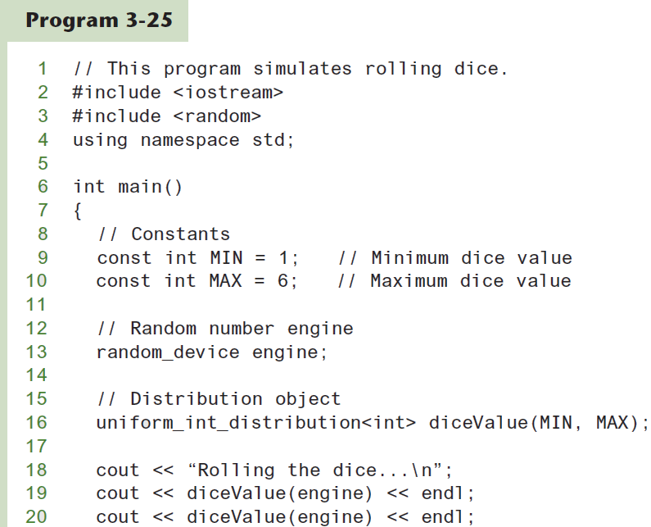
Simulating Dice
Continued…

Slide 61
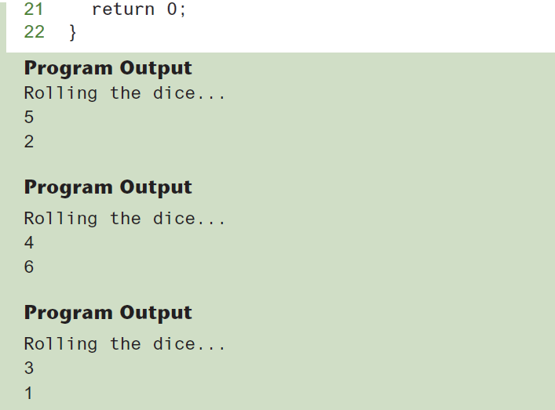
Simulating Dice

Slide 62
3.10
Hand Tracing a Program

Slide 63
Hand Tracing a Program
Hand trace a program: act as if you are the computer, executing a program:
  step through and ‘execute’ each statement, one-by-one
  record the contents of variables after statement execution, using a hand trace chart (table)
Useful to locate logic or mathematical errors

Slide 64
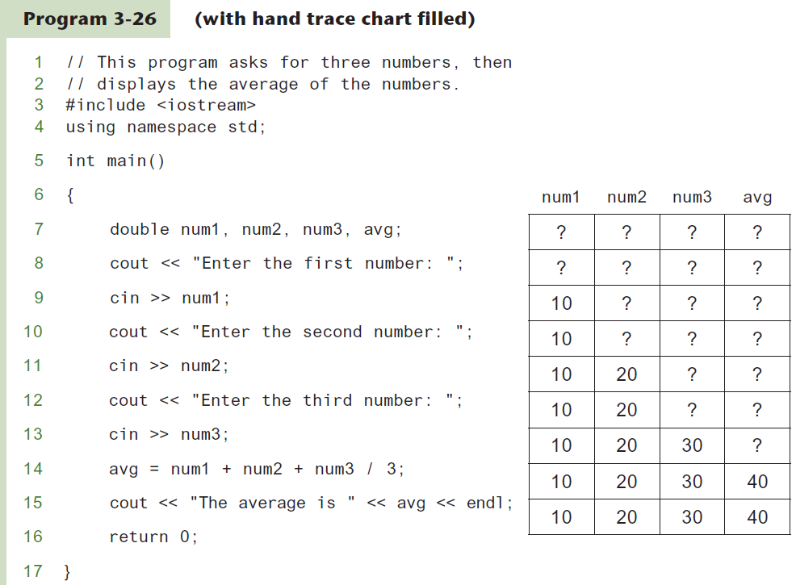
Program 3-26 with Hand Trace Chart

Slide 65
3.11
A Case Study

Slide 66
A Case Study
General Crates, Inc. builds custom-designed wooden crates.
You have been asked to write a program that calculates the:
  Volume (in cubic feet)
  Cost
  Customer price
  Profit of any crate GCI builds

Slide 67
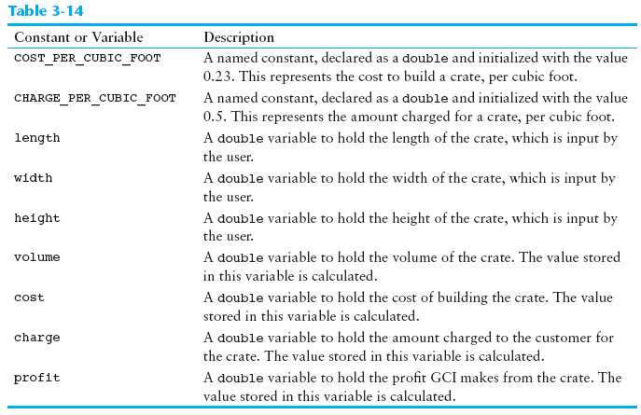
Variables

Slide 68
Program Design
The program must perform the following general steps:
Step 1:
Ask the user to enter the dimensions of the crate
Step 2:
Calculate:
the crate’s volume
the cost of building the crate
the customer’s charge
the profit made
Step 3:
Display the data calculated in Step 2.

Slide 69
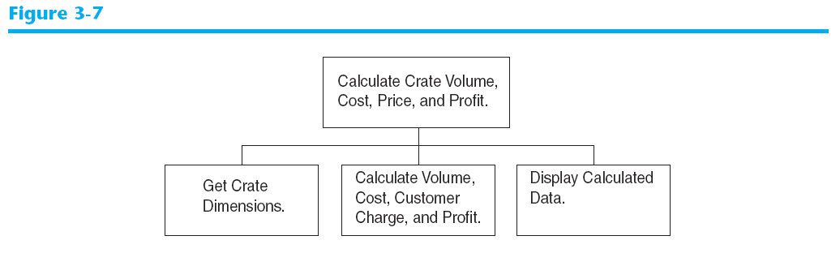
General Hierarchy Chart

Slide 70
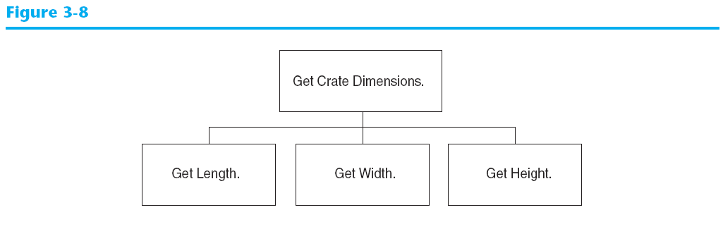
Get Crate Dimensions

Slide 71
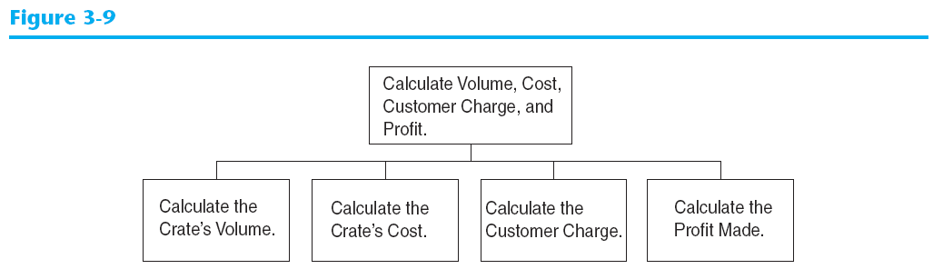
Calculate Volume, Cost, Customer Charge, and Profit

Slide 72
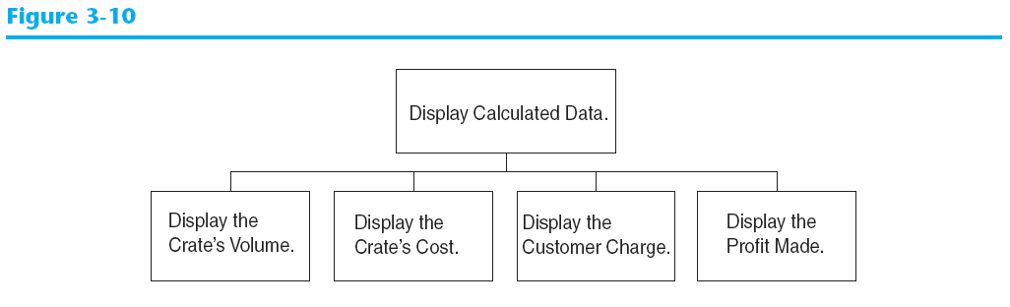
Display Calculated Data

Slide 73
Psuedocode
Ask the user to input the crate's length.
Ask the user to input the crate's width.
Ask the user to input the crate's height.
Calculate the crate's volume.
Calculate the cost of building the crate.
Calculate the customer's charge for the crate.
Calculate the profit made from the crate.
Display the crate's volume.
Display the cost of building the crate.
Display the customer's charge for the crate.
Display the profit made from the crate.

Slide 74
Calculations
The following formulas will be used to calculate the crate’s volume, cost, charge, and profit:
volume = length × width × height
cost = volume × 0.23
charge = volume × 0.5
profit = charge − cost

Slide 75
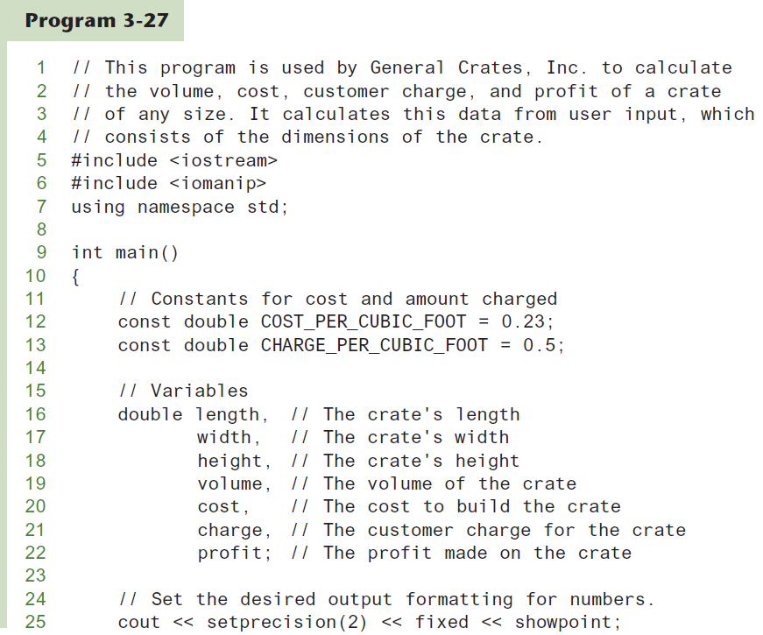
The Program
Continued…

Slide 76
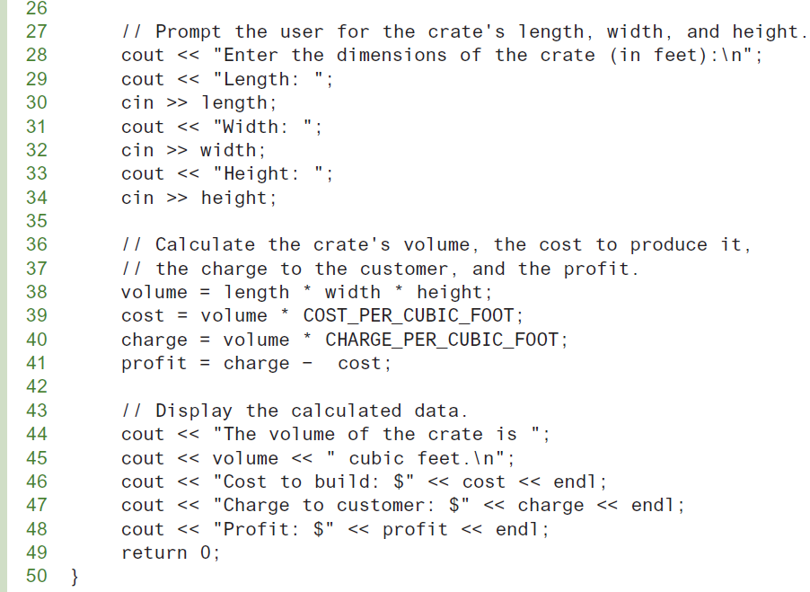
The Program
Continued…

Slide 77
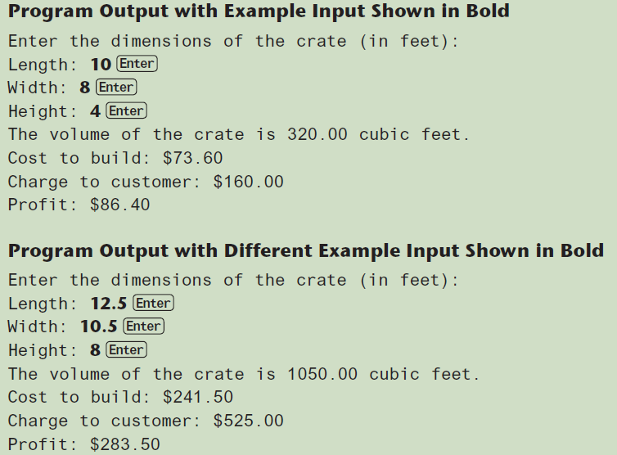
The Program

