Slide 1

Welcome To Lakota’s Food Fusion

Slide 2
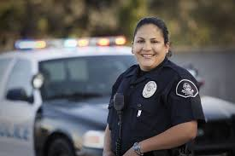
We Support our Troops and Officers

Slide 3
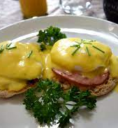

Breakfasts

Slide 4
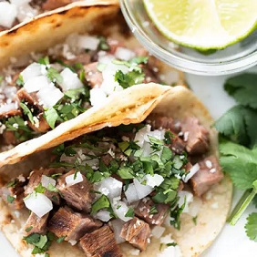
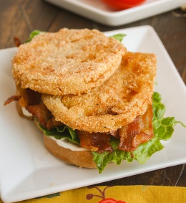
Lunch

Slide 5
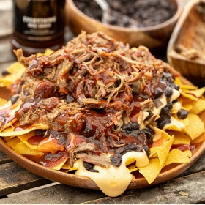

Appetizer

Slide 6
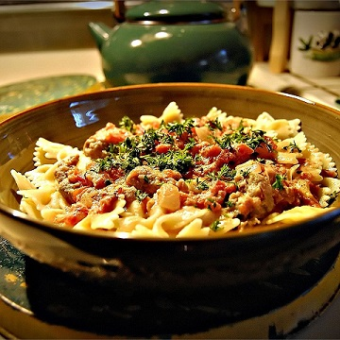

Dinner

Slide 7
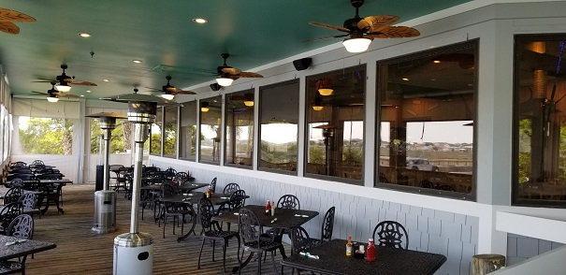

Come see Us at Either of Our Locations

Slide 8

Come see Us at Either of Our Locations

