Slide 1
CSCI 440 Project
BY: Lakota Dolce Student ID: 03

Slide 2


My Story
My plan is to take a piece of paper and animate a fold up sequence and then to have the plane fly around a room, landing back on the desk.

Slide 3
Course of Action
1
2
3
4
Concepts and Initial Ideas
Shapes and basic animations
Finishing animations and put together
Finishing touches and clean up

Slide 4
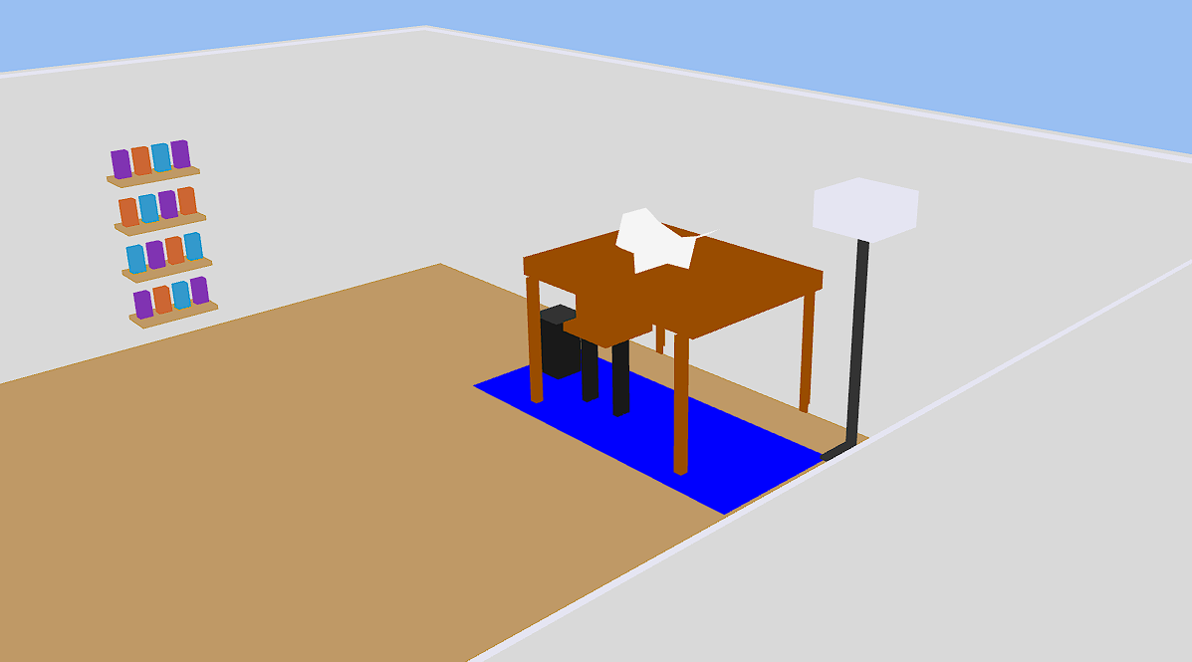
Where I am at
As of now I have the scene rendered out and I have the paper plane folding sequence. Next I have to work on the plane flying around the room as well as some tweaks on the geometry of objects and lighting.

Slide 5
AI
For the AI I have it doing a lot of the geometry, and repetitive tasks such as making all the books on the book shelf or moving all of the legs on the desk to match the desk. I also had it help me develop the folding animation so that it would work correctly. Although it still needs some tweaks.

Slide 6
THANK
YOU!

