Slide 1
Chapter 2:
Introduction to C++

Slide 2
2.1
The Parts of a C++ Program

Slide 3
The Parts of a C++ Program
// sample C++ program
#include <iostream>
using namespace std;
int main()
{
cout << "Hello, world!";
return 0;
}

Slide 4
The Parts of a C++ Program
// sample C++ program
#include <iostream>
using namespace std;
int main()
{
cout << "Hello, world!";
return 0;
}
comment
preprocessor directive
which namespace to use
beginning of function named main
beginning of block for main
output statement
string literal
Send 0 to operating system
end of block for main

Slide 5
Special Characters
Character | Name | Meaning
// | Double slash | Beginning of a comment
# | Pound sign | Beginning of preprocessor directive
< > | Open/close brackets | Enclose filename in #include
( ) | Open/close parentheses | Used when naming a function
{ } | Open/close brace | Encloses a group of statements
" " | Open/close quotation marks | Encloses string of characters
; | Semicolon | End of a programming statement

Slide 6
2.2
The cout Object

Slide 7
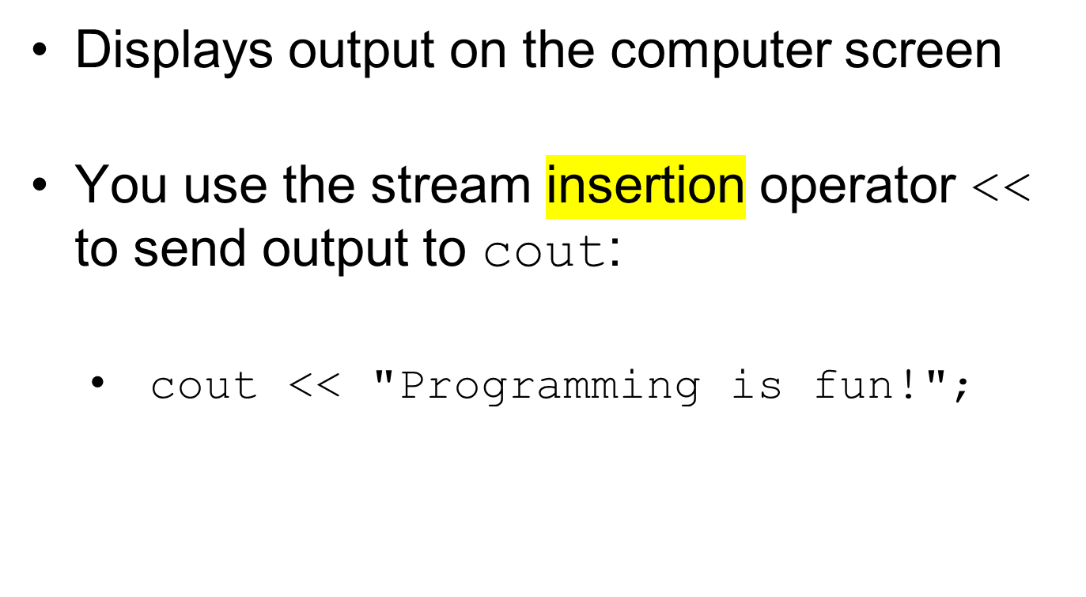
The cout Object

Slide 8
The cout Object
Can be used to send more than one item to cout:
  cout << "Hello " << "there!";
  Or:
  cout << "Hello ";
  cout << "there!";

Slide 9
The cout Object
This produces one line of output:
cout << "Programming is ";
cout << "fun!";

Slide 10
The endl Manipulator
You can use the endl manipulator to start a new line of output. This will produce two lines of output:
cout << "Programming is" << endl;
cout << "fun!";

Slide 11

The endl Manipulator
cout << "Programming is" << endl;
cout << "fun!";
Programming is
fun!

Slide 12
The endl Manipulator
You do NOT put quotation marks around endl
The last character in endl is a lowercase L, not the number 1.
endl
This is a lowercase L

Slide 13
The \n Escape Sequence
You can also use the \n escape sequence to start a new line of output. This will produce two lines of output:
cout << "Programming is\n";
cout << "fun!";
Notice that the \n is INSIDE
the string.

Slide 14
The \n Escape Sequence
cout << "Programming is\n";
cout << "fun!";
Programming is
fun!

Slide 15
2.3
The #include Directive

Slide 16
The #include Directive
Inserts the contents of another file into the program
This is a preprocessor directive, not part of C++ language
#include lines not seen by compiler
Do not place a semicolon at end of #include line

Slide 17
2.4
Variables and Literals

Slide 18
Declaration verse Definition
https://learn.microsoft.com/en-us/cpp/cpp/declarations-and-definitions-cpp?view=msvc-170

Slide 19
Variables and Literals
Variable: a storage location in memory
  Has a name and a type of data it can hold
  Must be defined before it can be used:
  int item;

Slide 20
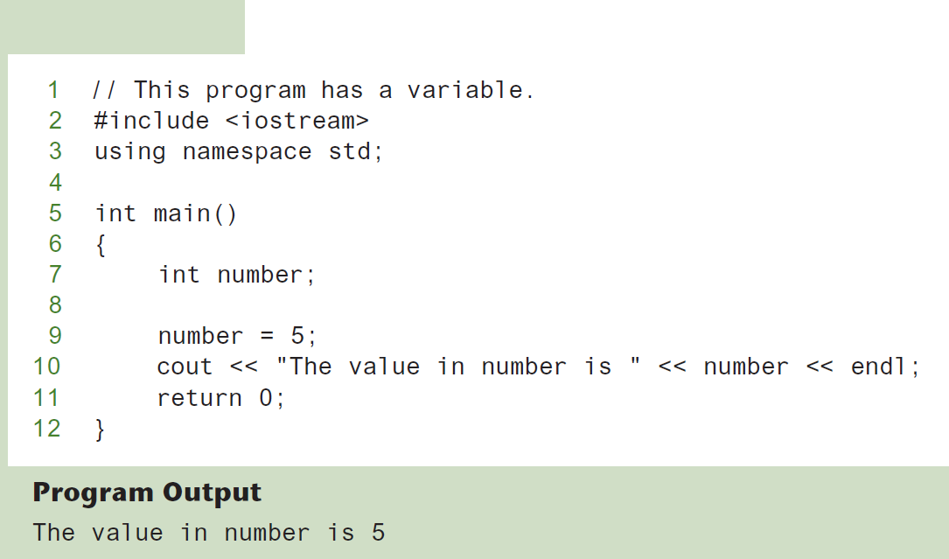
Variable Definition
Program 2-8
Variable Definition

Slide 21
Literals
Literal: a value that is written into a program’s code.
"hello, there" (string literal)
12 (integer literal)

Slide 22
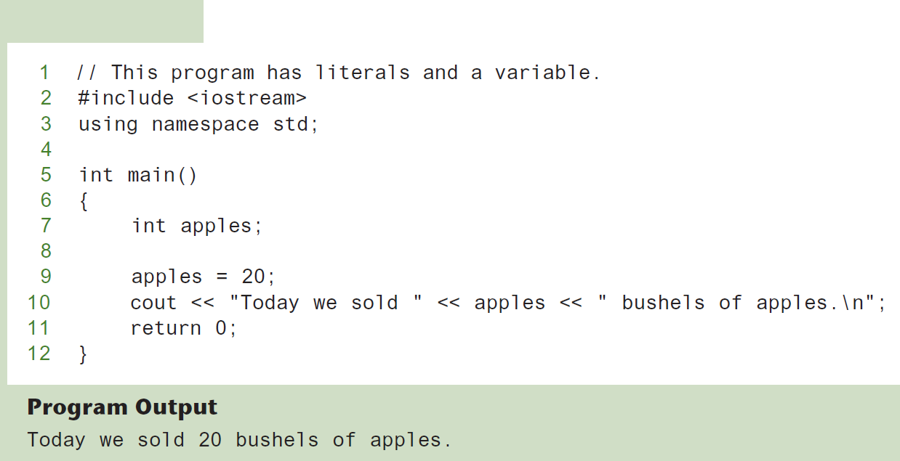
Integer Literal
Program 2-10
20 is an integer literal

Slide 23
String Literals
Program 2-10
These are string literals

Slide 24
2.5
Identifiers

Slide 25
Identifiers
An identifier is a programmer-defined name for some part of a program: variables, functions, etc.

Slide 26
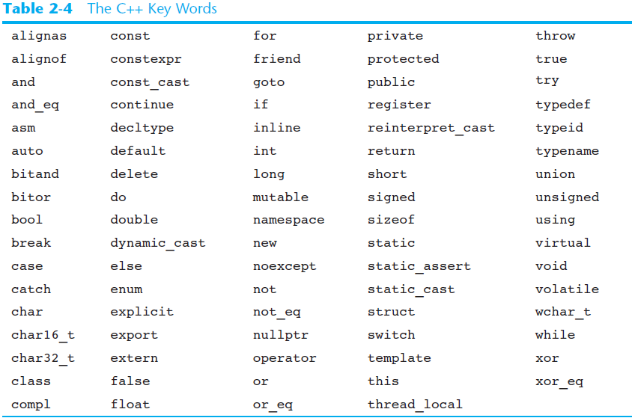
C++ Key Words
You cannot use any of the C++ key words as an identifier. These words have reserved meaning.

Slide 27
Variable Names
A variable name should represent the purpose of the variable. For example:
itemsOrdered
The purpose of this variable is to hold the number of items ordered.

Slide 28
Identifier Rules
The first character of an identifier must be an alphabetic character or and underscore ( _ ),
After the first character you may use alphabetic characters, numbers, or underscore characters.
Upper- and lowercase characters are distinct

Slide 29
Valid and Invalid Identifiers
IDENTIFIER | VALID? | REASON IF INVALID
totalSales | Yes
total_Sales | Yes
total.Sales | No | Cannot contain .
4thQtrSales | No | Cannot begin with digit
totalSale$ | No | Cannot contain $

Slide 30
2.6
Integer Data Types

Slide 31
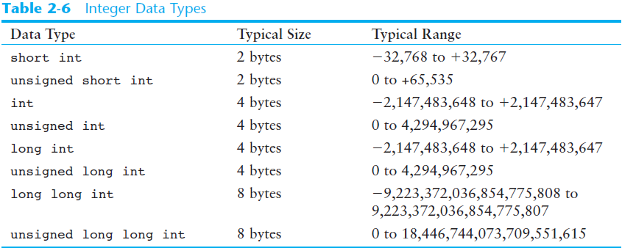
Integer Data Types
Integer variables can hold whole numbers such as 12, 7, and -99.

Slide 32
Defining Variables
Variables of the same type can be defined
  - On separate lines:
  int length;
  int width;
  unsigned int area;
  - On the same line:
  int length, width;
  unsigned int area;
Variables of different types must be in different definitions

Slide 33
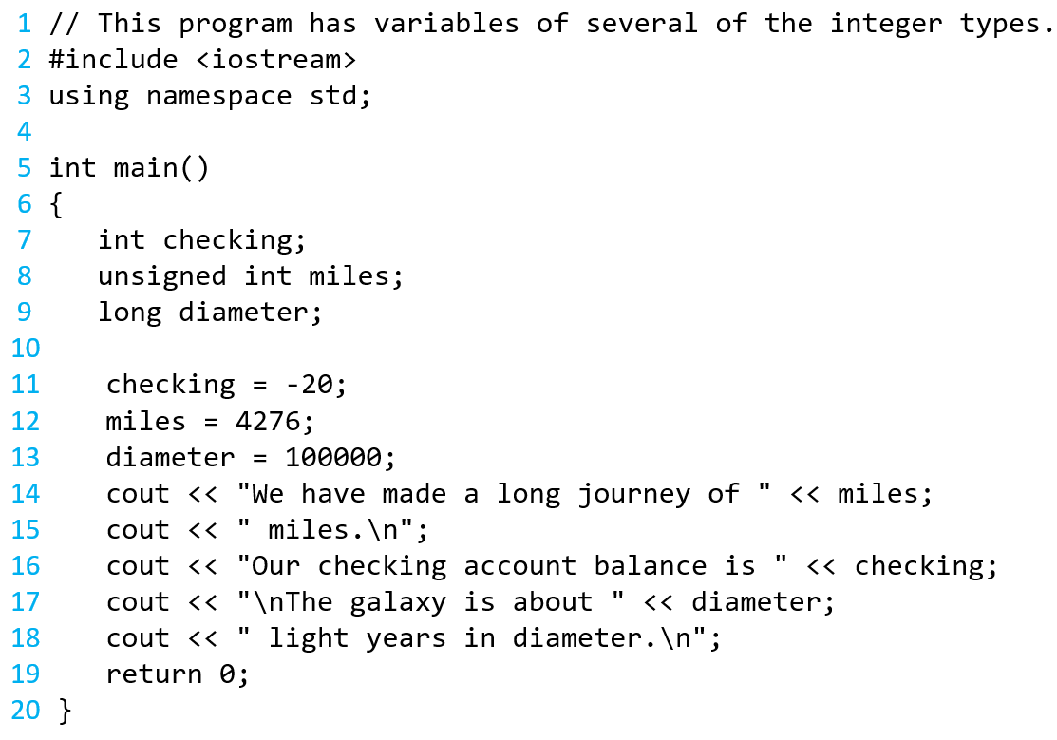
Integer Types in Program 2-11
This program has three variables:
checking, miles, and diameter

Slide 34
Integer Literals
An integer literal is an integer value that is typed into a program’s code. For example:
itemsOrdered = 15;
In this code, 15 is an integer literal.

Slide 35
Integer Literals in Program 2-11
Integer Literals

Slide 36
Integer Literals
Integer literals are stored in memory as ints by default
To store an integer constant in a long memory location, put ‘L’ at the end of the number: 1234L
To store an integer constant in a long long memory location, put ‘LL’ at the end of the number: 324LL
Constants that begin with ‘0’ (zero) are base 8: 075
Constants that begin with ‘0x’ are base 16: 0x75A

Slide 37
2.7
The char Data Type

Slide 38
The char Data Type
Used to hold characters or very small integer values
Usually 1 byte of memory
Numeric value of character from the character set is stored in memory:
CODE:
char letter;
letter = 'C';
MEMORY:
letter
67

Slide 39
Character Literals
Character literals must be enclosed in single quote marks. Example:
'A'

Slide 40
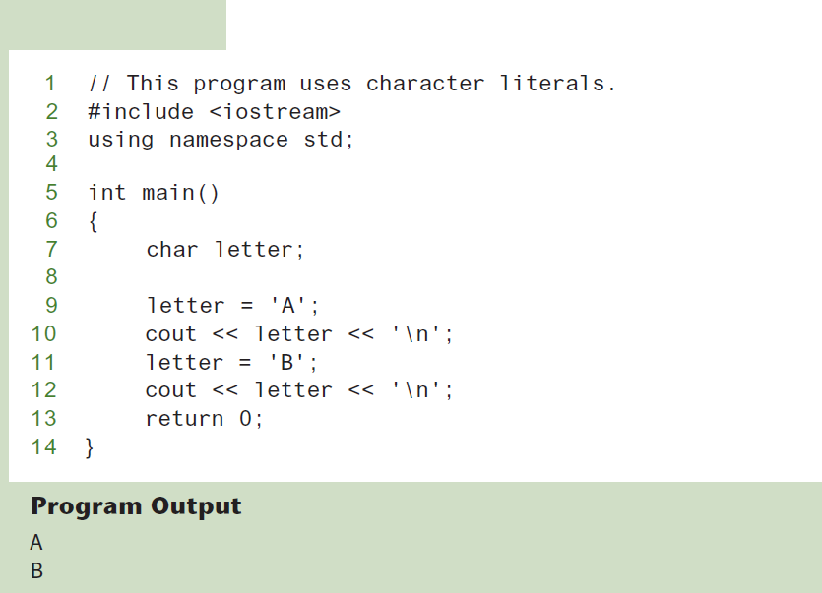
Character Literals
Program 2-15

Slide 41
Character Strings
A series of characters in consecutive memory locations:
  "Hello"
Stored with the null terminator, \0, at the end:
Comprised of the characters between the " "
H | e | l | l | o | \0

Slide 42
2.8
The C++ string Class

Slide 43
The C++ string Class
Special data type supports working with strings
#include <string>
Can define string variables in programs:
  string firstName, lastName;
Can receive values with assignment operator:
  firstName = "George";
  lastName = "Washington";
Can be displayed via cout
  cout << firstName << " " << lastName;

Slide 44
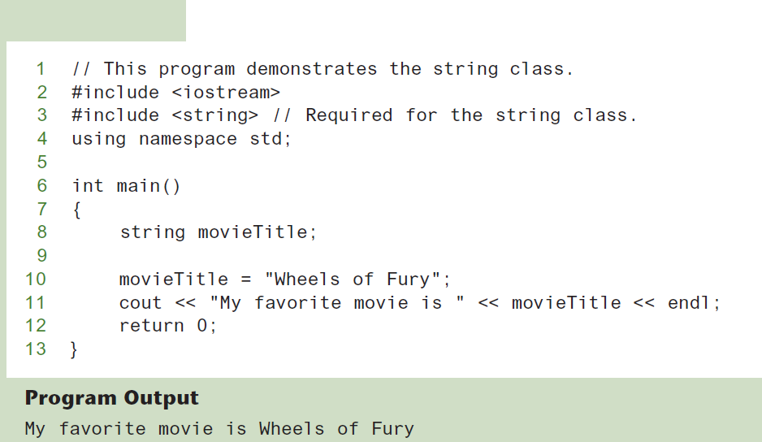
The string Class
Program 2-16

Slide 45
2.9
Floating-Point Data Types

Slide 46
Floating-Point Data Types
The floating-point data types are:
float
double
long double
They can hold real numbers such as:
  12.45 -3.8
Stored in a form similar to scientific notation
All floating-point numbers are signed

Slide 47
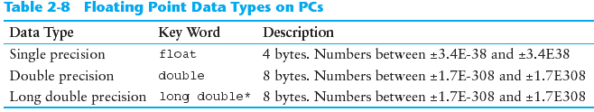
Floating-Point Data Types

Slide 48
Floating-Point Literals
Can be represented in
  Fixed point (decimal) notation:
  31.4159 0.0000625
  E notation:
  3.14159E1 6.25e-5
Are double by default
Can be forced to be float (3.14159f) or long double (0.0000625L)

Slide 49
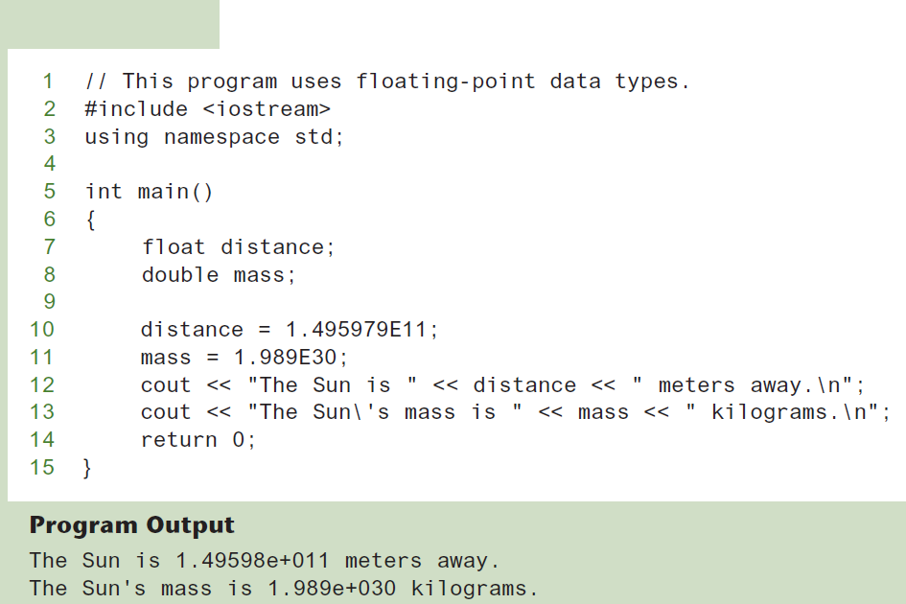
Floating-Point Data Types in Program 2-16
Program 2-17

Slide 50
2.10
The bool Data Type

Slide 51
The bool Data Type
Represents values that are true or false
bool variables are stored as small integers
false is represented by 0, true by 1:
  bool allDone = true;
  bool finished = false;
allDone
finished
1
0

Slide 52
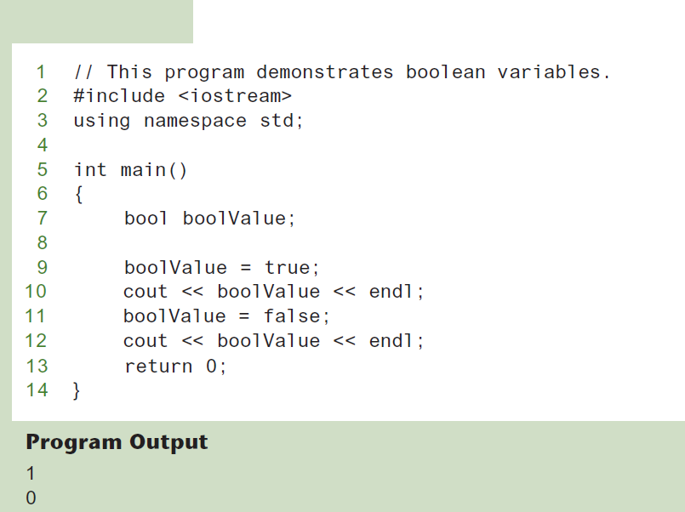
Boolean Variables
Program 2-18

Slide 53
2.11
Determining the Size of a Data Type

Slide 54
Determining the Size of a Data Type
The sizeof operator gives the size of any data type or variable:
double amount;
cout << "A double is stored in "
<< sizeof(double) << "bytes\n";
cout << "Variable amount is stored in "
<< sizeof(amount)
<< "bytes\n";

Slide 55
2.12
Variable Assignments and Initialization

Slide 56
Variable Assignments and Initialization
An assignment statement uses the = operator to store a value in a variable.
item = 12;
This statement assigns the value 12 to the item variable.

Slide 57
Assignment
The variable receiving the value must appear on the left side of the = operator.
This will NOT work:
// ERROR!
12 = item;

Slide 58
Variable Initialization
To initialize a variable means to assign it a value when it is defined:
  int length = 12;
Can initialize some or all variables:
  int length = 12, width = 5, area;

Slide 59
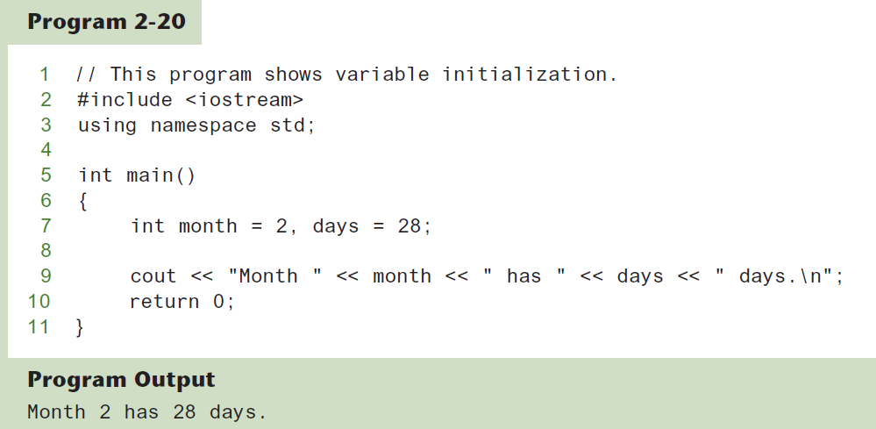
Variable Initialization

Slide 60
Declaring Variables With the auto Key Word
C++ 11 introduces an alternative way to define variables, using the auto key word and an initialization value. Here is an example:
auto amount = 100;
The auto key word tells the compiler to determine the variable’s data type from the initialization value.
auto interestRate= 12.0;
auto stockCode = 'D';
auto customerNum = 459L;
int
double
char
long

Slide 61
2.13
Scope

Slide 62
Scope
The scope of a variable: the part of the program in which the variable can be accessed
A variable cannot be used before it is defined

Slide 63
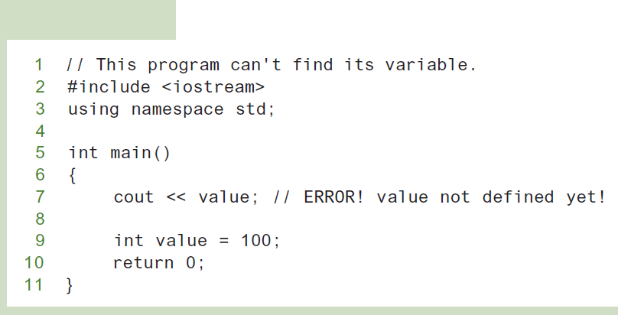
Variable Out of Scope
Program 2-21

Slide 64
2.14
Arithmetic Operators

Slide 65
Arithmetic Operators
Used for performing numeric calculations
C++ has unary, binary, and ternary operators:
  unary (1 operand) -5
  binary (2 operands) 13 - 7
  ternary (3 operands) exp1 ? exp2 : exp3

Slide 66
Binary Arithmetic Operators
SYMBOL | OPERATION | EXAMPLE | VALUE OF ans
+ | addition | ans = 7 + 3; | 10
- | subtraction | ans = 7 - 3; | 4
* | multiplication | ans = 7 * 3; | 21
/ | division | ans = 7 / 3; | 2
% | modulus | ans = 7 % 3; | 1

Slide 67
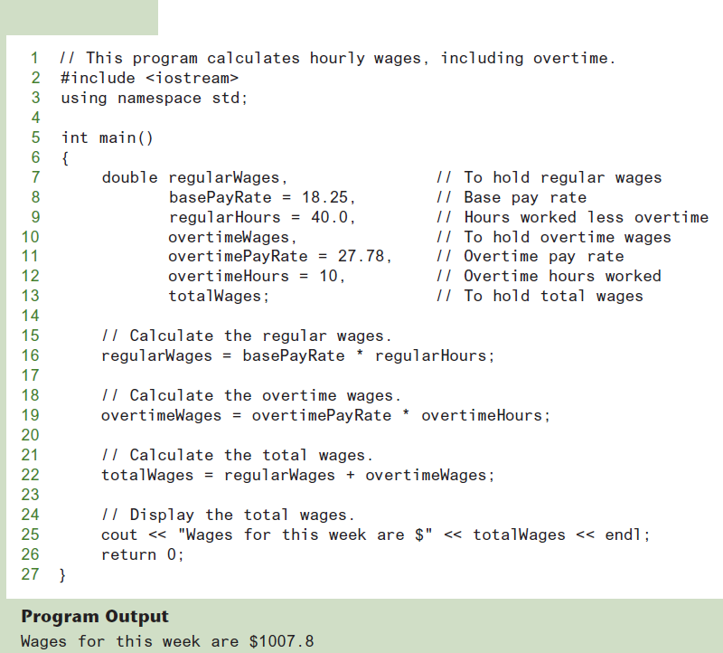
Arithmetic Operators
Program 2-22

Slide 68
A Closer Look at the / Operator
/ (division) operator performs integer division if both operands are integers
  cout << 13 / 5; // displays 2
  cout << 91 / 7; // displays 13
If either operand is floating point, the result is floating point
  cout << 13 / 5.0; // displays 2.6
  cout << 91.0 / 7; // displays 13.0

Slide 69
A Closer Look at the % Operator
% (modulus) operator computes the remainder resulting from integer division
  cout << 13 % 5; // displays 3
% requires integers for both operands
  cout << 13 % 5.0; // error

Slide 70
2.15
Comments

Slide 71
Comments
Used to document parts of the program
Intended for persons reading the source code of the program:
  Indicate the purpose of the program
  Describe the use of variables
  Explain complex sections of code
Are ignored by the compiler

Slide 72
Single-Line Comments
Begin with // through to the end of line:
  int length = 12; // length in inches
  int width = 15; // width in inches
  int area; // calculated area
  // calculate rectangle area
  area = length * width;

Slide 73
Multi-Line Comments
Begin with /*, end with */
Can span multiple lines:
  /* this is a multi-line
  comment
  */
Can begin and end on the same line:
  int area; /* calculated area */

Slide 74
2.16
Named Constants

Slide 75
Named Constants
Named constant (constant variable): variable whose content cannot be changed during program execution
Used for representing constant values with descriptive names:
  const double TAX_RATE = 0.0675;
  const int NUM_STATES = 50;
Often named in uppercase letters

Slide 76
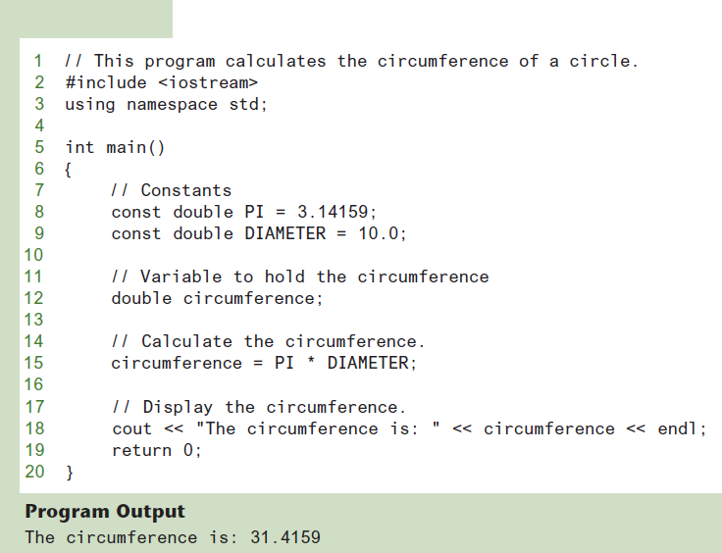
Named Constants in Program 2-28
Program 2-29

Slide 77
2.17
Programming Style

Slide 78
Programming Style
The visual organization of the source code
Includes the use of spaces, tabs, and blank lines
Does not affect the syntax of the program
Affects the readability of the source code

