Slide 1
MIPS01
Lakota Dolce

Slide 2
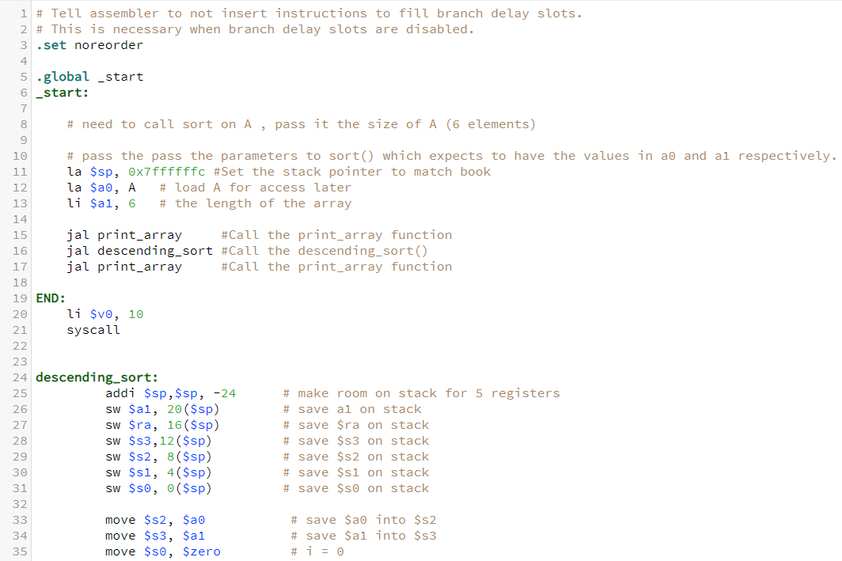
MIPS Code
This is the start of the MIPS code, it takes and initiates the stack pointer to 0x7ffffffc. It then takes and stores the address of A in register a0 and the length of the array in a1. This then calls the print array, descending sort, and the final print array functions.
The End function sets the register v0 to 10 and calls the system call for that ending the program.
The Descending sort function takes and first makes room for and stores registers a1, ra, s3, s2, s1, and s0 on the stack, and then loads the values in a0 to s2, a1 to s3, and zero to s0.

Slide 3
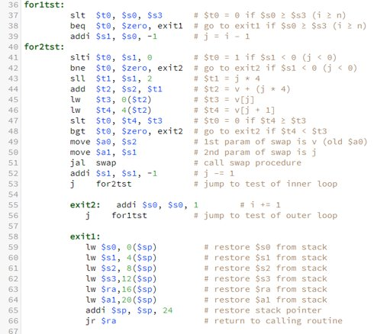

MIPS Code Cont.
This is a continuation of the Descending sort functions, in the function for1tst it compares the value in s0 and the value in s3 and sets the temporary register t0 to a 1 s0 is less than s3 or a zero if not. It then compares the value to zero, and if they match it jumps to the exit 1 function. If not, then it adds a –1 to s0 and stores that in s1.
The for2tst function starts by setting register t0 to 1 if s0 is equal to zero, if t0 is equal to 0 then it jumps to the exit 2 function, if not, then it continues and multiplies s1 by 4 and stores that value in t1. It then adds that value to s2 and stores the result in t2, which is an address. The next two lines then take the item at that address and one past that address and stores them into registers. Next it compares the two numbers and if the number in t4 is greater than t3 it stores a 1 or zero in t0 and compares that to see if it should test the outer loop again (calling exit2). If not then it stores the values in register a0, and a1 and calls the swap function, switching the two numbers and repeating until the array has been sorted into descending order. To change from ascending order to descending order all that needed to be done was to change the comparison from less than to greater than ass seen on line 48.
The exit2 function simply calls back to for1tst to check the outer loop, and exit1 restores all values from the stack and resets the stack pointer.

Slide 4
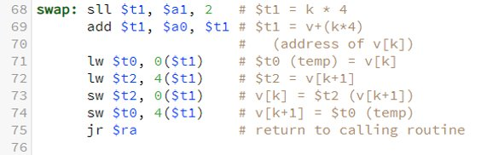
MIPS Code Cont.
This is the swap function, it takes in two parameters, and then swaps the two parameters in memory.

Slide 5
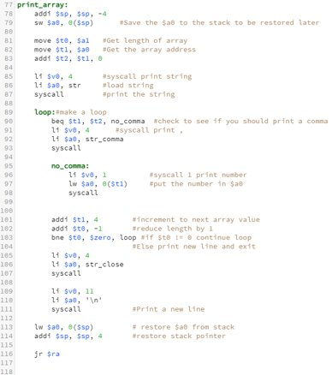
MIPS Code Cont.
This is the print array, it takes in two parameters, the array length and the array location. It takes and stores these value in the stack well as it stores the values in registers t0, t1, and t2 ( a second length saved). This then makes a system call to print a string by storing the value 4 in register v0, and the string in a0. Then the loop is set up and it first checks if the loop has been iterated at least one time, if not then it will not print the "," and will continue through the loop. Then it prints the number of the array by making a syscall with v0 = 1 and loading the word at the address provided. After that it increments to the next array value, reduces the counter, and checks if the counter has hit 0. and repeats the process until all items in the array are printed and finishes by printing the closing curly brace, resets the stack and values, and returning to the main function with a jump return address call.

Slide 6
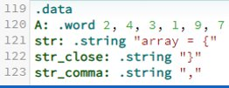
MIPS Code Cont. .data
Here is the .data portion of the code, it contains the array (A), and the strings needed for printing.

Slide 7
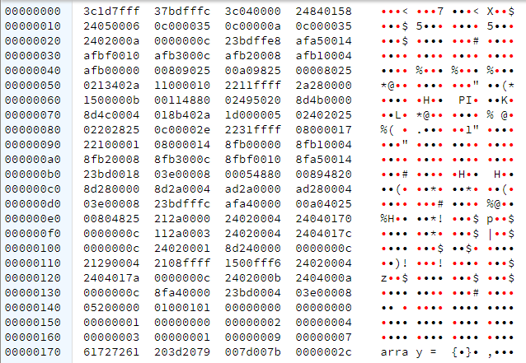


Memory before
Here is the memory after compiling and before the code is ran. You can see the array stored in the memory address 158 (hex) to 16c (hex) and the strings stored directly after that to 17c (hex).

Slide 8
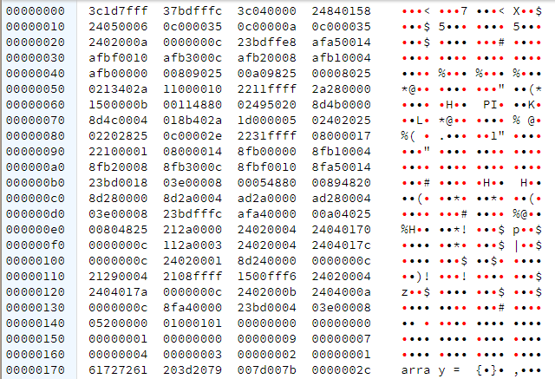


Memory After
Here is the array after the program was ran, you can now see the array (158-16c) has now changed and is in descending order.

Slide 9

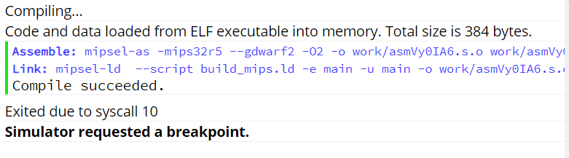

Terminal and messages
Here is the terminal showing how the program printed the strings and array to the terminal. Below that is the message box showing that there were no errors while running the program and it was exited with a syscall.

Slide 10

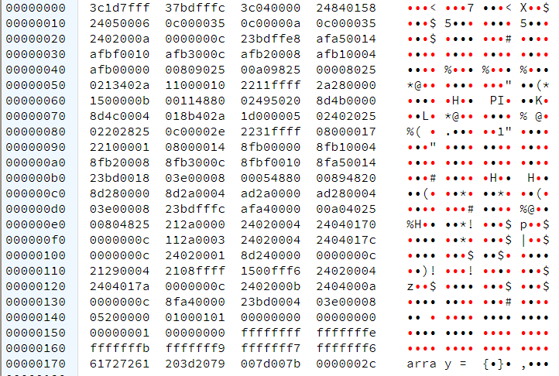

With negative numbers,
Here is the same program ran but with negative numbers, the arrays are shown in the same memory location (158-16c) and the terminal at the top shows the printout from the program.

Slide 11
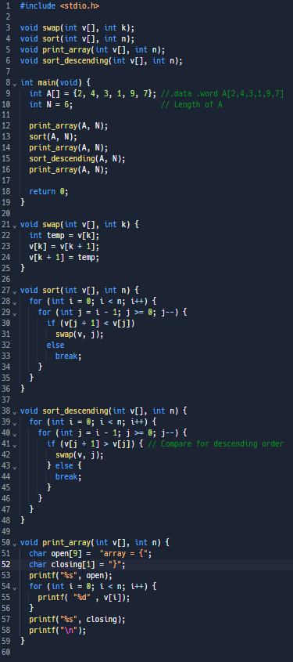

Code in C
Here is the program in C doing the same thing as the MIPS program. Resulting in the printout below.

