Slide 1
Domain driven mikroservisne arhitekture

Slide 2

Sadržaj
Uvod
Domain Driven Design
Mikroservisi
Ticket4U
Zaključak

Slide 3

Uvod

Slide 4


Monolitne aplikacije
1 baza
Jako složeni sistemi
Komplikovani sistemi
Teški za održavanje
DDD – Domain Driven Design
Razumevanje nekog problema
Mikroservisna arhitektura
Više manjih servisa koji zajedno rešavaju (kompleksan) problem

Slide 5
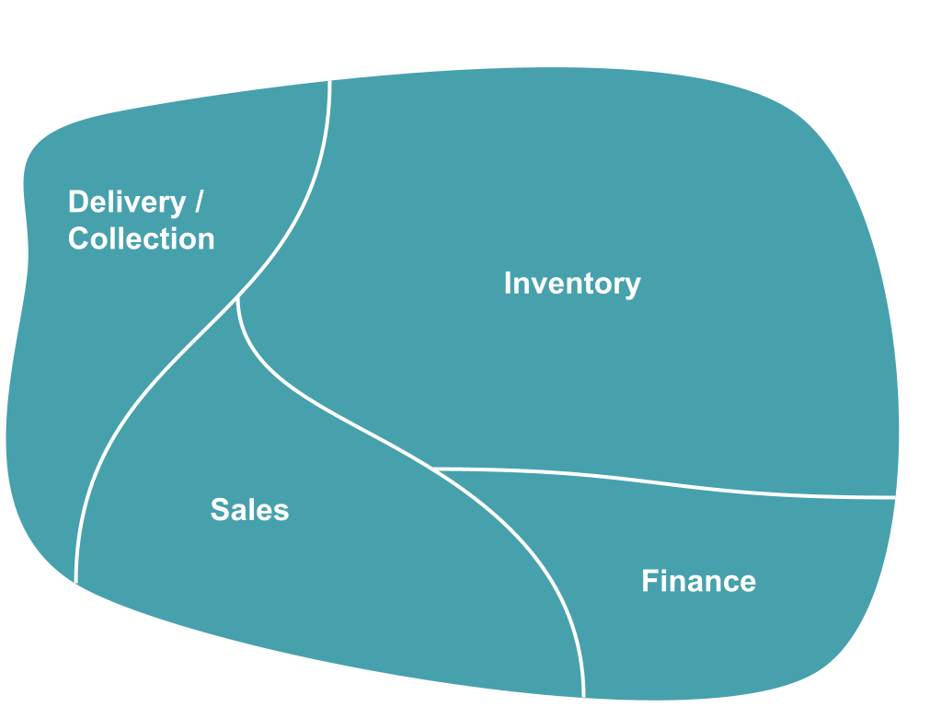
DDD-Domain Driven Design
Razumevanje domena problema
Razvoj adekvatnog modela
Niz šablona/pattern-a
Posledice:
Jasan, čist i testabilan kod
Fleksibilan softver
Jasna putanja prilikom rešavanja kompleksnog problema
Centralizovana poslovna logika
Divide and conquer / Separation of concerns

Slide 6
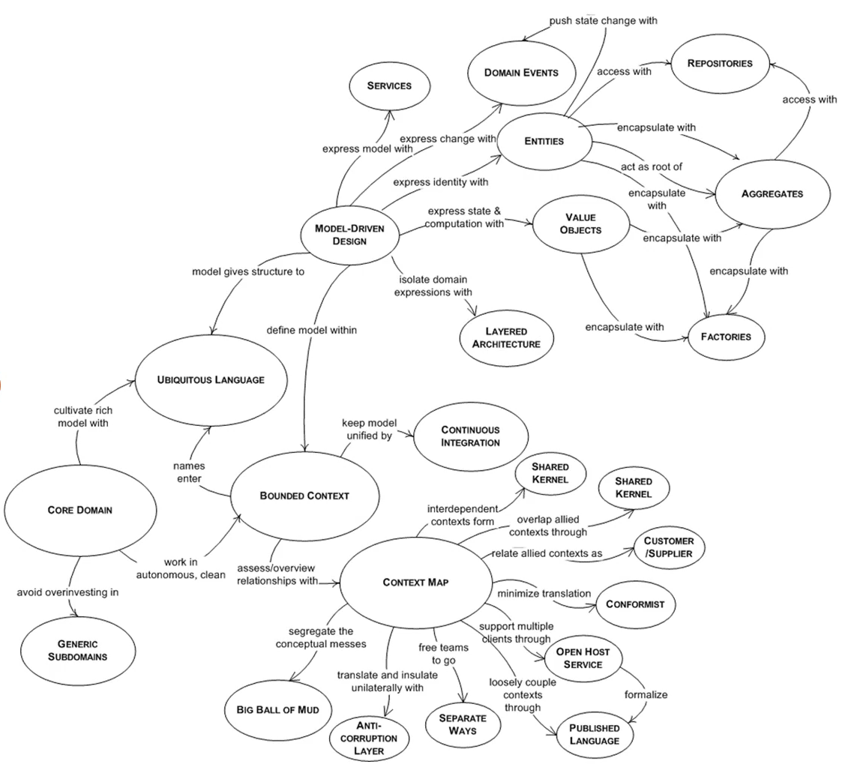
Mind Map

Slide 7
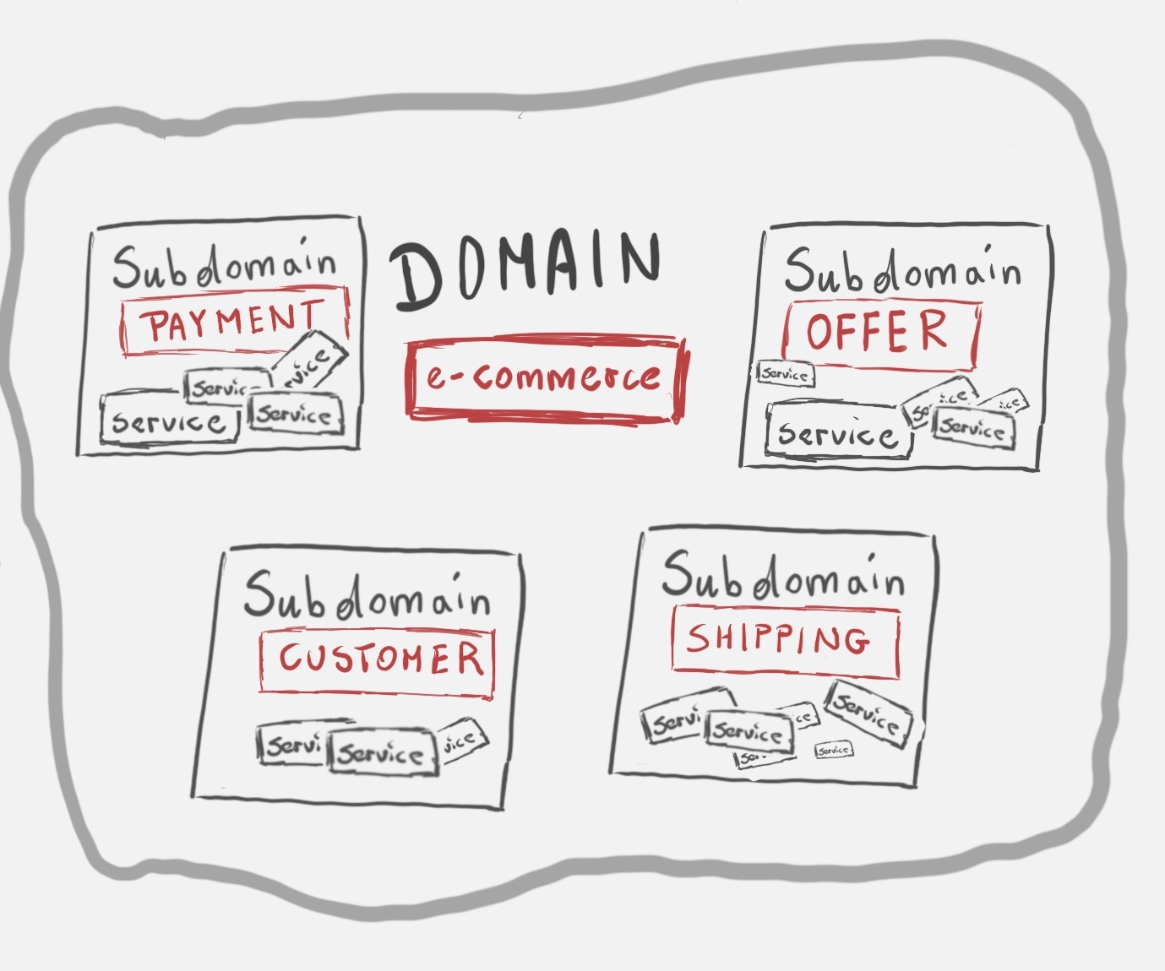
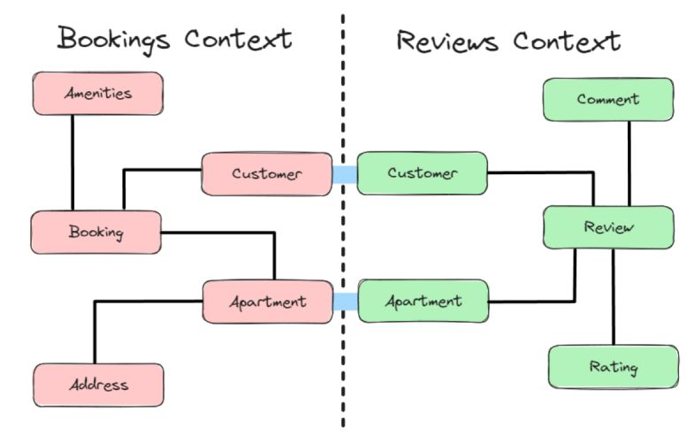
Domain, subdomain, bounded context
Domain (domen) – sfera znanja/informacija u stvarnom životu
Subdomain – deo domena problema
Bounded context – deo modela podataka (rešenje problema)
Granica gde se primenjuje model
Context map – kako su povezani bounded context-i
Svoj jezik ubiquitous language
(konzistentna terminologija)
Subdomain == bounded context?
Nepisano pravilo: 1 bounded context – 1 mikroservis – 1 baza
Shared kernel
Anemičan domenski model
Stanje objekata
Samo getteri i setteri
Anti-pattern
Bogat domenski model
Stanje + ponašanje
Preporuka (pattern)

Slide 8
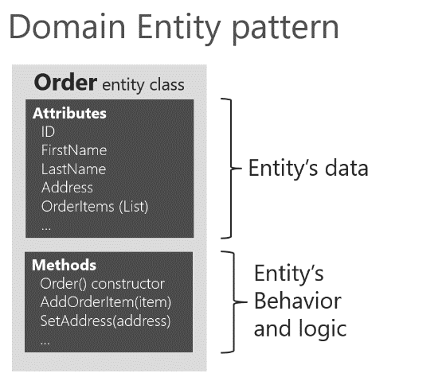
Entitet i value object pattern-i
2 osnovna gradivna elementa u DDD-u
Razlika: Po čemu se definišu? (identitet ili vrednosti)
Entitet
Value object
Da li su ova 2 entiteta ista?
Identifikator
Ključ – jedinstveni identifikator
Primer: Čovek, narudžbenica, rezervacija,...
Skup atributa bez identiteta
Nepromenljiv
Promena? Kreiranje novog!
Primer: Novac
Količina
Valuta

Slide 9
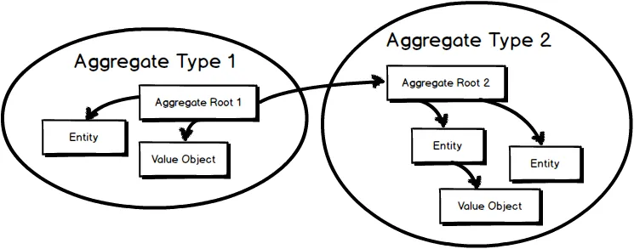
Aggregate i aggregate root pattern-i
Aggregate – skup više entiteta i/ili value object-a
Celina
Primer: entitet order + entitet order item + value object price
Osnovna jedinica transfera/izmene podataka
Aggregate root – glavna komponenta aggregate-a
Svaka referenca/izmena u aggregate-u ide preko aggregate root-a
Integritet, konzistentnost

Slide 10
Repository pattern
Perzistiranje podataka
Nije pattern samo DDD-a
Popunjavaju podatke o domenskim entitetima iz memerije u bazu
Apstrakcija (u domenskom ili aplikativnom delu)
Implementacija (u infrastrukturnom delu)
1 aggregate : 1 repository
Aggregate root se perzistira/menja/briše/manipuliše,...

Slide 11
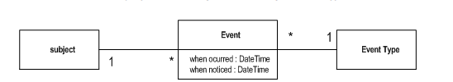
Domain event (domenski događaj)
“Stvari se dešavaju, nisu sve interesantne. Posebno su interesantne one koje izazivaju reakciju.“ - Martin Fowler
Event – nešto što se desilo u prošlosti
Domain event – nešto što se desilo u domenu i neophodno je da ostali delovi domena budu obavešteni (i reaguju na adekvatan način)
Domain event pattern

Slide 12
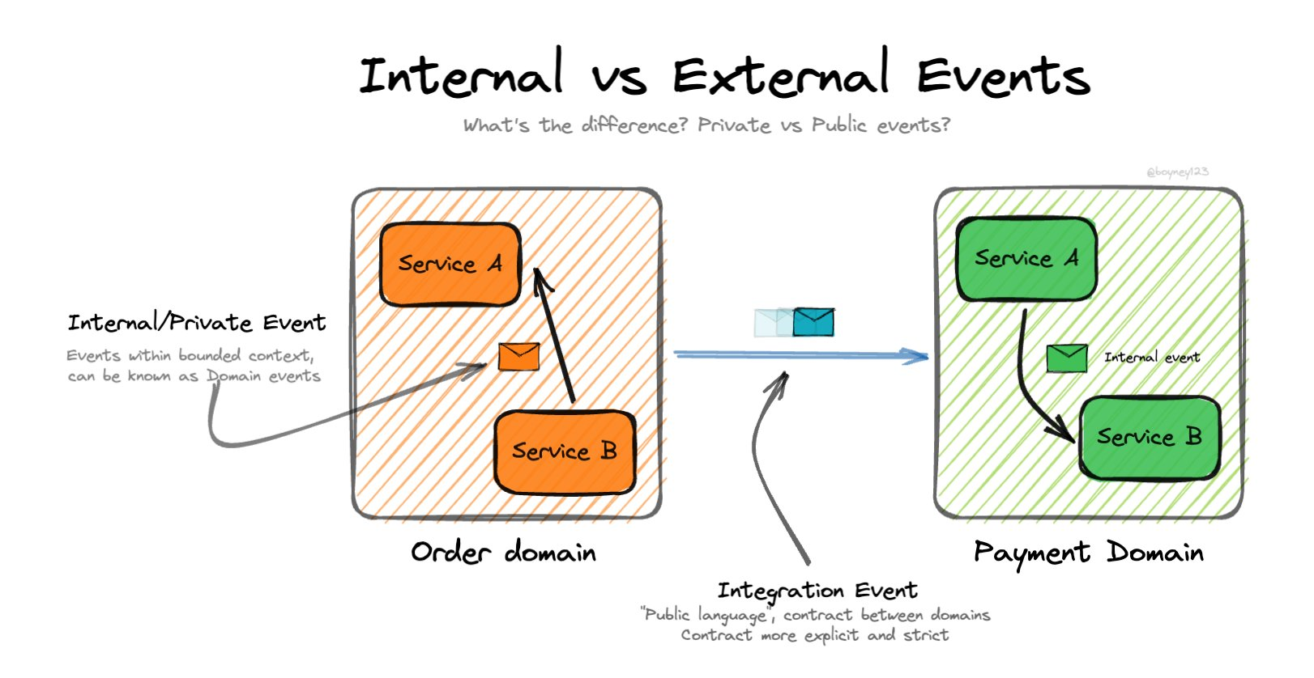
Integration event
Notifikacija o nečemu što se desilo
Slično domenskom eventu
Razlika: obaveštavaju se drugi sistemi, mikroservisi, bounded context-i,...
Message queue

Slide 13
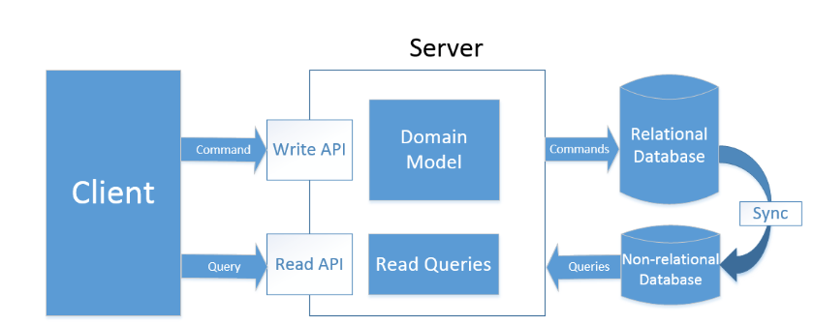
CQRS
Command Query Responsibility Segregation
Arhitekturni pattern
Query (upit) – operacija koja vraća rezultate i ne menja stanje sistema
Command (komanda) – operacija koja menja stanje sistema
Event
Prednosti:
Bolja skalabilnost
Lakše održavanje koda
Korišćenje prednosti baza sa efikasnim čitanjem/upisom
Mane:
Duže vreme razvoja
Nekonzistentnost (u slučaju 2 baze)
Bespotrebna složenost za jednostavne sisteme
CQRS + DDD
Arhitekturni pattern i pristup u razvoju softvera
CQRS upiti i komande mogu biti na nivou DDD aggregate-a
DDD i CQRS podržavaju događaje
DDD ima bounded context – izražava granice, kao i CQRS preko upita i komandi

Slide 15

Overcoming nervousness
Confidence-building strategies

Slide 16
Selecting visual aids
Enhancing your presentation

Slide 17
Effective delivery techniques
This is a powerful tool in public speaking. It involves varying pitch, tone, and volume to convey emotion, emphasize points, and maintain interest.
Pitch variation
Tone inflection
Volume control
Effective body language enhances your message, making it more impactful and memorable.
Meaningful eye contact
Purposeful gestures
Maintain good posture
Control your expressions

Slide 18
Navigating Q&A sessions
Know your material in advance
Anticipate common questions
Rehearse your responses
Maintaining composure during the Q&A session is essential for projecting confidence and authority. Consider the following tips for staying composed:
Stay calm
Actively listen
Pause and reflect
Maintain eye contact

Slide 19
Speaking impact
Your ability to communicate effectively will leave a lasting impact on your audience
Effectively communicating involves not only delivering a message but also resonating with the experiences, values, and emotions of those listening

Slide 20
Dynamic delivery
Learn to infuse energy into your delivery to leave a lasting impression
One of the goals of effective communication is to motivate your audience
Metric | Measurement | Target | Actual
Audience attendance | # of attendees | 150 | 120
Engagement duration | Minutes | 60 | 75
Q&A interaction | # of questions | 10 | 15
Positive feedback | Percentage (%) | 90 | 95
Rate of information retention | Percentage (%) | 80 | 85

Slide 21
Final tips & takeaways
Consistent rehearsal
Strengthen your familiarity
Refine delivery style
Pacing, tone, and emphasis
Timing and transitions
Aim for seamless, professional delivery
Practice audience
Enlist colleagues to listen & provide feedback
Seek feedback
Reflect on performance
Explore new techniques
Set personal goals
Iterate and adapt

Slide 22
Speaking engagement metrics
Impact factor | Measurement | Target | Achieved
Audience interaction | Percentage (%) | 85 | 88
Knowledge retention | Percentage (%) | 75 | 80
Post-presentation surveys | Average rating | 4.2 | 4.5
Referral rate | Percentage (%) | 10 | 12
Collaboration opportunities | # of opportunities | 8 | 10

Slide 23

Thank you
Brita Tamm
502-555-0152
brita@firstupconsultants.com
www.firstupconsultants.com

