Slide 1

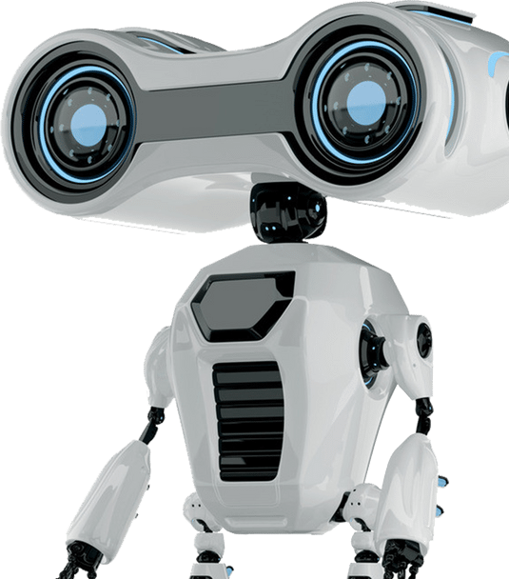
AUTO
FORGE
AUTO FORGE: MULTI-AGENT LLM SYSTEM
Presented by: R26-SE-033

Slide 2
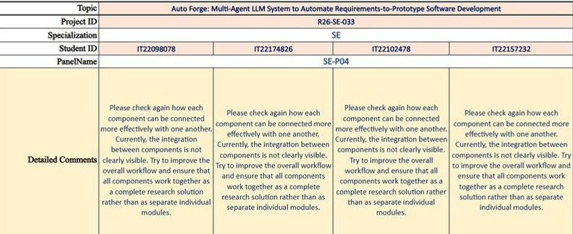
AUTO
FORGE
How we addressed it
Built one connected pipeline (LangGraph) Added MongoDB checkpointingt
Proved integration by tracing one real feature through all 7 stages end-to-end Added human-approval gates between every stage

Slide 3

AUTO
FORGE
The problem : Multi-Agent LLM System

Slide 4




AUTO
FORGE
Problem, Impact and Benefits
PROBLEM
Current solutions don’t reliably capture domain workflows and business rules, They don’t generate versioned SDLC artifacts from SRS to a working prototype while enforcing human approval,
tool-based validation, and end-to-end requirement-to-code traceability.
STAKEHOLDERS
Business Analysts / Product Owners
Architects & UI/UX Designers Developers & QA Engineers DevOps & Security Teams Software organizations / startups
MEASURABLE PAIN POINT
Missing domain workflows → misunderstandings + rework Fragmented artifacts across tools
→slow reviews, inconsistencies Weak approval/traceability → low trust in AI-generated code

Slide 5


Research Gap , Objectives
AUTO
FORGE
RESEARCH GAP
No existing system lets you save progress, pause, resume, add domain knowledge, and run real security/QA checks — all in one pipeline.
OBJECTIVES
Every stage is saved and approved by a human before moving to the next The system can pause and resume anytime, even after a restartt
Test the full pipeline, including security and testing, on one real feature

Slide 6


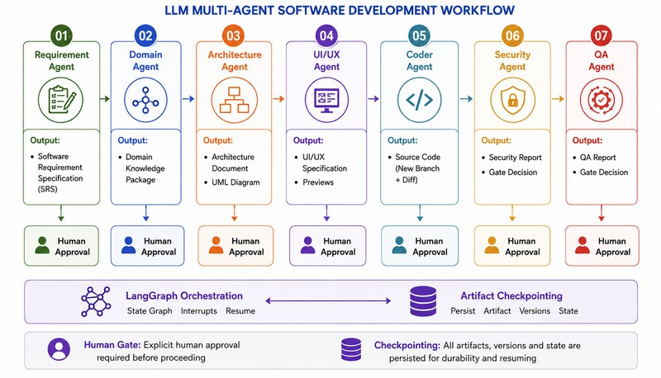
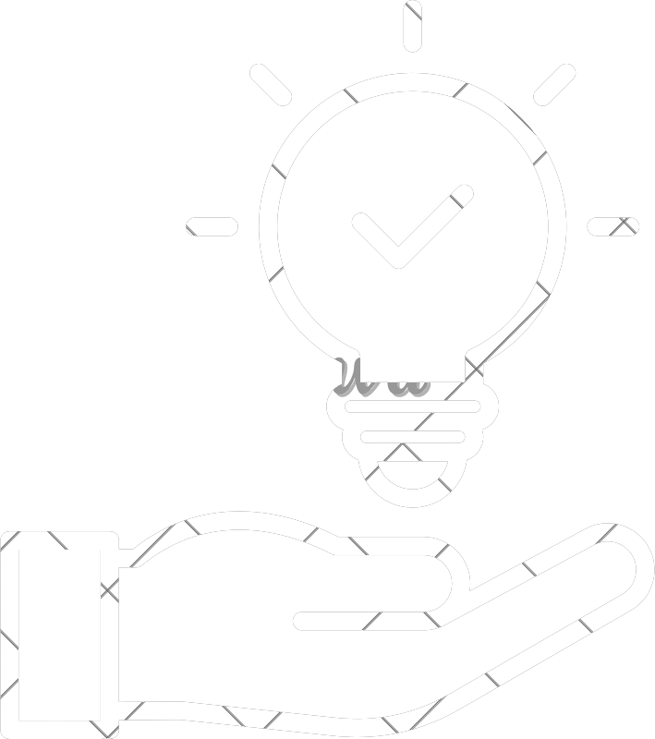

SOLUTION OVERVIEW , ARCHITECTURE
AUTO
FORGE
ARCHITECTURE
SOLUTION
AutoForge is a 7-agent, human-in-the-loop pipeline — Requirement → Domain → Architecture → UI/UX → Coder → Security → QA — orchestrated as a checkpointed LangGraph state graph, that turns a business requirement into a reviewed, working e-commerce web application.

Slide 7



INTEGRATION AND COMPLETION STATUS
What's built and working together:
All 7 agents run as one connected pipeline (LangGraph), not separate tools
Every stage saves its progress to MongoDB Full tech stack runs together
What we tested it on:
tested on real features of increasing difficulty: Item Listing , Login/Authentication, Every output is saved as a version, so reviewers always see the approved copy

Slide 8




EVALUATION EVIDENCE , NFRS
AUTO
FORGE
Pipeline works end-to-end Human review catches problems
Recovers from a crash
Security and testing hold up - bugs caught, tests passed
Domain knowledge helps - Fewer missing requirements, fewer revisions
NON-FUNCTIONAL REQUIREMENTS
Reliability Security Traceability
Saves progress at every step, resumes after a crash 3 layers of automatic checks + optional AI review
Every file is versioned, every decision logged
Each agent is a separate, swappable module
Maintainability

Slide 9
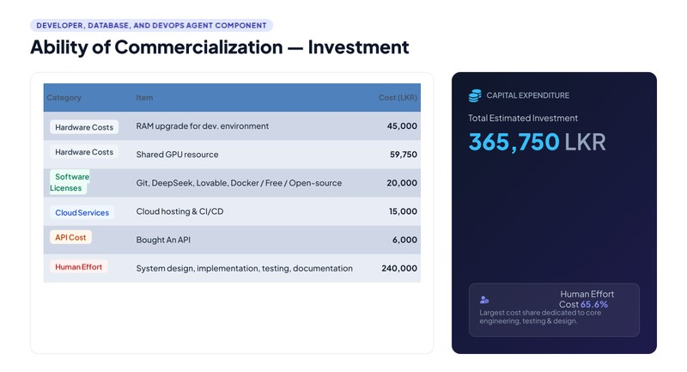
COMMERCIALIZATION

Slide 10
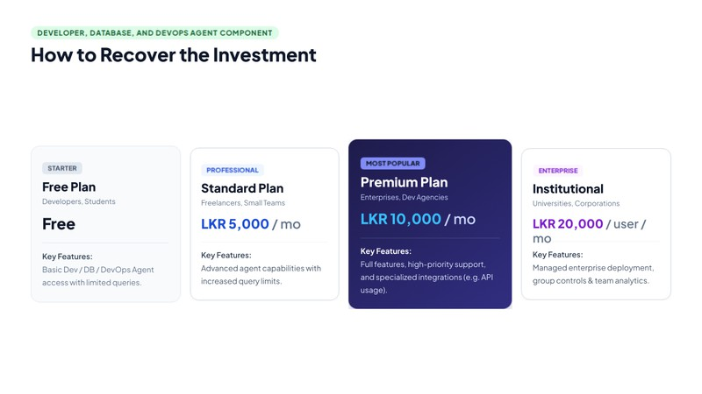

Slide 11


AUTO
FORGE
THANK YOU
Presented by:
R26-SE-033

