Slide 1
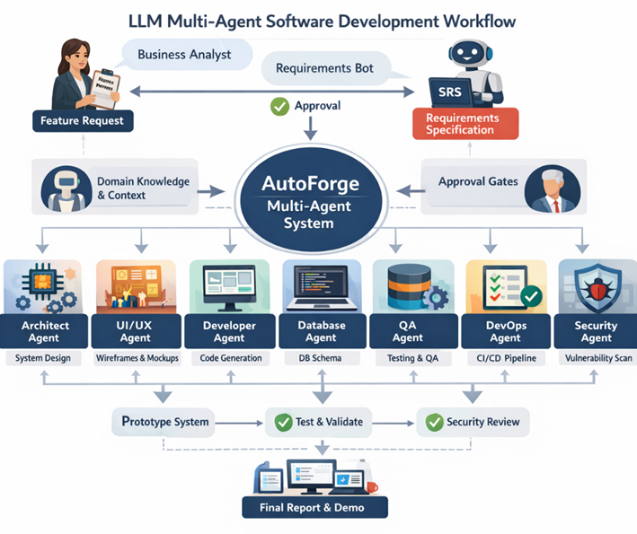
Auto Forge: Multi-Agent LLM System
R26-SE-033

Slide 2
Video that introduce the problem and the system
Note: This is an AI generated video
R26-SE-033

Slide 3
Users & Stakeholders
Users
Stakeholders
Business Analysts
Software Architects & UI/UX designers
Developers, QA engineers, DevOps engineers
Startup teams
Engineering managers / Tech leads
Security/compliance teams
Clients/end users (indirect beneficiaries)
Software Organizations
Product Owners
R26-SE-033

Slide 4
The Problem
Current solutions lack a reliable mechanism to capture domain workflows and rules early and then generate versioned SDLC artifact from SRS to prototype while enforcing human approval gates, tool-based validation, and requirement-to-code traceability.
R26-SE-033

Slide 5
Impact of the Problem For Users & Society
Impact on users
Domain workflows/rules not captured early → misunderstandings + rework
SDLC outputs are fragmented (SRS/SDS/API/UI/code) → slow reviews + inconsistencies
Weak approval/traceability in many tools → low trust in AI-generated artifacts
R26-SE-033

Slide 6
Impact of the Problem For Users & Society
Impact on Society
Inconsistent requirements-to-implementation → more reliability & security risks
Rework and manual coordination waste time → lower productivity and slower innovation
R26-SE-033

Slide 7
Existing Research Solutions and Their Limitations (Research-based)
Researches
What research provides today
ChatDev / MetaGPT: multi-agent collaboration for software tasks; emphasizes staged workflows and communication to reduce fragmented development [1][2].
AgentVerse / AutoGen: frameworks for multi-agent orchestration and conversation patterns[7][6].
AgentCoder: multi-agent code generation strengthened by test generation + execution feedback loops[5].
SWE-agent / OpenHands / CodeAct: tool-executing agents with sandboxed execution; show the importance of interfaces, guardrails, and executable actions[4][3].
R26-SE-033

Slide 8
Existing Research Solutions and Their Limitations (Research-based)
Limitation
Key limitations (why Auto-Forge is still needed)
Many systems target coding or issue-fixing, not requirements-to-prototype and working product with human approval gates.
Weak or missing domain workflow capture as a first-class step before design/coding.
Incomplete traceability across artifacts (SRS → SDS → design → code → tests → security).
Security is often afterthought, not integrated as part of the pipeline.
R26-SE-033

Slide 9
The Proposed Solution (Auto-Forge)
Auto Forge is a human-in-the-loop, multi-agent system that converts business requirements into a validated prototype & working product with traceability and security checks.
Inputs: BA interview/feature request, domain documents, target tech stack.
Process:
  Requirements bot → SRS (FR/NFR/acceptance) → BA approval
  Domain agents → workflow/rule pack → feed into SDS
  Pipeline generates SDS, architecture pack, UI/UX pack, DB pack, prototype + tests, devops pack, security pack, testing pack, working project with reports
  Return prototype + reports for review & working product
Outputs: approved SRS+SDS, working prototype, Design pack,testing, security findings, working product + reports.
R26-SE-033

Slide 11
Solution Overview: How it Overcomes Limitations
Partial SDLC automation → full pipeline with stage gating (SRS→…→Prototype).
Weak domain grounding → Domain workflow/rule pack before SDS/design.
Hard to trust outputs → human approvals + versioned artifacts.
Hard to prove coverage → Traceability matrix (FR → design/code/test/security).
Security late → security pack integrated (threat scan + SAST/dependency scan)
SAST (Static Application Security Testing)
R26-SE-033

Slide 12

IT22098078 | Santhuka d.n.m.d
Title of the scope
Requirements Bot, Domain Agents, and Orchestrator for Controlled Requirement Engineering.
IT22098078 | Santhuka D.N.M.D| R26-SE-033

Slide 13
Combines requirement generation, domain grounding, and approval-controlled orchestration in one workflow.
Requirements Bot, Domain Agents & Orchestrator : Business Needs-to-SRS Generation
Novelty
Current AI tools focus more on coding than on requirement quality, which can lead to unclear, unapproved, and weakly traceable requirements.
Problem Definition
Research Objective
Develop a requirement-first component that produces structured, domain-aware, and approved requirement artifacts.
IT22098078 | Santhuka D.N.M.D| R26-SE-033

Slide 14
Requirements Bot, Domain Agents & Orchestrator : Business Needs-to-SRS Generation
Sub Objectives
Generate structured requirements
Add domain context and rules
Manage traceability and versioning
Enforce BA approval before handover
IT22098078 | Santhuka D.N.M.D| R26-SE-033

Slide 15
Requirements Bot, Domain Agents & Orchestrator : Business Needs-to-SRS Generation
Research Methodology- Knowledge Domains
Requirements engineering – used to turn raw business inputs into structured requirement artifacts
Domain analysis – used to capture workflow rules, business terms, constraints, and use-case logic
Multi-agent orchestration – used to control workflow stages, approvals, traceability, and versioning
Human-in-the-loop governance – used to keep business analyst review before handover
IT22098078 | Santhuka D.N.M.D| R26-SE-033

Slide 16
Requirements Bot, Domain Agents & Orchestrator : Business Needs-to-SRS Generation
Latest Technologies Used
Openai responses API – for structured requirement generation and tool-based orchestration
Python – for implementing agent logic and workflow control
Fastapi – for backend apis and approval handling
Pydantic – for schema validation of requirement artifacts
Postgresql – for storing SRS, domain packs, traceability ids, and version history
Docker – for consistent deployment and testing
Github actions – for automated validation and workflow checks
IT22098078 | Santhuka D.N.M.D| R26-SE-033

Slide 17
Requirements Bot, Domain Agents & Orchestrator : Business Needs-to-SRS Generation
The way of validation and evaluation of the proposed solution
Check whether the Requirements Bot generates a complete and structured SRS draft
Check whether Domain Agents correctly add domain rules, terms, and context
Check whether the Orchestrator correctly manages workflow stages and approvals
Test whether unapproved artifacts are blocked from moving forward
Use review-based evaluation to measure clarity, completeness, and domain relevance
IT22098078 | Santhuka D.N.M.D| R26-SE-033

Slide 18
Requirements Bot, Domain Agents & Orchestrator : Business Needs-to-SRS Generation
Business inputs such as stakeholder needs, feature requests, constraints, and interview notes
Domain documents, workflow descriptions, and business rules
Prepared case scenarios for testing the component
Public or authorized materials used as requirement and domain references
Data Availability
Use only authorized or publicly available data
Avoid unnecessary personal or confidential information
Anonymize any real project data before use
Protect artifacts using role-based access control
Keep approval records, versions, and logs securely stored
Keep human review before outputs move to the next SDLC stage
Security and Ethical Clearance
IT22098078 | Santhuka D.N.M.D| R26-SE-033

Slide 19
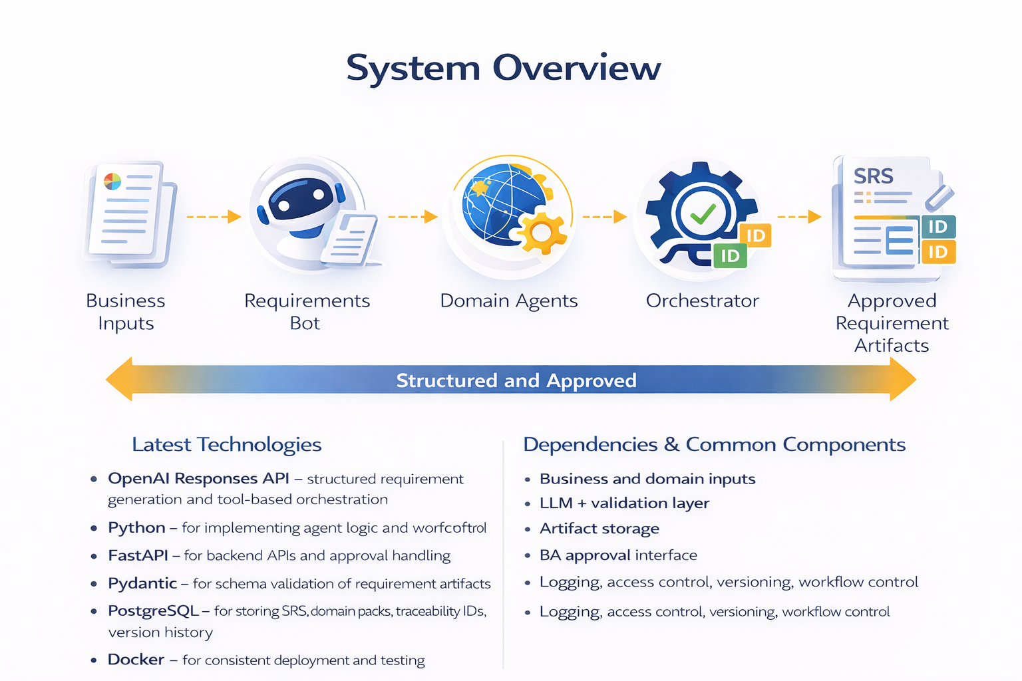
Requirements Bot, Domain Agents & Orchestrator : Business Needs-to-SRS Generation
IT22098078 | Santhuka D.N.M.D| R26-SE-033

Slide 20

IT22174826 | Sansala T.G.B.D
Title of the scope
Architect Agent & UI/UX Agent : SRS-to-Design Pack Generation
IT22174826 | Sansala T.G.B.D | R26-SE-033

Slide 21
Automatically generates A design pack from an approved SRS, where the architect agent produces API contract & UML diagrams, the UI/UX agent produces user flows and wireframes.
Architect Agent & UI/UX Agent : SRS-to-Design Pack Generation
Novelty
Problem: Converting An Approved SRS Into Complete Design Artifacts Is Often Slow & Inconsistent, And Existing Tools Still Struggle To Reliably Generate A Full Implementation-ready Design Set
solution : Automatically Generate A Design Pack From Approved SRS
Architect Agent - OpenApi/Swagger API Contract & UML Diagrams,
UI/UX Agent - User Flows And Wireframes
Problem Definition
IT22174826 | Sansala T.G.B.D | R26-SE-033

Slide 22
Architect Agent & UI/UX Agent : SRS-to-Design Pack Generation
By the end of the project, build AI agents that generate A design pack (API, UML, user flows, wireframes) from an approved SRS.
Research Objective
Implement Architect Agent generates OpenApi/swagger API contract
Implement Architect Agent generate UML diagrams (use case, class, sequence, object) from the approved SRS.
Implement UI/UX Agent user flows and low-fidelity wireframes
SUB
OBJECTIVEs
IT22174826 | Sansala T.G.B.D | R26-SE-033

Slide 23
Architect Agent & UI/UX Agent : SRS-to-Design Pack Generation
Applies API ENGINEERING To Generate An OpenApi/Swagger API Contract (Endpoints, Schemas, Validations).
Applies UML MODELING To Generate Use Case, Class, Sequence, & Object Diagrams From The Approved SRS.
Applies UI/UX DESIGN To Generate User Flows & Low-fidelity Wireframes Aligned With Requirements.
Research Methodology
API contract: OpenApi + Swagger UI/Editor
UML: PlantUml (+ Graphviz)
User flows: Mermaid
Wireframes: LLM → HTML (Tailwind) → PNG (Playwright)
Latest Technology
IT22174826 | Sansala T.G.B.D | R26-SE-033

Slide 24
Architect Agent & UI/UX Agent : SRS-to-Design Pack Generation
Validation & Evaluation | Data Availability
Confirm the component generates the full Design Pack | Uses requirements artifacts generated within approved SRS
Confirm the OpenAPI/Swagger file opens without errors (valid structure). | Inputs: Approved SRS (user stories, FRs/NFRs, requirement IDs)
Confirm the UML diagrams render correctly | Outputs: OpenAPI/Swagger API contract, UML diagrams , user flows & wireframes.
Confirm the user flow diagram & wireframes is clear | No external or sensitive datasets are required.
Design Verified
IT22174826 | Sansala T.G.B.D | R26-SE-033

Slide 25
Architect Agent & UI/UX Agent : SRS-to-Design Pack Generation
Security Considerations | Ethical Considerations
Store the SRS and generated Design Pack securely | Collect survey feedback with informed consent and voluntary participation.
Avoid exposing confidential project details when using LLMs. | Do not collect personal identifiers; report results only in aggregated form.
Use anonymized or synthetic examples when sharing data with AI systems | System supports designers/developers rather than replacing them
Restrict access to project artifacts to authorized users only. | Generated outputs remain reviewable, editable, and traceable back to the approved SRS
Safe
Design
IT22174826 | Sansala T.G.B.D | R26-SE-033

Slide 26

Architect Agent & UI/UX Agent : SRS-to-Design Pack Generation
Input: Approved SRS (REQ IDs, user stories, FR/NFR).
Architect Agent Output: OpenAPI/Swagger API contract and UML diagrams (use case, class, sequence, object).
UI/UX Agent Output: User flows and low-fidelity wireframes.
Final Output: Implementation-ready Design Pack (folder/ZIP) for review & downstream development
System Overview
Depends On: Approved SRS (Requirements Specification)
Common Modules: Artifact Storage/Export Module (Design Pack) And Standard Templates
Handover To: Developer, DB, QA, Devops, And Security Agents For Prototype Implementation
Dependencies & common components
IT22174826 | Sansala T.G.B.D | R26-SE-033

Slide 27

IT22157232 | Dissanayake T.C
Title of the scope
Development Agent for Automated Code Generation with Controlled Patch-Based Code Editing
IT22157232 | Dissanayake T.C | R26-SE-033

Slide 28
Controlled Patch-based Code Editing
Development Agent for Automated Code Generation with Controlled Patch-Based Code Editing
Novelty
Current AI coding tools often rewrite entire files instead of making small controlled updates. This can overwrite correct code, remove developer logic, and make changes difficult to review or roll back.
Problem Definition
Research Objective
To Design And Implement A Development Agent Component That Automatically Generates Code, Database Schemas, And DevOps Configurations From Approved Design Artifacts While Ensuring Safe And Traceable Code Modifications Through A Patch-based Editing Approach.
IT22157232 | Dissanayake T.C | R26-SE-033

Slide 29
Development Agent for Automated Code Generation with Controlled Patch-Based Code Editing
Generate Prototype + Working Product Application Code Based On Architecture Artifacts And API Contracts
Automatically Generate Database Schemas And Migration Scripts From The Approved SRS.
Produce Containerization And CI/CD Configurations
SUB
OBJECTIVEs
IT22157232 | Dissanayake T.C | R26-SE-033

Slide 30
Development Agent for Automated Code Generation with Controlled Patch-Based Code Editing
Research Methodology
Ai-assisted Software Development Using Large Language Models (LLMs)
Prototype-driven Development From Approved Design Artifacts
Multi-agent Software Engineering Workflow.
Automated Code Generation From Architecture And API Contracts
Patch-based Code Modification Instead Of Full File Rewriting
Python – Core Implementation Language
LLM APIs – Code Generation And Code Modification
FastAPI – Backend API Development
PostgreSQL– Database Schema Implementation.
Docker – Containerization And Reproducible Environments
Git-style Diff/Patch Mechanism – Controlled Code Modification
CI/CD Pipelines – Automated Build And Validation
Latest Technology
IT22157232 | Dissanayake T.C | R26-SE-033

Slide 31
Development Agent for Automated Code Generation with Controlled
Patch-Based Code Editing
Validation & Evaluation | Data Availability
Correctness of patch-based code updates | Uses design artifacts generated within AutoForge
Automated build validation through CI / CD | Inputs: API contracts, architecture specifications, system requirements
Database schema and migration consistency | No external sensitive datasets required
IT22157232 | Dissanayake T.C | R26-SE-033

Slide 32
Development Agent for Automated Code Generation with Controlled
Patch-Based Code Editing
Security Considerations | Ethical Considerations
Secure containerized execution using Docker | System designed to assist developers, not replace them
Patch-only code editing reduces accidental overwriting of correct existing code | Generated code remains reviewable and traceable
Role-based access and controlled artifact storage help protect generated outputs | Developers maintain control over final implementation
IT22157232 | Dissanayake T.C | R26-SE-033

Slide 33
Development Agent for Automated Code Generation with Controlled
Patch-Based Code Editing
Developer Agent → Code Generation
Patch-only Editing → Safe Code Updates As Diffs
Database Agent → Schema + Migrations
DevOps Agent → Docker + CI/CD Configs
Output → Runnable Prototype + Working Product After Approval/Testing
System Overview
Inputs From Earlier Agents: API Contract, UI Component List, System Constraints
Common Coordinator: Orchestrator
Version Control: Git For Patch History And Rollback
Execution Environment: Docker
CI Support: Github Actions Or Similar CI Service
LLM Support: deepseek / Hugging Face / Lovable
Dependencies & Common Components
IT22157232 | Dissanayake T.C | R26-SE-033

Slide 34

IT22102478 | Oberathna R.D.T.D
Title of the scope
Integrated Security Analysis and Testing Component
IT22102478 | Oberathna R.D.T.D | R26-SE-033

Slide 35
An integrated Security Analysis and Testing component that combines custom static security analysis, vulnerability validation, and traceability to improve the security of AI-generated software artifacts.
Integrated Security Analysis and Testing Component
Novelty
Existing AI-assisted development tools mainly focus on generating code quickly, but they provide limited support for security validation, vulnerability detection, and traceability across software artifacts.
Problem Definition
Research Objective
To design and develop a Security Analysis and Testing component that identifies, validates, and reports security vulnerabilities in AI-generated software artifacts.
IT22102478 | Oberathna R.D.T.D | R26-SE-033

Slide 36
Integrated Security Analysis and Testing Component
Sub Objectives
Build a custom static security analysis module
Build a custom security testing mechanism
Perform dependency vulnerability checking
Use LLM-assisted secure code review
Create a compliance & traceability dashboard
Evaluate using coverage, false positives, efficiency, and traceability
IT22102478 | Oberathna R.D.T.D | R26-SE-033

Slide 37
Integrated Security Analysis and Testing Component
Research Methodology
Static Security Analysis - Supports detection of insecure coding patterns without executing the program.
Security Testing and Validation - Confirms whether detected vulnerabilities are real, mitigated, or still present.
Dependency Vulnerability Analysis - Detects risks in third-party libraries and packages used in generated prototypes.
Traceability and Compliance Monitoring - Links requirements, code, vulnerabilities, and validation results for transparency and auditability.
IT22102478 | Oberathna R.D.T.D | R26-SE-033

Slide 38
Integrated Security Analysis and Testing Component
Latest Technologies Used
Python – main implementation language
Python AST – custom static security analysis
pytest + requests – custom security testing and validation
OSV.dev + NVD – dependency vulnerability checking
CVE ID - common mapping key between OSV.dev and NVD
OpenAI API – LLM-assisted secure code review
FastAPI – backend service and API integration
React – Compliance & Traceability Dashboard
PostgreSQL – storing findings, validation results, and traceability data
IT22102478 | Oberathna R.D.T.D | R26-SE-033

Slide 39
Integrated Security Analysis and Testing Component
The way of validation and evaluation of the proposed
solution
Unit testing, integration testing, regression testing
Custom security testing for vulnerability validation
Evaluate using coverage, false positives, efficiency, traceability
Dashboard-based analysis
Generated source code from autoforge prototypes
Dependency lists of third-party libraries
Security testing artifacts and validation results
Public vulnerability data from OSV.Dev and NVD
Survey responses supporting the research gap
Data Availability
IT22102478 | Oberathna R.D.T.D | R26-SE-033

Slide 40
Integrated Security Analysis and Testing Component
Security Considerations | Ethical Considerations
Use only authorized or public data | Keep survey responses confidential
Protect source code and reports from unauthorized access | Use the system only for defensive security analysis
Store findings and traceability records securely | Follow responsible academic and research practice
IT22102478 | Oberathna R.D.T.D | R26-SE-033

Slide 41
Integrated Security Analysis and Testing Component
Static Security Analysis output: Detect selected security weaknesses in generated code
Dependency Checking Output: Identify known risks in third-party libraries using OSV.dev / NVD
LLM-Assisted Review Output: Security observations and mitigation suggestions
Security Testing Output: Validate detected vulnerabilities as confirmed / mitigated / still present
Final Output: Security Assessment Report and Compliance & Traceability Dashboard for review and secure prototype continuation
System Overview
Depends On: Generated source code, dependency list / package details, and testing artifacts
Common: Code references, traceability mapping, report storage, output templates
Dependency & Common Components
IT22102478 | Oberathna R.D.T.D | R26-SE-033

Slide 42
Auto Forge: Multi-Agent LLM System
Commercial Product Potential
Autoforge can be offered as a software engineering productivity/Software automation tool that automates a governed pipeline: SRS → SDS → design pack → prototype + tests → devops → security → traceability.
Fits real industry needs: faster prototyping with approval gates, versioned artifacts, tool-verified QA, and security reporting.

Slide 43
Auto Forge: Multi-Agent LLM System
INVESTMENT / COST & COST RECOVERY (PRICING)
Investment / Cost
Cost Recovery / Pricing Model
0-5$
Total Estimated Budget: LKR 1,090,000
Student / Academic
Affordable access for universities and student teams
Hardware (RAM upgrades + shared GPU)
LKR 115000
10-15$
Startup / Team
For small software teams needing faster delivery
Cloud Services ( AWS / Azure hosting, storage, CI/CD)
>30$
LKR 15000 apx.
Enterprise
Private deployment and advanced support for companies
Software Licenses (open-source toolchain)
LKR 0
Credit based
Subscription Model
Monthly or annual billing based on usage and team size
Labour Cost (40,000 *4 members × 6 months)
LKR 960,000

Slide 44
Auto Forge: Multi-Agent LLM System
Target Market, Customer Profile & Value Proposition
Target Market
Software development companies
(SMEs to mid-size teams)
Startups needing rapid validated prototypes
Enterprises with governance and security requirements
Value Proposition
Reduces rework — captures domain workflows early and keeps artifacts consistent.
Builds trust — uses approvals, versioning, and traceability across artifacts.
Improves quality —security checks before handover.
Supports governance — helps teams work with clearer documentation and reviewable outputs.
Customer Profile
CTOs / Engineering Managers (need productivity + control)
Business Analysts / Product Owners (need structured requirements + approvals)
Developers / QA / DevOps (need tool-verified outputs)
Security / Compliance teams (need reports + traceability)

Slide 45
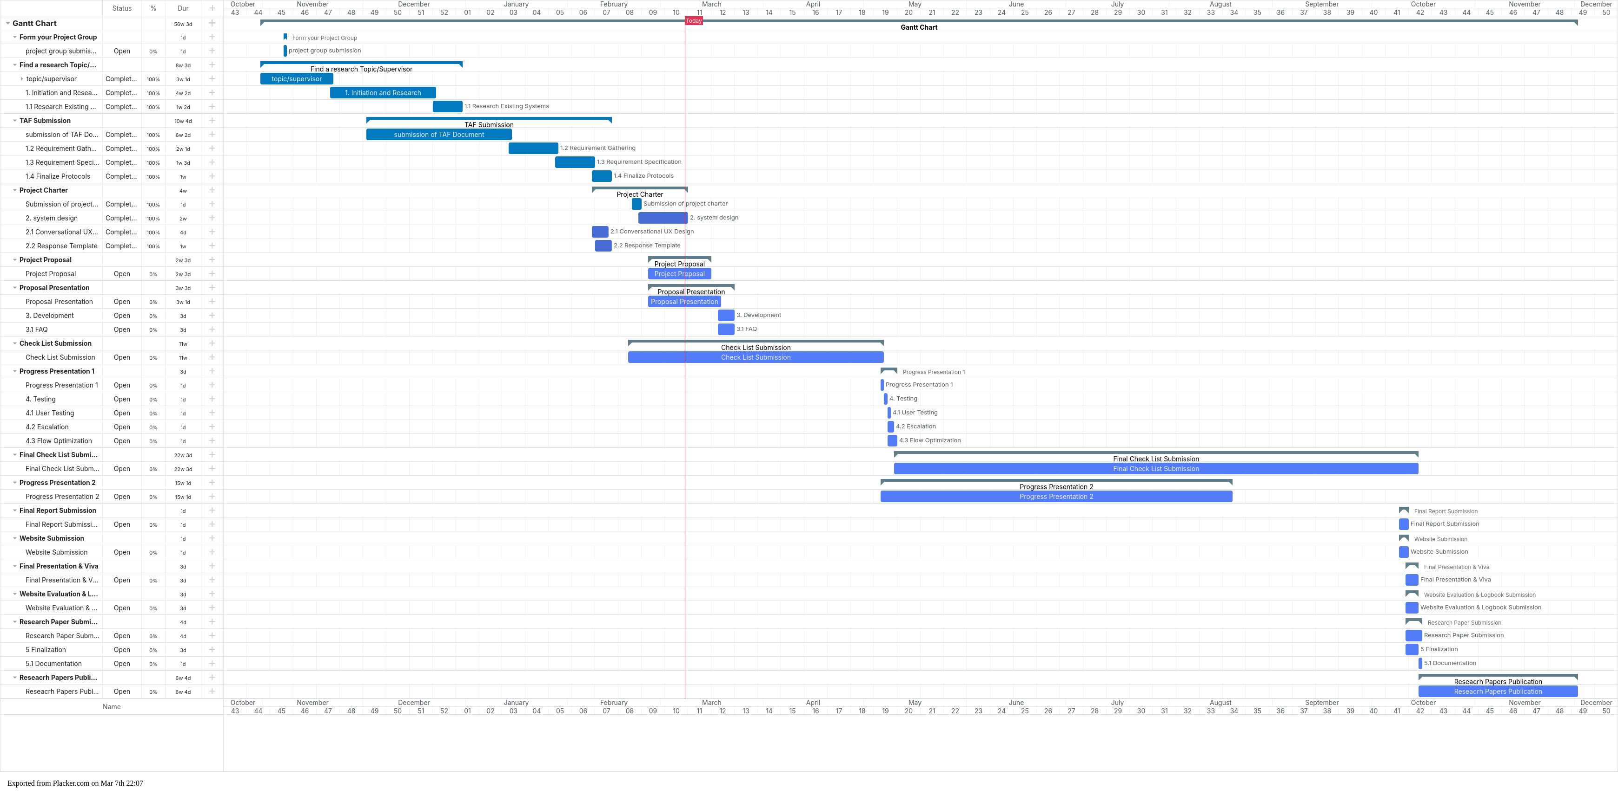
Gantt Chart

Slide 46
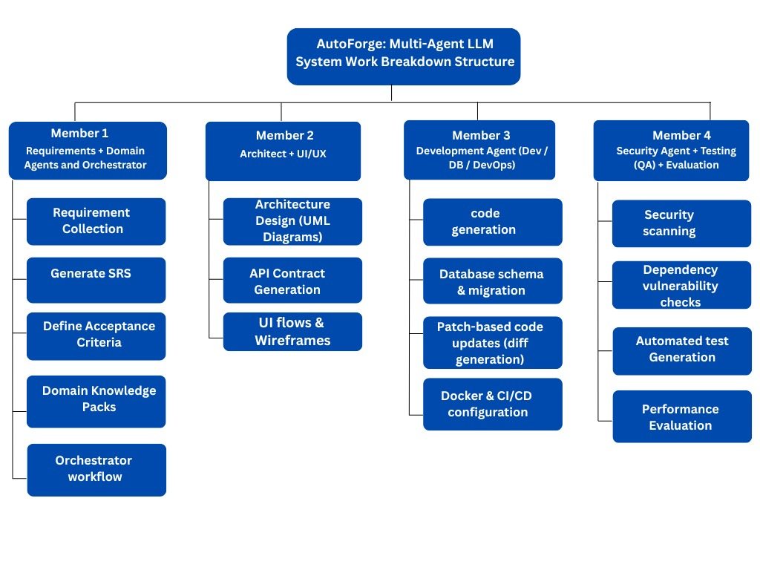
Work Breakdown Structure

Slide 47
References
[1] Chen Qian, Wei Liu, Hongzhang Liu, Nuo Chen, Yufan Dang, Jiahao Li, Cheng Yang, Weize Chen, Yusheng Su, Xin Cong, Juyuan Xu, Dahai Li, Zhiyuan Liu, Maosong Sun “Chatdev: Communicative Agents for Software Development”, pp.1-5, arxiv:2307.07924v5 [cs.SE] 5 jun 2024
[2] Sirui Hong, Mingchen Zhuge, Jiaqi Chen, Xiawu Zheng, Yuheng Cheng, Ceyao Zhang, Jinlin Wang, Zili Wang, Steven Ka Shing Yau, Zijuan Lin, Liyang Zhou, Chenyu Ran, Lingfeng Xiao, Chenglin Wu, Jürgen Schmidhuber, “Metagpt: Meta Programming For A Multi-agent Collaborative Framework”, arxiv:2308.00352v7 [Cs.AI] 1 Nov 2024
[3] Xingyao Wang, Boxuan Li, Yufan Song, Frank F. Xu, Xiangru Tang, Mingchen Zhuge, Jiayi Pan, Yueqi Song, Bowen Li, Jaskirat Singh, Hoang H. Tran, Fuqiang Li, Ren Ma, Mingzhang Zheng, Bill Qian, Yanjun Shao, Niklas Muennighoff, Yizhe Zhang, Binyuan Hui, Junyang Lin, Robert Brennan, Hao Peng, Heng Ji, Graham Neubig, “Openhands: An Open Platform For AI Software Developers As Generalist Agents”, arxiv:2407.16741v3 [Cs.SE] 18 Apr 2025

Slide 48
References
[4] John Yang, Carlos E. Jimenez, Alexander Wettig, Kilian Lieret, Shunyu Yao, Karthik Narasimhan, Ofir Press ,“Swe-agent: Agent-computer Interfaces Enable Automated Software Engineering,” arxiv:2405.15793 [Cs.SE], 11 Nov 2024
[5] Dong Huang, Jie M.Zhang, Michael Luck, Qingwen Bu, Yuhao Qing, Heming Cui, “Agentcoder: Multi-Agent-based Code Generation With Iterative Testing And Optimisation,” arxiv:2312.13010v3 [Cs.CL] 24 May 2024.
[6] Q. Wu Et Al., “Autogen: Enabling Next-gen LLM Applications Via Multi-agent Conversation,” arxiv:2308.08155v2 [Cs.AI], Oct. 2023.
[7] W. Chen Et Al., “AGENTVERSE: Facilitating Multi-agent Collaboration And Exploring Emergent Behaviors,” arxiv:2308.10848v3 [Cs.CL], Oct. 2023

Slide 49
THANK YOU

