Slide 1
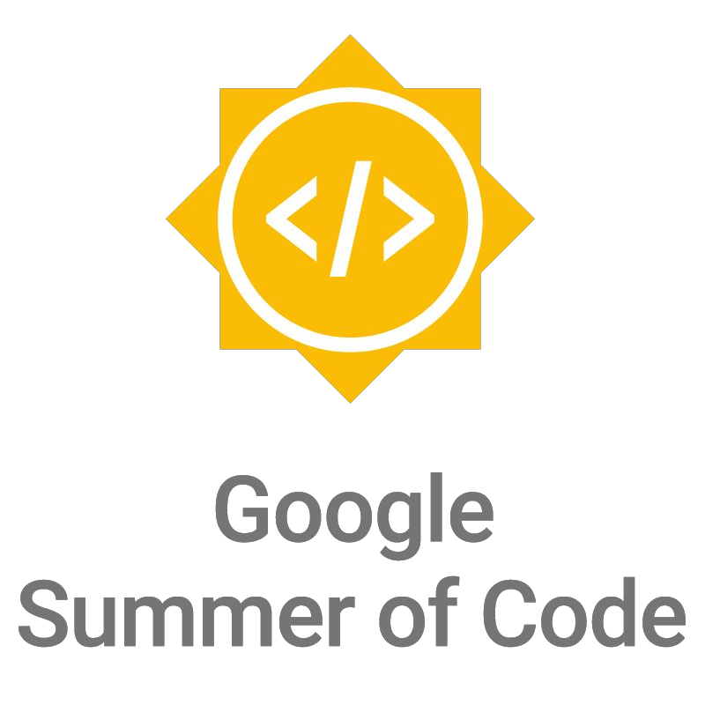

Slide 2
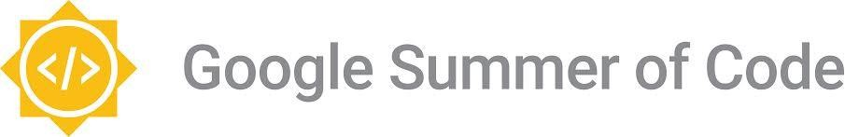
What is open source?
Computer software where the source code is distributed
under an open source license that allows anyone to study,
change, improve and distribute the software.
● Promotes collaboration
● Community of dedicated developers

Slide 3
What is GSoC?
Google Summer of Code (GSoC) is an online, international
program designed to encourage university student participation
in open source software development.

Slide 4
About
Students work for an open source software organization, and
earn a stipend for successfully completing the project.
University students spend their time outside of school working
in a field that can help them with their studies and career after
university.

Slide 5
Goals of the program
Motivate students to begin participating in open source development.
Provide students in Computer Science and related fields the opportunity to do work related to their academic pursuits.
Give students exposure to real-world software development scenarios (e.g., testing, version control, software licensing, mailing-list etiquette, etc.).
● Create more open source code.
● Help open source projects bring in new developers.

Slide 6
How does GSoC work?
Open source software projects apply to be mentor
organizations
● Google chooses the organizations to participate (206 in
2018)
● Students submit project proposals to mentor organizations

Slide 7
How does GSoC work?
Mentor organizations choose the students they’d like to
accept
Students are paired with a mentor to help them throughout
their project
Coding begins! Students work towards milestones laid out
in their project proposal with their mentor over 12 weeks

Slide 8
Evaluations
● Students must pass three evaluations
Students who pass each evaluation are paid a stipend for
their work
At the conclusion of GSoC, students submit the code they’ve
written for their project for everyone to see and use!

Slide 9
Eligibility
● Over 18 upon registration
Accepted into or enrolled in a university program by the
student acceptance date
● Eligible to work in the country in which you reside
● Have participated in no more than 1 previous GSoC

Slide 10
Statistics
In 14 years over 14,762 students from 109 countries have
been accepted into GSoC
● Countries with the most students:
○ India (3,436), United States (2,432), and Germany (825)
● Approximately 35+ million lines of code have been produced

Slide 11
Useful links
● Program Site: http://g.co/gsoc
● Student Guide: http://g.co/gsoc/resources/manual
● Google Open Source Blog: https://opensource.googleblog.com/

Slide 12
2019 Program Timeline
● January 15 Organization applications open
● March 25-April 9 Students submit their proposals
● May 6 Accepted students are announced
● May 6-May 27 Community bonding period with orgs
● May 27-Aug 26 Students code the summer away
● September 3: Successful student projects are announced

Slide 13
Questions?

