Slide 1
Dumebi Duru
CSC 102 WEEK 2 PROJECT 1

Slide 2
PROJECT I PSEUDOCODE
BEGIN
SET Aminat at (0,0)
SET destination = flower at (3,0)
SET goal = plant the flower
MOVE 3 steps to the right
PICK the flower
MOVE 2 steps downwards
PLANT the flower
MOVE 1 step to the right
PRINT "Goal achieved“
END

Slide 3

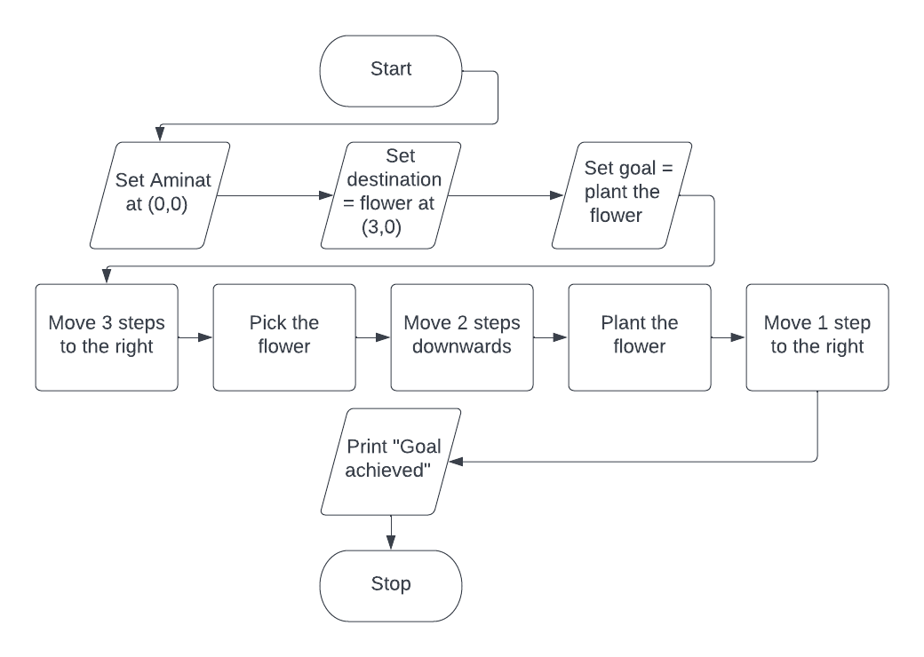
PROJECT I FLOWCHART

Slide 4
PROJECT II PSEUDOCODE
BEGIN
SET list of employees
INPUT name
IF name in employees THEN
5.PRINT “Welcome”
ELSE
7. PRINT "Please leave“
END IF
END

Slide 5

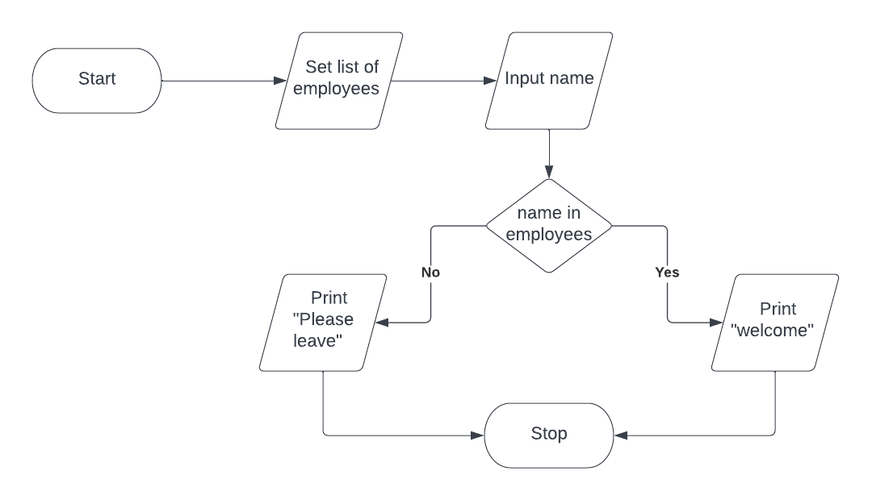
PROJECT II FLOWCHART

Slide 6
PROJECT III PSEUDOCODE
BEGIN
INPUT location
INPUT weight
IF location = PAU
IF weight > = 10 THEN
PRINT "The price is N2000“
ELSE
PRINT "The price is N1500“
ELSE location = Epe
IF weight > = 10 THEN
PRINT "The price is N5000"
PRINT "The price is N4000“
ELSE
PRINT "We do not deliver here“
END IF
END

Slide 7

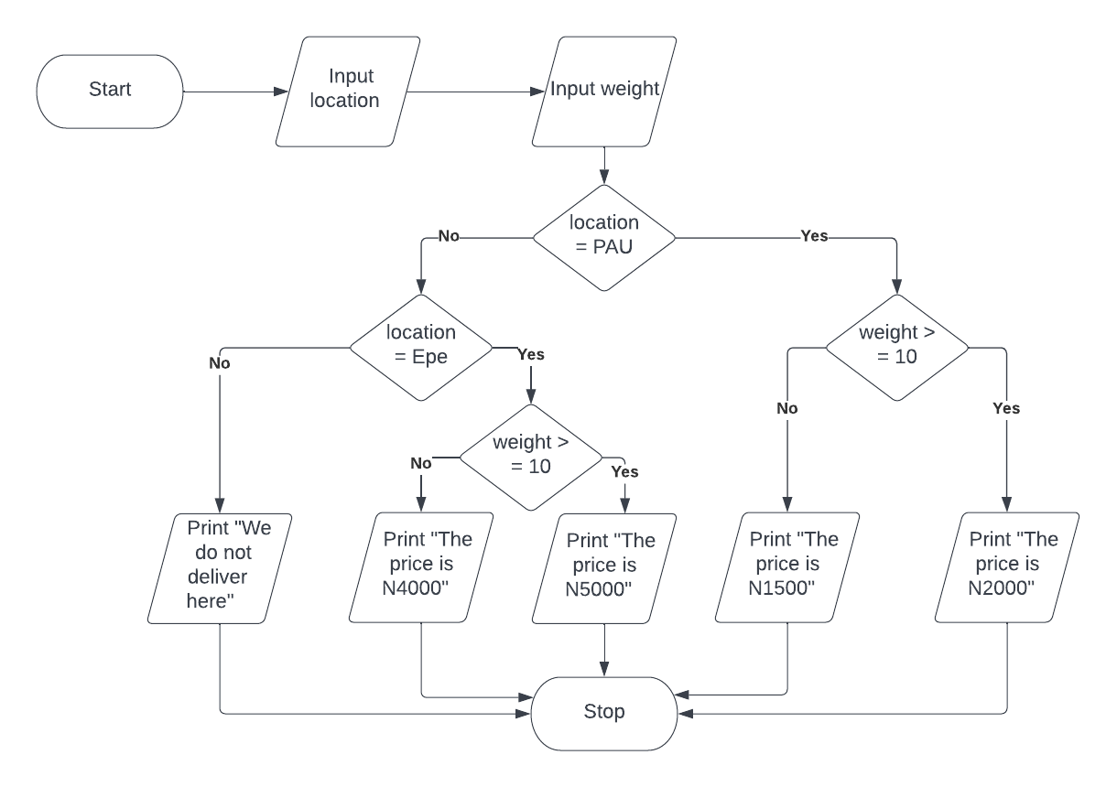
PROJECT III FLOWCHART

Slide 8
PROJECT IV PSEUDOCODE
BEGIN
Input jamb_score
Input no. of credits in key subjects
IF jamb_score>=230 THEN
IF no. of credits > = 5 THEN
6. IF Pass interview = Yes THEN
7. Print "Welcome to pau“
8.ELSE
9. GOTO 15
10. ELSE
11. GOTO 15
ELSE
GOTO 15
END IF
PRINT “Sorry, you can’t be admitted”
END

Slide 9

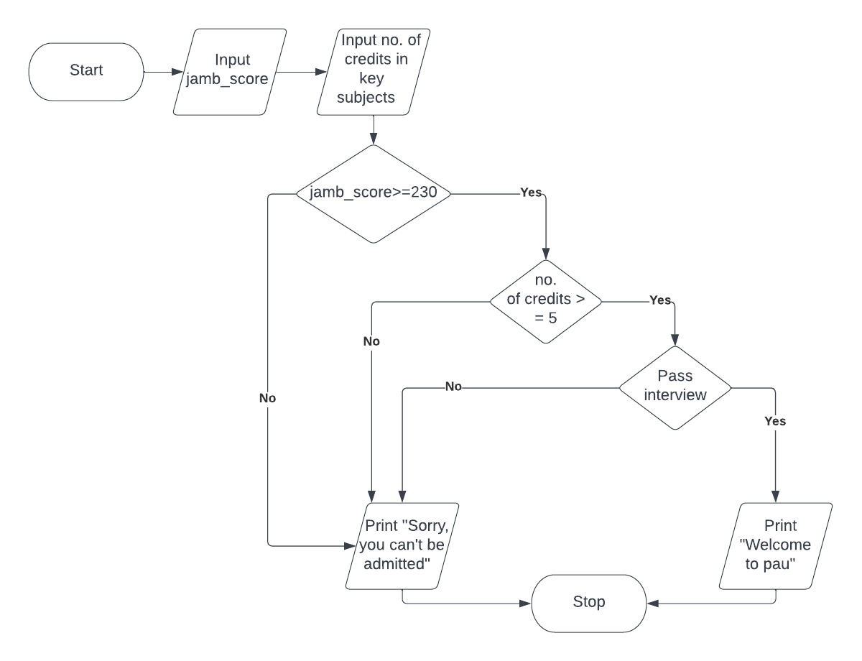
PROJECT IV FLOWCHART

Slide 10
PROJECT V PSEUDOCODE
BEGIN
SET boy at (0,0)
SET girl at (0,2)
SET destination = flower vase at (3,2)
SET goal = give the girl the flower
MOVE boy 2 steps downwards
GIVE the girl the flower
MOVE girl 3 steps to the right
PLANT the flower in vase
MOVE girl 2 steps downwards
FACE the right
PRINT "Goal achieved“
END

Slide 11

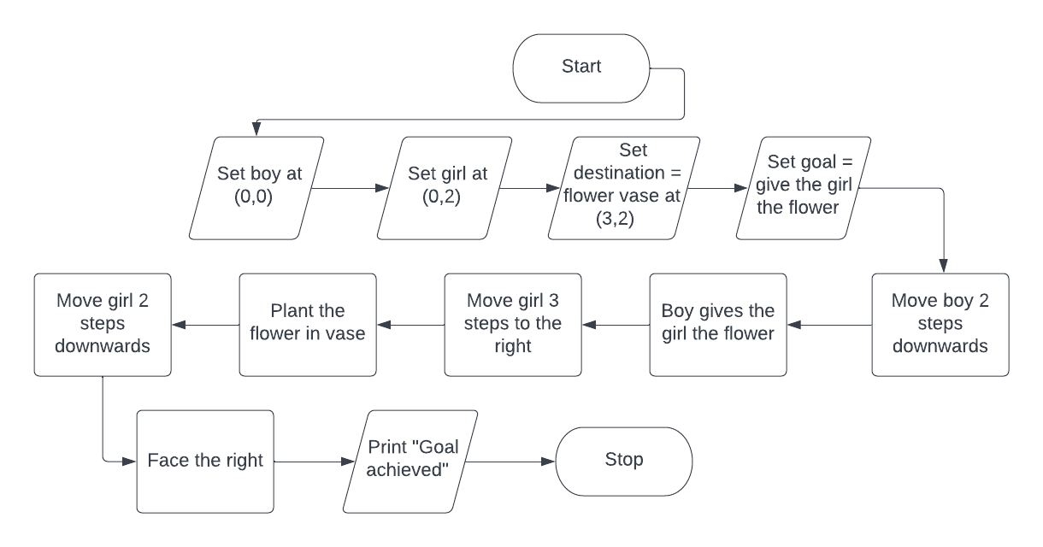
PROJECT V FLOWCHART

