Slide 1
Dumebi Duru
WEEK 1 PROJECT 1

Slide 2

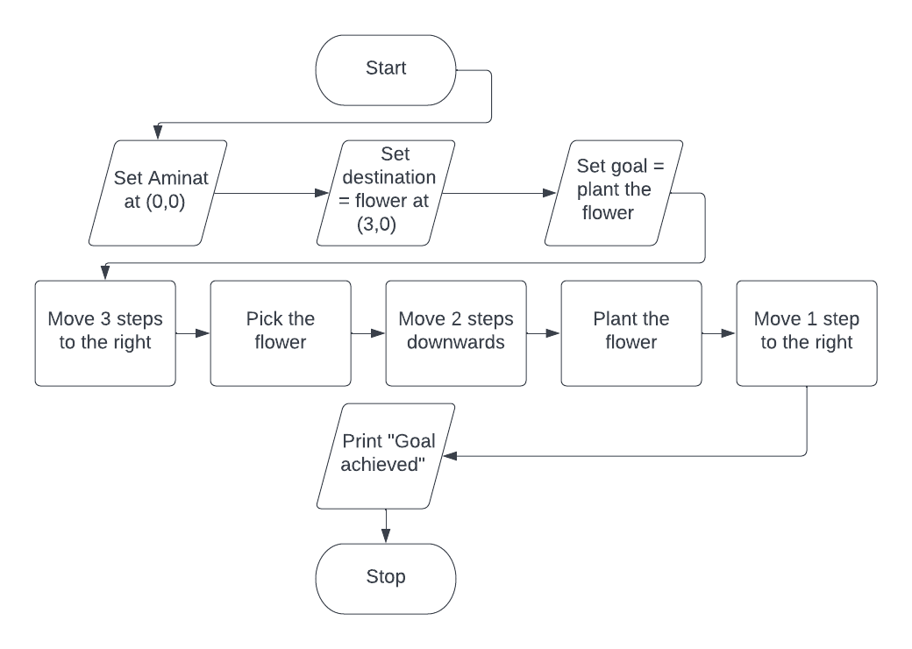
AMINAT

Slide 3

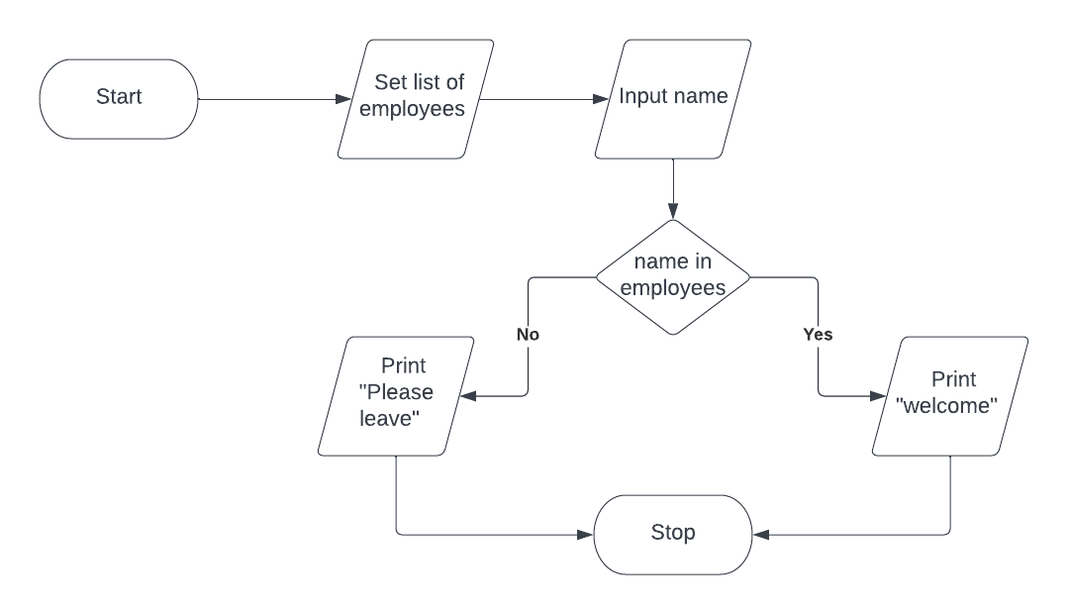
Employee Check

Slide 4

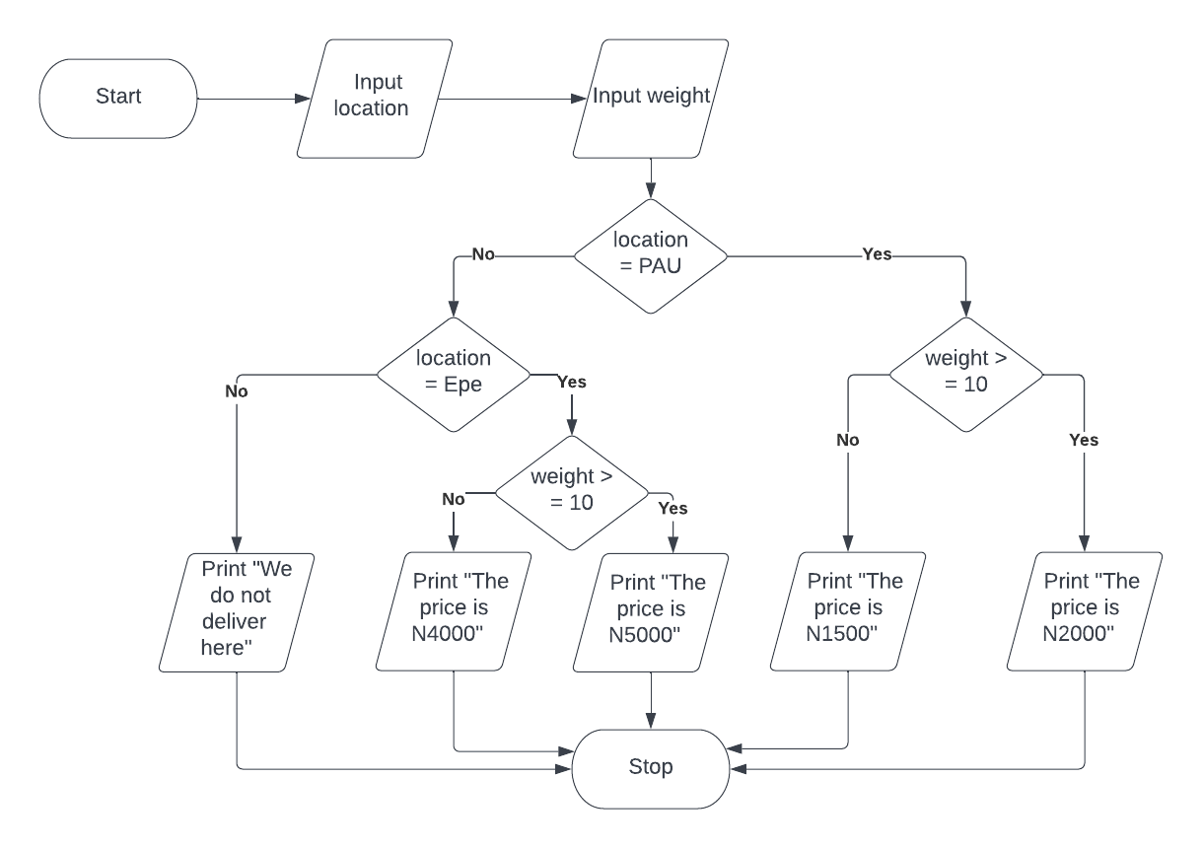
Delivery

Slide 5

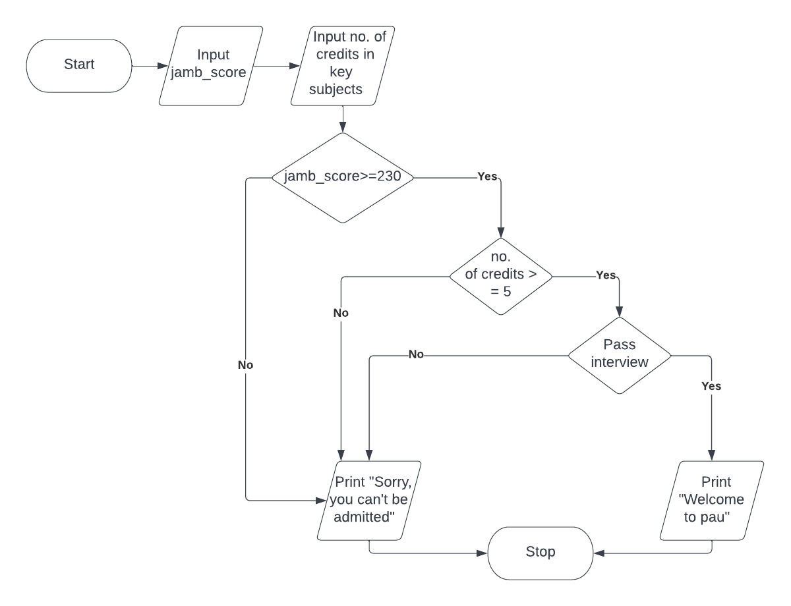
Admission into Computer Science

Slide 6

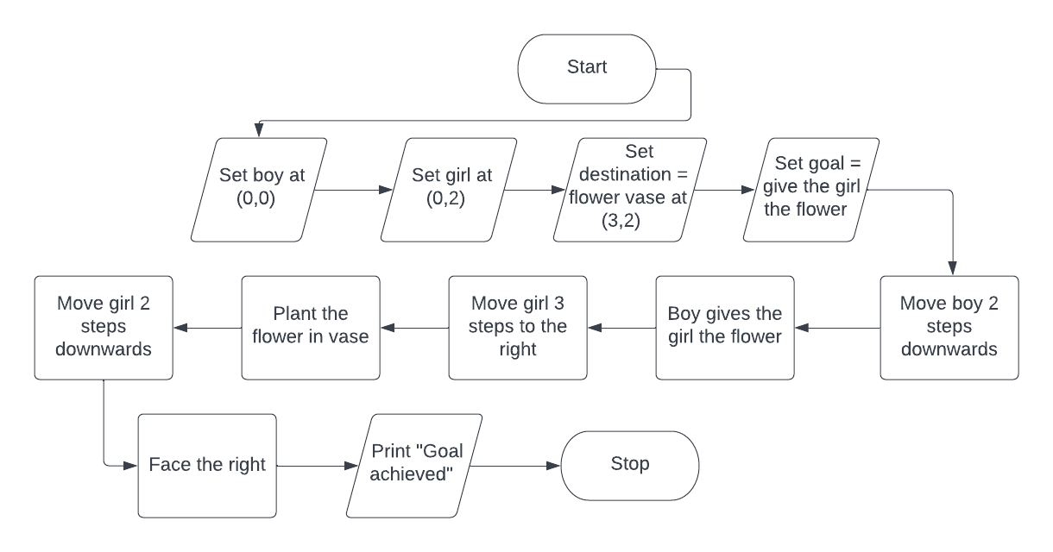
Flower from Boy to Girl

