Slide 1
TEXT CLASSIFICATION AND ANALYSIS PROJECT TO CLASSIFY ONLINE RETAIL DATA
VIKRAM SAMUDRALA
MOUNIKA DUMMU
MANEESH SETTIPETA

Slide 2
INTRODUCTION
PROJECT OVERVIEW:
Our text classification project aimed to develop a model capable of categorizing textual descriptions from an online retail dataset.
IMPORTANCE OF TEXT CLASSIFICATION:
Text classification plays a crucial role in automating tasks such as sentiment analysis, spam detection, and content categorization, leading to improved efficiency and decision-making.
DATASET DESCRIPTION:
The dataset used for training and testing the classifier contained textual descriptions of products from an online retail platform. It consisted of X number of records with Y categories.
OBJECTIVES:
The primary objectives of our project include training a text classifier on the provided dataset, predicting categories for new descriptions, and analyzing the results to gain insights into the dataset.
KEY POINTS:
Throughout this presentation, we will discuss the process of training the text classifier, evaluating its performance, making predictions on new data, analyzing the results, and presenting visualizations of the dataset

Slide 3
OVERVIEW OF THE PROJECT COMPONENTS:
DATA PREPROCESSING:
Clean, transform, and organize raw data.
MODEL TRAINING:
Train a machine learning model on preprocessed data.
PREDICTION:
Use the trained model to predict categories for new data.
ANALYSIS AND VISUALIZATION:
Analyze predictions and visualize insights.

Slide 4
TRAINING THE MODEL
TRAINING DATA PREPARATION:
The labeled data is manually cleaned and organized in a CSV format and is loaded into a pandas Data Frame.
The preprocessed text data is tokenized, splitting it into individual words or tokens.
The Count Vectorizer is used to transform the text data into a numerical format that the classifier can understand.
The labeled data is split into two parts: 80% for training and 20% for testing.

Slide 5
MODEL TESTING
MODEL TRAINING:
The vectorized training data is used to train the Naïve Bayes multinomial classifier. This involves feeding the classifier with the features (word counts) and their corresponding labels (categories).
The trained model is then used to predict the categories for the testing data (the remaining 20%).
Predicted categories are compared against the original categories from the labeled data to assess the model's accuracy.
The model predicted the categories for the test data with accuracy of 78%.

Slide 6
EVALUATION
Evaluation Metrics:
The primary evaluation metric used is accuracy, measuring the proportion of correctly classified instances.
Accuracy Score:
The classifier achieved an accuracy of approximately 80% on the test dataset.
Challenges and Solutions:
Challenge: Imbalanced data with certain categories having fewer instances.
Solution: Implemented a combination of oversampling and class weights to address the imbalance.
Challenge: Noise in text data (misspellings, abbreviations).
Solution: Applied extensive data cleaning techniques including lemmatization and removal of invalid words.

Slide 7
PREDICTIONS ON NEW DATA
Process Overview:
We applied our trained classifier to make predictions on a new dataset from the online retail platform.
Data Preparation:
We loaded the new dataset containing descriptions from the online retail platform and prepared it for prediction.
Text Preprocessing:
To ensure consistency with the training data, we preprocessed the new dataset by applying techniques such as lemmatization and removal of invalid words.

Slide 8
PREDICTIONS ON NEW DATA
Prediction Process:
We then applied the trained classifier to the preprocessed descriptions, categorizing them into respective product categories.
Output:
The predicted categories for the descriptions in the new dataset were obtained, allowing us to analyze the distribution of products across different categories.
Validation:
We conducted validation checks to assess the accuracy and reliability of the predictions on the new data, ensuring the effectiveness of our classifier in categorizing descriptions from the online retail dataset.

Slide 9
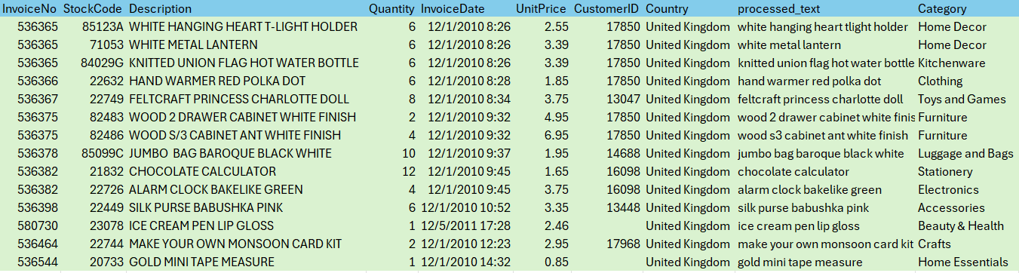
RESULTS

Slide 10
SAVING PREDICTIONS
Saving Predictions to CSV and JSON:
We saved our predictions in two common file formats: CSV and JSON.
This ensures that our data is easy to access and use for future analysis.
Whether we need to evaluate our model again or explore trends later, we've got it covered.
Importance of Storing Predictions:
Storing our predictions is like keeping a record of our insights for later.
It helps us refine our model, uncover new trends, and make better decisions.
Plus, having our predictions handy makes reporting and sharing findings a breeze.

Slide 11
ANALYSIS AND VISUALIZATION
Fetching data from a data frame and by using a Matplot-library showing the data in a visual way in a different types like bar charts, Histograms Generated three types of reports a) Highest Category
b) Total sales by month
c) Total Sales by top 10 countries

Slide 12
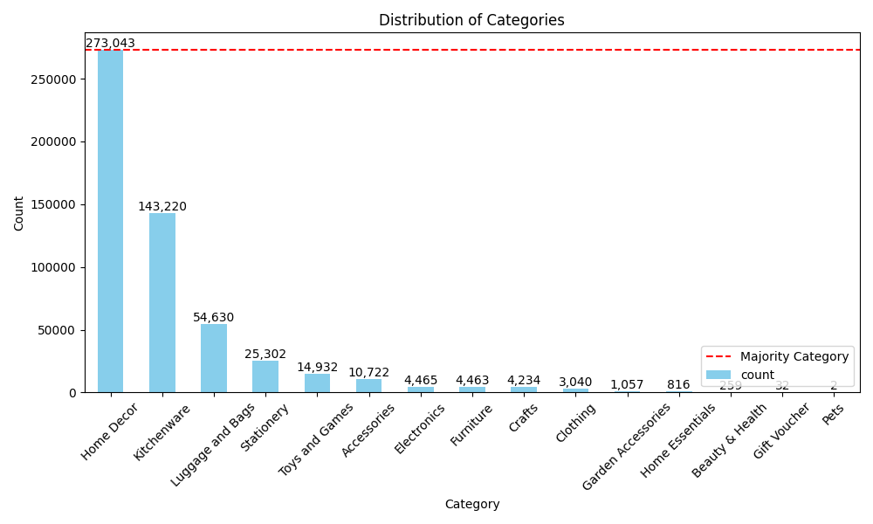
CATEGORY COUNT
We'll visualize the distribution of product categories in our online retail dataset using a bar chart. This will show us which categories are most prevalent and if there are any notable trends in purchasing behavior.

Slide 13
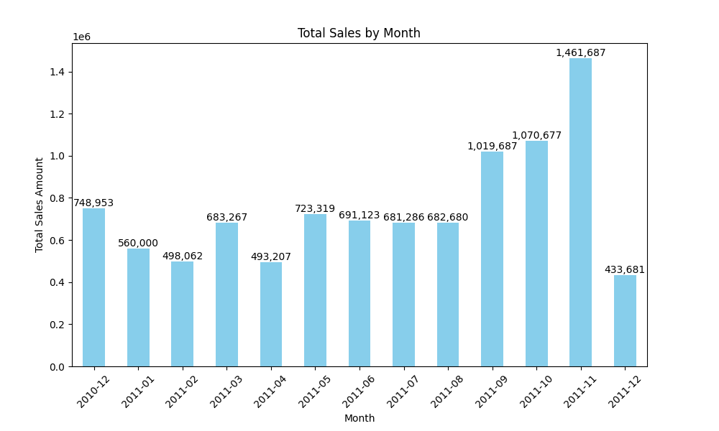
TOTAL SALES BY MONTH
We'll plot the total sales amounts over different months using bar chart. This will allow us to identify seasonal patterns and fluctuations in sales over the course of the year.

Slide 14
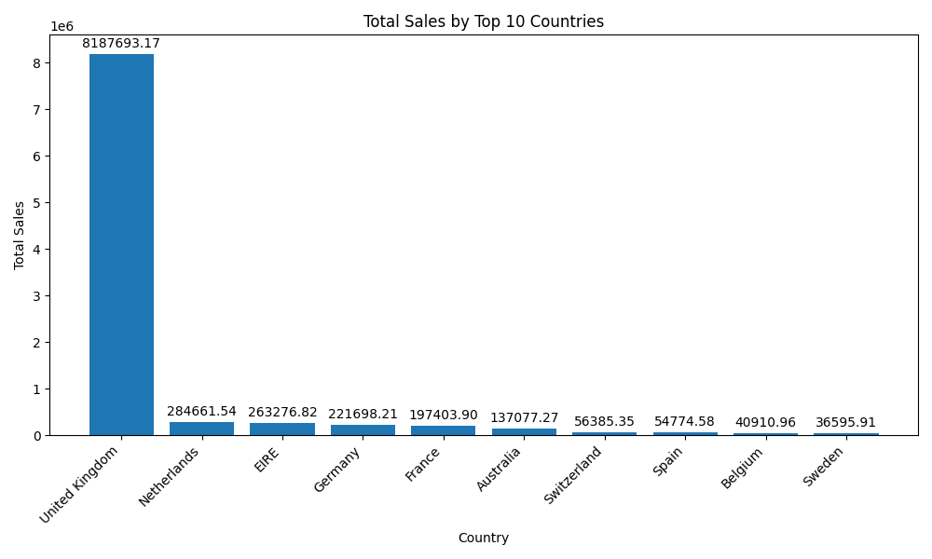
TOTAL SALES BY TOP 10 COUNTRIES
Using a bar chart or map, we'll illustrate the total sales generated by different countries. This visualization will highlight which countries are driving our sales and any geographical trends in purchasing behavior.

Slide 15
TOP CUSTOMERS ANALYSIS:
Utilized the plot_top_customers function to identify the top customers based on their total quantity purchased.
Extracted the customer ID and total quantity information to understand customer purchasing behavior.
While the function does not directly plot the data, it provides crucial insights into the customers contributing the most to total quantity purchased, aiding in strategic decision-making.

Slide 16
CONCLUSION
Main Findings and Outcomes:
Our analysis revealed significant insights into the distribution of product categories, top customer contributions, geographical sales trends, and seasonal patterns within the online retail dataset.
Implications and Potential Applications:
These findings have direct implications for business strategy, such as optimizing product offerings, tailoring marketing efforts, and improving inventory management to meet customer demand more effectively.
Future Work and Improvements:
Moving forward, we can explore enhancements to the model by incorporating additional features or refining preprocessing techniques. This could lead to improved prediction accuracy and further insights into customer behavior and market trends.

Slide 17
THANKYOU

