Slide 1
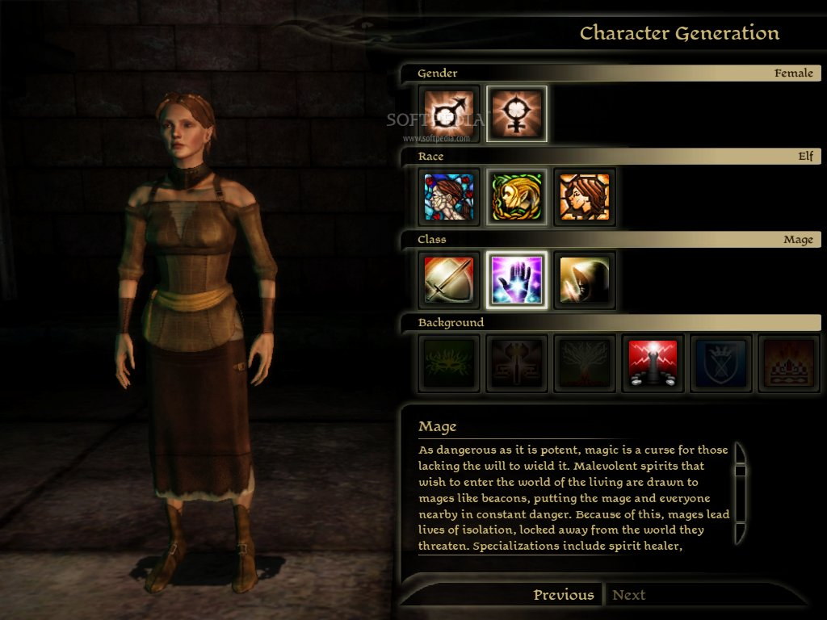
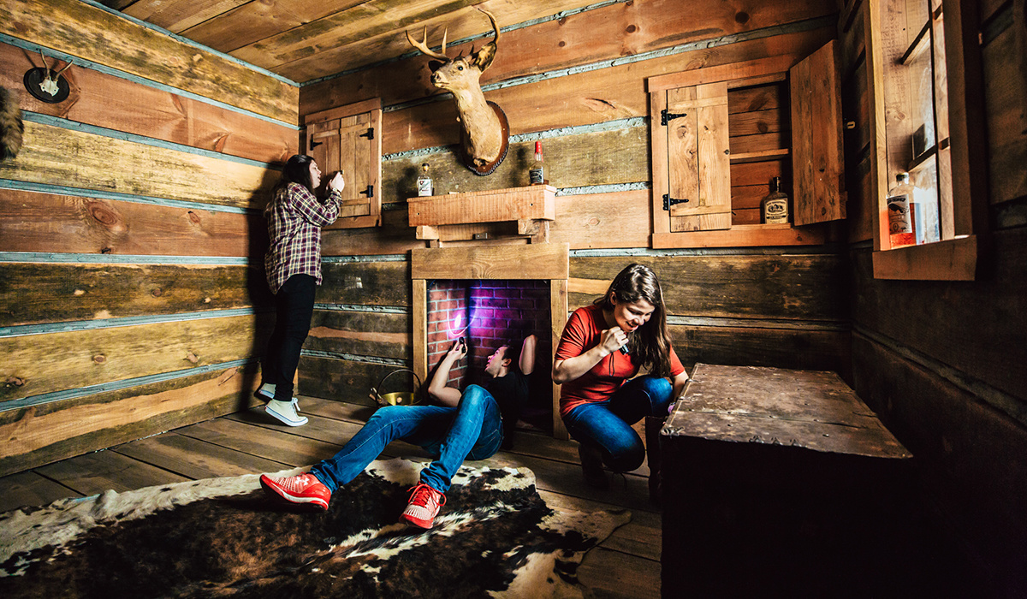
Breaking Out
Escape Game x Video Game
Videogames enthusiast
Escapegame enthusiast
Our primary target

Slide 2


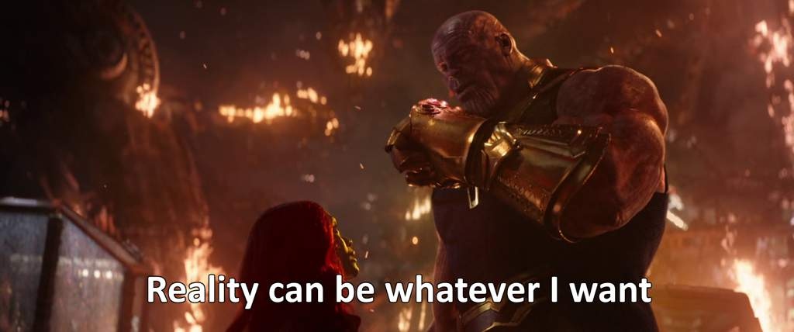
Real limits and Breaking Out’s solutions
Pandemic
Geographic constraint
Real means
Currently, people can’t really go into escape games
For veteran escapegame players, there are only so many escape games near home you can go to
Reality can be constraining; escape games have scenario and immersion is never really high given the difficulty of the task.

Slide 3
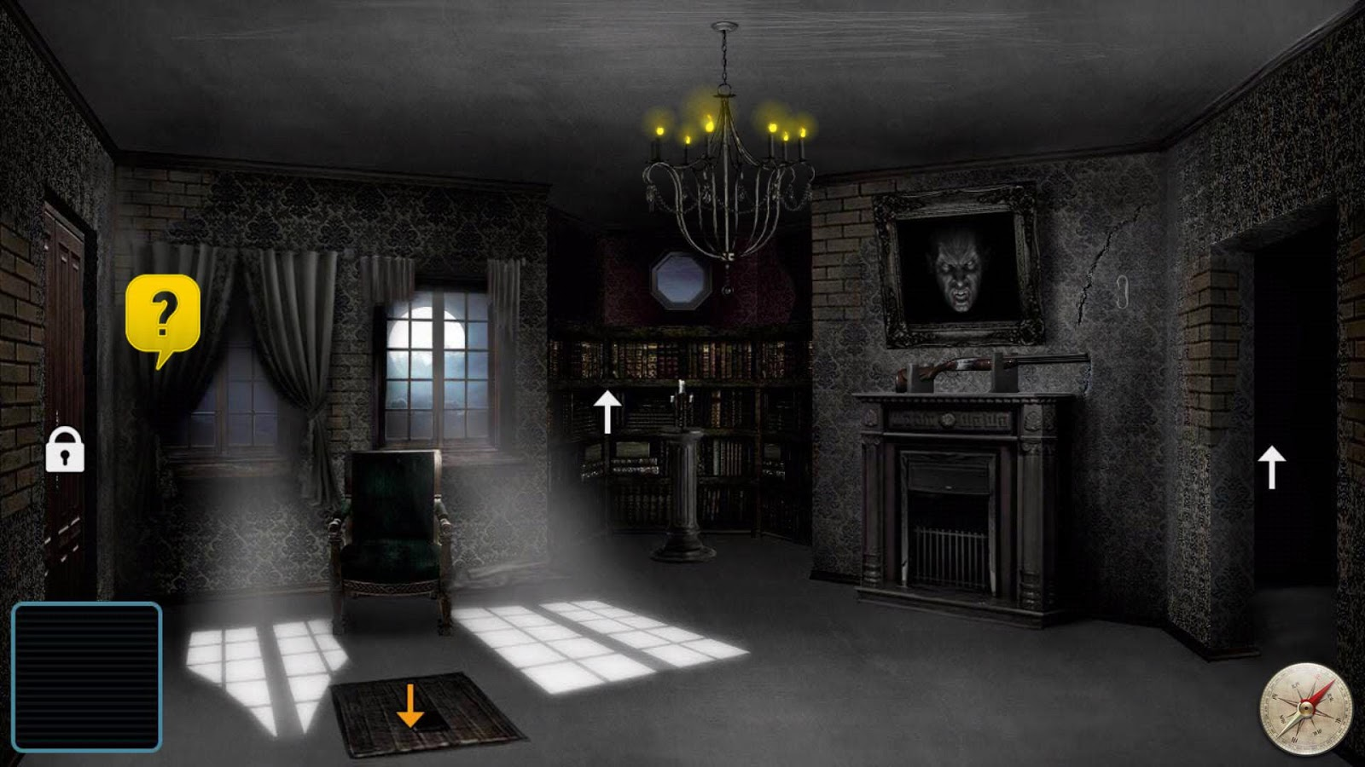
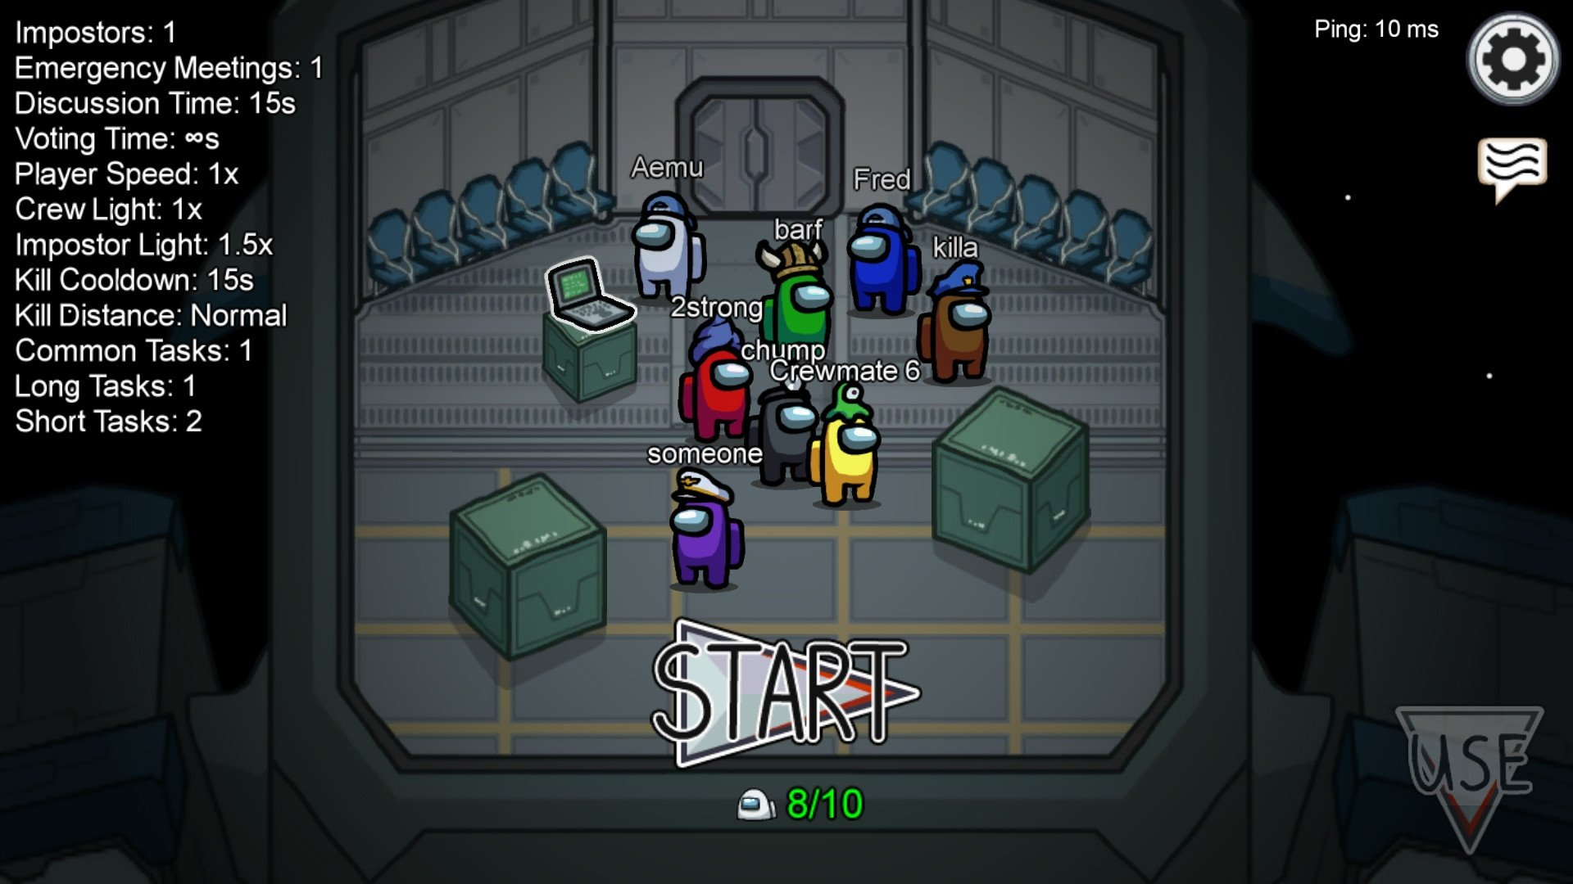
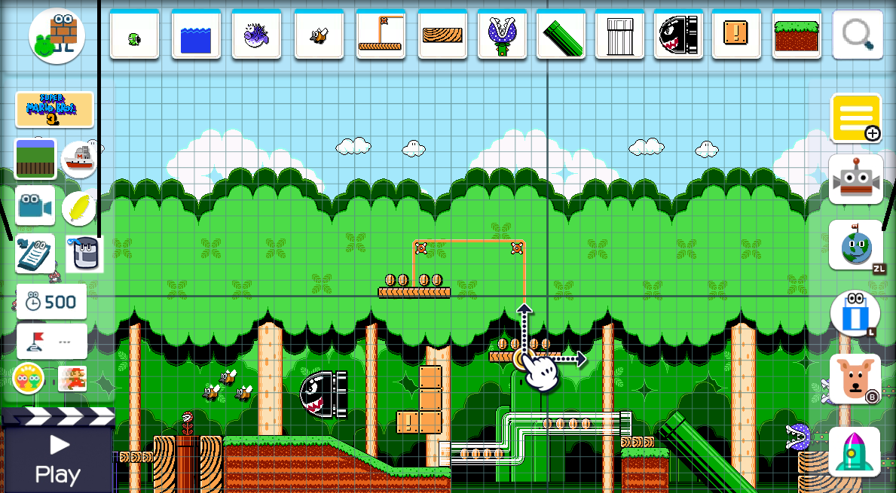
Breaking Out, what is it?
An online escape game…
…But minimalistic…
…With eventually a map creator?
That’s kinda my pitch after all.
Easier for us, better for users (more functionalities?)
If possible, we would want users to be able to create their own maps and play with their friends!

