Slide 1
Your Title
Optional Subtitle Here in Title Case

Slide 2
Attention
MMS sessions are 60-75 minutes followed by LONG Q&A
Please hold detailed questions until that Q&A starts
Feel free to ask clarification questions
Remind the speakers to use Zoom It when you can’t see

Slide 3

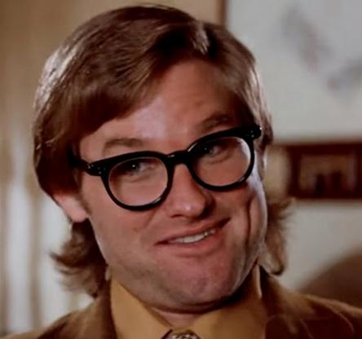


Jack Burton
Scooby-Doo
CIO, Pork Chop Express Transportation
IT Security, Mystery Inc.
discord
in/jackBurton
discord
in/scoobydoo

Slide 4
The First Section
With a little description here

Slide 5
Welcome
Don’t be shy
We won’t talk about the Society for Critical Care Medicine
Long live … Intune?
Use Zoom It
My Data | Day | Week
123 | 3 | M
456 | 5 | W
789 | 7 | F

Slide 6
How to win at life
According to Brian

Slide 7
Spread the word
Live Long and Prosper
Go forth and multiply

