Slide 1
Aviation Accident Database and Synopses
Duncan Githaiga DATA SCIENCE
mORINGA

Slide 2
introduction
Question: Which aircraft is the lowest risk for the company to start this business endeavor

Slide 3
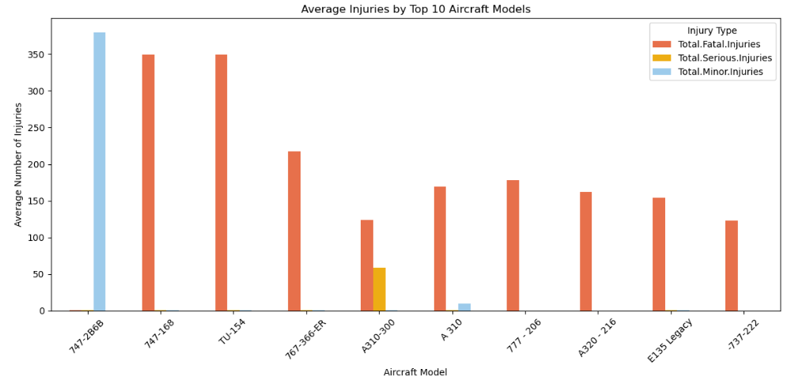
BAR GRAPH
Average injuries was put side by side in a bar graph with top 10 aircraft models. And we can see that 747-2B6B has very high number of minor injuries while 747-168 and TU-154 has very fatal injuries

Slide 4
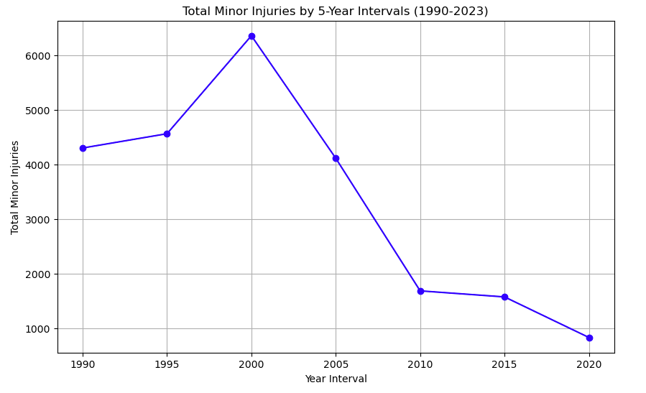
Line graph
Total minor injuries were put side by side with 5-year intervals from 1990 and we can see in 2000 there was high total minor injuries

Slide 5
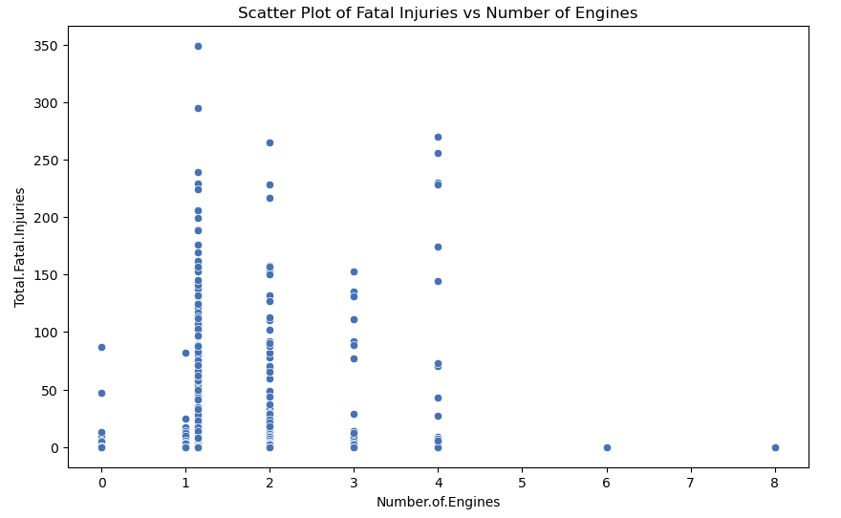
Scatter plot
Fatal Injuries vs Number of Engines
We can see with one engine there is a large number of total fata injuries

Slide 6
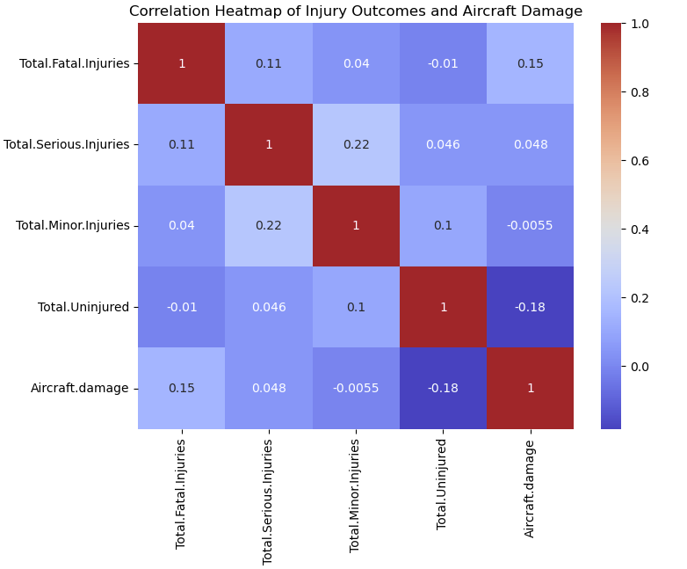
Heatmap

Slide 7
Conclusion
According to the bar chart which was for the top 10 aircrafts. Aircraft 747-2B6B is the best choice according to injuries

