Slide 1
LLMs and ToM week 4

Slide 2
Building the test suite
After last weeks meeting, I showed a few findings on the system generated belief distributions from testing the system with various messages
Since then, I have built a test suite to systematically investigate these findings.
These are based on LLM generated inputs, I generated 10 prompts. Then adjusted them to have a set of prompts with explicit emotions (control), and one with implicit emotions.
I generate the distributions from the prompts first, then generate statistics on them later. This mitigates variance from the LLM based system

Slide 3
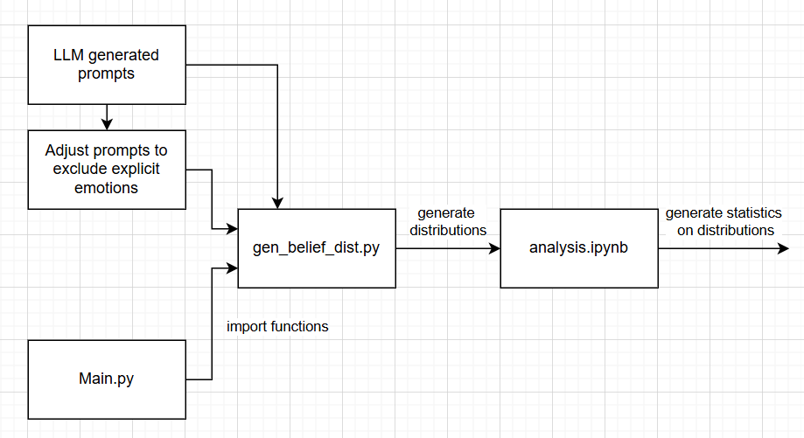
Overview of test suite

Slide 4
What am I testing?
I generate belief distributions for 2 cases:
Case 1: The User’s belief + system’s belief about other character
Case 2: The User’s belief + system’s belief about user’s belief about other character
Then for each message (with explicit emotions and implicit emotions) I compare the belief distribution of the User against that of the other character:
L1 norm distance
Jenson-Shannon divergence
Pearson correlation
Spearman correlation
Entropy of User’s distribution
Entropy of other character’s distribution
Difference in entropy

Slide 5
Results
I generate and display results for the pair of distributions for each prompt
I then display aggregated results for each metric over each prompt as a boxplot
SHOW RESULTS ON NOTEBOOK

Slide 6
Results
Median values for metrics tend to align with the difference in explicit or implicit emotions, rather than the different cases. Only L1 normed distance aligns with cases.
High Pearson correlation, quite high Spearman correlation. Low JS-divergence.

Slide 7
Outliers - JSD
All around 0.6 (too high)
Case 1:
“I’m working with someone on a project, and it feels like I’m carrying the bulk of the responsibility. They haven’t contributed much, but we’re supposed to share the outcome. What’s a good way to approach this?”
“I could use some guidance. My manager is very involved in every little detail of my work. I know they mean well, but it’s making it hard for me to focus or feel like I own anything.”
Case 2:
“I’m working closely with someone who isn’t great at responding to messages or keeping me in the loop. It’s creating a lot of delays, and I’m not sure how to bring it up without sounding confrontational.”
“There’s someone on my team who always seems to get ahead by making sure their work is seen—sometimes even when it’s shared work. I want to stand out too, but not by playing the same game.”

Slide 8
Outliers – Pearson correlation
All too low
Case 1: “I’m frustrated and honestly a little anxious. My project partner has a chaotic, last-minute approach that clashes completely with my structured style. It’s causing a lot of stress. How can I address this without creating more tension?” Explicitly says they are very different
Case 2:
“I could use some guidance. My manager is very involved in every little detail of my work. I know they mean well, but it’s making it hard for me to focus or feel like I own anything.” Explicitly says they are very different
“There’s someone on my team who always seems to get ahead by making sure their work is seen—sometimes even when it’s shared work. I want to stand out too, but not by playing the same game.” Explicitly says they don’t want to do the same

Slide 9
Outliers – Spearman correlation
All too low
Case 2:
“I could use some guidance. My manager is very involved in every little detail of my work. I know they mean well, but it’s making it hard for me to focus or feel like I own anything.”
“I’m feeling hurt and confused. I recently got promoted, and someone I was close with at work has been acting cold and distant since then. I don’t want to lose that connection, but I don’t know how to fix this.”

Slide 10
Outliers – User Entropy
Most significant:
Entropy very low: 2.026 (3 d.p.)
“I’m frustrated and honestly a little anxious. My project partner has a chaotic, last-minute approach that clashes completely with my structured style. It’s causing a lot of stress. How can I address this without creating more tension?”

Slide 11
Outliers – Other character’s entropy
Case 1: Entropy too low - 1.357 (3 d.p.)
“I’m annoyed and a bit resentful. I’m working on a joint project, and I’ve done almost everything while my colleague barely shows up. I don’t want to create tension, but I can’t keep picking up the slack.”
Case 2: Entropy too high – 8.358 (3 d.p.)
“I’m feeling hurt and confused. I recently got promoted, and someone I was close with at work has been acting cold and distant since then. I don’t want to lose that connection, but I don’t know how to fix this.”

Slide 12
Next steps
Add statistics on number of mental of states assigned non-zero probability & maybe max assigned probability (could replace L1 distance)
Investigate results further, try and test for hypothesis of

Slide 13
Notes
Relabel axes for Sytem’s belief about user
Redo to plot 3 different beliefs, instead of pairwise
Try with sentence for explicit emotion of other
Try in 3rd person, person A and B
Deliberately construct control protocol (instead of removal), e.g. give me mental state correlated set & uncorrelated, user expresses their emotional state then other’s state & vice versa
Label with mathematical expressions

