Slide 1
LLMs and ToM
What I have done so far
Evaluation and considerations
Next steps

Slide 2
Initial idea and implementation
After last week’s meeting, I read up on POMDPs and how I could combine them with an LLM
After discussing with Harry, a good place to start seemed to be with a basic prompt engineering implementation, where I would prompt the LLM to act like a POMDP
I was initially unsure about a specific context, but I decided to go with the proposal of navigating workplace problems and dynamics.
I created a public GitHub repository to work on:

Slide 3
Prompt engineering implementation
States – Initial idea was to have tuples of the mental state (emotion) of the user and the character that the user is talking about, according to the user. I used the 28 emotions from the Go Emotions dataset. I ended up using 2 sets of states instead, although this is not in the formal style of a POMDP it made it feasible to prompt the LLM.
Observations – Message from the user
Action – System response
Rewards – Implicitly given through prompts

Slide 4
Prompt engineering implementation
This approach essentially uses 2 Markov Chains
This approach also does not learn, it only tries to make the LLM “think” like a POMDP.
The prior belief distribution is assumed to be uniform over all states, instead of based on data.
It is assumed that the user is always talking about exactly 1 other character.
From the initial observation, the character’s name is extracted, to fine tune the prompts.

Slide 5
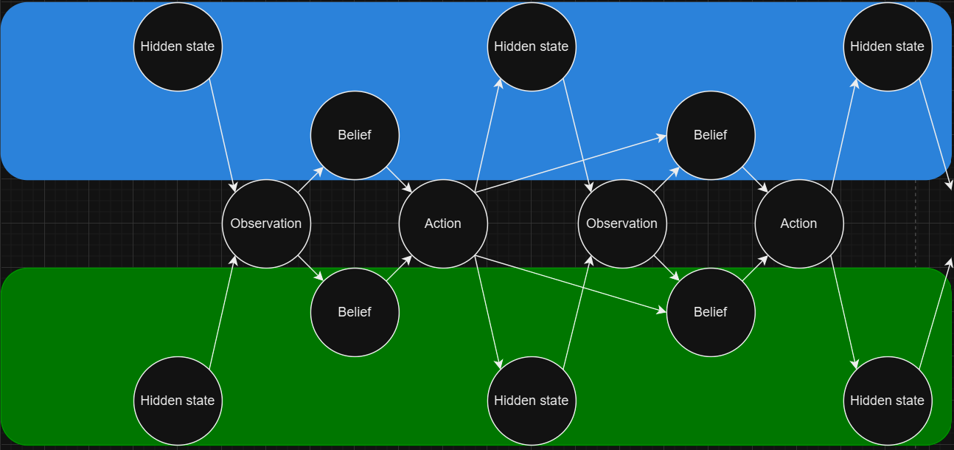
Prompt engineering implementation - diagram
User’s mental state
…
Other character’s
mental state
according to User

Slide 6
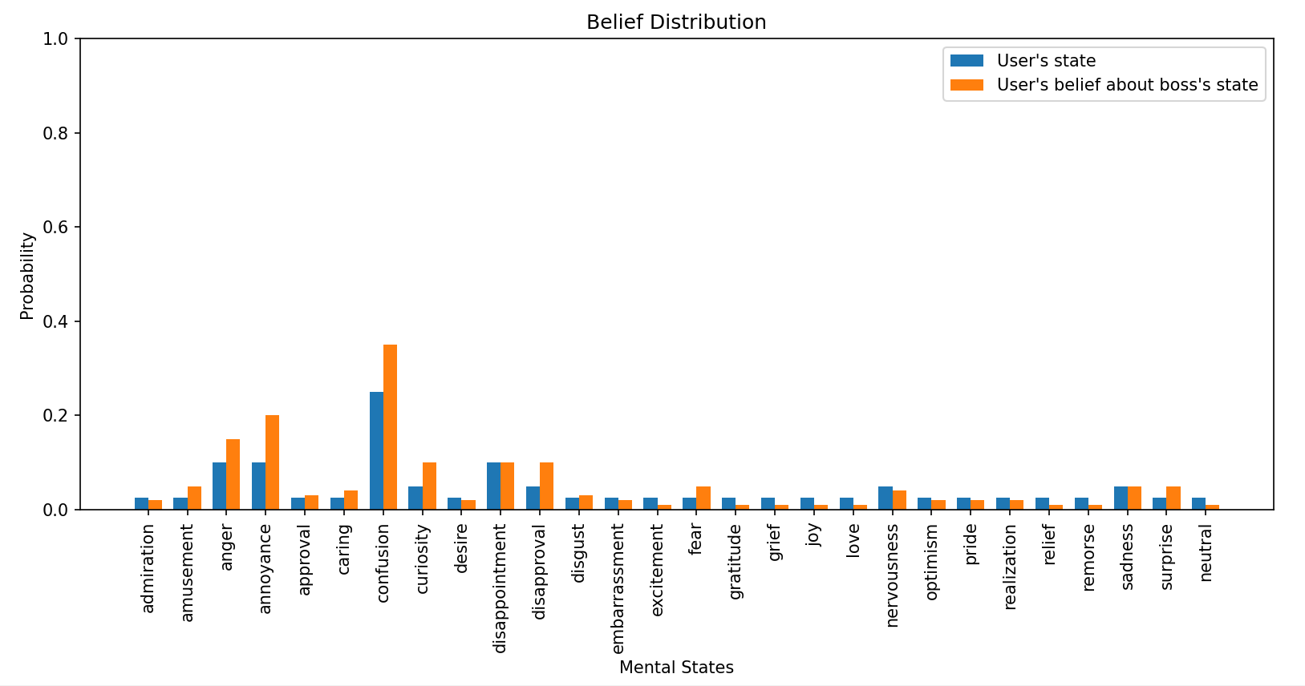
Real example – 1st step
Observation – “I am very confused at this email my boss sent me, I have been working at this company for years and he is giving me entry level work to do.”
Character name identified as “boss”

Slide 7
Real example – 1st step
Action – “It sounds like receiving entry-level work after years of experience can be confusing and frustrating. Have you considered scheduling a meeting with your boss to discuss your role and responsibilities? This could help clarify expectations and provide insight into the reasoning behind the assigned tasks.”

Slide 8
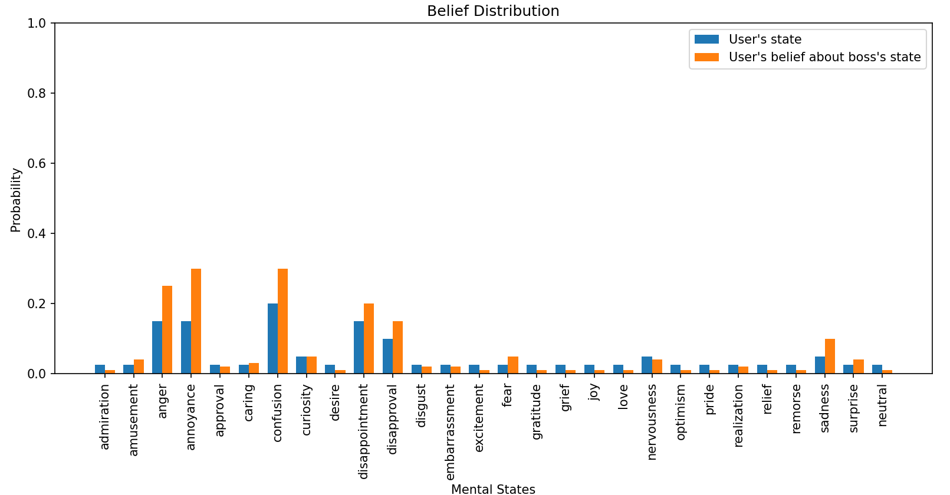
Real example – 2nd step
Observation – “I have emailed him but he just ignored me .”

Slide 9
Real example – 2nd step
Action – “It sounds like you're feeling a mix of annoyance and disappointment. It can be frustrating when someone ignores your emails. Have you tried following up with him in person or giving him a call to ensure he received your message?

Slide 10
Prompt engineering approach - limitations
Actions made by the system are still very generic and similar to what the LLM would say without any added structure.
You can’t train the system with this simple approach.

Slide 11
Ideas for next steps – POMDP model with RL
Have a fixed set of observations and actions instead.
Learning
Use RL to learn an optimal policy, mapping beliefs to actions
Using system
Use the LLM to extract an observation from the inputted text
Compute belief state recursively using Baye’s rule
The agent selects an action based on the belief state, using optimal policy
LLM is prompted with action to generate a message (LLM takes selected action)
Also, I would only have 1 set of states, maybe being tuples for different people’s mental states. Higher order reasoning?

Slide 12
Considerations
POMDP model with RL:
How would I define the observations and actions?
How would I get the required data?
General:
Is this still within the scope of LLMs and ToM?
What would be the goal of the project, to just build something that works or to use the tool to look at ToM capabilities?

