Slide 1
LLMs and ToM – week 5

Slide 2
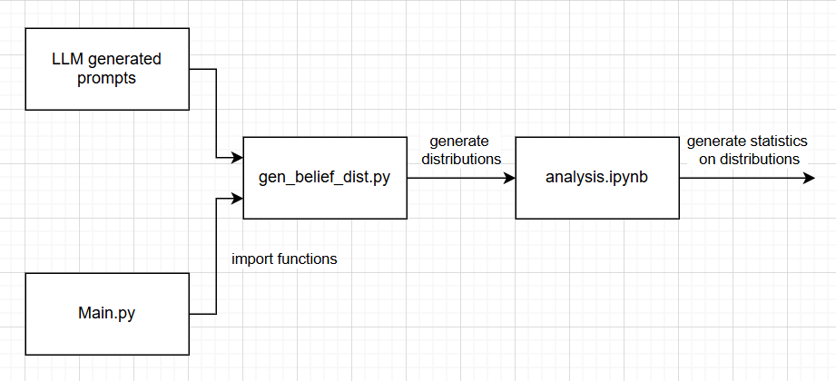
Overview of test suite

Slide 3
Adjustments to mental state belief analysis
For each prompt, gen_belief_dist.py generates 3 belief distributions:
System’s belief of User’s mental state
System’s belief of other character’s mental state
System’s belief of User’s belief of other character’s mental state
I now have 2 tests cases/batches, with separate sets of prompts:
Jensen-Shannon Divergence
Entropy

Slide 4
Jensen-Shannon Divergence
3 LLM generated sets of 10 prompts:
Messages with positively correlated emotions between the User and other character, e.g. both stressed
Messages with uncorrelated emotions between the User and other character
Messages with negatively correlated emotions between the user and other character, e.g. user stressed other character happy
I calculate the JSD for all 3 pairs of distributions

Slide 5
Entropy test case
4 LLM generated sets of 10 prompts:
User’s emotions explicit & other character’s emotions explicit
User’s emotions explicit & other character’s emotions implicit
User’s emotions implicit & other character’s emotions explicit
User’s emotions implicit & other character’s emotions implicit
I calculate the entropy for each distribution

Slide 6
Displaying results
For each individual prompt I display the 3 distributions as a bar chart, along with the statistics calculated: either JSD or entropy
I then display the aggregated results as boxplots for each statistic:
Each set of 10 prompts is plotted as a separate boxplot

Slide 7
Results
Instead of correlation: aligned, or no guidance in prompt
Don’t describe expected outcome of prompt, only prompt
Or entropy: Plot 1 graph for 3 cases, combining subcases
Ask system to differentiate between 2 users with diff beliefs, e.g. 1 angry about something and 1 anxious
If null results, reduce # states, e.g. 3 or 2 (classifier)
Reduce emotions, clusters of similar

Slide 8
Notes

