Slide 1
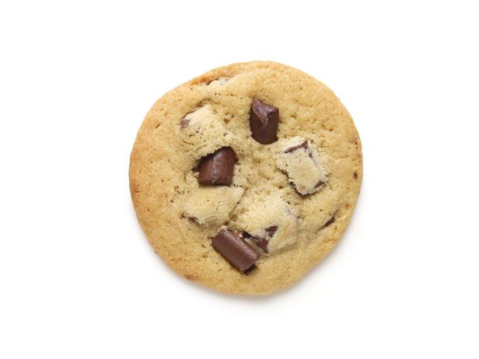
Welcome to the experiment!
In this experiment, you will be asked to identify a series of objects.
When you see an object, please type in how you would refer to the object in a conversation.
Here is an example:
Name

Slide 2
Please type in the name of the object in lowercase letters, without using any numbers or symbols.
Please be as accurate as you can with spelling.
For example, if you think the object is called “cookie”:
Name
cookie

Slide 3
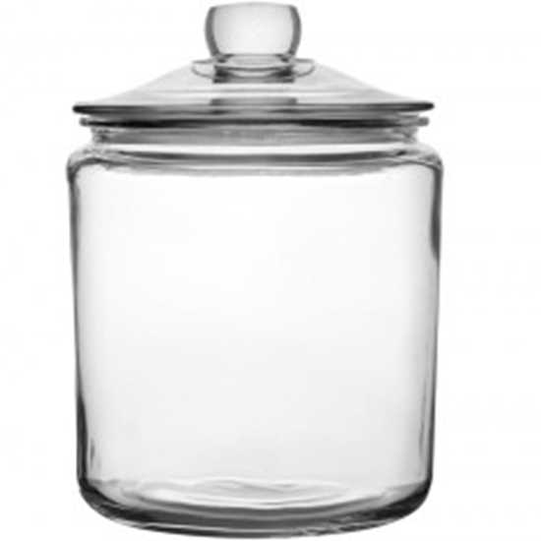
Sometimes, the name of the object may be more than one word.
In this case, separate each word with a space.
For example:
Name
cookie jar

Slide 4
If you are unsure what the object is called or how it is spelled, please give it your best guess.
There are 200 objects to name. For each object, you will have 10 seconds to enter your response into the box provided. Press Enter when you are done.
For every 50 object you name, you will get a 60 second break.
Please press the space bar to begin the experiment.

