Slide 1
Modelling Creep in Python
Comparing numerically-generated models with FIB code
Duncan Law
22 July 2022

Slide 2
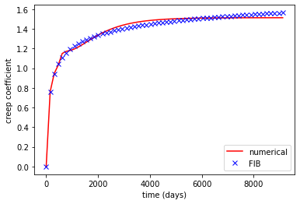
Calibration
calibration.py
This is for:
Loading age of 40 days
60 observation times
9 retardation times

Slide 3
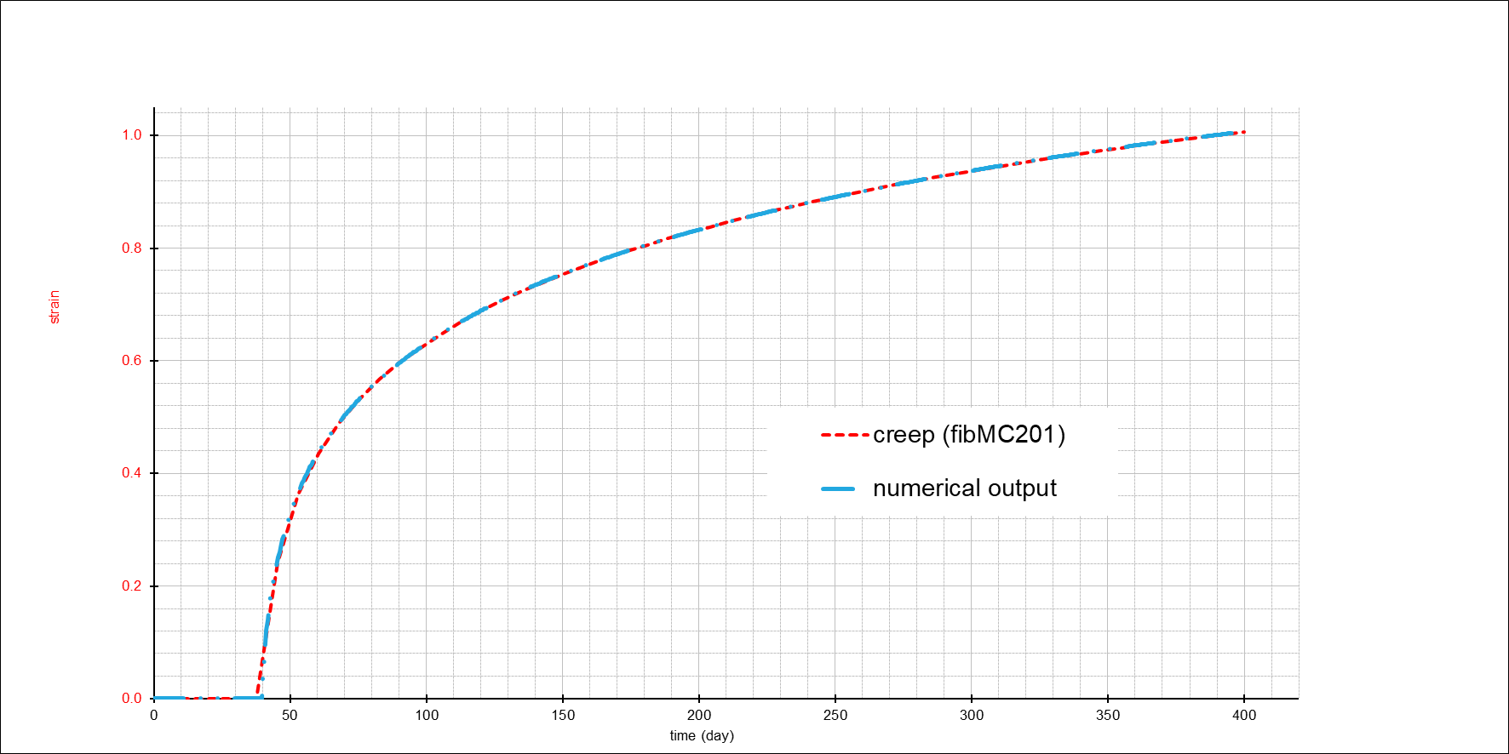
Single unit step load
strain_test1.py
For a 400-day testing cycle with 1000 observation times, when a unit step load applied at the 40th day, the numerical output matches very strongly to the FIB code, with the error mostly lying near the time of force application.

Slide 4
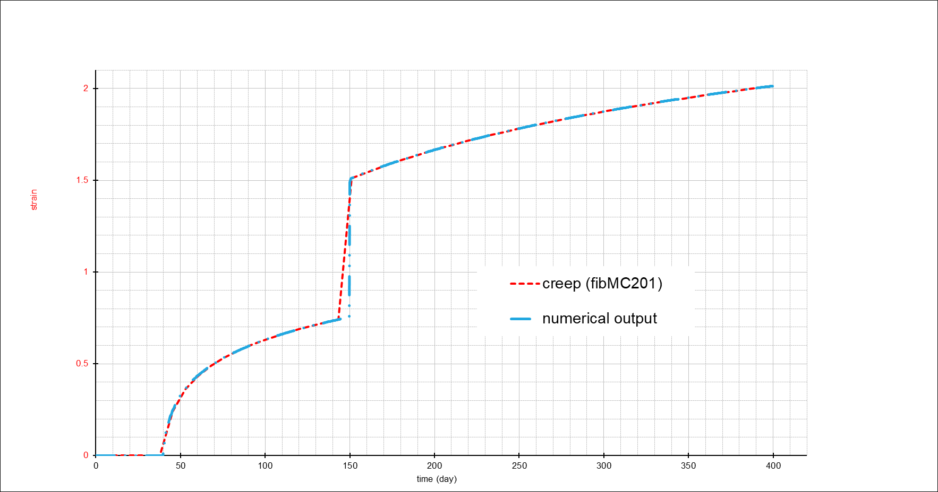
Two unit step loads
strain_test2.py
The same test cycle but now another unit step load applied at the 150th day. The asymptotes look to match well. The biggest discrepancy is near the instant where the second unit load is applied (day 150) – this could be due to the fact that the timesteps of the numerical method being a lot smaller.

Slide 5
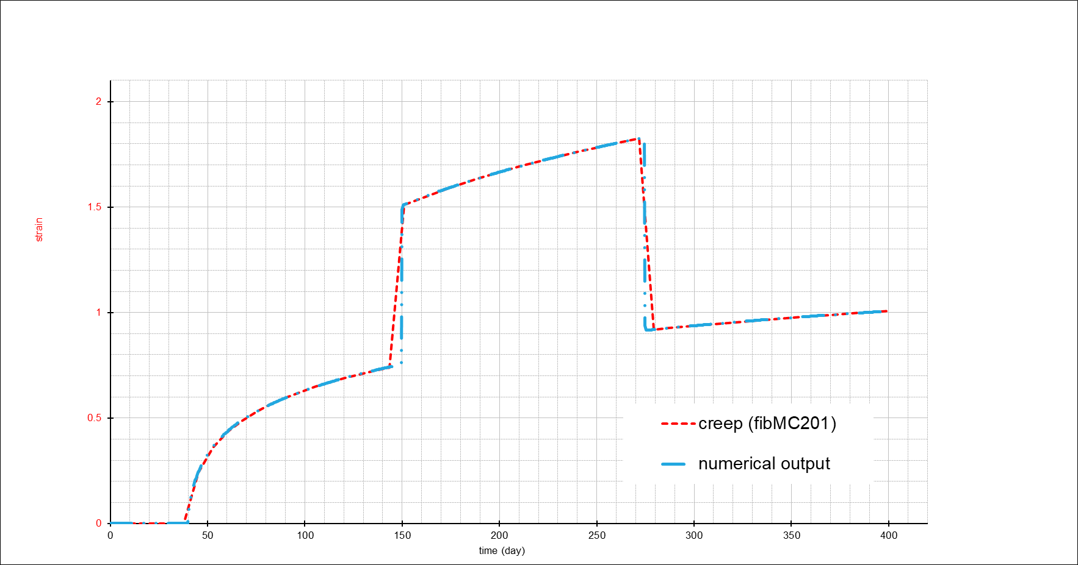
Three unit steps – 2 loads and 1 unload
strain_test3.py
The same test cycle but now a new unit step unload applied at the 275th day. The same thing at the transition points occur.

