Slide 1
Fundamentals of Multimedia
Part II:
Multimedia Data Compression
Chapter 7 :
Lossless Compression Algorithms

Slide 2
In this Part we examine the role played in multimedia by data compression, perhaps the most important enabling technology that makes modern multimedia systems possible.
So much data exist, in archives, via streaming, and elsewhere, that it has become critical to compress this information.
We start off in Chap. 7 looking at lossless data compression i.e., involving no distortion of the original signal once it is decompressed or reconstituted.

Slide 3
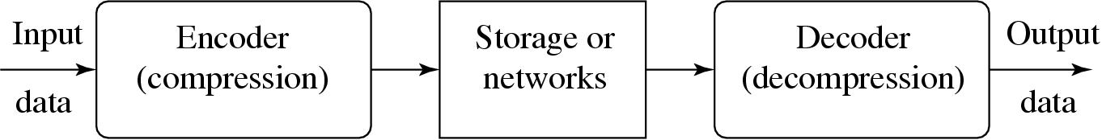
7.1 Introduction
Compression: the process of coding that will effectively reduce the total number of bits needed to represent certain information.
Figure 7.1 depicts a general data compression scheme, in which compression is performed by an encoder and decompression is performed by a decoder.
Fig. 7.1: A General Data Compression Scheme.

Slide 4
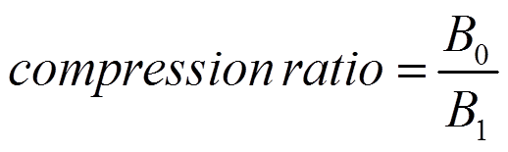
7.1 Introduction
If the compression and decompression processes induce no information loss, then the compression scheme is lossless; otherwise, it is lossy.
Compression ratio:
(7.1)
B₀ – number of bits before compression
B₁ – number of bits after compression
In general, we would desire any codec (encoder/decoder scheme) to have a compression ratio much larger than 1.0.
The higher the compression ratio, the better the lossless compression scheme, as long as it is computationally feasible.

Slide 5
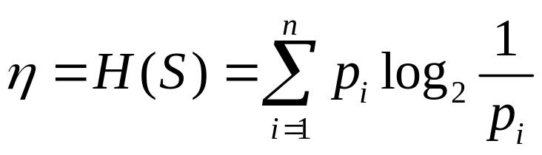
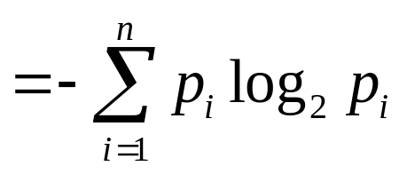
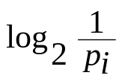
7.2 Basics of Information Theory
The entropy η of an information source with alphabet S = {s₁, s₂, . . . , s_{n}} is:
(7.2)
(7.3)
p_{i} – probability that symbol s_{i} will occur in S.
– indicates the amount of information ( self-information as defined by Shannon) contained in s_{i}, which corresponds to the number of bits needed to encode s_{i}.
Li & Drew

Slide 6
7.2 Basics of Information Theory
What is entropy? is a measure of the number of specific ways in which a system may be arranged, commonly understood as a measure of the disorder of a system.
As an example, if the information source S is a gray-level digital image, each s_{i} is a gray-level intensity ranging from 0 to (2^{k} − 1), where k is the number of bits used to represent each pixel in an uncompressed image.
We need to find the entropy of this image; which the number of bits to represent the image after compression.

Slide 7
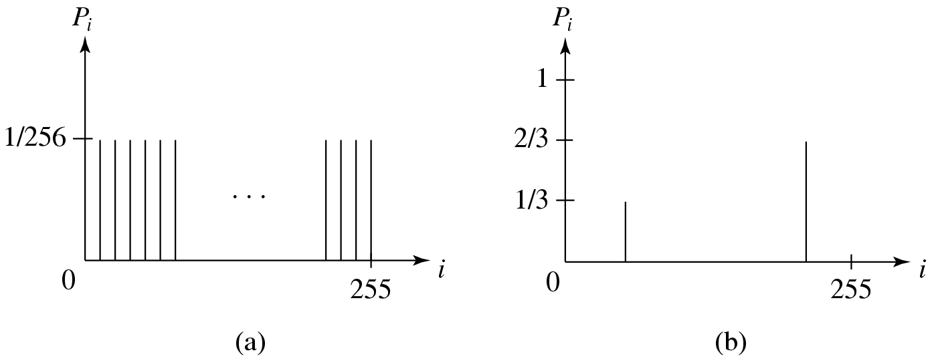
Distribution of Gray-Level Intensities
Fig. 7.2 Histograms for Two Gray-level Images.
• Fig. 7.2(a) shows the histogram of an image with uniform distribution of gray-level intensities, i.e., ∀i p_{i} = 1/256. Hence, the entropy of this image is:
log₂256 = 8 (7.4)
• Fig. 7.2(b) shows the histogram of an image with two possible values (binary image). Its entropy is 0.92.
Li & Drew

Slide 8
Distribution of Gray-Level Intensities
It is interesting to observe that in the above uniform-distribution example (fig. 7-2 (a)) we found that α = 8, the minimum average number of bits to represent each gray-level intensity is at least 8. No compression is possible for this image.
In the context of imaging, this will correspond to the “worst case,” where neighboring pixel values have no similarity.

Slide 9
7.3 Run-Length Coding
RLC is one of the simplest forms of data compression.
The basic idea is that if the information source has the property that symbols tend to form continuous groups, then such symbol and the length of the group can be coded.
Consider a screen containing plain black text on a solid white background.
There will be many long runs of white pixels in the blank space, and many short runs of black pixels within the text. Let us take a hypothetical single scan line, with B representing a black pixel and W representing white: WWWWWBWWWWBBBWWWWWWBWWW
If we apply the run-length encoding (RLE) data compression algorithm to the above hypothetical scan line, we get the following: 5W1B4W3B6W1B3W
The run-length code represents the original 21 characters in only 14.

Slide 10
7.4 Variable-Length Coding
variable-length coding (VLC) is one of the best-known entropy coding methods
Here, we will study the Shannon–Fano algorithm, Huffman coding, and adaptive Huffman coding.

Slide 11
7.4.1 Shannon–Fano Algorithm
To illustrate the algorithm, let us suppose the symbols to be coded are the characters in the word HELLO.
The frequency count of the symbols is
Symbol H E L O
Count 1 1 2 1
The encoding steps of the Shannon–Fano algorithm can be presented in the following top-down manner:
1. Sort the symbols according to the frequency count of their occurrences.
2. Recursively divide the symbols into two parts, each with approximately the same number of counts, until all parts contain only one symbol.

Slide 12
7.4.1 Shannon–Fano Algorithm
A natural way of implementing the above procedure is to build a binary tree.
As a convention, let us assign bit 0 to its left branches and 1 to the right branches.
Initially, the symbols are sorted as LHEO.
As Fig. 7.3 shows, the first division yields two parts: L with a count of 2, denoted as L:(2); and H, E and O with a total count of 3, denoted as H, E, O:(3).
The second division yields H:(1) and E, O:(2).
The last division is E:(1) and O:(1).

Slide 13
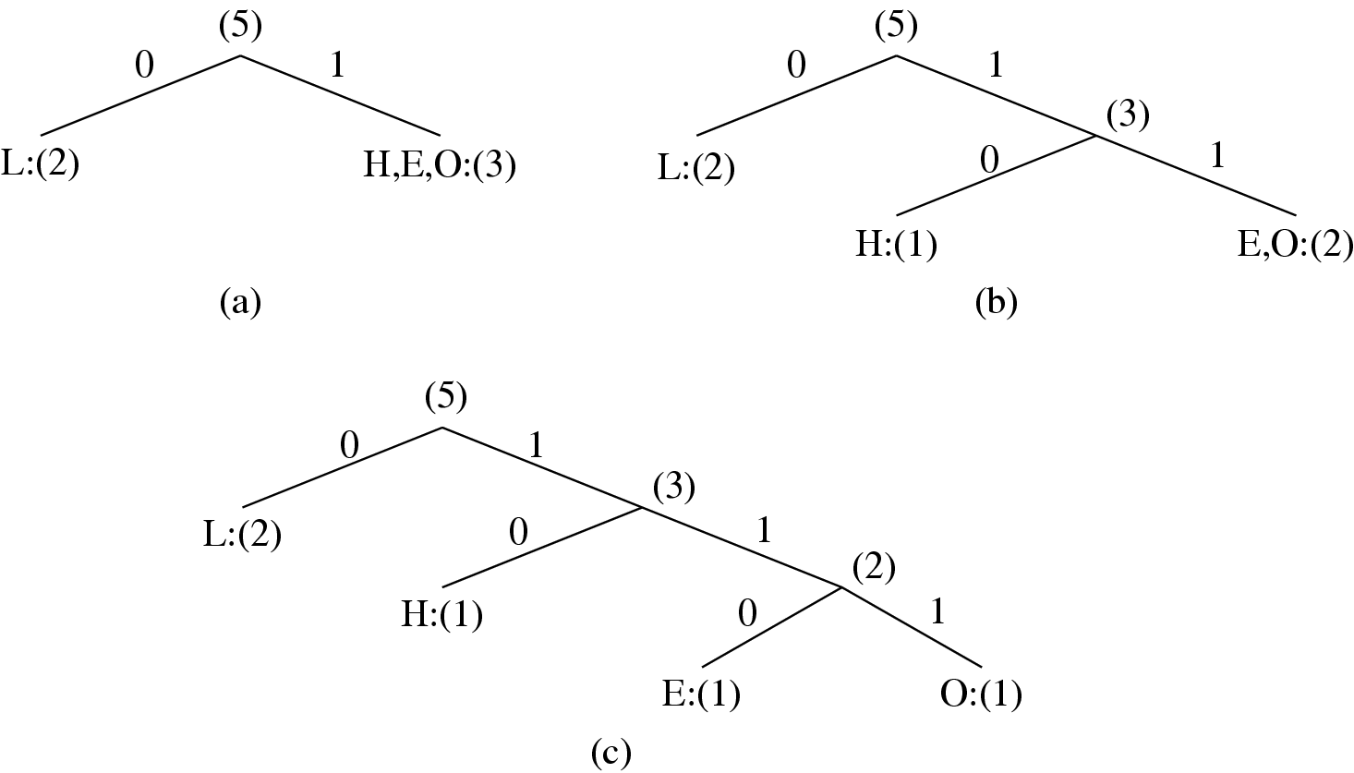
7.4.1 Shannon–Fano Algorithm
Fig. 7.3: Coding Tree for HELLO by Shannon-Fano.

Slide 14

Table 7.1: Result of Performing Shannon-Fano on HELLO
Symbol | Count | Log₂ | Code | # of bits used
L | 2 | 1.32 | 0 | 2
H | 1 | 2.32 | 10 | 2
E | 1 | 2.32 | 110 | 3
O | 1 | 2.32 | 111 | 3
TOTAL # of bits: |  |  |  | 10
Li & Drew

Slide 15
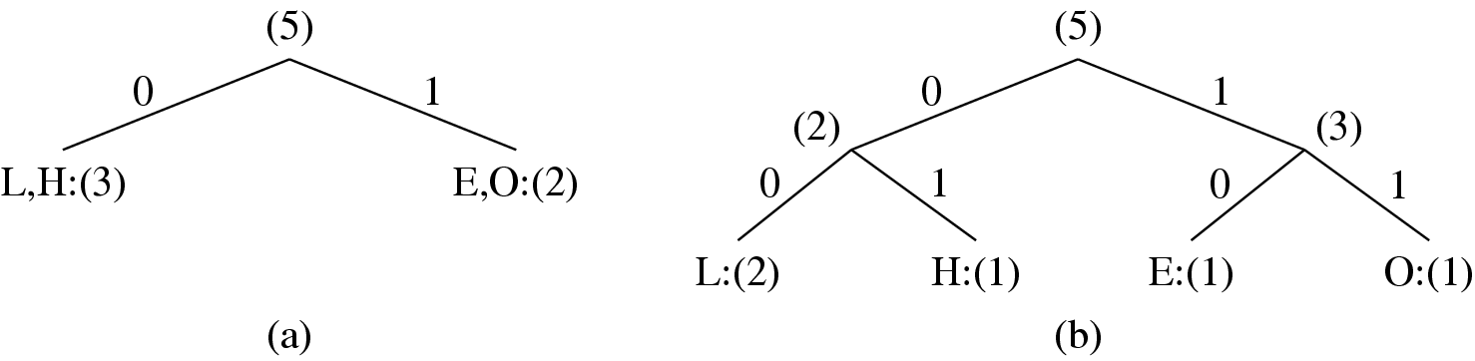
Fig. 7.4 Another coding tree for HELLO by Shannon-Fano.
Li & Drew

Slide 16
Table 7.2: Another Result of Performing Shannon-Fano
on HELLO (see Fig. 7.4)
Symbol | Count | Log₂ | Code | # of bits used
L | 2 | 1.32 | 00 | 4
H | 1 | 2.32 | 01 | 2
E | 1 | 2.32 | 10 | 2
O | 1 | 2.32 | 11 | 2
TOTAL # of bits: |  |  |  | 10
Li & Drew

Slide 17
7.4.1 Shannon–Fano Algorithm
The Shannon–Fano algorithm delivers satisfactory coding results for data compression, but it was soon outperformed and overtaken by the Huffman coding method.
The Huffman algorithm requires prior statistical knowledge about the information source, and such information is often not available.
This is particularly true in multimedia applications, where future data is unknown before its arrival, as for example in live (or streaming) audio and video.
Even when the statistics are available, the transmission of the symbol table could represent heavy overhead
The solution is to use adaptive Huffman coding compression algorithms, in which statistics are gathered and updated dynamically as the data stream arrives.

Slide 18
7.5 Dictionary-Based Coding
The Lempel-Ziv-Welch (LZW) algorithm employs an adaptive, dictionary-based compression technique.
Unlike variable-length coding, in which the lengths of the codewords are different, LZW uses fixed-length codewords to represent variable length strings of symbols/characters that commonly occur together, such as words in English text.
As in the other adaptive compression techniques, the LZW encoder and decoder builds up the same dictionary dynamically while receiving the data—the encoder and the decoder both develop the same dictionary.

Slide 19
7.5 Dictionary-Based Coding
LZW proceeds by placing longer and longer repeated entries into a dictionary, then emitting (sending) the code for an element rather than the string itself, if the element has already been placed in the dictionary.
Remember, the LZW is an adaptive algorithm, in which the encoder and decoder independently build their own string tables. Hence, there is no overhead involving transmitting the string table.
LZW is used in many applications, such as UNIX compress, GIF for images, WinZip, and others.

Slide 20
Fundamentals of Multimedia
Part II:
Multimedia Data Compression
Chapter 8 :
Lossy Compression Algorithms

Slide 21
8.1 Introduction
As discussed in Chap. 7, the compression ratio for image data using lossless compression techniques (e.g., Huffman Coding, Arithmetic Coding, LZW) is low when the image histogram is relatively flat.
For image compression in multimedia applications, where a higher compression ratio is required, lossy methods are usually adopted.
In lossy compression, the compressed image is usually not the same as the original image but is meant to form a close approximation to the original image perceptually

Slide 22
8.2 DistortionMeasures
To quantitatively describe how close the approximation is to the original data, some form of distortion measure is required.
A distortion measure is a mathematical quantity that specifies how close an approximation is to its original, using some distortion criteria.
When looking at compressed data, it is natural to think of the distortion in terms of the numerical difference between the original data and the reconstructed data.

Slide 23
Fundamentals of Multimedia
Part II:
Multimedia Data Compression
Chapter 9 :
Image Compression Standards

Slide 24
Recent years have seen an explosion in the availability of digital images, because of the increase in numbers of digital imaging devices such as smart phones, webcams, digital cameras, and scanners.
The need to efficiently process and store images in digital form has motivated the development of many image compression standards for various applications and needs.
In general, standards have greater longevity than particular programs or devices and therefore warrant careful study.

Slide 25
9.1 image compression standard
In this chapter , some current standards are examined.
JPEG
JPEG2000 standard
JPEG-LS Standard
JBIG Standard
JBIG2 Standard

Slide 26
Fundamentals of Multimedia
Part II:
Multimedia Data Compression
Chapter 10 :
Basic Video Compression Techniques

Slide 27
As discussed in Chap. 7, the volume of uncompressed video data could be extremely large.
Even a modest CIF video with a picture resolution of only 352 × 288, if uncompressed, would carry more than 35 Mbps.
In HDTV, the bitrate could easily exceed 1 Gbps.
This poses challenges and problems for storage and network communications.

Slide 28
This chapter introduces some basic video compression techniques and illustrates them in standards H.261 and H.263—two video compression standards aimed mostly at videoconferencing.
The next two chapters further introduce several MPEG video compression standards and the latest, H.264 and H.265.

Slide 29
10.1 Introduction to Video Compression
A video consists of a time-ordered sequence of frames—images. An obvious solution to video compression would be predictive coding based on previous frames.
For example, suppose we simply created a predictor such that the prediction equals the previous frame.
However, it turns out that at acceptable cost, we can do even better by searching for just the right parts of the image to subtract from the previous frame.
After all, our naive subtraction scheme will likely work well for a background of office furniture and sedentary university types

Slide 30
Fundamentals of Multimedia
Part II:
Multimedia Data Compression
Chapter 11 :
MPEG Video Coding: MPEG-1,2,4,and7

Slide 31
The Moving Picture Experts Group (MPEG) was established in 1988 to create a standard for delivery of digital video and audio.
With the emerging new video compression standards such as H.264 and H.265, one might view these MPEG standards as old, i.e., outdated.
This is simply not a concern because:
The fundamental technology of hybrid coding and most important concepts
Although the visual-object-based video representation and compression approach developed in MPEG-4 and 7 has not been commonly used in current popular standards, it has a great potential to be adopted in the future when the necessary Computer Vision technology for automatic object detection becomes more readily available.

Slide 32
This chapter introduces some basic video compression techniques and illustrates them in standards H.261 and H.263—two video compression standards aimed mostly at videoconferencing.
The next two chapters further introduce several MPEG video compression standards and the latest, H.264 and H.265.

