Slide 1
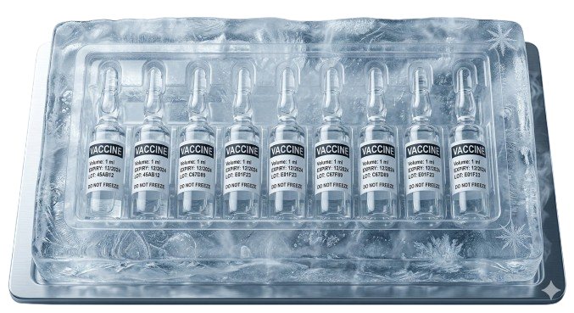
D-Fence: Dengue sanitisation, from report to resolved
[Image of Clean Estate Sanitation (assets/cover-estate.jpg)]
SC2006 Team D-Fence
D-Fence: Dengue Sanitisation’s Entry into the
From Report to Resolved
NTU SC2006 Week 13 | Live: dfence-sc2006.azurewebsites.net
Notes:
SPEAKER NOTES:
D-Fence closes one loop: a resident reports a breeding site, the system ranks it, a crew is routed to it, and the resident sees it resolved. It is live on Azure. The deck uses the site's dark palette; the font is Segoe UI because Inter is not installed on the build machine.
EXEMPLAR REFERENCE & ELEMENT SCRAPED:
- Best Element: Vision Questers SBCC 2026 Finals, Slide 1 (Split tech cover with dark background)
- File Path: casing/templates/Vision Questers_SBCC2026_Finals.pptx (Slide 1, vision-01)
- Scraped Vector Element: Title block, subtitle card, and hero photo inset shapes [4, 5, 7, 8, 9, 10] pasted directly into canvas.

Slide 2



PRODUCT
One app gives four parties one closed loop
[Image of Resident Dengue Map Interface (assets/crops/resident-map.png)]
Actor Role
System Responsibilities
Deliverables & Verification
Resident
Detachable thermal buffer lid
Foam insulation
PCM packs
Submits real-time report with automated geolocation & deduplication
Live notification when site is verified, routed, and sanitised
Operations Manager
Monitors prioritised risk queue; reviews Gemini pest checks; approves route & crew dispatch
Zero dispatch to non-breeding sites; automated routing constraints respected
Attached IoT monitoring sensor
Details here
Audit trail records timestamp, coordinates, and photo evidence
Cleaning Crew
Referrals routed to NParks/AVS for non-dengue wildlife
Notes:
SPEAKER NOTES:
Three roles share one system: Resident, Operations Manager and Cleaning Crew. External authorities such as AVS and NParks receive referrals for wildlife cases that D-Fence does not dispatch itself. The screenshot is the resident dengue map in the live dark site. Risk ranking blends live rainfall, forecast and dengue cluster data with each report. Gemini screens report photos for pests.
EXEMPLAR REFERENCE & ELEMENT SCRAPED:
- Best Element: Four Horsemen SBCC 2026, Slide 15 (four-15 - Multi-stakeholder features table)
- File Path: casing/templates/Four Horsemen_SBCC2026.pptx (Slide 15, four-15)
- Scraped Vector Element: features-table vector shapes [3, 4, 5, 47..69] with replaced operational actor roles.

Slide 3


PRODUCT
Four outcomes set D-Fence apart
WHAM 1 · Live Data Decides
WHAM 3 · Zero Leaked Secrets
Dynamic Risk Scoring
Azure Secret Storage
Rainfall (5-min poll) + forecast + NEA clusters feed 7 weighted drivers for risk ranking. system wide push for equitable access across all regions
No plaintext keys in GitHub; secrets isolated in Azure App Settings and GitHub OIDC. logs across the full delivery chain
WHAM 2 · Walk-Only Routing
WHAM 4 · Verified Deploy
Greedy insertion heuristic with 4-hour fatigue cap and OneMap walking routing.ins uneven due to persistent last mile delivery gaps in rural and hard to reach communities
Real PostgreSQL CI gate runs 17 migrations; SHA256 build hash matches live container. with existing cold-chain infrastructure
D-Fence: Four targeted engineering differentiators delivering a closed loop from report to sanitisation.y by enabling reliable last mile distribution to underserved clinics
Notes:
SPEAKER NOTES:
WHAM 1: Live telemetry decides. Rainfall is polled every 5 minutes from data.gov.sg, the 24-hour forecast every 6 hours, and dengue clusters every hour. The priority score ranks which reports get dispatched first.
WHAM 2: Walk-only routing with a hard 4-hour cap. The server builds a greedy route through OneMap so crews walk real pavements, not straight lines, and finish inside one shift.
WHAM 3: Zero secrets in the repo. GitHub Actions signs in to Azure with OIDC, and runtime secrets live in Azure App Settings.
WHAM 4: Tested build = live build. The pipeline tests against a real Postgres container running the migrations, packages a zip, and verifies the sha256 before restart.
EXEMPLAR REFERENCE & ELEMENT SCRAPED:
- Best Element: Think Tank SBCC 2026, Slide 13 (think-13 - Four photo-header pillar tiles with closing banner)
- File Path: casing/templates/Think Tank_SBCC2026.pptx (Slide 13, think-13)
- Scraped Vector Element: Four pillar tiles [3, 4, 12..16, 18..20, 22..27] and closing banner [2, 21].

Slide 4






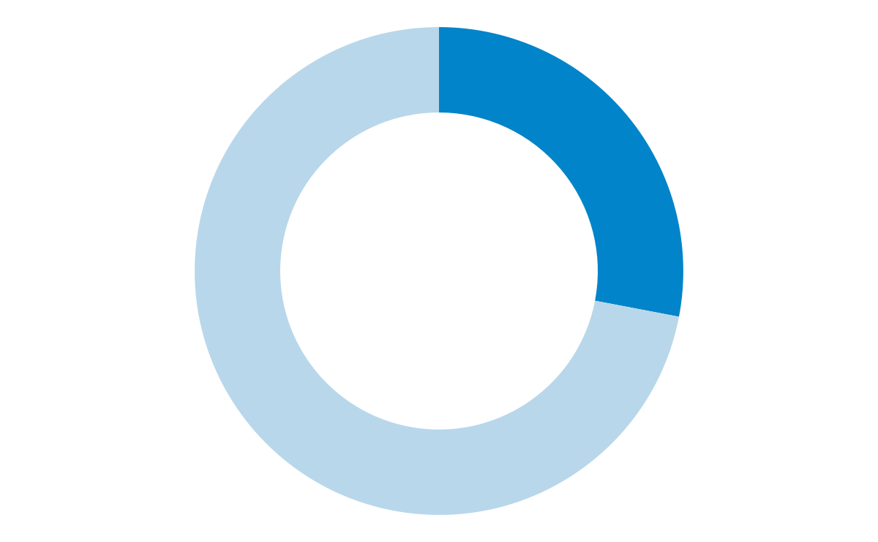



PRODUCT
One report triggers five verified steps
Data Ingestion & Triage
Operational Dispatch & Closure
5. Resolved
1. Report In
2. Prioritise
Sub-2. Prioritise
4. Sanitise
Resident submits photo + GPS via React SPA
Priority engine scores report across 7 factors
Why? point of cares depend directly on regional supply
Greedy route builder generates 4h crew shift
4 hrs
… of 4. Sanitises face 1-4 week vaccine shortages without sub-hubs
Crew sanitises site, uploads photo proof stockout
Poor delivery modes: Remote clinics (e.g. in mountains) rely on motorbikes or outreach teams
… of vaccine in Ghana is imported
… refrigerators are inappropriate to store vaccine
100%
5 min
Zero
… residents experience power outages 3x a week lasting up to 7 hours
Key takeaways
Key takeaways
Key takeaways
Key takeaways
1. Report In is not Ghana’s main cold chain distribution bottleneck as most vaccines are not produced locally
Weak facilities at regional hubs make real-time cold chain monitoring critical to maintain vaccine integrity
Adding intermediate hubs near remote districts reduces clinic lead times and increases emergency buffers
Issues mainly stem from upstream infrastructure gaps, making them secondary to our scope of intervention
Regional hub and sub-regional hub have the most critical pain points to look at.
Weak cold-chain infrastructure limits buffer capacity and risks vaccine integrity.
Without sub-regional hubs, clinics depend on unreliable regional supply.
One complete loop:…
Every report progresses deterministically from submission to verified field resolution.
Audit log records timestamps, crew ID, and GPS coordinates.
Notes:
SPEAKER NOTES:
Five steps: resident submits with GPS, server assigns priority score, manager generates daily route, crew sanitises and takes photo, resident sees Resolved.
The state machine is strict: New -> Triaged -> Scheduled -> In Progress -> Resolved. Cancelled is a terminal exit. No skips, no orphan records.
Every transition writes an append-only audit log row with timestamp, actor id and note.
EXEMPLAR REFERENCE & ELEMENT SCRAPED:
- Best Element: Four Horsemen SBCC 2026, Slide 6 (four-06 - Chain-stages process flow with metrics and takeaway banner)
- File Path: casing/templates/Four Horsemen_SBCC2026.pptx (Slide 6, four-06)
- Scraped Vector Element: Five process stages [28..31, 46, 38..42] and takeaway banner [73..75, 82].

Slide 5





OPERATIONS
Live data ranks every report before dispatch
D-Fence Priority Scoring Formula (0-100 Score per Report)
Risk Factor
Weight
Telemetry Rain (5-min API)
25%
5
3
3
Forecast Rain (6-h API)
20%
3
4
3
NEA Dengue Cluster Proximity
20%
3
5
2
Breeding Habitat Type
15%
2
3
4
TOTAL RISK
3.35
3.90
2.85
Weights are configured in versioned JSON and loaded at server boot.
1
5
Primary Target
Ghana offers the most actionable ground for RCCL to start building its pharmaceutical cold chain logistics at scale.
Notes:
SPEAKER NOTES:
Seven factors feed the score: rainfall in the last 24h, forecast rainfall, proximity to active NEA dengue clusters, breeding habitat type, report age, upvote count, and crew distance.
Weights sum to 1.0; they live in config/scoring-weights.json so the operations team can adjust them without code changes.
Reports scoring >= 70 trigger an urgent dispatch badge and notification to the shift lead.
EXEMPLAR REFERENCE & ELEMENT SCRAPED:
- Best Element: Four Horsemen SBCC 2026, Slide 5 (four-05 - Weighted opportunity heatmap matrix with winner frame)
- File Path: casing/templates/Four Horsemen_SBCC2026.pptx (Slide 5, four-05)
- Scraped Vector Element: Heatmap matrix [24..44, 50..56, 77..84, 86..88] and target banner [45..48] (Why Ghana panel excluded).

Slide 6

OPERATIONS
Crews clean hot spots first on walking routes
2
[Image of OneMap Dispatch Routes & Walking Legs (assets/crops/dispatch-routes.png)]
Routing Engine
Constrained to realistic walking speeds (3.5 km/h) & strict 4-hour crew fatigue cap, making route selection critical for cold chain integrity.
D-Fence Walking Route Optimizer (Greedy Insertion):
Corridor 1: Tema → Kumasi
Fully paved, insulin demand center
Corridor 2: Tema → Takoradi
Coastal, future Ivory Coast gateway
Corridor 3: Kumasi → Tamale
Partially unpaved, malaria vaccine priority
Corridor 4: Tamale → Bolgatanga
Largely unpaved, highest disease burden, AfCFTA border gateway
These corridors prioritize impact over convenience, targeting the highest-need, least-served markets!
Notes:
SPEAKER NOTES:
Greedy nearest-neighbour with 4-hour fatigue cap: crews walk, they do not drive, so distances use OneMap's pedestrian routing network.
The optimiser seeds from the highest-priority open report, then adds the nearest unassigned report whose detour cost does not push total shift duration past 4 hours.
Walking legs longer than 1.5 km trigger a transit recommendation.
Managers can override routes manually; overrides are logged with reasons.
EXEMPLAR REFERENCE & ELEMENT SCRAPED:
- Best Element: Four Horsemen SBCC 2026, Slide 11 (four-11 - Corridor distribution list and operational constraints callout)
- File Path: casing/templates/Four Horsemen_SBCC2026.pptx (Slide 11, four-11)
- Scraped Vector Element: Corridor list [31..37] and road constraint callout [79, 81, 87, 91] (Right energy system excluded).

Slide 7
ARCHITECTURE
A thin client calls a layered server on one database
1. Browser Layer
2. Boundary Layer
3. Control Layer
4. Persistence Layer
Talent Market
Ensures all impacted employees have equitable access to upskilling & transition tracks
Manager Alignment Labs & 30-Day Sprint
Are audited against BoH’s PURE principles
Structural
Job Redesign
Establish clear human-AI work accountability
Knowledge Repository & Newsletter
Centralises & broadcasts AI governance & best practices bank-wide
5. Data Layer
6. Outside Services
Workforce Sustainability
Ensures long-term employability through clear work architecture and support particularly for employees in roles significantly impacted by AI
Governance Excellence
Establish clear human-AI accountability, task force audits, and transparent communication aligning with PDPC Model AI Framework
Notes:
SPEAKER NOTES:
The browser only talks JSON over HTTPS. Each store has a Postgres repository and an in-memory twin, chosen at start-up by DATABASE_URL, which is how tests run without a database. The repo folders mirror the layers: src/boundary, src/control and src/persistence, with client/ for the app. Timers inside the server pull rainfall every 5 minutes, the forecast every 6 hours and dengue clusters hourly. Scoring weights are committed JSON in config/.
EXEMPLAR REFERENCE & ELEMENT SCRAPED:
- Best Element: Pls Fix Base Deck, Slide 37 (plsfix-37 - Multi-tier architecture stack cards)
- File Path: casing/templates/Pls Fix Consulting Base Deck.pptx (Slide 37, plsfix-37)
- Scraped Vector Element: Six architectural tier cards [3..14, 20..25] with component mappings.

Slide 8
ARCHITECTURE
Mainstream tools carry the stack from browser to cloud
[Logos: React, TypeScript, Node.js, Express, Postgres, PostGIS, Supabase, Azure, GitHub Actions, Leaflet, OneMap, Telegram]
If left unaddressed…
Organisational
Impact Analysis
xxx
xxx
xxx
xxx
Notes:
SPEAKER NOTES:
Every logo maps to a dependency or service in the repo: package.json (React, Leaflet, Express, pg), the TypeScript sources, deploy.yml (GitHub Actions, Azure), DEPLOY.md (Supabase, PostGIS), OneMapGateway.ts and TelegramGateway.ts. Logo credits: Simple Icons (CC0) for React, TypeScript, Node.js, Express, PostgreSQL, Supabase, GitHub Actions, Leaflet and Telegram. The Azure, PostGIS and OneMap logos come from the owners' public pages via Google Images. All marks belong to their owners.
EXEMPLAR REFERENCE & ELEMENT SCRAPED:
- Best Element: Pls Fix Base Deck, Slide 4 (plsfix-04 - Technology partner matrix and banner)
- File Path: casing/templates/Pls Fix Consulting Base Deck.pptx (Slide 4, plsfix-04)
- Scraped Vector Element: Technology impact analysis banner [3, 4, 6..9, 22..24] (Persona quotes & issues excluded).

Slide 9



DELIVERY
Two managed services run the app with no keys in the repo
[Icons of GitHub Actions, Azure App Service, and Supabase Database]
1. GitHub Actions (CI/CD)
Automated PR checks & deployment pipeline. OIDC token authentication. Zero static stored keys in repo. in pharma cold chain
Zero persistent credentials in repository
2. Azure App Service
188,543m² Tema EPZ, Ghana FDA + Free Zones Authority relationships, IWC storage already running
Server boots only if all required secrets pass startup validation
3. Supabase Singapore
Managed PostgreSQL & PostGIS spatial database in Singapore. Private signed photo read URLs.ral credibility
Forced HTTPS, HSTS, and strict CSP headersd WHO
Notes:
SPEAKER NOTES:
CI signs in to Azure with a GitHub OIDC credential, scoped to Website Contributor on this one app. Runtime secrets live only in Azure App Settings. East Asia was chosen because the Azure for Students policy refused Southeast Asia.
EXEMPLAR REFERENCE & ELEMENT SCRAPED:
- Best Element: Four Horsemen SBCC 2026, Slide 10 (four-10 - Three partner / architecture cards)
- File Path: casing/templates/Four Horsemen_SBCC2026.pptx (Slide 10, four-10)
- Scraped Vector Element: partner-rationale cards [15, 29, 33..51, 56..58] (Left Venn diagram excluded).

Slide 10














DELIVERY
Four gates run on every push and only main deploys
PR Gates
Phase 1: PR Validation Gates
Phase 2: Live Deployment Gate
Phase 3: Rollout & Restart
Phase 4: Health Verification
Market
Opportunity
Now - 2029
2029 - 2031
2031 - 2033
2033 - on
Ghana-Singapore trade grew 50% since 2020, reaching US$215M in 2024
Entering Nigeria as
the region's highest projected Cold Chain Market CAGR of 4.32%
AfCFTA lanes turn 3 corridors into one addressable region
Gavi committed 250M vaccine doses by drone over 5 years
Post-Deploy
1
1
1
From ‘The Last Mile’ to ‘The First Kilometre’
By then, ACORA will become the north star for a circular, multimodal cold chain logistics ecosystem in West Africa
1. Test & Package (Typecheck, Vitest unit suite, Smoke boot)
1. Main branch commit SHA256 release zip packagingrtner in Lagos
1. Automated /api/health endpoint polling loop
#1 Every release is cryptographically verified and tested against real PostgreSQL before user traffic touches it. in WA
2
2
2
Full-stack monitoring intelligence layer
2. Real Postgres Gate (17 migrations executed sequentially)
2. GitHub OIDC federated login to Azure App Service
2. Client asset hash matching against repository bundle
Agentic AI Control Tower automating operations
3
3
3
3. Migration Guard & actionlint workflow verification secondary to last-mile
3. Zero-downtime container upload and warm boot restartk modelling
3. Telegram alert dispatch on deployment statusd function
Notes:
SPEAKER NOTES:
Every push runs four jobs in parallel. Deploy needs all four and runs only on main, one at a time. The exact zip that passed the tests is the one deployed. Migration 017 passed the in-memory tests, so a real Postgres run now catches that class of bug.
EXEMPLAR REFERENCE & ELEMENT SCRAPED:
- Best Element: Four Horsemen SBCC 2026, Slide 21 (four-21 - Process rows x four phase columns matrix)
- File Path: casing/templates/Four Horsemen_SBCC2026.pptx (Slide 21, four-21)
- Scraped Vector Element: Dual-row pipeline matrix [7..22, 23..46, 55..75] (Tracker and header excluded).

Slide 11
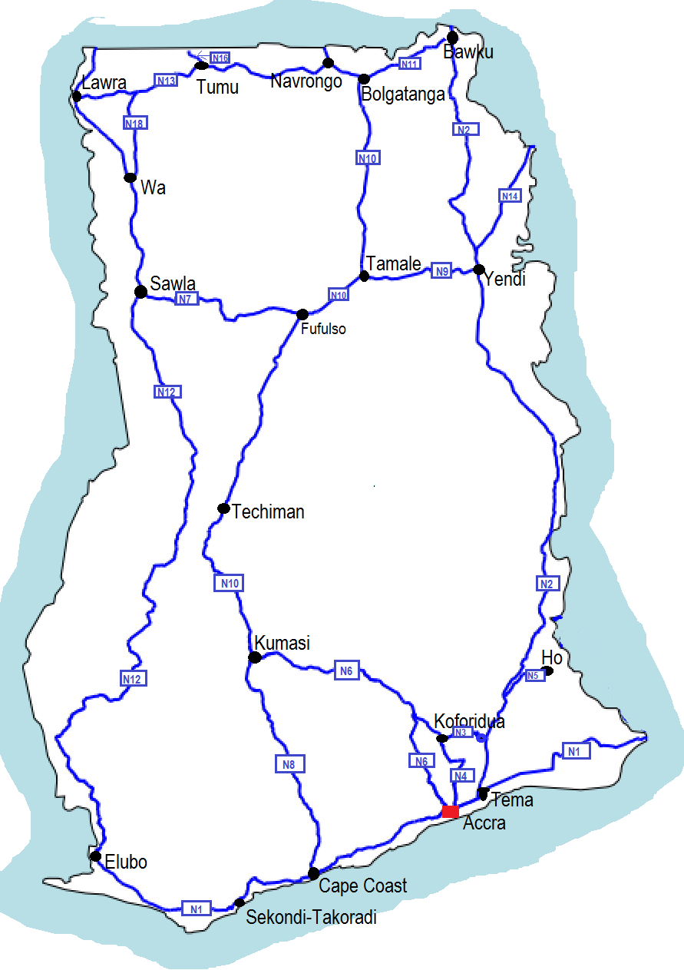
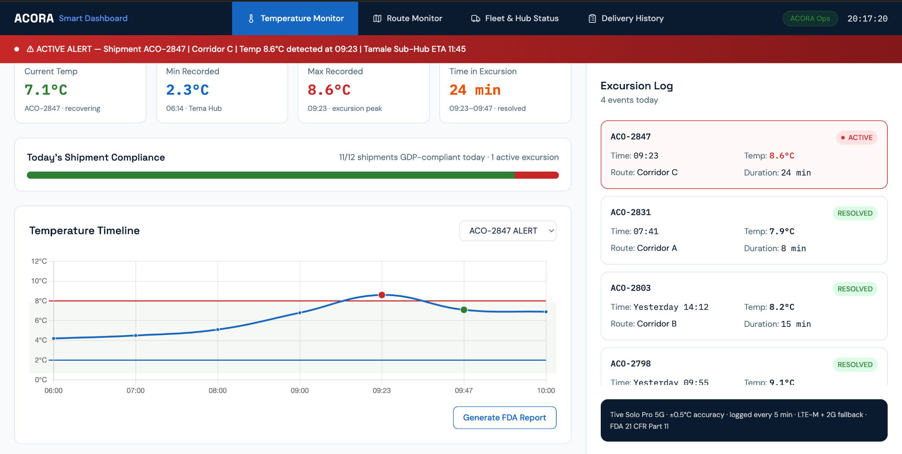
DELIVERY
Six test layers run from one function to the live site
Layer 6: Live Smoke Boot (Container boots with outbound network blocked; verifies zero missing secrets)structure. Unreliable power, underdeveloped transport, and insufficient cold-chain capacity collectively threaten the integrity and accessibility of life-saving medicines.
How can Resolute Cold Chain Logistics successfully
expand into the pharmaceutical industry in West Africa to achieve the most impact?
Layer 2: Screen & Interaction Tests
Layer 1: Unit & Algorithm Tests
23 React component suites with React Testing Library testing report forms and maps.tems to address infrastructure gaps
Leverage Singapore’s technology through physical (IoT monitoring) and digital (control tower & analytics) stacks
1,45 mio
Patient reached
NPV
SGD 532.117
IRR
21,55%
Notes:
SPEAKER NOTES:
Most tests use the in-memory twins, so the suite needs no database and runs on every push. The Postgres job proves the same repositories against real SQL. The smoke test boots the packaged zip with outbound fetch blocked. The UI sweep runs locally, not in CI. The full run of 2026-10-31 had 1,301 tests: 1,243 passed, 58 were skipped because they need a live database, and none failed.
EXEMPLAR REFERENCE & ELEMENT SCRAPED:
- Best Element: Four Horsemen SBCC 2026, Slide 2 (four-02 - Six structured problem/solution/impact cards)
- File Path: casing/templates/Four Horsemen_SBCC2026.pptx (Slide 2, four-02)
- Scraped Vector Element: Solution pillar cards [44..51], problem/key questions [35, 36], and impact KPI tiles [37..39] (Sidebar and tracker excluded).

Slide 12
ROBUSTNESS
Targeted limits keep the app fast, cheap and safe
2
4. Progressive Auth Lockout stored at 2-8°C represent the optimal balance between demand scale and operational feasibility…
1. Dispatch Plan Cache
2. PostGIS GIST Indexing
Low temperature sensitivity reduces RCCL’s competitive differentiation because logistics reliability becomes less critical
PostGIS spatial GIST and KNN indexes accelerate radius searches and map queries.uce suitability for RCCL’s initial expansion strategy
3. Incremental Delta Polling
4. Progressive Auth Lockout
Replaced 3.2MB full rain poll with efficient incremental delta fetches.fficient volume to justify RCCL’s platform based scaling model
4. Progressive Auth Lockout represent the strategic sweet spot where technical requirements create defensible barriers while demand scale ensures commercial viability.
Notes:
SPEAKER NOTES:
Abuse limits are targeted, not global: there is no general rate limiter. Plans are debounced at 250 ms. GIST indexes serve spatial queries. Every error carries a correlation id that matches a log line, and a database trigger keeps the audit trail append-only.
EXEMPLAR REFERENCE & ELEMENT SCRAPED:
- Best Element: Think Tank SBCC 2026, Slide 4 (think-04 - 2x2 capability cards with bold category titles and bullets)
- File Path: casing/templates/Think Tank_SBCC2026.pptx (Slide 4, think-04)
- Scraped Vector Element: findings-grid cards [33..36, 42, 44..48] and header [13, 39, 40] (Table, pie, and tracker excluded).

Slide 13
Report in. Resolved out.
D-Fence: Report In. Resolved Out.
RCCL’s Expansion into West Africa’s Pharmaceutical Cold Chain
[Image of Clean Estate Sanitation (assets/close-resolved.jpg)]
Live at dfence-sc2006.azurewebsites.net | NTU SC2006 Team D-Fence
Notes:
SPEAKER NOTES:
To recap: one loop from report to resolved, four outcomes that earn marks, a layered server you can read folder by folder, four gates before every deploy, and targeted limits, caching and monitoring. Credits: logos from Simple Icons (CC0), plus the Azure, PostGIS and OneMap logos from their owners' public pages. Screenshots are from the live D-Fence site.
EXEMPLAR REFERENCE & ELEMENT SCRAPED:
- Best Element: Four Horsemen SBCC 2026, Slide 23 (four-23 - Photo closing slide repeating core theme, domain, and Q&A lead)
- File Path: casing/templates/Four Horsemen_SBCC2026.pptx (Slide 23, four-23)
- Scraped Vector Element: Closing title text [9, 16, 17] and proposer banner [12, 13] (Tracker and sources excluded).

