Slide 1

D-Fence
8653E3
SC2006 WEEK 13
AF89F4
D-Fence
771FFF
F66F87
Dengue sanitisation, from report to resolved
75F9AA
4CC9F0
FFD500
0C0120
272036
Notes:
Imagine it is Saturday night. You spot stagnant water behind your block, take a photo and report it.
Two weeks later, the water is still there. Nobody came, and your neighbour is down with dengue.
(pause, let the story land)
That gap between a report and a fix is what we set out to close.
We are proud to present D-Fence.
D-Fence joins residents, operations managers and field officers in one loop. It ranks every hazard with live government data and plans routes that fit a four-hour shift.
The system runs live on Azure today.

Slide 2



Three roles share one loop, from the resident's report to the field team's fix
8653E3
AF89F4
771FFF
F66F87
75F9AA
4CC9F0
FFD500
Nur Aisyah
Rachel Lim
Ahmad Faizal
0C0120
Resident, Tampines
Operations Manager
Field Officer
272036
Goal: report stagnant water in under a minute
Goal: treat the highest-risk sites first
Goal: a clear job list with stops in order
Goal: see proof that the site was treated
Goal: send field teams on routes that fit one shift
Goal: the right gear packed before leaving HQ
Pain: past reports vanished with no progress update
Pain: scattered feeds and manual route planning
Pain: vague tasks and missing equipment on site
Source: client/src/lib/staffVisuals.ts; resident portrait AI-generated
Notes:
(handoff point if the team splits here)
Three distinct roles share one system, from citizen hazard report to verified field resolution.
Our software provides dedicated accounts for three key user roles.
Nur Aisyah lives in Tampines. She wants to report stagnant water in under one minute, and she needs proof that teams treated the site. In the past, her reports vanished without updates.
Rachel Lim directs operations. She needs to treat the highest-risk sites first and build routes that fit one shift. Scattered feeds and manual planning slowed her down.
Ahmad Faizal is our field officer. He needs an ordered job list and the right gear packed before leaving HQ. Vague tasks and missing tools wasted his time on site.
(emphasize the contrast)
What stands out in this design is that three separate roles share one verified data record.
Wildlife cases go to a dedicated wildlife response team in our own crew.

Slide 3

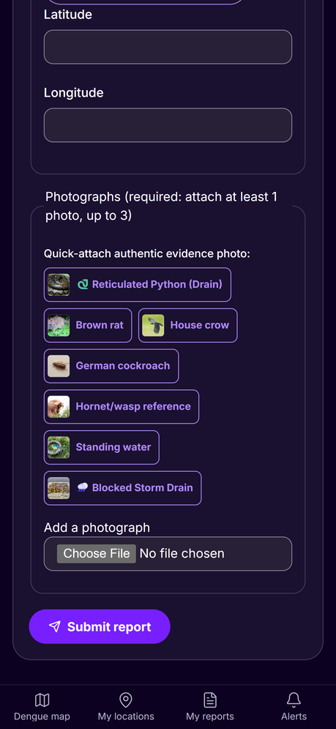
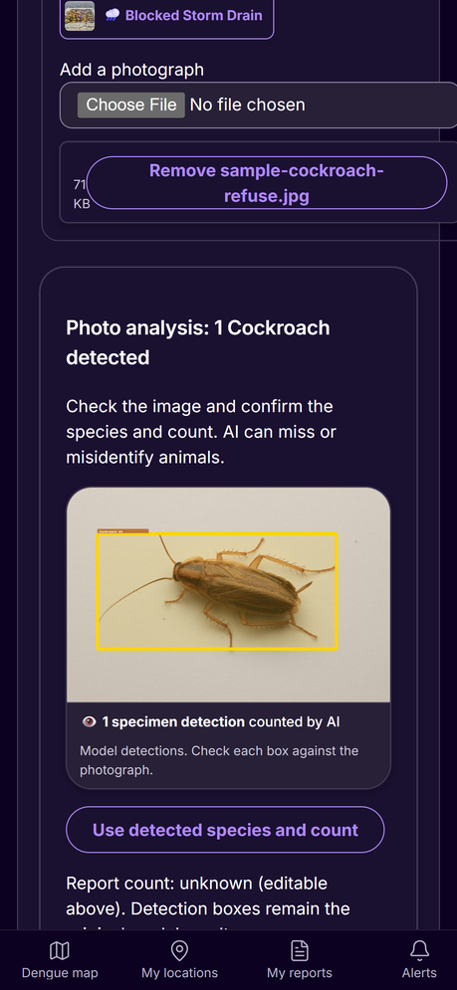
A resident uploads a photo, and an AI model detects and counts the pest in it
8653E3
AF89F4
Report
Rank
Plan
Review
Dispatch
Resolve
771FFF
F66F87
Resident
Server
Server
Manager
Field team
Everyone
75F9AA
4CC9F0
FFD500
0C0120
272036
Nur Aisyah
Resident
Finds the address with OneMap search or drops a pin
A Gemini vision model boxes and counts the pest in her photo
Duplicates of one pest within 50 m and 24 h are refused
Upload a photo
AI detects the pest
Source: src/control/ReportController.ts
Notes:
Residents submit pest photographs, while an automated vision model detects and counts specimens.
Stage one starts the operational loop. Nur Aisyah reports a pest hazard through our mobile web form or the map view.
OneMap address search and device satellite coordinates resolve the exact location.
She uploads a camera photo, or picks a sample test image.
On upload, a Gemini vision model checks the photo.
The model draws bounding boxes around detected pests and counts every specimen.
(point to the phone mockups on screen)
Nur Aisyah confirms the detected species and count with one tap before submitting.
To protect operational capacity, our server checks existing nearby submissions.
The platform refuses duplicate reports of the same pest within fifty metres.
Background ingestion jobs also collect records from public agency feeds, so the system never depends on resident reports alone.

Slide 4

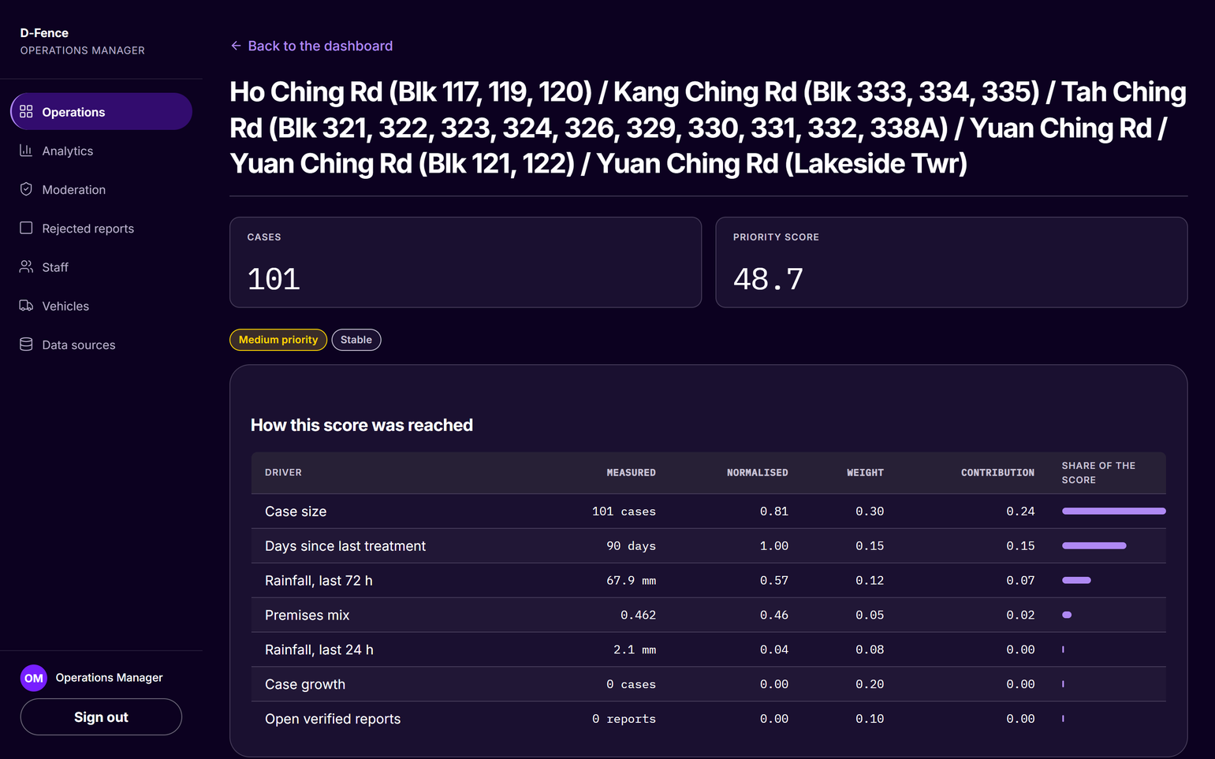
The server scores every task, for every pest, and shows how each score was reached
8653E3
AF89F4
Report
Rank
Plan
Review
Dispatch
Resolve
771FFF
F66F87
Resident
Server
Server
Manager
Field team
Everyone
75F9AA
4CC9F0
FFD500
0C0120
272036
Rachel Lim
Operations Manager
Sees one ranked list instead of five data feeds
Opens any cluster to see each driver's share
A stale feed is flagged, not hidden
Source: src/control/PriorityScoringEngine.ts
Notes:
The platform ranks every hazard into one list, combining severity with live environmental urgency.
Stage two computes operational priority.
Background ingestion jobs pull active dengue clusters from the National Environment Agency, alongside rainfall readings and weather forecasts.
Our scoring engine rates every municipal task by multiplying species severity by environmental urgency.
Rachel Lim sees one clear ranked list instead of separate agency feeds.
On screen, you see an active dengue cluster with one hundred and one cases.
The engine calculates its priority score and places this cluster into the Medium tier.
(steady tone, walk through the driver contributions)
The interface displays each driver's contribution so the manager understands the calculation.
Stale data feeds never hide.
When a feed goes stale, the server redistributes that driver weight and flags the score as degraded.

Slide 5
Every task, whatever the pest, gets one 0-100 score: severity times urgency
8653E3
AF89F4
Report
Rank
Plan
Review
Dispatch
Resolve
771FFF
F66F87
Resident
Server
Server
Manager
Field team
Everyone
75F9AA
Pest (22 in catalogue) | Severity | Evidence
Mosquito | 1.00 | A: NEA feeds
Rat | 1.00 | C: reports
Macaque | 0.92 | C: reports
Wild boar | 0.83 | C: reports
Cockroach | 0.75 | B: sightings
Snake | 0.75 | B: sightings
Bee or wasp | 0.75 | B: sightings
Pigeon | 0.58 | B: sightings
Bed bug | 0.50 | C: reports
Termite | 0.33 | B: sightings
Urgency driver | A | B | C
NEA case size and growth | 0.50 | - | -
Rainfall, 72 h and 24 h | 0.20 | - | -
Premises mix | 0.05 | - | -
Open verified reports | 0.10 | 0.30 | 0.35
Report velocity, 14 days | - | 0.20 | 0.25
Corroborations | - | 0.10 | 0.15
iNaturalist sightings, 90 days | - | 0.20 | -
Days since treatment | 0.15 | 0.15 | 0.20
Distance to a pest operator | - | 0.05 | 0.05
4CC9F0
FFD500
0C0120
272036
Score = 100 x severity x urgency. High is 70 or more, Medium 40 or more; a verified hazard overrides to Critical.
Source: PEST-PRIORITY-MODEL.md; config/pests.default.json
Notes:
A unified scoring formula rates every pest species on disease risk and active evidence.
One unified scoring queue holds every task across our catalogue of twenty-two pests.
Severity is fixed per species based on disease risk, physical harm, statutory duty, and property damage.
Mosquitoes and rats sit at the top of the severity scale.
Urgency sums normalised data drivers, and the active driver set depends on the evidence available for that species.
Mosquitoes belong to evidence tier A, supported by live government case counts and rainfall data.
Tier B species incorporate citizen wildlife observations from iNaturalist.
Tier C pests, including rats, depend on resident reports and treatment history.
(lift energy on the practical trade-off)
What surprised our team was that a high-volume rat block can legitimately outrank a moderate dengue cluster.
At the same time, an influx of ant complaints can never displace genuine disease vectors.
Life-safety cases, such as a snake indoors, a crocodile or an injury, skip the calculation and enter Critical priority immediately.

Slide 6
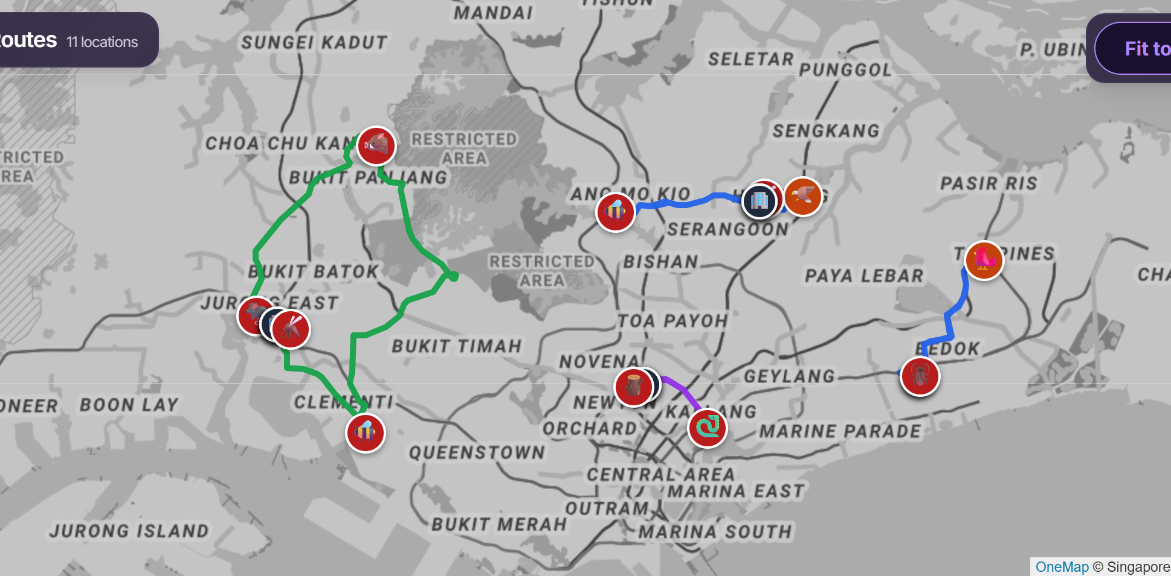
The server builds road-checked team routes that fit one four-hour shift
8653E3
AF89F4
Report
Rank
Plan
Review
Dispatch
Resolve
771FFF
F66F87
Resident
Server
Server
Manager
Field team
Everyone
75F9AA
4CC9F0
FFD500
0C0120
272036
Rachel Lim
Operations Manager
Gets proposed routes for a seven-day horizon
Each colour is one field team's route from its HQ
Routes follow real roads, then a short walk
Source: src/control/RouteOptimizationService.ts
Notes:
Automated route planning builds complete field schedules that fit within a single work shift.
Stage three plans field routes for the teams.
The route planner assigns ranked tasks to HQ teams for the days ahead.
The map displays proposed routes, where each colour represents one field team starting from HQ.
OneMap driving routes check every road travel leg.
When a vehicle cannot park directly at the work site, the system checks pedestrian access.
The planner allows only a short walk from the vehicle stopping point.
(deliberate pace, stress the hard boundary)
Each route sums driving travel, pedestrian walking, on-site treatment, and on-call buffer time.
The combined total keeps every field route strictly under the four-hour shift limit.

Slide 7
Cheap straight-line estimates shortlist each insertion; OneMap checks the best six
8653E3
AF89F4
Report
Rank
Plan
Review
Dispatch
Resolve
771FFF
F66F87
Resident
Server
Server
Manager
Field team
Everyone
75F9AA
Sort
Estimate
Verify
Insert
2-opt
Swap
4CC9F0
FFD500
Critical first, then scarce skills
Rank every slot by straight-line time
OneMap road and walk times, best 6
Cheapest verified slot within 4 hours
Reverse same-tier stops if shorter
Move or swap jobs between crews
0C0120
2-opt example | Stop order | Time
Before | Depot-1-2-3-4-5-Depot | 55 min
Cut legs | 1-2 and 4-5 cross | -
Reverse 2 to 4 | Depot-1-4-3-2-5-Depot | 37 min
Keep it? | Yes: OneMap time falls; same tier only | -18 min
272036
2-opt cuts two legs and reverses the stops between them; it is kept only when OneMap time falls.
Source: src/control/RouteOptimizationService.ts; ROUTING-ALGORITHM.md
Notes:
Fast straight-line filters screen candidate stops before official road routing verifies the best paths.
Our route planner uses greedy insertion.
The algorithm sorts the tasks first. Critical hazards come first, then jobs that few crews can do, then short jobs.
For each task, the planner evaluates every available slot across all team schedules.
The algorithm estimates transit time using straight-line distances.
That simple estimate lets the engine test every potential slot cheaply.
(lean forward, emphasize the optimization trick)
The best part is that OneMap verifies only the best six candidate slots.
OneMap returns verified road and walking travel times, and the task takes the slot with the lowest verified time increase.
Then two-opt optimization cleans up each route.
Two-opt cuts two legs and reverses the stops between them, keeping the change only when OneMap time decreases.
Reversals only operate across stops of identical priority tier.
Finally, the planner moves or swaps jobs between crews when that shortens the routes.

Slide 8
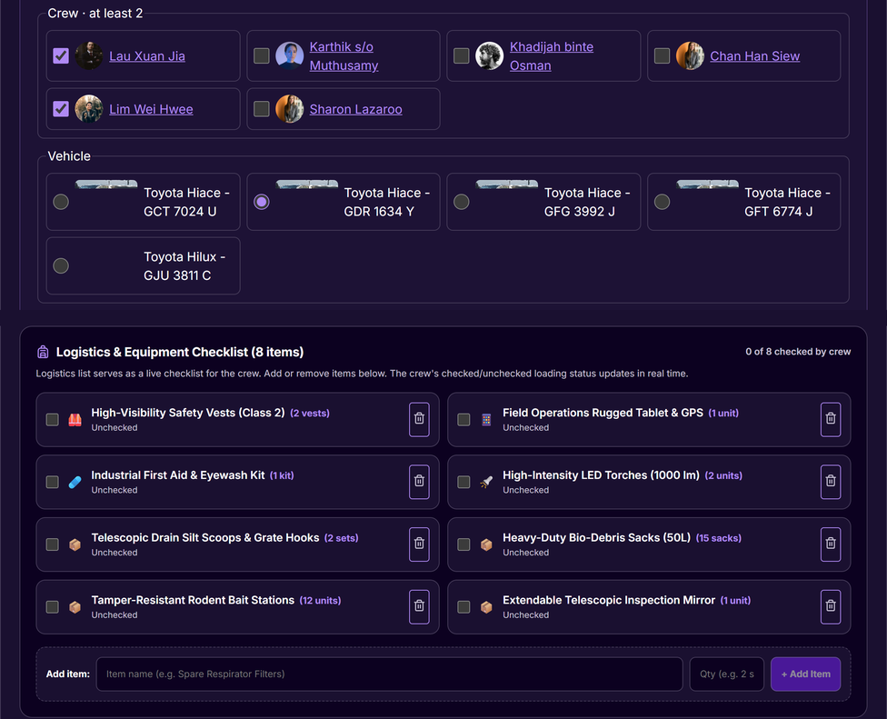
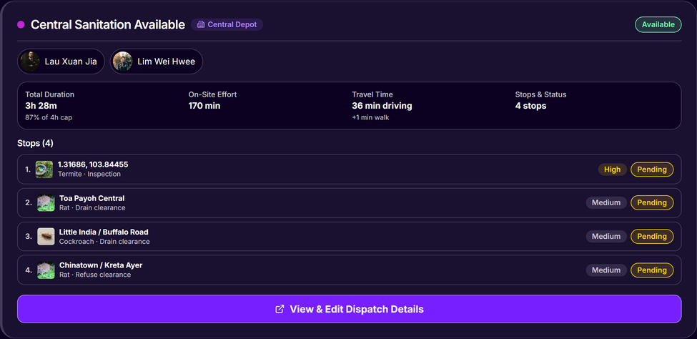
Each dispatch is a full route: ordered stops, a crew, a vehicle and a logistics list
8653E3
AF89F4
Report
Rank
Plan
Review
Dispatch
Resolve
771FFF
F66F87
Resident
Server
Server
Manager
Field team
Everyone
75F9AA
4CC9F0
FFD500
0C0120
272036
Rachel Lim
Operations Manager
Reviews each proposed route from its HQ
Edits stops, crew, vehicle and logistics list
A saved edit locks the route against replanning
Route: crew and stops
Crew, vehicle, logistics
Source: client/src/screens/operations/
Notes:
Operations managers review full vehicle dispatches with assigned crews and ordered stops.
Stage four provides the operations manager review gate.
In D-Fence, a dispatch is never an isolated individual task.
A dispatch is one complete circuit that starts from HQ.
The left screen shows the Central Sanitation route.
The proposed schedule assigns field officers to ordered task locations.
This route takes three hours and twenty-eight minutes, inside the shift limit.
The right screen shows the route details page.
Rachel Lim inspects the assigned vehicle and crew members.
The page displays a logistics packing list that officers tick as they load equipment.
(firm, authoritative)
What I love most is that saving an edited route locks it against background re-planning.
Rachel Lim can adjust stops, swap vehicles, or modify crews, and her manual decision remains completely stable.

Slide 9

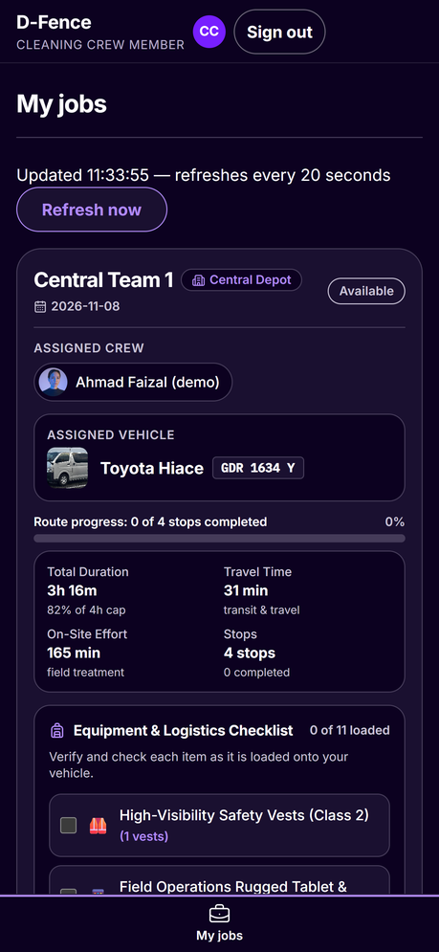
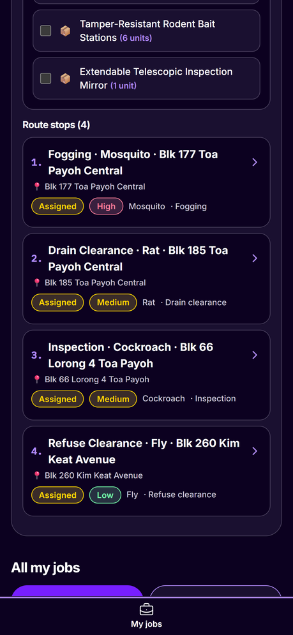
The field officer opens one phone screen with the crew, van, load list and ordered stops
8653E3
AF89F4
Report
Rank
Plan
Review
Dispatch
Resolve
771FFF
F66F87
Resident
Server
Server
Manager
Field team
Everyone
75F9AA
4CC9F0
FFD500
0C0120
272036
Ahmad Faizal
Field Officer
Sees crew, van and plate for today's route
Sees the route fill 82% of a 4-hour shift
Ticks the load list; stops run in priority order
My dispatch
Ordered stops
Source: client/src/screens/crew/MyJobsScreen.tsx
Notes:
Field officers manage daily work from a mobile device, packing required tools and following stops.
Stage five moves into physical field execution.
Ahmad Faizal signs in on his mobile phone and opens the My Jobs screen.
The top card displays today's dispatch for Central Team One.
The card shows the assigned crew, the van model, and the registration plate.
The planned route fills eighty-two per cent of the shift.
Field officers split time between vehicle travel and on-site treatment.
(point to the mobile checklist)
Ahmad Faizal checks off gear on the equipment load list as items enter the van.
Every checkbox tap persists immediately to the database.
The right phone screen lists the task stops in priority order.
The crew performs high-priority mosquito fogging first, followed by medium and low jobs.
This crew and its route are demo data on the live site.

Slide 10
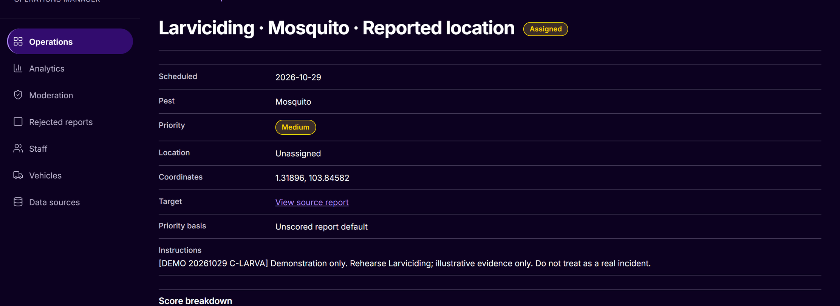
A table-driven state machine needs photo evidence before a job can close
8653E3
AF89F4
Report
Rank
Plan
Review
Dispatch
Resolve
771FFF
F66F87
Resident
Server
Server
Manager
Field team
Everyone
75F9AA
Created
Assigned
Accepted
In Progress
Completed
Verified
4CC9F0
FFD500
Server
Manager
Field team
Field team
With evidence
Manager
0C0120
Rule | Effect
Evidence | Photos, notes and time before Completed
Roles | The field team completes; only a manager verifies
Rework | Rejection returns the job to In Progress
272036
Source: src/control/WorkOrderTransitionTable.ts
Notes:
A strict lifecycle state table requires photographic evidence before any field task can close.
A table-driven state machine governs the complete work order lifecycle.
We implemented this logic in our WorkOrderTransitionTable class.
We chose one declarative table over a separate class for each state.
A single table keeps transition rules transparent and makes every branch directly testable.
A work order advances across six defined lifecycle states: Created, Assigned, Accepted, In Progress, Completed, and Verified.
Only the assigned field officer can advance a job to Completed.
The system strictly demands completion photos, treatment notes, and a timestamp before closing.
(emphasize role authority)
The key advantage is that only an operations manager can verify completed work.
If a manager rejects the submitted evidence, the job returns to In Progress with an explanatory reason.

Slide 11
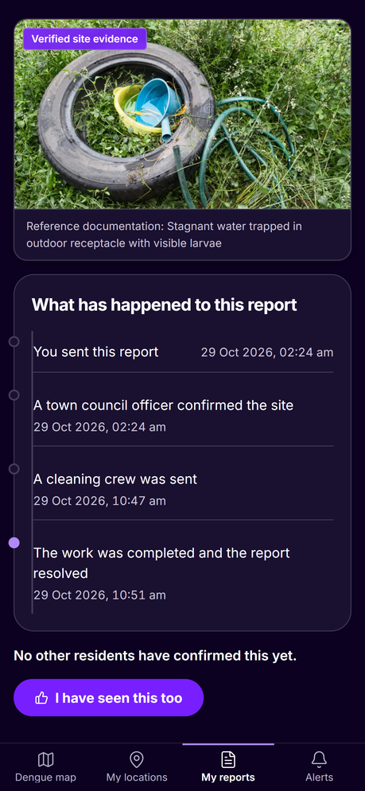
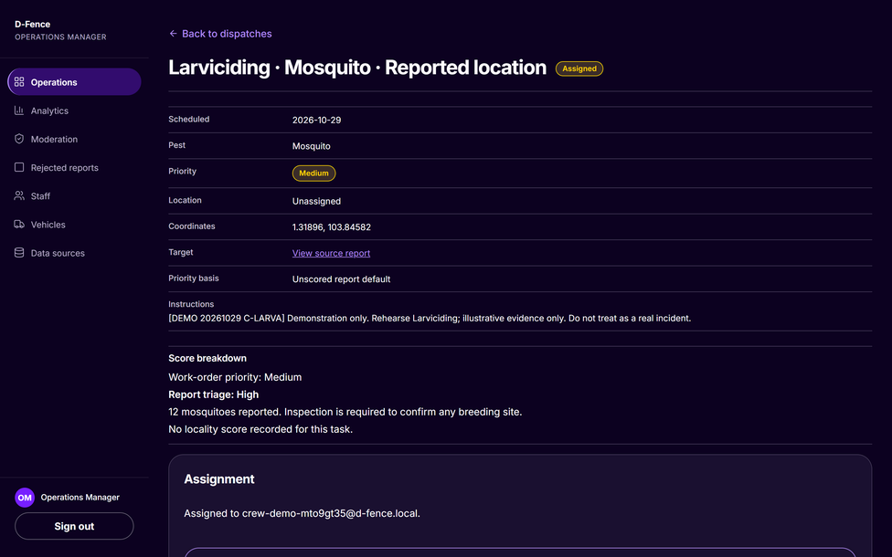
The resident and the manager see the same verified status when the work is done
8653E3
AF89F4
Report
Rank
Plan
Review
Dispatch
Resolve
771FFF
F66F87
Resident
Server
Server
Manager
Field team
Everyone
75F9AA
4CC9F0
FFD500
0C0120
272036
Nur Aisyah
Resident
My Reports shows each report's current status
Gets a Telegram alert if she linked her account
Every status change is kept in an append-only audit log
Resident: report timeline
Manager: verified job
Source: src/control/observer/
Notes:
Residents and managers track identical verified outcomes when field teams complete their assignments.
Stage six completes the loop.
When Rachel Lim verifies a completed work order, all linked resident reports update immediately.
Nur Aisyah opens My Reports on her phone and sees the verified resolution status.
The operations manager sees the identical completion state on her dashboard.
Residents who connected their account receive an automated Telegram alert confirming the treatment.
(calm, conclusive)
Domain observers record every status transition in an append-only database audit log.
The platform maintains a permanent, tamper-resistant history of all municipal actions.
Citizen reports never disappear into unmonitored queues, because every step to verified resolution is recorded and visible to everyone.

Slide 12
Each use case runs down one chain of classes: route, controller, port, repository, entity
8653E3
AF89F4
Report
Rank
Plan
Close
771FFF
Boundary
F66F87
Report Routes
Work Order Routes
Crew Routes
75F9AA
Control
4CC9F0
Report Controller
Priority Scoring Engine
Route Optimization Service
Work Order Lifecycle Controller
FFD500
Ports (interfaces)
0C0120
Report Store
Priority Score Store
IRouteStrategy
Work Order Store
272036
Persistence
Report Repository
Priority Score Repository
Work Order Repository
Entity
Report
Priority Score
Work Order
Source: Import statements in src/; src/server.ts
Notes:
(handoff point if the team splits here)
Three distinct architectural layers separate user interfaces from core business logic and storage.
Our system architecture follows the Boundary, Control, Entity design pattern.
Read each swimlane column on screen from top to bottom, where arrows represent dependency calls.
A boundary route class receives incoming HTTP requests, validates syntax, and calls one controller.
The controller executes business rules and depends strictly on abstract port interfaces.
For example, ReportController depends only on the ReportStore interface. A PostgreSQL repository implements that port and returns Report domain entities.
In route planning, WorkOrderRoutes calls RouteOptimizationService, which depends on the IRouteStrategy port.
Our OneMap road strategy implements that interface.
(highlight testability)
And this is where it gets interesting, because every port has an in-memory twin repository.
Unit tests use these twins and run without a database. At start-up, the server picks the real or in-memory version from its configuration.

Slide 13
Five design patterns keep algorithms swappable and data ingestion safe to fail
8653E3
AF89F4
Pattern | Where in the code | Why we use it
Strategy | NormalisationStrategy, IRouteStrategy, IPestVisionStrategy | Swap a formula, router or vision model without changing callers
Template Method | AbstractIngestionJob | Every feed runs fetch, validate, transform, persist; a failure keeps old data
Observer | IReportObserver, IWorkOrderObserver, AuditLogObserver | State changes trigger audit and alerts without coupling
Adapter | OneMapGateway, TelegramGateway, NEAFeedGateway | External APIs map onto stable domain types
Repository | ReportRepository, WorkOrderRepository + in-memory twins | SQL and PostGIS stay behind port interfaces
771FFF
F66F87
75F9AA
4CC9F0
FFD500
0C0120
272036
Source: src/control/
Notes:
Standard design patterns isolate external interfaces and keep background data ingestion pipelines resilient.
Our design applies five design patterns to solve concrete architectural challenges.
Strategy isolates normalisation formulas, routing algorithms, and pest vision models so we can swap implementations without altering callers.
Template Method structures our ingestion pipeline in AbstractIngestionJob.
Every external feed follows a uniform sequence: fetch, validate, transform, and persist.
(deliberate pace, stress safety)
A failed agency feed never corrupts stored data.
If an external API fails, the ingestion job logs a skip and preserves earlier database records.
Observer decouples work order lifecycle events from audit logging and Telegram alerts.
Adapters wrap OneMap, Telegram, and National Environment Agency endpoints into stable internal models.
Repositories isolate SQL queries and PostGIS spatial operations behind clean port contracts.

Slide 14

















One TypeScript stack runs from the browser to the cloud, grouped by purpose
8653E3
AF89F4
Front end
Back end
Data
771FFF
F66F87
75F9AA
4CC9F0
React
TypeScript
Tailwind
Leaflet
FFD500
Node.js
Express
PostgreSQL
PostGIS
Supabase
0C0120
Maps and external APIs
CI/CD and hosting
Testing
272036
Vitest
Testing Library
Playwright
OneMap
Telegram
Gemini
Actions
Azure
Source: package.json; client/package.json. Logos: Simple Icons (CC0)
Notes:
A unified TypeScript codebase connects browser interfaces with backend services and government endpoints.
Our team chose a unified TypeScript stack across the entire application lifecycle.
The slide organises our tools across six functional groups.
On the front end, React, TypeScript, and Tailwind CSS deliver clean user interfaces, while Leaflet renders maps and cluster boundaries.
On the back end, Node.js and Express manage API routes and controllers.
For data, PostgreSQL with the PostGIS spatial extension runs on Supabase in Singapore.
External services integrate OneMap for routing, Telegram for alerts, and Gemini for vision inspection.
GitHub Actions manages automated deployment to Azure App Service using OpenID Connect.
Our test suite runs on Vitest, React Testing Library, and Playwright.

Slide 15









Four parallel checks gate every commit, then OIDC deploys the exact tested build
8653E3
AF89F4
Test and package
Disposable SQL
Migration guard
Workflow lint
771FFF
F66F87
75F9AA
Typecheck, build, 1,247 tests
17 migrations on PostGIS 15
Released migrations stay append-only
actionlint checks the workflows
4CC9F0
FFD500
Sign in
Add schema
Deploy
Verify live
Remove schema
0C0120
1
2
3
4
5
272036
Short-lived OIDC token, no stored password
New tables and columns go live first
Zip deploy to App Service, restart
Health ok, live hash equals tested zip
Drop unused schema, then recheck health
The old build still fits the schema, so rollback just redeploys the last good zip.
Source: .github/workflows/deploy.yml; tools/
Notes:
(handoff point if the team splits here)
Every push runs four checks, and only a fully green build reaches production.
All of this lives in workflows/deploy.yml.
Test and package builds the app, runs the unit tests and zips the release. This stops us from shipping broken code.
Disposable SQL applies every migration to a blank PostGIS database. This catches a broken migration before it reaches the live DB.
Migration guard blocks edits to a released migration. This keeps the live DB and a fresh DB on the same schema.
Workflow lint checks the workflow file itself, so an error in the pipeline can't break or skip a deploy.
(strong security emphasis)
Once all four checks pass, GitHub signs in to Azure with a short-lived token.
It then adds any new tables and columns to the live DB, so the code never runs ahead of its schema.
Next, the zip with the app and its dependencies is unpacked and started. Health and file checks confirm that the right version is live.
Only after those checks pass does it remove old schema that the code no longer uses. Then it checks health once more. So if a release goes wrong, the last good zip still fits the database, and rollback is just a redeploy.

Slide 16






Six test layers check domain rules, real SQL and the live release
8653E3
AF89F4
Unit tests
771FFF
1,247 Vitest tests on scoring, routing and state tables
F66F87
Component tests
75F9AA
23 screen suites with React Testing Library
Integration tests
4CC9F0
Repository tests run real SQL on a disposable PostGIS 15
FFD500
Smoke test
0C0120
The release zip boots with outbound network blocked
End-to-end tests
272036
Playwright walkthroughs with axe-core checks
Deployment verification
Health poll and live hash check after each deploy
Every layer tests the same build: in memory, on real SQL, then live.
Source: tests/; tests-ui/; tools/smoke-release.mjs
Notes:
Six test layers check D-Fence, from fast in-memory tests up to the live site.
The tests folder holds one file per feature. For example, priority-scoring tests the ranking, and greedy-dispatch-routing tests the route planner.
Layer one is unit tests. More than twelve hundred Vitest tests use in-memory copies of the database, so they run in seconds.
Layer two is component tests. Testing Library renders each screen on its own.
Layer three is integration tests. They run real SQL on the throwaway PostGIS from the last slide.
(lean in, high confidence)
Layer four is a smoke test in the tools folder. It starts the release zip with the internet cut off, which proves the zip is complete.
Layer five is end-to-end tests in tests-ui. Playwright clicks through the app, and axe checks accessibility.
Layer six is deployment verification. After each deploy, it checks health and compares the live files with the tested build.

Slide 17


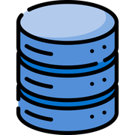



Caching, spatial indexes and hardening keep the app fast and safe under load
8653E3
AF89F4
771FFF
Dispatch caching
Abuse protection
F66F87
Plans are precomputed and served from memory; data changes refresh them
15-minute lockout after failed sign-ins; bounded back-off on 429s
75F9AA
4CC9F0
FFD500
Spatial indexes
Security hardening
PostGIS GIST indexes speed up containment and distance queries
scrypt hashing, server-side role checks, strict CSP and HSTS
0C0120
272036
Data efficiency
Append-only audit
SQL aggregation removes 3.2 MB per 5 min of rainfall traffic
Database triggers protect the audit log; errors carry a correlation ID
Source: src/control, persistence, entity, boundary
Notes:
(handoff point if the team splits here)
Six safeguards keep the app fast under load and safe from abuse.
The left column is speed. The right column is safety.
For speed, DispatchPlanService builds route plans ahead of time and keeps them in memory.
Spatial indexes in the first migration make map lookups fast. A spatial index groups shapes by location, so a query checks only the nearby areas instead of every one.
(proud delivery on concrete engineering gain)
SQL aggregation means the database adds up the rainfall readings itself and sends back only the totals. Here is the result I like best. Doing that cut three point two megabytes of traffic every five minutes.
For safety, Account dot ts locks an account after repeated failed sign-ins. The HTTP client backs off when an outside service says slow down.
Passwords are stored as scrypt hashes. A database trigger blocks any edit to the audit log.
And every error carries an ID, so one complaint maps to one log line.

Slide 18

Report in. Resolved out.
8653E3
QUESTIONS AND DISCUSSION
AF89F4
Report in. Resolved out.
771FFF
F66F87
dfence-sc2006.azurewebsites.net
75F9AA
4CC9F0
FFD500
0C0120
272036
Notes:
(handoff point if the team splits here)
So think back to that stagnant water behind your block.
Too often, the resident never learns if anyone came.
D-Fence closes that gap. The resident reports. The server ranks and plans. The manager reviews, and the field team fixes. Everyone sees the same verified result.
(build the energy)
Picture a future where every report ends in a fix. Residents trust that someone is coming. Managers send crews where the risk is highest. And dengue stops at the source, before it reaches the next neighbour.
(slow down, look at the room)
Report in. Resolved out. D-Fence is live today, at the address on screen.
(pause)
Thank you. We are ready for your questions, on stale data feeds and on scaling to more crews.

Slide 19
One score multiplies fixed pest severity by evidence-driven urgency, then bands it
8653E3
AF89F4
Normalise
Weight
Urgency
Severity
Band
Override
771FFF
F66F87
Each driver scaled to 0 to 1
Tier weights sum to 1
Weighted sum of drivers
Times pest severity, times 100
High 70+, Medium 40+
Life-safety goes Critical
75F9AA
Kampong Ubi dengue cluster, tier A, severity 1.00 (points)
Rule | How it works
Formula | Score = 100 x severity x urgency
Severity | Fixed per pest, 0 to 1. Mosquito and rat are 1.00
Urgency | Sum of weight x normalised driver, 0 to 1
Stale feed | Driver dropped. Other weights rescaled to sum to 1
Bands | High 70 or more, Medium 40 or more, else Low
Override | Verified life-safety report goes Critical
4CC9F0
2.0
54.9
FFD500
6.0
4.0
1.9
0C0120
7.5
11.8
272036
21.7
Case size
Case growth
Days since treated
Rain 72 h
Rain 24 h
Open reports
Premises mix
Score
Each bar is weight x normalised driver x 100. A stale feed never drags a score down.
Source: PEST-PRIORITY-MODEL.md s1, s5.2, s7; UrgencyCalculator.ts
Notes:
Not spoken. Use in Q&A on ranking.
The bars rebuild the Kampong Ubi row of the worked example. Each bar is one tier A weight times its normalised value. Case size, for example, is weight 0.30 on a normalised value of about 0.72, which gives 21.7 points.
If a feed is stale, UrgencyCalculator drops that driver and divides by the weights that remain. So a missing rainfall feed does not push every score down.

Slide 20
Severity stops a flood of minor reports outranking real risk, and overrides put life-safety first
8653E3
AF89F4
1.0
Place and pest | Sev. | Urg. | Score | Band
Toa Payoh, rat | 1.00 | 0.710 | 71.0 | High
Kampong Ubi, mosquito | 1.00 | 0.549 | 54.9 | Medium
Bukit Timah, snake | 0.75 | 0.515 | 38.6 | Critical
Sims Drive, ant | 0.50 | 0.745 | 37.3 | Low
771FFF
Urgency
F66F87
75F9AA
Ant 37.3
Rat 71.0
4CC9F0
Mosquito 54.9
FFD500
Snake 38.6
Override (verified report) | Condition
Snake | Indoors
Crocodile | Any location
Wild boar | Residential or school zone
Bee or wasp | School or healthcare site
Macaque | Indoors
Any pest | Injury reported
0C0120
272036
0
0
Severity
1.0
The ant has the highest urgency yet finishes last. The snake scores 38.6 yet goes straight to Critical.
Source: PEST-PRIORITY-MODEL.md s6 (overrides), s7 (worked example)
Notes:
Not spoken. Use in Q&A on ranking.
Rat and mosquito share severity 1.00, so urgency decides, and the rat block outranks the dengue cluster. The ant has the highest urgency, but severity 0.50 holds it down. The snake scores Low by arithmetic, but the indoor-snake rule forces it to Critical. Arithmetic and life-safety are kept in separate mechanisms. Wildlife cases go to AVS, and D-Fence does not send its own crew.

Slide 21
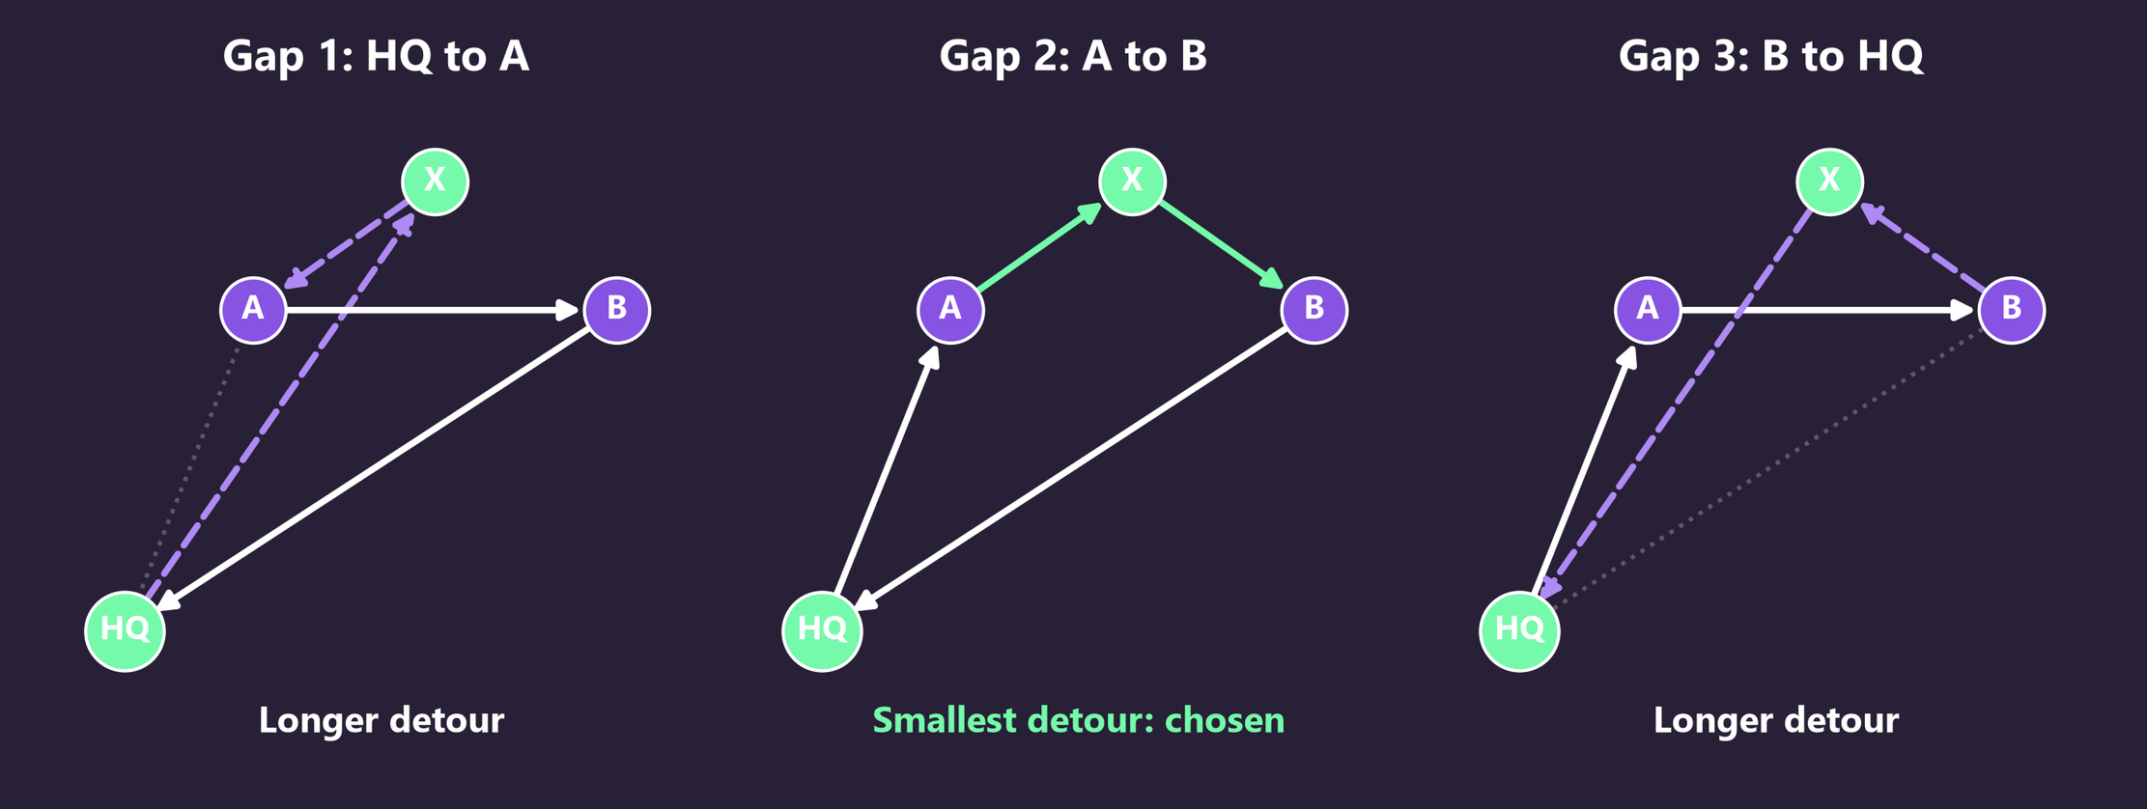
Cheap estimates rank every gap, OneMap checks the best six, and the smallest verified detour wins
8653E3
AF89F4
Sort
Filter
Estimate
Verify
Insert
771FFF
F66F87
Critical first, then scarce skills
Staff, vehicle and cargo fit
Straight line, 35 km/h
OneMap checks the best 6
Smallest verified detour
75F9AA
Route time | Rule
Drive | OneMap legs, HQ back to HQ
Walk | Road ends over 25 m away: two walks, 10 min max each
Work | Planning default, e.g. fogging 45 min
On-call | Delay before on-call staff arrive
Total | 4 hours or less
4CC9F0
FFD500
0C0120
272036
X is tried in every gap that keeps priority order. The gap that adds the least verified time wins.
Source: ROUTING-ALGORITHM-STE100.md s4 to s7
Notes:
Not spoken. Use in Q&A on routing.
For each task, the planner tries every gap in every compatible crew's route, plus a new route. It first drops gaps that break staff, vehicle or cargo limits. It ranks the rest by a straight-line estimate, then asks OneMap for real road and walking times on the best six only. The task goes into the gap with the smallest verified increase that keeps the route within four hours.

Slide 22
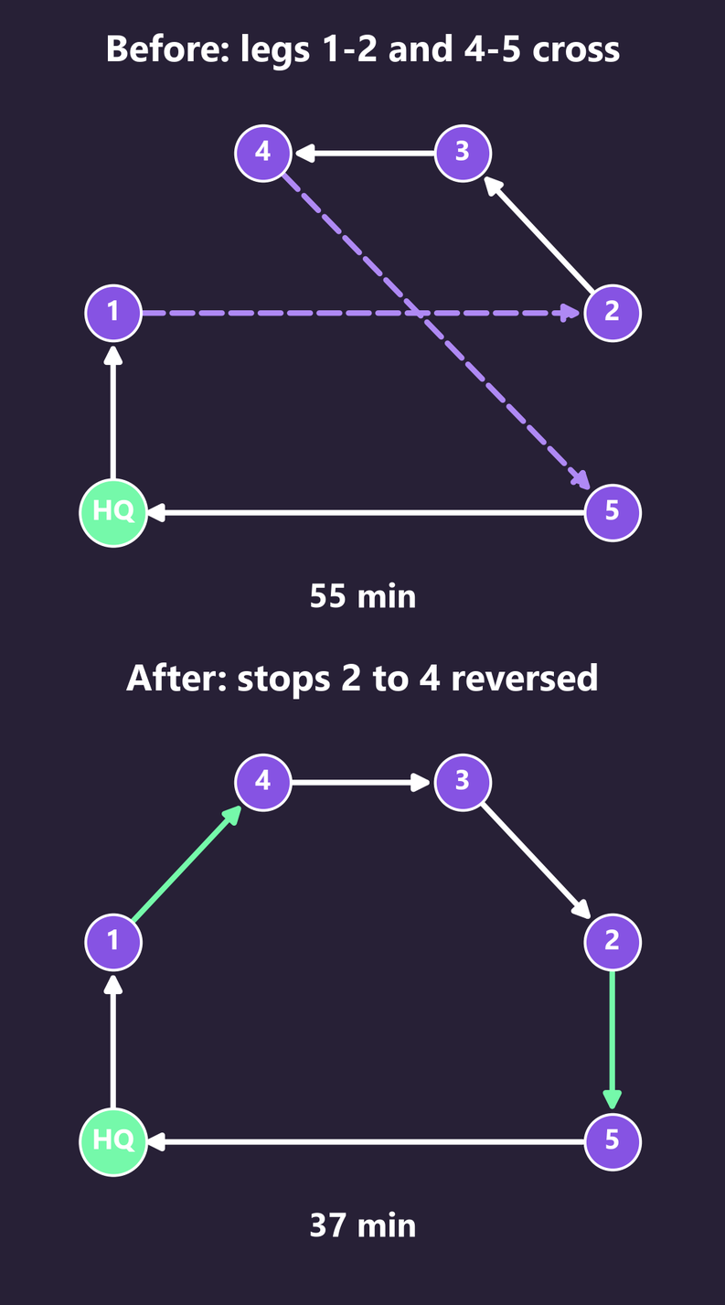
Local search removes crossings and moves jobs between crews, keeping only verified time savings
8653E3
AF89F4
Move | What it does | Kept only if
2-opt | Reverses a run of same-priority stops in one route | OneMap time falls
Swap | Exchanges equal-priority tasks between two routes | Time falls and both crews still fit
Relocate | Moves a task to another crew's route | Time falls and the first route keeps a stop
Limits | 64 in-route and 136 cross-route checks, 30 s budget | Stops at the first cross-route gain
771FFF
F66F87
75F9AA
4CC9F0
FFD500
0C0120
272036
Every move must cut verified travel time and keep every limit. The plan is good, not proven shortest.
Source: ROUTING-ALGORITHM-STE100.md s8; RouteOptimizationService.ts. Timings illustrative
Notes:
Not spoken. Use in Q&A on routing.
Left: legs 1-2 and 4-5 cross. 2-opt removes both legs and reverses stops 2 to 4, so the route no longer crosses itself. Reversal only runs over stops of the same priority, so priority order holds. Between crews, the planner swaps or moves tasks when verified time falls. The search has fixed limits, so the planner does not claim the shortest possible plan.

