Slide 1
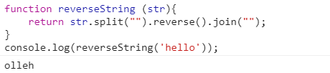
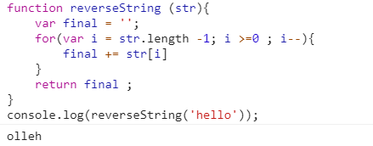
Challenge #1: Reverse a String

Slide 2
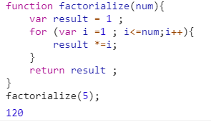
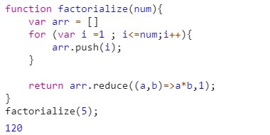
Challenge #2: Fatorialize

Slide 3
Challenge #1: Reverse a String

Slide 4
Challenge #1: Reverse a String

Slide 5
Challenge #1: Reverse a String

Slide 6
Challenge #1: Reverse a String

Slide 7
Challenge #1: Reverse a String

Slide 8
Challenge #1: Reverse a String

