Slide 1




Presentation on MS Lists Functionalities
bbv Software Services AG | Date: 21/07/2025

Slide 2

Agenda
Introduction
Key Functionalities
Q&A

Slide 3

Introduction
What is MS Lists?

Slide 4
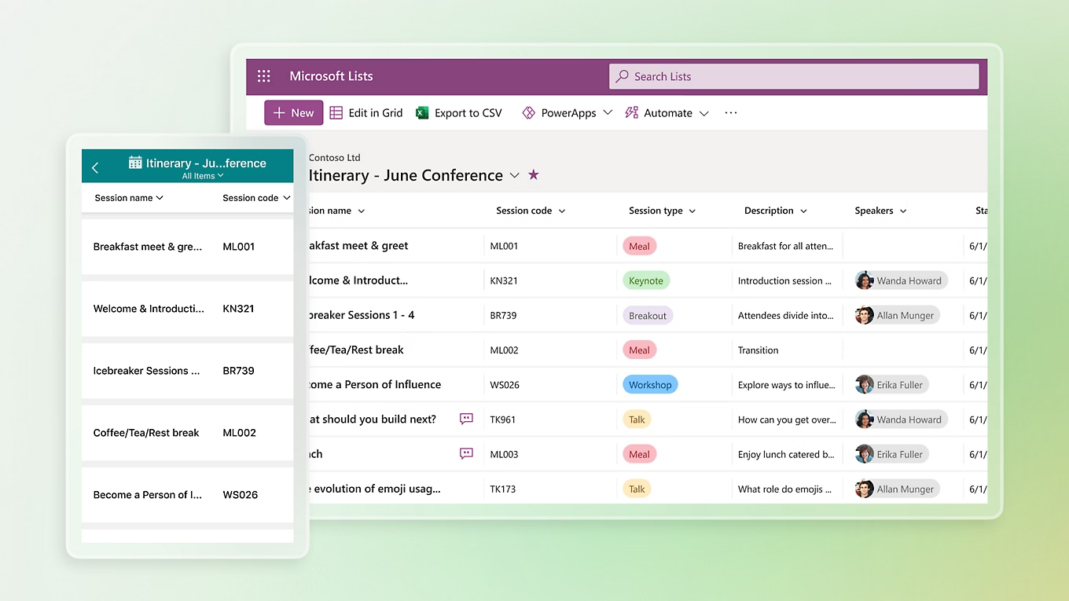
Introduction
What is Microsoft Lists
MS List is a tool for managing structured lists of data
Works like a simple table or database
Let’s users:
Create lists
View data
Manage info clearly and easily

Slide 5

Key Functionalities

Slide 6
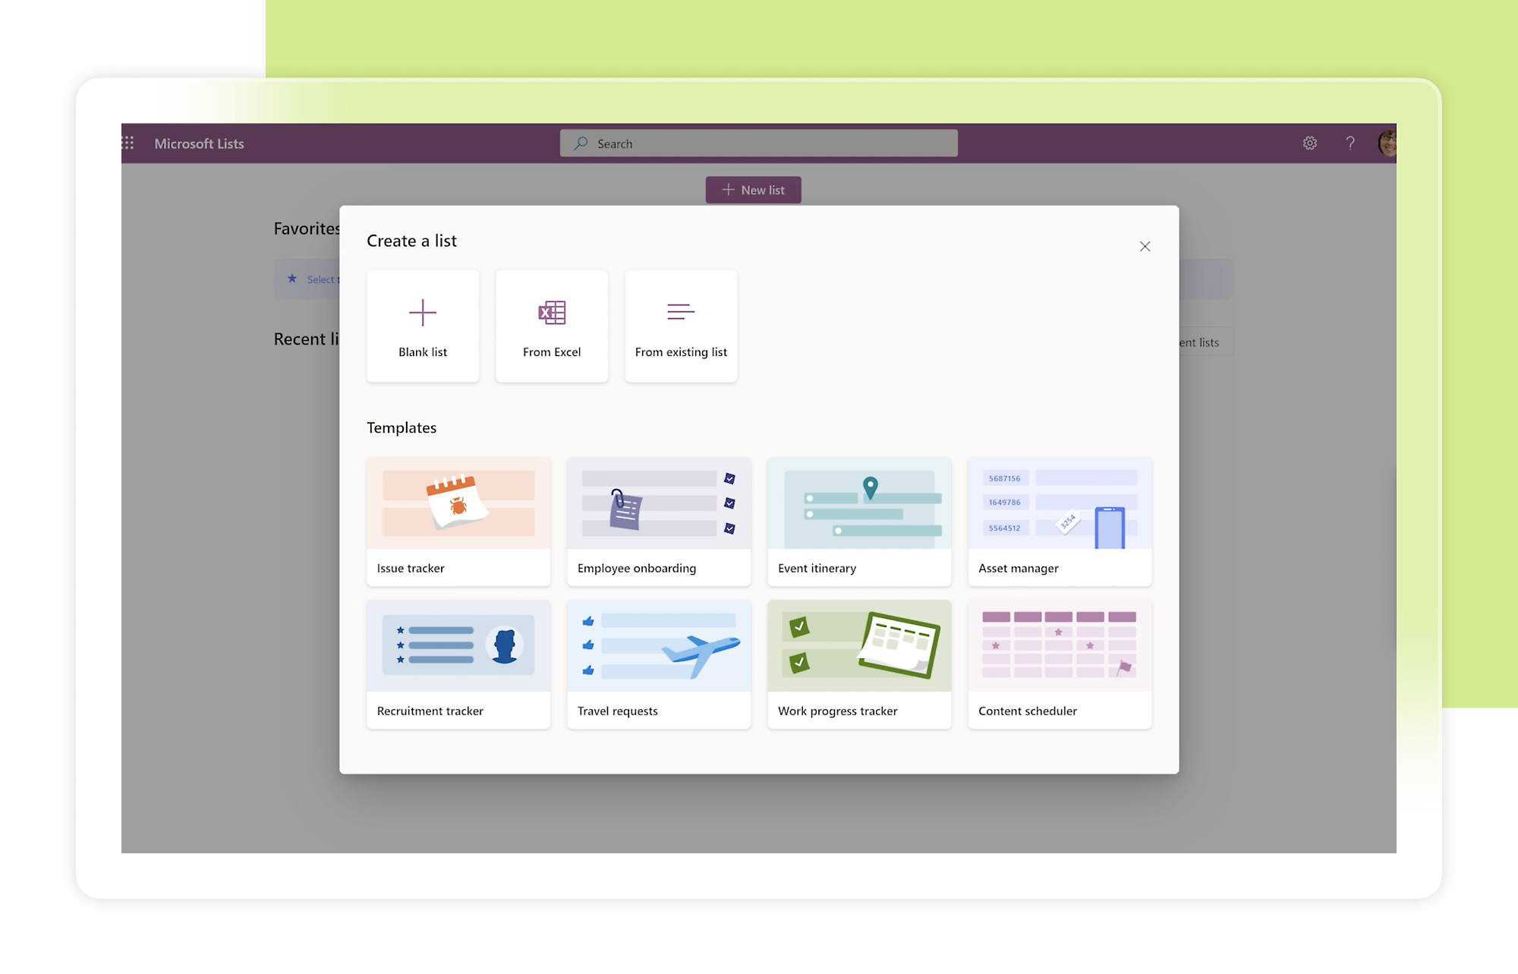
Key Functionalities of MS Lists
Create and Manage Lists
Custom Columns
Manage List Items
Custom Views
Conditional Formatting
Permissions and Sharing
Built-in Templates

Slide 7
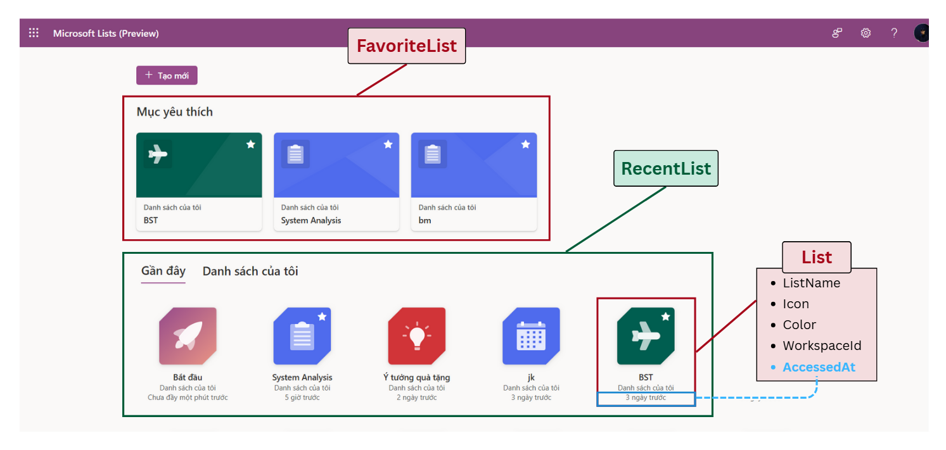
Dashboard Screen
Notes:
-- Dashboard Screen
-- Get information of a user
DECLARE @AccountId INT;
SET @AccountId = 1; -- DungTran910@live.com
SELECT acc.Id, acc.Avatar, acc.Email, acc.FirstName, acc.LastName, acc.Company, acc.AccountStatus
FROM
Account AS acc
WHERE acc.Id = @AccountId
-- Get lists created by a user
SELECT l.Id, l.Color, l.Icon, l.ListName, l.ListStatus, l.UpdatedAt
FROM
List AS l
INNER JOIN
Account AS acc ON l.CreatedBy = acc.Id
WHERE
acc.Id = @AccountId
ORDER BY
l.UpdatedAt ASC
-- Get favorite lists of a user
SELECT
l.Id, l.Color, l.Icon, l.ListName, l.ListStatus
FROM
List AS l
INNER JOIN
FavoriteList AS fl ON l.Id = fl.ListId
WHERE
fl.AccountId = @AccountId
ORDER BY
l.UpdatedAt ASC;

Slide 8
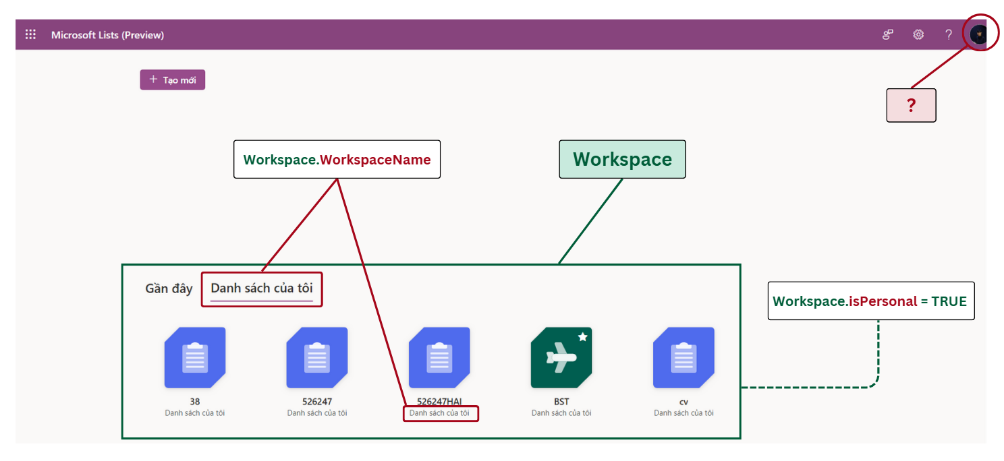
Dashboard Screen
Notes:
-- Dashboard Screen
-- Get information of a user
DECLARE @AccountId INT;
SET @AccountId = 1; -- DungTran910@live.com
SELECT acc.Id, acc.Avatar, acc.Email, acc.FirstName, acc.LastName, acc.Company, acc.AccountStatus
FROM
Account AS acc
WHERE acc.Id = @AccountId
-- Get lists created by a user
SELECT l.Id, l.Color, l.Icon, l.ListName, l.ListStatus, l.UpdatedAt
FROM
List AS l
INNER JOIN
Account AS acc ON l.CreatedBy = acc.Id
WHERE
acc.Id = @AccountId
ORDER BY
l.UpdatedAt ASC
-- Get favorite lists of a user
SELECT
l.Id, l.Color, l.Icon, l.ListName, l.ListStatus
FROM
List AS l
INNER JOIN
FavoriteList AS fl ON l.Id = fl.ListId
WHERE
fl.AccountId = @AccountId
ORDER BY
l.UpdatedAt ASC;

Slide 9
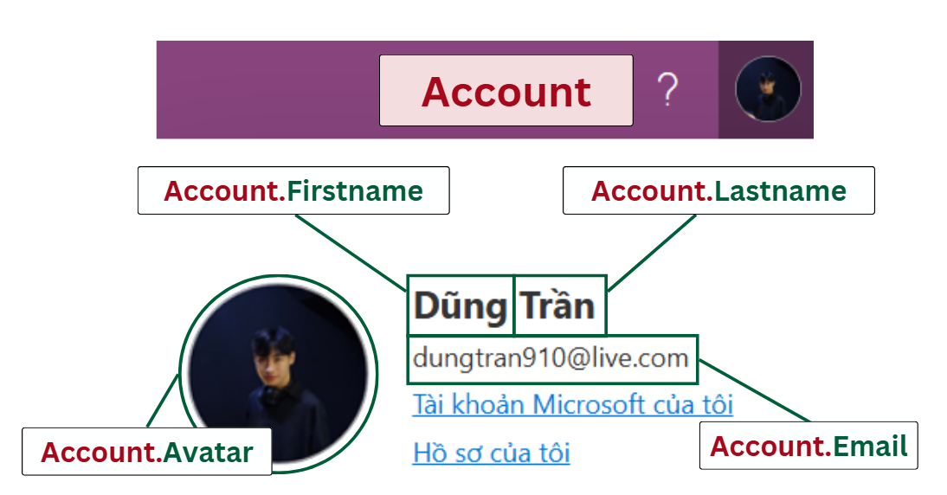
Dashboard Screen
Notes:
-- Dashboard Screen
-- Get information of a user
DECLARE @AccountId INT;
SET @AccountId = 1; -- DungTran910@live.com
SELECT acc.Id, acc.Avatar, acc.Email, acc.FirstName, acc.LastName, acc.Company, acc.AccountStatus
FROM
Account AS acc
WHERE acc.Id = @AccountId
-- Get lists created by a user
SELECT l.Id, l.Color, l.Icon, l.ListName, l.ListStatus, l.UpdatedAt
FROM
List AS l
INNER JOIN
Account AS acc ON l.CreatedBy = acc.Id
WHERE
acc.Id = @AccountId
ORDER BY
l.UpdatedAt ASC
-- Get favorite lists of a user
SELECT
l.Id, l.Color, l.Icon, l.ListName, l.ListStatus
FROM
List AS l
INNER JOIN
FavoriteList AS fl ON l.Id = fl.ListId
WHERE
fl.AccountId = @AccountId
ORDER BY
l.UpdatedAt ASC;

Slide 10
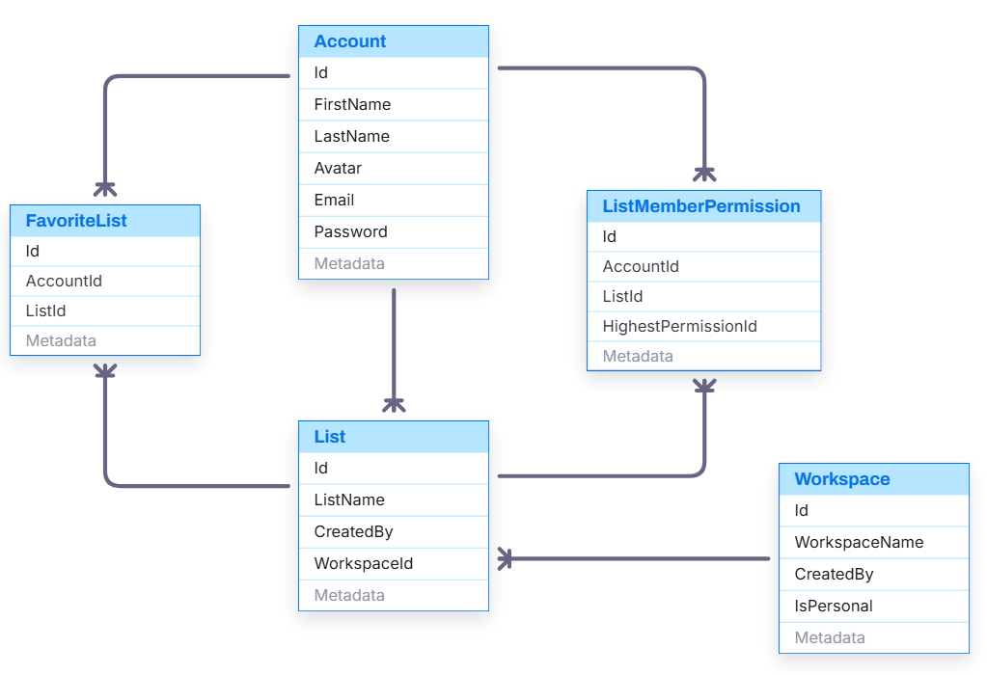
Dashboard Screen

Slide 11
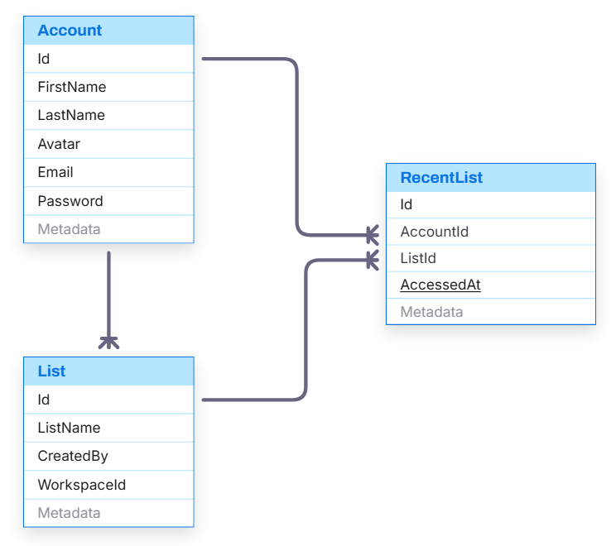
Dashboard Screen
Notes:
-- Dashboard Screen
-- Get information of a user
DECLARE @AccountId INT;
SET @AccountId = 1; -- DungTran910@live.com
SELECT acc.Id, acc.Avatar, acc.Email, acc.FirstName, acc.LastName, acc.Company, acc.AccountStatus
FROM
Account AS acc
WHERE acc.Id = @AccountId
-- Get lists created by a user
SELECT l.Id, l.Color, l.Icon, l.ListName, l.ListStatus, l.UpdatedAt
FROM
List AS l
INNER JOIN
Account AS acc ON l.CreatedBy = acc.Id
WHERE
acc.Id = @AccountId
ORDER BY
l.UpdatedAt ASC
-- Get favorite lists of a user
SELECT
l.Id, l.Color, l.Icon, l.ListName, l.ListStatus
FROM
List AS l
INNER JOIN
FavoriteList AS fl ON l.Id = fl.ListId
WHERE
fl.AccountId = @AccountId
ORDER BY
l.UpdatedAt ASC;

Slide 12
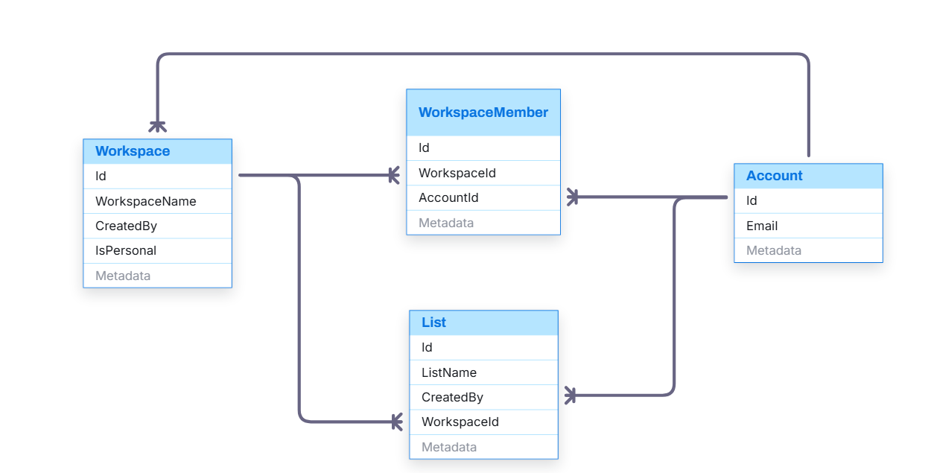
Dashboard Screen
Notes:
-- Create List From List Type
-- Get HeaderImage of a specific list type
SELECT
lt.Id, lt.HeaderImage
FROM
ListType lt
WHERE
lt.Id = 1
-- Get all workspaces of a specific user
SELECT
w.Id AS WorkspaceId, w.WorkspaceName, wm.AccountId AS UserId
FROM
WorkspaceMember wm
INNER JOIN
Workspace w ON wm.WorkspaceId = w.Id
WHERE
wm.AccountId = 3
ORDER BY
wm.Id DESC;

Slide 13
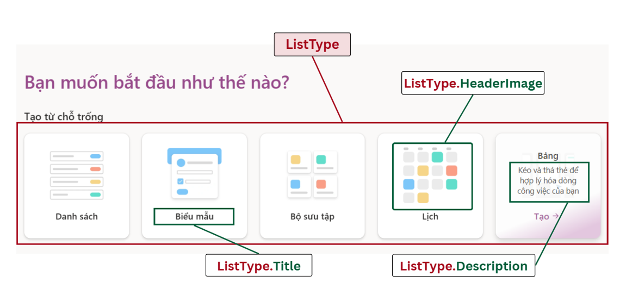
Create List Screen
Notes:
-- Create List
-- Get all list types
SELECT lt.Id, lt.Icon, lt.Title, lt.[Description] FROM ListType lt

Slide 14
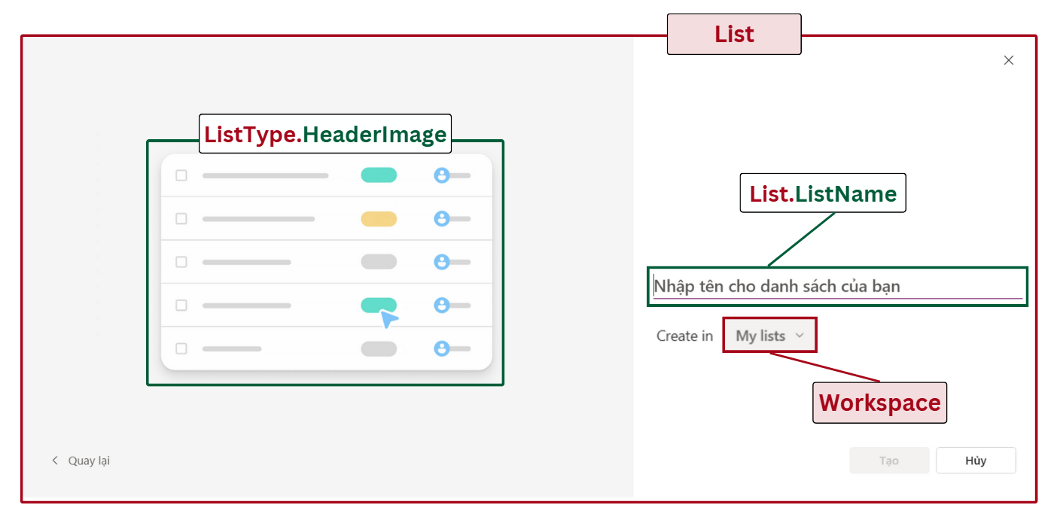
Create List From List Type
Notes:
-- Create List From List Type
-- Get HeaderImage of a specific list type
SELECT
lt.Id, lt.HeaderImage
FROM
ListType lt
WHERE
lt.Id = 1
-- Get all workspaces of a specific user
SELECT
w.Id AS WorkspaceId, w.WorkspaceName, wm.AccountId AS UserId
FROM
WorkspaceMember wm
INNER JOIN
Workspace w ON wm.WorkspaceId = w.Id
WHERE
wm.AccountId = 3
ORDER BY
wm.Id DESC;

Slide 15
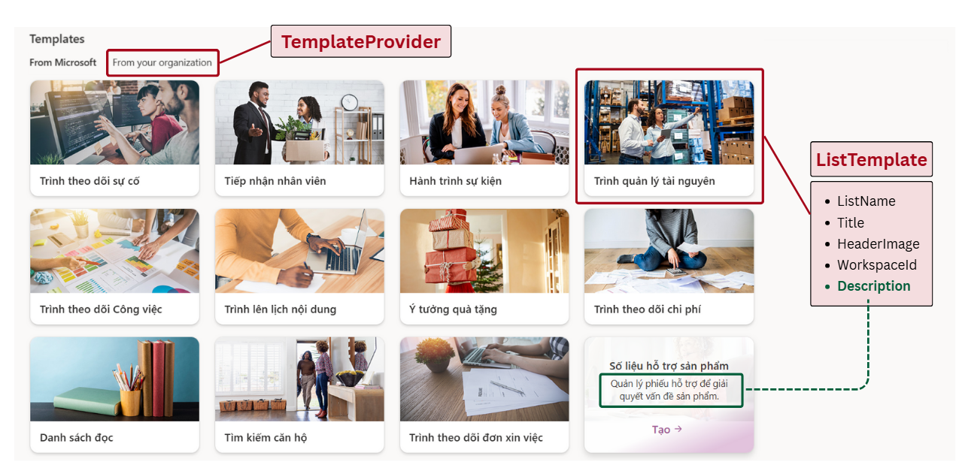
Create List Screen
Notes:
-- Create List
-- Get all providers
SELECT tp.Id, tp.ProviderName FROM TemplateProvider tp
-- Get all templates of a specific provider
SELECT
tp.Id, tp.ProviderName, lt.Id,lt.Title, lt.[Description], lt.HeaderImage
FROM
TemplateProvider tp
INNER JOIN
ListTemplate lt ON tp.Id = lt.ProviderId
WHERE
tp.Id = 1;

Slide 16
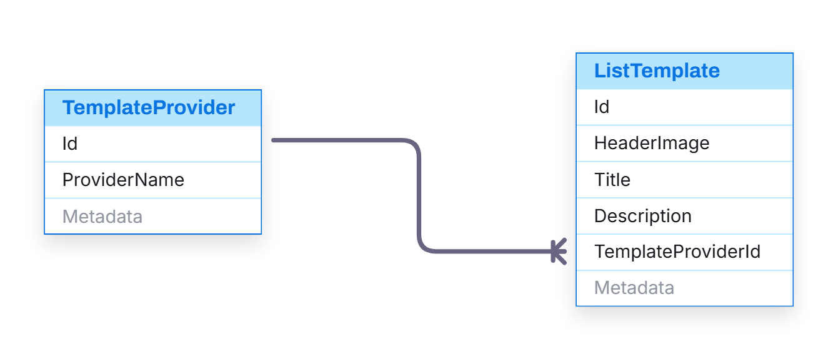
Create List Screen
Notes:
-- Create List
-- Get all providers
SELECT tp.Id, tp.ProviderName FROM TemplateProvider tp
-- Get all templates of a specific provider
SELECT
tp.Id, tp.ProviderName, lt.Id,lt.Title, lt.[Description], lt.HeaderImage
FROM
TemplateProvider tp
INNER JOIN
ListTemplate lt ON tp.Id = lt.ProviderId
WHERE
tp.Id = 1;

Slide 17
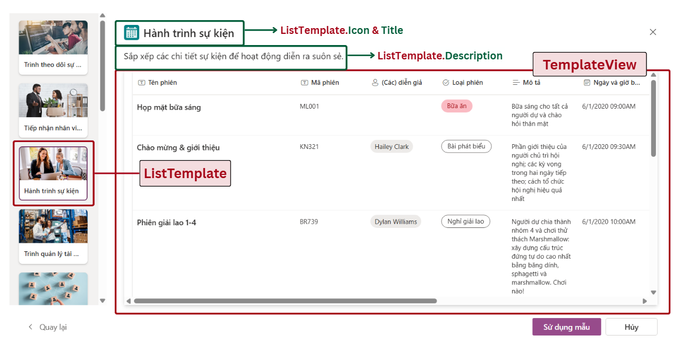
Create List From Template
Notes:
-- Create List From Template
-- Get basic information of a specific template
SELECT
lt.Id, lt.Title, lt.Icon, lt.Summary, lt.Feature
FROM
ListTemplate lt
WHERE
lt.Id = 1
-- Get sample data of a specific template
SELECT
tcol.Id AS colId,
tcol.ColumnName,
sdt.Icon,
trow.Id rowid,
tcell.CellValue,
tcol.ListTemplateId
FROM
TemplateColumn tcol
INNER JOIN
SystemDataType sdt ON tcol.SystemDataTypeId = sdt.Id
INNER JOIN
TemplateSampleRow trow ON tcol.ListTemplateId = trow.ListTemplateId
INNER JOIN
TemplateSampleCell tcell
ON tcol.Id = tcell.TemplateColumnId
AND trow.Id = tcell.TemplateSampleRowId
WHERE
tcol.ListTemplateId = 1

Slide 18
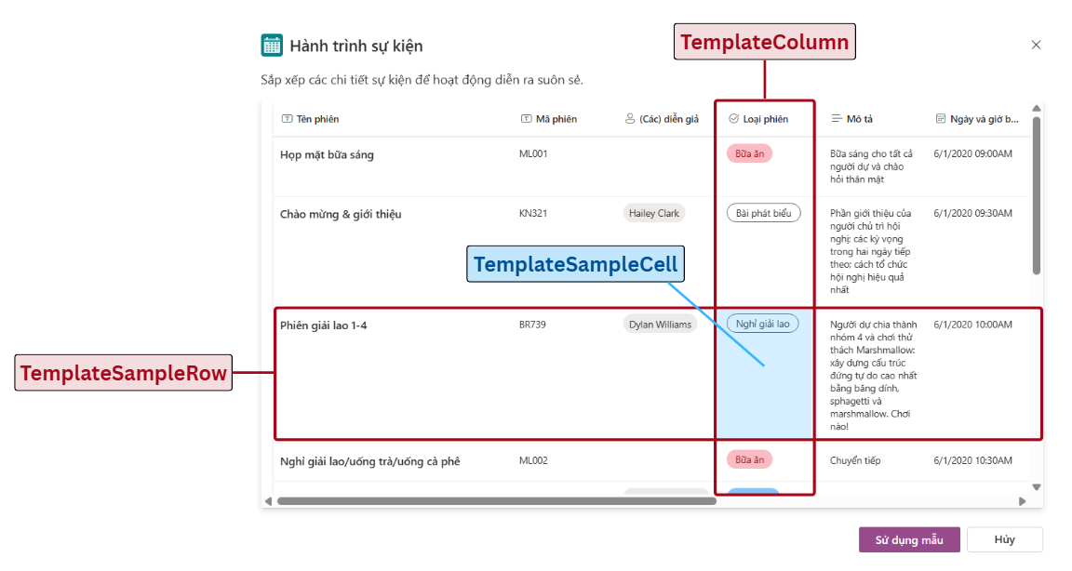
Create List From Template
Notes:
-- Create List From Template
-- Get basic information of a specific template
SELECT
lt.Id, lt.Title, lt.Icon, lt.Summary, lt.Feature
FROM
ListTemplate lt
WHERE
lt.Id = 1
-- Get sample data of a specific template
SELECT
tcol.Id AS colId,
tcol.ColumnName,
sdt.Icon,
trow.Id rowid,
tcell.CellValue,
tcol.ListTemplateId
FROM
TemplateColumn tcol
INNER JOIN
SystemDataType sdt ON tcol.SystemDataTypeId = sdt.Id
INNER JOIN
TemplateSampleRow trow ON tcol.ListTemplateId = trow.ListTemplateId
INNER JOIN
TemplateSampleCell tcell
ON tcol.Id = tcell.TemplateColumnId
AND trow.Id = tcell.TemplateSampleRowId
WHERE
tcol.ListTemplateId = 1

Slide 19
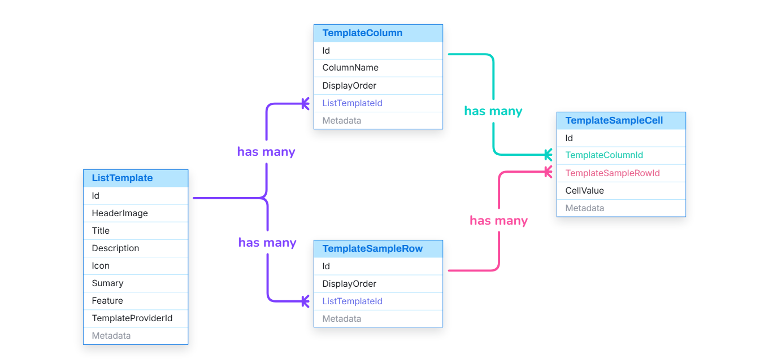
Create List From Template
Notes:
-- Create List From Template
-- Get basic information of a specific template
SELECT
lt.Id, lt.Title, lt.Icon, lt.Summary, lt.Feature
FROM
ListTemplate lt
WHERE
lt.Id = 1
-- Get sample data of a specific template
SELECT
tcol.Id AS colId,
tcol.ColumnName,
sdt.Icon,
trow.Id rowid,
tcell.CellValue,
tcol.ListTemplateId
FROM
TemplateColumn tcol
INNER JOIN
SystemDataType sdt ON tcol.SystemDataTypeId = sdt.Id
INNER JOIN
TemplateSampleRow trow ON tcol.ListTemplateId = trow.ListTemplateId
INNER JOIN
TemplateSampleCell tcell
ON tcol.Id = tcell.TemplateColumnId
AND trow.Id = tcell.TemplateSampleRowId
WHERE
tcol.ListTemplateId = 1

Slide 20
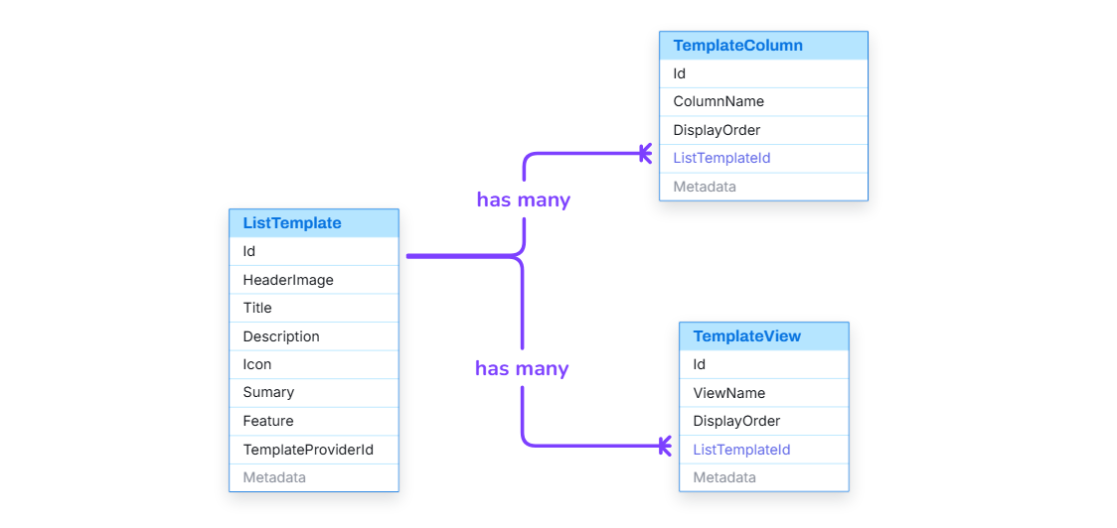
Template View & Template Column
Notes:
-- Create List From Template
-- Get all views of a template
SELECT
tv.Id,
tv.ViewName,
tv.ViewTypeId,
vt.Icon,
vs.SettingKey,
tvs.GroupByColumnId,
tvs.RawValue
FROM
TemplateView tv
INNER JOIN
ViewType vt ON tv.ViewTypeId = vt.Id
LEFT JOIN
TemplateViewSetting tvs ON tv.Id = tvs.TemplateViewId
LEFT JOIN
ViewTypeSetting vts ON tvs.ViewTypeSettingId = vts.Id
LEFT JOIN
ViewSetting vs ON vts.ViewSettingId = vs.Id
WHERE
tv.ListTemplateId = 1
ORDER BY
tv.DisplayOrder
-- Get all columns of a template and their setting value
SELECT
tc.Id, tc.ColumnName, sdt.Icon, ks.KeyName, tcsv.KeyValue
FROM
TemplateColumn tc
INNER JOIN
SystemDataType sdt ON tc.SystemDataTypeId = sdt.Id
LEFT JOIN
TemplateColumnSettingValue tcsv ON tc.Id = tcsv.TemplateColumnId
LEFT JOIN
DataTypeSettingKey dtsk ON tcsv.DataTypeSettingKeyId = dtsk.Id
LEFT JOIN
KeySetting ks ON dtsk.KeySettingId = ks.Id
WHERE
tc.ListTemplateId = 1
ORDER BY
tc.DisplayOrder
-- Get all column setting object of needed columns (choice)
SELECT
lcso.Id,
lcso.DisplayName,
lcso.DisplayColor,
lcso.DisplayOrder
FROM
ListColumnSettingObject lcso
INNER JOIN
TemplateColumn tc ON lcso.ColumnId = tc.Id
WHERE
lcso.Context = 'TEMPLATE'
AND tc.ListTemplateId = 1;

Slide 21
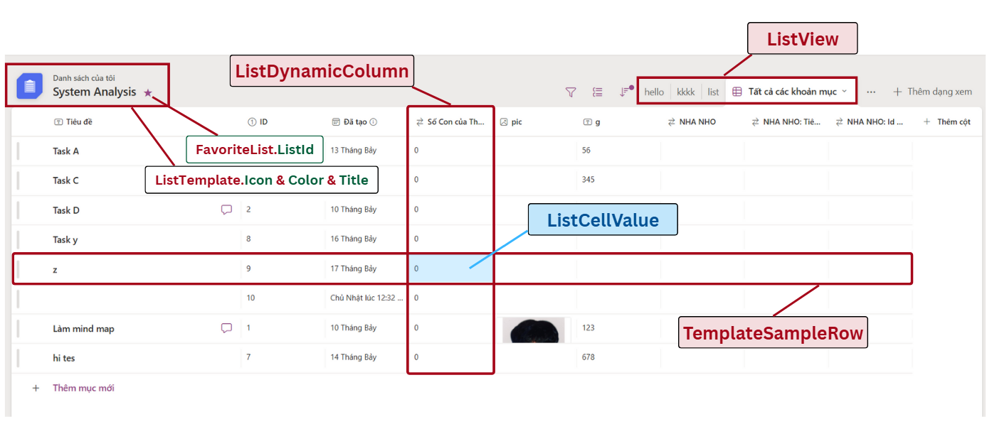
List Management
Notes:
-- List Management
-- Get all data of a specific list
SELECT
lc.Id AS ColumnId,
sdt.Icon AS ColumnIcon,
lc.ColumnName AS ColumnName,
lr.Id AS RowId,
lcvl.[Value] AS CellValue
FROM
ListDynamicColumn AS lc
INNER JOIN
ListRow AS lr ON lc.ListId = lr.ListId
INNER JOIN
ListCellValue AS lcvl ON lcvl.ListColumnId = lc.Id AND lcvl.ListRowId = lr.Id
INNER JOIN
SystemDataType AS sdt ON lc.SystemDataTypeId = sdt.Id
WHERE
lc.ListId = 1
ORDER BY lc.DisplayOrder ASC, lr.DisplayOrder ASC
-- Get all column setting object of needed columns (choice)
SELECT
lcso.Id,
lcso.ColumnId AS ListDynamicColumnId,
lcso.DisplayName,
lcso.DisplayColor,
lcso.DisplayOrder,
lcso.Context
FROM
ListColumnSettingObject lcso
INNER JOIN
ListDynamicColumn ldc ON lcso.ColumnId = ldc.Id
WHERE
lcso.Context = 'LIST'
AND LDC.ListId = 1;
-- Get all datatype settings of a specific column
SELECT
ks.Id,
ks.KeyName,
ks.DefaultValue,
ks.ValueType,
lcsv.KeyValue
FROM
KeySetting ks
INNER JOIN
DataTypeSettingKey dtsk ON ks.Id = dtsk.KeySettingId
LEFT JOIN
ListColumnSettingValue lcsv
ON dtsk.Id = lcsv.DataTypeSettingKeyId
AND lcsv.ColumnId = 1
WHERE
dtsk.DataTypeId = 1;
-- Get all views of a specific list
SELECT
lv.Id, lv.ViewName, vt.Icon
FROM
ListView lv
INNER JOIN
ViewType vt ON lv.ViewTypeId = vt.Id
WHERE
lv.ListId = 1
ORDER BY
lv.DisplayOrder ASC
-- Get all view settings of a specific list view
SELECT
vs.Id,
vs.SettingKey,
vs.ValueType,
lvs.ListViewId,
lvs.GroupByColumnId,
lvs.RawValue
FROM
ViewSetting vs
INNER JOIN
ViewTypeSetting vts ON vs.Id = vts.ViewSettingId
LEFT JOIN
ListViewSetting lvs
ON vts.Id = lvs.ViewTypeSettingId
AND lvs.ListViewId = 1
WHERE
vts.ViewTypeId = 4

Slide 22
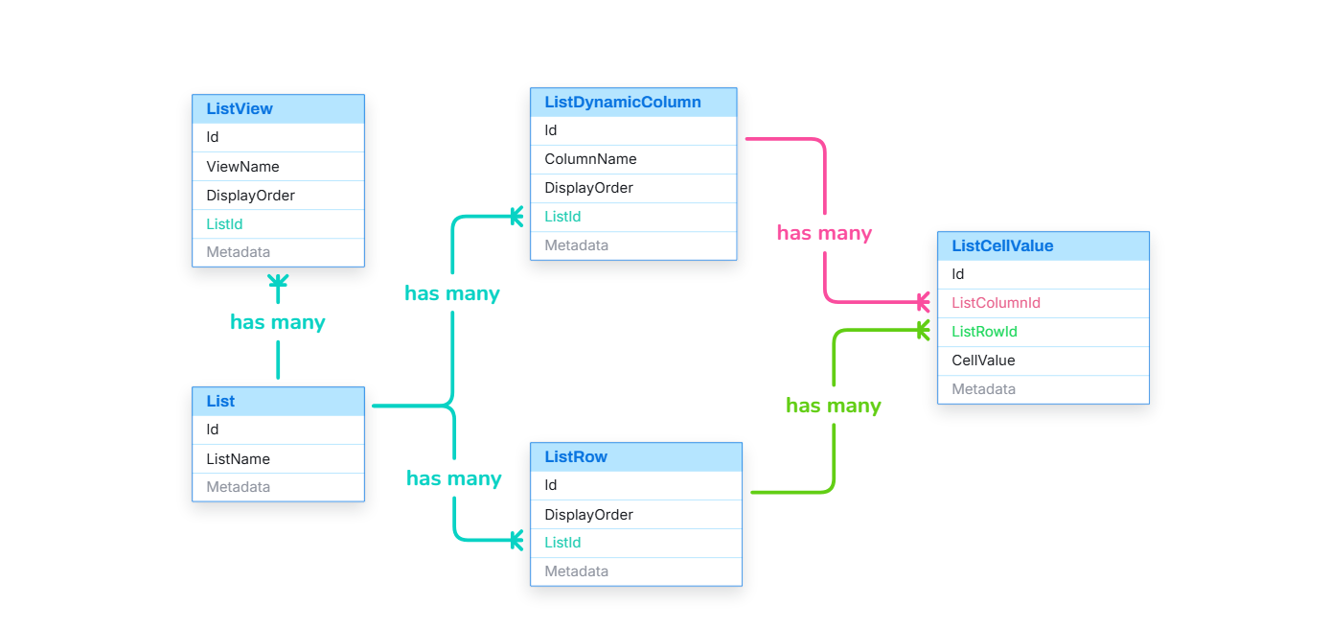
List Management
Notes:
-- List Management
-- Get all data of a specific list
SELECT
lc.Id AS ColumnId,
sdt.Icon AS ColumnIcon,
lc.ColumnName AS ColumnName,
lr.Id AS RowId,
lcvl.[Value] AS CellValue
FROM
ListDynamicColumn AS lc
INNER JOIN
ListRow AS lr ON lc.ListId = lr.ListId
INNER JOIN
ListCellValue AS lcvl ON lcvl.ListColumnId = lc.Id AND lcvl.ListRowId = lr.Id
INNER JOIN
SystemDataType AS sdt ON lc.SystemDataTypeId = sdt.Id
WHERE
lc.ListId = 1
ORDER BY lc.DisplayOrder ASC, lr.DisplayOrder ASC
-- Get all column setting object of needed columns (choice)
SELECT
lcso.Id,
lcso.ColumnId AS ListDynamicColumnId,
lcso.DisplayName,
lcso.DisplayColor,
lcso.DisplayOrder,
lcso.Context
FROM
ListColumnSettingObject lcso
INNER JOIN
ListDynamicColumn ldc ON lcso.ColumnId = ldc.Id
WHERE
lcso.Context = 'LIST'
AND LDC.ListId = 1;
-- Get all datatype settings of a specific column
SELECT
ks.Id,
ks.KeyName,
ks.DefaultValue,
ks.ValueType,
lcsv.KeyValue
FROM
KeySetting ks
INNER JOIN
DataTypeSettingKey dtsk ON ks.Id = dtsk.KeySettingId
LEFT JOIN
ListColumnSettingValue lcsv
ON dtsk.Id = lcsv.DataTypeSettingKeyId
AND lcsv.ColumnId = 1
WHERE
dtsk.DataTypeId = 1;
-- Get all views of a specific list
SELECT
lv.Id, lv.ViewName, vt.Icon
FROM
ListView lv
INNER JOIN
ViewType vt ON lv.ViewTypeId = vt.Id
WHERE
lv.ListId = 1
ORDER BY
lv.DisplayOrder ASC
-- Get all view settings of a specific list view
SELECT
vs.Id,
vs.SettingKey,
vs.ValueType,
lvs.ListViewId,
lvs.GroupByColumnId,
lvs.RawValue
FROM
ViewSetting vs
INNER JOIN
ViewTypeSetting vts ON vs.Id = vts.ViewSettingId
LEFT JOIN
ListViewSetting lvs
ON vts.Id = lvs.ViewTypeSettingId
AND lvs.ListViewId = 1
WHERE
vts.ViewTypeId = 4

Slide 23
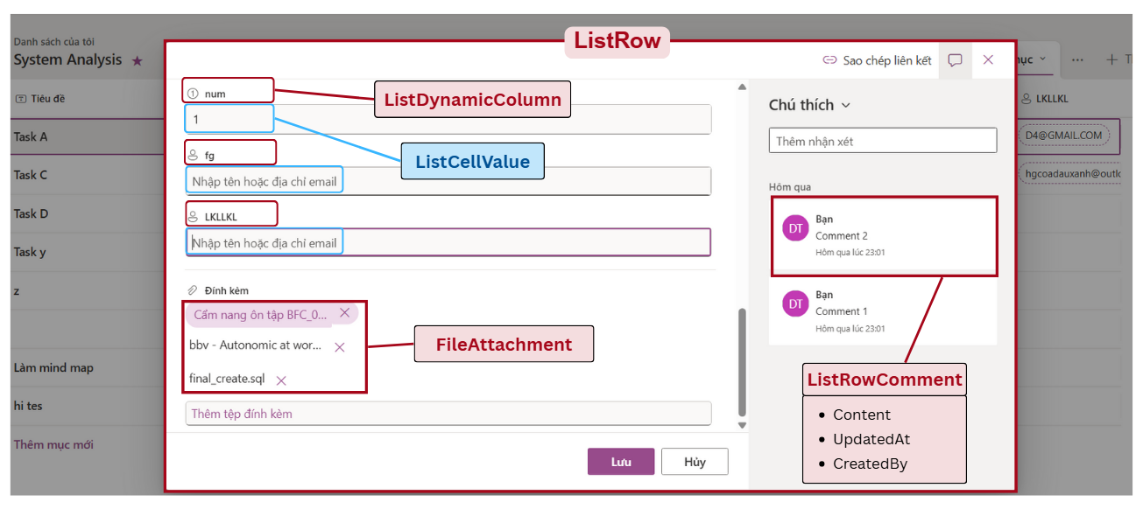
List Row Detail
Notes:
-- List Management
-- Get all comment of a row
SELECT
lrc.Id AS RowId, a.Avatar, a.FirstName, a.LastName, lrc.Content, lrc.UpdateAt
FROM
Account a
INNER JOIN
ListRowComment lrc ON a.Id = lrc.CreatedBy
WHERE
lrc.ListRowId = 1
ORDER BY
lrc.UpdateAt DESC
-- Get all attachment files of a row
SELECT
fa.Id, fa.[FileName], fa.FileUrl
FROM
FileAttachment fa
WHERE
fa.ListItemId = 1
ORDER BY
fa.CreateAt DESC

Slide 24
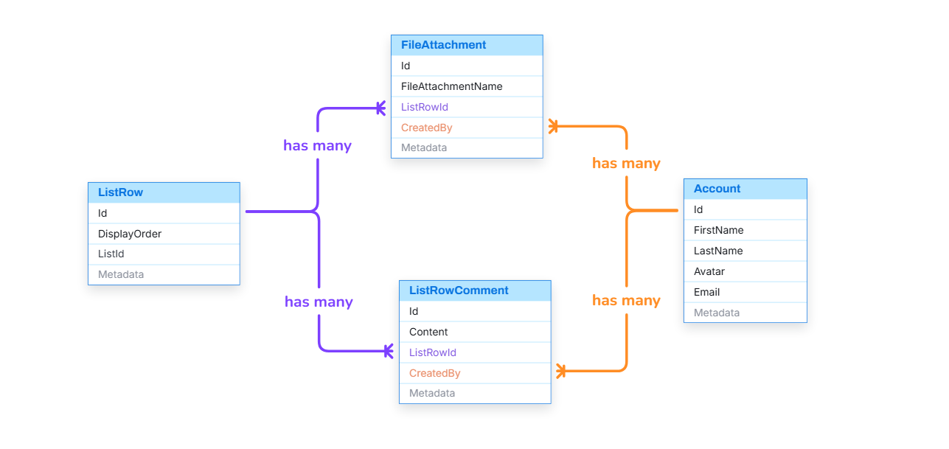
List Row Detail
Notes:
-- List Management
-- Get all comment of a row
SELECT
lrc.Id AS RowId, a.Avatar, a.FirstName, a.LastName, lrc.Content, lrc.UpdateAt
FROM
Account a
INNER JOIN
ListRowComment lrc ON a.Id = lrc.CreatedBy
WHERE
lrc.ListRowId = 1
ORDER BY
lrc.UpdateAt DESC
-- Get all attachment files of a row
SELECT
fa.Id, fa.[FileName], fa.FileUrl
FROM
FileAttachment fa
WHERE
fa.ListItemId = 1
ORDER BY
fa.CreateAt DESC

Slide 25
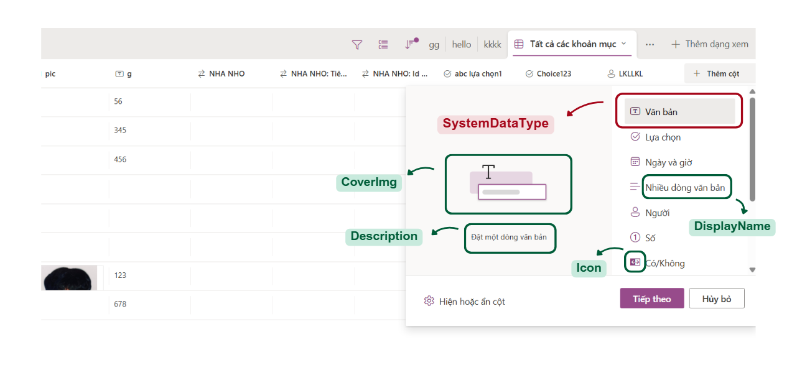
List Dynamic Column
Notes:
-- List Management
-- Get all system data types
SELECT
sdt.Id, sdt.Icon, sdt.[Description], sdt.DisplayName
FROM
SystemDataType sdt

Slide 26
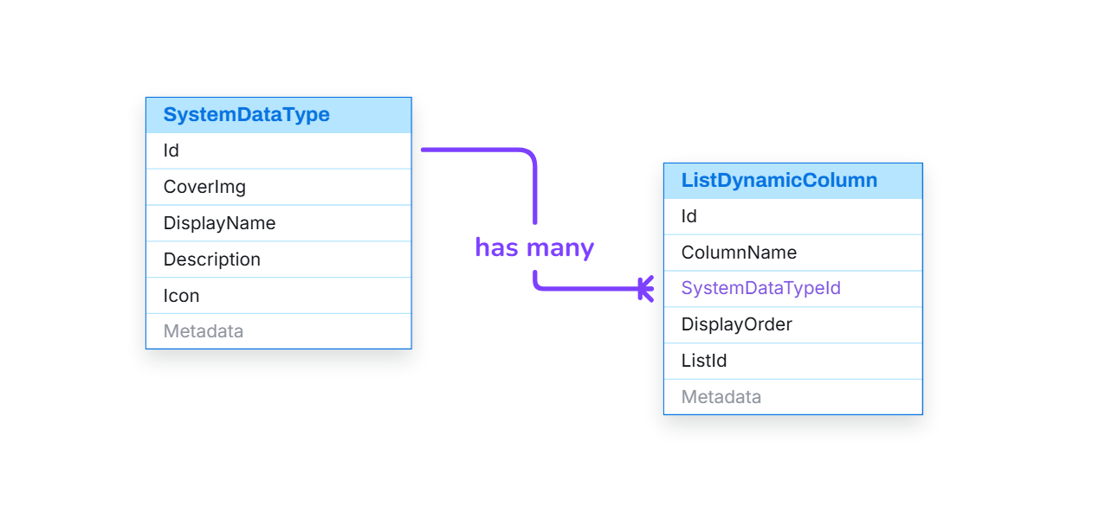
List Dynamic Column
Notes:
-- List Management
-- Get all system data types
SELECT
sdt.Id, sdt.Icon, sdt.[Description], sdt.DisplayName
FROM
SystemDataType sdt

Slide 27
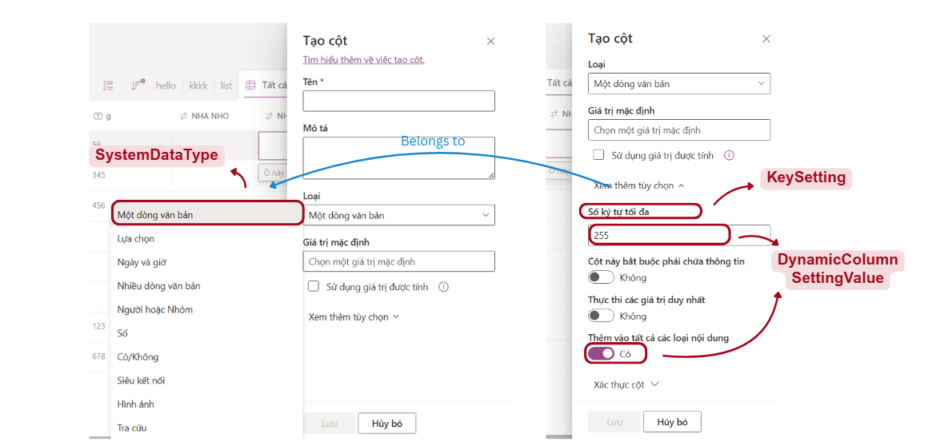
Dynamic Column Setting
Notes:
-- List Column Setting
-- Get all key setting of a specific system data type
SELECT
ks.Id, ks.KeyName, ks.DefaultValue, ks.ValueType
FROM
KeySetting ks
INNER JOIN
DataTypeSettingKey dtsk ON ks.Id = dtsk.KeySettingId
WHERE
dtsk.DataTypeId = 1
-- Get all datatype settings of a specific column
SELECT
ks.Id,
ks.KeyName,
ks.DefaultValue,
ks.ValueType,
lcsv.KeyValue
FROM
KeySetting ks
INNER JOIN
DataTypeSettingKey dtsk ON ks.Id = dtsk.KeySettingId
LEFT JOIN
ListColumnSettingValue lcsv
ON dtsk.Id = lcsv.DataTypeSettingKeyId
AND lcsv.ColumnId = 1
WHERE
dtsk.DataTypeId = 1;

Slide 28
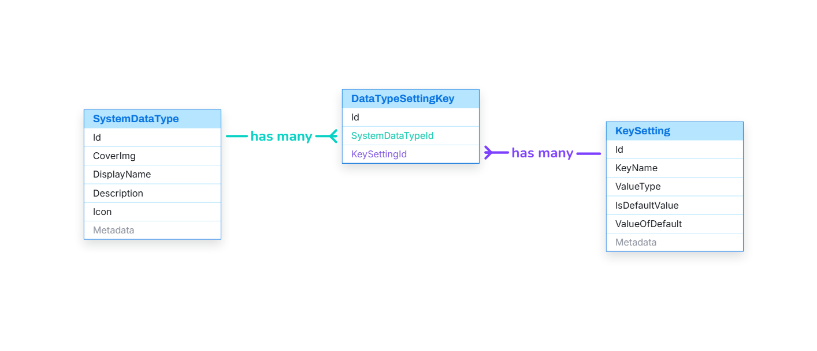
Dynamic Column Setting
Notes:
-- List Column Setting
-- Get all key setting of a specific system data type
SELECT
ks.Id, ks.KeyName, ks.DefaultValue, ks.ValueType
FROM
KeySetting ks
INNER JOIN
DataTypeSettingKey dtsk ON ks.Id = dtsk.KeySettingId
WHERE
dtsk.DataTypeId = 1
-- Get all datatype settings of a specific column
SELECT
ks.Id,
ks.KeyName,
ks.DefaultValue,
ks.ValueType,
lcsv.KeyValue
FROM
KeySetting ks
INNER JOIN
DataTypeSettingKey dtsk ON ks.Id = dtsk.KeySettingId
LEFT JOIN
ListColumnSettingValue lcsv
ON dtsk.Id = lcsv.DataTypeSettingKeyId
AND lcsv.ColumnId = 1
WHERE
dtsk.DataTypeId = 1;

Slide 29
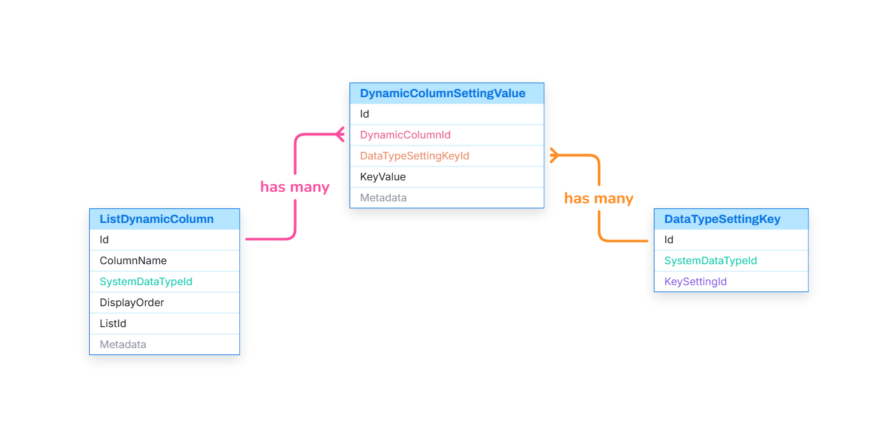
Dynamic Column Setting
Notes:
-- List Column Setting
-- Get all key setting of a specific system data type
SELECT
ks.Id, ks.KeyName, ks.DefaultValue, ks.ValueType
FROM
KeySetting ks
INNER JOIN
DataTypeSettingKey dtsk ON ks.Id = dtsk.KeySettingId
WHERE
dtsk.DataTypeId = 1
-- Get all datatype settings of a specific column
SELECT
ks.Id,
ks.KeyName,
ks.DefaultValue,
ks.ValueType,
lcsv.KeyValue
FROM
KeySetting ks
INNER JOIN
DataTypeSettingKey dtsk ON ks.Id = dtsk.KeySettingId
LEFT JOIN
ListColumnSettingValue lcsv
ON dtsk.Id = lcsv.DataTypeSettingKeyId
AND lcsv.ColumnId = 1
WHERE
dtsk.DataTypeId = 1;

Slide 30
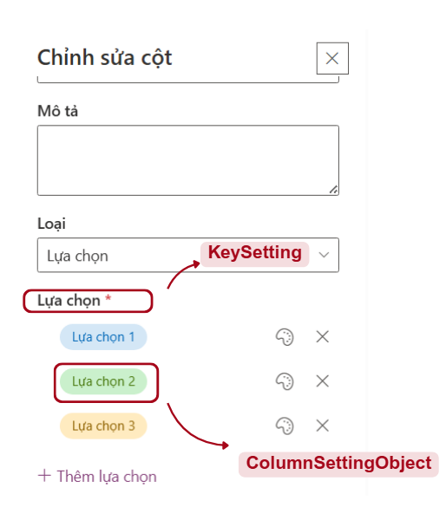
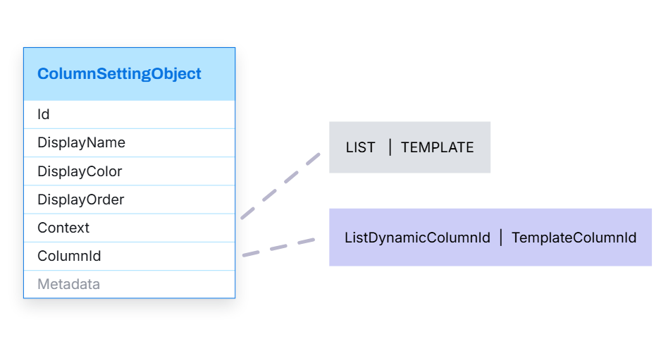
Dynamic Column Setting

Slide 31
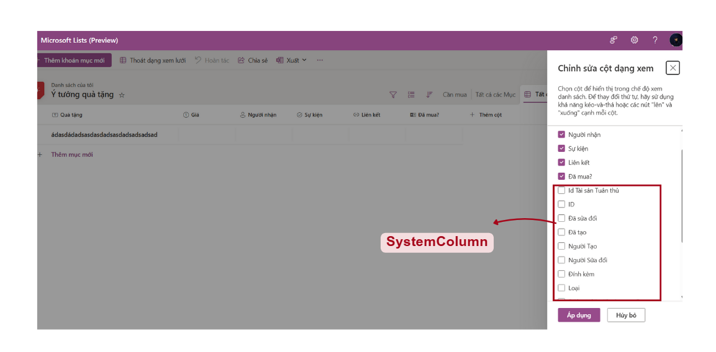
System Column

Slide 32
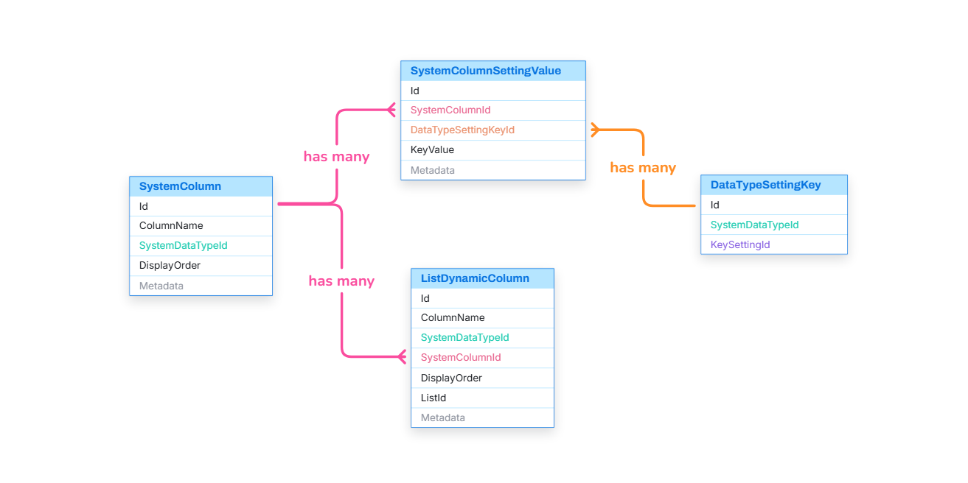
System Column

Slide 33
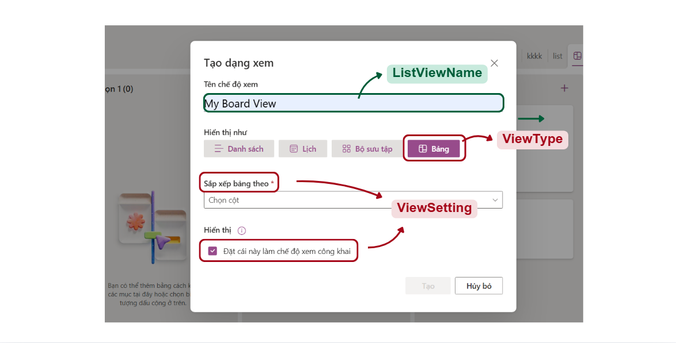
List View
Notes:
-- List View
-- Get all view types
SELECT
vt.Id, vt.Title, vt.[Description], vt.Icon
FROM
ViewType vt
-- Get all settings of a specific view type
SELECT
vs.Id,
vs.SettingKey,
vs.ValueType
FROM
ViewSetting vs
INNER JOIN
ViewTypeSetting vts ON vs.Id = vts.ViewSettingId
WHERE
vts.ViewTypeId = 4;

Slide 34
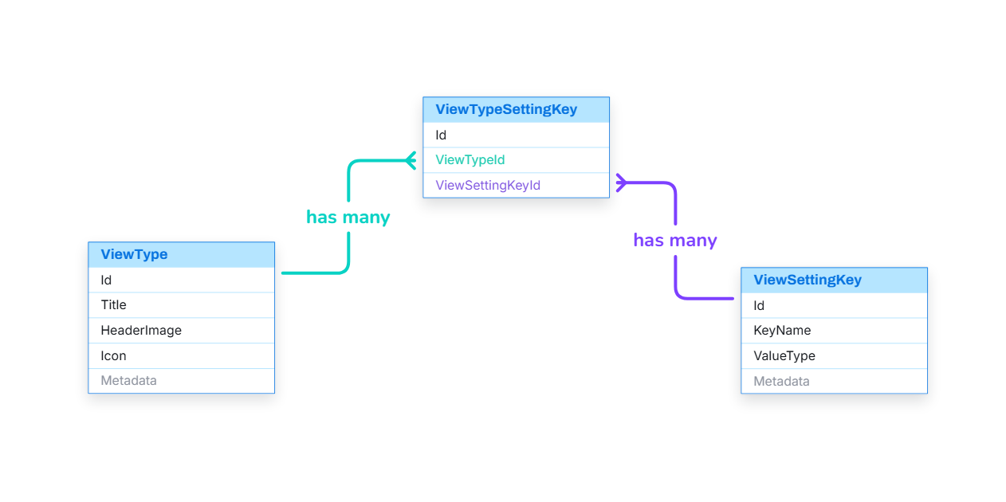
List View
Notes:
-- List View
-- Get all view types
SELECT
vt.Id, vt.Title, vt.[Description], vt.Icon
FROM
ViewType vt
-- Get all settings of a specific view type
SELECT
vs.Id,
vs.SettingKey,
vs.ValueType
FROM
ViewSetting vs
INNER JOIN
ViewTypeSetting vts ON vs.Id = vts.ViewSettingId
WHERE
vts.ViewTypeId = 4;

Slide 35
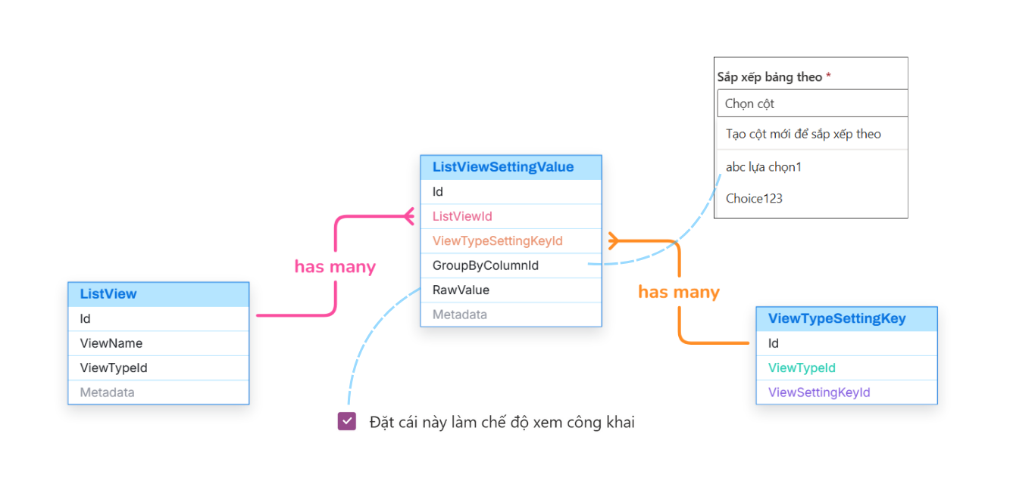
List View
Notes:
-- List View
-- Get all view types
SELECT
vt.Id, vt.Title, vt.[Description], vt.Icon
FROM
ViewType vt
-- Get all settings of a specific view type
SELECT
vs.Id,
vs.SettingKey,
vs.ValueType
FROM
ViewSetting vs
INNER JOIN
ViewTypeSetting vts ON vs.Id = vts.ViewSettingId
WHERE
vts.ViewTypeId = 4;

Slide 36
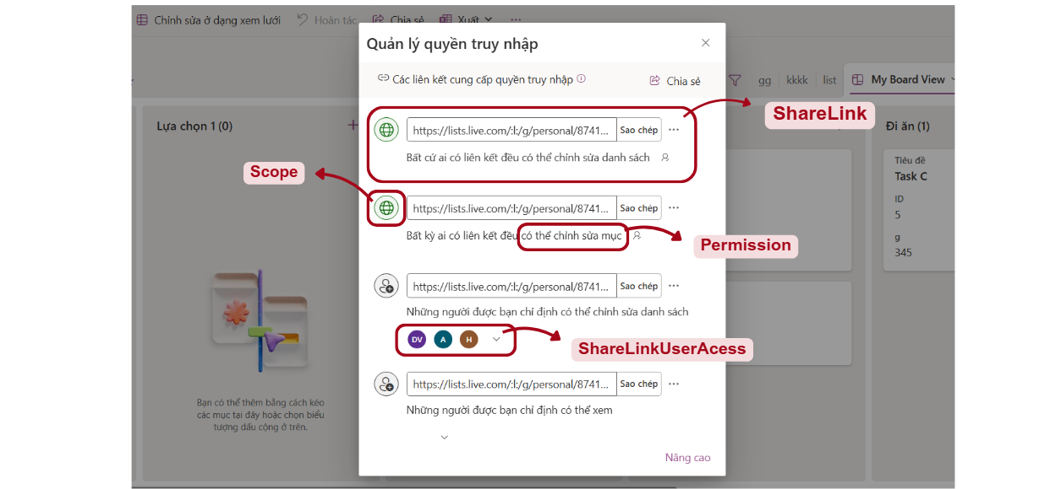
Manage Access
Notes:
-- Manage Access
-- Get all sharelinks of a specific list
SELECT
sl.Id, sl.[URL], sl.Note, p.[Name], s.Icon, a.Avatar, slua.AccountId, slua.Email
FROM
ShareLink sl
INNER JOIN
Scope s ON sl.ScopeId = s.Id
INNER JOIN
Permission p ON sl.PermissionId = p.Id
LEFT JOIN
ShareLinkUserAccess slua ON sl.Id = slua.ShareLinkId AND s.Code = 'SPECIFIC'
LEFT JOIN
Account a ON slua.AccountId = a.Id
WHERE
sl.ListId = 1
-- Get all settings of a specific sharelink
SELECT
ks.Id, ks.KeyName, ks.Icon, ks.ValueType, ks.DefaultValue, slsv.KeyValue
FROM
KeySetting ks
LEFT JOIN
ShareLinkSettingValue slsv
ON ks.Id = slsv.KeySettingId
AND slsv.ShareLinkId = 1
WHERE
ks.isShareLinkSetting = 1

Slide 37
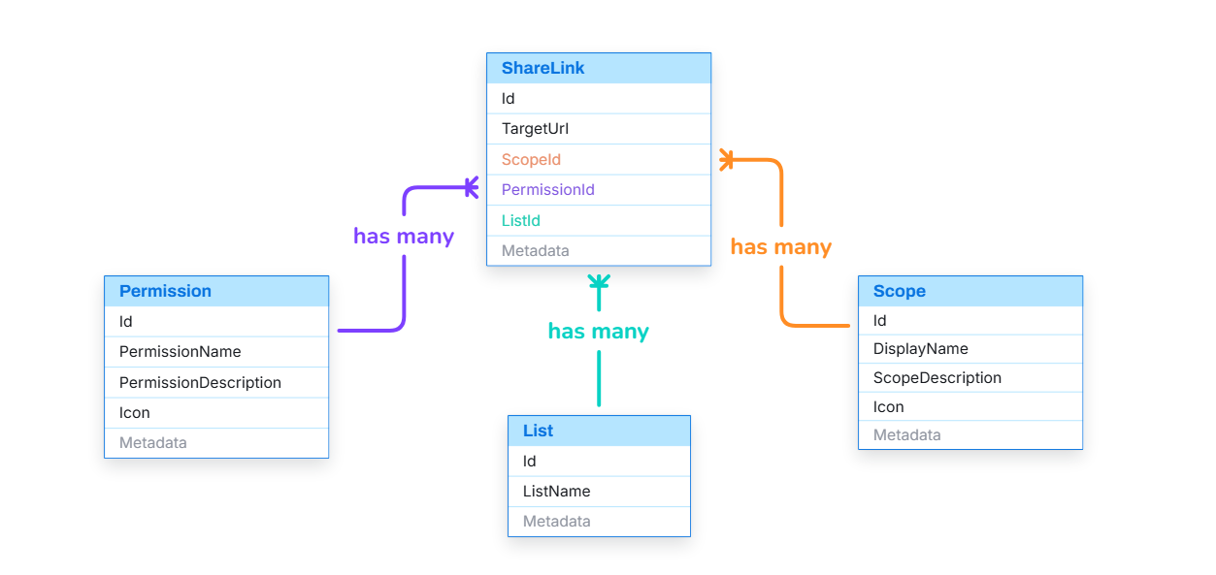
Manage Access
Notes:
-- Manage Access
-- Get all sharelinks of a specific list
SELECT
sl.Id, sl.[URL], sl.Note, p.[Name], s.Icon, a.Avatar, slua.AccountId, slua.Email
FROM
ShareLink sl
INNER JOIN
Scope s ON sl.ScopeId = s.Id
INNER JOIN
Permission p ON sl.PermissionId = p.Id
LEFT JOIN
ShareLinkUserAccess slua ON sl.Id = slua.ShareLinkId AND s.Code = 'SPECIFIC'
LEFT JOIN
Account a ON slua.AccountId = a.Id
WHERE
sl.ListId = 1
-- Get all settings of a specific sharelink
SELECT
ks.Id, ks.KeyName, ks.Icon, ks.ValueType, ks.DefaultValue, slsv.KeyValue
FROM
KeySetting ks
LEFT JOIN
ShareLinkSettingValue slsv
ON ks.Id = slsv.KeySettingId
AND slsv.ShareLinkId = 1
WHERE
ks.isShareLinkSetting = 1

Slide 38
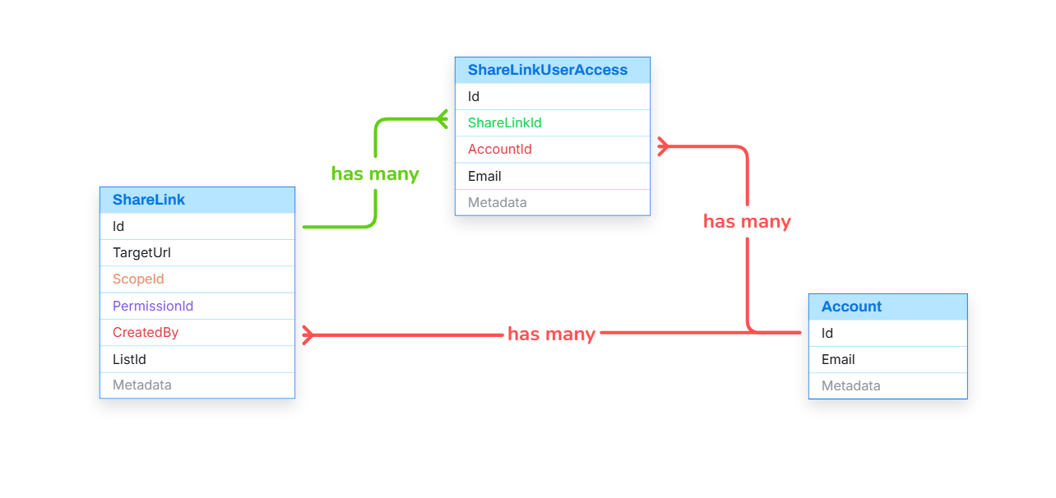
Manage Access
Notes:
-- Manage Access
-- Get all sharelinks of a specific list
SELECT
sl.Id, sl.[URL], sl.Note, p.[Name], s.Icon, a.Avatar, slua.AccountId, slua.Email
FROM
ShareLink sl
INNER JOIN
Scope s ON sl.ScopeId = s.Id
INNER JOIN
Permission p ON sl.PermissionId = p.Id
LEFT JOIN
ShareLinkUserAccess slua ON sl.Id = slua.ShareLinkId AND s.Code = 'SPECIFIC'
LEFT JOIN
Account a ON slua.AccountId = a.Id
WHERE
sl.ListId = 1
-- Get all settings of a specific sharelink
SELECT
ks.Id, ks.KeyName, ks.Icon, ks.ValueType, ks.DefaultValue, slsv.KeyValue
FROM
KeySetting ks
LEFT JOIN
ShareLinkSettingValue slsv
ON ks.Id = slsv.KeySettingId
AND slsv.ShareLinkId = 1
WHERE
ks.isShareLinkSetting = 1

Slide 39
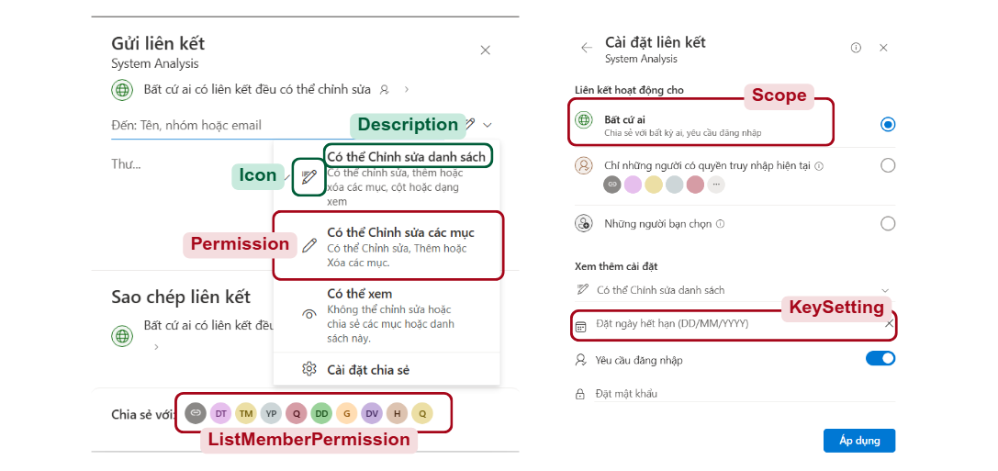
Manage Access
Notes:
-- Manage Access
-- Get all permisions
SELECT
p.Id, p.Code, p.[Name], p.Icon
FROM
Permission p
-- Get all scopes
SELECT
s.Id, s.Code, s.[Name], s.Icon, s.[Description]
FROM
Scope s
-- Get all sharelink settings
SELECT
ks.Id, ks.Icon, ks.KeyName, ks.ValueType, ks.DefaultValue
FROM
KeySetting ks
WHERE
ks.IsShareLinkSetting = 1
-- Get all current list members
SELECT
a.Avatar,
lmp.Email AS Email,
a.FirstName,
a.LastName
FROM
ListMemberPermission lmp
LEFT JOIN
Account a ON a.Id = lmp.AccountId
WHERE
lmp.ListId = 1;

Slide 40
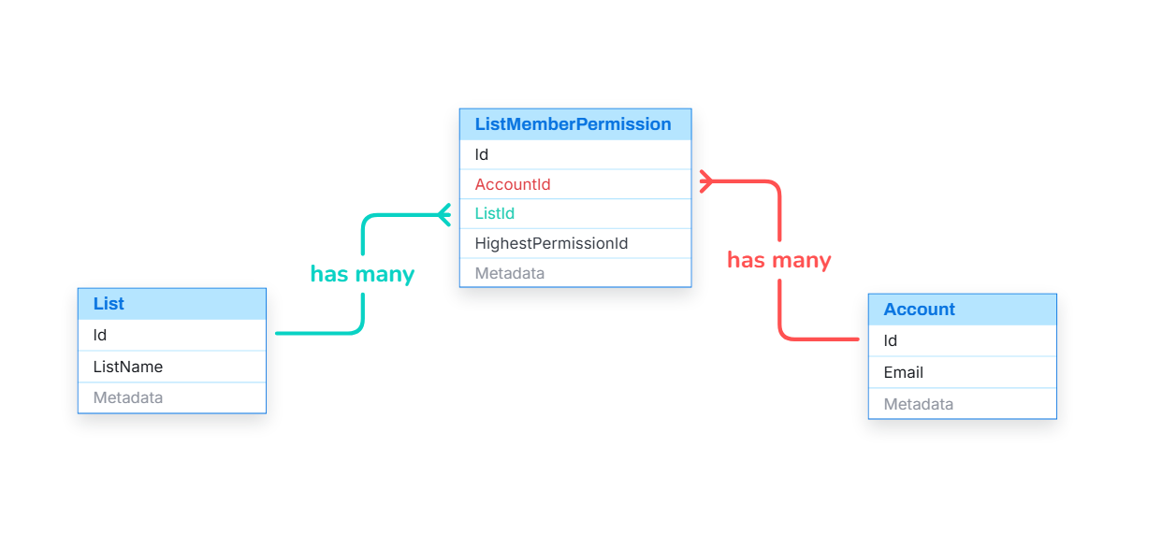
Manage Access
Notes:
-- Manage Access
-- Get all sharelinks of a specific list
SELECT
sl.Id, sl.[URL], sl.Note, p.[Name], s.Icon, a.Avatar, slua.AccountId, slua.Email
FROM
ShareLink sl
INNER JOIN
Scope s ON sl.ScopeId = s.Id
INNER JOIN
Permission p ON sl.PermissionId = p.Id
LEFT JOIN
ShareLinkUserAccess slua ON sl.Id = slua.ShareLinkId AND s.Code = 'SPECIFIC'
LEFT JOIN
Account a ON slua.AccountId = a.Id
WHERE
sl.ListId = 1
-- Get all settings of a specific sharelink
SELECT
ks.Id, ks.KeyName, ks.Icon, ks.ValueType, ks.DefaultValue, slsv.KeyValue
FROM
KeySetting ks
LEFT JOIN
ShareLinkSettingValue slsv
ON ks.Id = slsv.KeySettingId
AND slsv.ShareLinkId = 1
WHERE
ks.isShareLinkSetting = 1

Slide 41
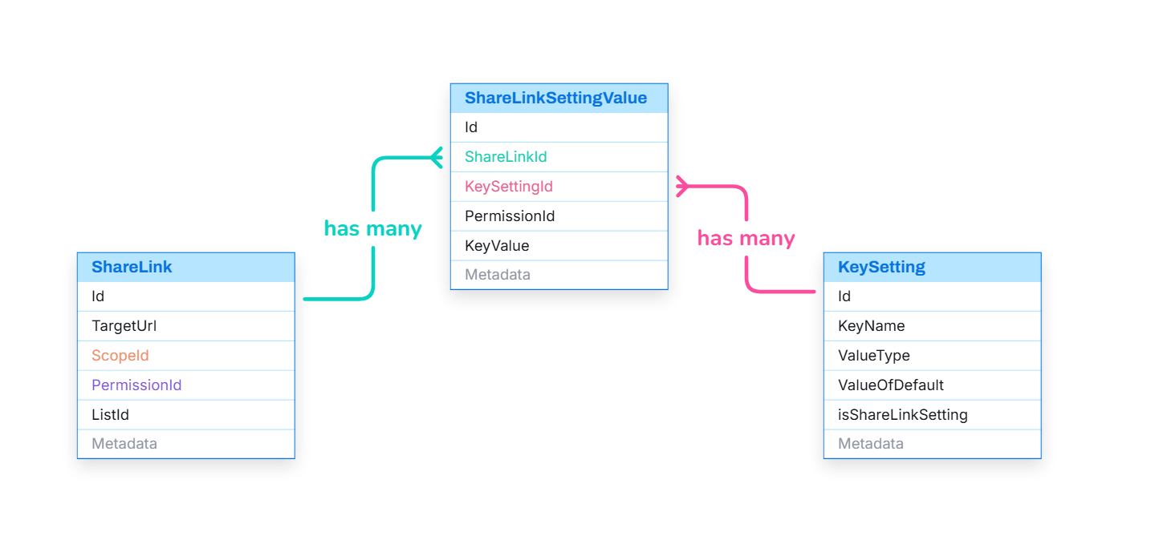
Manage Access
Notes:
-- Manage Access
-- Get all permisions
SELECT
p.Id, p.Code, p.[Name], p.Icon
FROM
Permission p
-- Get all scopes
SELECT
s.Id, s.Code, s.[Name], s.Icon, s.[Description]
FROM
Scope s
-- Get all sharelink settings
SELECT
ks.Id, ks.Icon, ks.KeyName, ks.ValueType, ks.DefaultValue
FROM
KeySetting ks
WHERE
ks.IsShareLinkSetting = 1
-- Get all current list members
SELECT
a.Avatar,
lmp.Email AS Email,
a.FirstName,
a.LastName
FROM
ListMemberPermission lmp
LEFT JOIN
Account a ON a.Id = lmp.AccountId
WHERE
lmp.ListId = 1;

Slide 42
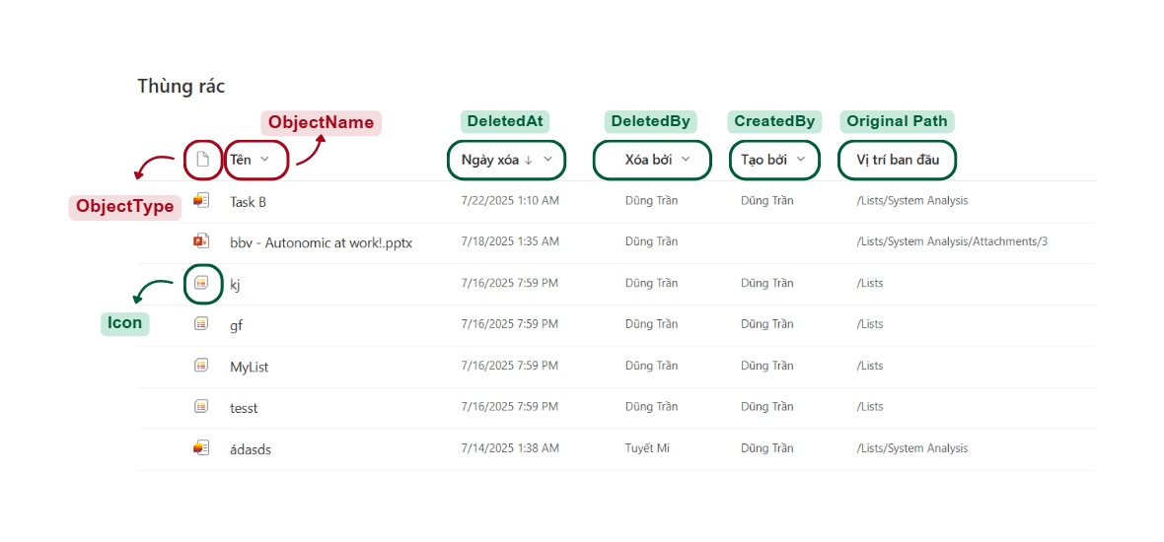
Trash Screen
Notes:
-- SCREEN: TRASH
-- Get all trash items of a specific user
SELECT
ti.Id, ti.ObjectId, ti.ObjectName, ti.ObjectTypeId, ot.Icon, ti.DeleteBy, ti.DeletedAt, ti.ObjectStatus, ti.[Path]
FROM
TrashItem ti
INNER JOIN
ObjectType ot ON ti.ObjectId = ot.Id
WHERE
ti.CreatedBy = 1

Slide 43
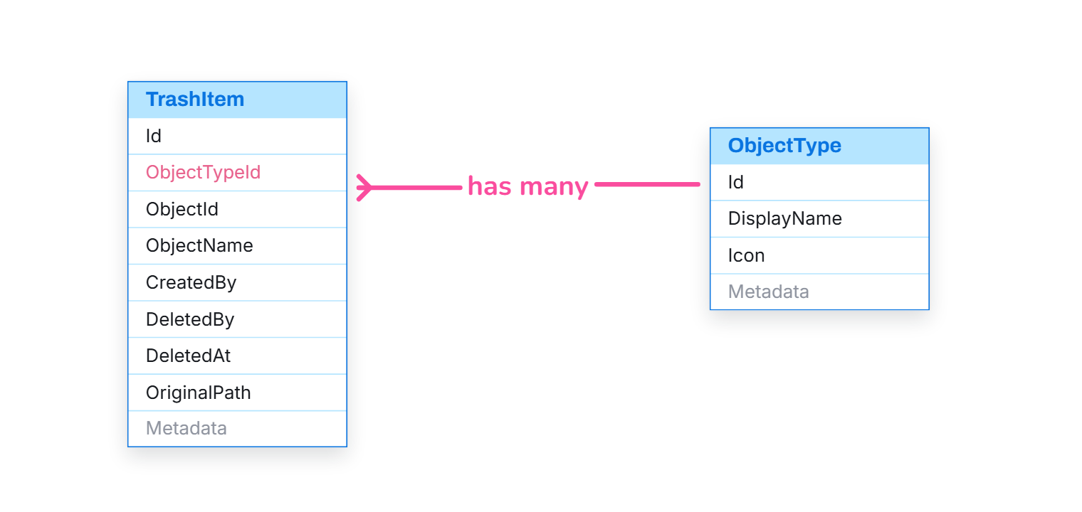
Trash Screen
Notes:
-- SCREEN: TRASH
-- Get all trash items of a specific user
SELECT
ti.Id, ti.ObjectId, ti.ObjectName, ti.ObjectTypeId, ot.Icon, ti.DeleteBy, ti.DeletedAt, ti.ObjectStatus, ti.[Path]
FROM
TrashItem ti
INNER JOIN
ObjectType ot ON ti.ObjectId = ot.Id
WHERE
ti.CreatedBy = 1

Slide 44
Q&A

