Slide 1
COMPUTER SECURITY
Group 3
Nguyễn Văn Bình
Trần Minh Đức
Nguyễn Thị Thanh Loan
Đặng Thị Mai Lam
Lường Văn Dũng

Slide 2
Agenda
01
What is Computer Security? Its Types?
02
Goals of Computer Security?
03
What to Secure? Computer Security Threats?
Motives behind these attacks & Potential Losses due to Security Attacks
04
05
How to Secure Computer?

Slide 3
What is Computer Security?
Computer security basically is the protection of computer systems and information from harm, theft, and unauthorized use.

Slide 4
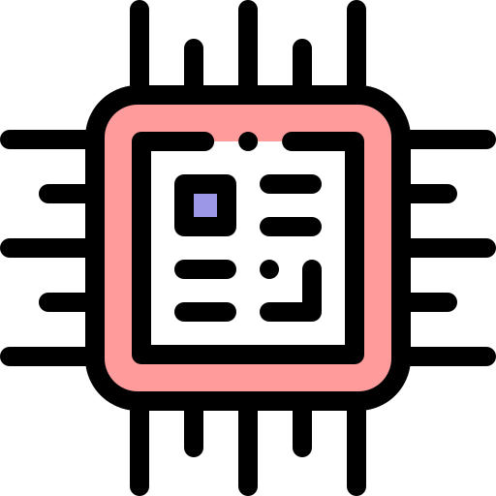
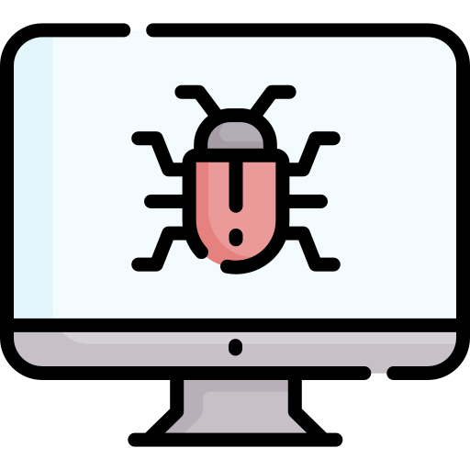

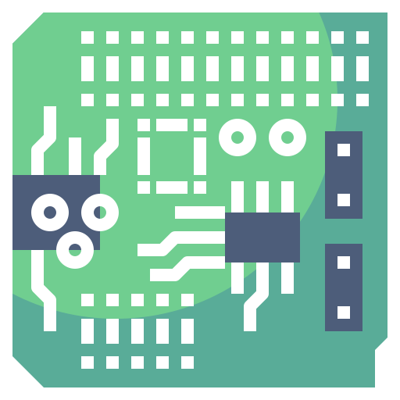
Hardware
Software
Firmware

Slide 5
Types of Computer Security?
One way to ascertain the similarities and differences among Computer Security is by asking what is being secured. For example:
Information security is securing information from unauthorized access, modification & deletion
Application Security is securing an application by building security features to prevent from Cyber Threats such as SQL injection, DoS attacks, data breaches and etc.
Computer Security means securing a standalone machine by keeping it updated and patched
Network Security is by securing both the software and hardware technologies
Cybersecurity is defined as protecting computer systems, which communicate over the computer networks

Slide 6


02
Goals of Computer Security

Slide 7




Goals of Computer Security
Confidentiality
Integrity
Availability

Slide 8
Goals of Computer Security
Confidentiality (privacy, secrecy)
The computer system are accessible only by authorized parties. Access type is read-only access (read, view, print, or only know the existence of an object).
Integrity
means different things in different contexts. (precise, accurate, unmodified, modified only in acceptable ways, modified only by authorized people or processes, consistent, etc.) but there are three aspects of integrity. - Authorized actions - Separate and protect resources - Error detection and correction.
Availability
is to protecting information from being modified by unauthorized parties

Slide 9
Confidentiality: Keep your Secrets
Confidentiality
Typically achieved by:
Physical isolation
Integrity
Cryptography
Background checks on People
Availability

Slide 10
Data Integrity: Prevent people Modifying Data
Confidentiality
Typically achieved by:
Backups
Integrity
Redundancy
Checksums & digital signatures
Availability

Slide 11
Availability:
Make sure you can use your system
Confidentiality
Typically achieved by:
Hardening
Integrity
Redundancy
Reference Checks on People
Availability

Slide 12

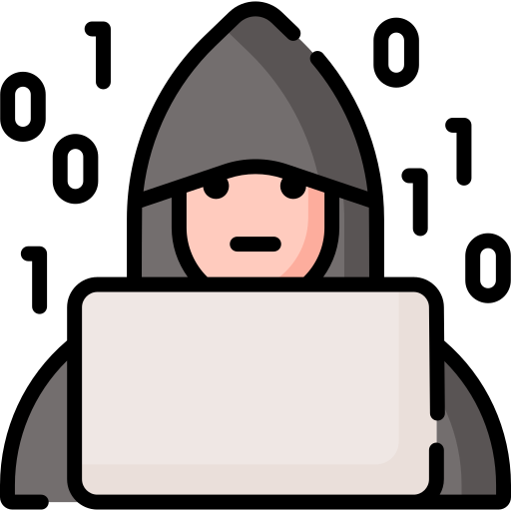
03 What to Secure? Computer Security Threats?

Slide 13
What to Secure?
Controlling who gets access to a computer
Physical Security
Permission controlling schemes, making sure users
are authorized to perform certain actions
OS Security
Access Control
Managing who can Access what resources, from
physical machines to programs to networks

Slide 14






01
04
Viruses
Botnet
02
05
Computer Worm
Rootkit
03
06
Phishing
Keylogger
Computer Security Threats

Slide 15
Computer Security Threats
Viruses : is a malicious program which is loaded onto the user's computer without the user's knowledge. It replicates itself and infects files and programs on the user's PC. The ultimate goal of the virus is to ensure that the victim's computer will never be able to operate properly or even at all
Computer Worm: is a software program that can copy itself from one computer to another without human interaction. The potential risk here is that it will use up your computer's hard drive space because a worm can regenerate at great volume and speed
Phishing: Disguising to be a trustworthy person or business, phishers attempt to steal financial or sensitive personal information through fraudulent emails or instant messages. Phishing is unfortunately very easy to execute. You're deluded into thinking it's legitimate mail and you may enter your personal information.

Slide 16
Computer Security Threats
Botnet: is a group of computers connected to the internet that has been compromised by a hacker using a computer virus. An individual computer is called the 'zombie computer'. The result of this threat is the victim's computer, which is the bot that will be used for malicious activities and for a larger scale attack like DDOS.
Rootkit: is a computer program designed to provide continued privileged access to a computer while actively hiding its presence. Once a rootkit has been installed, the controller of the rootkit will be able to remotely execute files and change system configuration on the server.
Keylogger: Also known as the keystroke logger, keyloggers can track th real-time activity of a user on his computer. It keeps a record of all the keystrokes made by the user keyboard. Keylogger is also a very powerful threat to steal people's login credential such as username and password.

Slide 17
04 Motives behind these attacks & Potential Losses due to Security Attacks

Slide 18

Motives behind these attacks
Damaging reputation Of the target
Information theft and
manipulating data
Financial loss to the target

Slide 19
Potential Losses due to Security Attacks
Losing your data
Unethical usage of Computer Resources
Reputation Loss
Identity
Theft

Slide 20
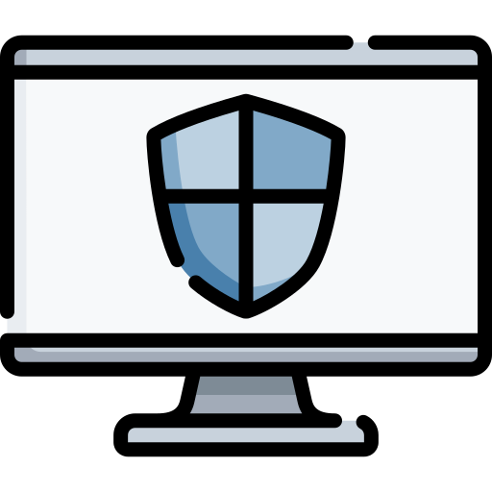

05
How to Secure Computer?

Slide 21
How to Secure Computer?
1
Secure passwords
2
2-Way authentication
MIKE DOWSON
3
Regular updates
4
Antivirus

5
Firewall
6
No Phishing

Slide 22
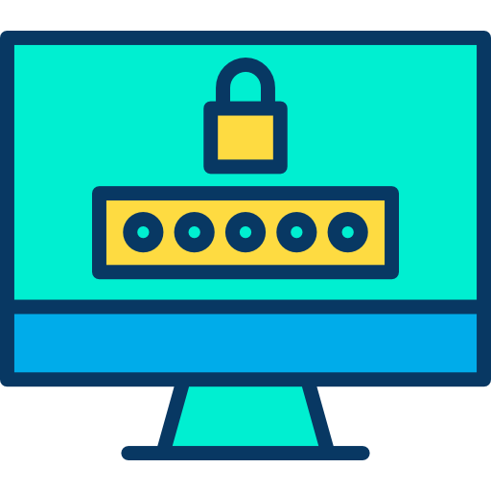
Secure passwords
Create strong passwords so that no one will be able to hack or remember your password
These are tips to create strong password
At least 15 characters
Include capital letters
Include special characters
Example:@#$...
Include numbers

Slide 23
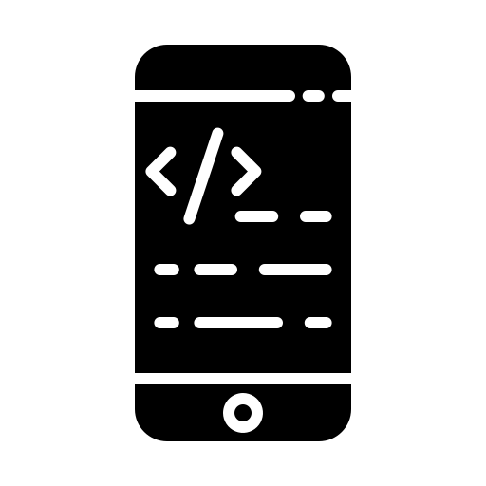
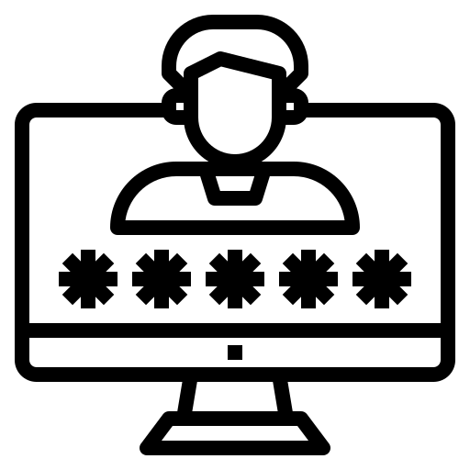
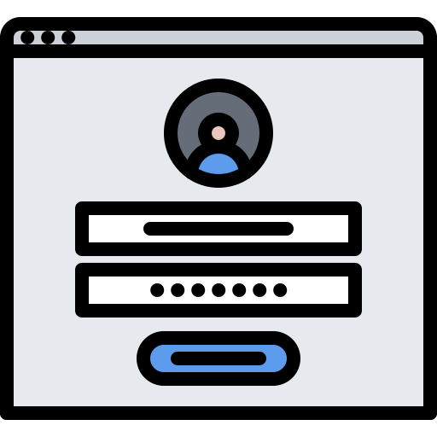
2-Way authentication
Two-factor authentication adds layer of security to the authentication process by making it
harder for attackers to gain access to a person's devices or online accounts
For example:
The user enters in
their username and
password.
An authentication
code is sent to the
user's mobile device.
The user enters in their authentication code to log into the application.

Slide 24

Regular updates
Always keep your system and all software updated
You get updates because the older version was hacked or was vulnerable

Slide 25


Antivirus
Antivirus is a computer program used to prevent, detect, and remove malware

Slide 26

Firewall
A firewall is a system designed to prevent unauthorized access to or from a private network
Firewalls prevent unauthorized Internet users from accessing private networks connected to the internet, especially intranets

Slide 27



No Phishing
When you get an e-mail that looks suspicious to you or has no relation with you, then do the following:
Never click on the link that given in the e-mail
Do not give any personnel details if asked
Do not open the attached files

Slide 28
THANK You For Listening!

