Slide 1

Soldier Supportive Acoustics
Swinburne University of Technology & Defence Science Technology Group

Slide 2
Aims
Provide human operators with a sense of the 3D spatial sound environment.
Equip a 3D microphone onto a mobile robot.
Test the human-robot interoperability in a series of complex environments.

Slide 3
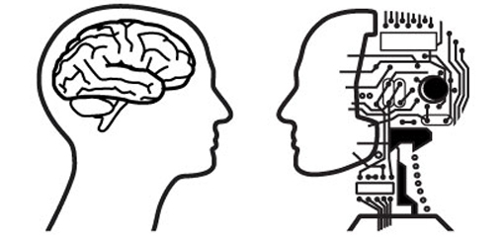
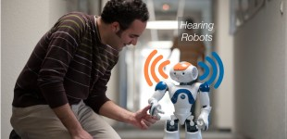
Robot Audition
Artificial Intelligence
Human Computer Interaction
OKUNO, H. G. & NAKADAI, K. Robot audition: Its rise and perspectives. 2015 IEEE International Conference on Acoustics, Speech and Signal Processing (ICASSP), 19-24 April 2015 2015. 5610-5614

Slide 4
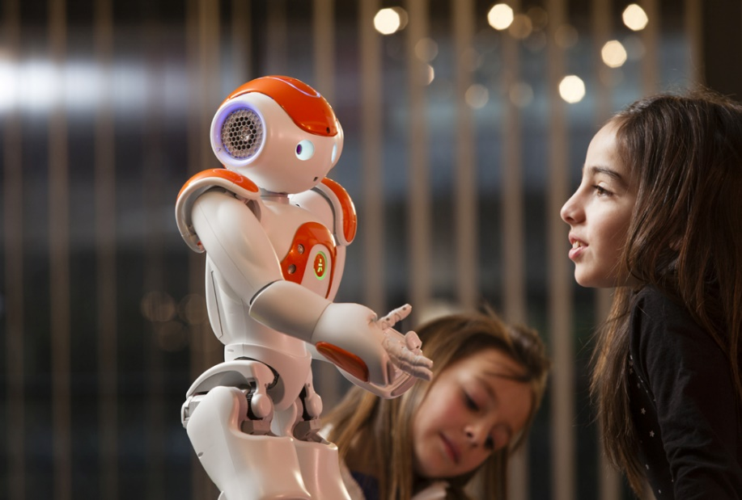
Robot Audition: Human-Robot Interaction
Okuno & Nakadai envisioned mainly HRI:
Speech recognition.
Achieving hearing capability equivalent to humans; enabling bidirectional human robot interactions
Without robot audition, HRI is mostly one-directional.

Slide 5
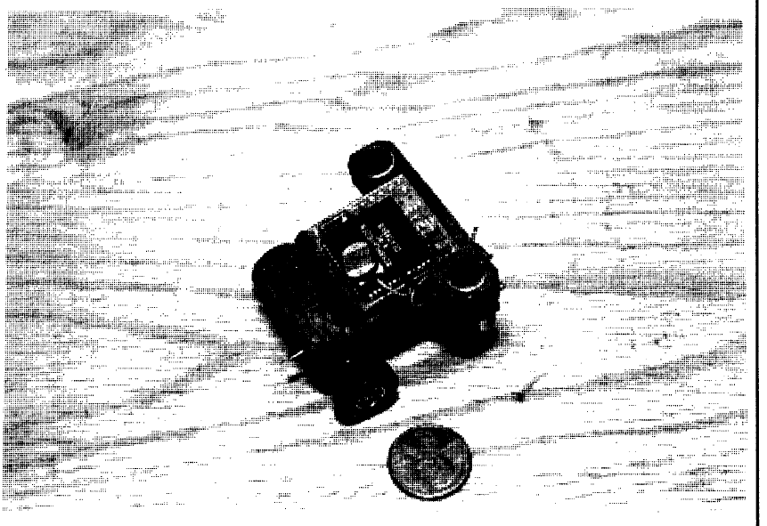
Robot Audition: Artificial Intelligence
‘Squirt: The Prototypical Mobile Robot for Autonomous Graduate Students’ developed by the AI Lab at MIT (now CSAIL at MIT) in 1989.
Micro robot designed to
hide in a dark place and
locate a sound sources.

Slide 6
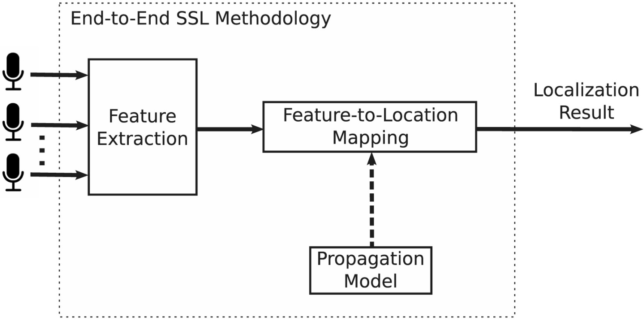
Sound Source Localization (SSL)
“ …the issue of estimating the position of a source via audio data alone” (Rascon and Meza, 2017).

Slide 7
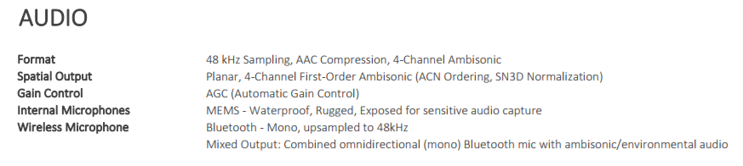
Equipment/Tools
Parrot Jumping Sumo. + UAV (DJI?)
Garmin VIRB 60 w/4-ambisonic output.
SolidWorks
Youtube 360

Slide 8
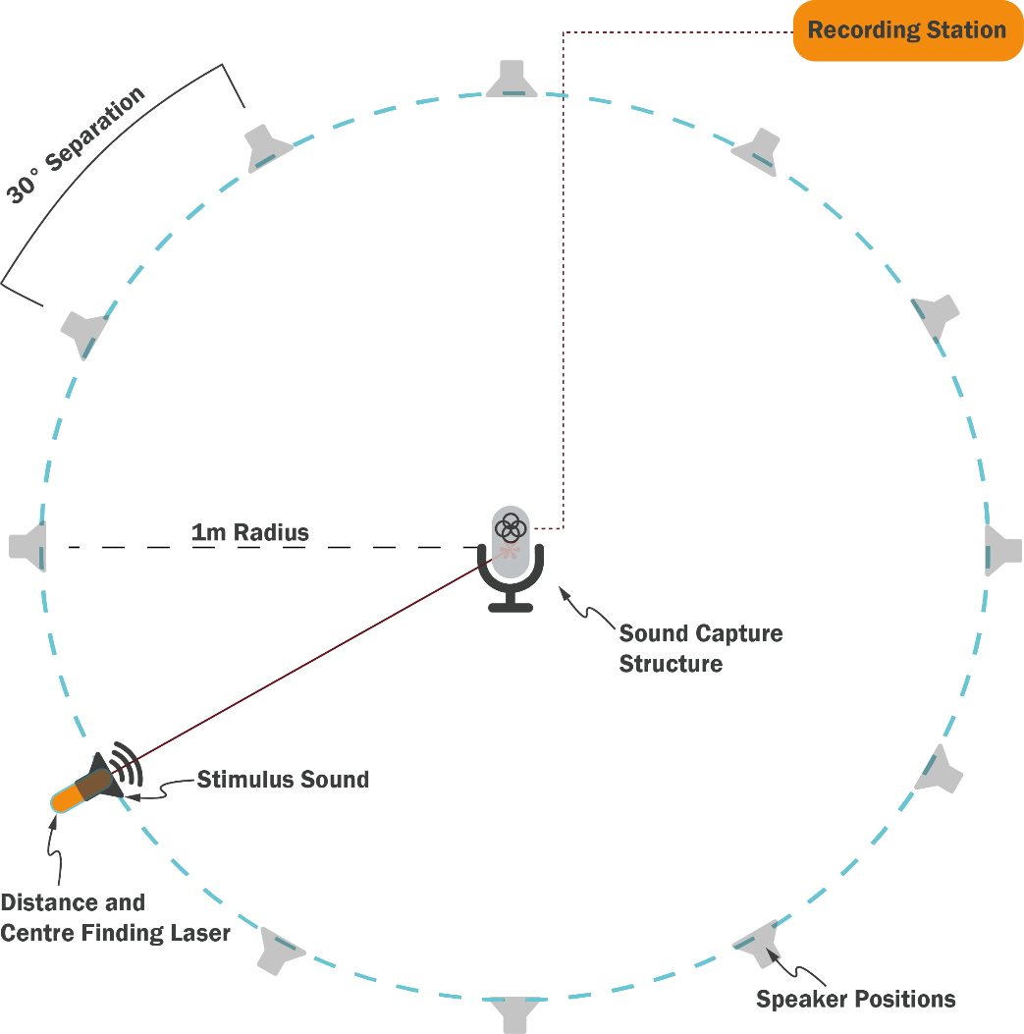
Mic Choice: Ambeo VS Garmin 360
Conducted AR Experiment at Flinders St Station.
Observed noticeable performance of Garmin VIRB 360
Currently preparing experiment with participants on Ambeo and 360 performance.

Slide 9

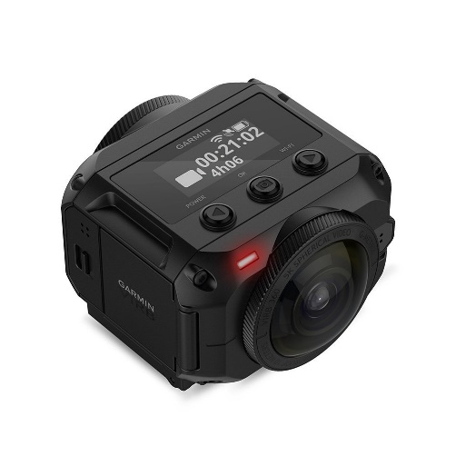
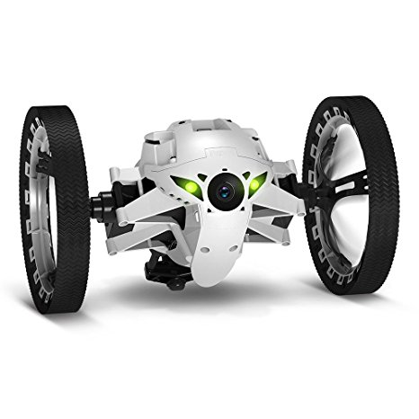


Approach
Mechanical Design: Mount
Ground Station Design: Headphones
Environment Testing

Slide 10
Development Timeline
Week 1 | Week 2 | Week 3 | Week 4
Acquired Robot | 3D Printed Garmin 360 Mount | Interfering sound sources identified | Interfering sound sources removed/minimised
Cable tied Garmin to Sumo. | Garmin 360 Integrated w/3D printed mount | Refined 3D CAD Design | Final Testing
Began CAD Design Mount for Garmin 360. | Stability testing conducted | Environmental Testing Conducted | Poster Presentation Finalised

Slide 11
“Setting oneself on a predetermined course in unknown waters is the perfect way to sail straight into an iceberg.”
― Stanley McChrystal, Team of Teams: New Rules of Engagement for a Complex World

Slide 12
Questions?

Slide 13
References
RASCON, C. & MEZA, I. 2017. Localization of sound sources in robotics: A review. Robotics and Autonomous Systems, 96, 185
OKUNO, H. G. & NAKADAI, K. Robot audition: Its rise and perspectives. 2015 IEEE International Conference on Acoustics, Speech and Signal Processing (ICASSP), 19-24 April 2015 2015. 5610-5614
Images:
http://www.writeopinions.com/cognitive-robotics
https://nootrix.com/diy-tutos/lean-how-make-robots-hear-and-localize-sound-sources/
https://www.amazon.co.uk/Garmin-360-Degree-Waterproof-Resolution-Stabilisation/dp/B071J8CGMC
http://www.redorbit.com/news/technology/1112892978/robotics-perception-key-to-interaction-070913/

