Slide 1
Chapter 3
Design of Relational Database Schema

Slide 2
Objectives
1
Understand what are anomalies
2
Understand why must decompose a relation
3
Understand what are normal forms (1NF, 2NF, 3NF, BCNF)
4
Understand the good, bad and ugly of decomposition

Slide 3
Contents
1
Anomalies
2
What are decomposition?
3
Decomposition: The good, bad and the ugly
4
1NF, 2NF, 3NF, BCNF definition
5
Algorithms to decompose a relation into BCNF, 3NF

Slide 4
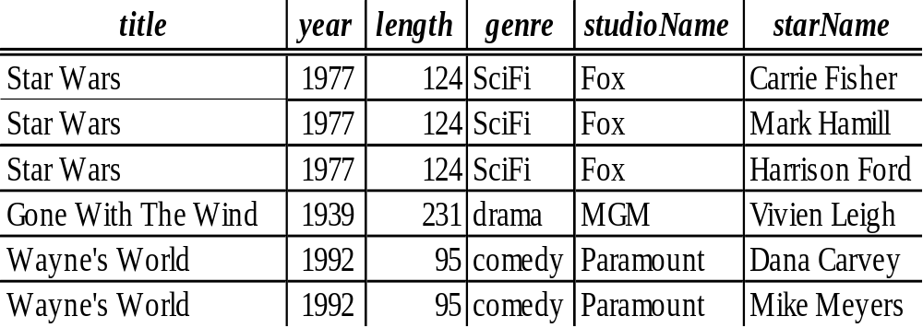
1. Anomalies introduction
Careless selection of a relational database schema can lead to redundancy and related anomalies
Which problems do you see in the relation?

Slide 5
1. Anomalies introduction
Careless selection of a relational database schema can lead to redundancy and related anomalies
Which problems do you see in the relation?
→ redundant

Slide 6
1. Anomalies
Problems such as redundancy that occur when we try to cram too much into a single relation are called anomalies
The principal kinds of anomalies:
Redundancy: information maybe repeated unnecessarily in several tuples
Update Anomalies: We may change information in one tuple but leave the same information unchanged in another
Deletion Anomalies: If a set of values becomes empty, we may lose other information as a side effect

Slide 7
1. Anomalies
The principal kinds of anomalies in the relation:
Redundancy:
Update Anomalies:
Deletion Anomalies:

Slide 8
1. Anomalies
The principal kinds of anomalies in the relation:
Redundancy: the length and genre
Update Anomalies: if we found that Star Wars is 125 minutes long, we may change the length in the first tuple but not in the second and third tuples
Deletion Anomalies: if we delete “Vivien Leigh” from the set of stars of Gone with the Wind, then we have no more stars for that movie. The last tuple for the movie would disappear also its information of length, genre

Slide 9
2. Decomposition
The accepted way to eliminate anomalies is the decomposition of relations
Decomposition of a relation R involves splitting the attributes of R to make the schemas of 2 new relations
Definition: Given a relation R(A₁,..,A_{n}), we say R is decomposed into S(B₁,..,B_{m}) and T(C₁,..,C_{k}) if:
+ {A₁,..,A_{n}} = {B₁,..,B_{m}} U {C₁,..,C_{k}}
+ S = ∏_{B1,..Bm}(R)
+ T = ∏_{C1,..,Ck}(R)

Slide 10
Example: Decomposition
Movies
How can you split the attributes of Movies relation into 2 new schema?

Slide 11
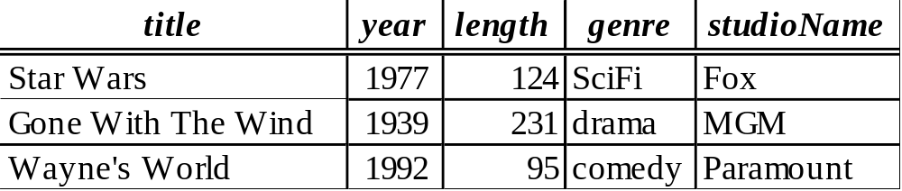
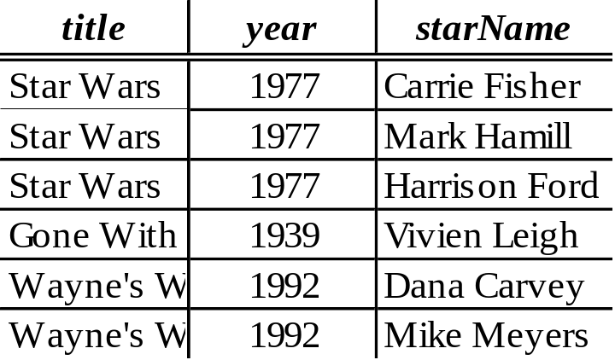
Example: Decomposition
Movies
Movies1
Movies2

Slide 12
Discuss
Movies1
Movies2
The redundancy is eliminated (the length of each film appears only once)
The risk of an update anomaly is gone (we only have to change the length of Star Wars in one tuple)
The risk of a deletion anomaly is gone (if we delete all the stars for Gone with the wind, that deletion makes the movie disappear from Movies2 but still be found in Movies1)

Slide 13
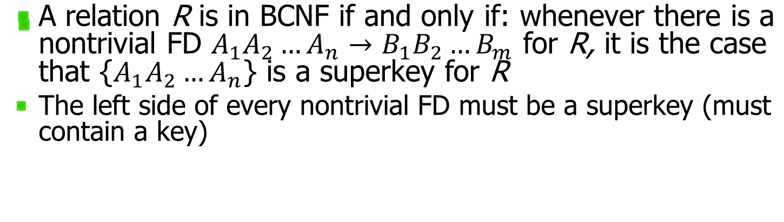
Boyce – Codd Normal Form (BCNF)
Movies
Is relation Movies in BCNF? Why?

Slide 14
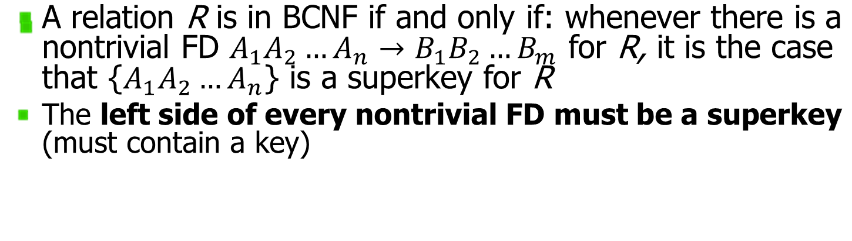

Boyce – Codd Normal Form (BCNF)
Movies

Slide 15
Boyce – Codd Normal Form (BCNF)
Movies1
Is relation Movies1 in BCNF?

Slide 16
Boyce – Codd Normal Form (BCNF)
Movies1
Relation Movies1 is in BCNF.

Slide 17
3. Decomposition:
The Good, Bad and Ugly
After we decompose a relation schema into BCNF, the resulting relation do not exhibit anomalies; That’s the “Good”
But decomposition can also have some bad/ugly consequences, such as:
  We can’t recovery the original information; OR
  After reconstruction, the FDs maybe not hold

Slide 18
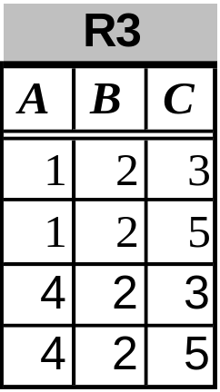
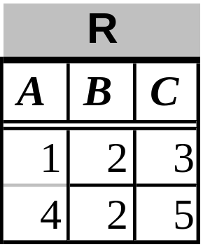
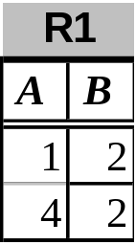
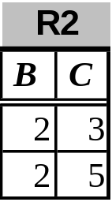
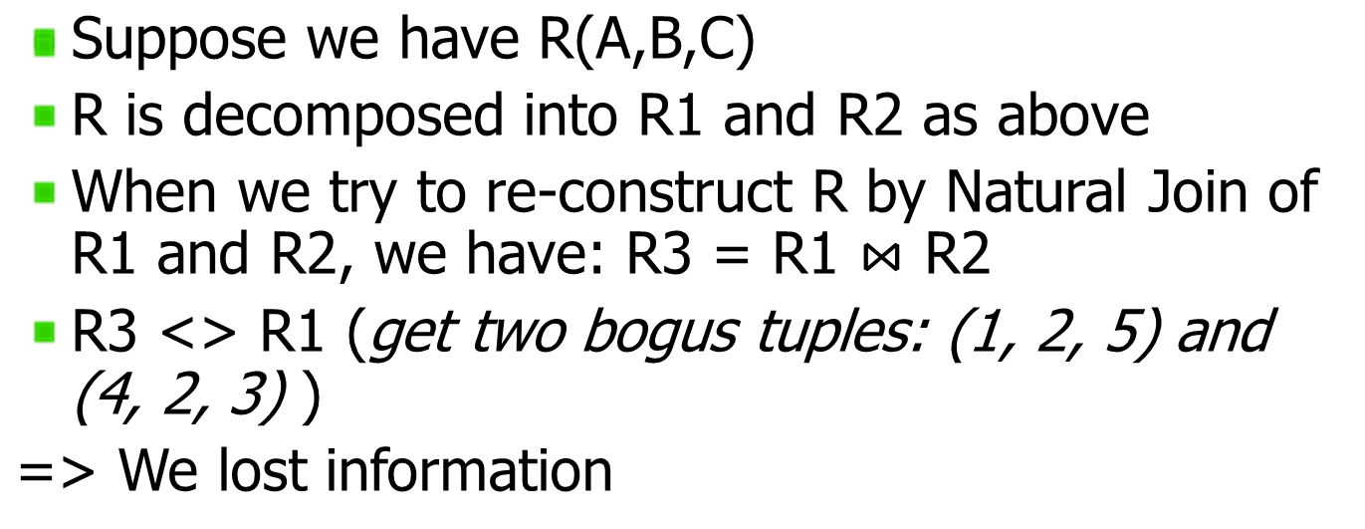
Example: Loss of information after decomposition

Slide 19
Example: Dependency Loss
If we check the projected FD’s in the relations of the decomposition, can we can be sure that when we reconstruct the original relation from the decomposition by joining, the result will satisfy the original FD’s?

Slide 20
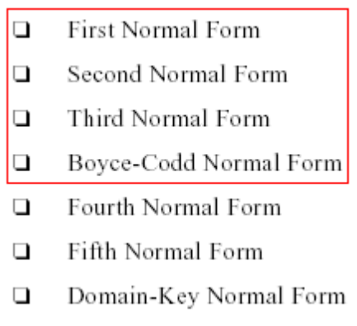

4. Normal Forms (NF)

Slide 21
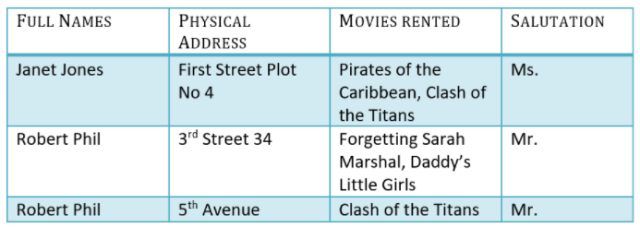
1NF
1NF A relation R is in first normal form (1NF) if and only if all underlying domains contain atomic values only (singled valued attribute)
Example: 1NF? Why?

Slide 23
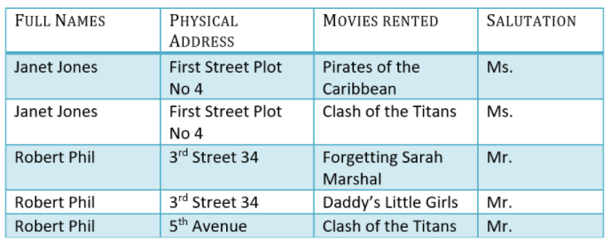

Slide 24
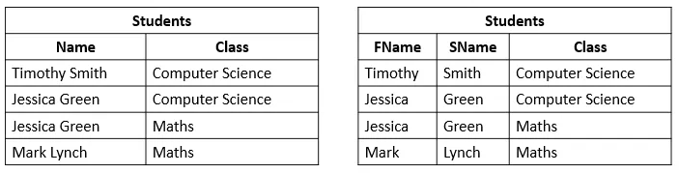
1NF

Slide 25
1NF

Slide 26
1NF

Slide 27
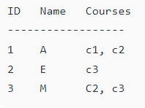
1NF

Slide 28
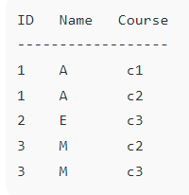
1NF

Slide 29
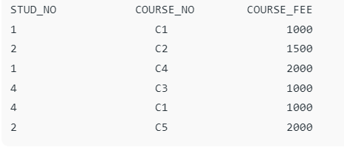
2NF
A relation R is in second normal form (2NF) if and only if it is in 1NF and every non-key attribute is fully dependent on the primary key
Example: 2NF? Why?

Slide 30
2NF
A relation R is in second normal form (2NF) if and only if it is in 1NF and every non-key attribute is fully dependent on the primary key
Example: 2NF? Why?

Slide 31
2NF
A relation R is in second normal form (2NF) if and only if it is in 1NF and every non-key attribute is fully dependent on the primary key
Example: 2NF? Why?

Slide 32
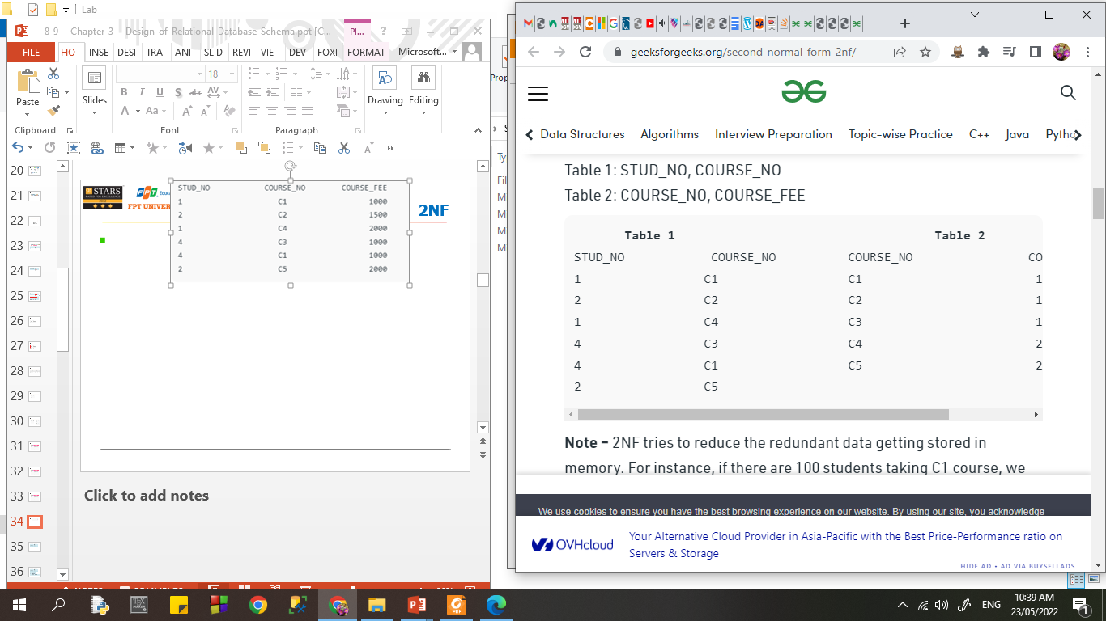
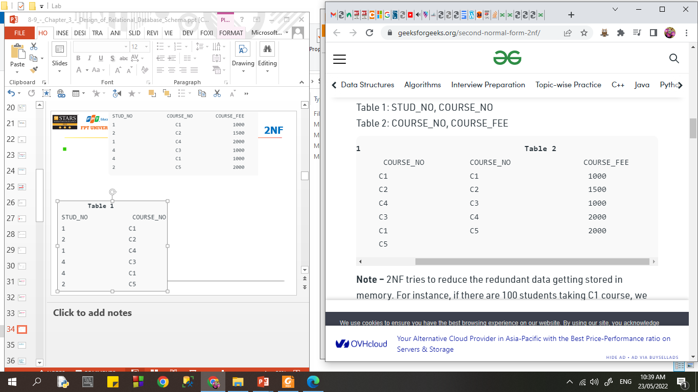
2NF

Slide 33
2NF

Slide 34
2NF

Slide 35
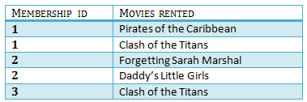

2NF

Slide 36
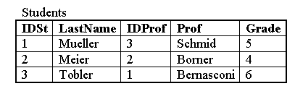
2NF

Slide 37
2NF

Slide 38
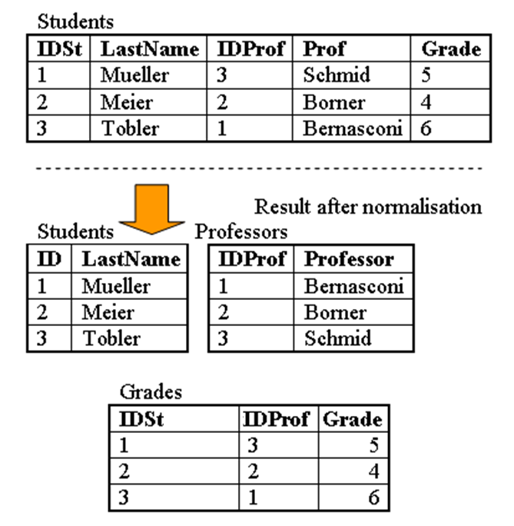
2NF

Slide 39
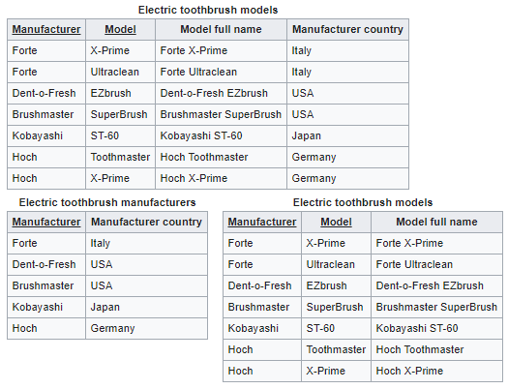

Slide 42
3NF
A relation R is in third normal form (3NF) if and only if it is in 2NF and every non-key attribute is non-transitively dependent on the primary key.
An attribute C is transitively dependent on attribute A if there exists an attribute B such that: A->B and B->C
Note that 3NF is concerned with transitive dependencies which do not involve candidate keys. A relation with more than one candidate key will clearly have transitive dependencies of the form: primary_key -> other_candidate_key -> any_non-key_column

Slide 43
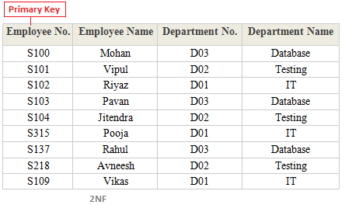
3NF
Employee No. → Department No.
Department No. → Department Name
A B C D

Slide 44
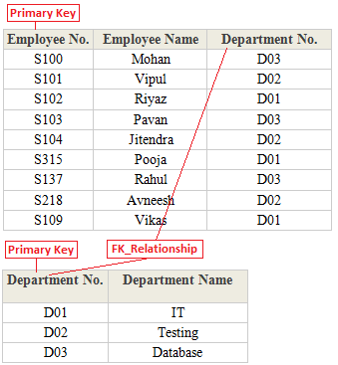
3NF

Slide 45
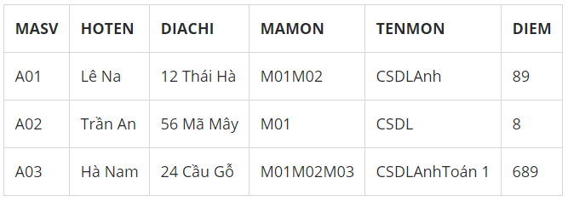
1NF -> 2N -> 3NF?

Slide 46
1NF -> 2N -> 3NF?
MASV | HOTEN | DIACHI | MAMON | TENMON | DIEM
A01 | Lê Na | 12 Thái Hà | M01 | CSDL | 8
A01 | Lê Na | 12 Thái Hà | M02 | Anh | 9
A02 | Trần An | 56 Mã Mây | M01 | CSDL | 8
A03 | Hà Nam | 24 Cầu Gỗ | M01 | CSDL | 6
A03 | Hà Nam | 24 Cầu Gỗ | M02 | Anh | 8
A03 | Hà Nam | 24 Cầu Gỗ | M03 | Toán 1 | 9

Slide 47
1NF -> 2N -> 3NF?
MASV | HOTEN | DIACHI | MAMON | TENMON | DIEM
A01 | Lê Na | 12 Thái Hà | M01 | CSDL | 8
A01 | Lê Na | 12 Thái Hà | M02 | Anh | 9
A02 | Trần An | 56 Mã Mây | M01 | CSDL | 8
A03 | Hà Nam | 24 Cầu Gỗ | M01 | CSDL | 6
A03 | Hà Nam | 24 Cầu Gỗ | M02 | Anh | 8
A03 | Hà Nam | 24 Cầu Gỗ | M03 | Toán 1 | 9
MASV | HOTEN | DIACHI
A01 | Lê Na | 12 Thái Hà
A02 | Trần An | 56 Mã Mây
A03 | Hà Nam | 24 Cầu Gỗ
MASV | MAMON | DIEM
A01 | M01 | 8
A01 | M02 | 9
A02 | M01 | 8
A03 | M01 | 6
A03 | M02 | 8
A03 | M03 | 9
MAMON | TENMON
M01 | CSDL
M02 | Anh
M03 | Toán 1

Slide 48

1NF -> 2N -> 3NF?

Slide 49
BCNF
A relation R is in BCNF if and only if: Whenever there is a Non-Trivial FD
A₁A₂..A_{n} -> B₁B₂..B_{m} for R, it is the case that:
{A₁,..,A_{n}} is a super-key for R
That is: the left side of every Non-Trivial FD must be a super-key

Slide 50
Example: BCNF or not
The above relation is not in BCNF because:
Consider the FD:
{title,year} -> {length, genre, studioName}
We know that {title, year} is not a super-key

Slide 51
Example: BCNF or not
The above relation is in BCNF because:
{title,year} -> {length, genre, studioName}
And: neither title nor year by itself functionally determines any of the other attributes

Slide 52
Example: BCNF or not
The above relation is in BCNF because: it has no Non-Trivial FD

Slide 53
Differences between BCNF and 3NF
3NF | Boyce-Codd
a nontrivial functional dependency: X -> A holds in R, either X is a superkey of R, or A is a prime attribute of R. | a nontrivial functional dependency X -> A holds in R, then: X is a superkey of R
Note:Attributes which are parts of any candidate key of relation are called as prime attribute, others are non-prime attributes A functional dependency X -> Y is a full functional dependency if removal of any attribute A from X means that the dependency does not hold any more; A partial functional dependency is not a full functional dependency

Slide 54
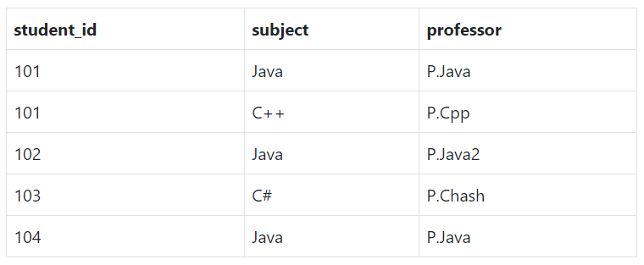
1 or 2 or 3 NF?

Slide 55
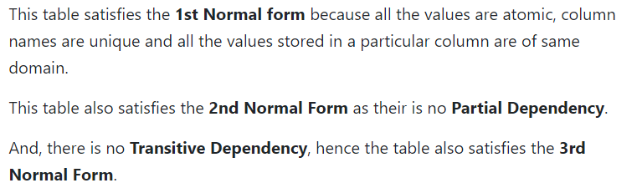
1 or 2 or 3 NF?

Slide 56
BCNF?

Slide 57
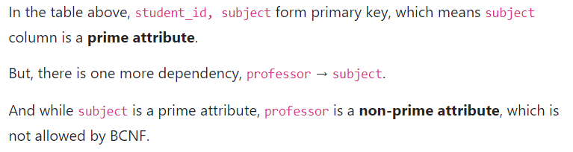
BCNF?

Slide 58
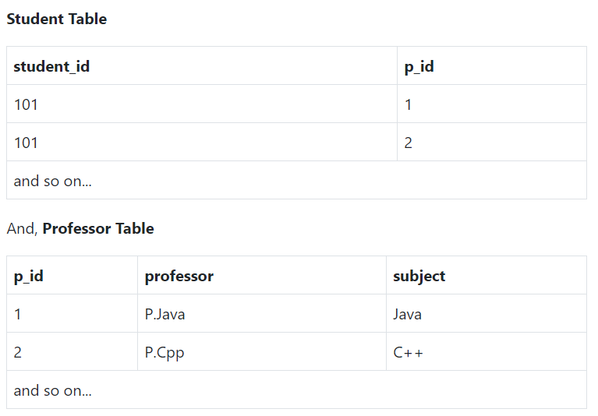
BCNF?

Slide 59
5. Decompose a relation into BCNF, 3NF
The goal of decomposition is to replace a relation by several relations that do not exhibit anomalies
So, it turns out, a simple condition under which the anomalies can be guaranteed not to exist. This condition is called Boyce-Codd Normal Form, or BCNF

Slide 60
5. Decompose a relation into BCNF, 3NF
BCNF is a solution for eliminating Anomalies
But, BCNF can lead to the loss of information and functional dependencies (in some cases, after decomposition into BCNF, we can’t keep both the lossless-join and dependency-preservation properties)
So, 3NF is the solution that have both the lossless-join and dependency-preservation properties

Slide 61
BCNF decomposition algorithm
Input: A relation R with a set of FD’s F
Output: A BCNF decomposition of R with lossless join Method:
  At each step compute the key for the sub-relation R
  if not in BCNF, pick any FD X->Y which violates
  break the relation into 2 sub-relations
    R1(XY)
    R2(S - Y)
    this has a lossless join
    project FD's onto each sub-relation
  continue until no more offending FD's

Slide 62
3NF decomposition algorithm
Input: A relation R with a set of FD’s F
Output: A decomposition of R into a collection of relations, all of which are in 3NF. This decomposition has a lossless join and dependency-preservation.
Method:
  Find minimal basic for F, say G.
  ∀ X->A ∈ G, use XA as the schema of one relations in the decomposition.
  If none of the sets of relations from Step 2 is a super key for R, add another relation whose schema is a key for R.

Slide 63
3NF decomposition algorithm
Step 1: Find the minimal cover of FDs
Step 2. Find all (candidate) keys.
Step 3: Merge FDs with same LHS and whose RHS are non-key attributes, we get the set F1.
Step 4: Check each FD in the set F1 for violation of 3NF, and split table accordingly.
  Checking FD: if the FD X --> Y violates 3NF as its LHS is not a superkey (and RHS is a set of non-key attributes), then the 3NF table is obtained by attributes {X,Y} with with FDs X --> Y
Step 5: Finally, add the table into normalized 3NF table set (obtained by removing RHS attributes of FDs using which we produced a table) with remain FDs

Slide 64
3NF decomposition example
Example: Consider r(ABCDEF) subject to the following FDs:
F = {A →BCF, B →DE, ABD →CF, AC →DE }
Find a 3NF database for r under F.
Step 1: Find the minimal cover of FDs
Step 2. Find all (candidate) keys.
Step 3: Merge FDs with same LHS and whose RHS are non-key attributes, we get the set F1.
Step 4: Check each FD in the set F1 for violation of 3NF, and split table accordingly.
  Checking FD: if the FD X --> Y violates 3NF as its LHS is not a superkey (and RHS is a set of non-key attributes), then the 3NF table is obtained by attributes {X,Y} with with FDs X --> Y
Step 5: Finally, add the table into normalized 3NF table set (obtained by removing RHS attributes of FDs using which we produced a table) with remain FDs

Slide 65
3NF decomposition example
Example: Consider r(ABCDEF) subject to the following FDs:
F = {A →BCF, B →DE, ABD →CF, AC →DE }
Find a 3NF database for r under F.
Step 1: Find the minimal cover of FDs, which contains
a --> b
b --> d
b --> e
a --> c
a --> f

Slide 66
3NF decomposition example
Example: Consider r(ABCDEF) subject to the following FDs:
F = {A →BCF, B →DE, ABD →CF, AC →DE }
Find a 3NF database for r under F.
Step 2. Find all candidate keys. The set of candidates keys is { (a) }.
The set of key attributes is: { a }.

Slide 67
3NF decomposition example
Example: Consider r(ABCDEF) subject to the following FDs:
F = {A →BCF, B →DE, ABD →CF, AC →DE }
Find a 3NF database for r under F.
Step 3: Merge FDs with same LHS and whose RHS are non-key attributes, we get the set F1 which contains:
a --> f,c,b
b --> e,d

Slide 68
3NF decomposition example
Example: Consider r(ABCDEF) subject to the following FDs:
F = {A →BCF, B →DE, ABD →CF, AC →DE }
Find a 3NF database for r under F.
Step 4: Check each FD in the set F1 for violation of 3NF, and split table accordingly.
Checking FD a --> f,c,b: FD does not violate 3NF
Checking FD b --> e,d: The FD violates 3NF as its LHS is not a superkey (and RHS is a set of non-key attributes).
The following 3NF table is obtained: b,e,d
with FDs: b --> e,d

Slide 69
3NF decomposition example
Example: Consider r(ABCDEF) subject to the following FDs:
F = {A →BCF, B →DE, ABD →CF, AC →DE }
Find a 3NF database for r under F.
Step 5: Finally, add the following table into normalized 3NF table set (obtained by removing RHS attributes of FDs using which we produced a table): a,b,c,f
with FDs: a --> b,c,f

Slide 70
3NF decomposition example
Example: Consider r(ABCDEF) subject to the following FDs:
F = {A →BCF, B →DE, ABD →CF, AC →DE }
Find a 3NF database for r under F.
Solution: Find a canonical cover for (R,F):
F= { A →B, B → DE, A →CF } same as
F= { A →BCF, B →DE }
Final decomposition: r = ( ABCF, BDE )

Slide 71
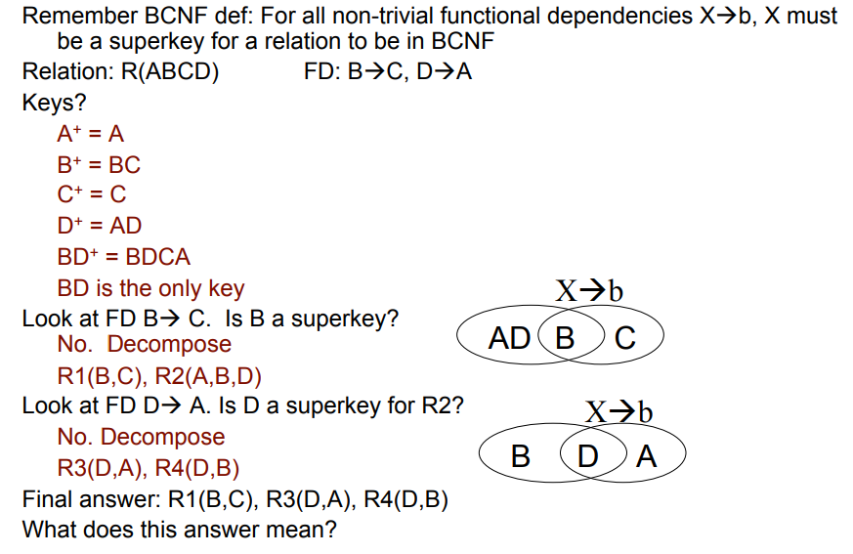

Slide 72
Step 1: Find the minimal cover of FDs, which contains
b --> c
d --> a

Slide 73
Step 2. Find all candidate keys. The set of candidates keys is { (b,d) }.
The set of key attributes is: { b,d }.

Slide 74
Step 3: Merge FDs with same LHS and whose RHS are non-key attributes, we get the set F1 which contains:
b --> c
d --> a

Slide 75
Step 4: Check each FD in the set F1 for violation of 3NF, and split table accordingly.
Checking FD b --> c: The FD violates 3NF as its LHS is not a superkey (and RHS is a set of non-key attributes).
The following 3NF table is obtained: b,c; with FDs: b --> c
Checking FD d --> a: The FD violates 3NF as its LHS is not a superkey (and RHS is a set of non-key attributes).
The following 3NF table is obtained: d,a; with FDs: d --> a

Slide 76
Step 5: Finally, add the following table into normalized 3NF table set (obtained by removing RHS attributes of FDs using which we produced a table): b,d; with FDs: empty

Slide 77
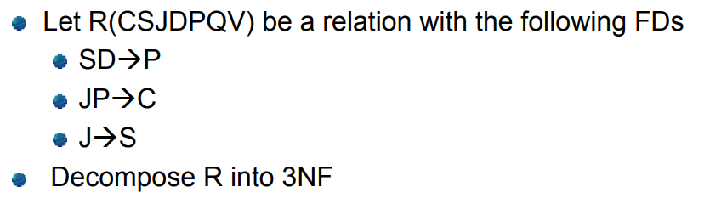

Slide 78
Step 1: Find the minimal cover of FDs, which contains
s,d --> p
j,p --> c
j --> s

Slide 79
Step 2. Find all candidate keys. The set of candidates keys is { (j,d,q,v), }.
The set of key attributes is: { j,d,q,v }.

Slide 80
Step 3: Merge FDs with same LHS and whose RHS are non-key attributes, we get the set F1 which contains:
s,d --> p
j,p --> c
j --> s

Slide 81
Step 4: Check each FD in the set F1 for violation of 3NF, and split table accordingly.
Checking FD s,d --> p: The FD violates 3NF as its LHS is not a superkey (and RHS is a set of non-key attributes).
The following 3NF table is obtained:s,d,p; with FDs: d,s --> p
Checking FD j,p --> c: The FD violates 3NF as its LHS is not a superkey (and RHS is a set of non-key attributes).
The following 3NF table is obtained: j,p,c; with FDs: j,p --> c
Checking FD j --> s: The FD violates 3NF as its LHS is not a superkey (and RHS is a set of non-key attributes).
The following 3NF table is obtained: j,s; with FDs: j --> s

Slide 82
Step 5: Finally, add the following table into normalized 3NF table set (obtained by removing RHS attributes of FDs using which we produced a table): j,d,q,v; with FDs: empty

Slide 83
Exercises 1
Are the following relations in BCNF? 3NF? (if R is not in BCNF, decompose it to BCNF)
  S(A,B,C,D): A->B, A->C, D->A
  T(A,B,C,D): A->B, B->C, C->D, BD->A
  U(A,B,C,D): AD->B, AB->C, BC->D, CD->A
  R(A,B,C,D,E): A->C, C->B, B->D, D->E, E->A
  R(A,B,C,D,E): BC->DE, A->E, D->A, E->B
  R(A,B,C,D,E): C->D, AD->E, BC->E, DE->A
  R(A,B,C,D,E):
  AB->E, AC->D, BC->E, E->A, D->B
  R(A,B,C,D): B->A, C->B, D->C, A->D

Slide 84
Exercises 2
Are the following relations in BCNF? 3NF? (if R is not in BCNF, decompose it to BCNF; if R is not in 3NF, decompose it to 3NF)
  R(X,Y, Z,T,V): XY->Z, Y->T, Z->V
  R(X,Y,Z,T): X->Y, Y->Z, Z->T
  R(A,B,C): AB->C, B->A, C->B
  R(ABCD): BD->C, AB->D, AC->B, BD->A
  R(ABCD): AD->C, CD->B, BD->C
  R(ABCD): A->C, B->A, A->D, AD->C
  R(ABCD): A->D, C->A, D->B, AC->B
  R(XYZT): XYT->Z, ZT->X, XZ->Y, XZ->T
  R(XYZT): XY->Z, XYT->Z, XYZ->T, XZ->T
  R(XYZT): YT->Z, XY->T, XZ->Y, YT->X
  R(XYZT): YZ->X, XT->Z, ZT->Y, YT->Z

Slide 85
Summary 1
Decompose a relation into BCNF is a solution for eliminating anomalies
But BCNF can cause information loss and dependency loss
3NF is a relax solution of BCNF that keep loss-less join and dependency-preservation properties

Slide 86
Summary 2:
2NF | 3NF | Boyce-Codd
every nonprime attribute A in R is not partially dependent on any key of R | a nontrivial functional dependency: X => A holds in R, either X is a superkey of R, or (b) A is a prime attribute of R. | a nontrivial functional dependency X => A holds in R, then: X is a superkey of R
Note:A functional dependency X => Y is a full functional dependency if removal of any attribute A from X means that the dependency does not hold any more; A partial functional dependency is not a full functional dependency

Slide 87

Fourth Normal Form

Slide 88
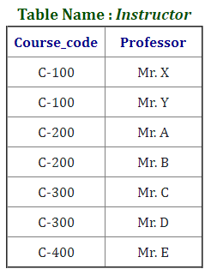

Fourth Normal Form

Slide 89
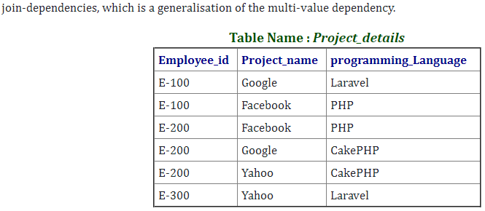
Fifth Normal Form (5NF)

Slide 90
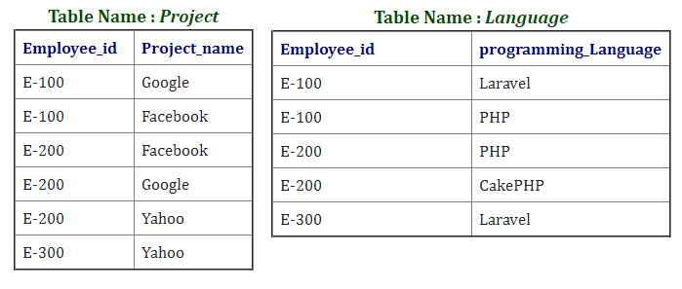
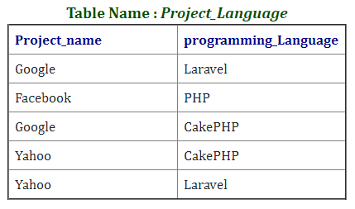
Fifth Normal Form (5NF)

Slide 91
Reference
1NF, 2NF, 3NF, BCNF, 4NF and 5NF in Database Normalization (questionsolves.com)
https://www.javatpoint.com/dbms-canonical-cover

Slide 92
Thank You !

