Slide 1
Chapter 4
High-level Database Models - ER model

Slide 2
Objectives
1
Understand the Database Design Process
2
Understand what is the high-level design (or Conceptual Design)
3
Understand why must use Conceptual Design (or Logical Design)
4
Understand the purpose of a ERD
5
Know what are Entity, Entity Set, Entity Instances, Attributes & others
6
Know what is a relationship and how to realize it
7
Know how to draw an ERD

Slide 3
Contents
1
Database design process
2
Entity relationship model
3
What are entity, entity set, attribute, relationship?
4
ERD
5
Attributes on Relationships
6
Weak Entities
7
Sub-class

Slide 4
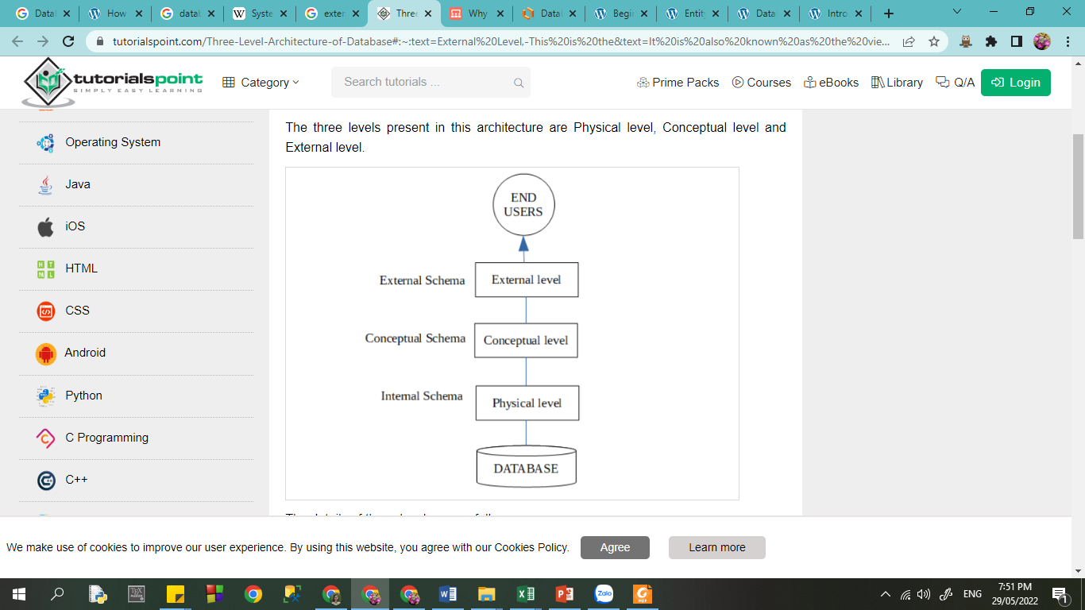
Data Model
The ANSI-SPARC Architecture (American National Standards Institute, Standards Planning And Requirements Committee), is an abstract design standard for a database management system (DBMS), first proposed in 1975.

Slide 5
Data Model
The lowest level
It describes how data is stored in the database
The data is stored in the external hard drives (in files and folders)
It includes compression and encryption techniques.

Slide 6
Data Model
It is also known as the logical level
It describes how the database appears to the users conceptually and the relationships between various data tables

Slide 7
Data Model
The highest level - closest to users
It is known as the view level.
It only shows the relevant database content to the users in the form of views and hides the rest of the data
So different users can see the database as a different view as per their individual requirements.

Slide 8
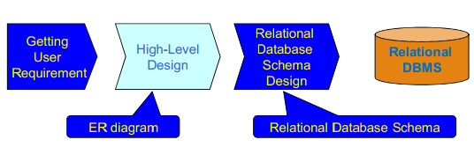
The database modeling and implementation process
Why do we use the relational model?

Slide 9
The database modeling and implementation process
It has only one concept – the relation
It is useful when we begin with a high-level design model

Slide 10
The database modeling and implementation process
Why do we need a database design?

Slide 11
Why doing database design
  Good application programs can't overcome bad database designs
  The existence of a DBMS does not guarantee good data management, nor does it ensure that the database will be able to generate correct and timely information
  The end user and the designer decide what data will be stored in the database

Slide 12
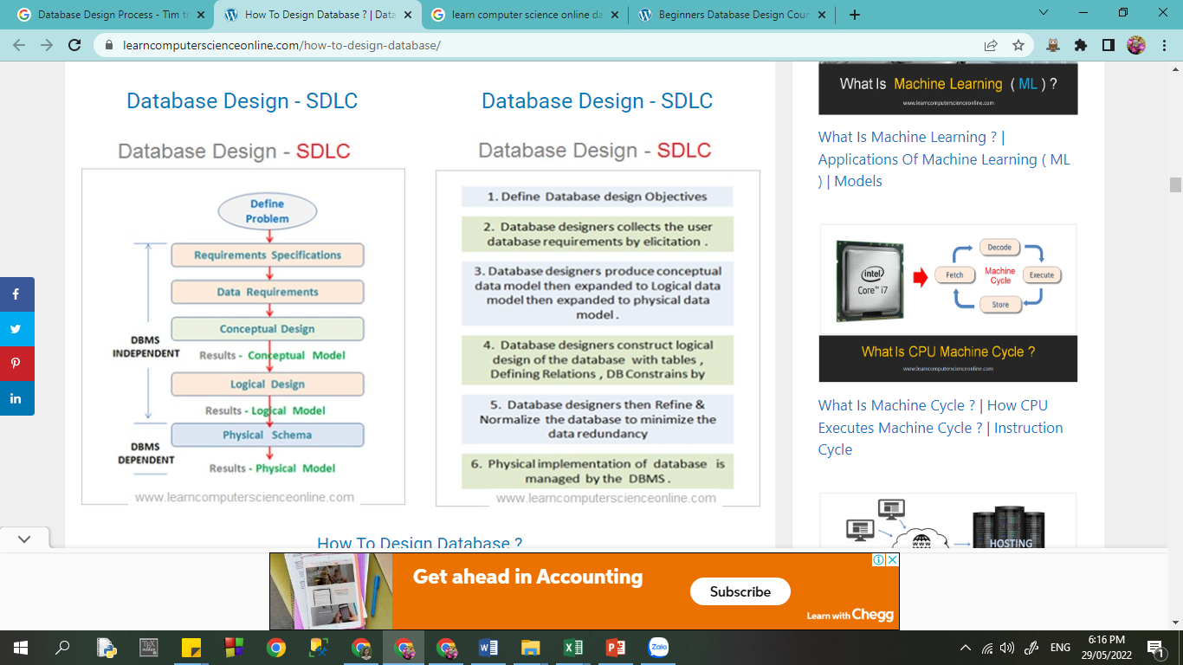
Steps in Database Design
ERD -
Entity Relationship Diagram

Slide 13
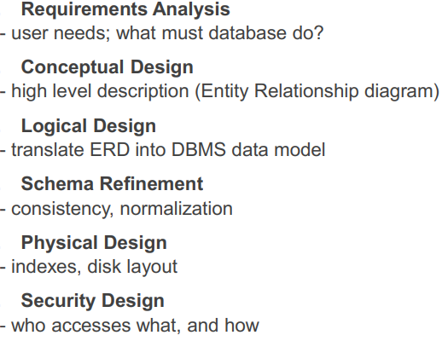
Steps in Database Design

Slide 14
4.1. Entity Relationship Model
Entity Relationship Diagram (ERD) is a graphical representation of the database structure
Also known as ER Model or ER Diagram
An ERD using 3-principal element types:
1. Entity sets
2. Attributes
3. Relationships

Slide 15
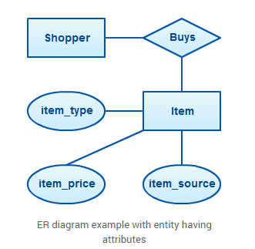
4.1. Entity Relationship Model
How many types of shapes does the ERD have?
https://creately.com

Slide 16
4.1. Entity Relationship Model
3 types of shape:
Rectangle
Diamond
Ellipse/Oval
Determine:
1. Entity Sets
2. Attributes
3. Relationships
https://creately.com

Slide 17
4.1. Entity Relationship Model
Entity Sets:
Shopper
Item
2. Attributes: item_type
item_price
item_source
3. Relationships:
Buys
https://creately.com

Slide 18
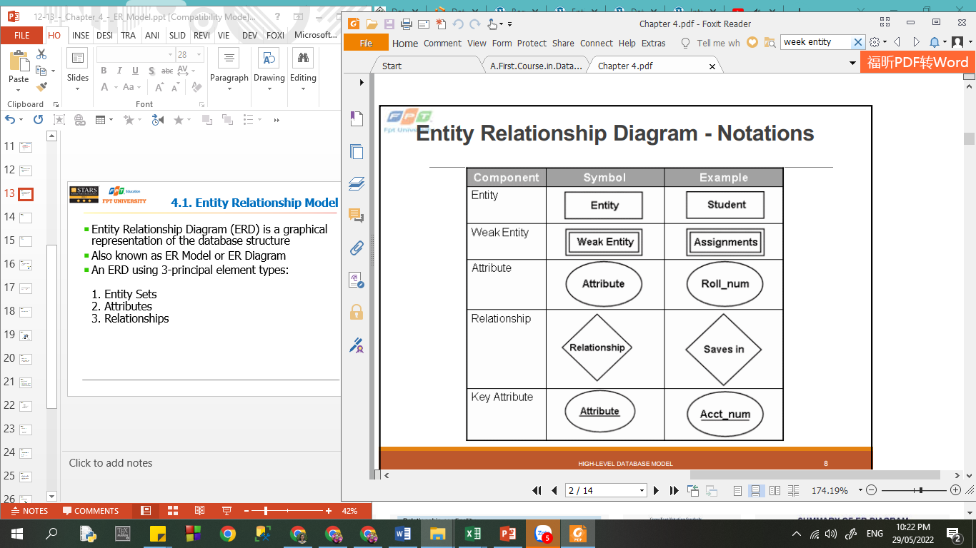
4.1. ERD - Notation

Slide 19

4.1.1 ERD - Entity sets
  Entity:
    Can be a person, place, event, or object that is relevant to a given system
    Named using singular nouns
    A collection of similar entities forms an entity set
  Weak entity:
    Is an entity that depends on the existence of another entity
    Uses a foreign key combined with its attributed to form the primary key
ODER and ORDER_ITEM
https://creately.com

Slide 20

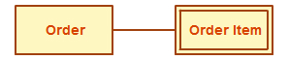
4.1.1 ERD - Entity sets
  Entity:
    Can be a person, place, event, or object that is relevant to a given system
    Named using singular nouns
    A collection of similar entities forms an entity set
  Weak entity:
    Is an entity that depends on the existence of another entity
    Uses a foreign key combined with its attributed to form the primary key
https://creately.com

Slide 21
4.1.1 ERD - Entity sets
A specific example of an entity is called an entity instance
Instances
Entities
A | B
PERSON | Bill Clinton, Obama
PRODUCT | Chair, Table, Motor
JOB | Violinist, Programmer
SKILL LEVEL | Fluent
https://creately.com

Slide 22
4.1.1 ERD - Entity sets
A specific example of an entity is called an entity instance
Entities | Instances
PERSON | Bill Clinton, Obama
PRODUCT | Chair, Table, Motor
JOB | Violinist, Programmer
SKILL LEVEL | Fluent
https://creately.com

Slide 23
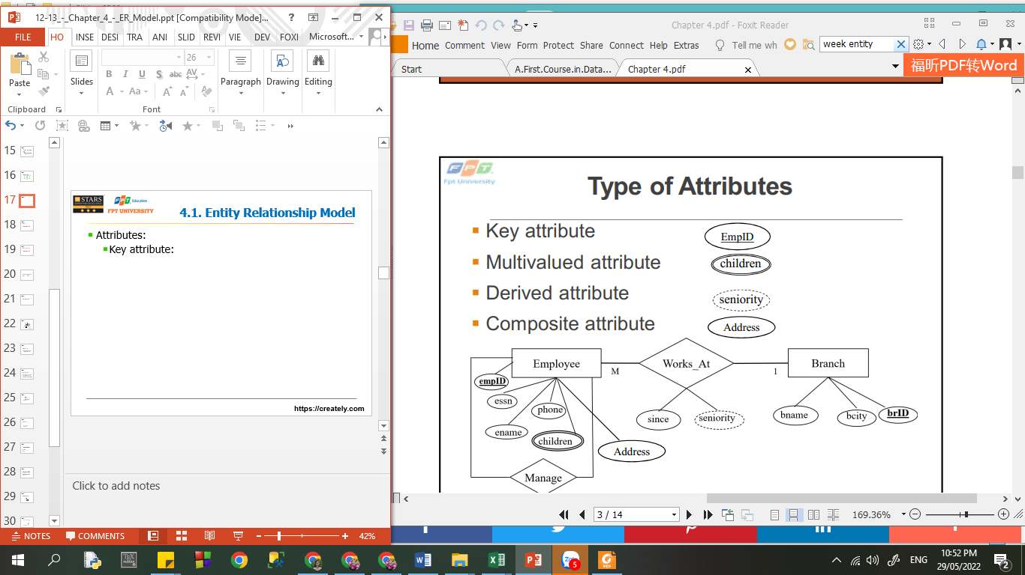
4.1.2 ERD - Attributes
  Attributes are properties or characteristics of an entity, relationship, or another attribute
https://creately.com

Slide 24
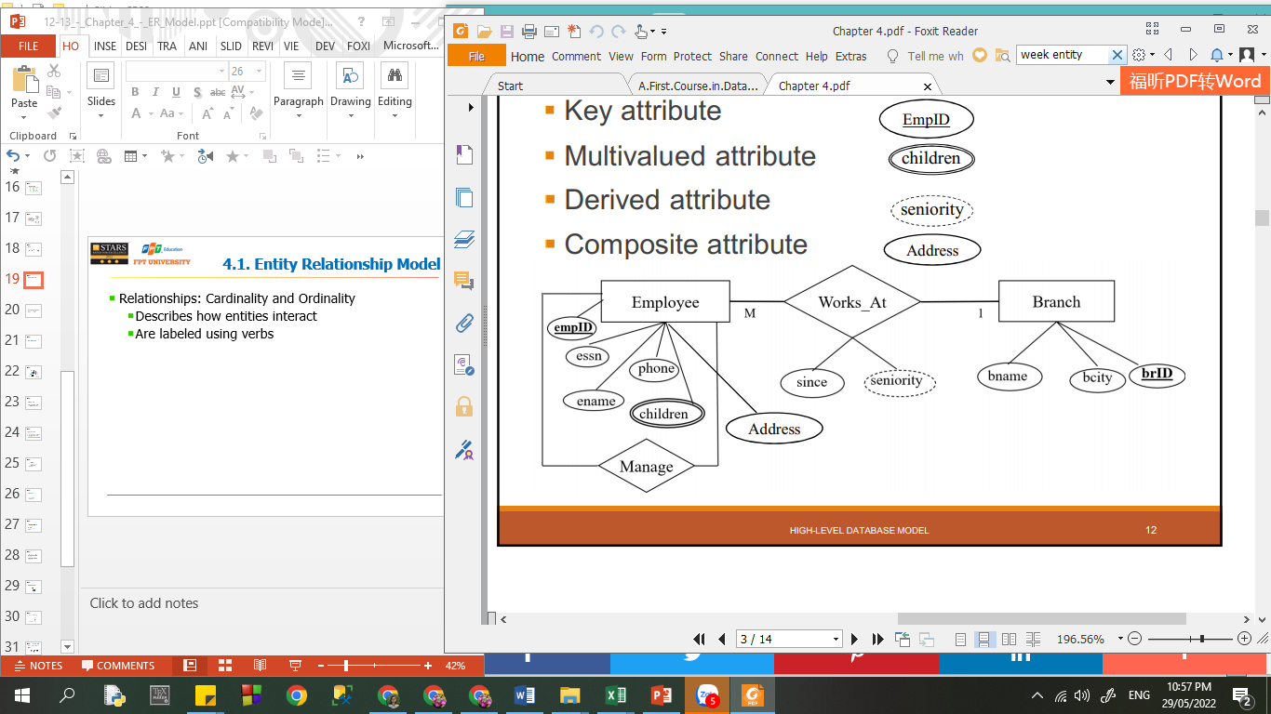
4.1.2 ERD - Attributes
No.
City
Street

Slide 25

4.1.2 ERD - Attributes
  Attributes are properties or characteristics of an entity, relationship, or another attribute
  Ex: Suggest the attributes for each entity:
    Office
    Job
    Deparment
    Skill
    Project

Slide 26
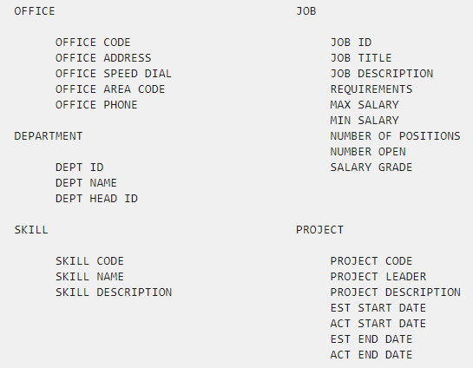
4.1.2 ERD - Attributes
  Attributes are properties or characteristics of an entity, relationship, or another attribute
  Ex: Suggest the attributes for each entity:
    Office
    Job
    Deparment
    Skill
    Project

Slide 27
4.1.2 ERD - Attributes
  Attributes are properties or characteristics of an entity, relationship, or another attribute
  Ex: Suggest the attributes for each entity:
    Office
    Job
    Deparment
    Skill
    Project

Slide 28
4.1.2 ERD - Attributes
  Attributes are properties or characteristics of an entity, relationship, or another attribute
  Ex: Suggest the attributes for each entity:
    Office
    Job
    Deparment
    Skill
    Project

Slide 29
4.1.2 ERD - Attributes
  Attributes are properties or characteristics of an entity, relationship, or another attribute
  Ex: Suggest the attributes for each entity:
    Office
    Job
    Deparment
    Skill
    Project

Slide 30
4.1.2 ERD - Attributes
  Attributes are properties or characteristics of an entity, relationship, or another attribute
  Ex: Suggest the attributes for each entity:
    Office
    Job
    Deparment
    Skill
    Project

Slide 31
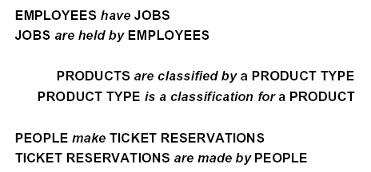
4.1.3 ERD - Relationships
  Exp:

Slide 32
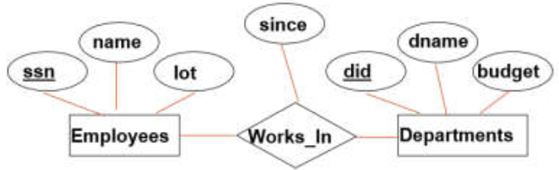
4.1.3 ERD - Relationships
  Relationships are connections among two or more entity sets
  Are labeled using verbs
  Sometimes associate with attributes

Slide 33
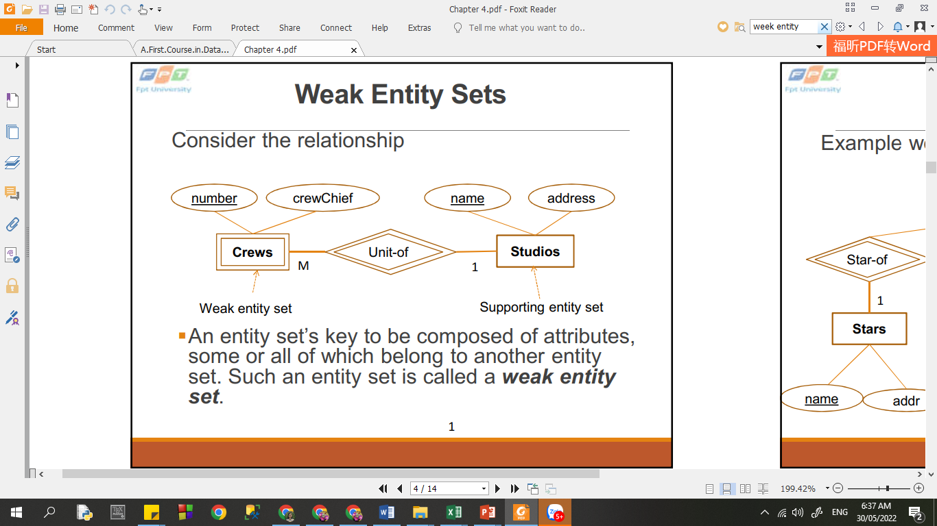


4.1.3 ERD - Relationships
Weak entity Relationship:
  is relationship between a weak entity and another entity

Slide 34
4.1.3 ERD - Relationships
Weak entity Relationship:
  is relationship between a weak entity and another entity

Slide 35

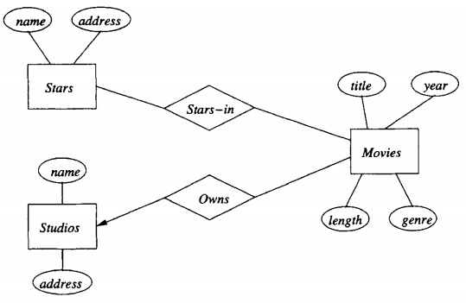
4.1.3 ERD - Relationships
Binary Relationships:
  relationships between two entities
The arrow (from Movies to Studios)
indicates that each entity in set Movies is related to at most one entity in set Studios

Slide 36
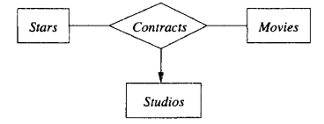
4.1.3 ERD - Relationships
Multiway Relationships:
  relationships involve more than two entities

Slide 37
4.1.3 ERD - Relationships
Recursive Relationships:
  If the same entity participates more than once in a relationship it is known as a recursive relationship

Slide 38
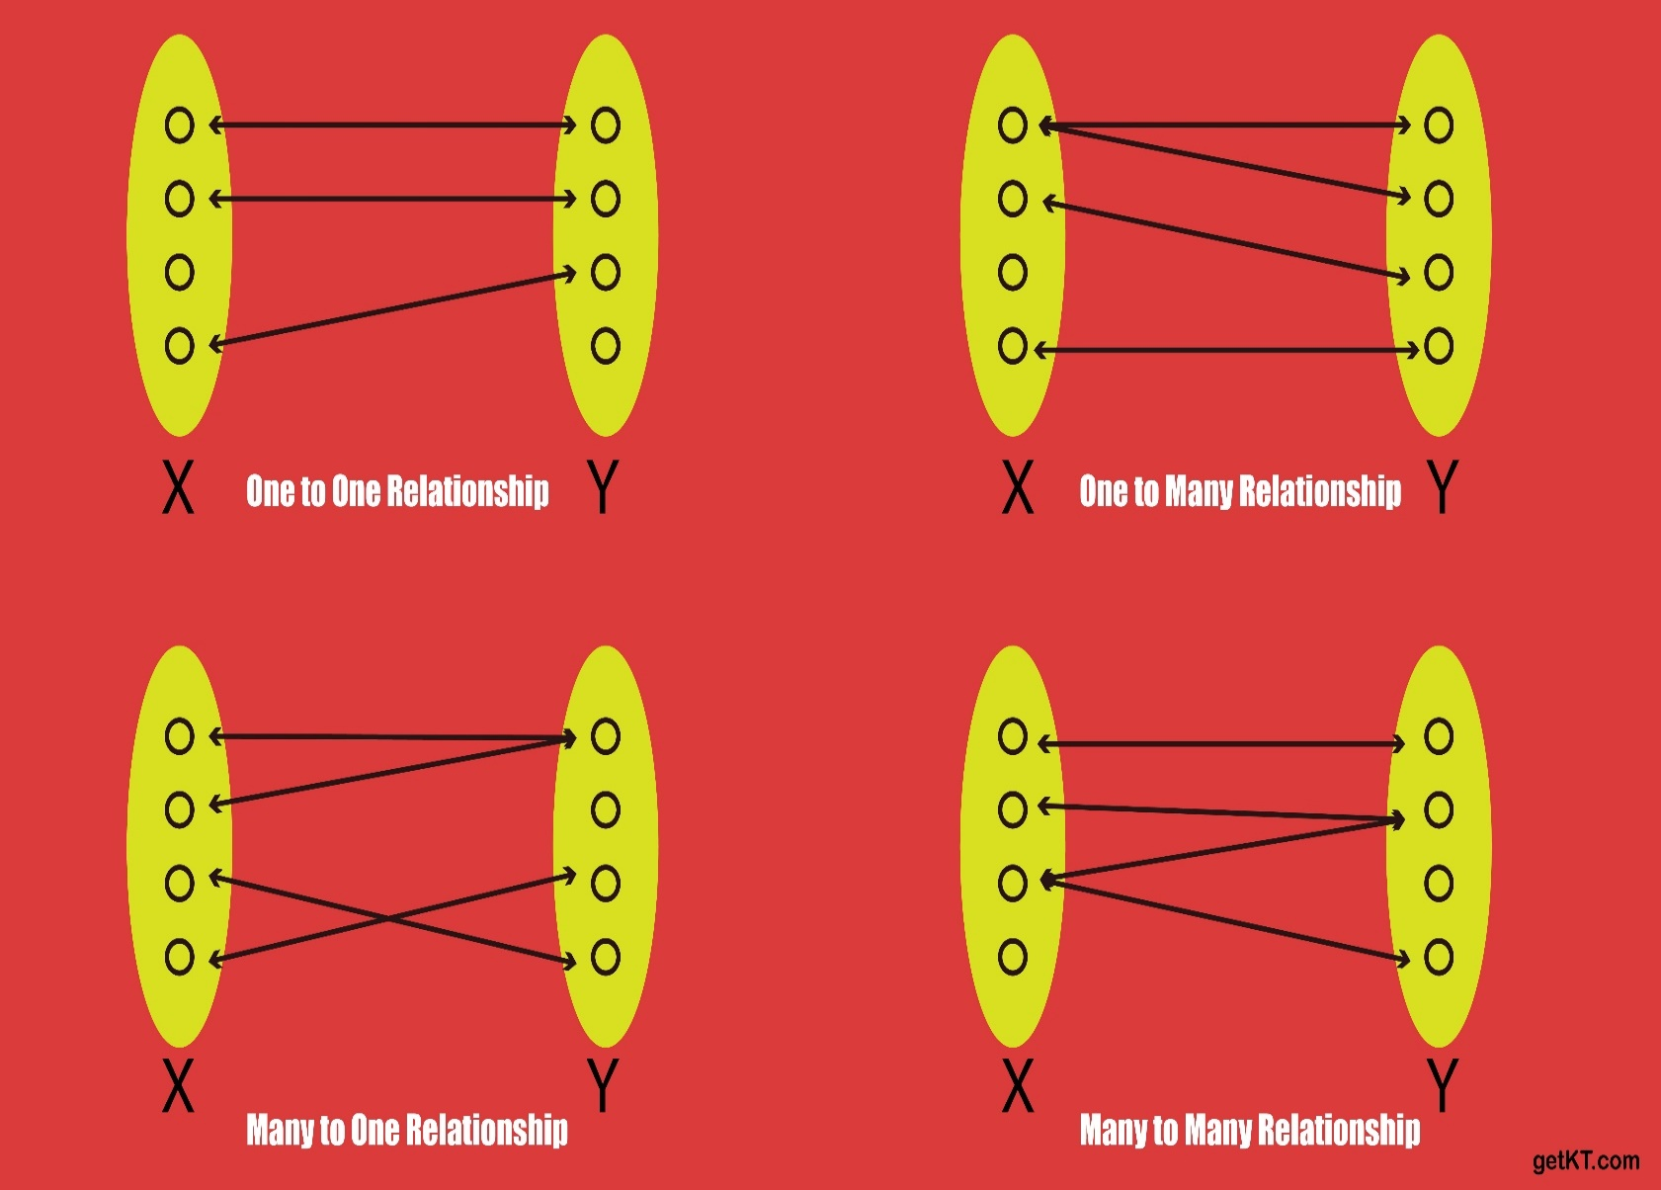
4.1.3 ERD - Relationships
Multiplicity of Binary E/R Relationships
(Cardinality and Ordinality)

Slide 39
4.1.3 ERD - Relationships
Multiplicity of Binary E/R Relationships
(Cardinality and Ordinality)

Slide 40
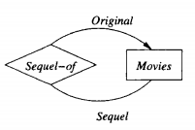
4.1.3 ERD - Relationships
Roles in Relationships:
  One entity set appears two or more times in a single relationship → each relationship line has a different role

Slide 41
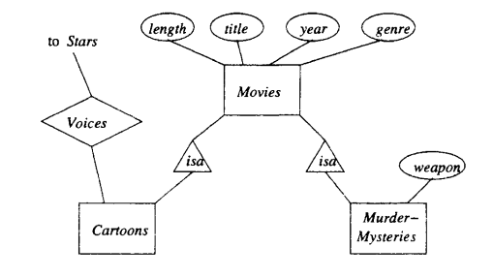
4.1.4 Subclasses
  A certain special-case entity sets, each with its own special attributes and/or relationships
  Using a relationship called isa (“an A is a B”)

Slide 42
4.1.4 Subclasses
  Exp: Among the special kinds of movies are cartoons and murder mysteries (with some special properties)

Slide 43
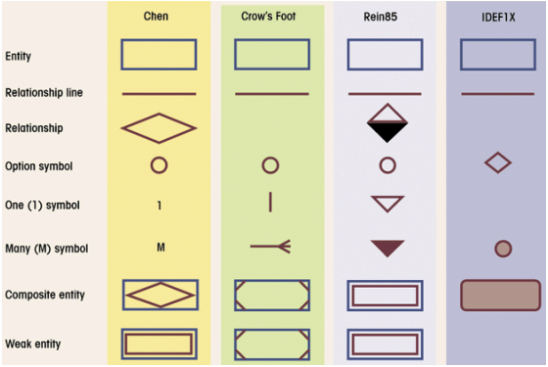
4.1.5 Comparision of ERD notation

Slide 44
Summary
Database design process has …A… phases: …B……..
E/R model has used in …C… phase to …D… of applications.
Main concepts in E/R model are: …E..
Relationship Cardinality: …F…
Others concepts are: weak entity, multi-way relationship, sub-class

Slide 45

Summary
Database design process has three phases: conceptual, logical and physical design.
E/R model has used in conceptual design phase to capture requirements of applications.
Main concepts in E/R model are: entity, entity instances, entity set, attribute, relationship (many-many, one-many, one-one, mandatory, optional)
Others concepts are: weak entity, multi-way relationship, sub-class

Slide 46
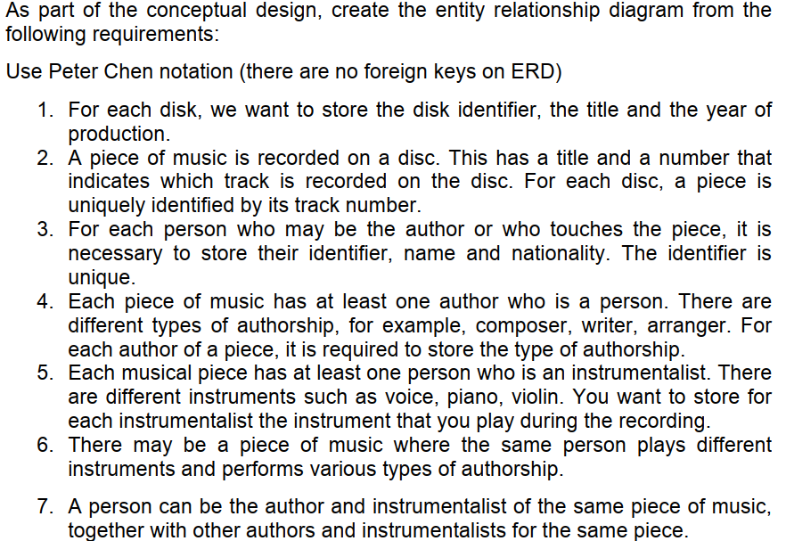
ERD - Homework

Slide 47
Thank You !

