Slide 1
Chapter 4
High-level Design Principles
& convert E/R diagram to relational model

Slide 2
Objectives
1
Understand design principles
2
Understand constraints in ERDs
3
Know how to convert from ERD to relational designs

Slide 3
Contents
1
Design Principles
2
From ERDs to relational designs

Slide 4
4.2. Design Principles
Faithfulness
Avoiding Redundancy
Simplicity Counts
Choosing the Right Relationships
Picking the Right Kind of Element
Limit the use of weak entity sets.
Don’t use an entity set when an attribute will do.

Slide 5
4.2.1. Faithfulness
First and Foremost, the design should be faithful to the specifications of the application:
  Entity sets and their attributes should reflect the reality
  Whatever relationships are asserted should make sense given what we know about the part of the real world being modeled

Slide 6

4.2.1. Faithfulness
  Exp: Which can we attach an attribute number-of-cylinders to?
    Stars
    Automobiles

Slide 7

4.2.1. Faithfulness
  Exp: Which can we attach an attribute number-of-cylinders to?
    Stars
    Automobiles

Slide 8
4.2.2. Avoiding Redundancy
Redundancy and anomalies are typical of problems in ERD
Redundancy = repetition of a fact = duplicate data = the same parts of data exist in multiple locations.
Resulting to
  waste space,
  be difficult database update (update anomaly),
  encourage inconsistency,
  be slow and inefficient in retrieval of data

Slide 9
4.2.2. Avoiding Redundancy
An update anomoly potential
Data inconsistency

Slide 10
4.2.2. Avoiding Redundancy
An update anomoly potential
  Two representations of the same fact become inconsistent if we change one and forget to change the other.
  Recall anomalies due to FD’s.
Data inconsistency
    The same data exists in different formats in multiple tables
    This can cause unreliable and meaningless information

Slide 11

4.2.2. Avoiding Redundancy - Exp
name
name
addr
ManfBy
Beers
Manfs
manf
Problem

Slide 12

4.2.2. Avoiding Redundancy - Exp
name
name
addr
ManfBy
Beers
Manfs
Solution
manf
This design states the manufacturer of a beer
Redundancy: a related entity set Manfs with the entity set Beers via the relationship ManfBy, also an attribute manf of entity set Beers

Slide 13
4.2.2. Avoiding Redundancy - Exp
name
name
addr
ManfBy
Beers
Manfs

Slide 14

4.2.3. Simplicity Counts
Avoid introducing more elements into your design than is absolutely nessessary
Hodings: the ownership of a single movie
Represents
Movies
Holdings
Owns
Studios

Slide 15
Example: A poor design with an Un-necessary entity set
That diagram truly represents the real world, since it is possible to go from a movie to its unique owning studio via Holdings, however, Holdings serves no useful purpose and we are better off without it. It makes programs that use the Movie-Studio relationship more complicated, waste space and encourages errors
Represents
Movies
Holdings
Owns
Studios

Slide 16
Example: A poor design with an Un-necessary entity set
Represents
Movies
Holdings
Owns
Studios
Owns
Movies
Studios

Slide 17
4.2.4. Choosing the Right Relationships
Adding to the design every possible relationship causes:
  redundancy,
  update anomalies,
  deletion anomalies
deletion anomalies

Slide 18
4.2.4. Choosing the Right Relationships
Adding to the design every possible relationship causes:
  redundancy,
  update anomalies,
  deletion anomalies
deletion anomalies: occurs when you delete a record that may contain attributes that shouldn't be deleted

Slide 19
Example: Choosing the Right Relationships
Salary
title
year
name
addr
Contracts
Movies
Stars
length
genre
If a star can work on a movie without there being a contract?
if there is the possibility that a studio owns a movie, yet has no stars under contract for that movie, or no such contract is known to our database?
Studios
name
addr

Slide 20
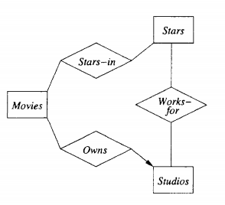
Example: Choosing the Right Relationships
Salary
title
year
name
addr
Movies
Contracts
Stars
length
genre
Studios
name
addr
Do we need the relationships between Movies and Studios and Movies and Stars directly?

Slide 21
4.2.5. Picking the Right Kind of Element
Sometimes we have many options regarding the type of design element used to represent a real-world concepts.
Many of these choices are between using attributes and using Entity set / Relationship combinations.
In general, an attribute is simpler to implement than either an Entity set or a Relationship
However, making everything an attribute will usually get us into trouble.

Slide 22
4.2.5. Picking the Right Kind of Element
Entity Sets Versus Attributes
An entity set should satisfy at least one of the following conditions should not be replaced by an attribute:
  Existing at least one nonkey attribute.
  Existing the “many” in a many-one or many-many relationship.

Slide 23
4.2.5. Picking the Right Kind of Element
Entity Sets Versus Attributes
name
name
ManfBy
Beers
Manfs
Manfs should be an entity set or an attribute?
Why?

Slide 24
4.2.5. Picking the Right Kind of Element
Entity Sets Versus Attributes
name
name
ManfBy
Beers
Manfs
name
manf
Beers
Since the Manfs has
only one attribute (key),
and only the “one” at end the relationship.
→ it should be replaced by an attribute.

Slide 25
4.2.5. Picking the Right Kind of Element
Entity Sets Versus Attributes
name
name
addr
ManfBy
Beers
Manfs
Manfs should be an entity set or an attribute? Why?
Beers should be an entity set or an attribute? Why?

Slide 26
4.2.5. Picking the Right Kind of Element
Entity Sets Versus Attributes
name
name
addr
ManfBy
Beers
Manfs
Manfs deserves to be an entity set because of the nonkey attribute addr.
Beers deserves to be an entity set because it has the “many” of the many-one relationship ManfBy.

Slide 27
4.2.6. Don’t
Over-use Weak Entity Sets
Beginning database designers often doubt that anything could be a key by itself.
  They make all entity sets weak, supported by all other entity sets to which they are linked.
In reality, we usually create unique ID’s for entity sets.
  Examples include social-security numbers, automobile VIN’s etc.

Slide 28
4.2.7. When Do
We Need Weak Entity Sets?
The usual reason is that there is no global authority capable of creating unique ID’s.
Sometimes, an Entity Set falls into a hierarchy

Slide 29
4.3. From E/R diagrams to Relational Designs
Step 1: A set of entities is transformed into a relation (set of tuples)
Step 2: An attribute is transformed into an attribute of the relation
Step 3: The identifier of the entity becomes the primary key of the relation
Step 4: Representation the relationships of the entity relationship model into the relational model

Slide 30
4.3. From E/R diagrams to Relational Designs
Step 4: Representation the relationships of the entity relationship model into the relational model
  M:M Any many-to-many relationships between entities of the diagram becomes a (new) relation in the relational model that we have as the primary key the two primary keys of the entities that it associates
  1:M The parent relationship will be on the “cardinality 1“ side. The child relationship will be on the “M” side. Represent each entity as a relation. Copy the primary key of the parent into the child relation as a foreign key
  1:1 The primary key of one relation is stored in the second relation. Look at example queries to determine which key is queried most often. Or the relationship between entities of the diagram becomes a (new) relation in the relational model that we have as the primary key the two primary keys of the entities that it associates
coursera

Slide 31
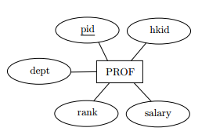
Convert entity set
Entity set => table
PROF (pid, hkid, dept, rank, salary)
Where pid is set as a candidate key

Slide 32
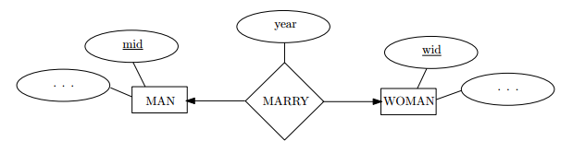
Convert one-one relationship
Table that has two candidate keys.
MARRY (mid, wid, year)
Where candidate key is mid, and another is wid

Slide 33
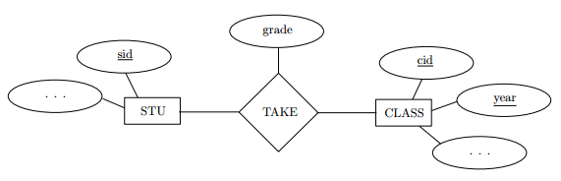
Convert many-many relationship
STU (sid,…) - candidate key is sid
CLASS (cid, year,…) – candidate key is (cid, year)
TAKE (sid, cid, year, grade) – candidate key is (sid, cid, year) and
- foreign key sid references to STU (sid)
- foreign key (cid, year) references to CLASS (cid, year)

Slide 34
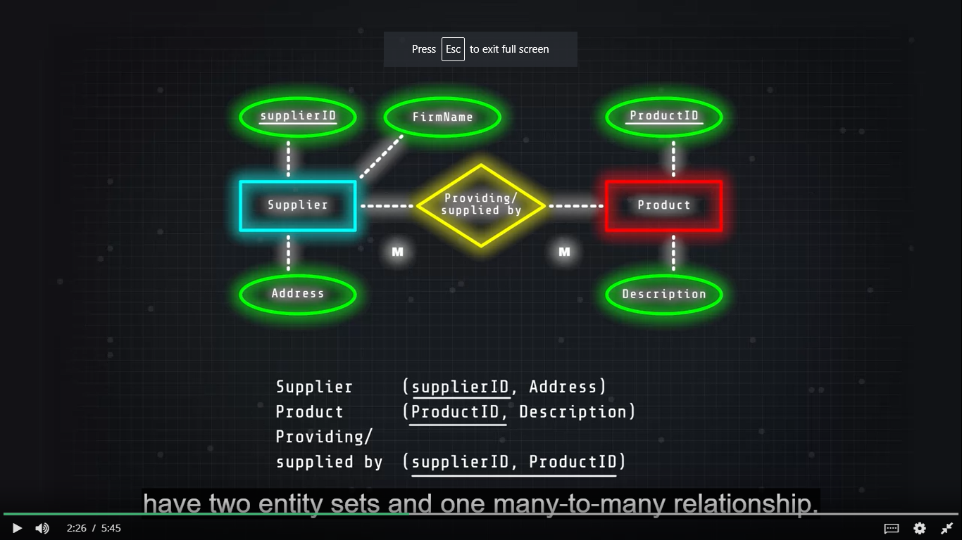

4.3. From E/R diagrams to Relational Designs
M:M
coursera

Slide 35
4.3. From E/R diagrams to Relational Designs
coursera

Slide 36
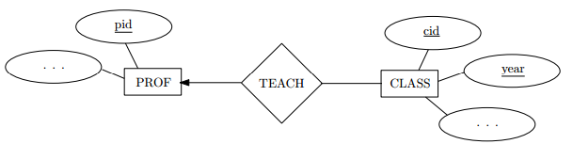
Convert one-many relationship
PROF (pid, …) - candidate key is pid
CLASS (cid, year, pid…) – candidate key is (cid, year) and pid is foreign key references to PROF (pid)

Slide 37
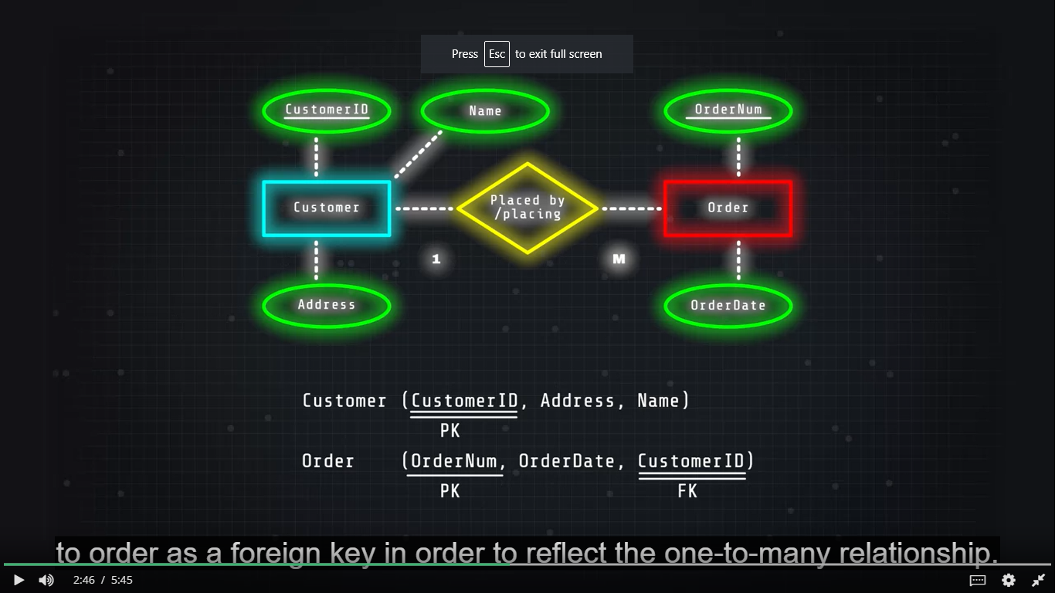
4.3. From E/R diagrams to Relational Designs
1:M
coursera

Slide 38
4.3. From E/R diagrams to Relational Designs
coursera

Slide 39
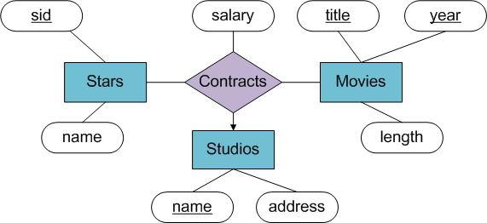
Convert multi-way relationship
MOVIES (title, year, length) - candidate key is (title, year)
STARS (sid, name) – candidate key is sid
STUDIOS (name, address) – candidate key is name
CONTRACTS (sid, title, year, studio-name, salary) – candidate key is (sid, title, year, studio-name) and
- foreign key sid references to STARS(sid)
- foreign key (title, year) references to MOVIES(title, year)
- foreign key studio-name references to STUDIOS(name)

Slide 40
Convert weak entity
name
number
name
Players
Plays-
on
Teams
TEAMS (name) - candidate key is name
PLAYERS (number, team-name, name) – candidate key is (number, team-name) and
- foreign key team-name references to TEAMS(name)

Slide 41
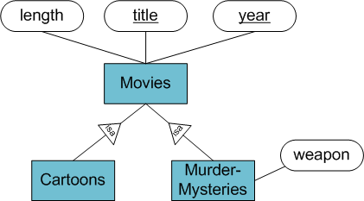
Convert sub-class structures
There are three strategy for conversion to relations:
E/R style conversion
An Object-oriented approach
Using null values to combine relations

Slide 42
Convert sub-class structures
E/R style conversion
MOVIES (title, year, length) – candidate key is (title, year)
MURDERMYSTERIES (title, year, weapon) – candidate key is (title, year)
CARTOONS (title, year) – candidate key is (title, year)
Movies relation has every movie.
Movies that are murder mysteries have a tuple in both Movies and Murdermysteries relations.
Movies that are cartoons have a tuple in both Movies and Cartoons relations.
Movies that are both cartoons and murder mysteries have a tuple in all three relations.

Slide 43
Convert sub-class structures
An Object oriented approach
MOVIES (title, year, length)
MOVIESC (title, year, length)
MOVIESMM (title, year, length, weapon)
MOVIESCMM (title, year, length, weapon)
Candidate key of all relations are the same – (title, year)
This approach enumerate all the possible sub-trees of hierarchy.
For each, create one relation that represents entities having components in exactly those sub-trees.

Slide 44
Convert sub-class structures
Using Null values to combine relations
In this approach, there is only one relation that has all attributes belonging to any entity set of the hierarchy.
Tuple has Null in each attribute that is not defined for appropriate entity.
MOVIES (title, year, length, weapon)
Candidate key of all relations are the same – (title, year)

Slide 45
The questions to Ensure that the tables are in 3NF
Does the table contain any repeating groups?
If not, and the table has a primary key then it is First normal form (1NF)
Does the table contain any partial dependencies?
If not, and it is in 1NF then it is in 2NF
Does the table contain any transitive dependencies or derived attributes?
If not, and it is in 2NF then it is in 3NF

Slide 46
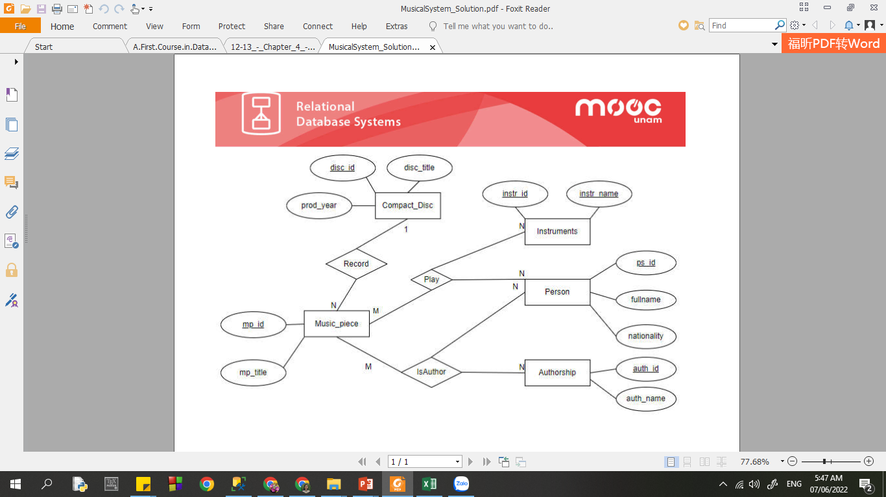
Example: Convert this ERD to Relational Design (HW)

Slide 47
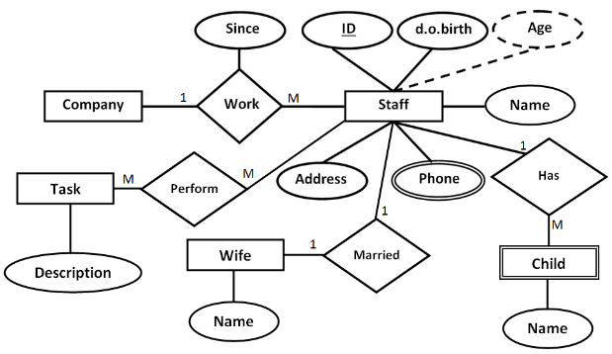
Example: Convert this ERD to Relational Design (HW)

Slide 48
Example: Convert this ERD to Relational Design
There are 4 entities in above ERD, so we have 4 tables create with following names:
- PRESENTER
- AGENT
- SHOW
- PRODUCTION_COMPANY
There are 3 relationships in above ERD, so we have more 3 tables:
- PRESENTER_AGENT (for “represent” relationship)
- PRESENTER_SHOW (for “present” relationship)
- SHOW_PROD_COMP (for “Pro-by” relationship)

Slide 49
Example: Convert this ERD to Relational Design
The table PRESENTER has following columns:
- SIN
- FNAME
- LNAME
- HAIR_COLOR
Exercise: Students must determine the attributes for AGENT, SHOW, PRODUCTION_COMPANY…
Exercise: Students must decompose to make the Relations 3NF

Slide 50
Thank You !

