Slide 1
Chapter 6
Simple Queries in SQL

Slide 2
Objectives
1
Understand why must use Bags concept
2
Understand how to write simple queries
3
Understand about NULL values
4
Understand about the string data type, date-time data type
5
Know how to order the output

Slide 3
Contents
1
Bag concept
2
Projection in SQL
3
Selection in SQL
4
Comparison of Strings and Pattern matching in SQL
5
Date time data type
6
NULL values
7
Ordering the output

Slide 4
6.1 Relational operations on Bags
A bag or multiset is like a set, but an element may appear more than once.
Exp: {1,2,1,3} is a bag.
Order in a bag is unimportant.
Some operations, like projection or union, are much more efficient on bags than sets. Why?

Slide 5
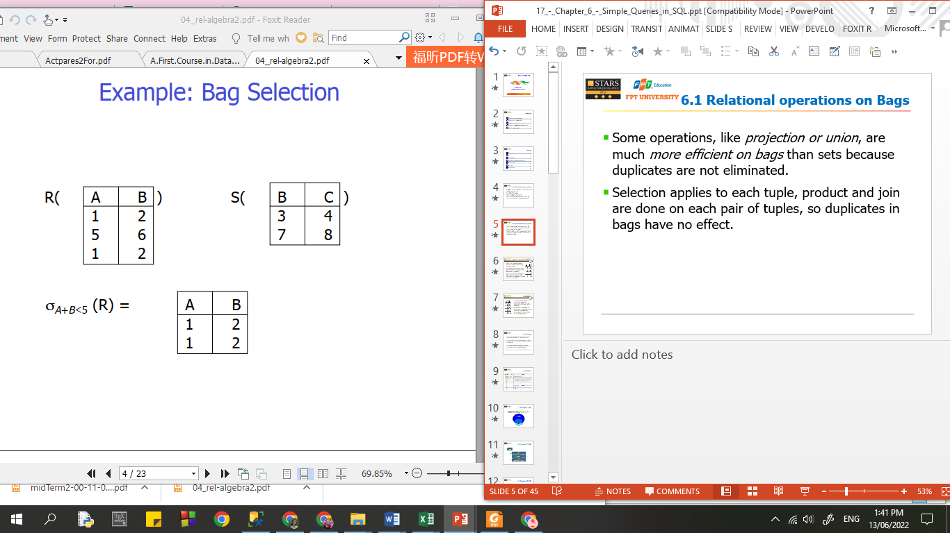

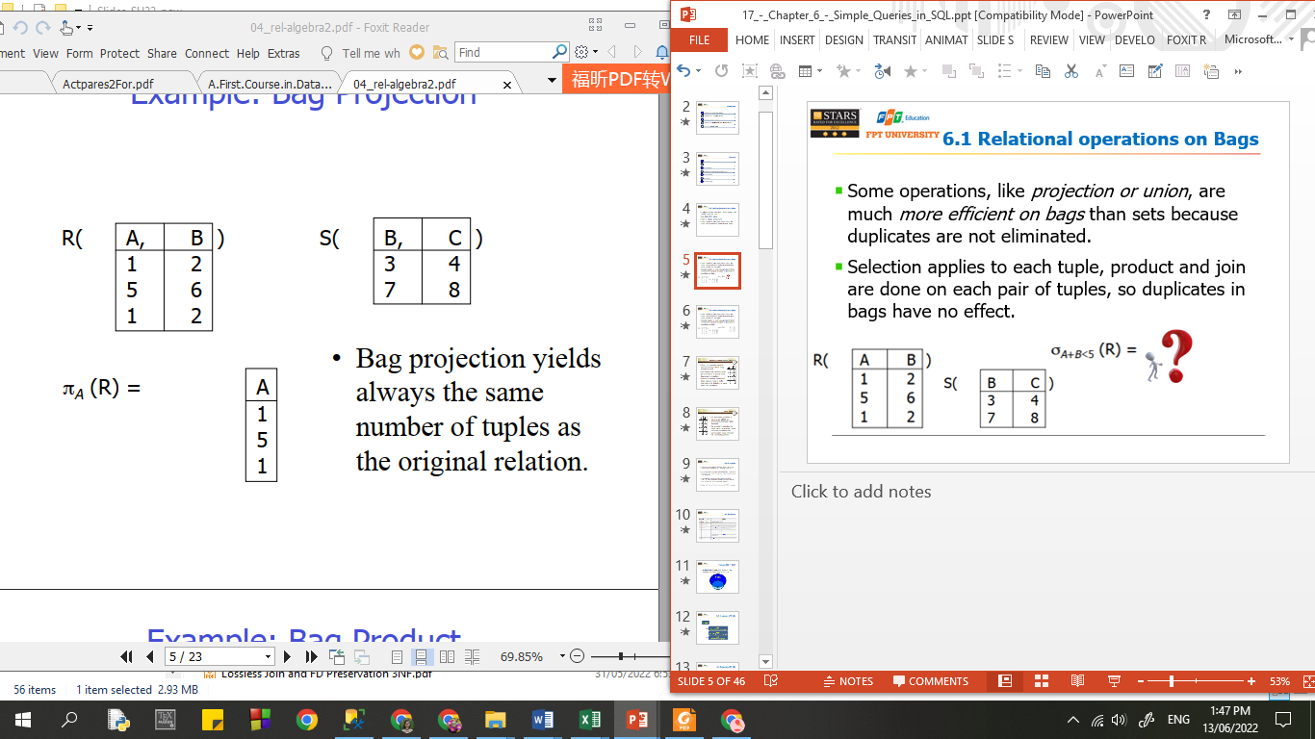
6.1 Relational operations on Bags
Some operations, like projection or union, are much more efficient on bags than sets because duplicates are not eliminated.
Selection applies to each tuple, product and join are done on each pair of tuples, so duplicates in bags have no effect.

Slide 6
6.1 Relational operations on Bags
Some operations, like projection or union, are much more efficient on bags than sets because duplicates are not eliminated.
Selection applies to each tuple, product and join are done on each pair of tuples, so duplicates in bags have no effect.

Slide 7
6.1 Relational operations on Bags
Some operations, like projection or union, are much more efficient on bags than sets because duplicates are not eliminated.
Selection applies to each tuple, product and join are done on each pair of tuples, so duplicates in bags have no effect.
Bag projection yields
always the same
number of tuples as
the original relation

Slide 8
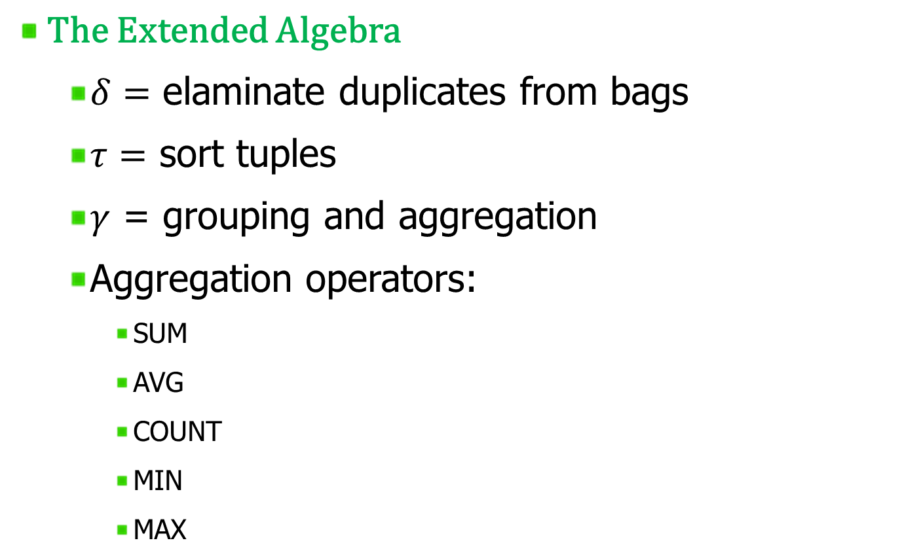
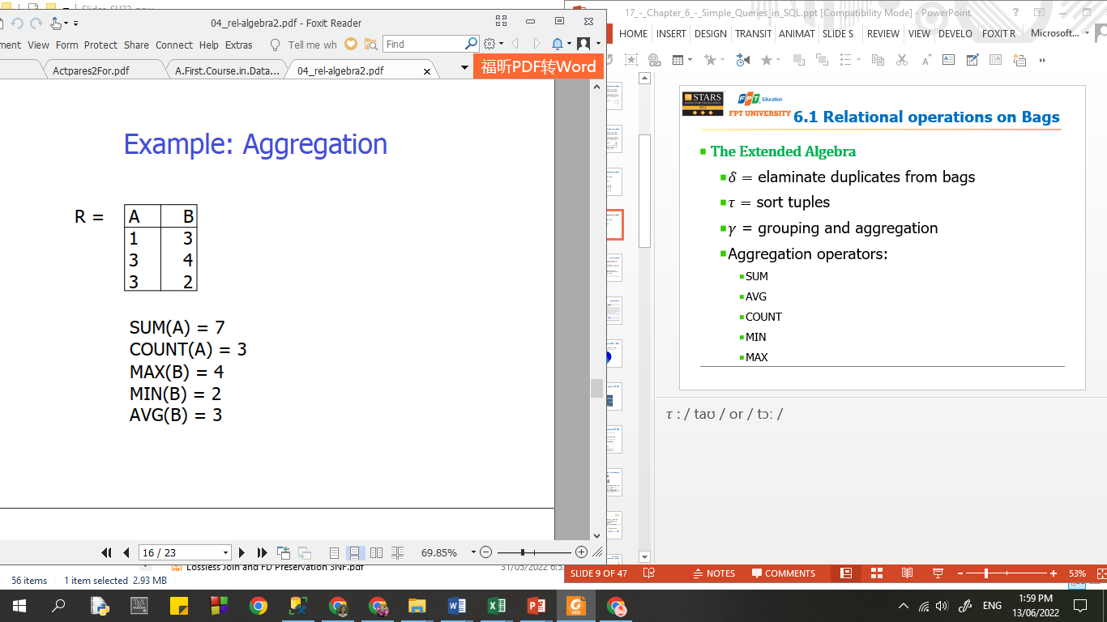
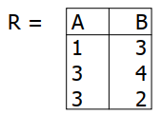
6.1 Relational operations on Bags

Slide 9
6.1 Relational operations on Bags

Slide 10
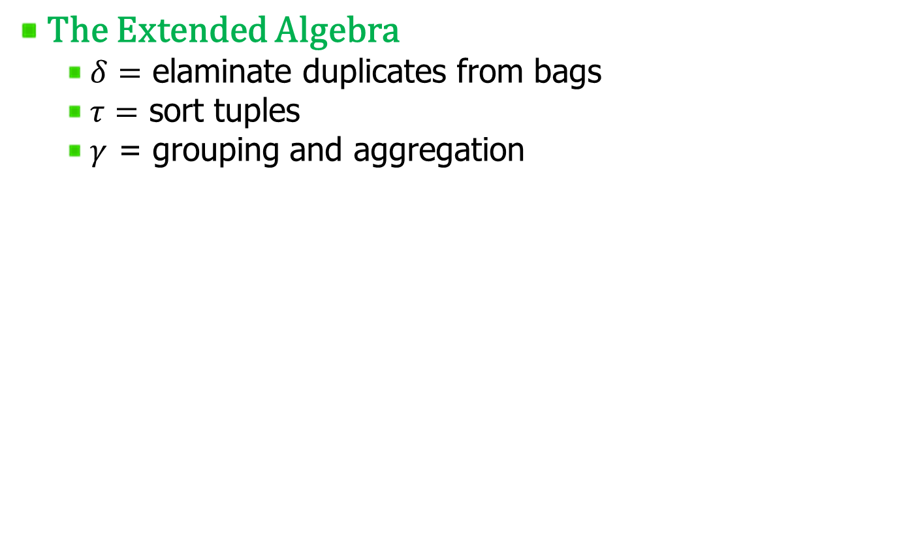
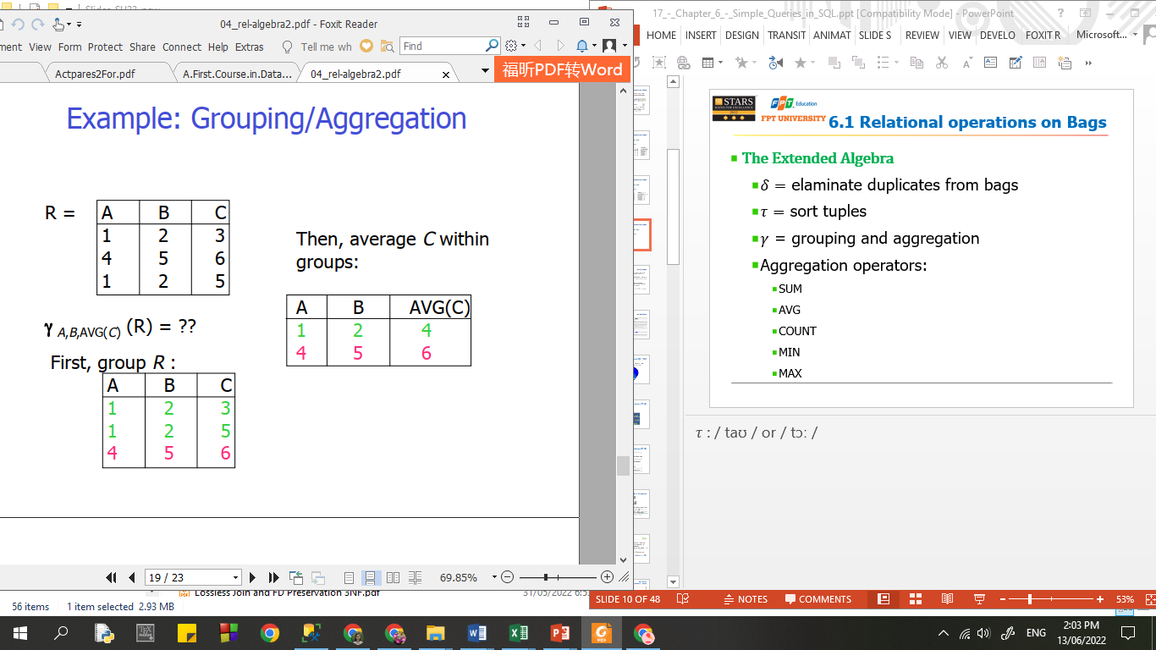
6.1 Relational operations on Bags

Slide 11
6.1 Relational operations on Bags

Slide 12
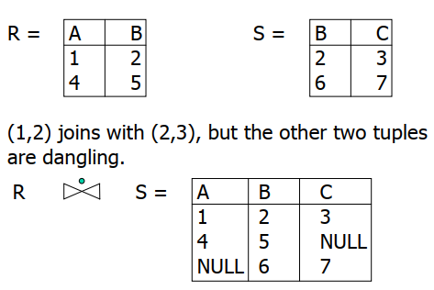
6.1 Relational operations on Bags
The Extended Algebra
  Outerjoin

Slide 13
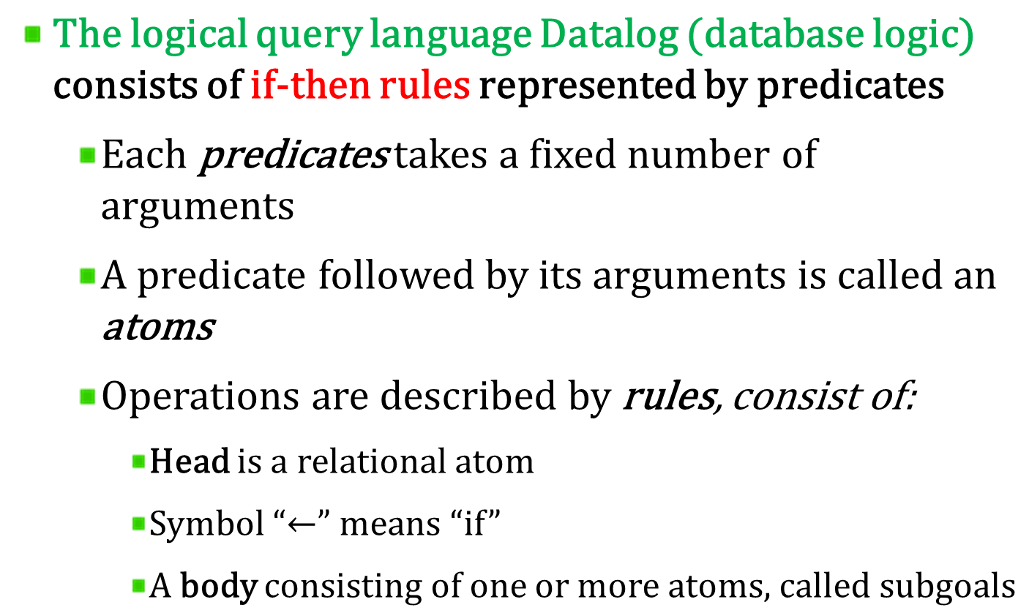
6.2 Relational algebra and Datalog

Slide 14
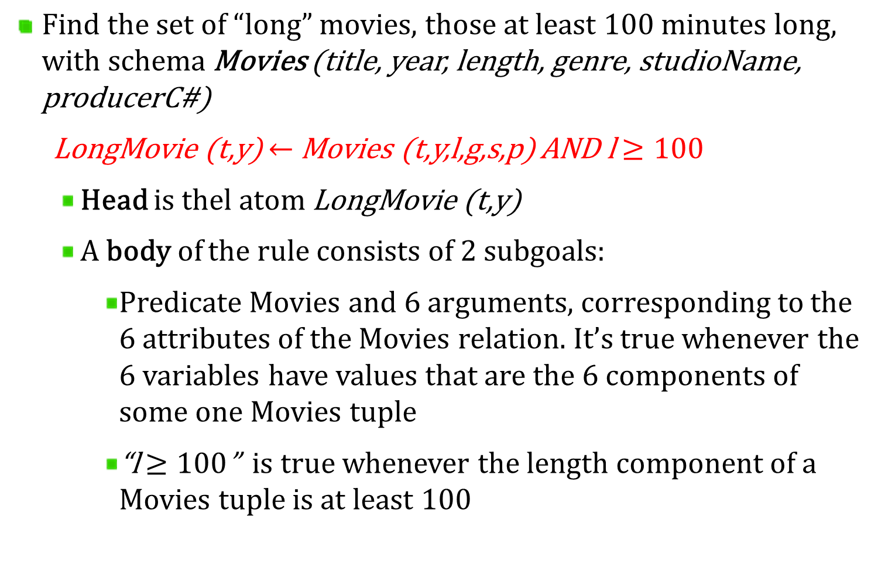
6.2 Relational algebra and Datalog

Slide 15
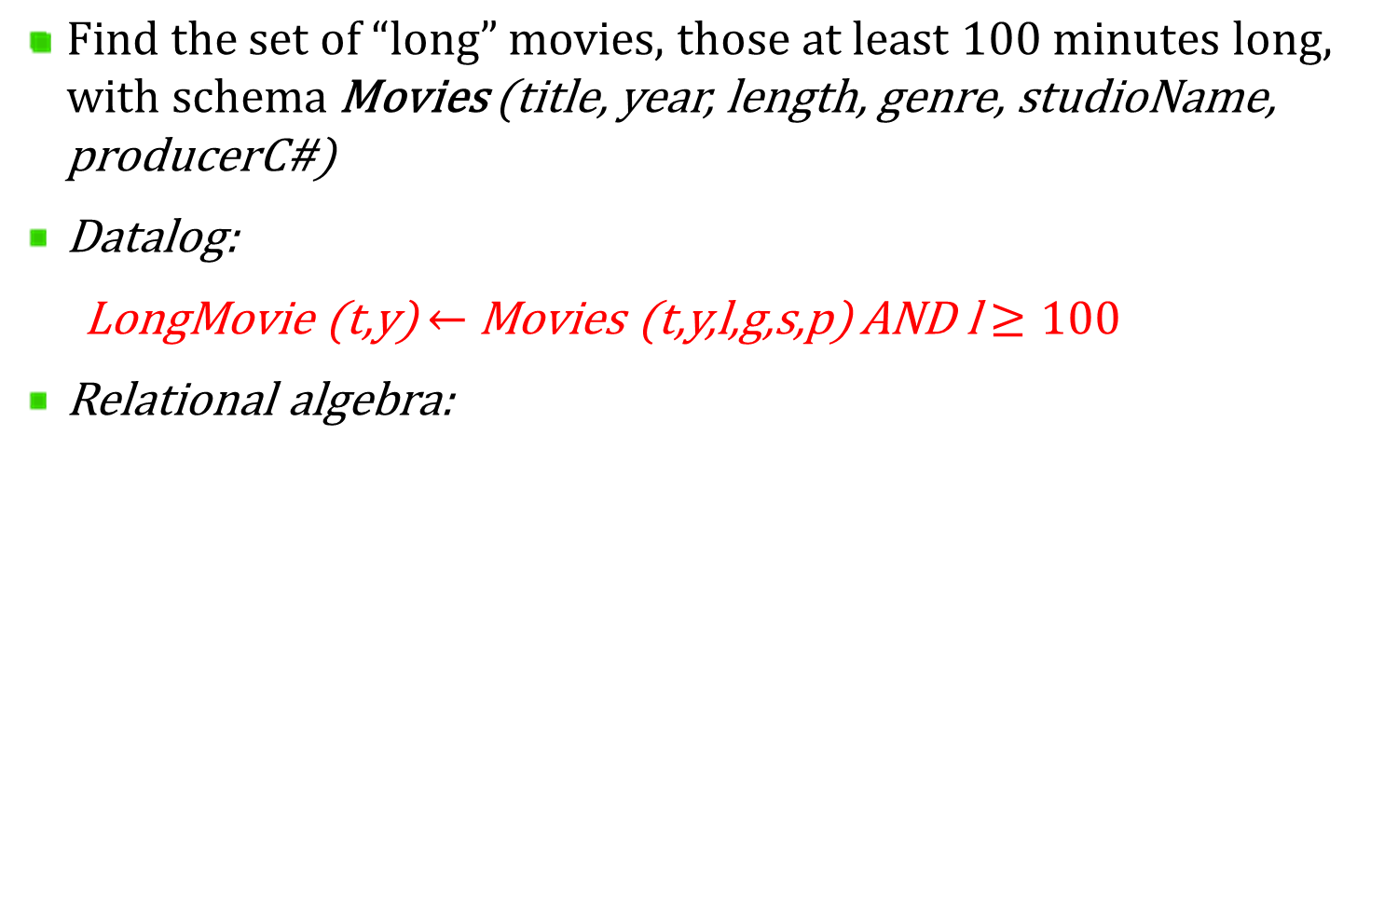
6.2 Relational algebra and Datalog

Slide 16
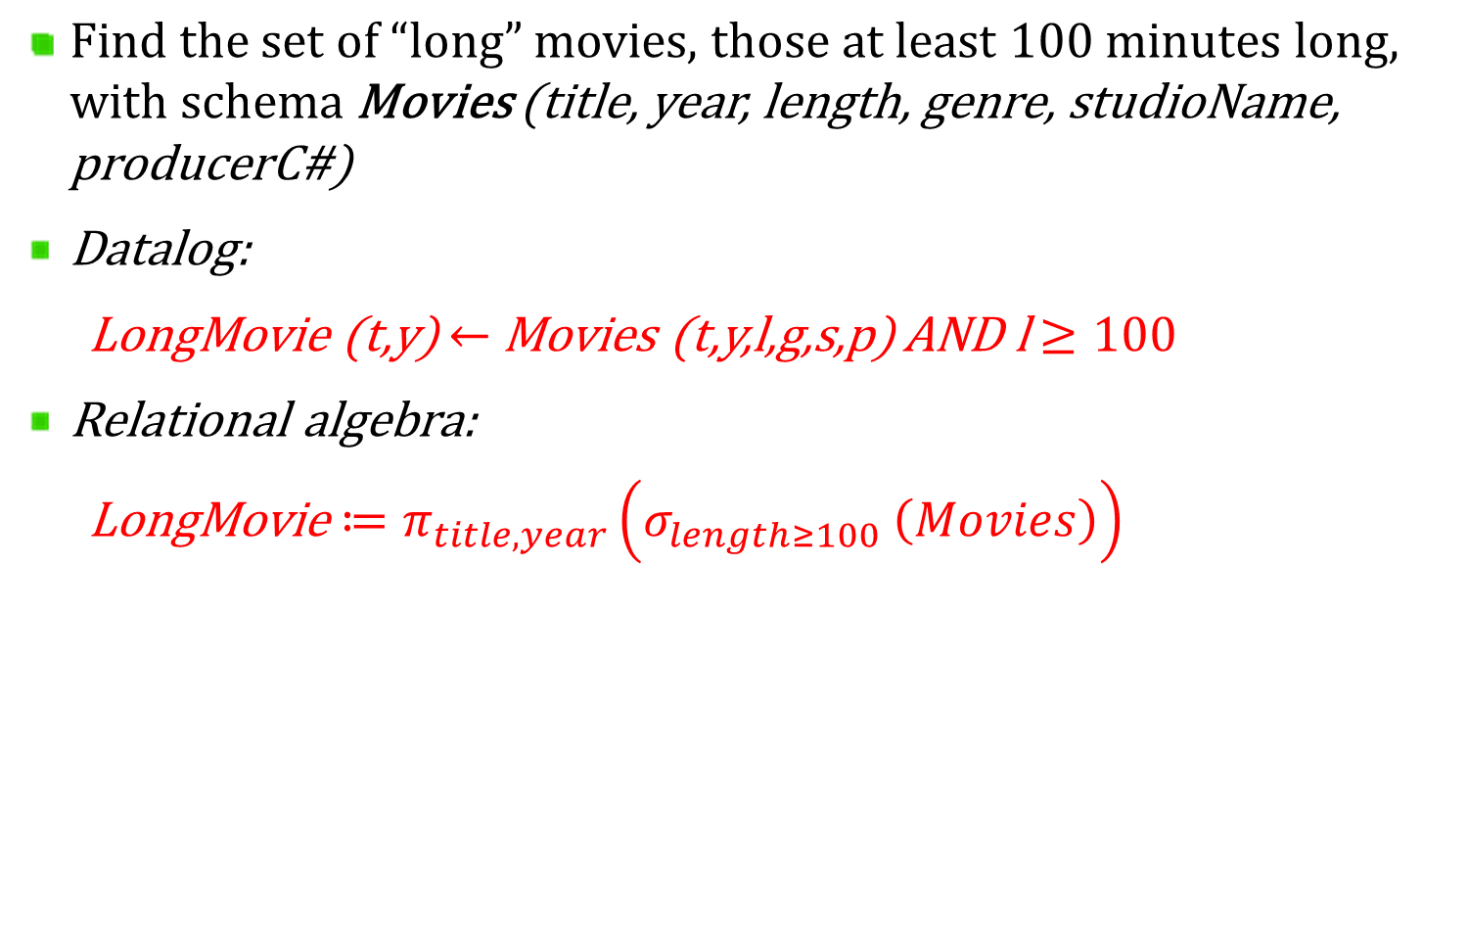
6.2 Relational algebra and Datalog

Slide 17
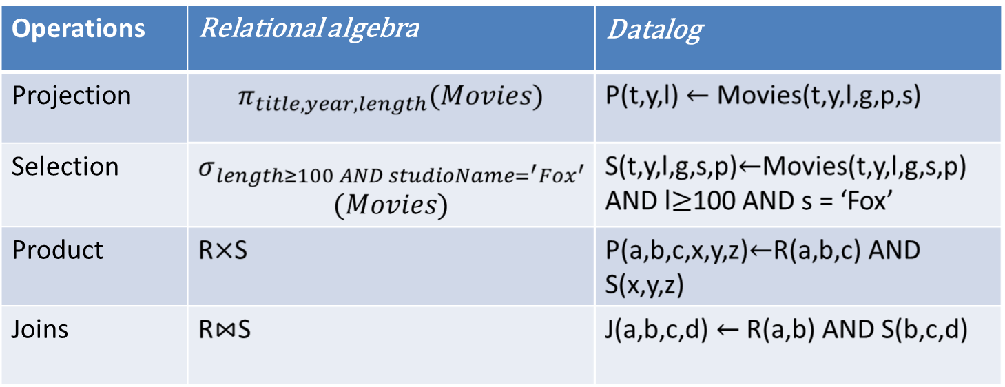
6.2 Relational algebra and Datalog
Operations

Slide 18
6.3 SQL Overview
The most commonly used relational DBMS’s query and modify the database through a language called SQL.
SQL (stands for Structured Query Language) is the set of statements with which all programs and users access data in an database.
The language, Structured English Query Language ("SEQUEL") was developed by IBM Corporation. SEQUEL later became SQL (still pronounced "sequel").
Today, SQL is accepted as the standard RDBMS language.

Slide 19
6.3 SQL Revisions
Year | Name | Alias | Comments
1986 | SQL-86 | SQL-87 | First published by ANSI. Ratified by ISO in 1987.
1989 | SQL-89 | FIPS 127-1 | Minor revision, adopted as FIPS 127-1.
1992 | SQL-92 | SQL2, FIPS 127-2 | Major revision (ISO 9075), Entry Level SQL-92 adopted as FIPS 127-2.
1999 | SQL:1999 | SQL3 | Added regular expression matching, recursive queries, triggers, support for procedural and control-of-flow statements, non-scalar types, and some object-oriented features.
2003 | SQL:2003 |  | Introduced XML-related features, window functions, standardized sequences, and columns with auto-generated values (including identity-columns).
2006 | SQL:2006 |  | ISO/IEC 9075-14:2006 defines ways in which SQL can be used in conjunction with XML. It defines ways of importing and storing XML data in an SQL database, manipulating it within the database and publishing both XML and conventional SQL-data in XML form. In addition, it provides facilities that permit applications to integrate into their SQL code the use of XQuery, the XML Query Language published by the World Wide Web Consortium (W3C), to concurrently access ordinary SQL-data and XML documents.
2008 | SQL:2008 |  | Defines more flexible windowing functions, clarifies SQL 2003 items that were still unclear ^{[1]}

Slide 20
6.3 Transact SQL (T-SQL)
Transact-SQL (T-SQL) is Microsoft's and Sybase's proprietary extension to SQL
T-SQL
SQL

Slide 21
6.3 Sub-languages of T-SQL
T - SQL
DDL
(Data Definition Language)
DML
(Data Manipulation Language)
DCL
(Data Control Language)

Slide 22
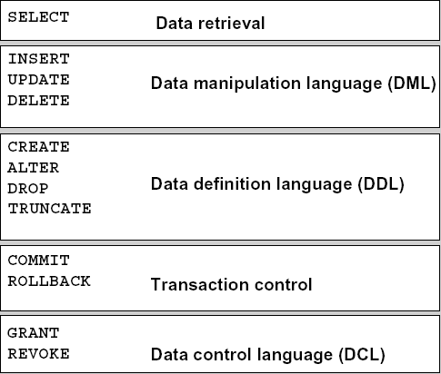
6.3 Sub-languages of T-SQL

Slide 23
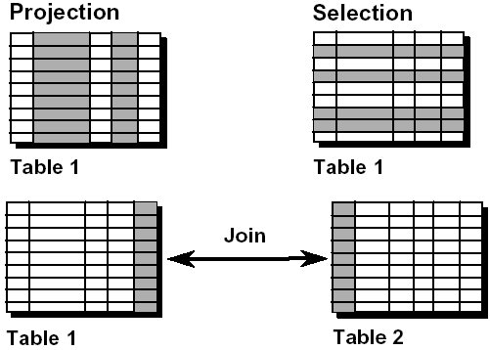
6.4 SELECT commands
A SELECT statement retrieves information from the database. Using a SELECT statement, you can do the following:
Projection: You can use the projection capability in SQL to choose the columns in a table that you want returned by your query.
Selection: You can use the selection capability in SQL to choose the rows in a table that you want returned by a query (with WHERE clause)
Joining: You can use the join capability in SQL to bring together data that is stored in different tables by creating a link between them.

Slide 24
6.4 SELECT commands
A keyword refers to an individual SQL element.
For example, SELECT and FROM are keywords.
A clause is a part of a SQL statement.
For example, SELECT employee_id, last_name, ... is a clause.
A statement is a combination of two or more clauses.
For example, SELECT * FROM employees is a SQL statement.

Slide 25
6.4 Basic Syntax for a simple SELECT queries
SELECT [ ALL | DISTINCT ]
[ TOP n [ PERCENT ] ]
* | {column_name | expression [alias],…}
[FROM table]
SELECT identifies what columns
  ALL: Specifies that duplicate rows can appear in the result set. ALL is the default
  DISTINCT: Specifies that only unique rows can appear in the result set. Null values are considered equal for the purposes of the DISTINCT keyword
  TOP n [ PERCENT ]:Specifies that only the first n rows are to be output from the query result set. n is an integer between 0 and 4294967295. If PERCENT is also specified, only the first n percent of the rows are output from the result set. When specified with PERCENT, n must be an integer between 0 and 100
FROM identifies which table

Slide 26
6.4 A trick for reading & writing queries
It’s generally easiest to examine a SELECT-FROM-WHERE query by:
  First looking at the FROM clause to learn which relations are involved in the query
  Then, move to the WHERE clause to learn what it is about tuples that is important to the query
  Finally, look at the SELECT clause to see what the output format is
The same order: FROM, then WHERE, then SELECT is often useful when writing queries of your own as well

Slide 27
6.4 Projection in SQL
We can, if we wish, eliminate some of the components of the chosen tuples; that is, we can project the relation produced by a SQL query onto some of its attributes
In place of the * of the SELECT clause, we may list some of the attributes of the relation mentioned in the FROM clause. The result will be projected onto the attributes listed

Slide 28
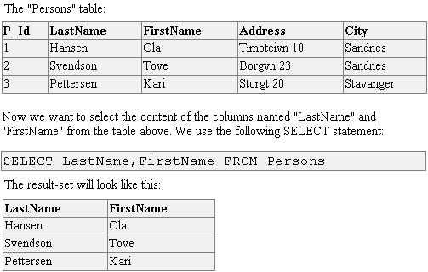
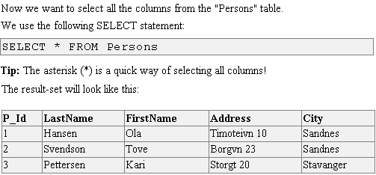
Example: SELECT all columns

Slide 29
Example: Projection in SQL

Slide 30

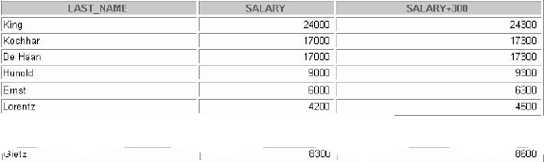
Example: Extended projection using Arithmetic Operators
Note that the resultant calculated column SALARY+300 is not a new column in the EMPLOYEES table; it is for display only.
By default, the name of a new column comes from the calculation that generated it— in this case, salary+300.

Slide 31
6.4 Renaming or Defining a Column Alias
A column alias:
  Renames a column heading
  Is useful with calculations
  Immediately follows the column name - there can also be the optional AS keyword between the column name and alias

Slide 32

Example: ALIAS
SELECT last_name AS ‘Name’,
salary*12 AS ‘Annual Salary’
FROM employees
The example displays the last names and annual salaries of all the employees.
Because Annual Salary contain a space, it has been enclosed in double quotation marks.
Notice that the column heading in the output is exactly the same as the column alias.

Slide 33
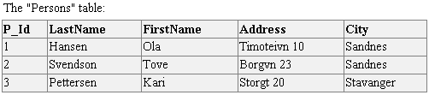


6.4 Duplication Eliminating with SELECT distinct

Slide 34
6.5 Selection in SQL or Restricting data
While retrieving data from the database, you may need to restrict the rows of data that are displayed
In that case, the solution is to use the WHERE clause
The WHERE clause is equal to the selection operator of relational algebra
The expression that may follow WHERE include conditional expressions like those found in C or Java

Slide 35
6.5 Selection in SQL or Restricting data
SELECT [ ALL | DISTINCT ]
[ TOP n [ PERCENT ] ]
* | {column_name | expression [alias],…}
[FROM table]
[WHERE conditions]
WHERE: restricts the query to rows that meet a condition
The WHERE clause follows the FROM clause.
Condition: is composed of column names, expressions, constants, and a comparison operator

Slide 36




Example: Restricting data

Slide 37



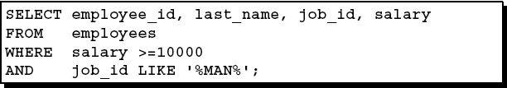
Example: Restricting data

Slide 38
6.5 Comparison of Strings
Two strings are equal if they are the same sequence of characters. Recall from the section 2.3.2 that strings can be stored as fixed-length strings (using CHAR) or variable-length strings (using VCHAR)
When comparing strings with different declarations, only the actual strings are compared (SQL ignores any “pad” characters that must be presenet in the database in order to give a string its required length)
We can use “<“, “>”, “=“ and “<>” operators to compare two strings

Slide 39
6.5 Pattern matching in SQL
SQL also provides the capability to compare strings on the basis of a simple pattern match. An alternative form of comparision expression is:
s LIKE p
where:
  S: is a string
  P: is a pattern (with the optional use of some special characters: “%”, “_” ..)
Similarly, “s NOT LIKE p” is true if and only if string s does not match pattern p

Slide 40
6.5 Dates and Times
SQL generally support dates and times as special data types. These values are often representable in a variety of formats such as:
  ‘05/14/1948’ or
  ’14 May 1948’
We can compare dates or times using the same comparison operators we use for numbers or strings

Slide 41
6.5 NULL values
Null means 'nothing' or without value or consequence
Null is a special marker used in SQL to indicate that a data value does not exist in the database. Introduced by the creator of the relational database model
Since Null is not a member of any data domain, it is not considered a "value", but rather a marker (or placeholder) indicating the absence of value. Because of this, comparisons with Null can never result in either True or False, but always in a third logical result, Unknown
However, certain operations on Null can return values if the value of Null is not relevant to the outcome of the operation

Slide 42
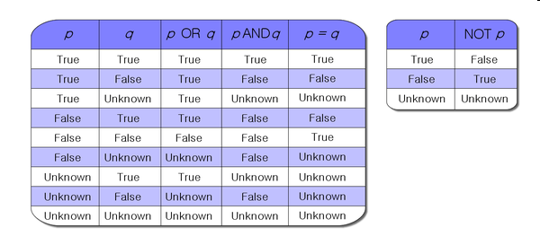
6.5 The Truth-value ‘Unknown’
Null is untyped in SQL, meaning that it is not designated as an integer, character, or any other specific data type

Slide 43
6.5 Ordering the Output
While retrieving data from the database, you may need to specify the order in which the rows are displayed.
In that case, the solution is to use the ORDER BY clause

Slide 44
6.5 Ordering the Output
SELECT [ ALL | DISTINCT ]
[ TOP n [ PERCENT ] ]
* | {column_name | expression [alias],…}
FROM table
[WHERE conditions]
[ORDER BY {expression [ASC | DESC] ,…} ]
If you use the ORDER BY clause, it must be the last clause of the SQL statement.
Expression: Specifies a column on which to sort.
A sort column can be specified as a name or column alias (which can be qualified by the table or view name), an expression, or a nonnegative integer representing the position of the name, alias, or expression in select list.
Multiple sort columns can be specified. The sequence of the sort columns in the ORDER BY clause defines the organization of the sorted result set.

Slide 45



Example: Ordering output

Slide 46
Exercise 1
Write SQL queries to create the following tables:
STUDIOS (name, address)
STARS (name, address, phone)
MOVIES (title, year, length, genre)
After creating, write SQL queries to drop them

Slide 47
Exercise 2
Write SQL queries to do following tasks:
Add a column named DESCRIPTION into MOVIES table (you must determine the data type for it)
Add a column named HOBBIES into STARS table (you must determine the data type for it)
Add a column named BIRTHDAY into STARS table (you must determine the data type for it)

Slide 48
Exercise 3
Write SQL queries to do following tasks:
Remove the column named DESCRIPTION from MOVIES table
Remove the column named HOBBIES from STARS table
Remove the column named BIRTHDAY from STARS table

Slide 49
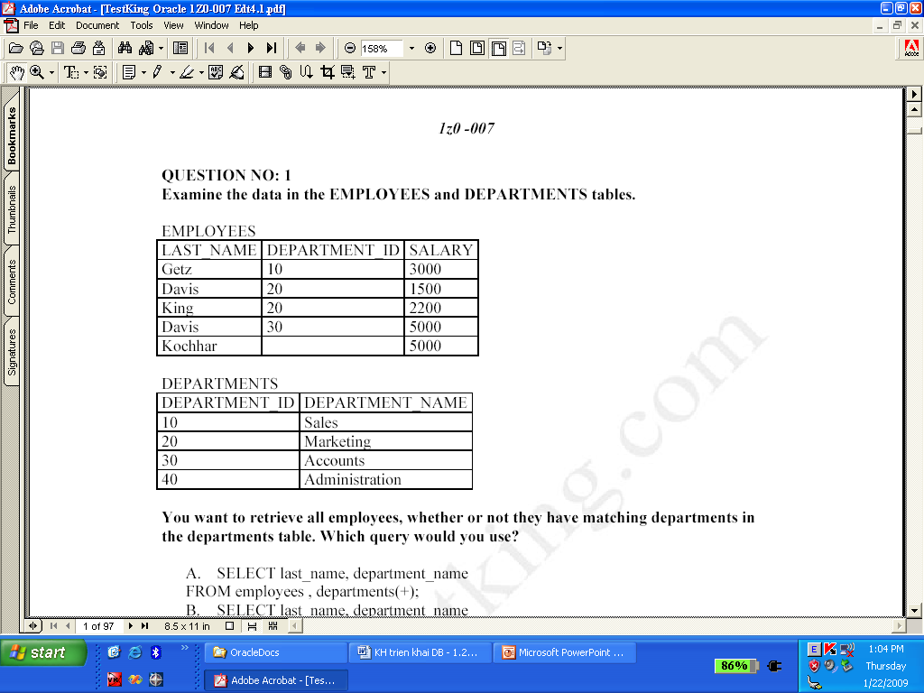
Exercise 4
Create relation EMPLOYEES with the columns LAST_NAME, DEPARTMENT_ID, SALARY
Insert the tuples (see figure above) into the relation EMPLOYEES
Write a SQL query to show all tuples in table EMPLYEES

Slide 50
Exercise 5
Write a SQL query to show all SALARY (but eliminating duplications) in table EMPLYEES
Write a SQL query to show all DEPARTMENT_ID (but eliminating duplications) in table EMPLYEES

Slide 51
Exercise 6
Write a SQL query to delete all tuples in EMPLOYEES table
Write a SQL query to delete all tuples with NULL value in DEPARTMENT_ID

Slide 52
Exercise 7
Write a SQL query to set DEPARTMENT_ID to the value 10
Write a SQL query to set DEPARTMENT_ID to the value 10 if DEPARTMENT_ID is NULL

Slide 53
Exercise 8
Write a SQL query to insert some new tuples into EMPLOYEES

Slide 54
Thank You !

