Slide 2




SP26_SE2002_DBI202_NhungNTH
ASSIGNMENT REPORT
BOOKSTORE MANAGEMENT SYSTEM
  Mentor: Nguyen Thi Hong Nhung
  Group 1:
Nguyen Tran Duc Anh
Huynh Nhat Duy
Le Tien Dung
Tran Huynh Giac
Nguyen Phu Trong

Slide 3

Presenter: Nguyen Tran Duc Anh
PROJECT OVERVIEW

Slide 4
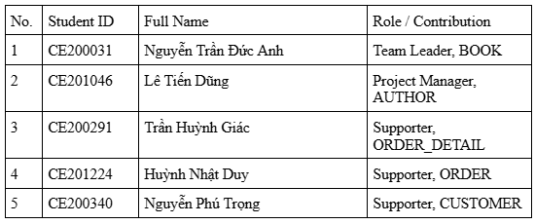
Presenter: Nguyen Tran Duc Anh
PROJECT OVERVIEW

Slide 5

Presenter: Nguyen Tran Duc Anh
PROJECT OVERVIEW
  Problem (Manual Management): Prone to errors, overselling out-of-stock items, and losing customer data.
  Objective: Build a Relational Database for a Book Store Management System.
  Core Operations: Inventory Management (Books, Authors) - Customers - Orders.
  System Solution:
    Digitize the entire workflow.
    Ensure data integrity & optimize query performance.
    Accurately record transactions & automate inventory updates.

Slide 6
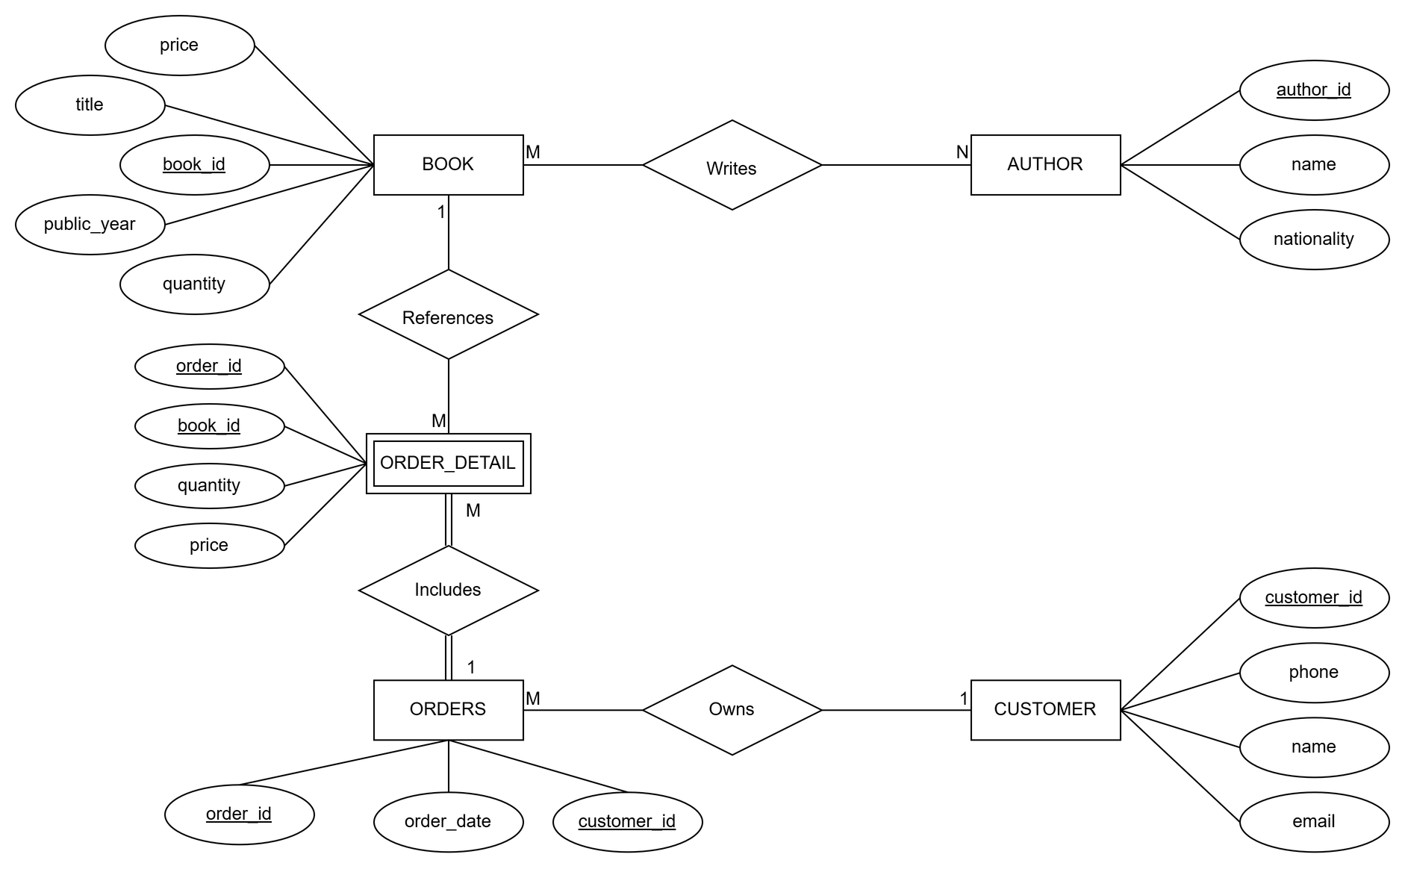
Presenter: Le Tien Dung
ENTITY RELATIONSHIP DIAGRAM (ERD)

Slide 7
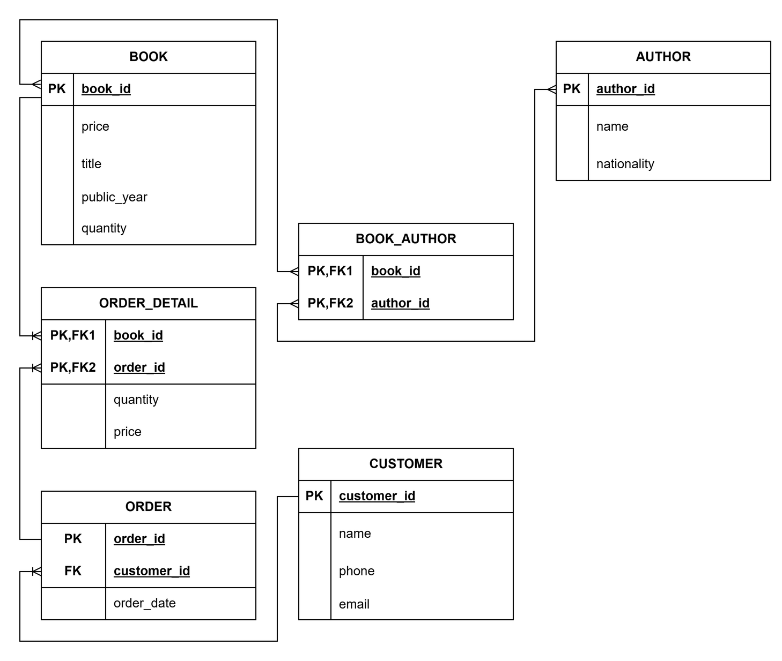
Presenter: Le Tien Dung
RELATIONAL DATABASE SCHEMA

Slide 8
Presenter: Nguyen Tran Duc Anh
BOOK

Slide 9
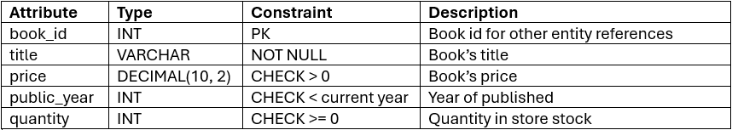
Presenter: Nguyen Tran Duc Anh
BOOK

Slide 10
Presenter: Lê Tiến Dũng
AUTHOR

Slide 11
Presenter: Le Tien Dung
AUTHOR & Relationships
  Relationship: Many-to-Many (N-N) between AUTHOR and BOOK
  Junction Table: BOOK_AUTHOR
  Key Procedure: sp_DeleteAuthor
  Enforces data integrity: Prevents deletion if associated books exist in order history

Slide 12
Presenter: Tran Huynh Giac
Index Performance Demo

Slide 13
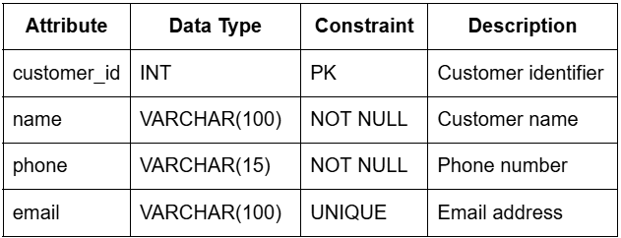
Presenter: Nguyen Phu Trong
Customer: Attributes
* Relationship: One-to-Many (1-N) to ORDERS.

Slide 14
Presenter: Nguyen Phu Trong
Customer: Key Procedure & Integrity:
  Procedure: sp_CreateCustomerAndOrder
- Create Customer informations and their first orders
  Trigger: trg_Prevent_Delete_Customer
- Prevent delete customer when they already have orders history

Slide 15
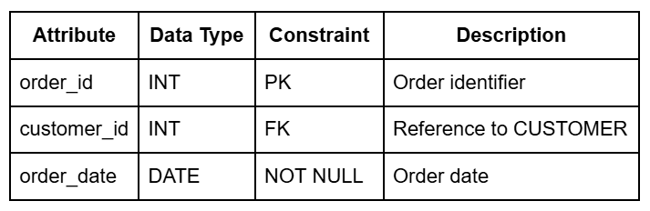
Presenter: Huỳnh Nhật Duy
Orders Attributes
  ORDERS Table: Captures transaction metadata (Date, Status, Shipping Address).
  Relational Link: Connects to the CUSTOMER table via customer_id (Foreign Key).
  Cancellation Logic: Executed via the sp_CancelOrder Stored Procedure to ensure data consistency.

Slide 16
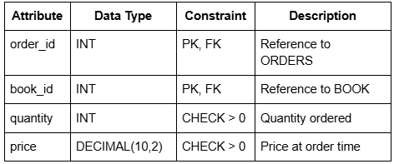
Presenter: Tran Huynh Giac
Order details: Attributes
* Weak entity: primary key with many partial parts
* Relationship ‘references’: Many-to-One (N-1) to BOOK.
* Relationship ‘includes’: Many-to-One (N-1) to ORDES.

Slide 17
Presenter: GROUP 1 MEMBERS
PHYSICAL IMPLEMENTATION

Slide 18
Presenter: Tran Huynh Giac
CONCLUSION & ACHIEVEMENTS

Slide 19
Presenter: Tran Huynh Giac
CONCLUSION
  Data Integrity: Achieved via Primary Keys, Foreign Keys, Constraints, and 5 Automated Triggers.
  Normalization: Database is normalized up to Third Normal Form (3NF).

Slide 20

SP26_SE2002_DBI202_NhungNTH
THANK YOU!

