Slide 1
CHAPTER 1
The essential of software requirement
Notes:
https://coggle.it/diagram/XDRkq9ktvd9kWBYb/t/chapter-1-the-essential-of-software-requirement

Slide 2
Objectives
Understand some key terms used in the software requirements domain.
Distinguish product requirements from project requirements.
Distinguish requirements development from requirements management.
Be alert to several requirements-related problems that can arise

Slide 3
Contents
Why is requirement engineering?
Software requirements defined.
Requirements development and management.
When bad requirements happen to good people.
Benefits from a high-quality requirements process.
Notes:
Why is requirement engineering? Tại sao yc kỹ thuật?
Software requirements defined: Yêu cầu phần mềm được định nghĩa.
When bad requirements happen to good people: Khi yêu cầu xấu xảy ra với người tốt.
Benefits from a high-quality requirements process: Lợi ích từ quy trình yêu cầu chất lượng cao

Slide 4
Why is requirement engineering?
Distribution of Defects
Distribution of Effort to Fix Defects
Code
7%
Code
1%
Requirements
56%
Other
10%
Other
4%
Design
13%
Requirements
82%
Design
27%
Source: Martin & Leffinwell

Slide 5
Software requirements defined
The errors introduced during requirements activities account for 40 to 50% of all defects found in software product.
Inadequate user input and shortcomings in specifying and managing customer requirements are major contributors to unsuccessful projects.
Notes:
The errors introduced during requirements activities account for 40 to 50% of all defects found in software product: Các lỗi trong giai đoạn lấy yêu cầu chiếm 40 đến 50% tất cả các lỗi được tìm thấy trong sản phẩm phần mềm.
Inadequate user input and shortcomings in specifying and managing customer requirements are major contributors to successful projects: Đầu vào của người dùng không đầy đủ và những thiếu sót trong việc chỉ ra và quản lý các yêu cầu của khách hàng là những đóng góp chính cho các dự án thành công.

Slide 6
Software requirements defined
Brian Lawrence: “anything that drives design choices” (Lawrence 1997)
“Requirements are a specification of what should be implemented. They are descriptions of how the system should behave, or of a system property or attribute. They may be a constraint on the development process of the system” Ian Sommerville and Pete Sawyer (1997)
Notes:
anything that drives design choices: bất cứ điều gì thúc đẩy sự lựa chọn thiết kế.
Requirements are a specification of what should be implemented. They are descriptions of how the system should behave, or of a system property or attribute. They may be a constraint on the development process of the system: Yêu cầu là một đặc điểm kỹ thuật của những gì nên được cài đặt. Chúng là những mô tả về cách hệ thống nên hoạt động, hoặc thuộc tính của hệ thống. Chúng có thể là một ràng buộc đối với quá trình phát triển của hệ thống.

Slide 7
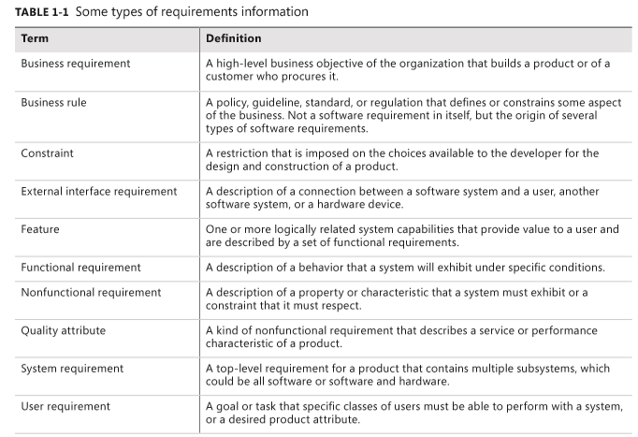
Types of requirements
Notes:
A hight-level business objective of the organization that builds a product or of a customer who procures it: Một mục tiêu kinh doanh cấp cao của tổ chức là xây dựng một sản phẩm hoặc bán nó cho một khách hàng
A restriction that is imposed on the choices available to the developer for the design and construction of a product: Một hạn chế/giới hạn được áp đặt cho các lựa chọn có sẵn để nhà phát triển việc thiết kế và xây dựng một sản phẩm.
a description of a behaviour that a system must exhibit or a constraint that it must respect: một mô tả về một hành vi mà một hệ thống phải thể hiện hoặc một ràng buộc mà nó phải tôn trọng/tuân thủ.

Slide 8
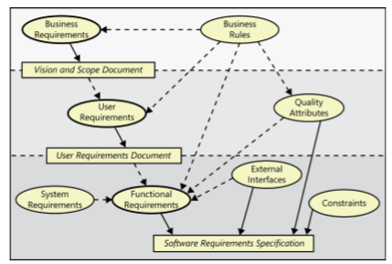
Levels and types of requirements
Relationships among several types of requirements information. Solid arrows mean “are stored in”; dotted arrows mean “are the origin of” or “influence”.
Notes:
- software requiements specification: Yêu cầu kỹ thuật PM

Slide 9
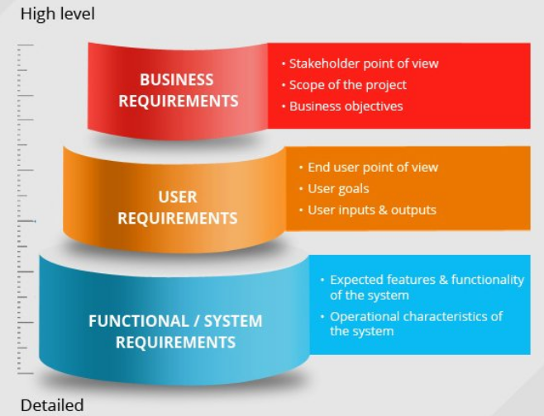
Business requirements
Biz requirements describe why the organization is implementing the system – the biz benefits the organization hopes to achieve.
Suppose an airline wants to reduce airport counter staff costs by 25%. This goal might lead to the idea of building a kiosk that passengers can use check in their flights at the airport.
Biz requirements typically come from the funding sponsor for a project, the acquiring customers, the manager of the actual users, the marketing department, or a product visionary.
We will study more details in chapter 5.
Notes:
- Biz requirements typically come from the funding sponsor for a project, the acquiring customers, the manager of the actual users, the marketing department, or a product visionary: Các yêu cầu kinh doanh thường đến từ nhà tài của một dự án, khách hàng có được, người quản lý của người dùng thực tế, bộ phận tiếp thị hoặc một người có tầm nhìn sản phẩm.

Slide 10
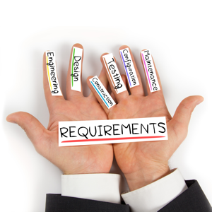
User requirements
User requirements describe goals or tasks the users must be able to perform with the product that will provide value to someone.
The domain of user requirements includes descriptions of product attributes or characteristics that are important to user satisfaction.
User requirements describe what the user will be able to do with the system.
Ways to represent user requirements includes user cases, user stories, or event-response tables.
We will study more details in chapter 8.

Slide 11
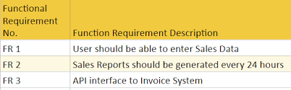
Functional requirements
Functional requirements specify the behaviors the product will exhibit under specific conditions.
They describe what the developers must implement to enable users to accomplish their tasks (user requirements), thereby satisfying the biz requirements.
Functional requirements often are written in the form of the traditional “shall” statements: “The passenger shall be able to print boarding passes for all flight segments for which he has checked in”.

Slide 12

Biz analyst (BA)
The BA documents functional requirements in a SW requirements specification (SRS), which describes as fully as necessary the expected behavior of the SW system.
The SRS is used in development, testing, quality assurance, project management, and related project functions.
We will study more details in chapter 10.

Slide 13
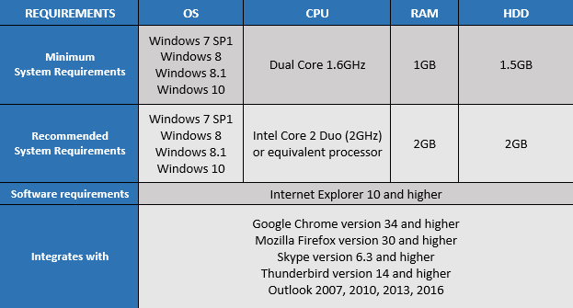
System requirements
System requirements describe the requirements for a product that is composed of multiple components or subsystems.
A system can be all SW or it can include both SW and HW subsystems.
People and processes are part of a system, too, so certain system functions might be
allocated to human being.
Notes:
- People and processes are part of a system, too, so certain system functions might be allocated to human being: Con người và quy trình cũng là một phần của một hệ thống, do đó, một số chức năng hệ thống nhất định có thể được phân bổ cho con người.

Slide 14
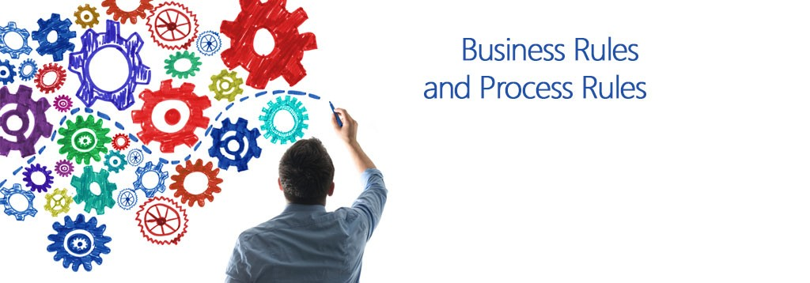
Business rules
Business rules include corporate policies, government regulations, industry standards, and computational algorithms.
Biz rules are not themselves SW requirements because they have an existence beyond the boudaries of any specific SW application.

Slide 15
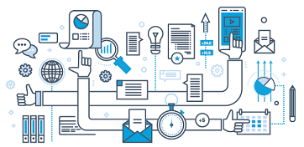
Feature
A feature consists of one or more logically related system capabilities that provide value to a user and are described by a set of functional requirements.
Web browser bookmarks, spelling checkers, … are examples of features.

Slide 16
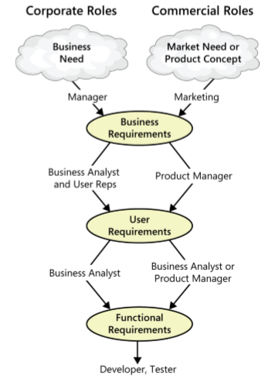
The participation of stakeholders in requirements development
This figure illustrates how various stakeholders might participate in eliciting the 3 levels of requirements..
Notes:
Working with three levels

Slide 17
Product vs. project requirements
Product requirements:
  properties of a software system to be built
Projects requirements:
  do have other expectations and deliverables that are not a part of the software the team implements, but that are necessary to the successful completion of the project as a whole.
Notes:
Product requirements consist of technical requirements, performance requirements and security requirements while Project requirements consist of delivery requirements, business requirements and project management requirements.

Slide 18
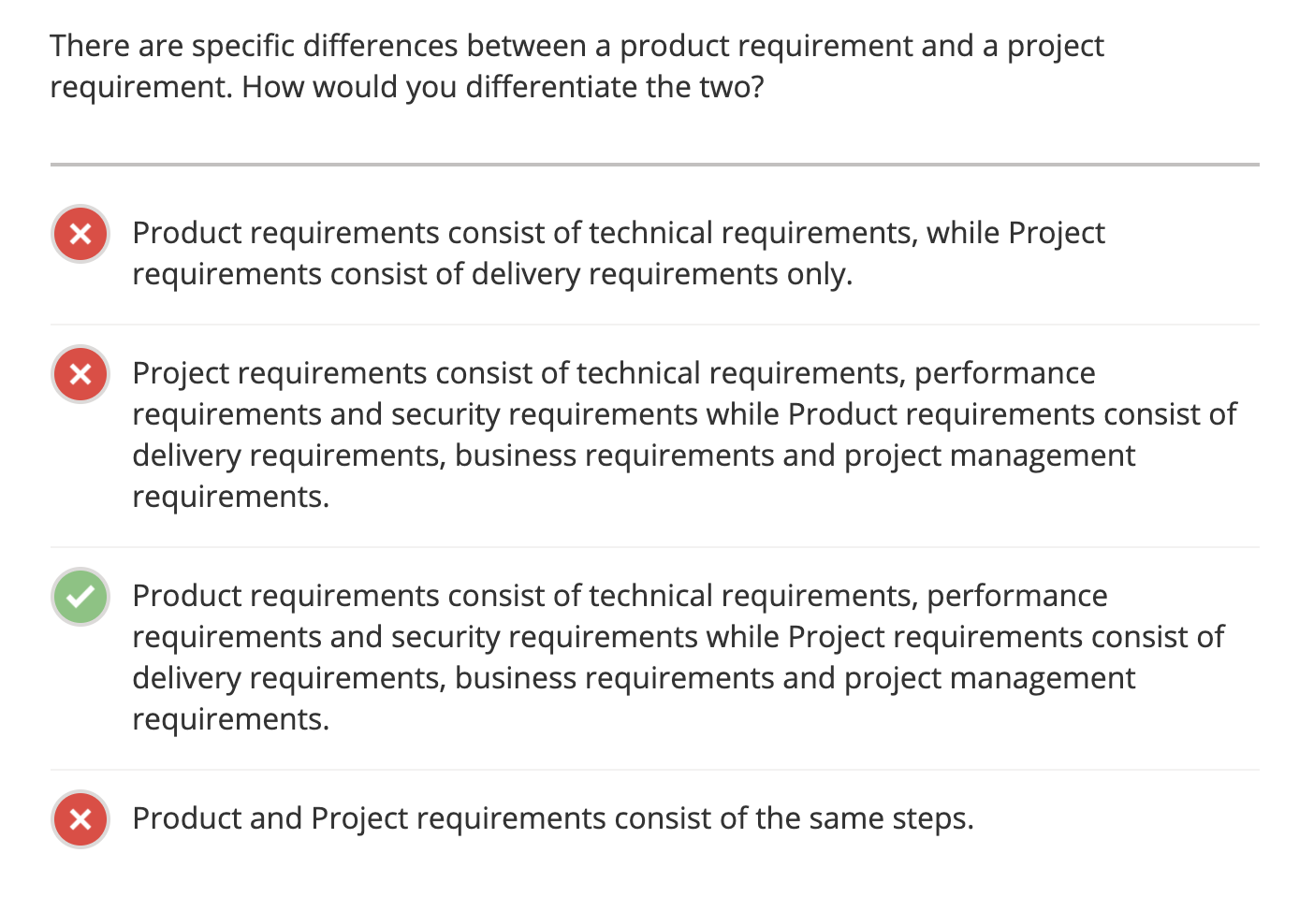

Slide 19
Project requirements
Physical resources the development team needs, such as workstations, HW devices, testing labs, testing tools and equipment, team room, ….
Staff training needs.
User documentation, including training materials, tutorials, reference manuals, and release notes.
Support documentation, such as help desk resources and field maintenance and service information for HW devices.
Requirements and procedures for releasing the product, installing it in the operating environment, configuring it, and testing the installation.
….
Notes:
Teacher should explain more detail about every type of requirements

Slide 20
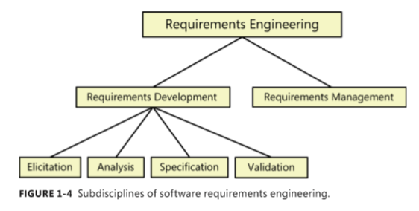
Requirements development and management
Depending on the life cycle, you will perform these activities at different times in the project and to varying of depth or detail.
Notes:
confusion about requirements terminology extends even to what to call the whole discipline.: sự nhầm lẫn về thuật ngữ yêu cầu thậm chí còn mở rộng đến những gì để gọi toàn bộ ngành học.
requirements engineering: YC kỹ thuật

Slide 21
Requirements development
We subdivide the requirements development into elicitation, analysis, specification, and validation.
Elicitation encompasses all of the activities involved with discovering requirements, such as interviews, workshops, document analysis, prototyping, and others. The key actions are:
  Identifying the product’s expected user classes and other stakeholders.
  Understanding user tasks and goals and the biz objectives with which those tasks align.
  Learning about environment in which the new product will be used.
  Working with individuals who represent each user class to understand their functionality needs and their quality expectations.

Slide 22
Usage-centric or product-centric?
Requirements elicitation typically takes either a usage-centric or product-centric approach.
The usage-centric focuses on understanding and exploring user goals to derive the necessary system functionality.
The product-centric focuses on defining features that you expect will lead to marketplace or biz success.
A risk with product-centric is that you might implement features that don’t get used much, even if they seemed like a good idea at the time.
We recommend understanding biz objectives and users goals first, then using that insight to determine the appropriate product feature and characteristics.
Notes:
- A risk with product-centric is that you might implement features that don’t get used much, even if they semed like a good idea at the time.: Một rủi ro với tiếp cận sản phẩm-tập trung là bạn có thể triển khai các tính năng mà chúng ko được sử dụng nhiều, ngay cả khi chúng được coi là một ý tưởng tốt vào thời điểm đó.

Slide 23
Requirements development
Analysis: Analyzing requirements involved reaching a richer and more precise understanding of each requirement and representing set of requirements in multiple ways.
Following are the principal activities:
  Analyzing the information received from users to distinguish their task goals from functional requirements, quality expectations, biz rules, suggestion solutions, and other information.
  Decomposing high-level requirements into an appropriate level of detail.
  Deriving functional requirements from other requirements.
  Understanding the relative importance of quality attributes.
  Allocating requirements to SW components defined in the system architecture.
  Negotiating implements priorities.
  Identifying gaps in requirements or unnecessary requirements.

Slide 24
Requirements development
Specification: Requirements spec involves representing and storing the collected requirements knowledge in a persistent and well-organized fashion. The principal activity is:
  Translating the collected user needs into written requirements and diagrams suitable for comprehension, review, and use by their intended audiences.
Validation: Requirements validation confirms that you have the correct set of requirements information that will enable developers to build a solution. The central activities are:
  Reviewing the documented requirements to correct any problems before the development group accept them.
  Developing acceptable tests and criteria to confirm that a product based on the requirements would meet customer needs and achieve the biz objectives.

Slide 25
Requirements management
Requirements management activities include:
Defining the requirements baseline, a snapshot in time that represents an agreed-upon, reviewed, and approved set of functional and nonfunctional requirements, often for a specific product release or development iteration.
Evaluating the impact of proposed requirements changes and incorporating approved changes into the project in a controlled way.
Keeping project plans current with the requirements as they evolve.
Negotiating new commitments based on the estimated impact of requirements changes.
Defining the relationships and dependencies that exist between requirements.
Tracing individual requirements to their corresponding designs, source code, and test.
Tracking requirements status and change activity throughout the project.
Notes:
Defining the requirements baseline, a snapshot in time that represents an agreed-upon, reviewed, and approved set of functional and nonfunctional requirements, often for a specific product release or development iteration.: Xác định đường cơ sở yêu cầu, ảnh chụp nhanh theo thời gian thể hiện một tập hợp các yêu cầu chức năng và không chức năng đã được thống nhất, xem xét và phe duyệt thuờng cho triển khai sản phẩm cụ thể hoặc lặp lại phát triển.
Evaluating the impact of proposed requirements changes and incorporating approved changes into the project in a controlled way.: Đánh giá tác động của những thay đổi yêu cầu được đề nghị và kết hợp những thay đổi được phê duyệt vào dự án một cách có kiểm soát.

Slide 26
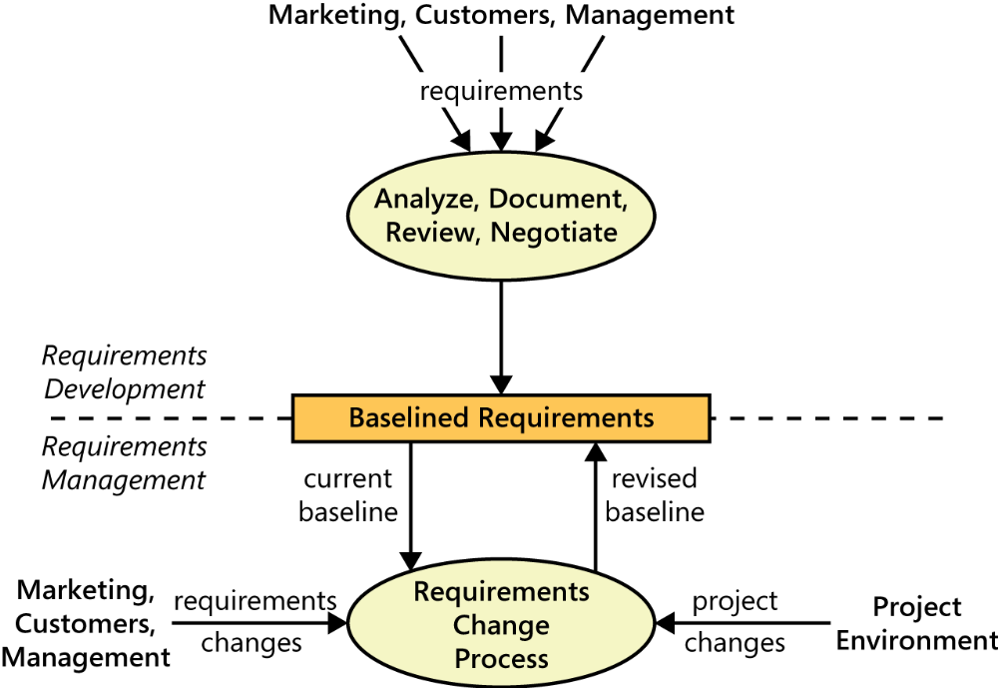
Requirements management

Slide 27
Every project has requirements
The hardest single part of building a software system is deciding precisely what to build. No other part of conceptual work is as difficult as establishing the detailed technical requirements, including all the interfaces to people, to machines, and to other SW systems. No other part of the work so cripples the resulting system if done wrong. No other part is more difficult to rectify later.
Every SW-containing system has stakeholders who rely on it. The time spent understanding their needs is a high-leverage investment in project success. If a project team does not have written representations of requirements that the stakeholders agree to, how can developers be sure to satisfy those stakeholders?
Notes:
Cripple (v): phá hỏng / làm tê liệt, làm què / đi khập khiểng
No other part of the work so cripples the resulting system if done wrong: Không có phần nào khác của công việc làm hỏng hệ thống kết quả nếu chạy sai.
No other part of conceptual work is as difficult as establishing the detailed technical requirements, including all the interfaces to people, to machines, and to other SW systems: No other part of conceptual work is as difficult as establishing the detailed technical requirements, including all the interfaces to people, to machines, and to other software systems.

Slide 28
When bad requirements happen to good people
The major consequence of requirements problem is rework – doing again something that you thought was already done – late in development or after release.
Rework often consumes 30-50% of total development cost, and requirements errors can account for 70-80% of the rework cost.
The most common requirements risks are described below:
  Insufficient user involvement
  Inaccurate planning
  Creeping user requirements
  Ambiguous requirements
  Gold plating
  Overlooked stakeholders

Slide 29
When bad requirements happen to good people
Insufficient user involvement:
  Customers often don’t understand why it is so essential to work hard on eliciting requirements and assuring their quality.
  Developers might not emphasize user involvement, because they think they already understand what the users need.
  Customers are busy so they don’t have enough time to involve in requirements development.
Inaccurate planning:
  Vague, poorly understood requirements lead to overly optimistic estimates, which come back to haunt you when the inevitable overruns occur.
  The top contributors to poor software cost estimation are frequent changes, missing requirements, insufficient communication with users, poor specification of requirements and insufficient requirements analysis (Davis 1995).
Notes:
Vague, poorly understood requirements lead to overly optimistic estimates, which come back to haunt you when the inevitable overruns occur.: Những yêu cầu mơ hồ, kém hiểu biết dẫn đến những ước tính quá lạc quan, nó quay trở lại ám ảnh bạn khi những sự vượt quá không thể tránh khỏi xảy ra.
The top contributors to poor software cost estimation are frequent changes, missing requirements, insufficient communication with users, poor specification of requirements and insufficient requirements analysis : Những đóng góp hàng đầu cho việc ước tính chi phí phần mềm kém là những thay đổi thường xuyên, thiếu yêu cầu, giao tiếp không đủ với người dùng, đặc tả kỹ thuật của yêu cầu kém và phân tích yêu cầu không đủ.

Slide 30
When bad requirements happen to good people
Creeping user requirements
  As requirements evolve during development, projects often exceed their planned schedules and budgets (which are nearly always too optimistic anyway). To manage scope creep, begin with a clear statement of the project’s biz objectives, strategic vision, scope, limitations, and success criteria.
  Requirements will change and grow. The PM should build contingency buffers into schedules so the first new requirement that comes along doesn’t derail the schedule (Wiegers 2007).
  Agile projects take the approach of adjusting the scope for a certain iteration.
Notes:
Creeping (adj): Từ từ, dần dần, giãn ra
Creep (v): bò, trườn
derail (v): phá hỏng/làm trật đường ray

Slide 31
When bad requirements happen to good people
Ambiguous requirements:
  One symptom of ambiguity in requirements is that a reader can interpret a requirement statement in several ways (Lawrence 1996).
  Ambiguity leads to different expectations on the part of various stakeholders. Some of them are then surprised at whatever is delivered. Ambiguous requirements cause wasted time when developers implement a solution for the wrong problem.
  One way to ferret out ambiguity is to have people who represent different perspectives inspect the requirements (Wieger 2002).
Notes:
Ferret out (v): khám phá

Slide 32
When bad requirements happen to good people
Gold plating
  Gold plating takes place when a developer adds functionality that wasn’t in the requirements specification but which developer believes “the users are just going to love.” If users don’t care about this functionality, the time spent implementing it is wasted. (need to be approved by stakeholders).
  Customers sometimes request certain features that look attractive but add little value to product. Everything you build costs time and money, so you need to maximize the delivered value.
Overlooked stakeholders
  Most project have several groups of users who might use different subset of features, have different frequencies of use, or have varying levels of experience. If you don’t identify the important user classes for your product early on, some user needs won’t be met.
  You need to think about support different users with different functionalities.
Notes:
Gold plating: mạ vàng
Take place when: xảy ra khi
Overlooked stakeholders: Các bên liên quan bị bỏ qua

Slide 33
Benefits from a high-quality requirements process
Sound requirements processes emphasize a collaborative approach to product development that involves stakeholders in a partnership throughout the project.
Customer involvement reduces the expectation gap between what the customer really needs and what the developer delivers.
The cost of better requirements includes developing new procedures and document templates, training the team, and buying tools.
Your greatest investment is the time to spend on requirements engineering tasks.
Notes:
Sound requirements processes emphasize a collaborative approach to product development that involves stakeholders in a partnership throughout the project.: Các quy trình yêu cầu hợp lý nhấn mạnh cách tiếp cận hợp tác để phát triển sản phẩm có sự tham gia của các bên liên quan trong quan hệ đối tác trong suốt dự án.
The cost of better requirements includes developing new procedures and document templates, training the team, and buying tools.: Chi phí cho việc lấy các yêu cầu tốt hơn bao gồm phát triển các quy trình và mẫu tài liệu mới, đào tạo nhóm và mua các công cụ.

Slide 34
Benefits from a high-quality requirements process
The potential payoff includes:
Fewer defects in requirements and in the delivered product.
Reduced development rework.
Faster development and delivery.
Fewer unnecessary and unused features
Lower enhancement costs
Fewer miscommunications.
Reduced scope creep.
Reduced project chaos.
Higher customer and team member satisfaction.
Products that do what they’re supposed to do.
Notes:
- pay-off (n): chi trả

Slide 35
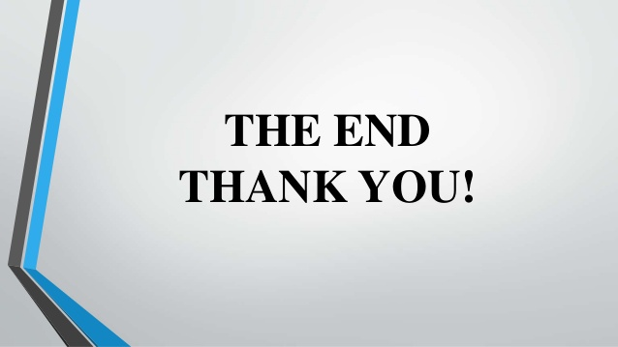
Notes:
- pay-off (n): chi trả

