Slide 1
CHAPTER 3
Requirements engineering good practices

Slide 2
Review chapter 2
Chapter 2
Who is stakeholders
Customer-Development partnership
The expectation gap
Customers
End-users
10 rights of customers
10 responsibilities of customers
Req. baseline
a set of requirements that has been reviewed and agreed upon and serves as the basis for further development
Agile Projects
User stories
Product backlog
best way to minimize the expectation gap
Notes:
Backlog (n): phần công việc còn tồn đọng thưa chực hiện.
Product backlog: phần còn lại của dự án
Velocity (n): Tốc độ

Slide 3
Objectives
Student should enhance every stage in the requirement development process framework and how to implement these stages.
Student should obtain a wide range of good practice in software requirements to prepare for the next chapters.
Need to help student understand these practices aren’t suitable for every situation, so use good judgment, common sense, and experience. Even the best practices need to be selected, applied, and adapted thoughtfully to appropriate situations by skilled business analysts.
Use cases and user interface prototypes might help for the client side, whereas interface analysis is more valuable on the server side…etc.
Notes:
Need to help student understand these practices aren’t suitable for every situation, so use good judgment, common sense, and experience. Even the best practices need to be selected, applied, and adapted thoughtfully to appropriate situations by skilled business analysts. : Cần giúp học sinh hiểu những thực hành này không phù hợp với mọi tình huống, vì vậy hãy sử dụng phán đoán tốt, ý thức chung và kinh nghiệm. Ngay cả những thực tiễn tốt nhất cũng cần được lựa chọn, áp dụng và điều chỉnh phù hợp với các tình huống phù hợp bởi các nhà phân tích kinh doanh lành nghề.
Student must enhance that different practices might be most appropriate for understanding the requirements for different portions of a given project.

Slide 4
Contents
Requirements engineering good practices.
A requirements development process framework
  Elicitation
  Analysis
  Specification
  Validation
A representative requirements development process.
Requirements management.

Slide 5
Requirements engineering good practices
The notion of best practices is debatable: who decides what is “best” and on what basis? One approach is to convene (tập hợp) a body of industry experts to analyze project from many organizations. These experts seek out practices whose effective performance is associated with successful projects and which are not at all on failed projects.
There are more than 50 practices, grouped into 7 categories, that can help all development teams do a better on their requirements activities.
Note that this chapter is titled “Good practices for requirements engineering”, not “Best practices.”
Notes:
- The notion of best practices is debatable: who decides what is “best” and on what basis? One approach is to convene (tập hợp) a body of industry experts to analyze project from many organizations. These experts seek out practices whose effective performance is associated with successful project and which are performed poorly or not at all on failed projects.: Khái niệm về các thực tiễn tốt nhất đang gây tranh cãi: ai là người quyết định thế nào là tốt nhất và trên cơ sở nào? Một cách tiếp cận là triệu tập (tập hợp) một nhóm các chuyên gia trong ngành để phân tích dự án từ nhiều tổ chức. Các chuyên gia này tìm kiếm các thực tiễn có hiệu suất hiệu quả được liên kết với các dự án thành công và được thực hiện kém hoặc hoàn toàn không có trong các dự án thất bại.

Slide 6
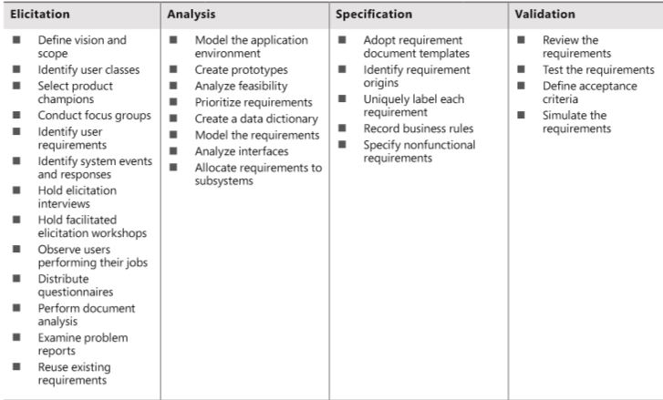
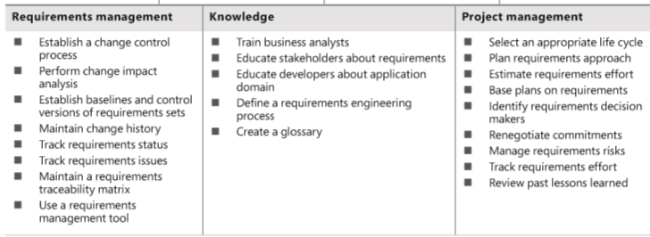
Requirements engineering
good practices
Notes:
Elicitation (n): sự rút ra, luận ra
select product champions: chọn SP vô địch
Adopt requirement document templates: Thông qua các mẫu tài liệu yêu cầu.
Uniquely label each requirement: Nhãn duy nhất mỗi yêu cầu.
Glossary (n): bảng chú giải thuật ngữ
Base plans on requirements: Xd các KH lấy yêu cầu

Slide 7
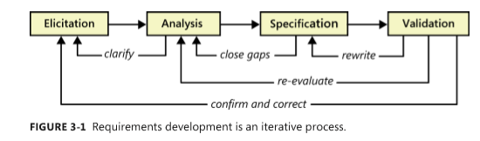
A requirements development process framework
Don’t expect to perform these activities in a simple linear. In practice, they are interwoven, incremental, and iterative, as above figure.
This iterative process continues throughout requirements development and possibly (1 cách hợp lý) – as with agile projects – throughout the full project duration.
Notes:
- Interveave (v): đan xen

Slide 8
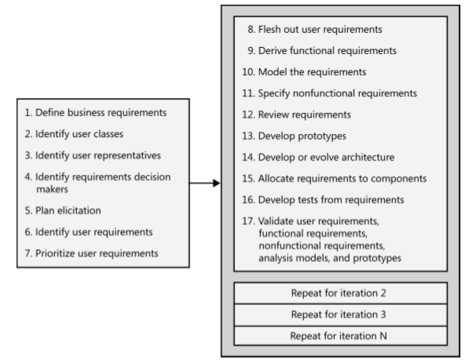
A representative requirements development process
The first 7 steps are typically performed once early in the project (although the team will need to revisit all of these activities periodically).
The remaining steps are performed for each release or development iteration.
Many of these activities can be performed iteratively, they can be interwoven.
Notes:
The first 7 steps are typically performed once early in the project (although the team will need to revisit all of these activities periodically): 7 bước đầu tiên thường được thực hiện sớm một lần trong dự án (mặc dù nhóm sẽ cần phải xem lại tất cả các hoạt động này theo định kỳ)
Flesh out: bổ sung

Slide 9
Requirements elicitation
Define product vision and project scope:
  The vision statement gives all stakeholders a common understanding of the product’s outcome.
  The scope defines the boundary between what’s in and what’s out for a specific release or iteration.
Identify user classes and their characteristics:
  To avoid overlooking the needs of any user community, identify the various groups of users for your product.
  Describe aspects of their job tasks, attitudes, location, or personal characteristics that might influence product design.
Select a product champion (người dùng tiêu biểu) for each user class:
  Identify an individual who can accurately serve as the literal voice (tiếng nói thật) of the customer for each user class.
  The product champion presents the needs of user class and makes decisions on its behalf.
Notes:
Identify an individual who can accurately serve as the literal voice of the customer for each user class: Xác định một cá nhân có thể phục vụ chính xác như tiếng nói đúng sự thật của khách hàng cho mỗi lớp người dùng.
The product champion presents the needs of user class and makes decisions on its behalf.: Người dùng tiêu biểu trình bày các nhu cầu của lớp người dùng và đưa ra quyết định thay cho nó.

Slide 10
Requirements elicitation
Conduct focus groups with typical users:
  Convene (tập hợp) groups of representative users of your previous products or of similar products. Collect their input on both functionality and quality characteristics for the product under development.
  Focus groups are particularly valuable for commercial product development.
Work with user representatives to identify user requirements:
  Explore with your user representatives the tasks they need to accomplish with the SW and the value they’re trying to achieve.
  User requirements can be use cases, user stories, or scenarios.
Identify system events and responses:
  List the external events that the system can experience and its expected response to each event.
Notes:
Conduct focus groups with typical users: Quản lý các nhóm trọng tâm với những user điển hình
List the external events that the system can experience and its expected response to each event: Liệt kê các sự kiện bên ngoài mà hệ thống có thể trải nghiệm và phản ứng dự kiến của nó đối với từng sự kiện.
There are three classes of external events. Signal events are control signals or data received from external hardware devices. Temporal, or time-based, events trigger a response, such as an external data feed that your system generates at the same time every night. Business events trigger use cases in business applications.: Có ba lớp sự kiện bên ngoài. Sự kiện tín hiệu là tín hiệu điều khiển hoặc dữ liệu nhận được từ các thiết bị phần cứng bên ngoài. Các sự kiện tạm thời hoặc dựa trên thời gian sẽ kích hoạt phản hồi, chẳng hạn như nguồn cấp dữ liệu ngoài mà hệ thống của bạn tạo ra cùng một lúc mỗi đêm. Sự kiện kinh doanh kích hoạt các trường hợp sử dụng trong các ứng dụng kinh doanh.

Slide 11
Requirements elicitation
Hold elicitation interviews:
  Interviews can be performed one-on-one or with a small group of stakeholders.
Hold facilitated elicitation workshops:
  Facilitated requirements-elicitation workshops that permit collaboration between analysts and customers are a powerful way to explore user needs and to draft requirements documents.
Observe users performing their jobs:
  Watching users perform their biz tasks establishes a context for their potential use of a new application.
  Simple process flow diagrams can depict the steps and decisions involved and show how different user groups interact.
Notes:
Facilitated requirements-elicitation workshops that permit collaboration between analysts and customers are a powerful way to explore user needs and to draft requirements documents: Các hội thảo khơi gợi các yêu cầu được tạo điều kiện cho phép cộng tác giữa các nhà phân tích và khách hàng là một cách mạnh mẽ để khám phá nhu cầu của người dùng và soạn thảo các tài liệu yêu cầu.

Slide 12
Requirements elicitation
Distribute questionnaires:
  Questionnaires are a way to survey large groups of users to determine what they need. If questions are well written, this help you quickly determine analytical information about needs.
Perform document analysis:
  Existing documentation can help reveal how system currently work or what they are supposed to do. Documentation includes any written information about current systems, biz processes, requirements specifications, competitor research, and COST (commercial off-the-shelf) package user manuals.
Examine problem reports of current systems for requirement ideas:
  Problem reports and enhancement requests from users provide a rich source of ideas for capabilities to include in a later release or in a new product.
Reuse existing requirements:
  If customers request functionality similar to that already present in an existing product, see whether the requirements are flexible enough to permit reusing or adapting the existing SW components.
Notes:
- (commercial off-the-shelf) package user manuals: (hướng dẫn sử dụng gói thương mại)

Slide 13
Requirements analysis
Requirements analysis involves refining the requirements to ensure that all stakeholders understand them and scrutinizing (nghiên cứu kỹ) them for errors, omissions, and other deficiencies.
Model the application environment:
  The context diagram is simple analysis model that shows how the new system fits into its environment.
  It defines the boundaries and interfaces between the system being developed and external entities, such as users, HW devices, and other systems.
Create user interface and technical prototypes:
  When the developers or users aren’t certain about the requirements, construct a prototype – a partial, possible, or preliminary implementation (cài đặt sơ bộ) – to make the concepts and possibilities more tangible.
Notes:
Scrutinize (v): nghiên cứu kỹ lưỡng
Deficiency (n): sự thiếu sót
Omission (n): sự bỏ quên
When the developers or users aren’t certain (ko chắc chắn) about the requirements, construct a prototype – a partial, possible, or preliminary implementation – to make the concepts and possibilities more tangible.: Khi các nhà phát triển hoặc người dùng không chắc chắn về các yêu cầu, hãy xây dựng một nguyên mẫu - triển khai một phần, có thể hoặc sơ bộ - để làm cho các khái niệm và khả năng trở nên rõ ràng hơn.

Slide 14
Requirements analysis
Analyze requirement feasibility:
  The BA work with developers to evaluate the feasibility of implementing each requirement at acceptable cost and performance in the intended operating environment.
  This allows stakeholders understand the risks associated with implementing each requirement, including conflicts and dependencies with other requirements.
Prioritize the requirements:
  Prioritizing requirements ensures that the team implements the highest value or most timely functionality first.
  Apply an analytical approach to determine the relative implementation priority of product features, use cases, user stories, or functional requirements.

Slide 15
Requirements analysis
Create a data dictionary:
  Definitions of data items and structures associated with the system reside in the data dictionary.
  That helps everyone working on the project to use consistent data definitions.
Model the requirements:
  An analysis model is a diagram that depicts requirements visually, in contrast to the textual representation of a list of functional requirements.
  Model can reveal incorrect, inconsistent, missing, and superfluous (vô dụng) requirements.
  Such models include data flow diagrams, entity-relationship diagrams, state-transition diagrams, state tables, dialog maps, decision trees, and others.
Notes:
Superfluous (adj): ko cần thiết
state-transition diagrams: Sơ đồ chuyển trạng thái
State tables: bảng trạng thái

Slide 16
Requirements analysis
Analyze interfaces between your system and the outside world:
  All SW systems have connections to others parts of the world through external interfaces. Information systems have user interfaces and often exchange data with other SW systems.
  Embedded systems involve interconnections between SW and HW components. Network-connected applications have communication interfaces.
Allocate requirements to subsystems:
  The requirements for complex product that contains multiple subsystems must be apportioned (chia ra) among the various SW, HW, and human subsystems and components.
Notes:
Apportion (v): chia ra từng phần, từng ô
Allocate requirements to subsystems: Phân bổ các yêu cầu cho các hệ thống con

Slide 17
Requirements specification
The essence of requirements specification is to document requirements of different types in a consistent, accessible, and reviewable way that is readily understandable by the intended audiences.
Adopt (áp dụng phù hợp) requirement document templates:
  Adopt standard templates for documenting requirements in your organization.
  The templates provide a consistent structure for recording various groups of requirements-related information.
Identify requirement origins:
  To ensure that all stakeholders know why every requirement is needed, trace each one back to its origin.
  This might be a use case or some other customer input, a high-level system requirement, or a biz rule.
Notes:
- Adopt (v): thông qua / kế tục / nhận làm con nuôi

Slide 18
Requirements specification
Uniquely label each requirement:
  Define a convention for giving each requirement a unique identifying label. The convention must be robust enough to withstand (chống lại) additions, deletions, and changes made in the requirements over time.
Record business rules:
  Biz rules include corporate policies, government regulations, standards, and computational algorithms.
  Document your biz rules separately from a project’s requirements because they typically have an existence beyond the scope of a specific project.
Specify nonfunctional requirements:
  It’s possible to implement a solution that does not exactly what it’s supposed to do but does not satisfy the users’ quality expectations.
  To avoid that problem, you need to go beyond the functionality discussion to understand the quality characteristics that are important to success. These characteristics are performance, reliability, usability, modifiability, and many others.
Notes:
Withstand (v): chống lại / chịu đựng
It’s possible to implement a solution that does not exactly what it’s supposed to do but does not satisfy the users’ quality expectations: Có thể triển khai một giải pháp không chính xác với những gì mà nó phải làm nhưng không thể không thỏa mãn những mong đợi về chất lượng của người dùng.

Slide 19
Requirements validation
Validation ensures that the requirements are correct, demonstrate the desired quality characteristics, and will satisfy customer needs.
Review the requirements:
  Peer review of requirements, particularly the type of rigorous review called inspection, is one of the highest-value SW quality practices available.
  The small teams of reviews (analyst, customers, developers, and testers) carefully examine the written requirements, analysis models, and related information for defects.
Test the requirements:
  Tests constitute an alternative view of the requirements.
  Writing tests requires you to think about how to tell if the expected functionality was correctly implemented.
Notes:
- Rigorous (adj): nghiên khắc

Slide 20
Requirements validation
Define acceptance criteria:
  Ask users to describe how they will determine whether the solution meets their needs.
  Acceptance criteria include a combination of SW passing a defined set of acceptance tests based on user requirements, demonstration satisfaction of specific nonfunctional requirements, tracking open defects and issues,…
Simulate the requirements:
  Commercial tools are available that allow a project team to simulate a proposed system either in place of or to augment written requirements specifications.

Slide 21
Requirements management
After you have the initial requirements for a body of work in hand, you must cope with the inevitable changes that customers, managers, marketing, the development team, and others request during development. You need to control all changes!
Establish a requirements change control process:
  Changes are inevitable!
  Your change process should define how requirements changes are proposed, analyzed, and resolved. In the project management, a Change Control Board (CCB) evaluates proposed requirements changes, decides which ones to accept, and set implementation priorities or target releases.
Perform impact analysis on requirements changes:
  Impact analysis is an important element of the change process that helps the CCB make informed biz decisions.
  Evaluate each proposed requirement change to assess the effect it will have on the project.
Notes:
- After you have the initial requirements for a body of work in hand, you must cope with the inevitable changes that customers, managers, marketing, the development team, and others request during development: Sau khi bạn có các yêu cầu ban đầu cho một nhóm công việc trong tay, bạn phải đối phó với những thay đổi không thể tránh khỏi mà khách hàng, người quản lý, tiếp thị, nhóm phát triển và những người khác yêu cầu trong quá trình phát triển.

Slide 22
Requirements management
Establish baselines and control versions of requirements sets:
  A baseline defines a set of agreed-upon requirements, typically for a specific release or iteration.
  After the requirements have been baselined, changes should be made only through the project’s change control process. Every change must have unique version.
Maintain a history of requirements changes:
  Retain a history of the changes made to individual requirement. Sometimes you need to revert to an earlier version of a requirement or want to know how a requirement came to be in its current form.
  Record the dates that requirements were changed, the changes that were made, who made each change, and why.
Notes:
Retain (v): giữ lại, ghi nhận lại
Revert (v): trở lại

Slide 23
Requirements management
Track the status of each requirement:
  Create a repository with one record for each discrete requirement of any type that affects implementation.
  Store key attributes about each requirement, including its status (such as proposed, approved, implemented, or verified), so you can monitor the number of requirements in each status category at any time.
Track requirements issues:
  When busy people are working on a complex project, it’s easy to lose sight of the many issues that arise, including questions about requirements that need resolution, gaps to eradicate (xóa bỏ), and issues arising from requirements reviews.
  Issue-tracking tools can keep these items from falling through the cracks (rơi vào vềt nứt).
Notes:
Eradicate (v): triệt tiêu/xóa bỏ
When busy people are working on a complex project, it’s easy to lose sight of the many issues that arise, including questions about requirements that need resolution, gaps, to eradicate, and issues arising from requirements reviews: Khi những người bận rộn đang làm việc trong một dự án phức tạp, nó dễ dàng đánh mất nhiều vấn đề phát sinh, bao gồm các câu hỏi về các yêu cầu cần giải quyết, các lỗ hổng để xóa bỏ và các vấn đề phát sinh từ các đánh giá yêu cầu.
Issue-tracking tools can keep these items from falling through the cracks: Các công cụ theo dõi vấn đề có thể giữ cho các hạng mục này không rơi vào vết nứt.

Slide 24
Requirements management
Maintain a requirements traceability matrix:
  Requirements traceability matrix is helpful for confirming that all requirements are implemented and verified.
  It’s also useful during maintenance when a requirement has to be modified.
  Populate this matrix during development, not at the end.
Use a requirements management tool:
  Commercial requirements management tools let you store various types of requirements in a database.
  This tool helps you implement and automate many of the other requirements management practices described in this section.
Notes:
- Requirements traceability matrix is helpful for confirming that all requirements are implemented and verified: Ma trận truy xuất nguồn gốc yêu cầu là hữu ích để xác nhận rằng tất cả các yêu cầu được thực hiện và được kiểm chứng.

Slide 25
Knowledge
Biz analysis is a specialized and challenging role, with its own body of knowledge. Training can increase the proficiency and comfort level of those who serve as analysts, but it can’t compensate for absent interpersonal skills or a lack of interest in the role.
Train business analysts:
  All team members who will perform BA tasks should be trained in requirements engineering.
  That gives them a solid foundation on which to build through their own experiences and advanced training.
Educate stakeholders about requirements
  Users who will participate in SW development should receive one or two days of education about requirements so they understand terminology, key concepts and practices, and why this is such an important contributor to project success.
Notes:
It isn’t reasonable to expect all people to be instinctively competent at the communication-intensive tasks of requirements engineering.: Thật không hợp lý khi hy vọng tất cả mọi người có khả năng bản năng trong các nhiệm vụ chuyên sâu về giao tiếp của kỹ thuật yêu cầu.
Training can increase the proficiency and comfort level of those who serve as analysts, but it can’t compensate for absent interpersonal skills or a lack of interest in the role.: Đào tạo có thể tăng mức độ thành thạo và mức độ thoải mái của những người làm phân tích, nhưng nó không thể bù đắp cho thiếu các kỹ năng cộng tác hoặc thiếu quan tâm đến vai trò.

Slide 26
Knowledge
Educate developers about the application domain:
  To give developers a basic understanding of the application domain, arrange a seminar on the customer’s biz activities, terminology, and objectives for the product being created. This can reduce confusion, miscommunication, and rework.
Define a requirements engineering process:
  Document steps your organization follows to elicit, analyze, specify, validate, and manage requirements. Providing guidance on how to perform the key steps will help analysts to a consistently good job.
Create a glossary:
  A glossary that defines specialized terms from the application domain will minimize misunderstandings. Include synonyms, acronyms or abbreviations, terms that can have multiple meanings, and terms that have both domain-specific and everyday meanings.

Slide 27
Project management
Select an appropriate software development life cycle:
  Your organization should define several development life cycles that are appropriate for various types of projects and different degrees of requirements uncertainty. Each PM should select and adapt the life cycle that best suits her project.
Plan requirements approach:
  Each project team should plan how it will handle its requirements development and management activities. An elicitation plan helps ensure that you identify and obtain input from appropriate stakeholders at the right stages of the project using the most appropriate techniques.
Estimate requirements effort:
  Stakeholders often want to know how long it’s going to take to develop the requirements for a project and what percentage of their total effort should be devoted (dành cho) to requirements development and management.
Notes:
- Devote (v): hiến dâng

Slide 28
Project management
Base project plans on requirements:
  Develop plans and schedules for your project iteratively as the scope and detailed requirements become clear. Begin by estimating the effort needed to develop the user requirements from the initial product vision and project scope.
Identify requirements decision makers:
  SW development involves making many decisions. Conflicting users inputs must be resolved, commercial package components must be selected, changes requests must be evaluated,… So we need to have decision makers.
Renegotiate project commitments when requirements change:
  A project team makes commitments to deliver specific set of requirements within a particular schedule and budget. If all changes impact to schedule, budget and scope of the project you need to renegotiate with stakeholders.

Slide 29
Project management
Analyze, document, and manage requirements-related risks:
  Unanticipated events and conditions can be wreak havoc on (tàn phá) an unprepared project. Identify and document risks related to requirements as part of the project’s risk-management activities.
Track the effort spent on requirements:
  To improve your ability to estimate the resources needed for requirements work on future projects, record the effort your team expends on requirements development and management activities.
Review lessons learned regarding requirements on other projects:
  A learning organization conducts periodic retrospective (nhìn lại) to collect lessons learned from completed projects for from earlier iterations of current project.
Notes:
Unanticipated events and conditions can be wreak havoc on an unprepared project.: Các sự kiện và điều kiện không lường trước được có thể tàn phá một dự án thiếu sự chuẩn bị.
Retrospective (adj): nhìn lại dĩ vãng, quá khứ / có hiệu lực hồi tố

Slide 30
Review chapter 3
Chapter 3
Req. development
Req. management
Good practices: Req. engineering
Elicitation
Analysis
Req. Baseline
Req. changes & monitor
Knowledge about Req. Eng.
Train BA
Projects Mgt.
Select SW dev. Life cycle
Plan req. approach
50 practices
7 categories
Specification
Validation
Req. traceability
Req. Mgt. tools
Educate stakeholders, Dev
Create req. processes
Define glossary
Estimate efforts
Identify decision makers
Notes:
Backlog (n): phần công việc còn tồn đọng thưa chực hiện.
Product backlog: phần còn lại của dự án
Velocity (n): Tốc độ

Slide 31

Notes:
- pay-off (n): chi trả

