Slide 1
CHAPTER 4
The business analyst

Slide 2
Review chapter 3
Chapter 3
Req. development
Req. management
Good practices: Req. engineering
Elicitation
Analysis
Req. Baseline
Req. changes & monitor
Knowledge about Req. Eng.
Train BA
Projects Mgt.
Select SW dev. Life cycle
Plan req. approach
50 practices
7 categories
Specification
Validation
Req. traceability
Req. Mgt. tools
Educate stakeholders, Dev
Create req. processes
Define glossary
Estimate efforts
Identify decision makers
Notes:
Backlog (n): phần công việc còn tồn đọng thưa chực hiện.
Product backlog: phần còn lại của dự án
Velocity (n): Tốc độ

Slide 3

Objectives
Enhancing:
  the vital functions the BA performs
  the skills and knowledge an effective analyst needs
  how to develop such people in organization
  proposes a job description for a requirements analyst, and you can also access a sample BA job description
Notes:
the vital functions the BA performs: các chức năng quan trọng mà BA thực hiện
proposes a job description for a requirements analyst, and you can also access a sample BA job description: đề xuất một mô tả công việc cho một nhà phân tích yêu cầu và bạn cũng có thể truy cập một mô tả công việc BA mẫu.

Slide 4
Contents
The business analyst role
The business analyst’s tasks
Essential analyst skills
Essential analyst knowledge
The making of a business analyst
The analyst role on agile projects
Creating a collaborative team

Slide 5
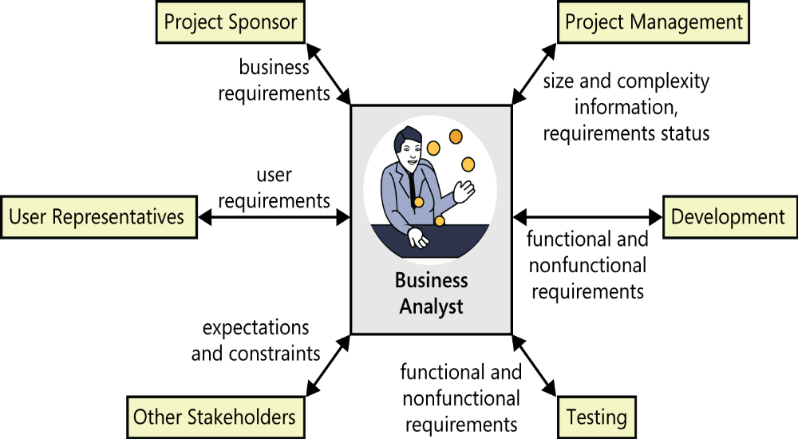
The business analyst role
Biz analyst (BA) enables change in organizational context by defining needs and recommending solutions that deliver (mang lại) value to stakeholders.
BA elicits analyzes others’ perspectives, transforms the information collected into a requirements specification, and communicates (truyền đạt) the information to others stakeholders.
BA helps stakeholders find
the difference between
what they say they want
and what they really need.
BA educates, questions,
listens, organizes, and
learns. It’s a tough job!

Slide 6
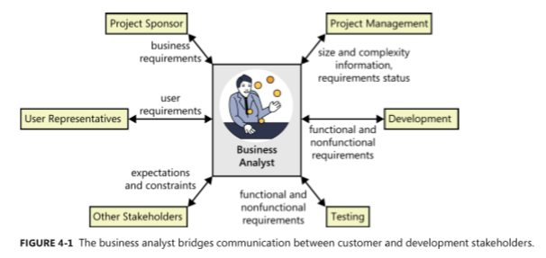
The business analyst role
The BA is a project role, not necessarily a job title.
The BA is the individual who has the primary responsibility to elicit, analyze, document, and validate the needs of stakeholders.

Slide 7

The business analyst’s tasks
The BA must first understand the biz objectives for the project and then define user, functional, and qualify requirements that allow teams to estimate and plan the project and to design, build, and verify the product.
Define business requirements
Plan the requirements approach
Identify project stakeholders and user classes
Elicit requirements
Analyze requirements
Document requirements
Communicate (truyền đạt) requirements
Lead requirements validation
Facilitate requirements prioritization
Manage requirements

Slide 8
The business analyst’s tasks
Define business requirements:
  BA helps the biz or funding sponsor, product manager, or marketing manager define the project’s biz requirements.
Plan the requirements approach:
  The BA should develop plans to elicit, analyze, document, validate, and manage requirements throughout the project. Work closely with the project manager to ensure these plans align with the overall project plans and will help achieve the project goals.
Identify project stakeholders and user classes:
  Work with sponsors to select appropriate representatives for each user class, enlist their participation, and negotiate their responsibilities.
Elicit requirements:
  The BA helps users articulate the system capabilities they need to meet their biz objectives by using a variety of information-gathering techniques.

Slide 9
The business analyst’s tasks
Analyze requirements:
  The BA uses requirements models to recognize patterns, identify gaps in the requirements, reveal conflicting requirements, and confirm that all requirements specified are within scope.
Document requirements:
  The BA is responsible for documenting requirements in a well-organized and well-written manner that clearly describes the solution that will address the customers’ problem.
Communicate requirements:
  The BA needs to communicate the requirements to all parties. The BA should determine when it’s useful to represent requirements by using methods other than text, including various types of visual analysis models.
Notes:
The BA uses requirements models to recognize patterns, identify gaps in the requirements, reveal conficting requirements, and confirm that all requirements specified are within scope: Nhà phân tích kinh doanh sử dụng các mô hình yêu cầu để nhận ra các mẫu, xác định các lỗ hổng trong các yêu cầu, tiết lộ các yêu cầu xung đột và xác nhận rằng tất cả các yêu cầu được chỉ định đều nằm trong phạm vi.
Communicate requirements: Truyền đạt các yêu cầu

Slide 10
The business analyst’s tasks
Lead requirements validation:
  The BA is the central participants in reviews of requirements. The BA should review designs and tests that were derived from requirements to ensure that the requirements were interpreted correctly.
Facilitate requirements prioritization:
  The BA works with stakeholders to prioritize all requirements to align with achieving biz objectives.
Manage requirements:
  The BA is involved throughout the entire SW development life cycle, so he/she should help create, review, and execute the project’s requirements management plan.
Notes:
- Facilitate requirements prioritization: Tạo điều kiện ưu tiên cho các yêu cầu

Slide 11
Essential analyst skills
Listening skills
Interviewing and questioning skills
Thinking on your feet (Kỹ năng ra QĐ nhanh chóng)
Analytical skills
Systems thinking skills
Learning skills
Facilitation skills
Leadership skills
Observational skills
Communication skills
Organizational skills
Modeling skills
Interpersonal skills
Creativity
Notes:
It can be intimidating to work with senior managers and with highly opinionated or aggressive individuals.: Nó có thể đáng sợ khi làm việc với các nhà quản lý cấp cao và với các cá nhân có quan điểm cao hoặc hung hăng.
Thinking on your feet: Suy nghĩ trên đôi chân của bạn. Kỹ năng suy nghĩ nhanh và đặt câu hỏi phù hợp trong quá trình phỏng vấn (ngoài kịch bản) để thu thập thông tin. Kỹ năng này giúp bạn phán đoán được ý đồ của người được PV thậm chi những ý mà họ còn suy nghĩ trong đầu. Cũng có thể gọi là kỹ năng đọc vị người khác.

Slide 12
Essential analyst knowledge
The BA needs a breadth (rộng rãi) of knowledge, much of which is gained through experience.
The BA needs to understand contemporary (đương thời) requirements engineering practices and how to apply them in the context of various software development life cycles.
The BA needs to educate and persuade those who are not familiar with established requirements practices.
The effective BA has a rich tool kit of techniques available and knows when—and when not—to use each one.
Notes:
Breadth (n): bề rộng / rộng rãi
Contemporary (adj): thuộc về đương thời, hiện đại
They need to understand contemporary requirements engineering practices and how to apply them in the context of various software development life cycles : Họ cần hiểu các yêu cầu kỹ thuật hiện đại và cách áp dụng chúng trong bối cảnh các vòng đời phát triển phần mềm khác nhau.

Slide 13
Essential analyst knowledge
The BA needs to understand project management, development life cycles, risk management, and quality engineering.
The BA can minimize miscommunications with users.
The BA needs to understand the organization and business domains often detect unstated assumptions and implicit requirements.
The BA also needs to suggest ways that users could improve their business processes or propose valuable functionality that no other stakeholder thought of.

Slide 14
The making of a business analyst
The former user:
  They understand the biz and the work environment, so they can easily gain the trust of their former colleagues. They speak the user’s language, and they know the existing systems and biz processes.
  On the downside (mặt trái), former users are now BAs might know little about SW engineering or how to communicate with technical people. Some of them believe they understand what is needed better than current users do, so they don’t solicit or respect input from those who will actually use the new system.
The former developer or tester:
  Some developers have little patience with users, preferring to work with the code and promote the glamour (hấp dẫn) of technology.
  Of course, some others recognize the criticality (tính chủ đạo) of the requirements process and can work as BA when necessary.
  The developer-turned-analysts might need to learn more about the biz domain. They can easily lapse into (sa ngã vào) technical thinking and jargon, focusing on the SW to be built instead of the customers’ needs.
  Testers aren’t commonly asked to perform the analyst role. However, a tester often has an analytical mindset that can lend itself to (tự cho mình) being a good BA.
Notes:
The making of a business analyst: Cái tạo nên nhà phân tích KD (BA)
On the downside: Mặt trái
Glamour (adj): sự hấp dẫn, mê hoặc
Criticality (n): tính chủ đạo
Lapse into: sa ngã vào
Lend itself to (v): Thích ứng với
Testers aren’t commonly asked to perform the analyst role. However, a tester often has an analytical mindset that can lend itself to being a good BA.: Người kiểm tra thường không được yêu cầu thực hiện vai trò phân tích. Tuy nhiên, một người thử nghiệm thường có một tư duy phân tích có thể tự cho mình là một BA tốt.

Slide 15
The making of a business analyst
The former (or concurrent) project manager:
  PMs are sometimes asked to also fill the role of BA, probably because they have some of the same skills and domain knowledge required.
  However, they will have to learn more about requirements engineering practices. They must learn to focus on understanding the biz needs and prioritizing those within existing project schedules, rather than focusing on timelines, resources, and budget constraints.
The subject matter expert (SME):
  The business analyst (from SME) who is a domain expert might specify the system’s requirements to suit his own preferences, rather than addressing the legitimate needs (nhu cầu hợp pháp) of the various user classes.
  The SMEs are expert in their understanding of the “as-is” system, but they are sometimes difficult to imagine the “to-be” system.
Notes:
Concurrent (adj): đồng thời
The business analyst who is a domain expert might specify the system’s requirements to suit his own preferences, rather than addressing the legitimate needs of the various user classes: Nhà phân tích kinh doanh là một chuyên gia về miền có thể chỉ định các yêu cầu của hệ thống phù hợp với sở thích của riêng mình, thay vì giải quyết các nhu cầu hợp pháp của các lớp người dùng khác nhau.

Slide 16

The making of a business analyst
The rookie (tân binh):
  The new graduate will have little relevant experience or knowledge. The advantage of hiring a novice (người mới vào nghề) as a BA is that he will have few preconceived notions about requirements processes should work.
  Because he lacks related experience and knowledge, a new graduate will have much to learn about how to execute the BA tasks and the intricacies of the practices (tính phức tạp của thực tiễn).
  The new BA needs to learn so much.
  Mentoring can reduce the learning curve
  for a novice BA and instill (thấm nhuần) good
  habits from the outset (từ đầu).
Notes:
Rooky (n): Tân binh, linh mới
Novice (n): người mới vào nghề
Preconceived (adj): hình thành trước ko dựa trên kiến thức, kinh nghiệm / hình thành trước.
Intricacy (n): tính phức tạp, rắc rối.

Slide 17
The analyst role on agile projects
Following are a few suggestions for a BA to apply her/his skills on an agile project:
Define a lightweight, flexible requirements process and adapt it as the project warrants (qui định).
Ensure that requirements documentation is at the right level: not too little and not too much.
Help determine the best approach to document the backlog, including whether story cards or more formal tools are most appropriate.
Apply facilitation and leadership skills to ensure that stakeholders are talking to one another frequently about requirements needs, questions, and concerns.
Help validate that customer needs are accurately represented in the product backlog, and facilitate backlog prioritization.
Work with customers when they change their minds about requirements and priorities, and help record those changes.
Work with the rest of the team to determine the impact of changes on iteration contents and release plans.
Notes:
Define a lightweight, flexible requirements process and adapt it as the project warrants. : Xác định một quy trình yêu cầu nhẹ, linh hoạt và áp dụng nó như là qui định của dự án.
Help determine the best approach to document the backlog, including whether story cards or more formal tools are most appropriate: Giúp xác định cách tiếp cận tốt nhất để ghi lại hồ sơ tồn đọng, bao gồm story cards hay các công cụ chính thức khác là phù hợp nhất.

Slide 18
Review chapter 4
Chapter 4
BA tasks
BA skills
BA roles
Define biz req.
14 skills
The making of a BA
Former user
Req. Mgt.
Req. Development
Former dev./tester
Former PM
Former SME
Plan the reqs approach
Identify project stakeholders and user classes
Req. dev.
Manage requirements
Rookie
Notes:
Backlog (n): phần công việc còn tồn đọng thưa chực hiện.
Product backlog: phần còn lại của dự án
Velocity (n): Tốc độ

Slide 19
https://coggle.it/diagram/XEcsfdoD5ySdKJ8V/t/chapter-4-the-business-analyst

Slide 20

Notes:
- pay-off (n): chi trả

