Slide 1
CHAPTER 12
A picture is worth 1024 words

Slide 2
Review chapter 11
Chapter 11: Write excellent requirements.
Characteristics of reqs. collections
Characteristics of excellent reqs.
Guidelines for writing reqs.
Complete
Complete
Correct
Feasible
Necessary
Prioritized
Unambiguous
Verifiable
Consistent
Modifiable
Traceable
Clarity and conciseness
The keyword “shall”:
Active voice
Individual requirements

Slide 3
Objectives
After finish this chapter, student should understand the purpose of every type of diagrams, when and how to build them.
Student could choice the plan to model requirements.

Slide 4
Contents
A useful of picture in requirements representation.
Modeling the requirements.
From voice of the customer to analysis models.
Selecting the right representations.
Data flow diagram.
Swimlane diagram.
State-transition diagram and state table.
Decision tables and decision trees.
Modeling on agile projects.

Slide 5
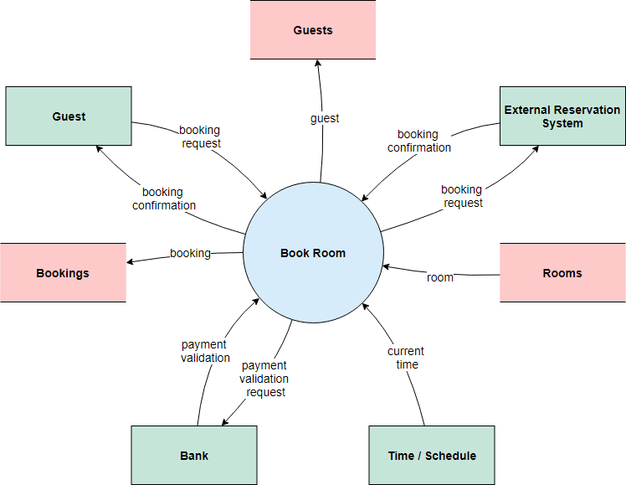
A useful of picture in requirements representation
Diagrams communicate certain types of information more efficiently than text can.
Pictures help bridge (thu hẹp) language and vocabulary barriers among team members.
There are many different diagrams and modeling techniques to choose from to create visual representations of the requirements.
Notes:
- Pictures help bridge language and vocabulary barriers among team members: Hình ảnh giúp thu hẹp rào cản ngôn ngữ và từ vựng giữa các thành viên trong nhóm..

Slide 6
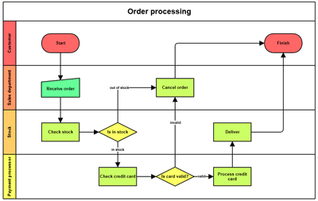
Modeling the requirements
Visual requirements models can help you identify missing, extraneous (ko liên quan), and inconsistent requirements.
Given the limitations (với sự hạn chế) of human short-term memory, analyzing a list of one thousand requirements for inconsistencies, duplication, and extraneous requirements is nearly impossible.
Swimlane diagrams sample
Notes:
Given the limitations of human short-term memory, analyzing a list of one thousand requirements for inconsistencies, duplication, and extraneous requirements is nearly impossible: Với những hạn chế của bộ nhớ ngắn hạn của con người, việc phân tích một danh sách một nghìn yêu cầu về sự không nhất quán, trùng lặp và các yêu cầu không liên quan là gần như không thể.

Slide 7
Modeling the requirements
Visual requirements models described in this book include:
  Data flow diagrams (DFDs).
  Process flow diagrams such as swimlane diagrams (Sơ đồ bơi).
  State-transition diagrams (STDs) and state tables
  Dialog maps.
  Decision tables and decision trees.
  Event-response tables.
  Feature trees (discussed in Chapter 5, “Establishing the business requirements”).
  Use case diagrams (discussed in Chapter 8, “Understanding user requirements”).
  Activity diagrams (also discussed in Chapter 8).
  Entity-relationship diagrams (ERDs) (discussed in Chapter 13, “Specifying data requirements”).

Slide 8
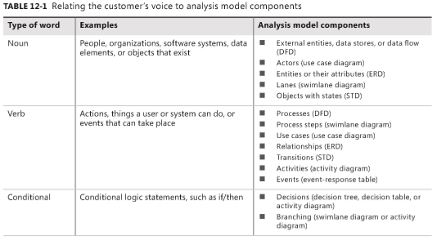
From voice of the customer to analysis models
By listening carefully to how customers present their requirements, the BA can pick out keywords that translate into specific model elements.
Notes:
Table 12-1 suggests possible mappings from customers’ word choices into model component

Slide 9
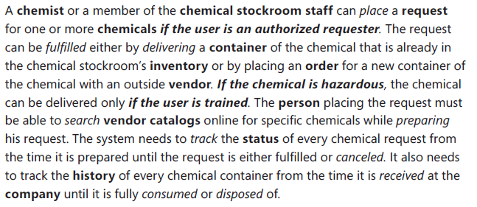
From voice of the customer to analysis models
EX: Significant unique nouns are highlighted in bold, verbs are in italics, and conditional statements are in bold italics; look for these keywords in the analysis models shown later in this chapter.

Slide 10
Selecting the right representations
Rarely does a team need to create a complete set of analysis models for an entire system.
Focus your modeling on the most complex and riskiest portions of the system and on those portions most subject to ambiguity or uncertainty.
Safety-critical, security-critical, and mission-critical system elements are good candidates (những ứng viên tốt) for modeling because the impact of defects in those areas is so severe.
Next slide shows you some representation techniques you can choose.

Slide 11
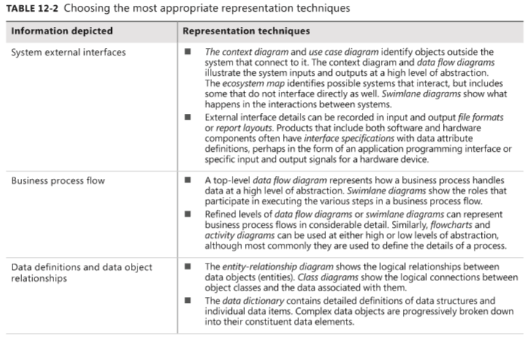
Selecting the right representations
Notes:
The data dictionary contains detailed definitions of data structures and individual data items. Complex data objects are progressively broken down into their constituent data elements.:Từ điển dữ liệu chứa các định nghĩa chi tiết về cấu trúc dữ liệu và các mục dữ liệu riêng lẻ. Các đối tượng dữ liệu phức tạp dần dần được chia thành các thành phần dữ liệu cấu thành của chúng.

Slide 12
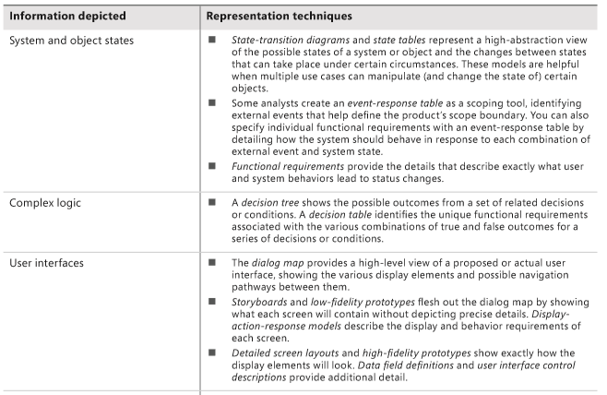
Selecting the right representations
Notes:
The dialog map provides a high-level view of a proposed or actual user interface, showing the various display elements and possible navigation pathways between them.: Bản đồ hộp thoại cung cấp cái nhìn mức cao về giao diện người dùng được đề xuất hoặc thực tế, hiển thị các yếu tố hiển thị khác nhau và các đường dẫn điều hướng có thể có giữa chúng.
Storyboards and low-fidelity prototypes flesh out the dialog map by showing what each screen will contain without depicting precise details. Display-action-response models describe the display and behavior requirements of each screen.: Bảng phân cảnh và các nguyên mẫu có độ trung thực thấp xuất hiện trên bản đồ hộp thoại bằng cách hiển thị những gì mỗi màn hình sẽ chứa mà không mô tả chi tiết chính xác. Các mô hình phản hồi hành động hiển thị mô tả các yêu cầu hiển thị và hành vi của từng màn hình.

Slide 13
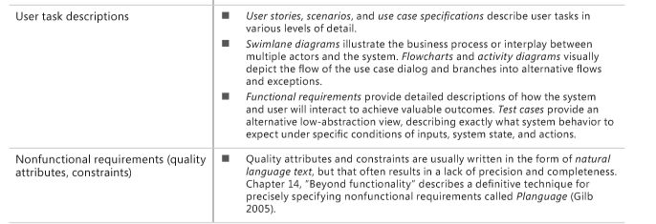
Selecting the right representations

Slide 14
Data flow diagram – context diagram
The data flow diagrams (DFD) is the basic tool of structured analysis. A DFD identifies the transformational processes of a system, the collections (stores) of data or physical materials that the system manipulates, and the flows of data or material between processes, stores, and the outside world.
Purpose
  DFDs provide a big-picture view of how data moves through a system, which other models don’t show well.
  A DFD gives context to the functional requirements regarding (liên quan đến) how the user performs specific tasks.
  DFDs can be used as a technique to identify missing data requirements.
Notes:
identifies the transformational processes of a system, the collections (stores) of data or physical materials that the system manipulates, and the flows of data or material between processes, stores, and the outside world : DFD xác định các quy trình biến đổi của một hệ thống, các bộ sưu tập (lưu trữ) dữ liệu hoặc vật liệu vật lý mà hệ thống thao tác và các luồng dữ liệu hoặc vật liệu giữa các quy trình, lưu trữ và thế giới bên ngoài.
A DFD gives context to the functional requirements regarding how the user performs specific tasks.: DFD cung cấp ngữ cảnh cho các yêu cầu chức năng liên quan đến cách người dùng thực hiện các tác vụ cụ thể.

Slide 15
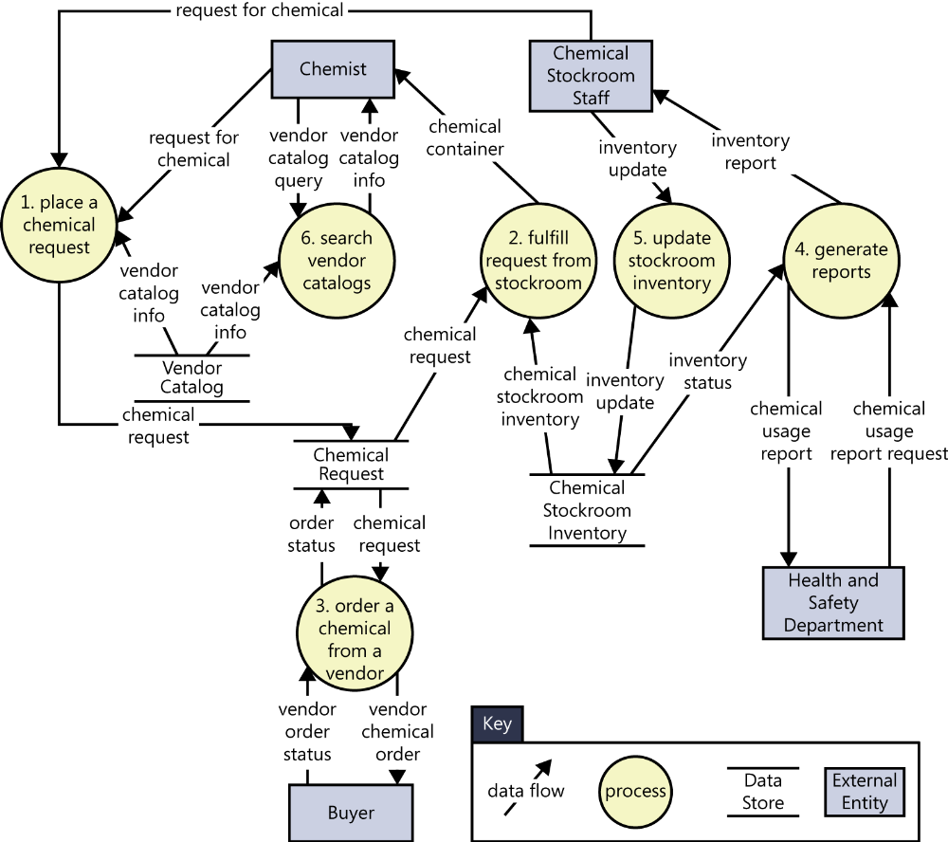
Dataflow diagram: example
FIGURE 12-1 Partial level 0 data flow diagram for the Chemical Tracking System.

Slide 16
Dataflow diagram: Explanation
Processes communicate through data stores, not by direct flows from one process to another. Similarly, data cannot flow directly from one store to another or directly between external entities and data stores; it must pass through a process bubble.
Name each process as a concise action: verb plus object (such as “generate reports”). Use names that are meaningful to the customers.
Number the processes uniquely and hierarchically. On the level 0 diagram, number each process with an integer. If you create a child DFD for process 3, number the processes in that child diagram 3.1, 3.2, and so on.
Don’t show more than 8 to 10 processes on a single diagram or it will be difficult to draw, change, and understand.
Bubbles with flows that are only coming in or only going out are suspect (nghi ngờ). The processing that a DFD bubble represents normally requires both input and output flows.
Notes:
- Don’t attempt to imply the processing sequence using the DFD:

Slide 17
Swimlane diagram
Purpose:
  Provide a way to represent the steps involved in (tham gia vào) a business process or the operations of a proposed software system.
  They are a variation of flowcharts, subdivided into visual subcomponents called lanes (con đường). The lanes can represent different systems or actors that execute the steps in the process.
  Swimlane diagrams are most commonly used to show business processes, workflows, or system and user interactions.
  They are similar to UML activity diagrams. Swimlane diagrams are sometimes called cross-functional diagrams.
  The swimlane diagram is one of the easiest models for stakeholders to understand because the notation is simple and commonly used.

Slide 18
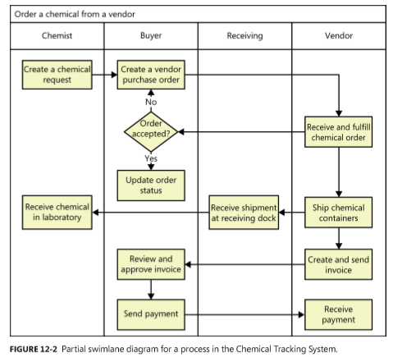
Swimlane example
Process steps, shown as rectangles.
Transitions between process steps, shown as arrows connecting pairs of rectangles.
Decisions, shown as diamonds with multiple branches leaving each diamond. The decision choices are shown as text labels on each arrow leaving a diamond.
Swimlanes to subdivide the process, shown as horizontal or vertical lines on the page. The lanes are most commonly roles, departments, or systems. They show who or what is executing the steps in a given lane.

Slide 19
State-transition diagram and state table
Purpose: Software systems involve (bao hàm) a combination of functional behavior (hoạt động), data manipulation, and state changes. Real-time systems and process control applications can exist in one of a limited number of states at any given time.
A state change can take place (xảy ra) only when well-defined criteria are satisfied, such as receiving a specific input stimulus (kích thích) under certain conditions.
State transition diagram contains three type of elements:
  Possible system states, shown as rectangles.
  Allowed state changes or transitions, shown as arrows connecting pairs of rectangles.
  Events or conditions that cause each transition to take place, shown as text labels on each transition arrow

Slide 20
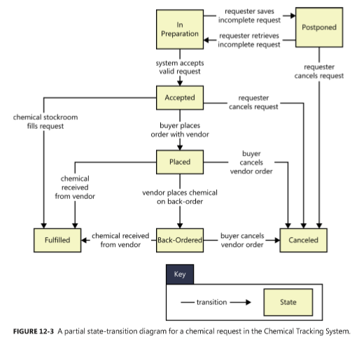
State-transition diagram example
In Preparation The Requester is creating a new request.
Postponed (trì hoãn)The Requester saved a partial request for future completion without either submitting the request to the system or canceling the request operation.
Accepted The Requester submitted a completed chemical request and the system accepted it for processing.
Placed The request must be satisfied by an outside vendor and a buyer has placed an order with the vendor.
Fulfilled The request has been satisfied, either by the delivery of a chemical container from the chemical stockroom to the Requester or by receipt of a chemical from a vendor.
Back-ordered The vendor didn’t have the chemical available and notified the buyer that it was back-ordered for future delivery.
Canceled The Requester canceled an accepted request before it was fulfilled, or the buyer canceled a vendor order before it was fulfilled or while it was back-ordered.
Notes:
Postpone (v): trì hoãn

Slide 21
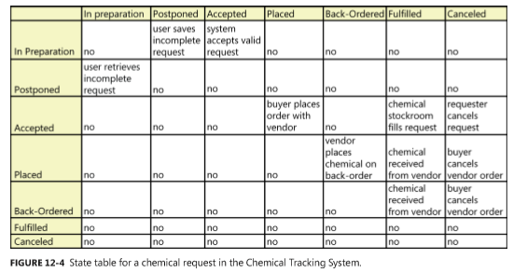
State table example

Slide 22

Several diagrams for self-studying
Dialog map
Decision tables and decision trees
Event-response tables

Slide 23
A few words about UML diagrams
Many projects use object-oriented analysis, design, and development methods. Objects typically correspond to real-world items in the business. They represent individual instances derived from a generic template called a class.
Class descriptions encompass both attributes (data) and the operations that can be performed on the attributes.
A class diagram is a graphical way to depict the classes identified during object-oriented analysis and the relationships among them.
The standard object-oriented modeling language is the Unified Modeling Language. The UML is primarily used for creating design models.
  Class diagrams, to show the object classes that pertain to (gắn với) the application domain; their attributes, behavior, and properties; and relations among classes.
  Use case diagrams, to show the relationships between actors external to the system and the use cases with which they interact.

Slide 24
Modeling on agile projects
The difference in how traditional and agile projects perform modeling is related to when the models are created and the level of detail in them.
The key point in using analysis models on agile projects—or really, on any project—is to focus on creating only the models you need, only when you need them, and only to the level of detail you need to make sure project stakeholders adequately understand the requirements.
Notes:
The difference in how traditional and agile projects perform modeling is related to when the models are created and the level of detail in them.: Sự khác biệt trong cách các dự án truyền thống và linh hoạt thực hiện mô hình hóa có liên quan đến thời điểm các mô hình được tạo ra và mức độ chi tiết của chúng.
The key point in using analysis models on agile projects—or really, on any project—is to focus on creating only the models you need, only when you need them, and only to the level of detail you need to make sure project stakeholders adequately understand the requirements: Điểm mấu chốt trong việc sử dụng các mô hình phân tích trên các dự án linh hoạt, hay thực tế, trên bất kỳ dự án nào là tập trung vào việc tạo ra các mô hình bạn cần, chỉ khi bạn cần chúng và chỉ ở mức độ chi tiết bạn cần đảm bảo các bên liên quan của dự án đầy đủ hiểu các yêu cầu.

Slide 25
Review chapter 12
Chapter 12: A picture is worth 1024 words.
Modeling reqs.
Useful of pictures
Selecting the right model
Data flow diagrams
Swimlane diagrams
State-transition diagrams
Dialog maps
…
DFD
Swimlane diagrams
State-transition diagram
about UML diagrams

Slide 26

Notes:
- pay-off (n): chi trả

