Slide 1
CHAPTER 13
Specifying data requirements

Slide 2
Review chapter 12
Chapter 12: A picture is worth 1024 words.
Modeling reqs.
Useful of pictures
Selecting the right model
Data flow diagrams
Swimlane diagrams
State-transition diagrams
Dialog maps
…
DFD
Swimlane diagrams
State-transition diagram
about UML diagrams

Slide 3
Objectives
Student should enhance the ways to explore and represent the data.
Student understand the ways to specify any reports or dashboards of application needs to generate.

Slide 4
Contents
Modeling data relationships
The data dictionary
Data analysis
Specifying reports
Dashboard reporting

Slide 5
Modeling data relationships
A commonly used data model is the entity-relationship diagram or ERD. If your ERD represents logical groups of information from the problem domain and their interconnections, you’re using the ERD as a requirements analysis tool.
When you create an ERD during design, you’re defining the logical or physical (implementation) structure of the system’s database.
That implementation view extends or completes the understanding of the system begun during analysis and optimizes its realization in, say, a relational database environment.
Entities could represent (đại diện) physical items (including people) or aggregations of data that are important to the business you’re analyzing or to the system you intend to build. Entities are named as singular nouns and are shown in rectangles in an ERD.
Notes:
- That implementation view extends or completes the understanding of the system begun during analysis and optimizes its realization in, say, a relational database environment.: Quan điểm triển khai đó mở rộng hoặc hoàn thành sự hiểu biết về hệ thống bắt đầu trong quá trình phân tích và tối ưu hóa việc thực hiện nó trong một môi trường cơ sở dữ liệu quan hệ.

Slide 6
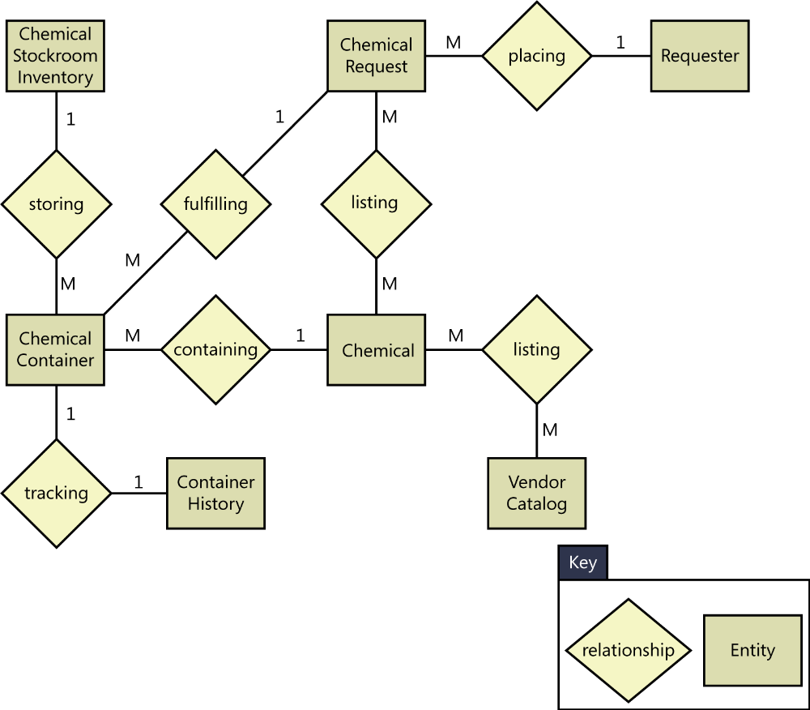
Modeling data relationships
The entities named Chemical Request, Vendor Catalog, and Chemical Stockroom Inventory appeared as data stores in the data flow diagram
Other entities represent actors who interact with the system (Requester), physical items that are part of the business operations (Chemical Container).
During physical database design of a relational database, entities normally become tables.

Slide 7
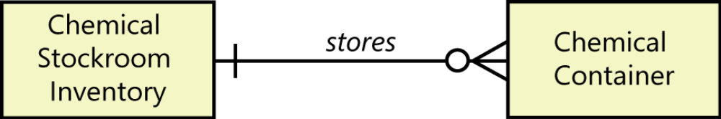
Modeling data relationships
Each entity is described by one or more attributes; individual instances of an entity will have different attribute values.
The diamonds in the ERD represent relationships, which identify the logical linkages between pairs of entities. Relationships are named in a way that describes the nature of the connection.
  For example, the relationship between the Chemical Request and the Requester is a placing relationship.
The cardinality, or multiplicity, of each relationship is shown with a number or letter on the lines that connect entities and relationships.
  Ex: Requester can place multiple requests, there’s a one-to-many relationship between Requester and Chemical Request.

Slide 8
The data dictionary
A data dictionary is a collection of detailed information about the data entities used in an application.
Collecting the information about composition, data types, allowed values, and the like into a shared resource identifies the data validation criteria, helps developers write programs correctly, and minimizes integration problems.
The data dictionary feeds into (góp phần) design in the form of database schemas, tables, and attributes, which ultimately lead to variable names in programs.
The time you invest in creating a data dictionary will be more than repaid by avoiding the mistakes that can result when project participants have different understandings of the data.
Maintaining a data dictionary is a serious investment in quality. Data definitions often are reusable across applications, particularly within a product line.
Notes:
- The time you invest in creating a data dictionary will be more than repaid by avoiding the mistakes that can result when project participants have different understandings of the data : Thời gian bạn đầu tư vào việc tạo một từ điển dữ liệu sẽ được trả nhiều hơn bằng cách tránh những sai lầm có thể xảy ra khi những người tham gia dự án có những cách hiểu khác nhau về dữ liệu.

Slide 9
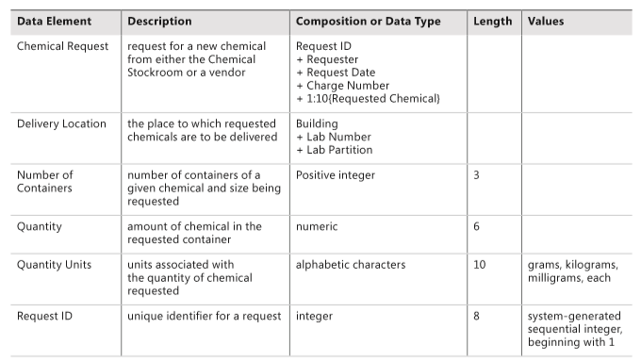
The data dictionary
Figure 13-4 illustrates a portion of the data dictionary for the Chemical Tracking System. Organize the entries in the data dictionary alphabetically to make it easy for readers to find what they need.

Slide 10
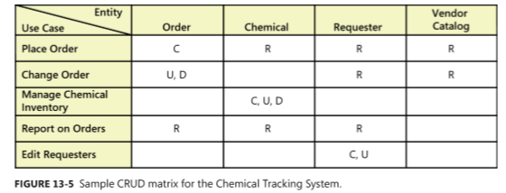
Data analysis
A CRUD matrix is a rigorous data analysis technique for detecting missing requirements.
CRUD stands for Create, Read, Update, and Delete. A CRUD matrix correlates (tương quan) system actions with data entities to show where and how each significant data entity is created, read, updated, and deleted.
EX:

Slide 11
Specifying reports
Many applications generate reports from one or more databases, files, or other information sources.
Reports can consist of traditional tabular presentations of rows and columns of data, charts and graphs of all types, or any combination.
Exploring the content and format of the reports needed is an important aspect of requirements development.
Report specification straddles (lưỡng lự) requirements (what information goes into the report and how it is organized) and design (what the report should look like).

Slide 12
Specifying reports
Eliciting reporting requirements: If you’re a BA working with customers on defining reporting requirements for an information system, consider asking questions like the following:
  What reports do you currently use? (Some reports from an existing system, or manually generated reports from the business, will need to be replicated in the new system.)
  Which existing reports need to be modified? (A new or revised information system project provides an opportunity to update reports that don’t fully meet current needs.)
  Which reports are currently generated but are not used? (Perhaps you don’t need to build those into the new system.)
  Can you describe any departmental, organizational, or government standards to which reports must conform, such as to provide a consistent look and feel or to comply with a regulation? (Obtain copies of those standards and examples of current reports that meet them.)

Slide 13
Specifying reports
Following are some questions to explore for each customer-requested report:
  What is the name of the report?
  What is the purpose or business intent of the report?
  Is the report generated manually? If so, how frequently and by which user classes?
  Is the report generated automatically? If so, how frequently and what are the triggering conditions or events?
  What are the typical and maximum sizes of the report?
  What is the disposition (bố trí) of the report after it is generated? Is it displayed on the screen, sent to a recipient, exported to a spreadsheet, or printed automatically? Is it stored or archived somewhere for future retrieval?
  Are there security, privacy, or management restrictions that limit the access of the report to specific individuals or user classes, or which restrict the data that can be included in the report depending on who is generating it? Identify any relevant business rules concerning security.

Slide 14
Specifying reports
The following questions will elicit information about the report itself:
  What are the sources of the data and the selection criteria for pulling data from the repository?
  What parameters are selectable by the user?
  What calculations or other data transformations are required?
  What are the criteria for sorting, page breaks, and totals?
  How should the system respond if no data is returned in response to a query when attempting to generate this report?
  Can this report be used as a template for a set of similar reports?
Notes:
- Should the underlying data of the report be made available to the user for ad hoc reporting?:

Slide 15
Specifying reports
Report specification considerations
  Consider other variations
  Find the data
  Anticipate growth
  Look for similarities
  Distinguish static and dynamic reports
  Prototype reports
A report specification template: page 255

Slide 16
Dashboard reporting
A dashboard is a screen display or printed report that uses multiple textual and/or graphical representations of data to provide a consolidated, multidimensional view of what is going on in an organization or a process.
Purpose
  pull together information about sales, expenses, key performance indicators (KPIs), and the like.
  Stock trading (giao dịch chứng khoán) applications display a bewildering (bối rối) (to the novice) array of charts and data that the skilled eye (con mắt nhà nghề) can scan and process at a glance (nháy mắt).
How to build:
  Determine what information the dashboard users need for making specific decisions or choices.
  Identify the sources of all the data to be presented so you can ensure that the application has access to those feeds (nguồn cấp dữ liệu) and you know whether they are static or dynamic.
  Choose the most appropriate type of display for each set of related data. Should it appear as a simple table of data, a modifiable spreadsheet containing formulas, blocks of text, bar chart, pie chart, line chart, video display, or one of many other ways to present information?
  Determine the optimal layout and relative sizing of the various displays in the dashboard, based on how the user will absorb and apply the information.

Slide 17
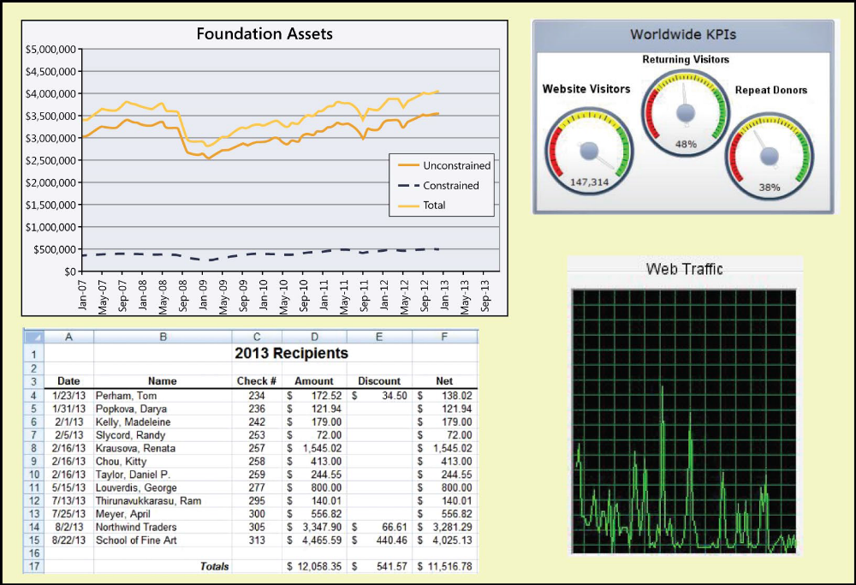
Dashboard reporting
Hypothetical reporting dashboard for a charitable foundation.

Slide 18
Review chapter 13
Chapter 13
Dada dictionary
Data analysis
Modeling data relationship
CRUD matrix
Specifying report
Dashboard reporting
ERD-Entities relationship diagram
Notes:
Backlog (n): phần công việc còn tồn đọng thưa chực hiện.
Product backlog: phần còn lại của dự án
Velocity (n): Tốc độ

Slide 19

Notes:
- pay-off (n): chi trả

