Slide 1
CHAPTER 14
Beyond functionality

Slide 2
Review chapter 13
Chapter 13 – Specifying Data requirements
Dada dictionary
Data analysis
Modeling data relationship
CRUD matrix
Specifying report
Dashboard reporting
ERD-Entities relationship diagram
Notes:
Backlog (n): phần công việc còn tồn đọng thưa chực hiện.
Product backlog: phần còn lại của dự án
Velocity (n): Tốc độ

Slide 3
Objectives
After finish this chapter, student could:
  detect and specify nonfunctional requirements.
  Understand the role of quality requirements in software development.

Slide 4
Contents
Software quality attributes.
Exploring quality attributes.
Defining quality requirements.
Specifying quality requirements with Planguage.
Quality attribute trade-offs (sự cân bằng).
Implementing quality attribute requirements.
Constraints.
Handling quality attributes on agile projects.

Slide 5
Beyond functionality
There’s more to software success than just delivering the right functionality. Users also have expectations, often unstated (thường ko nói ra), about how well the product will work.
Such expectations include how easy it is to use, how quickly it executes, how rarely it fails, how it handles unexpected conditions—and perhaps, how loud it is.
Such characteristics, collectively known as quality attributes, quality factors, quality requirements, quality of service requirements, constitute a major portion of the system’s nonfunctional requirements.
Notes:
- There’s more to software success than just delivering the right functionality. Users also have expectations, often unstated, about how well the product will work: Có nhiều thứ để thành công phần mềm hơn là chỉ cung cấp đúng chức năng. Người dùng cũng có những kỳ vọng, thường không được nói, về việc sản phẩm sẽ hoạt động tốt như thế nào.

Slide 6
Software quality attributes
External quality factors are primarily important to users, whereas internal qualities are more significant to development and maintenance staff.
Internal quality attributes indirectly contribute to customer satisfaction by making the product easier to enhance, correct, test, and migrate to new platforms.
Certain attributes are of particular importance on certain types of projects:
  Embedded systems: performance, efficiency, reliability, robustness, safety, security, usability,…
  Internet and corporate applications: availability, integrity, interoperability (khả năng tương tác), performance, scalability, security, usability,…
  Desktop and mobile systems: performance, security, usability,…

Slide 7
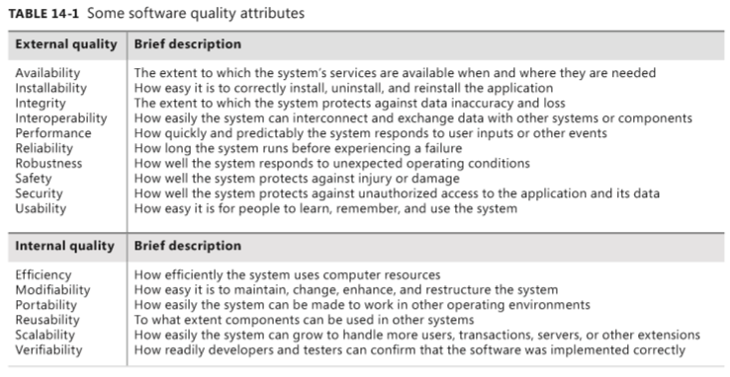
Software quality attributes
Notes:
How long the system runs before experiencing a failure.: hệ thống chạy trong bao lâu trước khi gặp sự cố.
How efficiently the system uses computer resources: Hệ thống sử dụng tài nguyên máy tính hiệu quả như thế nào:

Slide 8
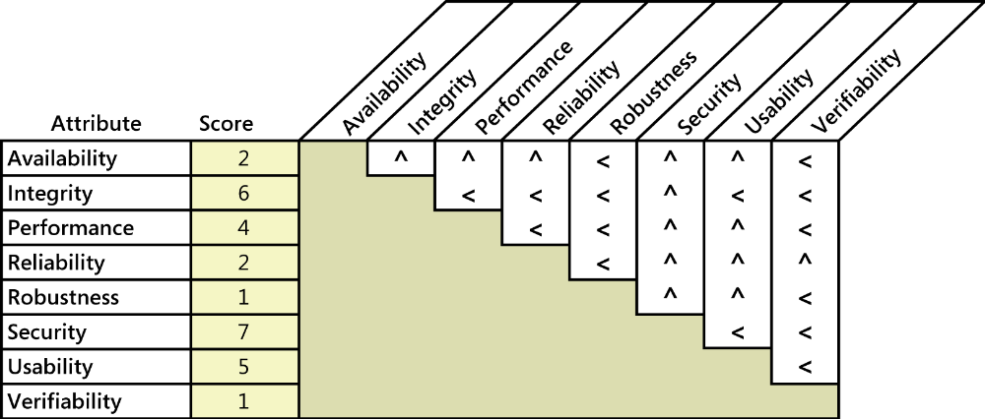
Exploring quality attributes
Different projects will demand different sets of quality attributes for success.
the following practical approach for identifying and specifying the most important attributes for your project (5 steps):
  Step 1: Start with a broad taxonomy: Begin with a rich set of quality attributes to consider, such as those listed in Table 14-1. This broad starting point reduces the likelihood (khả năng có thể xảy ra) of overlooking an important quality dimension.
a less-than sign (<) in the cell indicates that the attribute in the row is more important; a caret symbol (^) points to the attribute at the top of the column as being more important.
FIGURE 14-1 Sample quality attribute prioritization for an airport check-in kiosk.

Slide 9
Exploring quality attributes
  Step 2: Reduce the list
    Hold a meeting for cross-section of stakeholders to assess which of the attributes are likely to be important to the project.
    EX: An airport check-in kiosk needs to emphasize usability (because most users will encounter it infrequently) and security (because it has to handle payments).
  Step 3: Prioritize the attributes:
    Prioritizing the pertinent attributes sets the focus for future elicitation discussions.
    Pairwise ranking comparisons (so sánh xếp hạng theo cặp) can work efficiently with a small list of items like this.
  Step 4: Elicit specific expectations for each attribute:
    The comments users make during requirements elicitation supply some clues about the quality characteristics they have in mind for the product.
  Step 5: Specify well-structured quality requirements:
    When writing quality requirements, keep in mind the useful SMART mnemonic—make them Specific, Measurable, Attainable, Relevant, and Time-sensitive.
    Quality requirements need to be measurable to establish a precise agreement on expectations among the BA, the customers, and the development team.
Notes:
because most users will encounter it infrequently: bởi vì hầu hết người dùng sẽ gặp nó không thường xuyên.
Prioritizing the pertinent attributes sets the focus for future elicitation discussions : Ưu tiên các thuộc tính thích hợp đặt trọng tâm cho các cuộc thảo luận khơi gợi trong tương lai.

Slide 10
Defining quality requirements
External quality attributes:
  External quality attributes describe characteristics that are observed when the software is executing. They profoundly influence the user experience and the user’s perception of system quality. It includes Availability, Installability, Integrity, Interoperability, Performance, Reliability, Robustness, Safety, Security, Usability,
  Availability: Availability is a measure of the planned up time during which the system’s services are available for use and fully operational.
  Installability: Software is not useful until it is installed on the appropriate device or platform. Installability describes how easy is it to perform these operations correctly.
    Initial installation
    Recovery from an incomplete, incorrect, or user-aborted installation
    Reinstallation of the same version
    Installation of a new version
    Reverting to a previous version
    Installation of additional components or updates
    Uninstallation

Slide 11
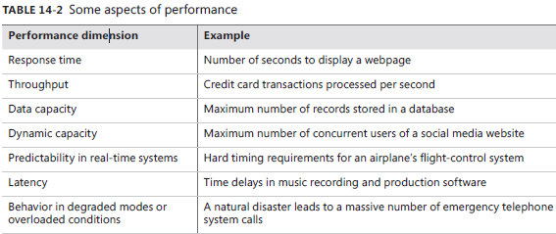
Defining quality requirements
External quality attributes:
  Integrity: Integrity deals with preventing information loss and preserving the correctness of data entered into the system. Integrity requirements have no tolerance (bao dung) for error: the data is either in good shape and protected, or it is not.
  Interoperability: Interoperability indicates how readily the system can exchange data and services with other software systems and how easily it can integrate with external hardware devices. To assess interoperability, you need to know which other applications the users will employ in conjunction with your product and what data they expect to exchange.
  Performance: Performance represents the responsiveness of the system to various user inquiries (yêu cầu) and actions, but it encompasses much more than that.
Notes:
- Integrity deals with preventing information loss and preserving the correctness of data entered into the system. Integrity requirements have no tolerance for error: the data is either in good shape and protected, or it is not. : Tính toàn vẹn liên quan đến việc ngăn ngừa mất thông tin và bảo vệ tính chính xác của dữ liệu được nhập vào hệ thống. Các yêu cầu về tính toàn vẹn không có bao dung cho lỗi: dữ liệu có dạng tốt và được bảo vệ hoặc không.

Slide 12
Defining quality requirements
External quality attributes:
  Reliability: The probability of the software executing without failure for a specific period of time is known as reliability. Reliability problems can occur because of improper inputs, errors in the software code itself, components that are not available when needed, and hardware failures.
  Robustness: Robustness is the degree to which a system continues to function properly when confronted with invalid inputs, defects in connected software or hardware components, external attack, or unexpected operating conditions. Robust software recovers gracefully (mềm mại) from problem situations and is forgiving of (bỏ qua) user mistakes.
  Safety: Safety requirements deal with the need to prevent a system from doing any injury (gây thương tích) to people or damage to property (tài sản). Safety requirements might be dictated by government regulations or other business rules, and legal or certification issues could be associated with satisfying such requirements. Safety requirements frequently are written in the form of conditions or actions the system must not allow to occur.

Slide 13
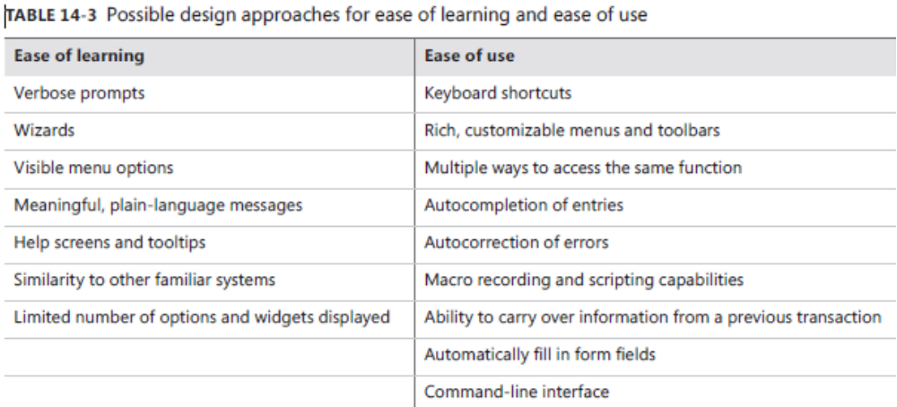
Defining quality requirements
External quality attributes:
  Security: Security deals with blocking unauthorized access to system functions or data, ensuring that the software is protected from malware attacks, and so on. Security is a major issue with Internet software. Users of e-commerce systems want their credit card information to be secure. Web surfers don’t want personal information or a record of the sites they visit to be used inappropriately. .
  Usability: Usability is often called as user-friendliness, ease of use, and human engineering. Usability
  measures the effort
  required to prepare
  input for a system,
  operate it, and
  interpret its outputs.

Slide 14
Defining quality requirements
Internal quality attributes
  Internal quality attributes are not directly observable during execution of the software. They are properties that a developer or maintainer perceives while looking at the design or code to modify it, reuse it, or move it to another platform.
  Some internal quality attributes: Efficiency, Modifiability, Portability, Reusability, Scalability, Verifiability.
  Efficiency: Efficiency is closely related to the external quality attribute of performance. Efficiency is a measure of how well the system utilizes processor capacity, disk space, memory, or communication bandwidth. If a system consumes too much of the available resources, users will encounter degraded (sụt giảm) performance.

Slide 15
Defining quality requirements
Internal quality attributes
  Modifiability: Modifiability addresses how easily the software designs and code can be understood, changed, and extended. Modifiability encompasses several other quality attribute terms that relate to different forms of software maintenance. If developers anticipate making many enhancements, they can choose design approaches that maximize the software’s modifiability.
  Portability: The effort needed to migrate software from one operating environment to another is a measure of portability. Portability has become increasingly important as applications must run in multiple environments, such as Windows, Mac, and Linux; iOS and Android; and PCs, tablets, and phones. Data portability requirements are also important.
  Reusability: Reusability indicates the relative effort required to convert a software component for use in other applications. Reusable software must be modular, well documented, independent of a specific application and operating environment,... Numerous project artifacts offer the potential for reuse, including requirements, architectures, designs, code, tests, business rules, data models, user class descriptions, stakeholder profiles, and glossary terms.

Slide 16
Defining quality requirements
Internal quality attributes
  Scalability: Scalability requirements address the ability of the application to grow to accommodate (phù hợp với) more users, data, servers, geographic locations, transactions, network traffic, searches, and other services without compromising (ko ảnh hưởng) performance or correctness. Scalability has both hardware and software implications.
  Verifiability: Verifiability refers to how well software components or the integrated product can be evaluated to demonstrate whether the system functions as expected. Systems with high verifiability can be tested both effectively (hiệu quả công việc) and efficiently (hiệu quả về kinh tế). Designing software for verifiability means making it easy to place the software into the desired pretest state, to provide the necessary test data, and to observe the result of the test.
Notes:
1. Effective là tính hiệu quả của một việc bạn làm, ta hiểu đơn giản là kết quả của việc bạn làm là đúng như mong đợi của bạn.
2. Efficient là hiệu quả về mặt kinh tế, sử dụng năng lượng hoặc thời gian. Ví dụ như khi nói về "dự án hiệu quả về kinh tế" thì phải dùng efficient.

Slide 17
Specifying quality requirements with Planguage
Definition: Planguage, a language with a rich set of keywords that permits precise statements of quality attributes and other project goals (Simmons 2001).
Purpose: address the problem of ambiguous and incomplete nonfunctional requirements.
Example: “At least 95 percent of the time, the system shall take no more than 8 seconds to display any of the predefined accounting reports.”
Notes:
At least 95 percent of the time, the system shall take no more than 8 seconds to display any of the predefined accounting reports: Ít nhất 95 phần trăm thời gian, hệ thống sẽ mất không quá 8 giây để hiển thị bất kỳ báo cáo kế toán được xác định trước nào.

Slide 18
Specifying quality requirements with Planguage
TAG Performance.Report.ResponseTime
AMBITION Fast response time to generate accounting reports on the base user platform.
SCALE (thang đo) Seconds of elapsed time (trôi qua) between pressing the Enter key or clicking OK to request a report and the beginning of the display of the report.
METER (dụng cụ đo) Stopwatch (đồng hồ bấm giờ) testing performed on 30 test reports that represent a defined usage operational profile for a field office accountant.
GOAL No more than 8 seconds for 95 percent of reports. ← Field Office Manager
STRETCH (tính co dãn) No more than 2 seconds for predefined reports, 5 seconds for all reports.
WISH No more than 1.5 seconds for all reports.
Base user platform DEFINED Quad-core processor, 8GB RAM, Windows 8, QueryGen 3.3 running, single user, at least 50 percent of system RAM and 70 percent of system CPU capacity free, network connection speed of at least 30 Mbps.
Notes:
Metter (n): dụng cụ đo
Scale (n): Thước chia độ
Stretch (n): tính co dãn

Slide 19
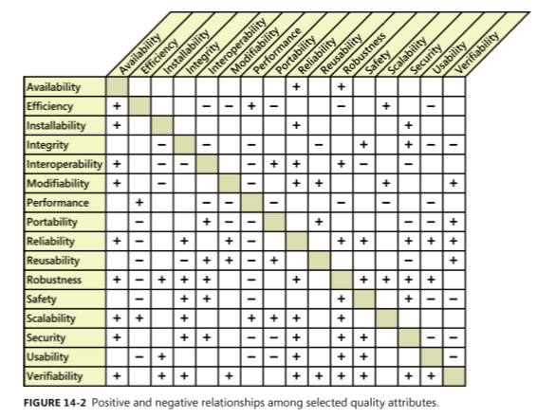
Quality attribute trade-offs
Certain attribute combinations have inescapable trade-offs.
Users and developers must decide which attributes are more important than others, and they must respect those priorities when they make decisions.
A plus sign in a cell indicates that increasing the attribute in the corresponding row usually has a positive effect on (tác động tích cực lên) the attribute in the column.
A minus sign in a cell means that increasing the attribute in that row generally adversely (bất lợi) affects the attribute in the column.
An empty cell indicates that the attribute in the row has little effect on the attribute in the column.
Notes:
- Certain attribute combinations have inescapable trade-offs. : Một số kết hợp thuộc tính nhất định có những yếu tố cần cân bằng không thể bỏ qua.

Slide 20
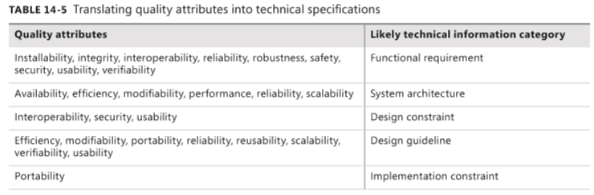
Implementing quality attribute requirements
Designers and programmers will have to determine the best way to satisfy each quality requirement.
Although these are nonfunctional requirements, they can lead to derived functional requirements, design guidelines, or other types of technical information that will produce the desired product characteristics.
This translation from external or internal quality requirements into corresponding technical information is part of the requirements analysis and high-level design processes.

Slide 21
Constraints
Definition: A constraint places restrictions on the design or implementation choices available to the developer.
Purpose:
  Constraints can be imposed by external stakeholders, by other systems that interact with the one you’re building or maintaining, or by other life cycle activities for your system, such as transition and maintenance.
  Other constraints result from existing agreements, management decisions, and technical decisions (ISO/IEC/IEEE 2011).
Sources of constraints:
  Specific technologies, tools, languages, and databases that must be used or avoided.
  Restrictions because of the product’s operating environment or platform, such as the types and versions of web browsers or operating systems that will be used.
  Required development conventions or standards. (For instance, if the customer’s organization will be maintaining the software, the organization might specify design notations and coding standards that a subcontractor must follow.)
  Backward compatibility (tương thích ngược) with earlier products and potential forward compatibility, such as knowing which version of the software was used to create a specific data file.

Slide 22
Constraints
Sources of constraints:
  Limitations or compliance requirements imposed by regulations or other business rules.
  Hardware limitations such as timing requirements, memory or processor restrictions, size, weight, materials, or cost.
  Physical restrictions because of the operating environment or because of characteristics or limitations of the users.
  Existing interface conventions to be followed when enhancing an existing product.
  Interfaces to other existing systems, such as data formats and communication protocols.
  Restrictions because of the size of the display, as when running on a tablet or phone.
  Standard data interchange formats used, such as XML, or RosettaNet for e-business.

Slide 23
Constraints
Example
  CON-1. The user clicks at the top of the project list to change the sort sequence. [specific user interface control imposed as a design constraint on a functional requirement]
  CON-2. Only open source software available under the GNU General Public License may be used to implement the product. [implementation constraint]
  CON-3. The application must use Microsoft .NET framework 4.5. [architecture constraint]
  CON-4. ATMs contain only $20 bills. [physical constraint]
  CON-5. Online payments may be made only through PayPal. [design constraint] CON-6. All textual data used by the application shall be stored in the form of XML files. [data constraint]
Notes:
- Hệ điều hành GNU

Slide 24
Handling quality attributes on agile projects
It can be difficult and expensive to retrofit (trang bị thêm) desired quality characteristics into a product late in development or after delivery.
That’s why even (đó là lý do tại sao ngay cả) agile projects that develop requirements and deliver functionality in small increments need to specify significant quality attributes and constraints early in the project.
This allows developers to make appropriate architectural and design decisions as a foundation for the desired quality characteristics.
Nonfunctional requirements need to have priority alongside (dọc theo) user stories; you can’t defer their implementation until a later iteration.
The quality requirements can span multiple stories and multiple iterations.
Example:
  “As a help desk technician, I want the knowledge base (cơ sở kiến thức) to respond to queries within five seconds so the customer doesn’t get frustrated and hang up (cúp máy).”
  “As an account owner, I want to prevent unauthorized users from accessing my account so I don’t lose any money.”

Slide 25
Review chapter 13
Chapter 14 – Beyond functionality
External quality attributes
Internal quality attributes
Software quality attributes
Efficiency
Quality Req. with Planguage
Tag
External quality
Internal quality
Availability,
Installability
Integrity
Interoperability
Performance
Reliability
Robustness
Safety
Security
Usability
Modifiability
Portability
Reusability
Scalability
Verifiability
Ambition
Scale
Meter
Goal
Tretch
…
Quality attribute trade-offs
Constraints
quality attributes on agile projects

Slide 26

Notes:
- pay-off (n): chi trả

