Slide 1
CHAPTER 18
Requirements reuse

Slide 2
Review chapter 17
Chapter 17 – Validating the requirements
Review the reqs.
Why validate the reqs.
Informal reviews
Formal reviews
Testing reqs.
Validating with…
Verification
Validation
A peer deskcheck
A passaround
A walkthrough
The inspection process
Defect checklist
Reqs. review tips
Reqs. review challenges
Acceptance criteria
Acceptance tests

Slide 3
Objectives
Describes several kinds of requirements reuse, identifies some classes of requirements information that have reuse potential in various contexts, and offers suggestions about how to perform requirements reuse.
It presents some issues around making requirements reusable.
Concluding with both barriers to effective reuse and success factors that can help organization better take advantage of its existing body of requirements knowledge.

Slide 4
Contents
Why reuse requirements?
Dimensions of requirements reuse.
Types of requirements information to reuse.
Common reuse scenarios.
Requirement patterns.
Tools to facilitate reuse.
Making requirements reusable.
Requirements reuse barriers and success factors.

Slide 5
Why reuse requirements?
Faster delivery, lower development costs, consistency both within and across applications, higher team productivity, fewer defects, and reduced rework.
Reusing trusted requirements can save review time, accelerate the approval cycle, and speed up other project activities, such as testing.
Reuse can improve your ability to estimate implementation effort if you have data available from implementing the same requirements on a previous project.
From the user’s perspective, requirements reuse can improve functional consistency across related members of a product line or among a set of business applications.
Even if the implementation varies in different environments, the requirements might be the same.

Slide 6
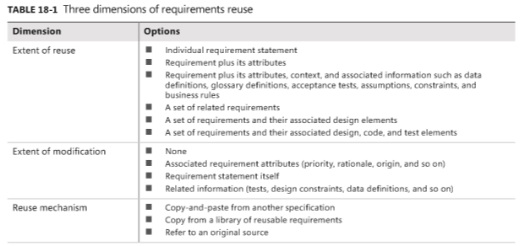
Dimensions of requirements reuse
Mức độ sử dụng lại
Mức độ thay đổi
Cơ chế sử dụng lại
Notes:
extent of reuse: Mức độ tái sử dụng

Slide 7
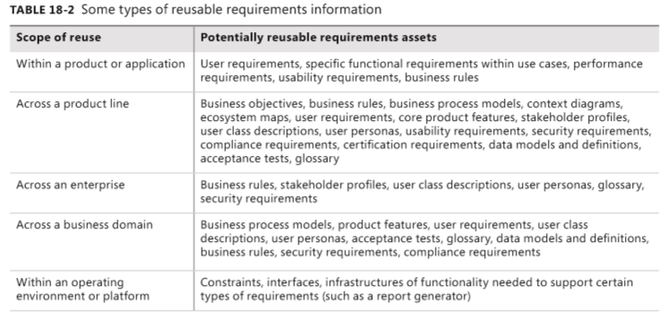
Types of requirements information to reuse
Trên 1 dòng sản phẩm

Slide 8
Common reuse scenarios
Let’s look at some scenarios where requirements reuse offers good potential.
Software product lines: Anytime you’re creating a set of products in a family—a software product line—those products will have a lot of functionality in common. Sometimes you’re producing variations (biến thể) of a base product for different customers or markets.
Reengineered and replacement systems: Reengineered and replacement systems always reuse some requirements from the original incarnation (hóa thân), even if those “requirements” were never written down. Often, you can harvest (thu hoạch) business rules that were embedded in an old system and reuse them on future projects, updating them as necessary.
Other likely reuse opportunities: Table 18-3 (next slide) lists several other situations in which reusing requirements information is common. If you previously worked on a project similar to the current one, consider whether you can use any artifacts from the earlier project again.

Slide 9
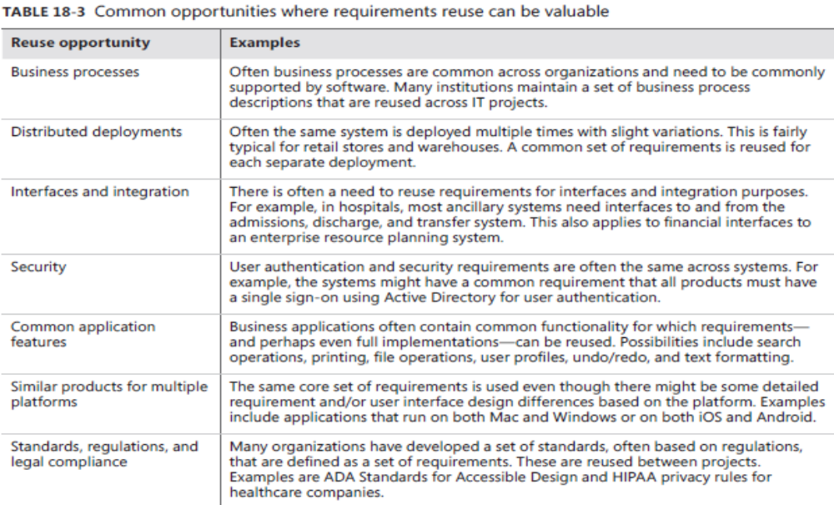
Common reuse scenarios
Notes:
slight variations: biến thể nhẹ
Ancillary (adj): lệ thuộc, phụ thuộc
Admission (n): Tiếp nhận bệnh
Discharge (n): Cho xuất viện
Transfer (n): chuyển viện

Slide 10
Requirement patterns
A requirement pattern offers a systematic approach to specifying a particular type of requirement.
A pattern defines a template with categories of information for each of the common types of requirements a project might encounter.
A requirement pattern contains several sections:
  Guidance: Basic details about the pattern, including related patterns, situations to which it is (and is not) applicable, and a discussion of how to approach writing a requirement of this type.
  Content: A detailed explanation of the content that such a requirement ought to (nên) convey, item by item.
  Template: A requirement definition with placeholders wherever variable pieces of information need to go.
  Examples: One or more illustrative requirements of this type.
  Extra requirements: Additional requirements that can define certain aspects of the topic, or an explanation of how to write a set of detailed requirements.
  Considerations for development and testing: Factors for developers to keep in mind when implementing a requirement of the type specified by the pattern, and factors for testers to keep in mind when testing such requirements.

Slide 11
Requirements reuse barriers and success factors
Reuse barriers
  Missing or poor requirements: A common barrier is that the requirements developed on previous projects weren’t documented, so it’s impossible to reuse them. And even if you find a relevant requirement, it might be badly written, incomplete, or a poor fit for your present circumstances.
  NIH and NAH: Two barriers to reuse are NIH and NAH syndromes (hội chứng). NIH means “not invented here.” Some people are reluctant to reuse requirements from another organization or generic requirements found in a public collection. NAH, or “not applicable here,” when practitioners protest that a new process or approach does not apply to their project or organization.
  Writing style: Requirements written in natural language are ambiguities, missing information, and hidden assumptions. Requirements that have embedded design constraints will offer little opportunity for reuse in a different environment. These issues reduce their reuse potential.
  Inconsistent organization: It can be difficult to find requirements to reuse because authors organize their requirements in many different ways: by project, process flow, business unit, product feature, category, subsystem or component, and so forth.
  Project type: Requirements that are tightly coupled (gắn chặt) to specific implementation environments or platforms are less likely (ít có khả năng) to generate reusable requirements or to benefit from an existing pool of requirements knowledge.
  Ownership: If you’re developing a software product for a specific customer, its requirements are likely the proprietary intellectual property of the customer.

Slide 12
Requirements reuse barriers and success factors
Reuse success factors
  Repository: You can’t reuse something if you can’t find it. A collection of requirements stored in a requirements management tool that can be searched across projects.
  Quality: No one wants to reuse junk (tạm nham). Potential reusers need confidence in the quality of the information.
  Interactions: Requirements often have logical links or dependencies on each other. Reused requirements must conform to existing business rules, constraints, standards, interfaces, and quality expectations.
  Terminology: Establishing common terminology and definitions across your projects will be helpful for reusability. Terminology variations won’t prevent you from reusing requirements.
  Organizational culture: The individuals, project teams, and organizations that practice reuse most effectively are likely to enjoy (có khả năng tận hưởng) the highest productivity. In a reuse culture, BAs look at the reusable requirements repository before creating their own requirements.

Slide 13
Review chapter 18
Chapter 18 – Requirements reuse
Common reuse scenarios
Requirements reuse.
SW product lines
Requirement patterns
Why reuse reqs.?
Dimension of reqs. Reuse
Reqs. Reuse
Types of reqs. Reuse
Reengineered and replacement systems
Other likely reuse opportunities
Guidance
Content
Template
Examples
Extra reqs.
Barriers factors
Success factors
Extent of reuse
Extent of modi.
Reuse mechanism
Within a product
Across a product lines
Across a biz domain
Within a platform

Slide 14

Notes:
- pay-off (n): chi trả

