Slide 1
CHAPTER 19
Beyond requirements development

Slide 2
Review chapter 18
Chapter 18 – Requirements reuse
Common reuse scenarios
Requirements reuse.
SW product lines
Requirement patterns
Why reuse reqs.?
Dimension of reqs. Reuse
Reqs. Reuse
Types of reqs. Reuse
Reengineered and replacement systems
Other likely reuse opportunities
Guidance
Content
Template
Examples
Extra reqs.
Barriers factors
Success factors
Extent of reuse
Extent of modi.
Reuse mechanism
Within a product
Across a product lines
Across a biz domain
Within a platform

Slide 3
Objectives
Exploring some approaches for bridging (thu hẹp) the gap between requirements development and a successful product release.
Student should understand the influence of requirements on project plans, designs, code, and test.

Slide 4
Contents
The effects of requirements on software development.
Estimating requirements effort.
From requirements to project plans.
From requirements to designs and code.
From requirements to tests.
From requirements to success.

Slide 5
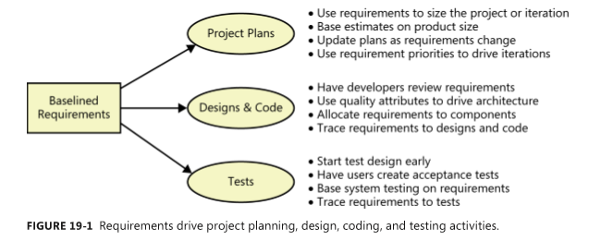
The effects of requirements on software development
We’ll look at several ways in which requirements influence project plans, designs, code, and tests, as shown in Figure 19-1.

Slide 6
Estimating requirements effort
One of the earliest project planning activities is to judge how much of the project’s schedule and effort should be devoted to requirements activities.
Requirements engineering activity is distributed throughout the project in different ways, depending on whether the project is following a sequential (waterfall), iterative, or incremental development life cycle (Agile projects).
Small projects typically spend 15 to 18 percent of their total effort on requirements work (Wiegers 1996), but the appropriate percentage depends on the size and complexity of the project.
Despite the fear (mặc dù lo sợ) that exploring requirements will slow down a project, considerable evidence shows that taking time to understand the requirements actually accelerates development.

Slide 7
From requirements to project plans
Because requirements are the foundation for the project’s intended work, you should base (bố trí) estimates, project plans, and schedules on those requirements. Remember, the most important project outcome is a system that meets its business objectives.
Estimating project size and effort from requirements: some frequently used metrics as follows:
  The number of individually testable requirements (Wilson 1995)
  Function points (Jones 1996b; IFPUG 2010)
  Story points (Cohn 2005; McConnell 2006) or use case points (Wiegers 2006)
  The number, type, and complexity of user interface elements
  Estimated lines of code needed to implement specific requirements
Requirements and scheduling: Effective project scheduling requires the following elements:
  Estimated product size.
  Known productivity of the development team, based on historical performance.
  A list of the tasks needed to completely implement and verify a feature or use case.
  Reasonably stable requirements, at least for the forthcoming (sắp tới) development iteration.
  Experience, which helps the project manager adjust for intangible factors (các yếu tố vô hình) and the unique aspects (khía cạnh độc đáo) of each project.
Notes:
Reasonably stable requirements, at least for the forthcoming development iteration: Yêu cầu hợp lý ổn định, ít nhất là cho lần lặp phát triển sắp tới.
Experience, which helps the project manager adjust for intangible factors and the unique aspects of each project.: Kinh nghiệm, giúp người quản lý dự án điều chỉnh các yếu tố vô hình và các khía cạnh độc đáo của mỗi dự án.

Slide 8
From requirements to designs and code
The boundary between requirements and design is not a sharp line (sắc nét) but a gray, fuzzy area. Try to avoid inadvertent (cẩu thả) design, needless (vô ích) or unintended restrictions on the design. Include designers in requirements reviews to make sure the requirements can serve as a solid foundation for design.
Architecture and allocation:
  Architecture is especially critical for systems that include both software and hardware components and for complex software-only systems.
  An essential step is to allocate the high-level system requirements to the various subsystems and components. An analyst, system engineer, or architect decomposes the system requirements into functional requirements for both software and hardware subsystems.
  Allocation of system capabilities to subsystems and components must be done from the top down.

Slide 9
From requirements to designs and code
Software design:
  A variety of software designs will satisfy most products’ requirements. These designs will vary in (khác nhau về) their performance, efficiency, robustness, and the technical methods employed. If you leap directly from requirements into code, you’re essentially designing the software mentally and on the fly (chủ quan và nhanh chóng hời hợt).
  The time you spend translating requirements into designs is an excellent investment in building high-quality, robust products.
  You needn’t develop a complete, detailed design for the entire product before you begin implementation, but you should design each component before you code it.
User interface design:
  User interface design is an extensively studied domain that goes well beyond the scope of this book.
  A display-action-response (DAR) model is a useful tool for documenting the UI elements that appear in screens and how the system responds to user actions.
  Example in the next slide.

Slide 10

From requirements to designs and code
FIGURE 19-4 High-fidelity webpage design.

Slide 11
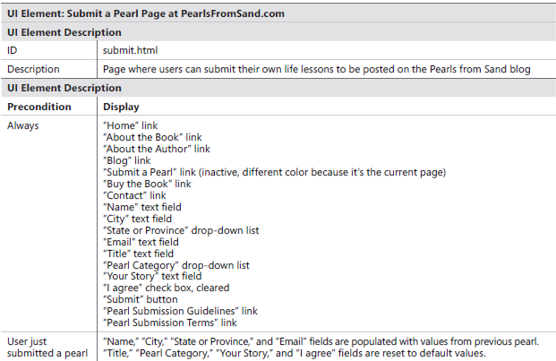
From requirements to designs and code

Slide 12
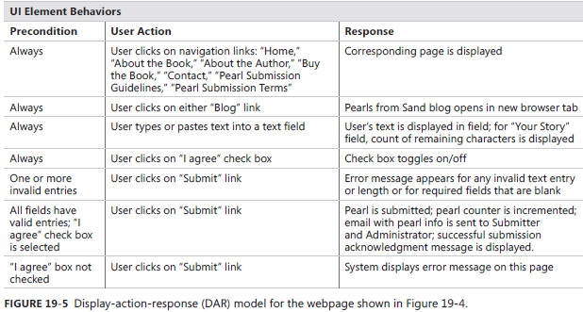
From requirements to designs and code

Slide 13
From requirements to tests
From requirements to tests:
  Requirements analysis and testing fit together beautifully.
  As consultant Dorothy Graham (2002) points out, “Good requirements engineering produces better tests; good test analysis produces better requirements.”
  Agile development teams typically write acceptance tests in lieu of (thay cho) precise requirements (Cohn 2004).
  The testers or quality assurance staff should determine how they’d verify the implementation of each requirement. Possible methods include:
    Testing (executing the software to look for defects).
    Inspection (examining the code to ensure that it satisfies the requirements).
    Demonstration (showing that the product works as expected).
    Analysis (reasoning through (lập luận thông qua) how the system should work under certain circumstances).

Slide 14
From requirements to success
From requirements to success:
  A more successful team had a practice of listing all the requirements that were planned for a specific release.
  The project’s quality assurance group evaluated each release by executing the tests for those requirements.
  A requirement that didn’t satisfy its test criteria was counted as a defect.
  The QA group rejected the release if more than a predetermined number of requirements weren’t met or if specific high-impact requirements weren’t satisfied.
  This project was successful largely because it used its documented requirements to decide when a release was shippable (sẵn sàng bàn giao).
  The ultimate deliverable from a software development project is a solution that meets the customers’ needs and expectations.
  Requirements are an essential step on the path from business need to satisfied customers.

Slide 15
Review chapter 19
Chapter 19 – Beyond requirements development
Estimating reqs. effort
The effects of reqs. on
SW dev.
Time/Schedule estimation
From reqs. to
project plans
Project plans
Designs & code
Tests
Effort estimation
15 to 18 percent of their total effort
Estimating project size and effort
Requirements and scheduling
From reqs. to
designs and code
Architecture and allocation
Software design
User interface design
From reqs. to
tests
From reqs. to
success

Slide 16

Notes:
- pay-off (n): chi trả

