Slide 1
CHAPTER 5
Establishing the business requirements

Slide 2
Review chapter 4
Chapter 4
BA tasks
BA skills
BA roles
Define biz req.
14 skills
The making of a BA
Former user
Req. Mgt.
Req. Development
Former dev./tester
Former PM
Former SME
Plan the reqs approach
Identify project stakeholders and user classes
Req. dev.
Manage requirements
Rookie
Notes:
Backlog (n): phần công việc còn tồn đọng thưa chực hiện.
Product backlog: phần còn lại của dự án
Velocity (n): Tốc độ

Slide 3
Objectives
Understanding the business requirements and how to define them.
Student should enhance the structure of vision and scope document, a deliverable that contains the project’s business requirements.
Student could write the vision and scope about project through using vision statement and scope representation techniques.
Understanding the vision and scope on agile project.

Slide 4
Contents
Business requirements
  Identifying desired business benefits
  Business objectives and opportunities
Scope representation techniques
  Context diagram
  Ecosystem map
  Feature tree
  Event list
Keeping the scope in focus
Vision and scope on agile project

Slide 5
Business requirements
“Biz requirements” refers to a set of information that describes a need that leads to one or more projects to deliver a solution and the desired ultimate biz outcomes. Biz opportunities, biz objectives, success metrics, and a vision statement make up the biz requirements.
Biz requirements issues must be resolved before the functional and nonfunctional requirements can be fully specified. A statement of the project’s scope and limitations helps greatly with discussions of proposed features and target releases.
Notes:
Aggregate (n): tập hợp lại / gộp chung lại

Slide 6
Business requirements
Identifying desired business benefits:
  Organizations should not initiate any project without a clear understanding of the value it will add to the biz. Set measurable targets (mục tiêu đo đếm được) with biz objectives, and then define success metrics (tham số) that allow you to measure whether you are on track to meet those activities.
  Biz requirements might come from funding sponsors, corporate executives, marketing managers, or product visionaries. However, it can be challenging to identify and communicate (truyền đạt) the biz benefits. Sometimes, sponsors don’t want to set objectives for the projects.
  The biz benefit has to represent a true value for the project’s sponsors and to the product’s customers. For EX, when merging 2 systems into one, the customers don’t care about 1, 5 or 10 systems, they just care about increasing revenue and decreasing costs.
Notes:
The biz benefit has to represent a true value for the project’s sponsors and to the product’s customers: Lợi ích kinh doanh phải thể hiện một giá trị đích thực cho các nhà tài trợ dự án và cho các khách hàng của sản phẩm.

Slide 7
Business requirements
Product vision and project scope:
  Product vision succinctly (súc tích) describes the ultimate product that will achieve the biz objectives. The vision describes what the product is about and what it ultimately could become.
  Project scope identifies what portion of the ultimately product vision the current project or development iteration will address. The statement of scope draws the boundary between what’s in and what’s out for the project.
  Scope for the current release should be clear, but the scope for the future releases will be fuzzier.
Notes:
Succinctly (adv): 1 cách súc tích
Project scope identifies what portion of the ultimately product vision the current project or development iteration will address: Phạm vi dự án xác định phần nào của tầm nhìn sản phẩm cuối cùng mà dự án hiện tại hoặc phần lặp tiếp theo của dự án sẽ giải quyết.

Slide 8
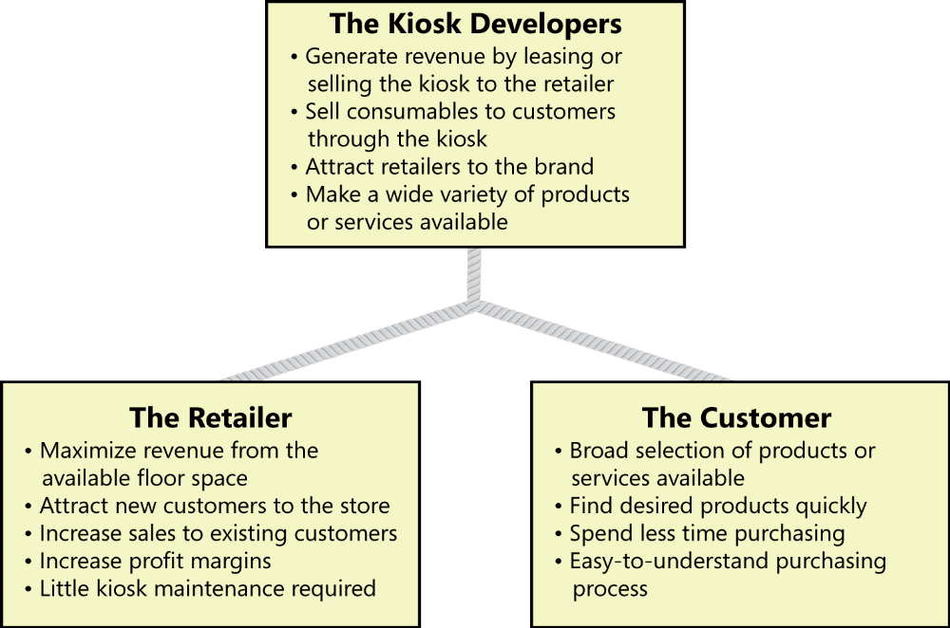
Conflicting business requirements
This picture shows you the conflicts between other stakeholders.
EX: The customer wants to spend less time purchasing goods and services, but the retailer would prefer to have customers linger in the store and spend more money.

Slide 9

Conflicting business requirements
Conflicting business requirements:
  In figure 5-2, both kiosk developers and the customers want to have a wide variety of products and services available through the kiosk. However, some biz objectives could conflict. The customers want to spend less time purchasing goods and services, but the retailer would prefer to have customers linger in the store and spend more money.
  The project’s decision makers must resolve these conflicts before the analyst can detail the kiosk’s requirements.
Notes:
Linger (v): nán lại, chần chừ

Slide 10
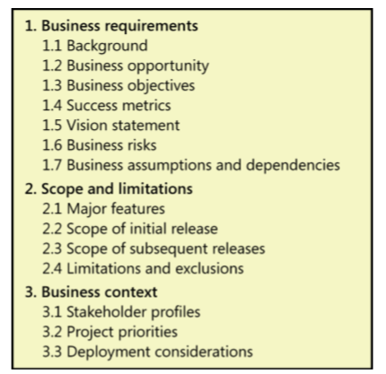
Vision and scope document
The owner of the vision and scope document is the project’s executive sponsor, funding authority, or someone in a similar role.
BA can works with this individual to articulate the biz requirements and write the vision and scope document.
Notes:
Articulate (v): nối khớp với, khớp lại với nhau

Slide 11
Explanations: Biz requirements
Background:
  Summarize the rationale (lý do cơ bản) and context for the new product or for changes to be made to an existing one. Describe the history or situation that leads to the decision to build this product.
Biz opportunities:
  For a commercial product, describe the biz opportunity that exists and the market in which the product will be competing. This section could include a comparative evaluation of existing products, indicating why the proposed product is attractive and the advantages it provides.
  Describe the needs of typical customers (KH tiêu biểu) or of the target market.
Notes:
Summarize the rationale and context for the new product or for changes to be made to an existing one. Describe the history or situation that leads to the decision to build this product.: Tóm tắt lý do và bối cảnh cho sản phẩm mới hoặc để thay đổi được thực hiện cho sản phẩm hiện có. Mô tả lịch sử hoặc tình huống dẫn đến quyết định xây dựng sản phẩm này.

Slide 12
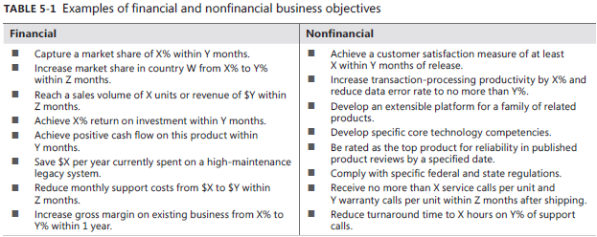
Explanations: Biz requirements
Biz objectives:
  Organizations generally undertake a project to solve a problem or exploit an opportunity.
  Given a set of objectives, ask: “What is keeping us from achieving the goal?” to identify a more detailed biz problem. Or work backward by asking “Why do we care about that goal?” to better understand to the top-level biz problem or opportunity.
Notes:
Return on investment: Hoàn lại vốn đầu tư.
Develop an extensible platform for a family of related products: Phát triển một nền tảng mở rộng cho một gia đình các sản phẩm liên quan.
Reduce turnaround time to X hours on Y% of support calls: Giảm thời gian quay vòng xuống X giờ trên Y% của các cuộc gọi hỗ trợ.
What is keeping us from achieving the goal? Điều gì khiến chúng ta không đạt được mục tiêu?
Keep someone from: giữ cho ai khỏi.

Slide 13
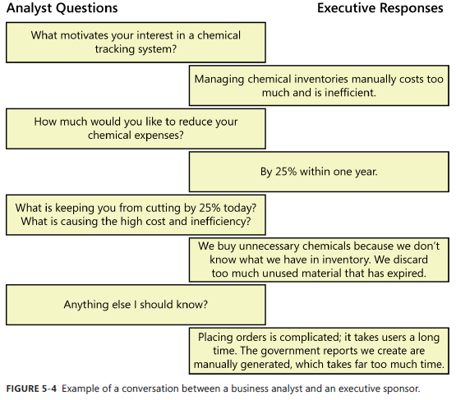
Explanations: Biz requirements
Analyst questions:

Slide 14
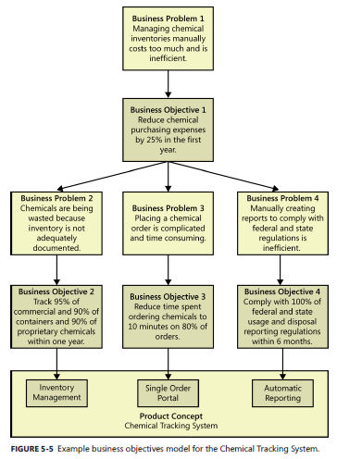
Explanations: Biz requirements
Success metrics (tham số):
  Specify the indicators that stakeholders will use to define and measure success on this project. Identify the factors that have the greatest impact on achieving that success, including factors both within and outside the organization’s control.
Notes:
Track 95% of commercial and 90% of containers and 90% of proprietary chemicals within one year:Theo dõi 95% hóa chất thương mại và 90% thùng đựng hóa chất và 90% hóa chất độc quyền trong vòng một năm.

Slide 15
Explanations: Biz requirements
Vision statement:
  Write a concise vision statement that summarizes the long-term purpose and intent of the product.
  The following keyword template works well for crafting product vision statement:
    For [target customer]
    Who [statement of the need or opportunity]
    The [product name]
    Is [product category]
    That [major capabilities, key benefit,…]
    Unlike [primary competitive alternative, current system, current biz process]
    Our product [statement of primary differentiation and advantages of new product]
For scientists who need to request containers of chemicals, the Chemical Tracking System is an information system that provide a single point of access to the chemical stockroom and to vendors. The system will store the location of every chemical container within the company, the quality of material remaining in it, and the complete history of each container’s locations and usage. Unlike the current manual ordering processes, our product will generate all reports required to comply with federal and state government regulations that require the reporting of chemical usage, storage, and disposal.
Notes:
Đối với các nhà khoa học cần yêu cầu các thùng chứa hóa chất, Hệ thống theo dõi hóa học là một hệ thống thông tin sẽ cung cấp một điểm truy cập duy nhất vào kho hóa chất và cho các nhà cung cấp. Hệ thống sẽ lưu trữ vị trí của mọi thùng chứa hóa chất trong công ty, số lượng vật liệu còn lại trong đó và lịch sử đầy đủ của từng vị trí và cách sử dụng của container. Hệ thống này sẽ tiết kiệm cho công ty 25% chi phí hóa chất trong năm đầu tiên sử dụng bằng cách cho phép công ty khai thác triệt để các hóa chất đã có sẵn trong công ty, loại bỏ các container ít sử dụng hoặc hết hạn và sử dụng quy trình mua hóa chất tiêu chuẩn. Không giống như các quy trình đặt hàng thủ công hiện tại, sản phẩm của chúng tôi sẽ tạo ra tất cả các báo cáo cần thiết để tuân thủ các quy định của chính phủ liên bang và tiểu bang yêu cầu báo cáo về việc sử dụng, lưu trữ và xử lý hóa chất

Slide 16
Explanations: Biz requirements
Biz risks:
  Summarize the major biz risks associated with developing the product. Risk categories include marketplace competition, timing issues, user acceptance, implementation issues, and possible negative impacts on the biz.
Biz assumptions and dependencies:
  An assumption (giả định) is statement that is believed to be true in the absence of proof or definitive (đáng tin) knowledge. If you learn that certain assumptions are wrong, you might have to change scope, adjust the schedule or launch other projects to achieve the objectives.
  Record any major dependencies (phụ thuộc) the projects has on external factors. Examples are pending industry standards or government regulations, deliverables from other projects, third-party suppliers, or development partners.
Notes:
An assumption is statement that is believed to be true in the absence of proof or definitive knowledge: Một giả định là tuyên bố được cho là đúng trong trường hợp không có bằng chứng hoặc kiến thức đáng tin cậy.
Record any major dependencies the projects has on external factors. Examples are pending industry standards or government regulations, deliverables from other projects, third-party suppliers, or development partners.:

Slide 17
Explanations: Scope and limitations
Major features (chức năng chính):
  List the product’s major features or user capabilities, emphasizing those that distinguish it from previous or competing products. Think about how users will use these features to ensure that the list is complete.
Scope of initial release:
  To focus the development effort and maintain a reasonable project schedule, avoid the temptation (cám dỗ) to include every feature that any potential customer might eventually want in release 1.0. Version 1 don’t have to be fast, pretty, or easy to use, but it has to be reliable (đáng tin cậy).
Notes:
Bloatware (n): phần mềm có nhiều chức năng dư thừa
To focus the development effort and maintain a reasonable project schedule, avoid the temptation to include every feature that any potential customer might eventually want in release 1.0.: Để tập trung nỗ lực phát triển và duy trì lịch trình dự án hợp lý, tránh sự cám dỗ bao gồm mọi tính năng mà bất kỳ khách hàng tiềm năng nào cuối cùng cũng có thể muốn trong phiên bản 1.0.

Slide 18
Explanations: Scope and limitations
Scope of subsequent releases:
  If you envision a staged evolution of the product, or if you are following an iterative or incremental life cycle, build a release roadmap that indicates which functionality chunks (các khối chức năng) will be deferred (trì hoãn) and the desired timing of later release.
  Subsequent releases let you implement additional use cases and features, as well as enriching (làm phong phú) the capabilities of the initial ones.
Limitations and exclusions:
  List any product capabilities or characteristics that a stakeholder might expect but that are not planned for inclusion in the product or in a specific release.
  Maybe a user requested that she be able to access the system from her phone while away from her desk, but this was deemed to be out of scope.
Notes:
If you envision a staged evolution of the product, or if you are following an iterative or incremental life cycle, build a release roadmap that indicates which functionality chunks will be deferred and the desired timing of later release.: Nếu bạn hình dung một sự tiến hóa theo giai đoạn của sản phẩm, hoặc nếu bạn đang theo một vòng đời lặp lại hoặc tăng dần, hãy xây dựng một lộ trình phát hành cho biết các khối chức năng nào sẽ được hoãn lại và thời gian phát hành mong muốn sau này.

Slide 19
Explanations: Biz context
Stakeholder profiles:
  Stakeholders are the groups, people, or organizations that are actively involved in a project, are affected by its outcome, or are able to influence its outcomes. The stakeholder profiles describe different categories of customers and other key stakeholders for the project.
  The information is in stakeholder profile:
    The major value or benefit that the stakeholder will receive from the product such as improved productivity; reduced rework and waste; cost saving; streamlined biz processes (qui trình KD hợp lý); …
    Their likely attitudes toward the product.
    Major features and characteristics of interest.
    Any known constraints that must be accommodated (cung cấp).
Notes:
streamlined business processes.: Những qui trình kinh doanh được sắp xếp hợp lý
Any known constraints that must be accommodated.: Bất kỳ hạn chế được biết đến phải được cung cấp.

Slide 20
Explanations: Biz context
Project priorities:
  To enable effective decision making about priotities, the stakeholders must agree on the project’s priorities. One way to approach this is to consider the 5 dimensions of features, quality, schedule, cost, and staff.
Deployment considerations:
  Describe the access that users will require to use the system, such as whether the users are distributed over multiple time zones or located close to each other. State when the users in various locations need to access the system.
  If infrastructure changes are needed to support the SW’s need for capacity, network access, data storage, or data migration, describe those changes.
Notes:
Describe the access that users will require to use the system, such as whether the users are distributed over multiple time zones or located close to each other. State when the users in various locations need to access the system.::::::: Mô tả quyền truy cập mà người dùng sẽ yêu cầu sử dụng hệ thống, chẳng hạn như liệu người dùng có được phân phối trên nhiều múi giờ hoặc nằm gần nhau hay không. Nhà nước khi người dùng ở các địa điểm khác nhau cần truy cập hệ thống.

Slide 21
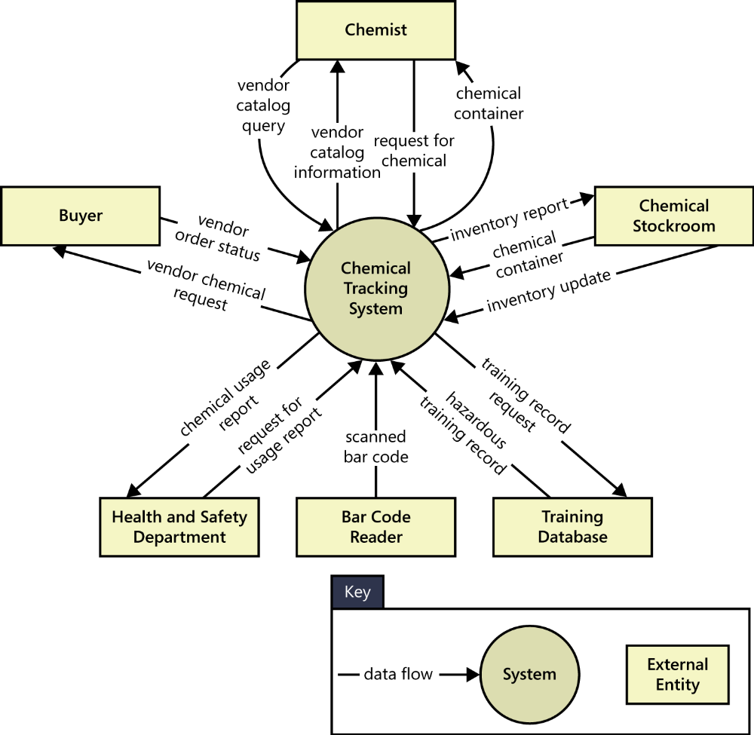
Scope representation techniques
There are many techniques to represent project scope:
Context diagram: visually illustrates the connections between external entities and the system in some way, as well as data, control, and material flows.

Slide 22
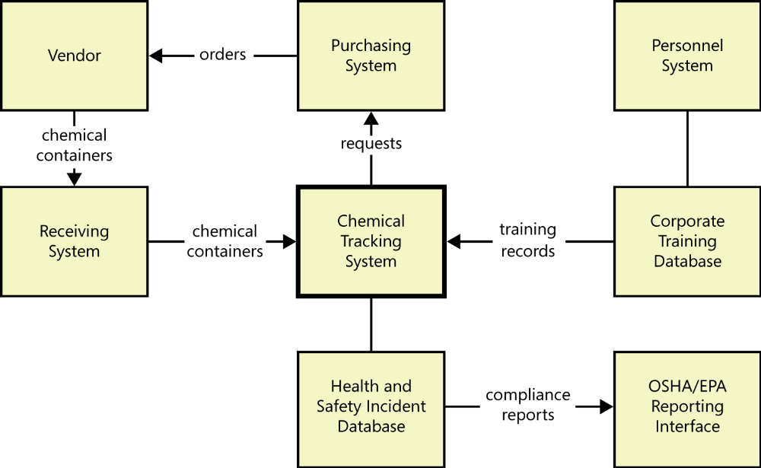
Scope representation techniques
Ecosystem map:
  It shows all of the systems related to the system of interest that interact with one another and the nature of those interactions.
  An ecosystem map represents scope by showing all the systems that interconnect and that therefore might need to be modified to accommodate (tương thích) your new system.
Notes:
Accommodate (v): tương thích
It shows all of the systems related to the system of interest that interact with one another and the nature of those interactions: Nó hiển thị tất cả các hệ thống liên quan đến hệ thống quan tâm tương tác với nhau và bản chất của các tương tác đó.

Slide 23
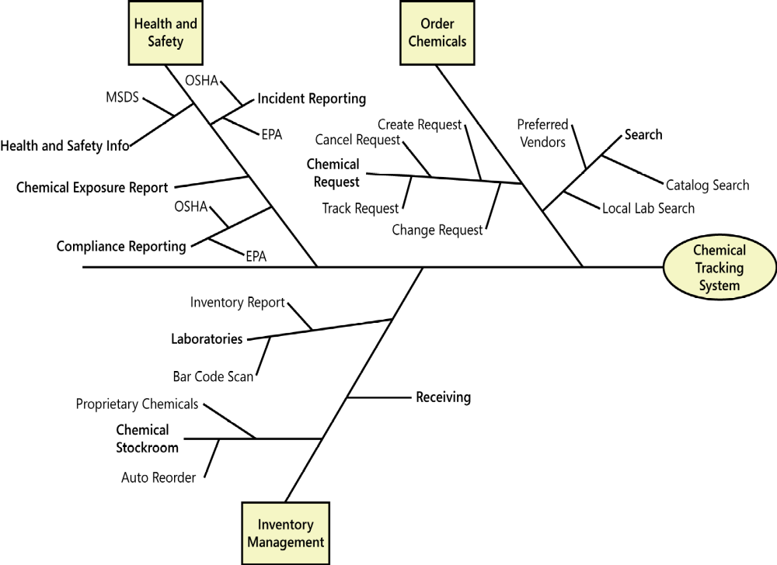
Scope representation techniques
Feature tree:
  It’s a visual depiction of the product’s features organized in logical groups, hierarchically subdividing each feature into further levels of detail.
  The feature tree is a concise view of all the features planned for a project, marking it an ideal model to show to executives who want to quick glance at the project scope.

Slide 24
Scope representation techniques
Event list:
  An event list identifies external events that could trigger (kích hoạt) behavior in the system.
  The event list depicts the scope boundary for the system by naming possible biz events triggered by users, time-triggered events, or signal events received from external components, such as HW devices.
External event for Chemical Tracking System
  Chemist places a chemical request.
  Chemical container bar code is scanned.
  Vendor issues new chemical catalog.
  New proprietary chemical (hóa chất độc quyền) is accessioned (được nhập vào) into system.
  Vendor indicates chemical is backordered.
  New vendor is added to preferred vendor list.
Notes:
An event list identifies external events that could trigger behavior in the system: Một danh sách sự kiện xác định các sự kiện bên ngoài có thể kích hoạt hành vi trong hệ thống.
Chemist places a chemical request: Nhà hóa học thực hiện một yêu cầu hóa học.
Vendor indicates chemical is backordered: Nhà cung cấp chỉ ra hóa chất được đặt hàng trước.
New proprietary chemical is accessioned into system: Hóa chất độc quyền mới được gia nhập vào hệ thống.

Slide 25
Keeping the scope in focus
The biz requirements and an understanding of how customers will use the product provide valuable tools for dealing with scope change. Scope change is not a bad thing if it helps you steer the project toward satisfying evolving customer needs.
Using business objectives to make scoping decisions:
  The biz objectives are the most important factor to consider when making scope decisions (đưa ra QĐ phạm vi).
  When a stakeholder wants to add functionality, consider how the suggested changes will contribute to achieving the biz objectives.
  When an executive requests a new feature that he thought of over the weekend (vào cuối tuần), you can use quantitative analysis to help determine if adding it is the right biz decision.
Notes:
When an executive requests a new feature that he thought of over the weekend, you can use quantitative analysis to help determine if adding it is the right biz decision: Khi một giám đốc điều hành yêu cầu một tính năng mới mà anh ấy nghĩ đến vào cuối tuần, bạn có thể sử dụng phân tích định lượng để giúp xác định xem việc thêm nó có phải là quyết định đúng đắn hay không.
Using business objectives to make scoping decisions: Sử dụng các mục tiêu kinh doanh để đưa ra quyết định phạm vi.

Slide 26
Keeping the scope in focus
Assessing the impact of scope changes:
  When project’s scope increases, the PM usually will have to negotiate the planned budget, resources, schedule, and/or staff.
  A common consequence of scope change is that completed activities must be reworked in response to the changes.
  Quality often suffers (bị ảnh hưởng) if the allocated resources or time are not increased when new functionality is added.
Notes:
- Quality often suffers if the allocated resources or time are not increased when new functionality is added.: Chất lượng thường bị ảnh hưởng nếu tài nguyên được phân bổ hoặc thời gian không được tăng lên khi chức năng mới được thêm vào.

Slide 27
Vision and scope on agile projects
Managing scope on an agile project, in which development is performed in a series of fixed timebox iterations, takes a different approach.
The scope of each iteration consists of user stories selected from a dynamic product backlog, based on their relative priority and the estimated delivery capability of the team for each timebox.
Instead of trying to fight scope creep, the team prioritizes new requirements against existing items in the backlog and allocates them to future iterations.
Although agile projects might not create a formal vision and scope document. Many agile projects conduct an upfront planning iteration (iteration zero) to define the overarching product vision and other business requirements for the project.
Notes:
Instead of trying to fight scope creep, the team prioritizes new requirements against existing items in the backlog and allocates them to future iterations: Thay vì cố gắng chống lại trượt phạm vi, nhóm ưu tiên các yêu cầu mới đối với các mục hiện có trong backlog và phân bổ chúng cho các lần lặp lại trong tương lai.
Many agile projects conduct an upfront planning iteration (iteration zero) to define the overarching product vision and other business requirements for the project.: Nhiều dự án linh hoạt thực hiện lần lặp lập kế hoạch trả trước (số 0) để xác định tầm nhìn bao quát của sản phẩm và các yêu cầu kinh doanh khác cho dự án.

Slide 28
Review chapter 5
Chapter 5
Scope repre. techniques
Keeping scope in focus
Biz req.
Context diagram
Using business objectives to make scoping decisions
Vision and scope on agile projects
Product vision and project scope.
Identify desired biz benefits
Feature tree
Conflicting biz req.
Ecosystem map
Event list
Assessing the impact of scope changes
Notes:
Backlog (n): phần công việc còn tồn đọng thưa chực hiện.
Product backlog: phần còn lại của dự án
Velocity (n): Tốc độ

Slide 29

Notes:
- pay-off (n): chi trả

