Slide 1
CHAPTER 6
Finding the voice of the user

Slide 2
Review chapter 5
Chapter 5: Establishing the biz requirements.
Scope repre. techniques
Keeping scope in focus
Biz req.
Context diagram
Using business objectives to make scoping decisions
Vision and scope on agile projects
Product vision and project scope.
Identify desired biz benefits
Feature tree
Conflicting biz req.
Ecosystem map
Event list
Assessing the impact of scope changes
Notes:
Backlog (n): phần công việc còn tồn đọng thưa chực hiện.
Product backlog: phần còn lại của dự án
Velocity (n): Tốc độ

Slide 3
Objectives
Student should understand that the success in software requirements, and hence in software development, depends on getting the voice of the user close to the ear of the developer.
Student should enhance step by step to find the voice of the user.
Student could classify users and try to understand what type of information the users from each department might supply based on their role in the organization and their department’s perspective on the projects.
Enhance the differences in user representation on agile projects.
Notes:
And hence: và từ đó
Student should understand that the success in software requirements, and hence in software development, depends on getting the voice of the user close to the ear of the developer: Sinh viên nên hiểu rằng sự thành công trong các yêu cầu phần mềm, và tiếp theo trong phát triển phần mềm, phụ thuộc vào việc đưa tiếng nói của người dùng đến gần tai của nhà phát triển.

Slide 4
Contents
User classes.
User personas (tính cách người dùng).
Connecting with user representatives.
The product champion.
User representation on agile projects.
Notes:
Personas (n): Nhân vật (trong truyện) / Vai trò, địa vị / Tính cách
The product champion: Khách hàng tiêu biểu

Slide 5
Finding the voice of the user
Success in SW requirements, and hence in SW development, depends on getting the voice of users close to the ear of the developers.
To find the voice of users, take the following steps:
  Identify the different classes of users for your product.
  Select and work with individuals who represent each user class and other stakeholder groups.
  Agree on who the requirements decision makers are for your project.
Customer involvement is the best way to avoid the mismatch between the product that customers expect to receive and what developers build.
The features that users present as their “wants” don’t necessarily equate to the functionality they need to perform their tasks with the new product. To gain a more accurate view of user needs, the BA must collect a wide range of user input, analyze and clarify it, and specify just what needs to be built to let users do their jobs.

Slide 6
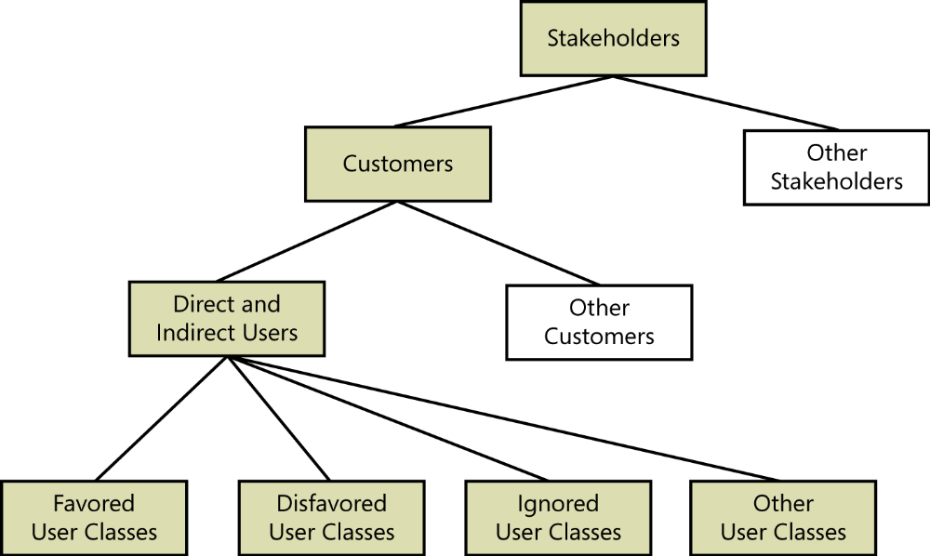
User classes: Classifying users
FIGURE 6-1 A hierarchy of stakeholders, customers, users, and user classes.
Notes:
favored user classes: Lớp người dùng ưa thích

Slide 7
User classes: Classifying users
There are many types of stakeholders, you can group users into a number of distinct user classes based on these sorts of differences:
Their access privilege or security levels (such as ordinary user, guest user, administrator).
The tasks they perform during their business operations.
The features they use.
The frequency with which they use the product.
Their application domain experience and computer systems expertise.
The platforms they will be using (desktop PCs, laptop PCs, tablets, smartphones, specialized devices).
Their native language.
Whether they will interact with the system directly or indirectly.
Notes:
Their access privilege or security levels : Đặc quyền truy cập hoặc mức độ bảo mật của họ.
Favored user classes are those whose satisfaction is most closely aligned with achieving the project’s business objectives: Các lớp người dùng ưa thích là những người có sự hài lòng được liên kết chặt chẽ nhất với việc đạt được các mục tiêu kinh doanh của dự án.
Disfavored user classes are groups who aren’t supposed to use the product for legal, security, or safety reasons.: Các lớp người dùng không hài lòng là các nhóm không được phép sử dụng sản phẩm vì lý do an toàn, pháp lý hoặc an toàn.

Slide 8
User classes: Identifying user classes for your project
Identify and characterize the different user classes for your product early in the project so you can elicit requirements from representatives of each important class.
A useful technique for this is a collaboration pattern (Ellen Gottesdiener) called by “expand then contract”:
  Start by asking the project sponsor who expects to use the system.
  Then brainstorm as many user classes as you can think of. Don’t be nervous if there are dozens at this stage. You’ll condense (viết súc tích) and categorize them later.
  It’s important not to overlook a user class, which can lead to problems later when someone complaints that the delivered solution doesn’t meet her needs.
Notes:
- Condense (v): Viết ngắn gọn, súc tích

Slide 9
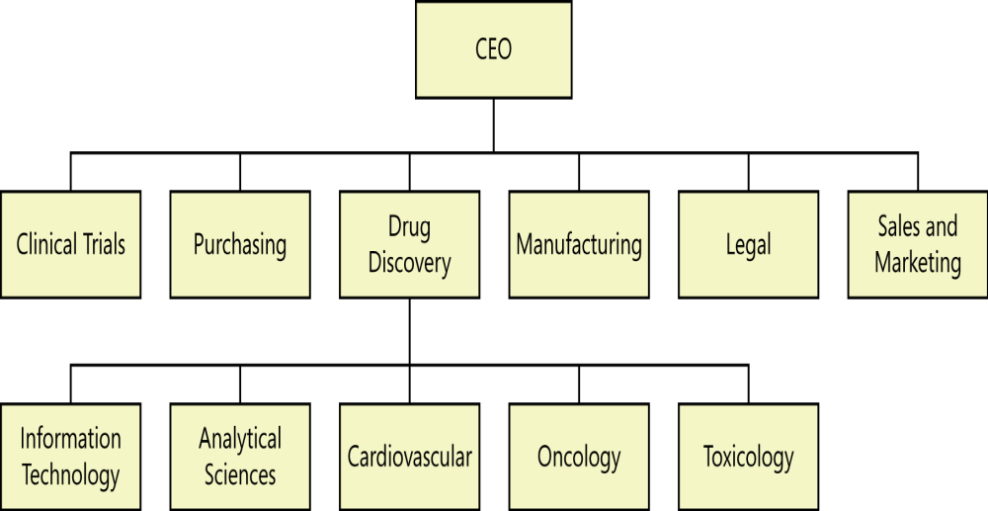
User classes: Identifying user classes for your project
The external entities shown outside your system on a context diagram are candidates for user classes.
A corporate organization chart can also help you discover potential users and other stakeholders (Beatty and Chen 2012).
Organizational chart analysis reduces the likelihood (khả năng có thể xảy ra) that you will overlook an important class of users within the organization.
Notes:
- Likelihood (n): Khả năng có thể xảy ra

Slide 10
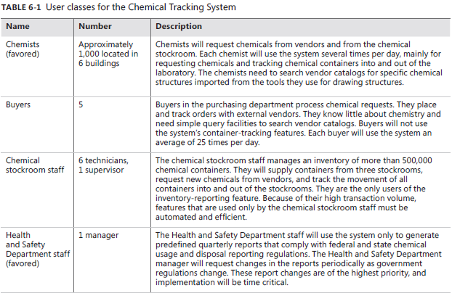
User classes: Identifying user classes for your project
Notes:
- Likelihood (n): Khả năng có thể xảy ra

Slide 11
User personas (nhân vật)
A persona is a description of a hypothetical (có tính giả thuyết), generic person who serves as a stand-in (người đóng thế vai) for a group of users having similar characteristics and needs.
A persona can serve as a placeholder when the BA doesn’t have an actual user representative at hand.
Personas details for a commercial customer include social and demographic (nhân khẩu học) characteristics and behaviors, preferences, annoyances, and similar information.
Using personas understand the requirements and to design the user experience to best meet the needs of specific user communities.
Notes:
Personas (n): Tính cách / Vai trò / Nhân vật (trong truyện)
Hypothetical (adj): có tính giả thuyết
Stand-in (n): người đóng thế vai
Annoyance (n): sự bực tức, bực bội
chemical exposure.: phơi nhiễm hóa chất
A persona is a description of a hypothetical, generic person who serves as a stand-in for a group of users having similar characteristics and needs. : Một nhân vật là một mô tả của một người giả định, chung chung, phục vụ như là một thay thế cho một nhóm người dùng có đặc điểm và nhu cầu tương tự.

Slide 12
Connecting with user representatives
Why do each user class needs someone to speak for requirements?
  All projects need suitable representatives to provide the voice of the users.
  These users should be involved throughout the development life cycle, not just in an isolated requirements phase at the beginning of the project.
Typical communication pathways between users and developers.
  One study indicated that using more kinds of communication links, and more direct links between developers and users led to more successful projects.
  The most direct communication occurs when developers can talk to appropriate users themselves. This means that if there are layers between the user and the developer, it increases the chance of miscommunication and delay transmission.

Slide 13
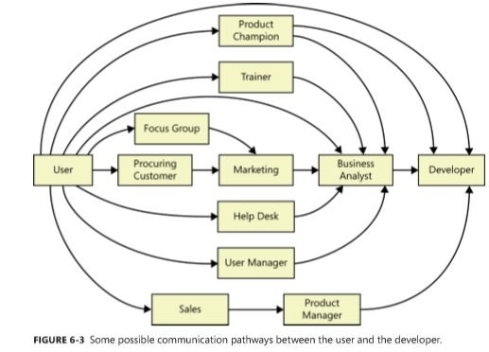
Typical communication pathways between users and developers

Slide 14
Product champion
Definition: product champions?
  Each of our projects included a few key members of our user community to provide the requirements. We called these people product champions.
What does the product champion do?
  Each product champion serves as the primary interface between members of a user class and BA.
  Product champions gather requirements from other members of the user class they represent and reconcile (điều hòa) inconsistencies.
  Best product champions have a clear vision of the system. They should be effective communicators who are respected by their colleagues.
  They understand clearly the application domain and the solution’s operating environment.
  They work best if they are fully empowered (được trao quyền) to make binding decisions on behalf of the user class they represent.
Notes:
Each of our projects included a few key members of our user community to provide the requirements. We called these people product champions: Mỗi dự án của chúng tôi bao gồm một vài thành viên chính của cộng đồng người dùng của chúng tôi để cung cấp các yêu cầu. Chúng tôi gọi những người này vô địch sản phẩm.

Slide 15
Product champion
External product champion:
  When developing commercial SW, it can be difficult to find product champions from outside your company. In this case, you can rely on internal subject matter experts or outside consultants to serve as surrogates (người đại diện) for actual users.
  Another alternative is to hire a suitable product champion who has the right background.
Product champion expectations:
  To help the product champions succeed, document what you expect your champions to do. These written expectations can help you build a case for specific individuals to fill this critical role.
  See more detail in next slide.

Slide 16
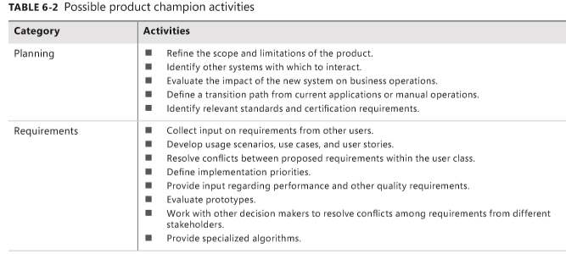
Product champion expectations

Slide 17
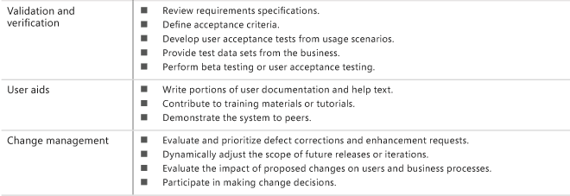
Product champion expectations

Slide 18
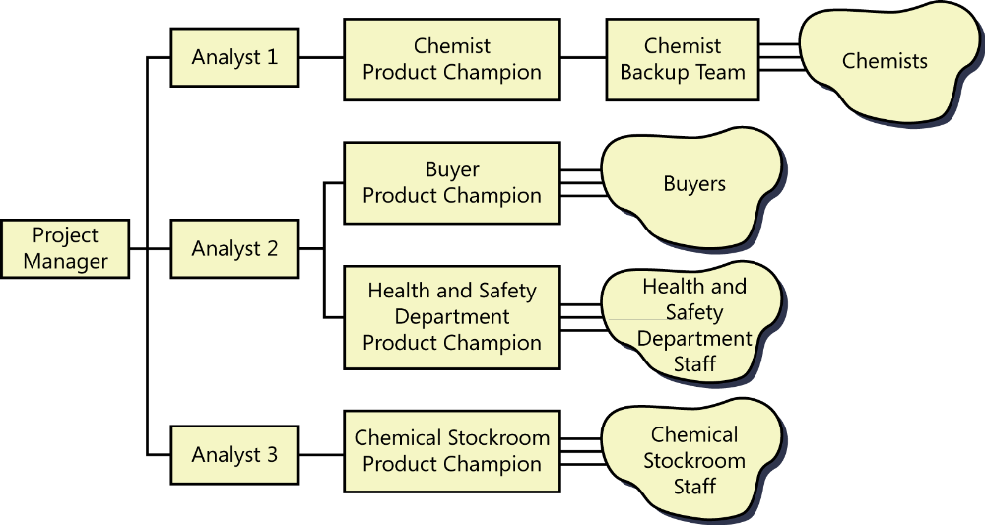
Multiple product champions
One person can not describe the needs for all users of an application.
These champions are not assigned full time, but each one spends several hours per week to work on the project.

Slide 19
Selling the product champion idea
Sometimes, we encounter resistance from the users, such as “the users are too busy.”, “Management wants to make the decision.”, “They will slow us down.”, “I don’t know what I’m supposed to do as a product champion.”,…
Managers are sometimes reluctant to delegate (giao quyền) authority for requirements to ordinary users.
If you encounter resistance, point out that insufficient user involvement is a leading cause of SW project failure.

Slide 20
Product champion traps to avoid
The product champion model has succeeded in many environments. It works only when the product champions understand and sign up for their responsibilities, have the authority to make decisions at the user requirements level, and have time available to do the job.
Some problems:
  Managers override the decisions of the product champions. Perhaps a manager has a wild new idea at the last minute, or thinks he knows what the users need.
  A product champion who forgets that he is representing other customers and presents only his own requirements won’t do a good job.
  A product champion who lacks a clear vision of the new system might differ decisions to the BA.
  A senior user might nominate (tiến cử) a less experienced user as champion because she/he doesn’t have time to do the job.
Notes:
A product champion who forgets that he is representing other customers and presents only his own requirements won’t do a good job.: Người dùng tiêu biểu quên rằng anh ta đang đại diện cho các khách hàng khác và chỉ đưa ra những yêu cầu của riêng anh ta thì sẽ ko thực hiện công việc tốt.
Nominate (v): bổ nhiệm, tiến cử

Slide 21
User representation on agile projects
Product owner:
  Some agile development methods include a single representative of stakeholders called product owner in the team to serve as the voice of the customer.
  Product owner defines the product’s vision and is responsible for developing and prioritizing the contents of the product backlog.
Differentiate between the product owner and product champion:
  The product owner spans all three levels of requirements: biz, user, and functional.
  He essentially straddles (đứng trên) the product champion and BA functions, representing the customer, defining product features, prioritizing them,…
Notes:
- He essentially straddles the product champion and BA functions, representing the customer, defining product features, prioritizing them: Về cơ bản, ông đứng trên chức năng người dùng tiêu biểu và chức năng BA, đại diện cho khách hàng, xác định các tính năng của sản phẩm, ưu tiên chúng

Slide 22
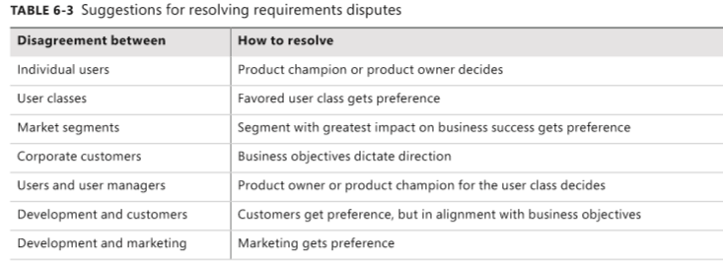
Resolving conflicting requirements
Someone must resolve conflicting requirements from different user classes, reconcile (dung hòa) inconsistencies, and arbitrate (phân xử) questions of scope that arise. The product champions or product owner can handle this in many, but likely not all, cases.
The project’s leaders need to determine who will decide what to do when such situation arise, who will make the call if agreement is not reached, and to whom significant issues must be escalated when necessary.
Notes:
The project’s leaders need to determine who will decide what to do when such situation arise, who will make the call if agreement is not reached, and to whom significant issues must be escalated when necessary: Các nhà lãnh đạo dự án cần xác định ai sẽ quyết định làm gì khi tình huống đó xảy ra, ai sẽ thực hiện cuộc gọi nếu không đạt được thỏa thuận và ai sẽ phải leo thang vấn đề quan trọng khi cần thiết.
Get preference: được ưu tiên

Slide 23
Review chapter 6
Chapter 6: Finding the voice of the user.
User personas
Connecting with user representatives
User classes
Product champion
Identifying user classes for your project
Classifying users
Product champion’s tasks
External product champion
Product champion expectations
Multiple product champions
Product champion traps
Agile projects
Product owner
Notes:
Backlog (n): phần công việc còn tồn đọng thưa chực hiện.
Product backlog: phần còn lại của dự án
Velocity (n): Tốc độ

Slide 24

Notes:
- pay-off (n): chi trả

